Slide 1
Latin influence
Kron

Slide 2
Latin is among the major influences on English. Yet it remains difficult to establish which words from Classical or Vulgar Latin entered English during the Continental period.
What has been believed as continental loanwords range from plants, animals, food, drink, household objects, vessels, coins, metals, and clothing to building materials, military, medical and commercial items. They are mostly nouns.
After the settlement, we can see the growing influence of words related to missionary activities, since they deal with religion and learning.
As the importance of the Church grew, the means of Latin words entering the language changed. Whereas the earliest words entered through speech, the later borrowings entered through writing.
(Crystal, 2004, 59 – 61)

Slide 3
Some words borrowed from Latin from c. 450 – c. 650 (Crystal, 2004, 62)
Old English word | Modern English gloss | Latin origin
cocc | cock | Coccus
cugle | cowl | Cuculla
cyrtan | to shorten, curtail | Curtus
forca | fork | Furca
fossere | spade | Fossorium
graef | stylus | Graphium
laeden | Latin | ladinus (Vulgar Latin)
leahtric | lettuce | Lactuca
meagester | master | Magister
nunne | nun | Nonna
pere | pear | Pirum
pinsian | to reflect, consider | Pensare
punt | punt, float boat | Ponto
relic | relic | Reliquia
renge | spider | Aranea
seglian | to seal | Sigillare
segn | mark, sign | Signum
stropp | strap | Stroppus
torr | tower | Turris
turl | ladle, trowel | Trulla

Slide 4
As far as the Latin loanwords are concerned, it is interesting to note that some loanwords were borrowed twice either to poor communication or to differ from previous usage or as a result of pronunciation changes that resulted in the loss of identity of the early borrowing. (Crystal, 2004, 63)
Some words borrowed twice from Latin during the Old English period
(Crystal, 2004, 64)
Early loan | Later loan | Modern English gloss | Latin origin
celc | calic | cup | Calicem
cliroc | cleric | cleric, clergyman | Clericus
laeden | latin | Latin | Latinus
leahtric | lactuca | lettuce | lactuca
minte | menta | mint | menta
spynge | sponge | sponge | spongea

Slide 5
The Ancient Romans were great borrowers.
The Roman Empire was acquired by dint of a superior fighting force and rigorous military discipline, but it was nmaintained by Roman law.
Thus , we should not be surprised that so many Latin legal terms have been carried over into Engliosh.
As an occupying force the Romans did not integrate with the native population to make a notable impression on the language during the centuries-long Roman presence in ancient Britain, even though remains of their civil engineering feats – roads, forts, aqueducts, baths, and walls – still survive in England today.
The Latin influence on the English language comes primarily through the Romance languages, particularly French and to a lesser degree Italian, as well as through the borrowings associated with the renewed interest in classical sources during the Renaissance.

Slide 6
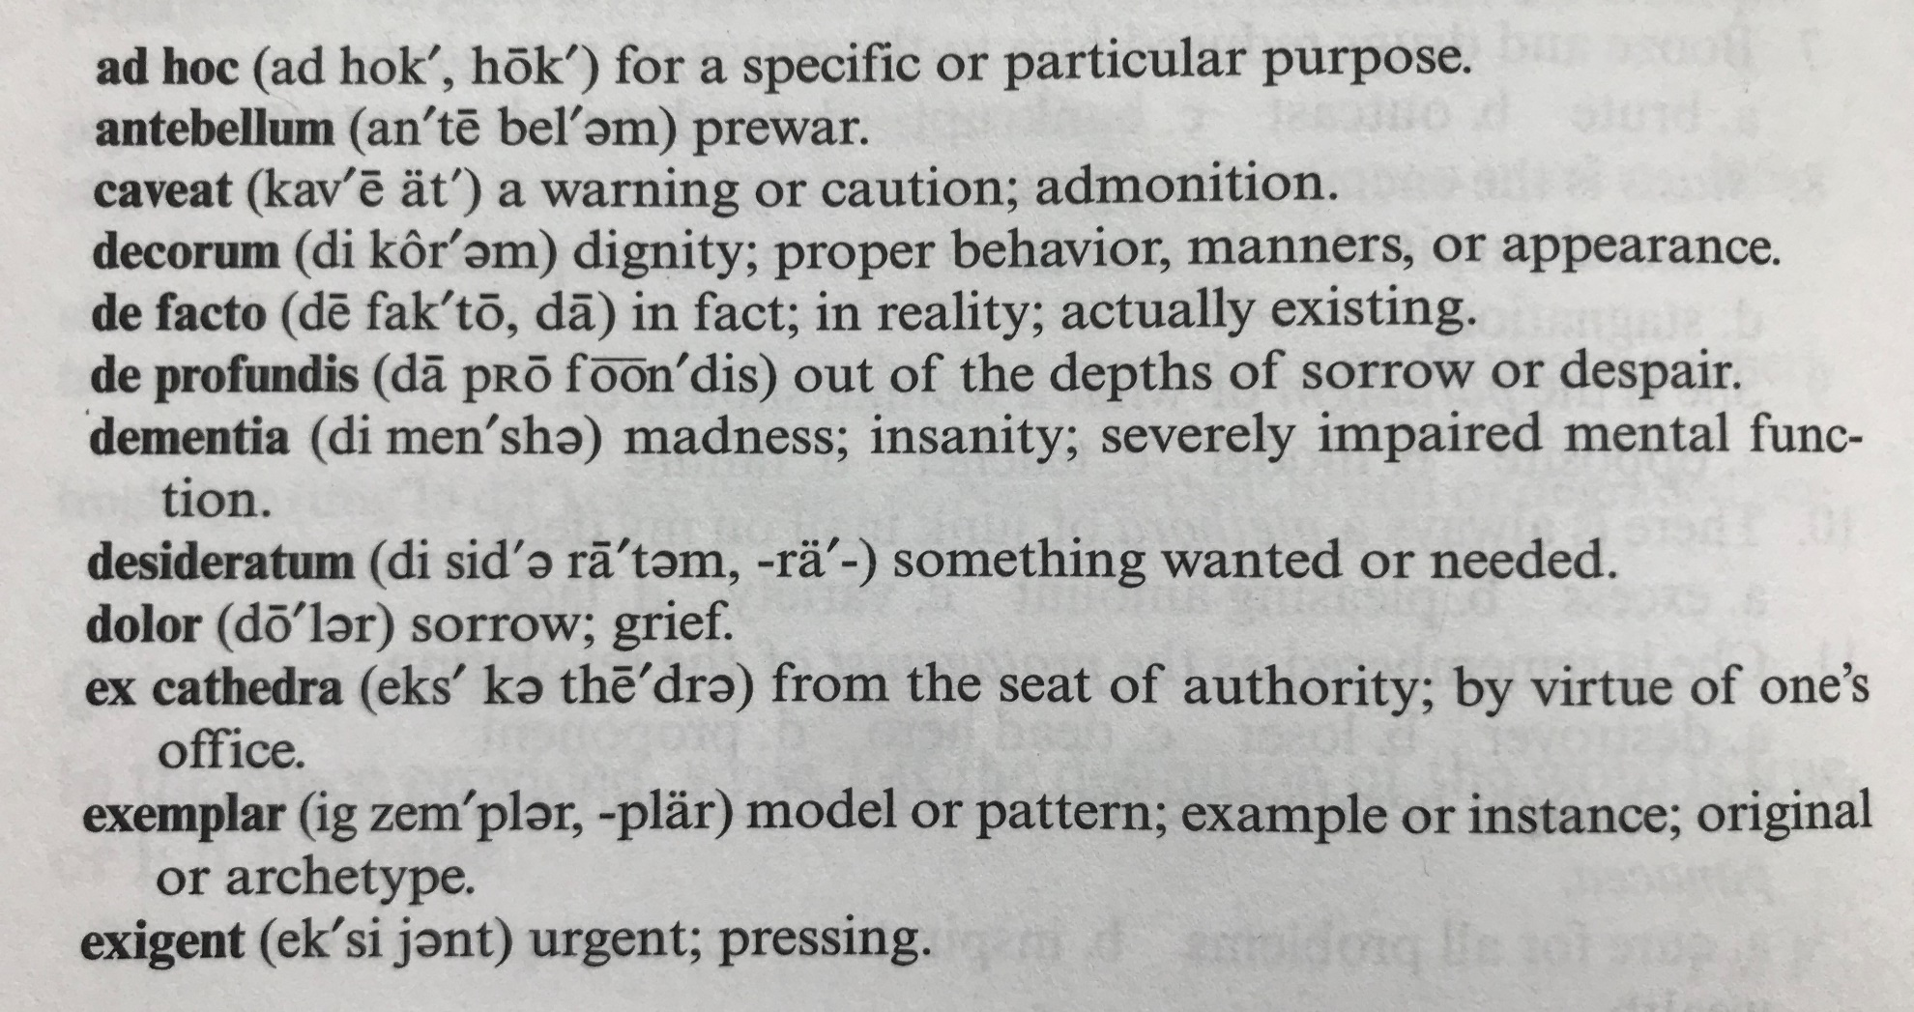
Not all the following terms are strictly legal, but they suggest the precision and practicality of th Latin mind and will also help you to clarify your speech and writing:

