Slide 1
Latin in English
Kron

Slide 2
Latin
The Ancient Romans were great borrowers; they are more distinguished for their military exploits and legal traditions than their cultural values or artistic accomplishments.
The Roman Empire was acquired by dint of superior fighting force and rigorous military discipline, but was maintained by Roman law.
Thus, we should not be surprised that so many latin legal terms have been carried over into English.
While the Empire stretched as far north as Scotland, as an occupying force the Romans did not integrate with the native population to make a notable impression on the Language during the centuries-long Roman presence in ancient Britain, even though the remains of their civil engineering feats – roads, forts, aqueducts, baths, and walls – still survive in England today.

Slide 3
The latin influence on the English language comes primarily through the Romance languages, particularly French and to a lesser degree Italian, as well as through the borrowings associated with the renewed interest in classical sources during the Renaissance.
Not all of the following terms are strictly legal, but they suggest the precision and particularity of the Latin mind and will also help you to clarify your speech and writing.

Slide 4
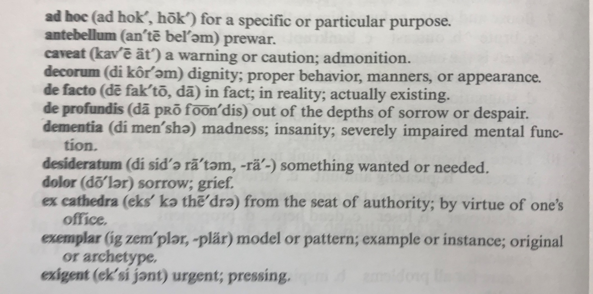

Slide 5
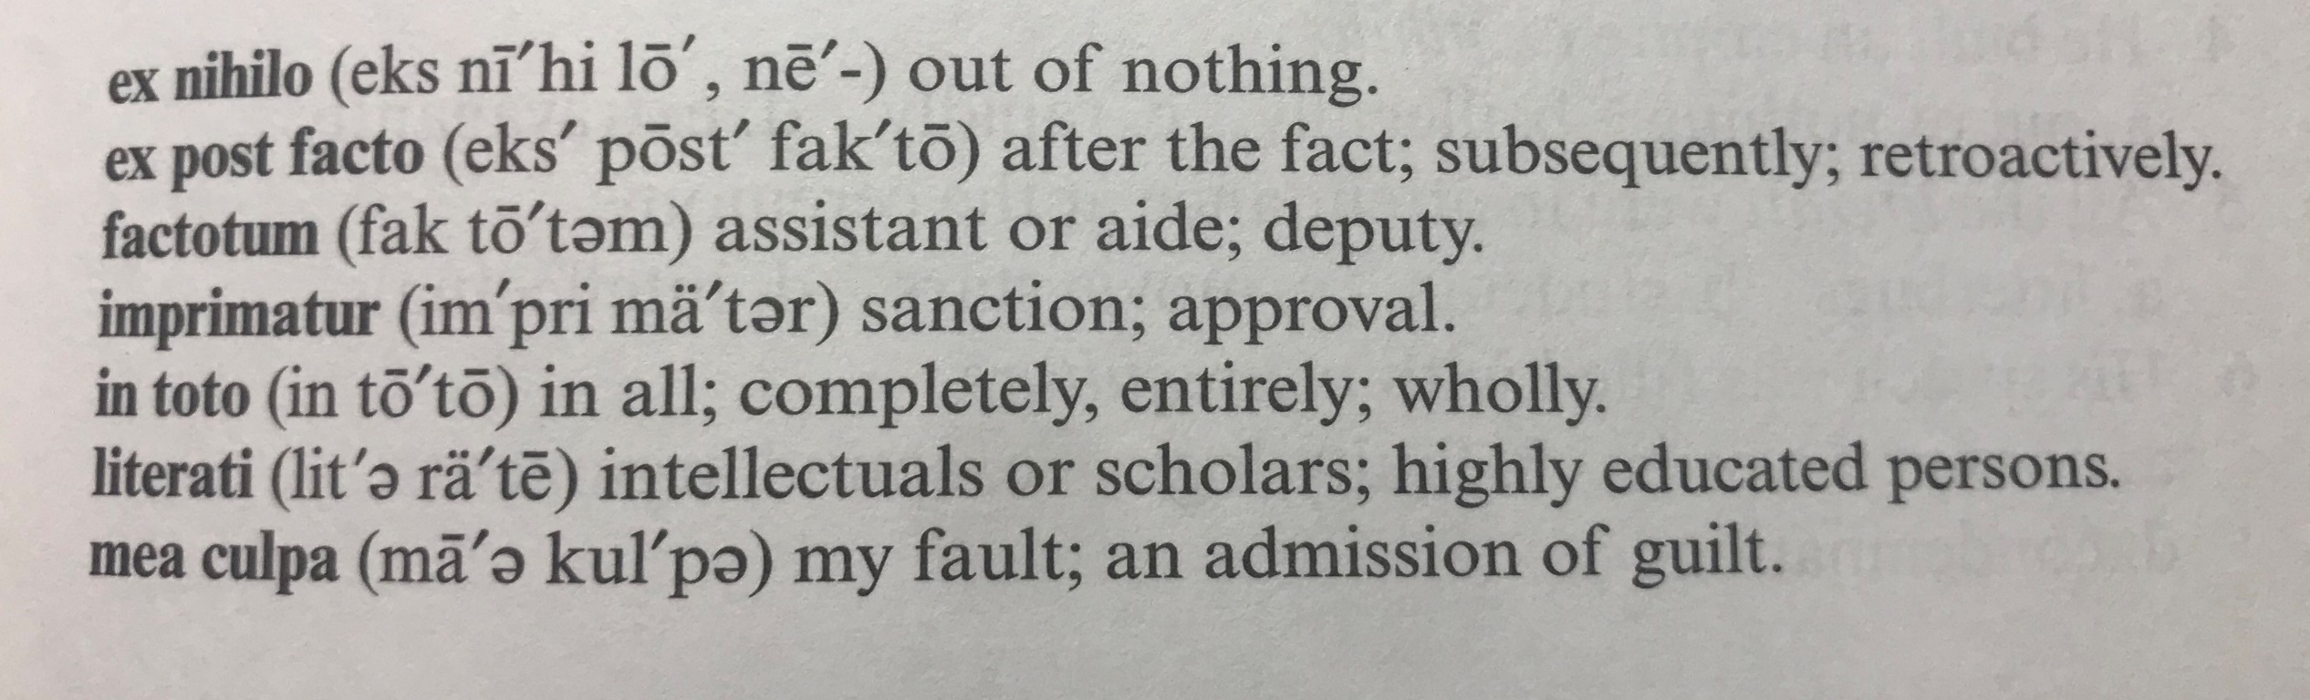

Slide 6
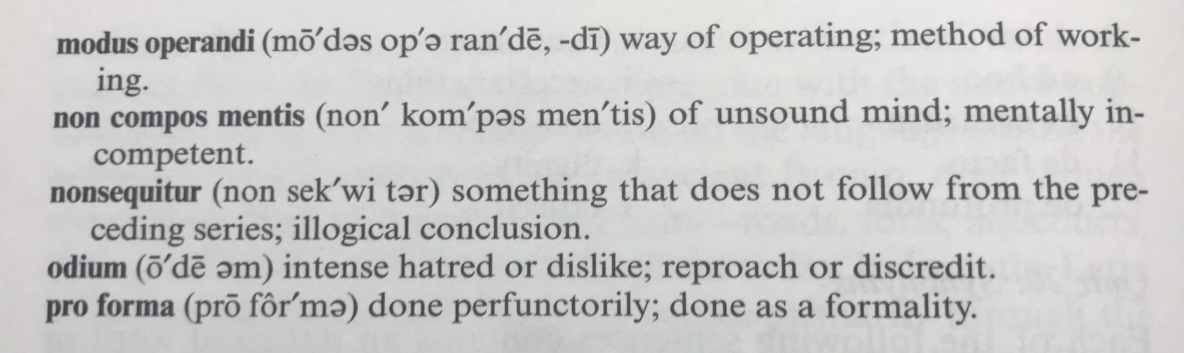

Slide 7
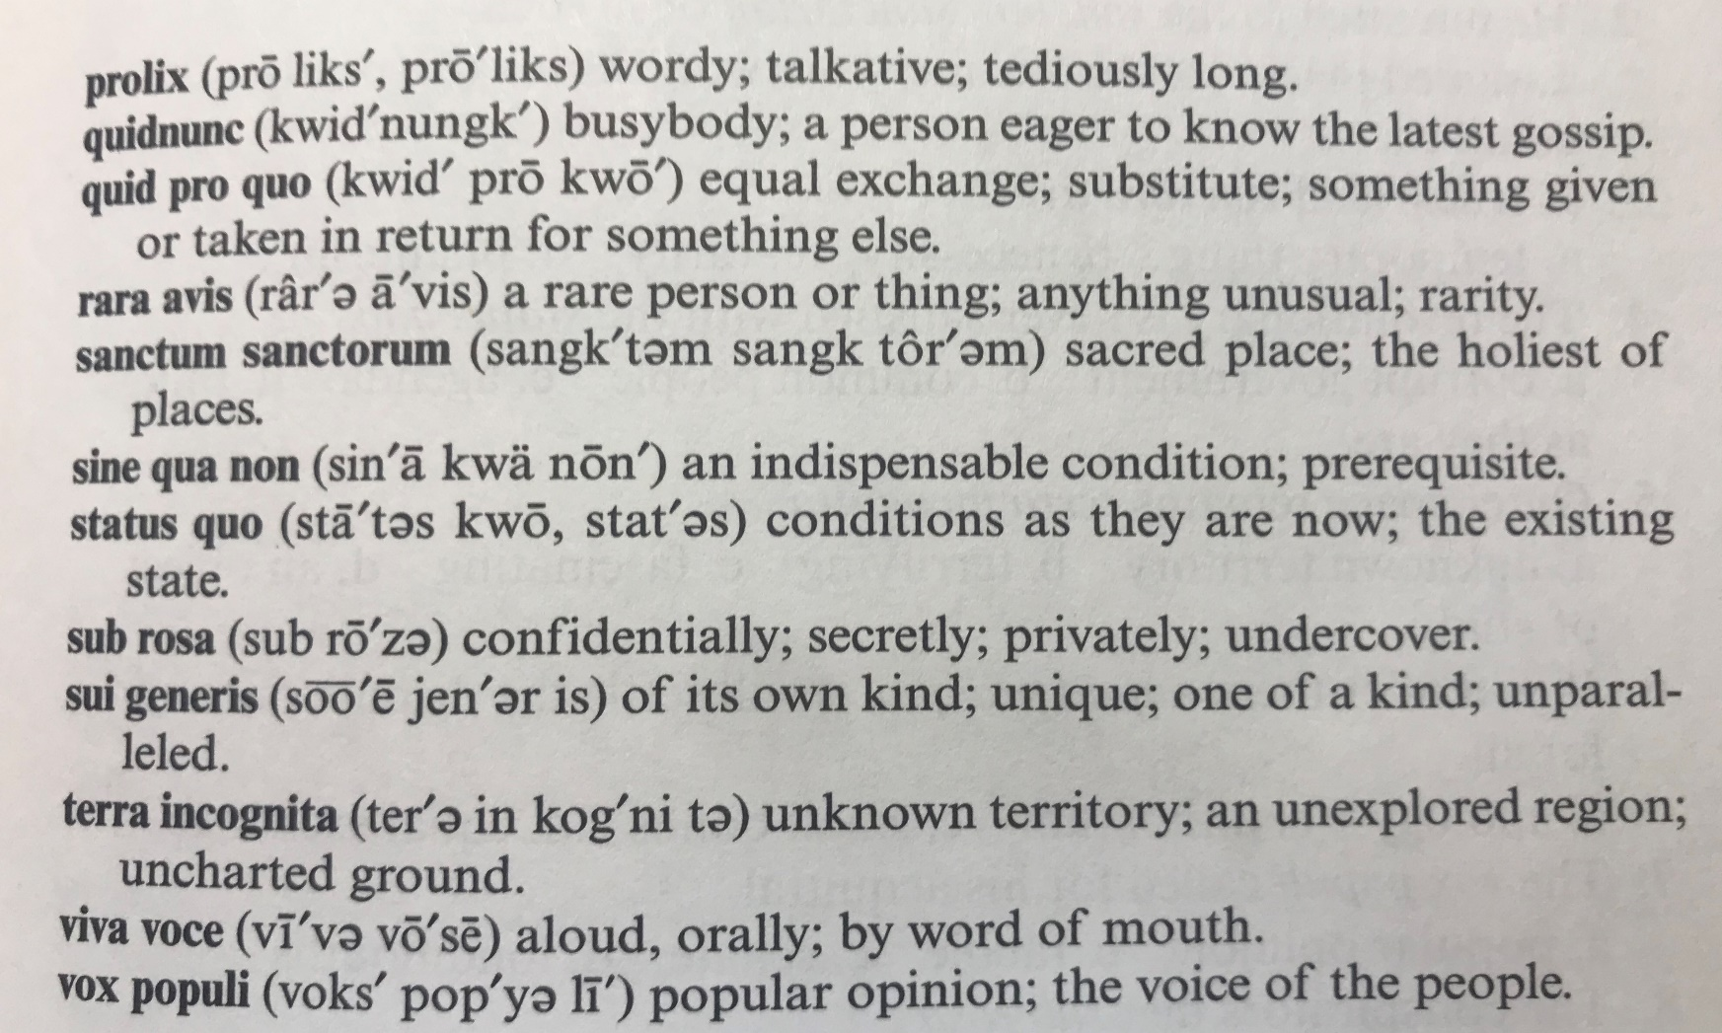

Slide 8
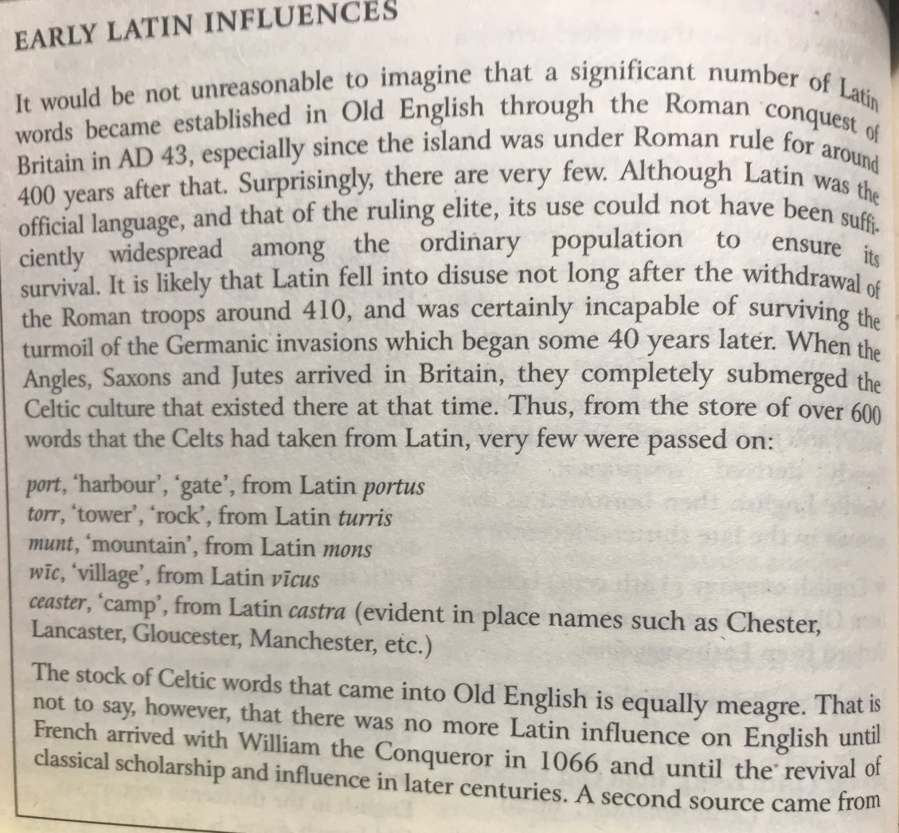

Slide 9
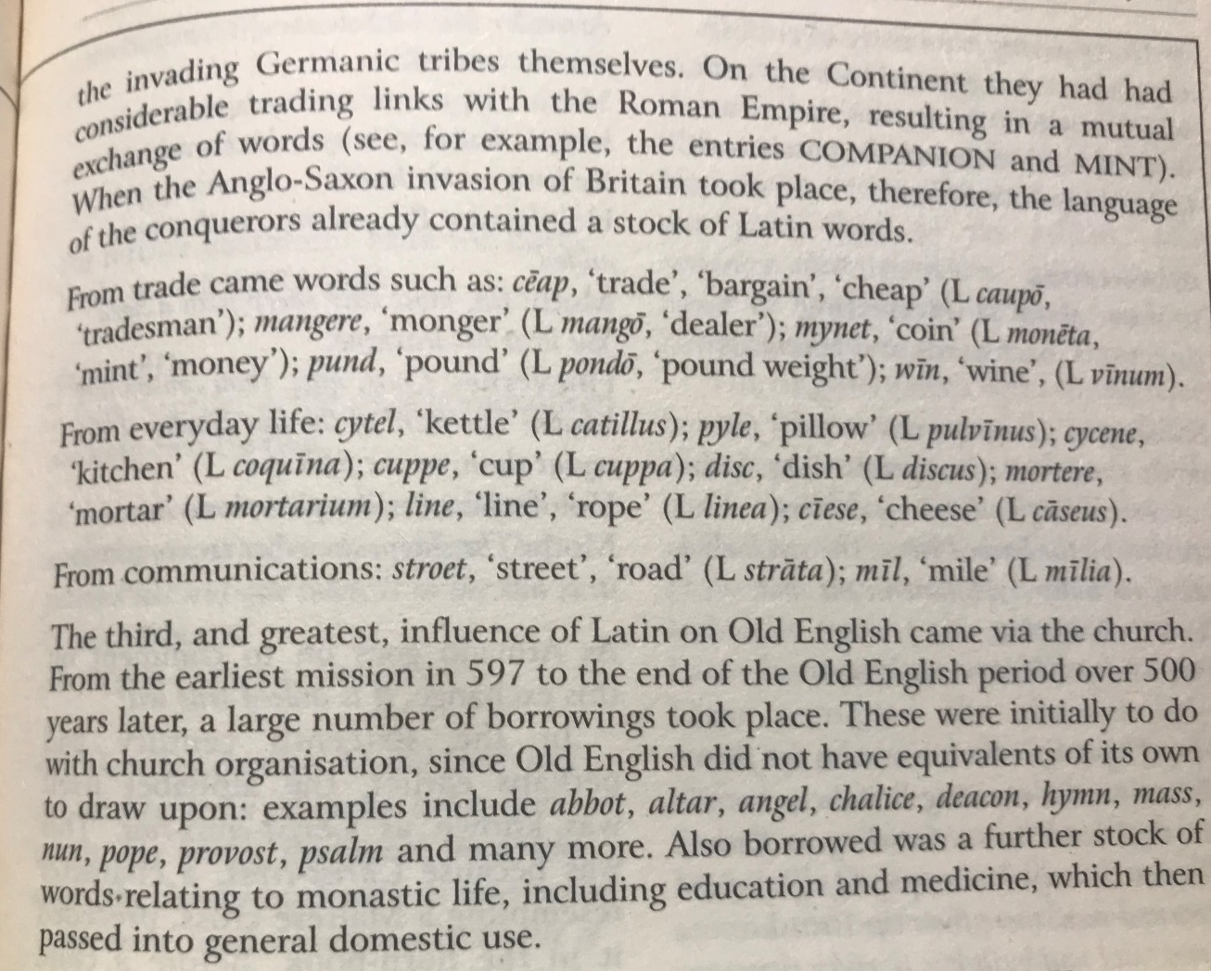

Slide 10
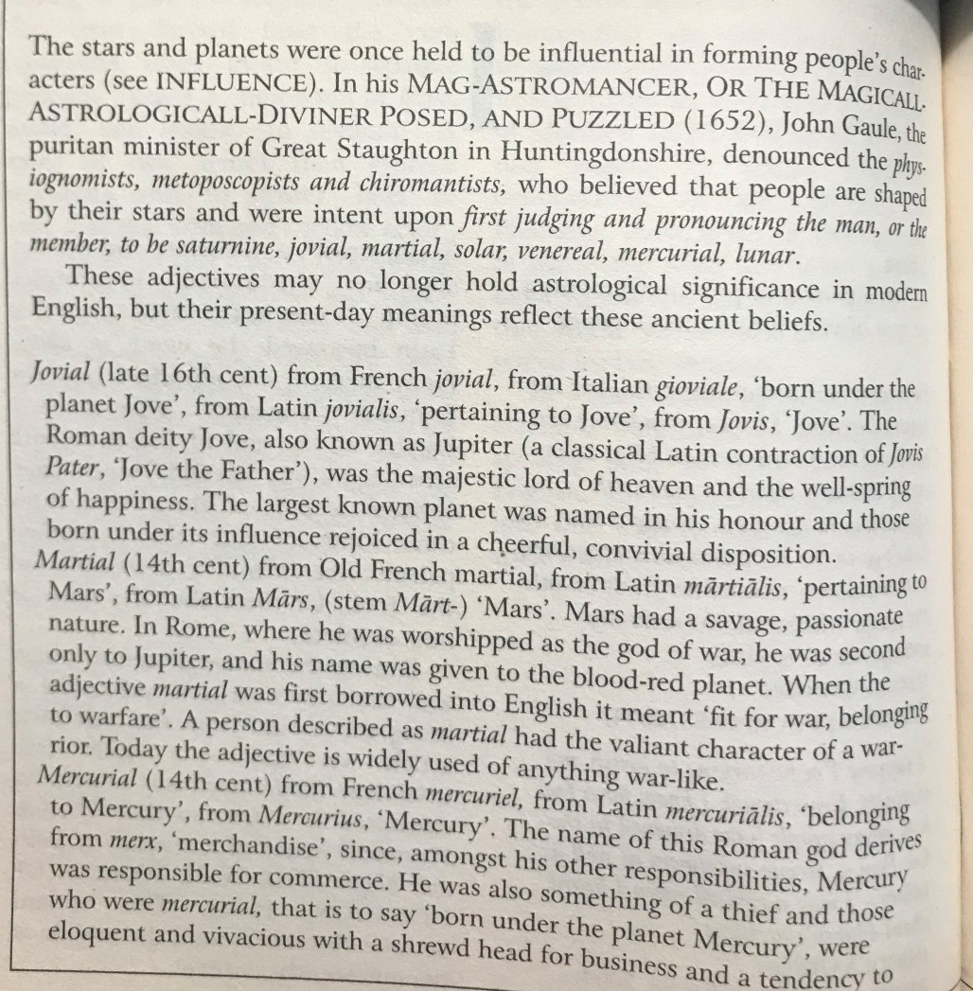

Slide 11
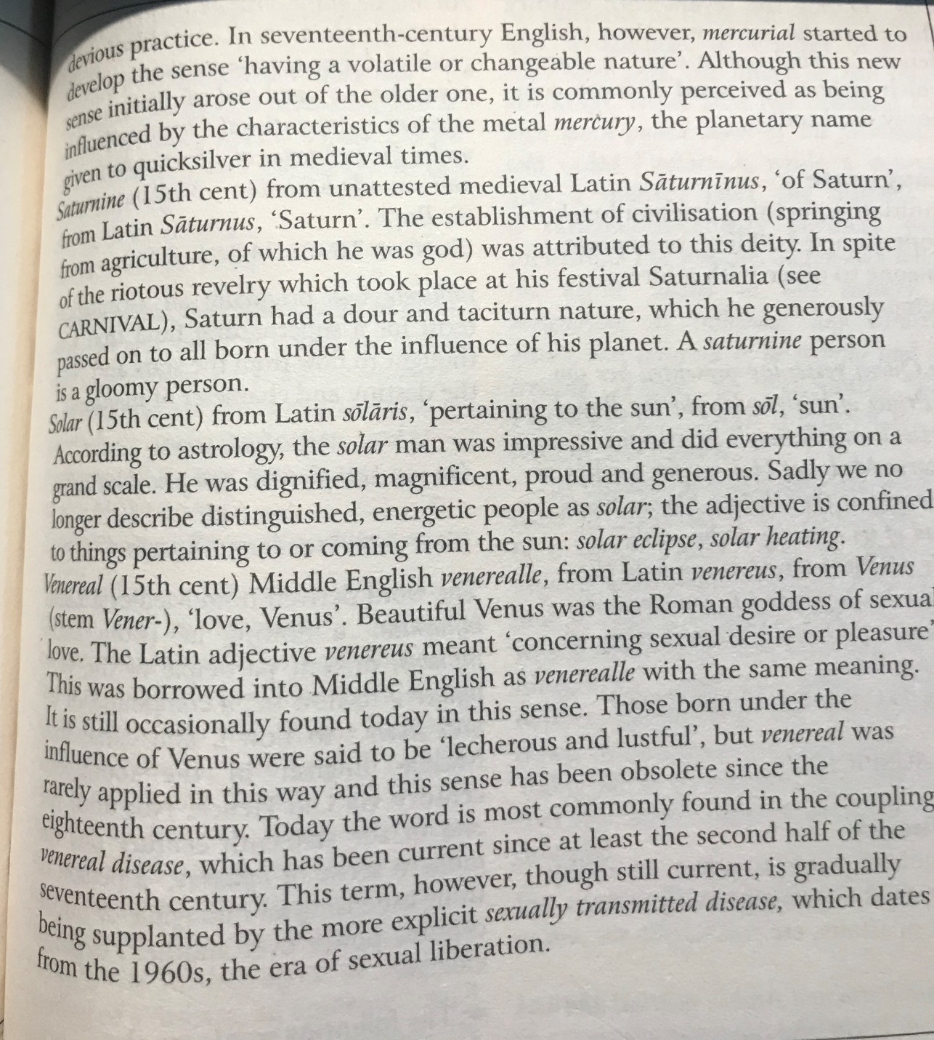

Slide 12


Slide 13
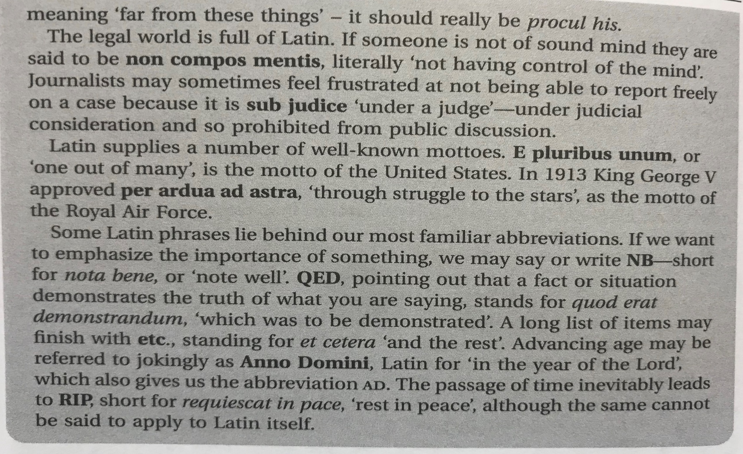

Slide 14
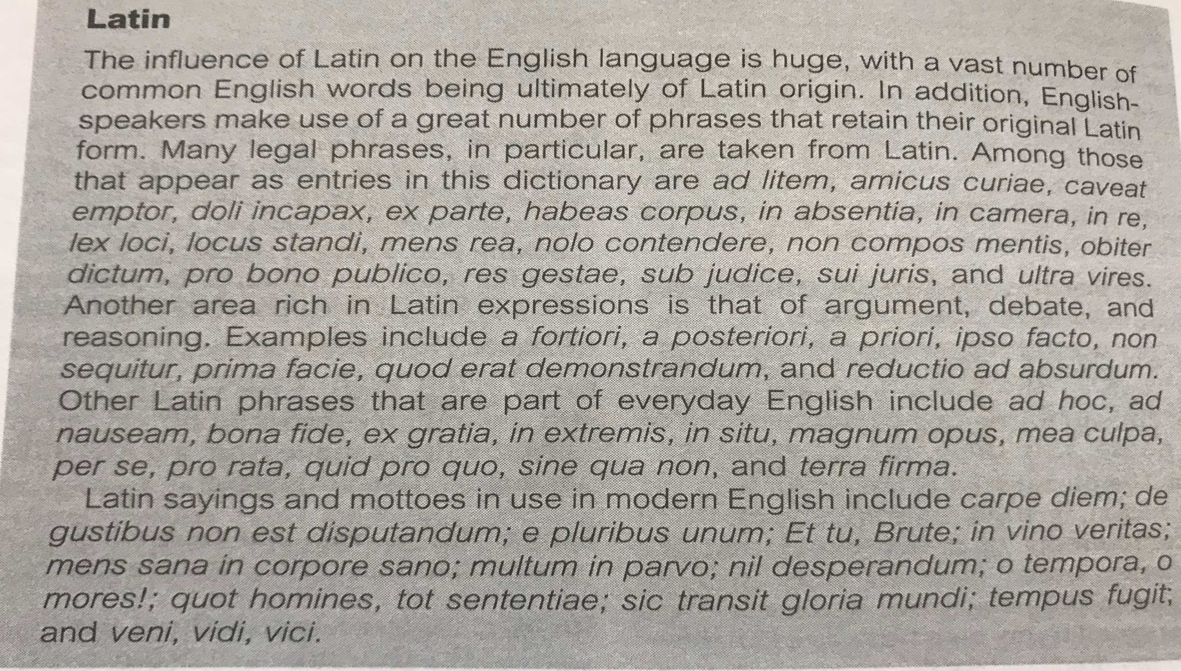

Slide 15
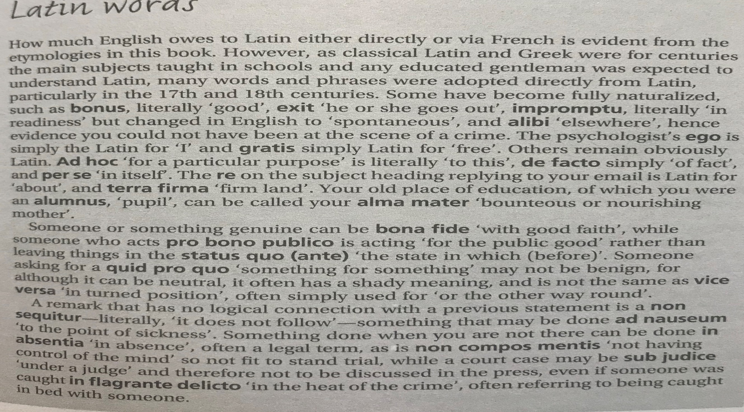

Slide 16
