Slide 1
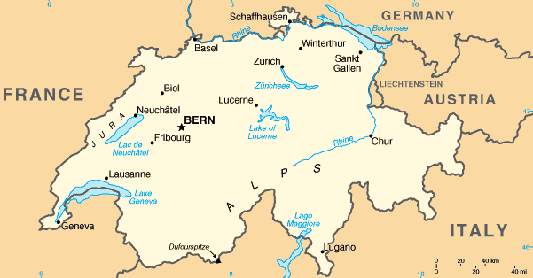
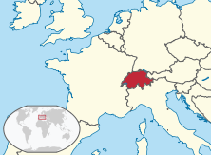
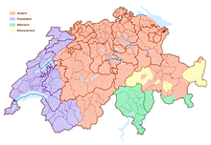
Switzerland
Schweiz (German), Suisse (French), Svizzera (italian), Svizra (Romansh), Confoederatio Helvetica (latin)
Landlocked country
France to the west, Italy to the south, Austria & Liechtenstein to the east, Germany to the north
Birthplace of the Red Cross (1863)
History of armed neutrality (1815)
41,300 km², 8.2 million people
Bern, called Bundesstadt (federal city)
9 million foreign tourists
German
French
Italian
Romansh

Slide 2
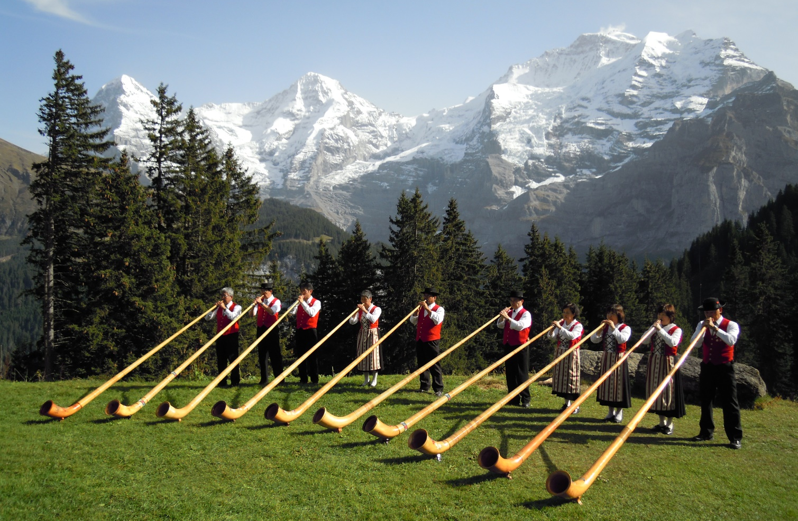
Tourist attractions
Key feature – distinct cultural diversity
Northeast – clean and correct, 8-to-5-working, firmer Swiss-German-speaking Switzerland
Southwest – wine drinking and laissez-faire style known from the French
Southeast (south of the Alps) – sun warms cappuccino-sippers strolling in Italian-style piazzas
Centre – classic Swiss mountain landscape and alphorns
Most obvious result of this variety – four official languages – German, French, Italian & Romansh

Slide 3
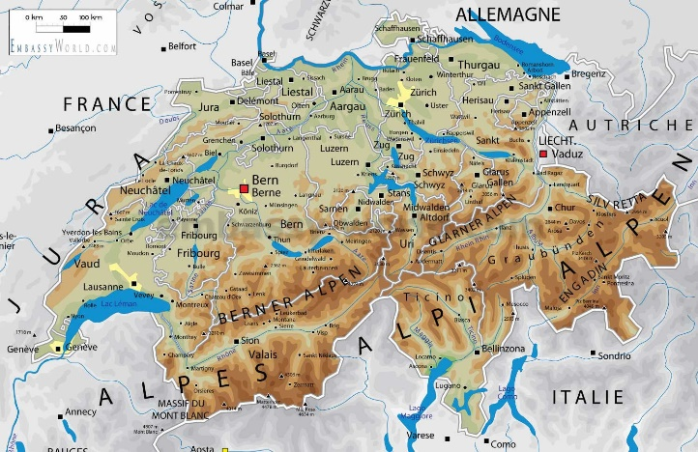
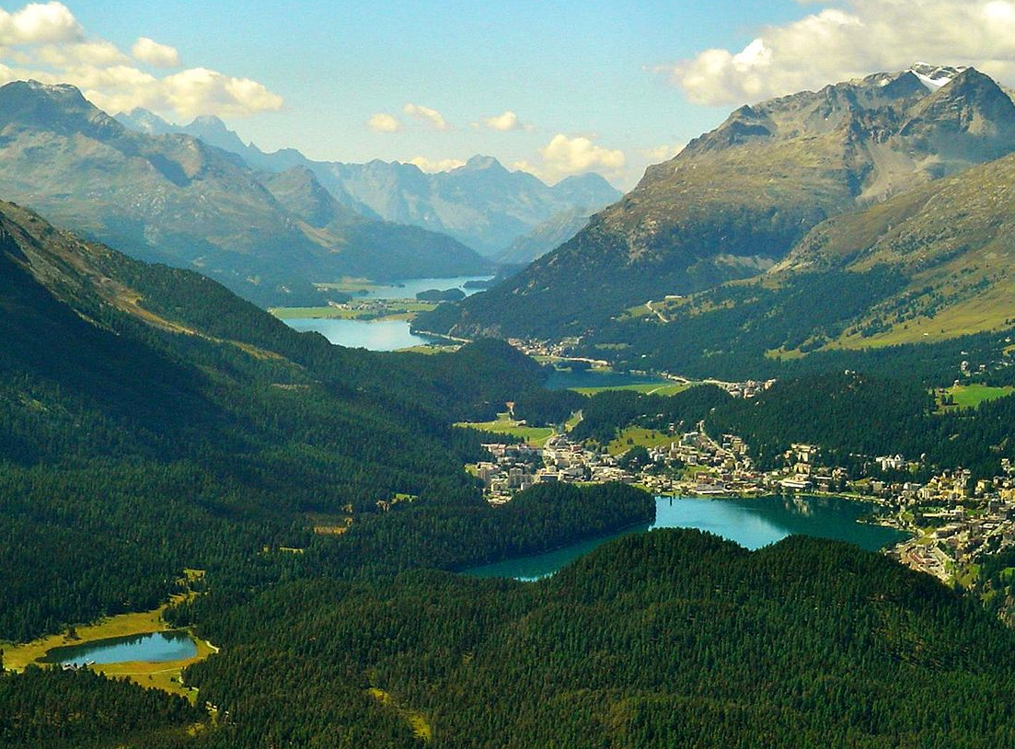
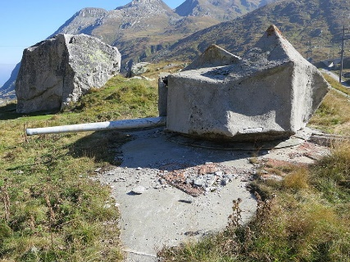
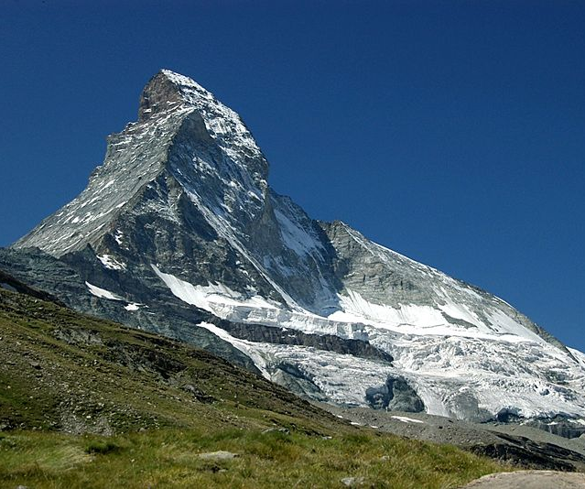
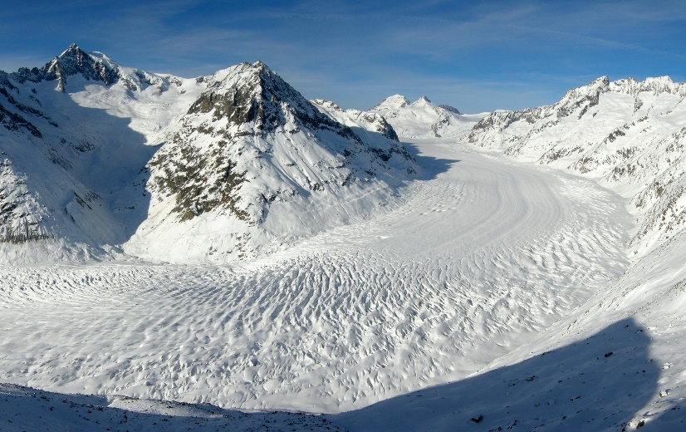
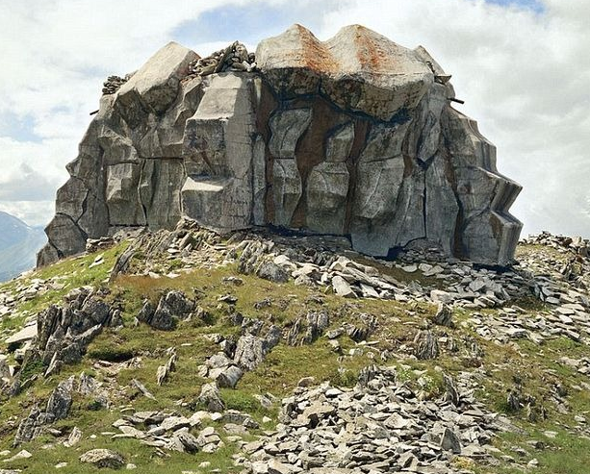
Natural beauties
Large part of the country – the Alps, app 100 peaks – close to or higher than 4,000 meters
3,000 km² of glaciers and firn – Aletschgletscher (largest, 118 km²), numerous lakes
Cave-like buildings in mountains to serve military purposes (hold arms & even fighter planes)
Matterhorn
Aletsch Glacier

Slide 4
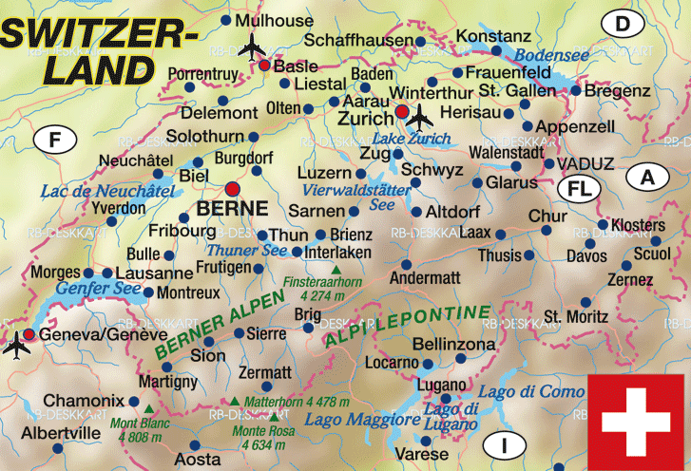
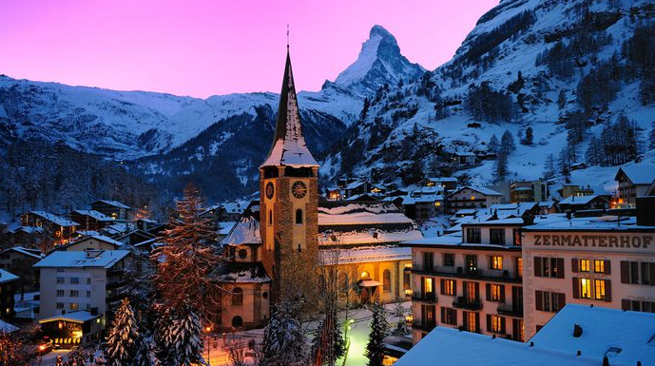
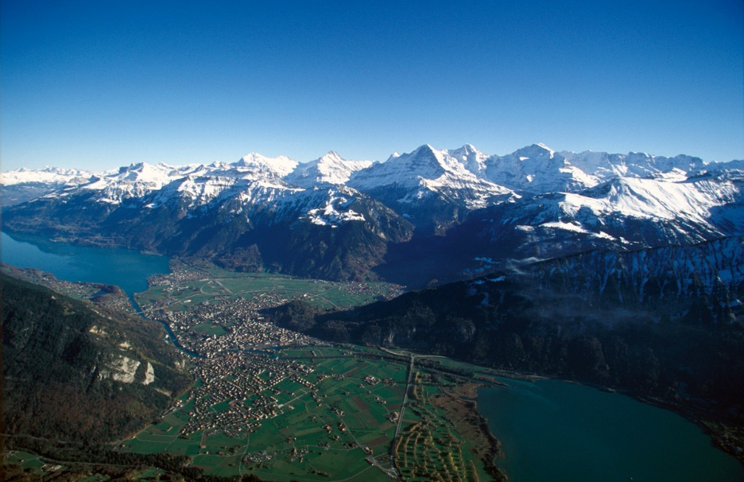
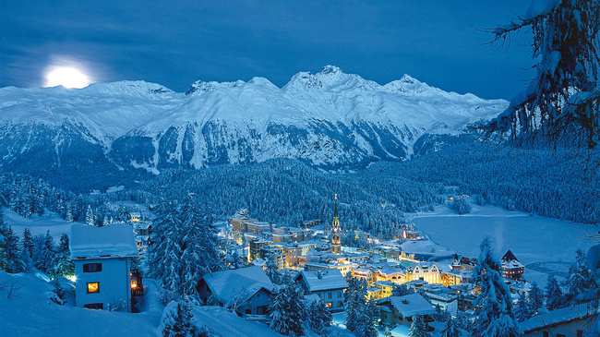
Natural beauties
Zermatt (starting point for Monte Rosa & Matterhorn), St Moritz (1928 & 1948 Winter Olympics)
Interlaken – along Aare River (between Lakes Thun & Brienz)

Slide 5
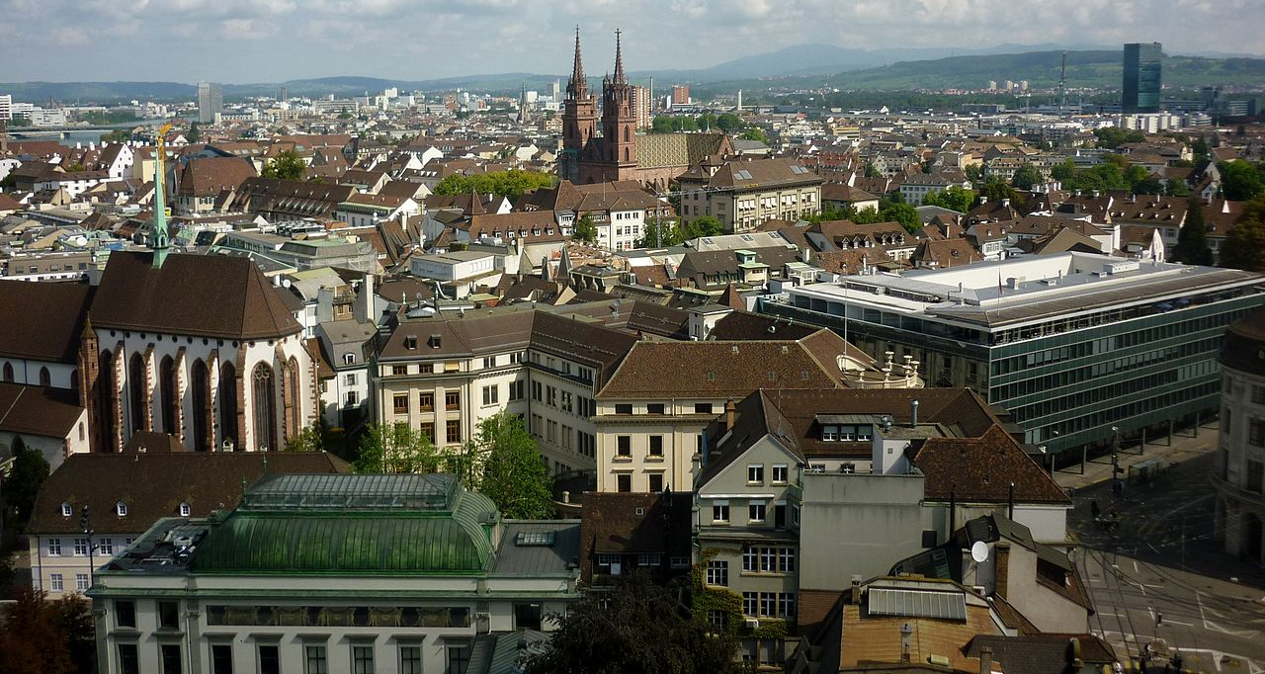
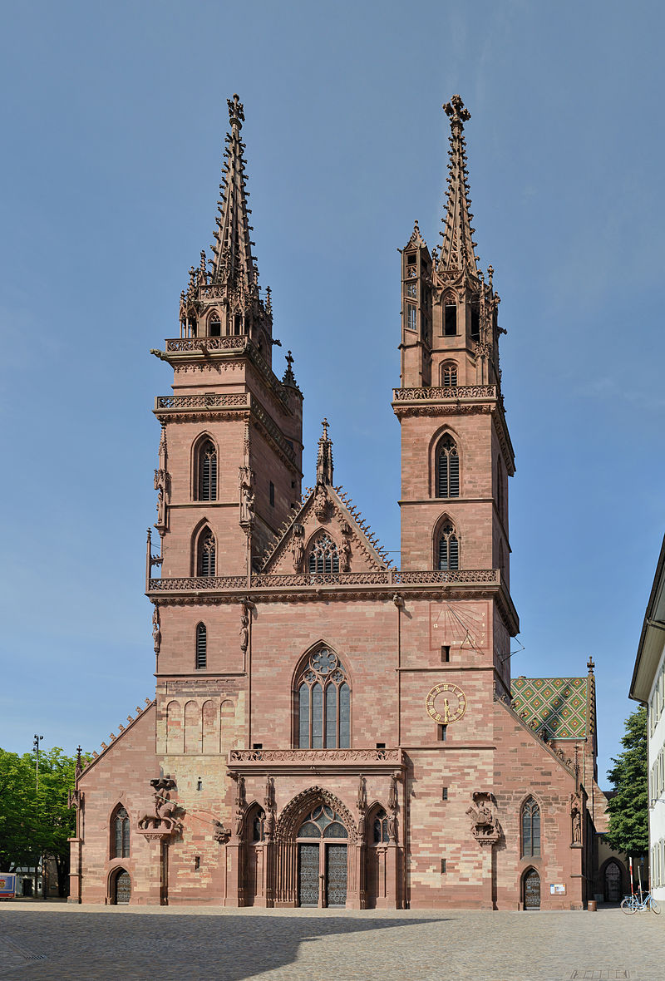
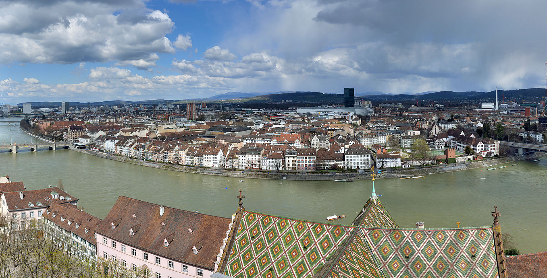
basel
Situated on Swiss, French & German border (suburbs in France & Germany)
Red sandstone Romanesque Cathedral (Erasmus of Rotterdam buried)

Slide 6
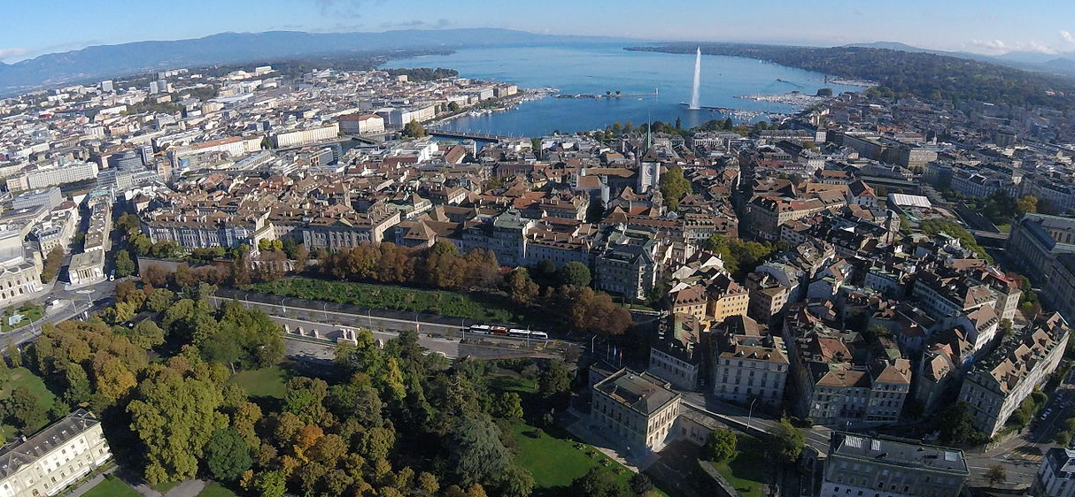
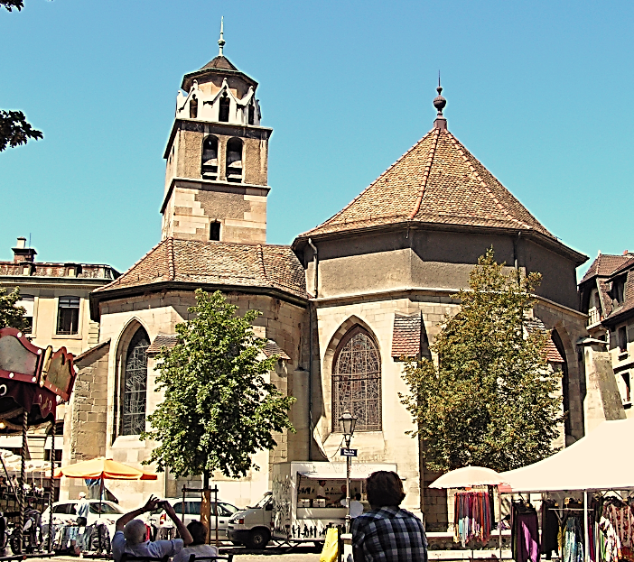
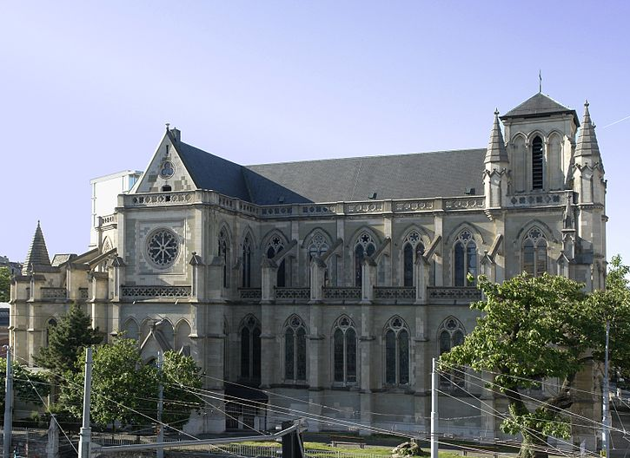
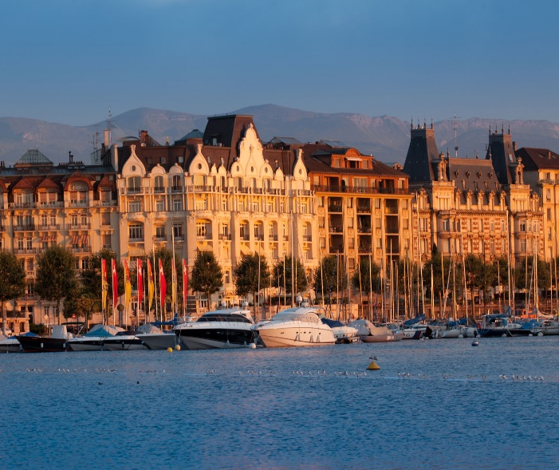
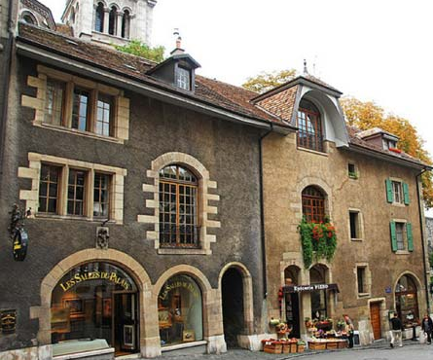
Geneva
Geneva – centre of French-speaking part of Switzerland (headquarters of United Nations & Red Cross)
Notre-dame, Temple de la Madeleine archaeological site
Madeleine
Notre Dame

Slide 7
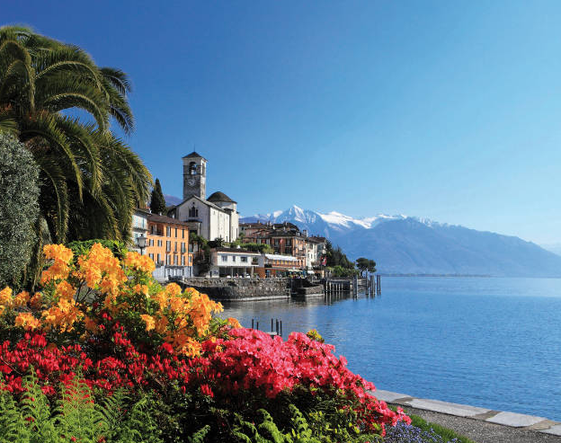
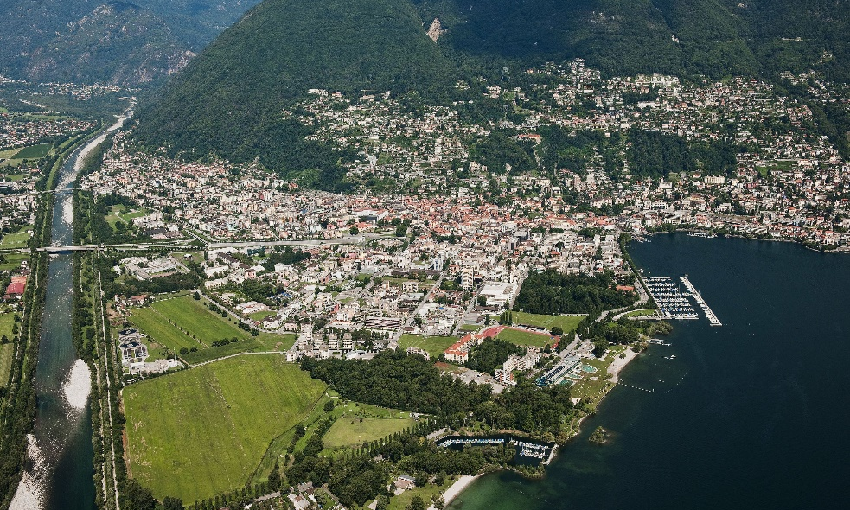
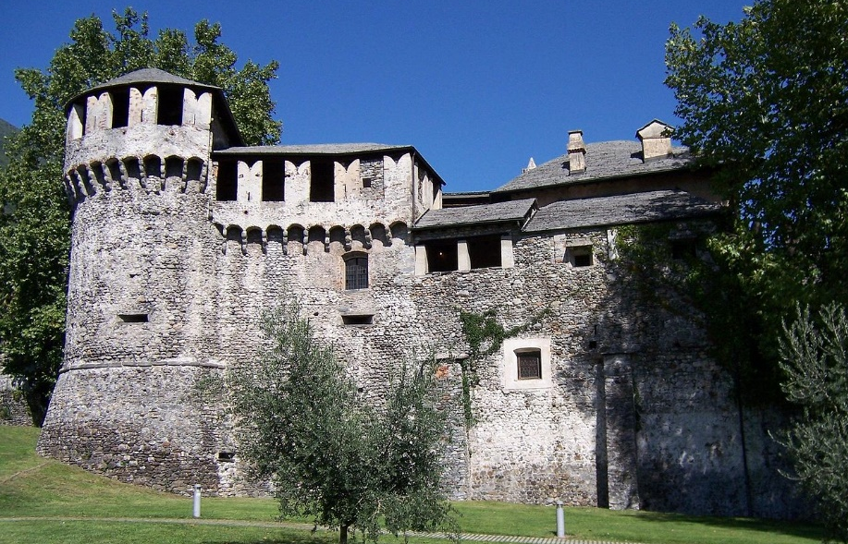
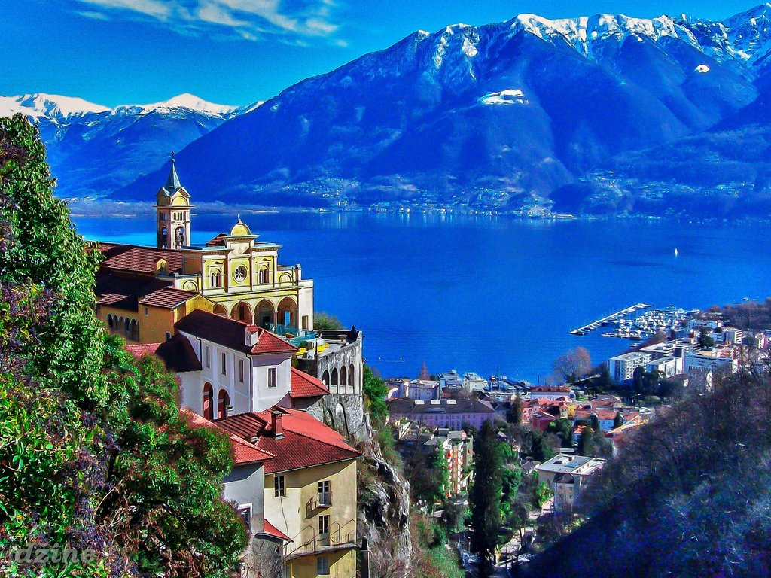
locarno
Italian-speaking part of the country, northern tip of Lake Maggiore at the foot of the Alps
Sanctuary of Madonna del Sasso – pilgrimage site from 15 century
Castello Visconteo – 12 century, part may have been designed by Leonardo da Vinci

Slide 8
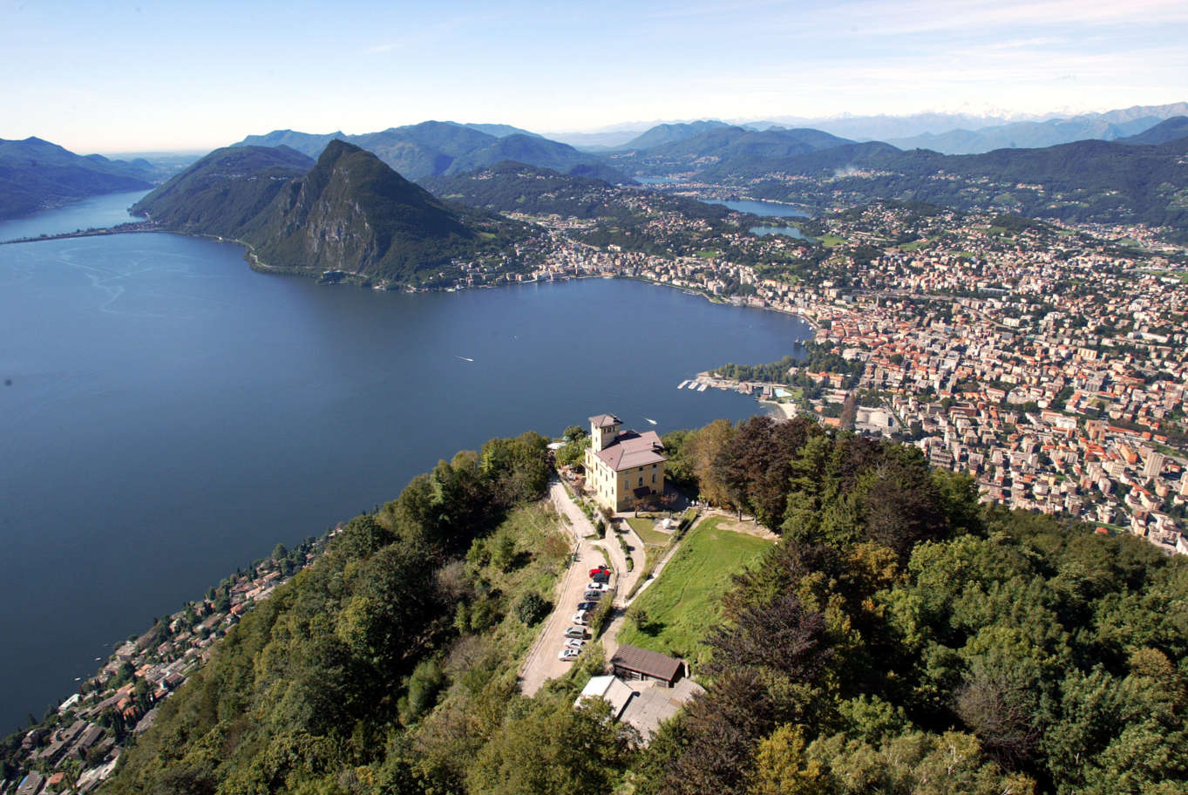
lugano
Italian-speaking part of the country (nicknamed Monte Carlo of Switzerland)
On Lake Lugano, surrounded by the Lugano Pre-Alps

Slide 9
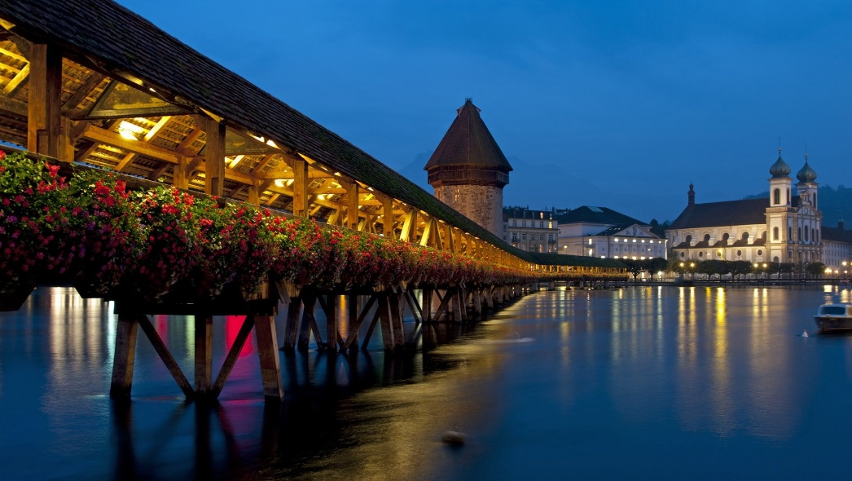
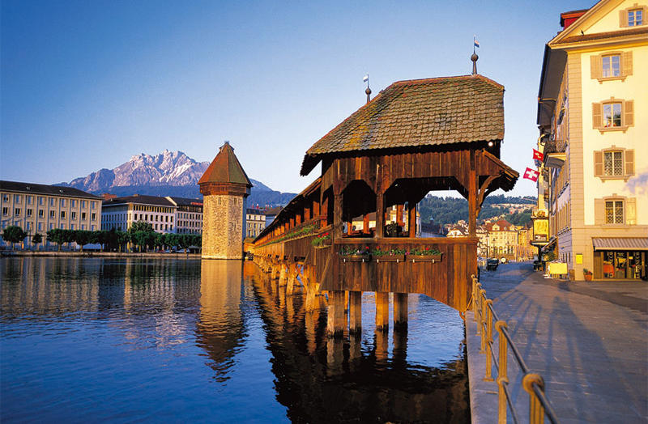
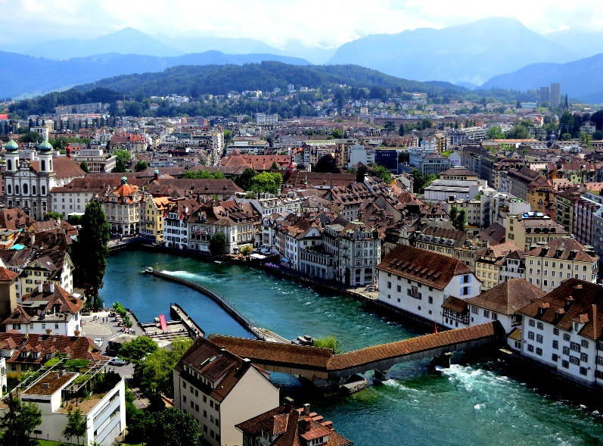
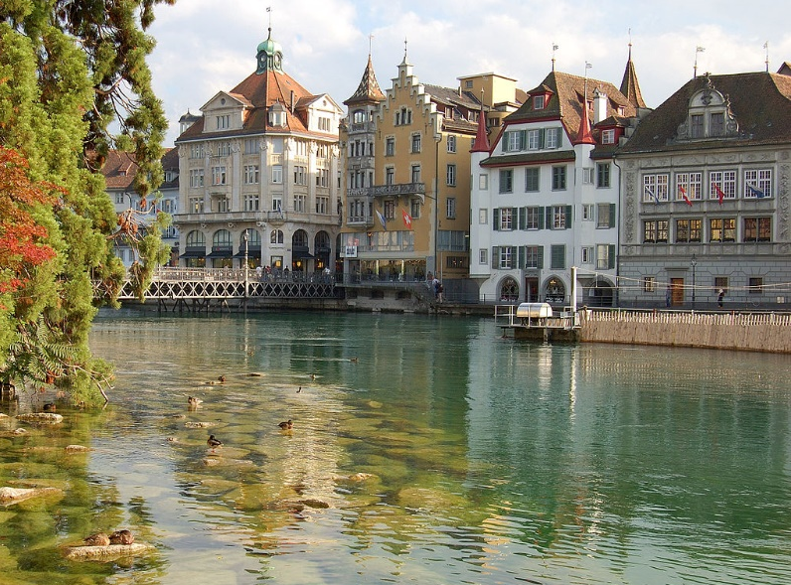
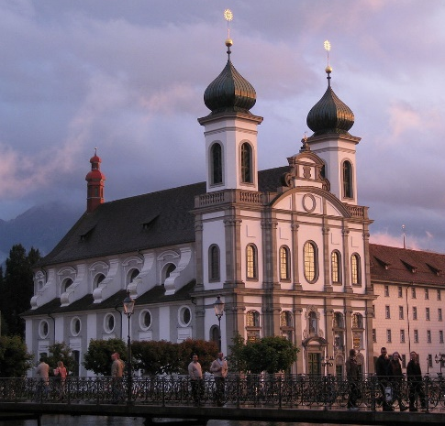
Lucerne (luzern)
German-speaking part in central Switzerland
Chapel Bridge (Kapellbrücke) – wooden bridge, built 1333, oldest covered bridge in Europe

Slide 10
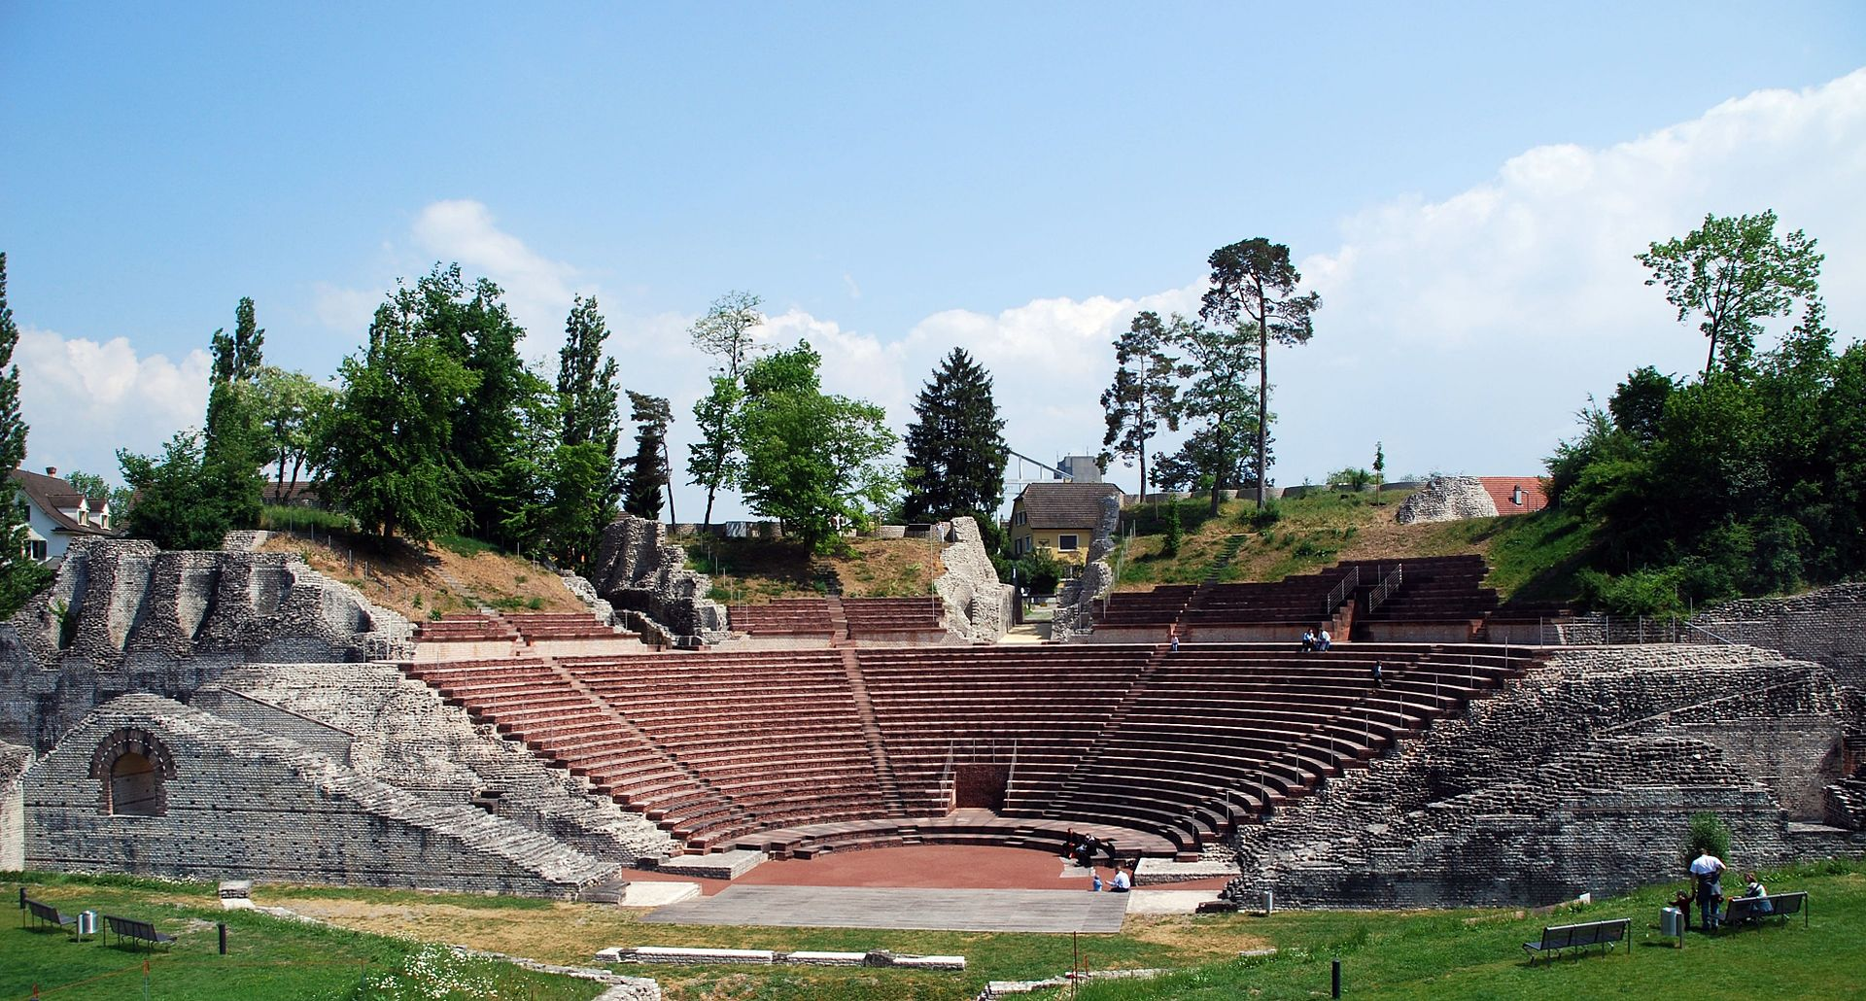
Augusta raurica
First Roman settlement on the Rhine, founded 44 BC (about 20 km from Basel)
Among most important archaeological sites in Switzerland, open-air museum

Slide 11
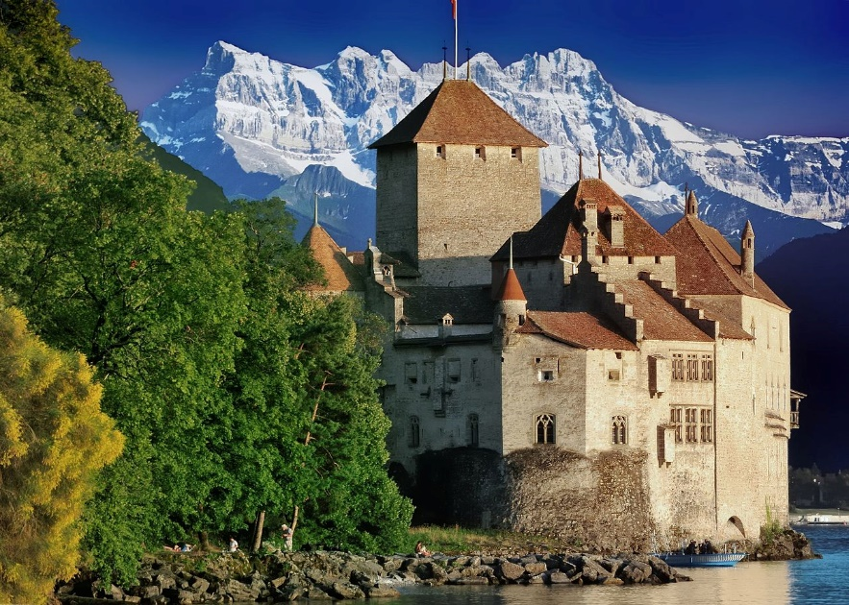
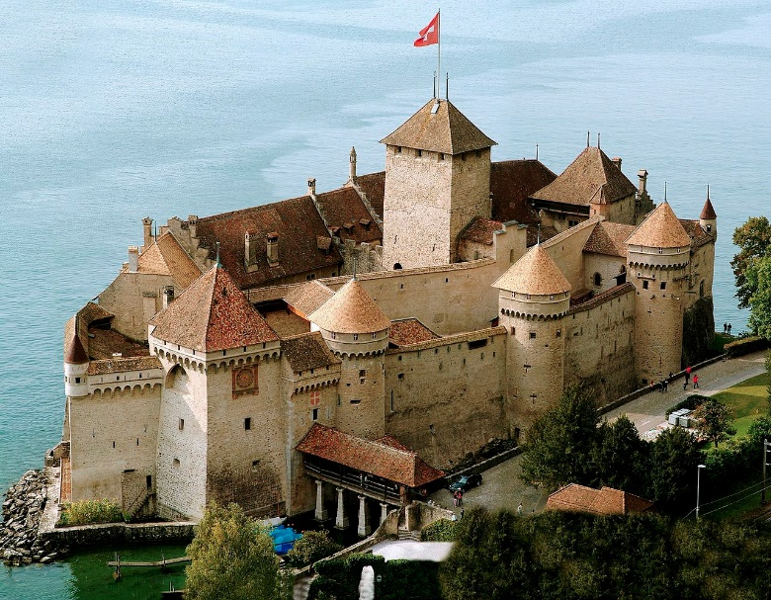
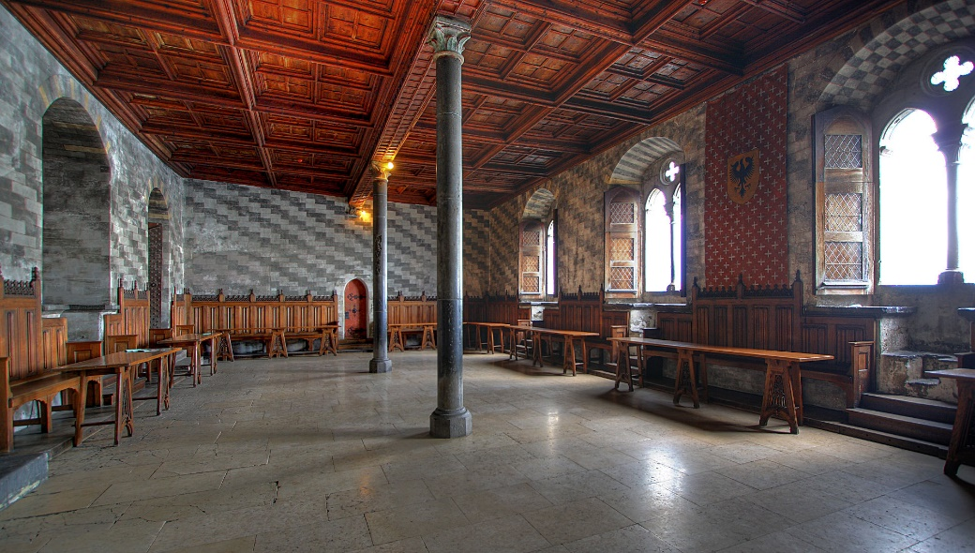
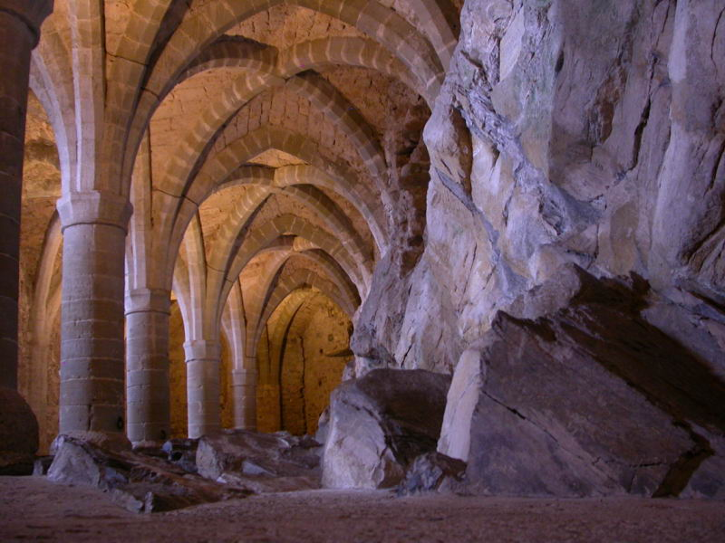
Chateau de chillon
On narrow shore of Lake Geneva & access to Alpine valley of the Rhone
Built to control the road from Burgundy to the Great Saint Bernard Pass in 1005

Slide 12
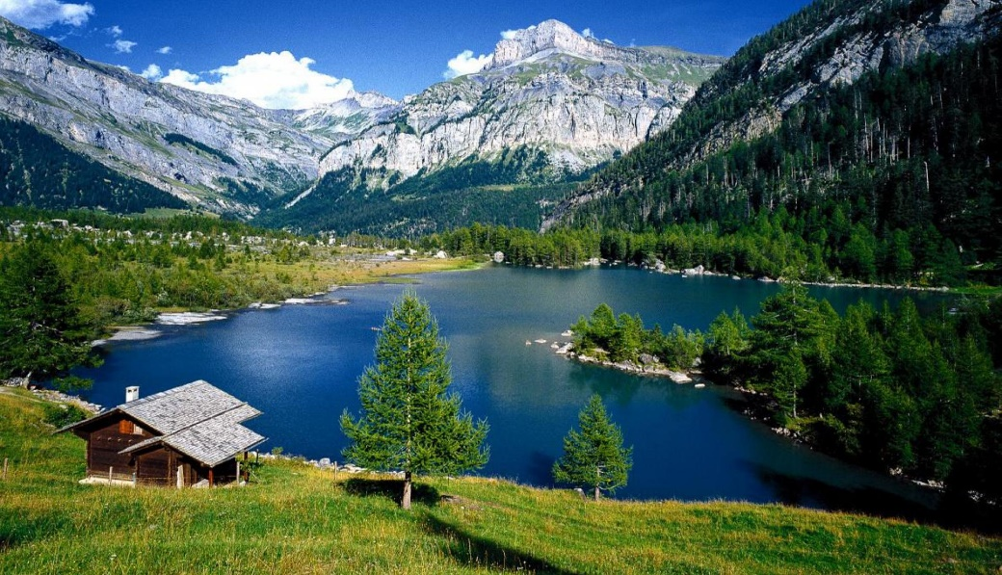
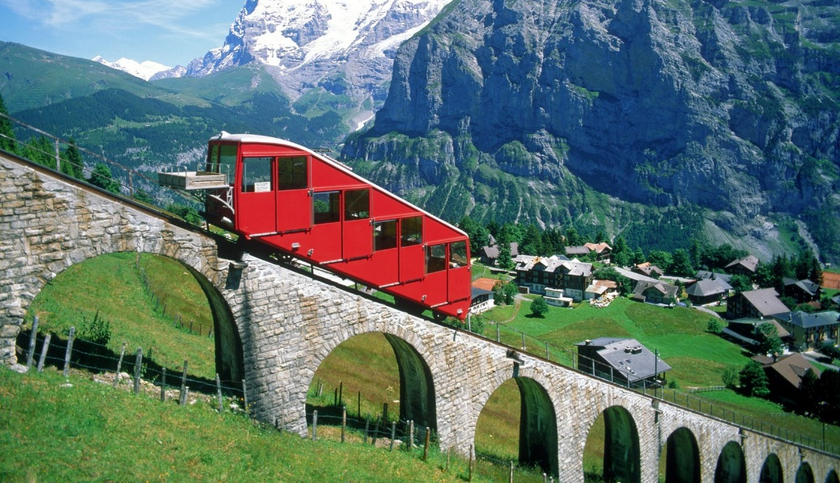
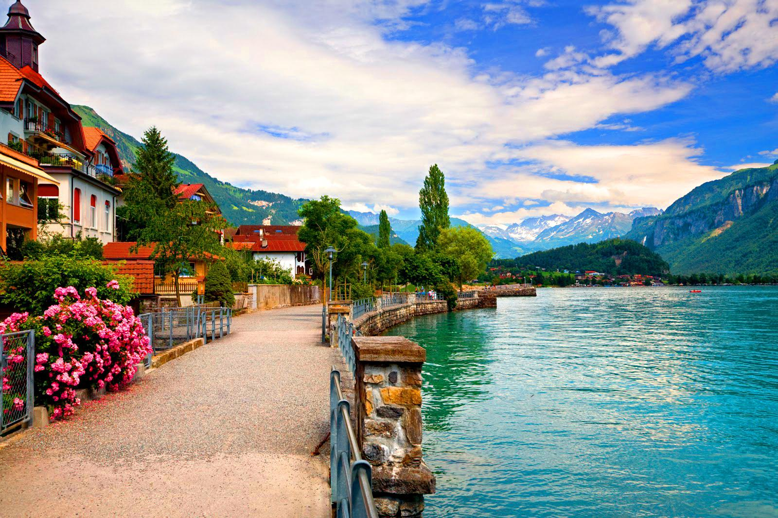
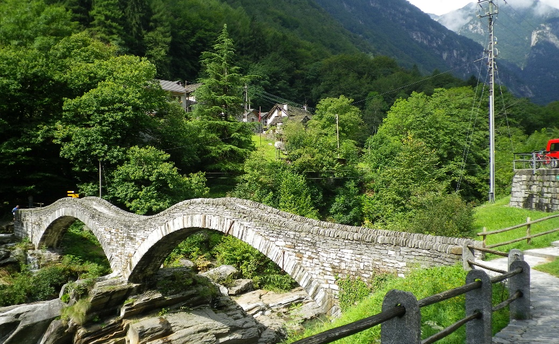
Unesco world heritage sites
Nine cultural sites, four natural sites
Two transboundary with Italy, one with Austria, Germany, Italy, Switzerland & Slovenia FRANCE

Slide 13
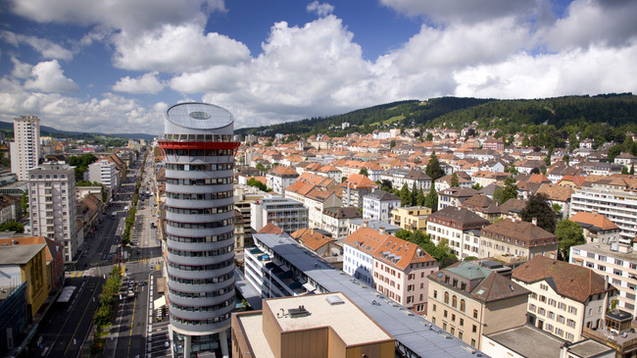
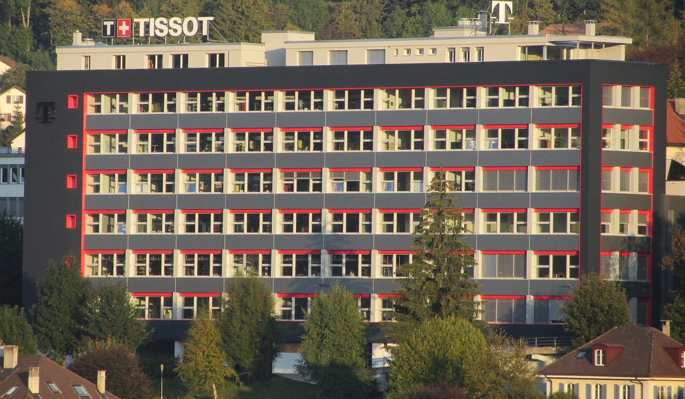
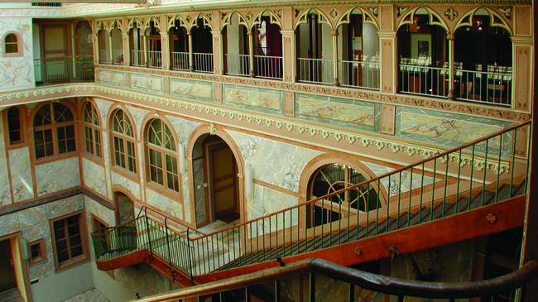
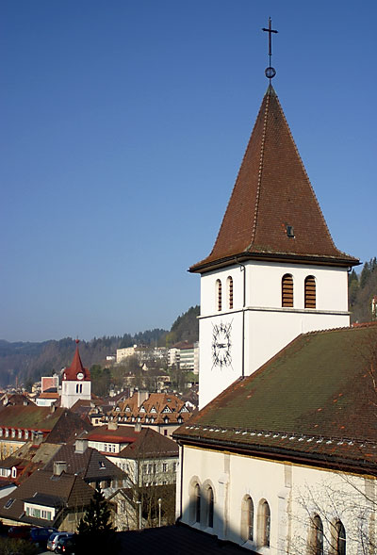
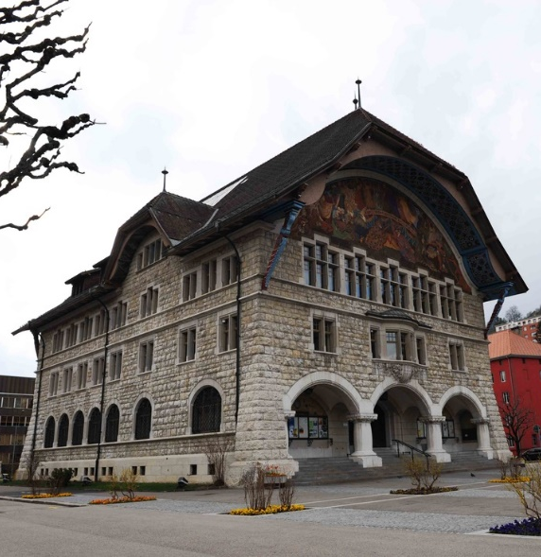
La Chaux-de-Fonds and Le Locle, Watchmaking Town Planning
Early 19 century to suit the needs of watchmaking (dedicated to single industry)
Along parallel strips, housing & workshops intermingled (watchmaking culture dating to 17 c)
Document transition from cottage industry to factory production of late 19 & 20 centuries

Slide 14
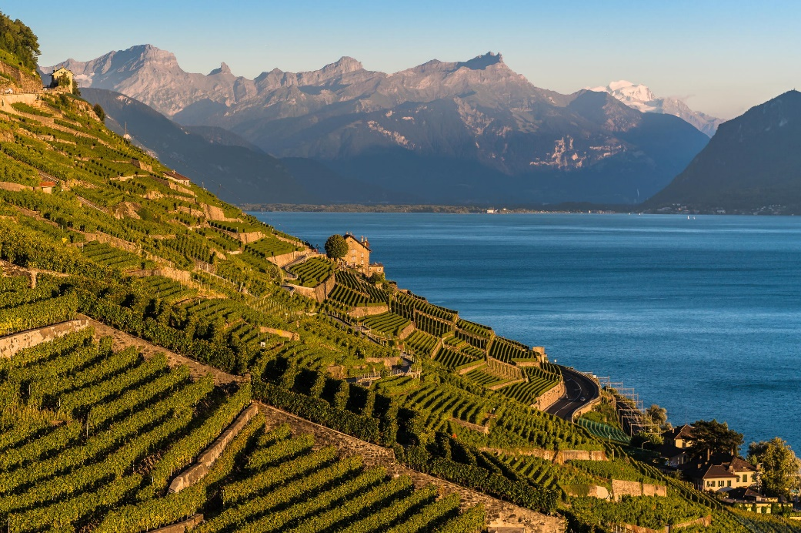
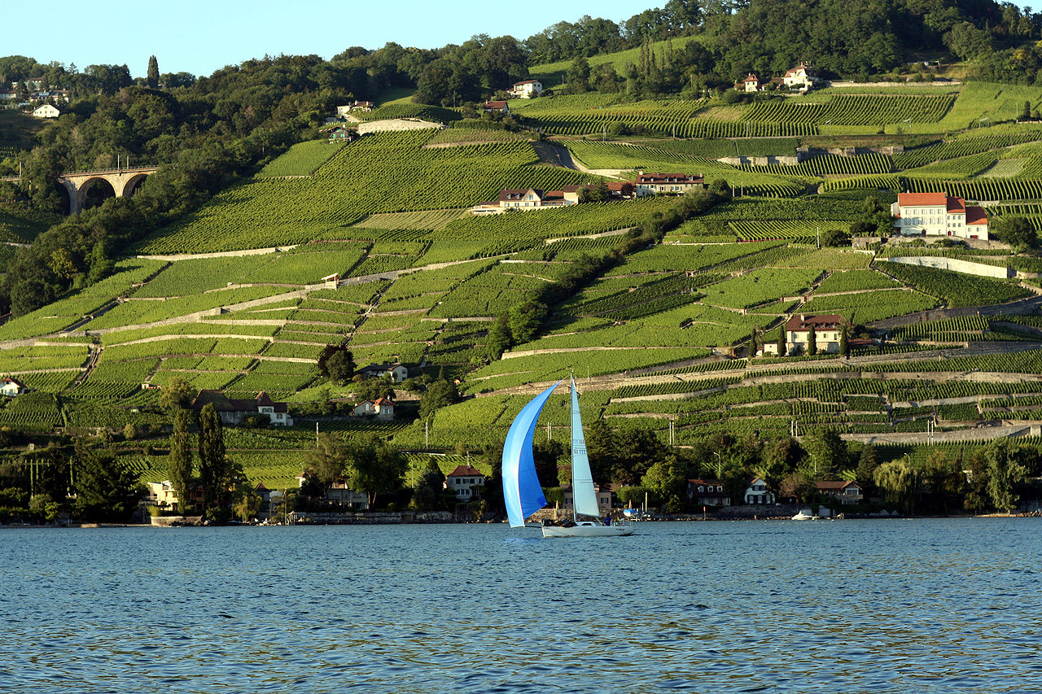
Lavaux Vineyard Terraces
30 km along shores of Lake Geneva (from Chateau de Chillon to outskirts of Lausanne)
Cover lower slopes of mountainside between villages & the lake (in continuous use & well maintained)
11 century, Benedictine & Cistercian monasteries

Slide 15
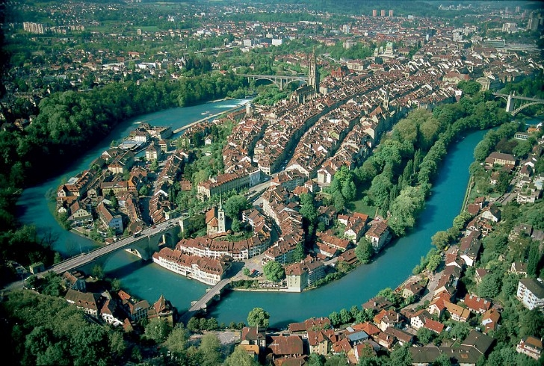
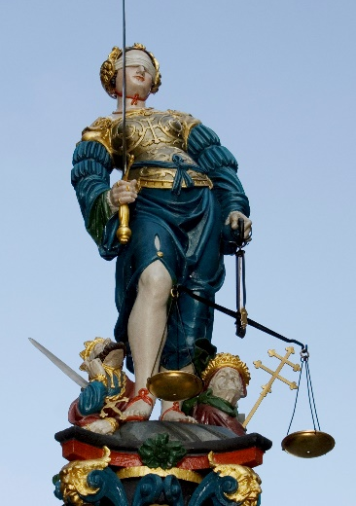
Old City of Berne
On a hill surrounded by Aare River, 12 c (fountains, sandstone facades, narrow streets & historic towers)
Lauben – 6 km of arcades (15c), one of longest covered shopping promenades in Europe
Over 100 public fountains, 16c – 11 topped with statues (Justice, Messenger, Piper, Samson, Moses)
Time Bell (Zytglogge, 1220s), Gothic Cathedral (Münster, 15c, tallest in Switzerland)
Town Hall (15c), Federal Palace (Bundeshause, 19c), Bear Garden (Bärengraben, heraldic animals of Bern)
Town Hall
Federal Palace

Slide 16
Abbey of St Gall
Carolingian monastery – important cultural centre of Europe (from 8c to 1805 – secularization)
Abbatial church (present cathedral), cloister housing Library (one of richest & oldest in the world)
Almost all important architectural periods from High Middle Ages to historicism
*Frankish Empire, 780-900, reign of Charlemange & his heirs

Slide 17
Swiss Tectonic Arena Sardona
Glarus Alps – glaciated mountains, 7 peaks above 3,000 m (north-eastern part of the country)
Example of mountain building through continental collision
Tectonic thrust (older, deeper rocks carried onto younger, shallower rocks)

Slide 18
Swiss Alps Jungfrau-Aletsch
Example of High Alps formation, centred on Eiger, Mönch & Jungfrau peaks
Spectacular peaks, U-shaped glacial valleys, cirques, horn peaks, valley glaciers & moraines
Most glaciated part of European Alps – Aletsch glacier (largest & longest in Europe)
Eiger
Mönch
Jungfrau
Cirque – kar, moraine – moréna (kamenný val)

Slide 19
Three Castles, Defensive Wall and Ramparts of the Market-Town of Bellinzona
Fortified walls & castles Castelgrande, Montebello & Sasso Corbano (around the town of Bellinzona)
Castelgrande – on rocky peak overlooking the entire Ticino valley
Fortified walls run from the Castle to Montebello (on rocky hilltop, integral part of fortifications)
Sasso Corbaro – isolated rocky promontory, highest of the three castles
Castelgrande
Sasso Corbaro
Montebello
Sasso Corbaro
Montebello

Slide 20
Monte San Giorgio
Pyramid-shaped wooded mountain beside Lake Lugano (shared with Italy)
Best fossil record of marine life & land-based fossils from Triassic Period (245-230 million years ago)
Records life in tropical lagoon (reptiles, fish, bivalves, ammonites, crustaceans) (reptiles, insects, plants)

Slide 21
Rhaetian Railway
Brings together two historic railway lines that cross Swiss Alps through two passes
Albula line – opened 1904, north-western part, 67 km long (Switzerland)
Features 42 tunnels & covered galleries & 144 viaducts & bridges
Bernina line – opened 1910, 61 km, features 13 tunnels & galleries & 52 viaducts & bridges (Italy)

Slide 22
Benedictine Convent of St John at Müstair
Carolingian* convent – founded around 775, probably on the orders of Charlemagne
Saint Cross Church, residential tower, residence of bishop, two courtyards surrounded by cloisters, two entrance towers & agricultural buildings
Greatest series of figurative murals (painted app 800 AD) & Romanesque frescoes & stuccoes
*Frankish Empire, 780-900, reign of Charlemange & his heirs
Charlemagne

Slide 23
Prehistoric Pile dwellings around the Alps
Serial property of 111 small individual sites
Switzerland 56 sites, Austria (5), France (11), Germany (18), Italy (19) & Slovenia (2)
Remains of prehistoric pile-dwelling (stilt house) settlements
Built from around 5000 to 500 BC on the edges of lakes, rivers & wetlands
Well-preserved & culturally rich archaeological sites (study of early agrarian societies in the region)
Original piles found in many Swiss lakes; reconstruction of a Neolithic dwelling in Neuchâtel

Slide 24
Thank you for attention

