Slide 1
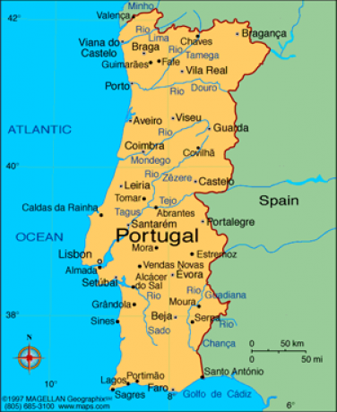
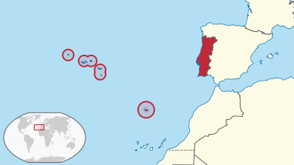
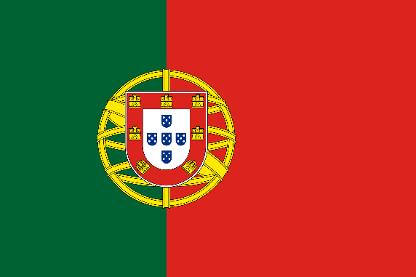
Portugal
República Portuguesa
Iberian Peninsula
Atlantic Ocean to the west & south, Spain to the north & east
Continental Portugal & Atlantic archipelagos of Azores & Madeira
Named after second largest city Porto (Latin name – Portus Cale)
92,400 km², 10.5 million people
Lisbon
8.5 million foreign tourists

Slide 2
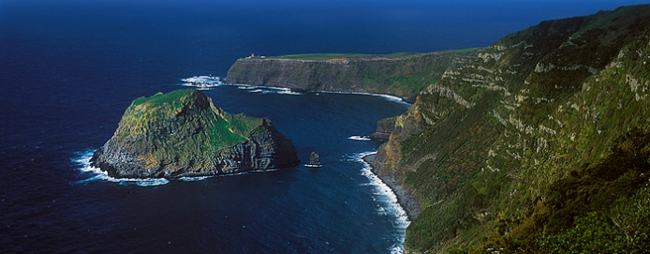
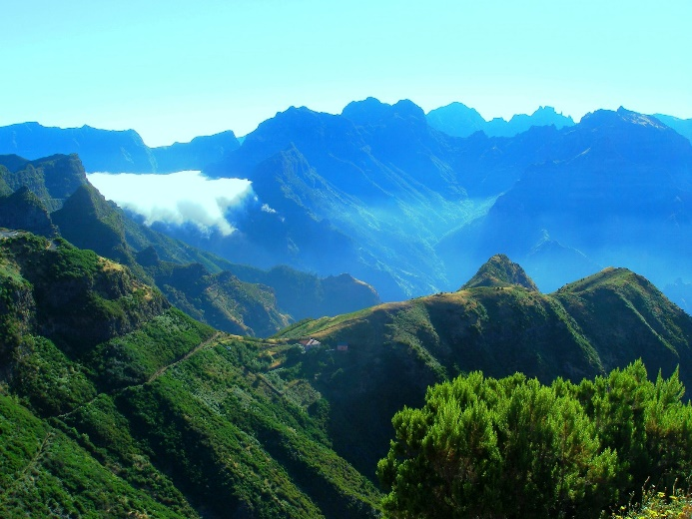
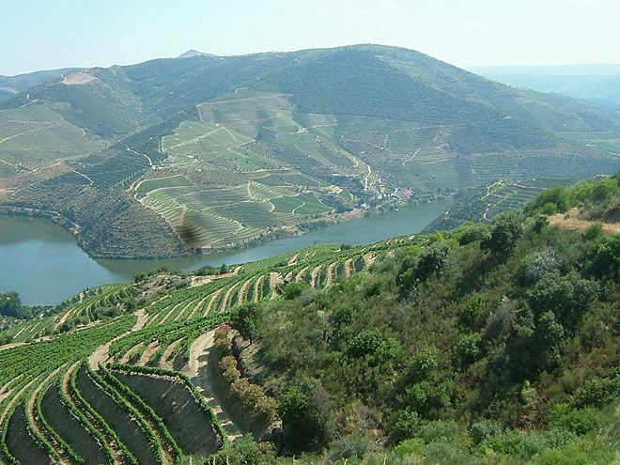
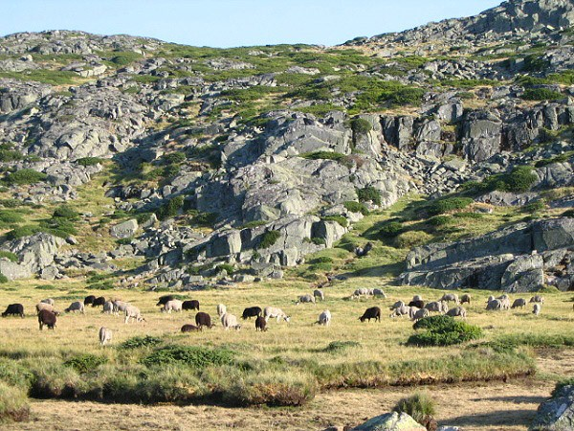
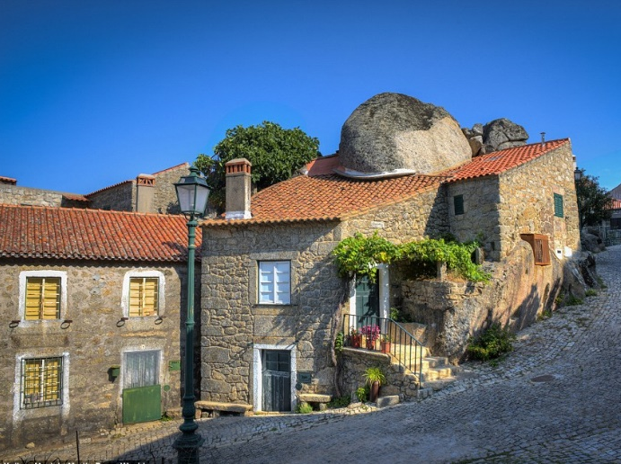
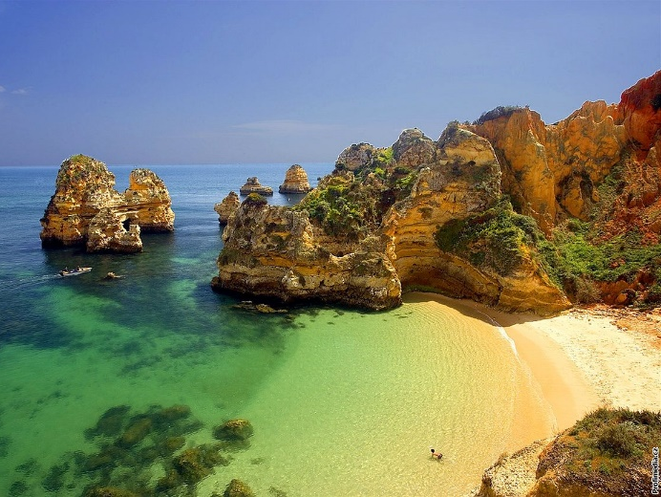
Portugal – tourist attractions
Green mountains in the North (covered with vines & forests)
Rocky mountains with rolling plains, slopes & falls in the Centre
Near-desert landscape in the Alentejo region
Beach destination of Algrave

Slide 3
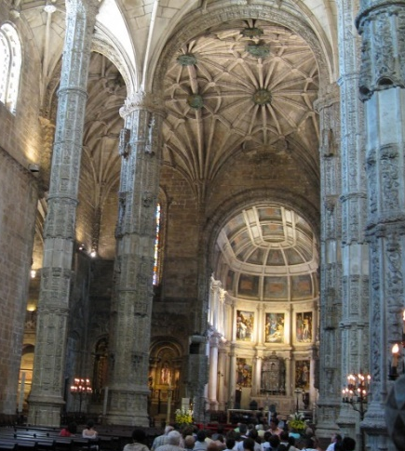
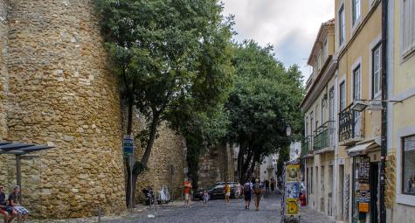
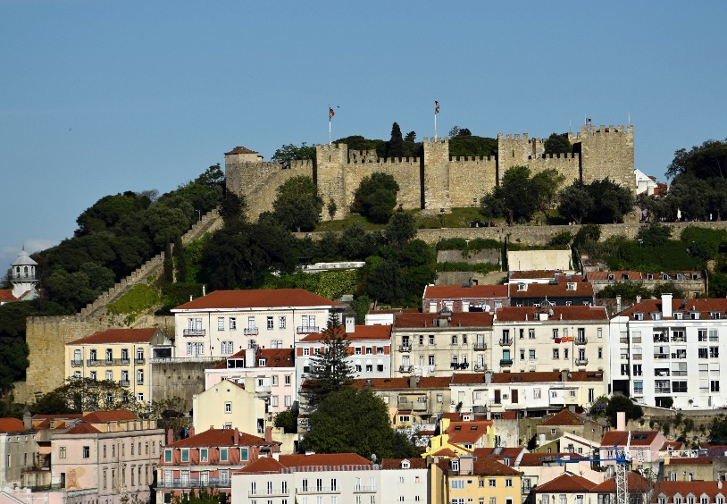
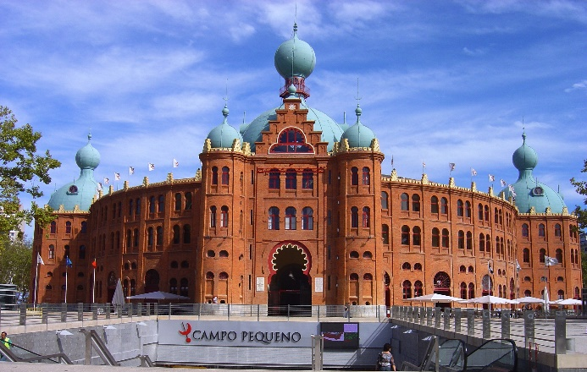
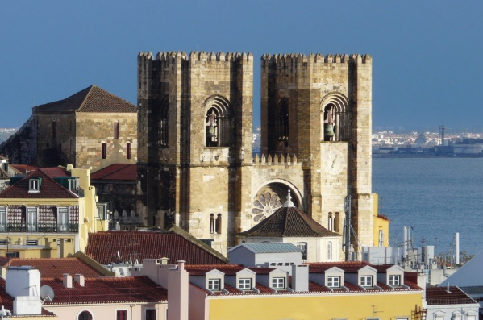
Lisbon
One of the oldest in the world & oldest in Western Europe
Ruled by Germanic tribes (5 century)
Captured by the Moors (8 century)
Reconquered by the Crusaders (1147)
Old Wall (Visigothic origin)
Ruins of Roman baths, temples & theatre
Alfama district (oldest part)
Saint George Castle (6 century)
Cathedral (12 century)
Campo Pequeno (bullring, Moorish style)
Belém Tower & Hieronymites Monastery

Slide 4
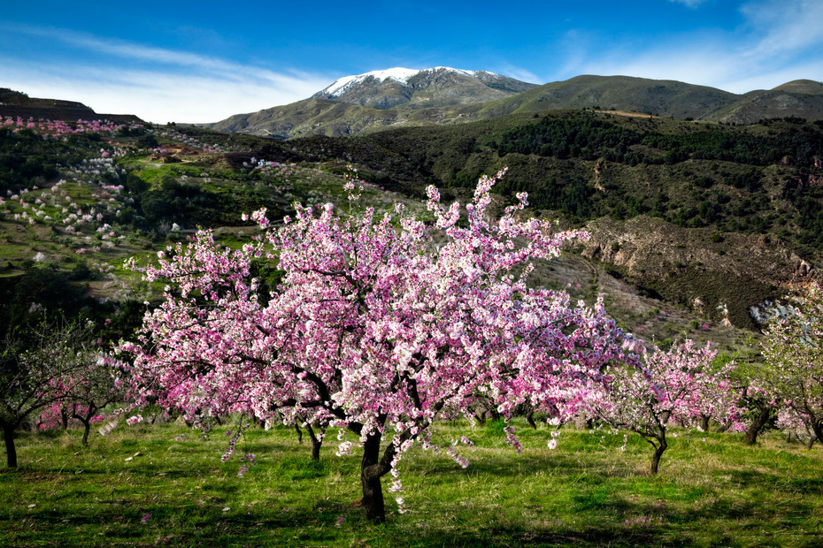
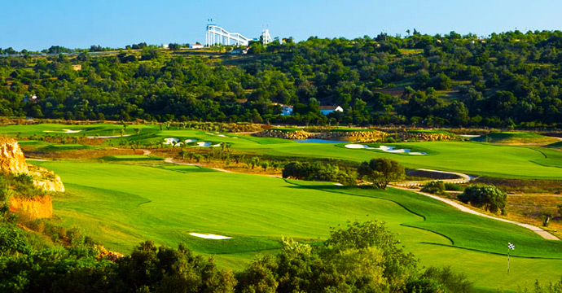
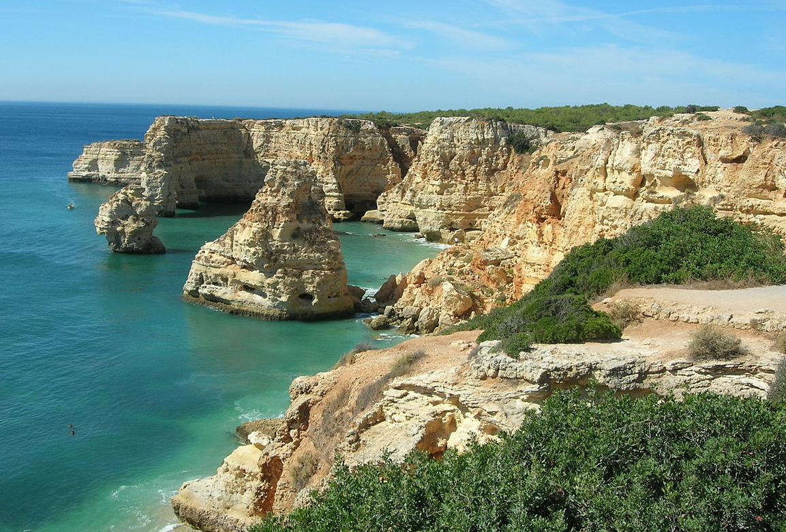
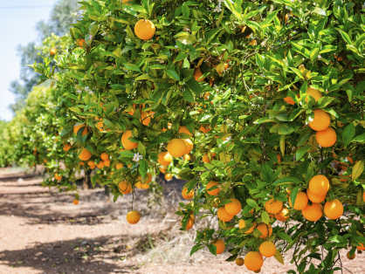
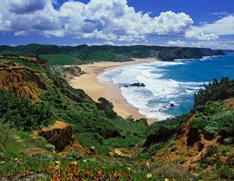
algarve
Beautiful landscape scattered with fig, almond & orange groves
Sunny beaches such Navy Beach (Praia da Marinha)
Network of golf courses
Caldas de Monchique (healing waters)
Church of Our Lady of Piety in Loulé

Slide 5
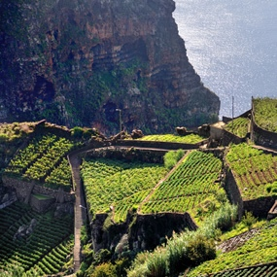
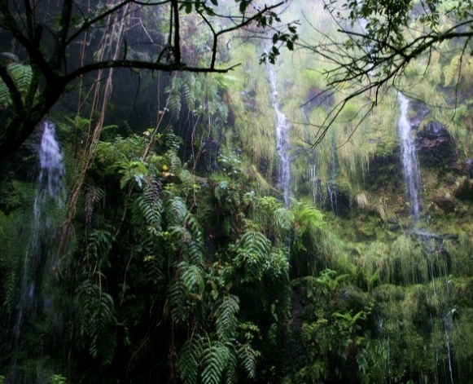
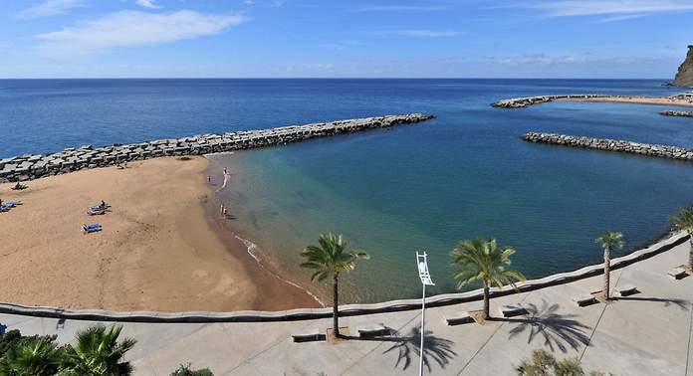
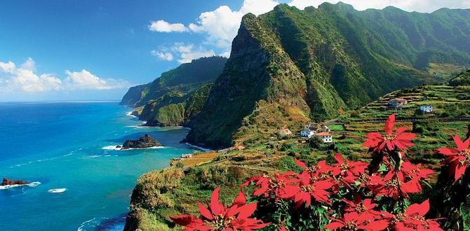
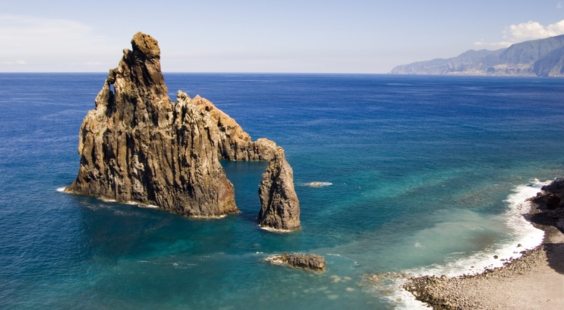
madeira
To the west of the mainland, volcanic origin
Subtropical climate, beautiful sandy beaches
Flora & fauna, laurel forests, Madeira wine
Whale & dolphin watching

Slide 6
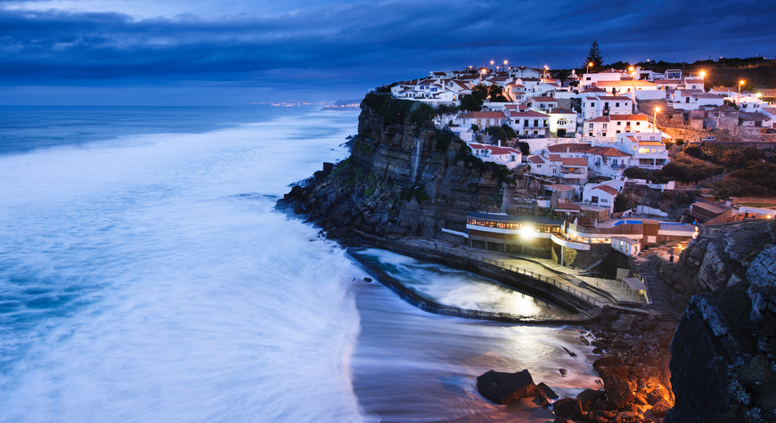
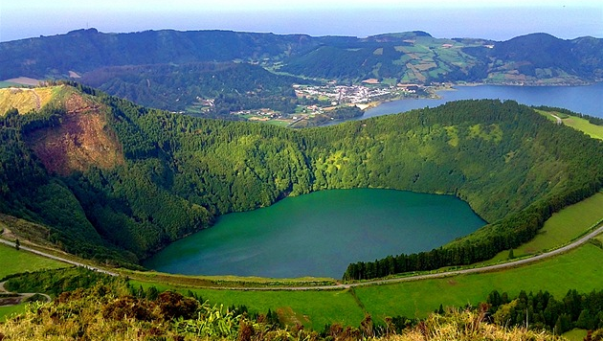
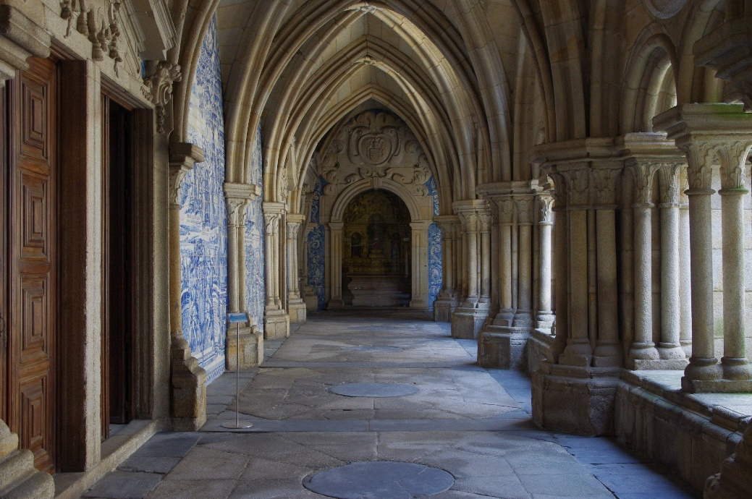
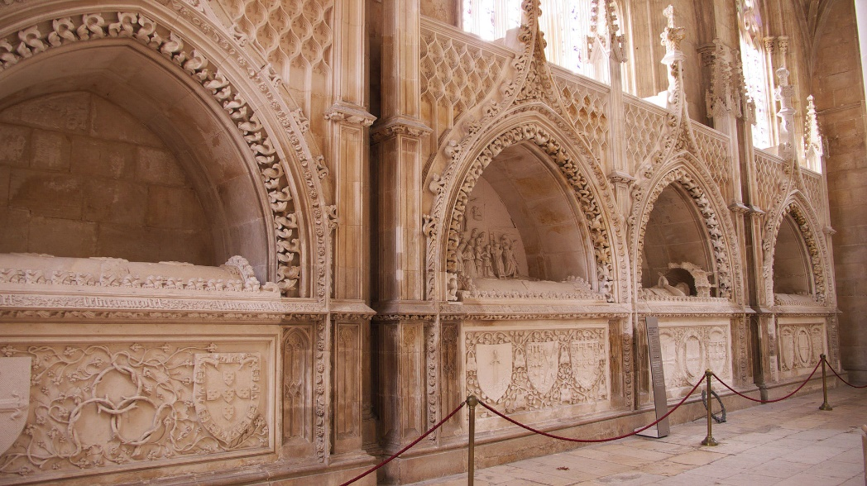
Unesco world heritage sites
14 cultural sites, one natural site
Three in the Azores & Madeira archipelagos
One transboundary shared with Spain

Slide 7
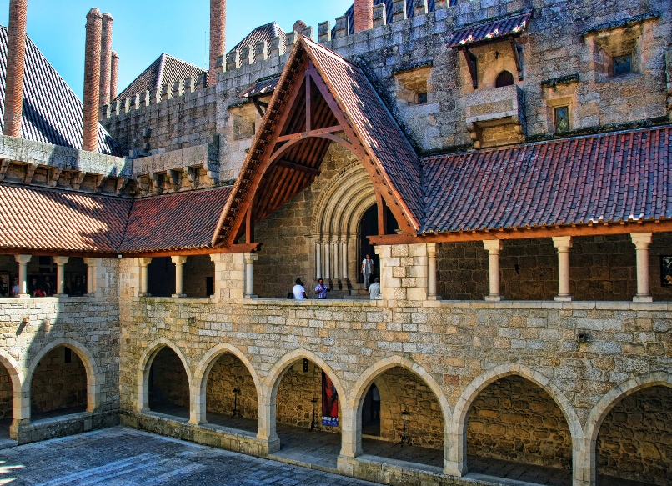
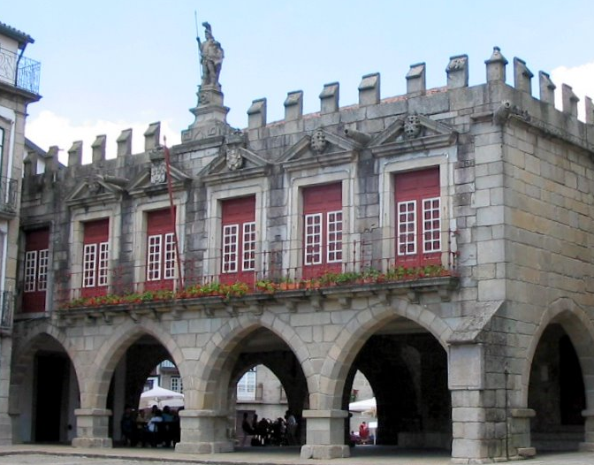
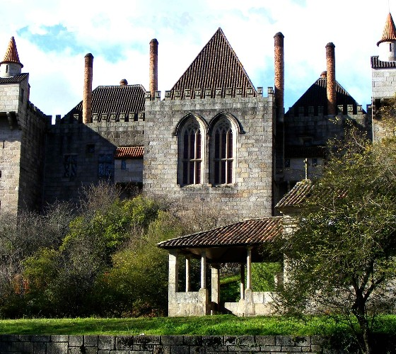
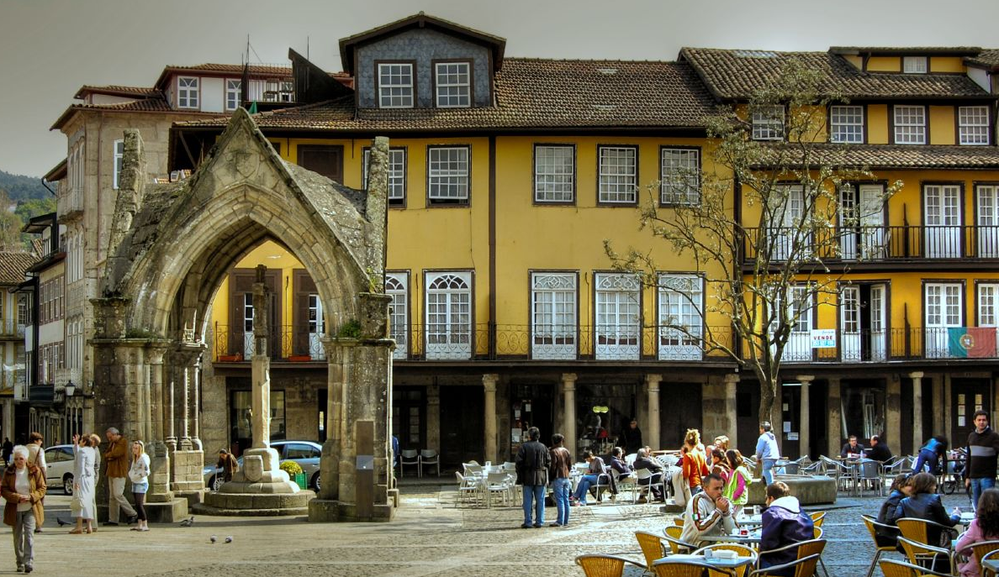
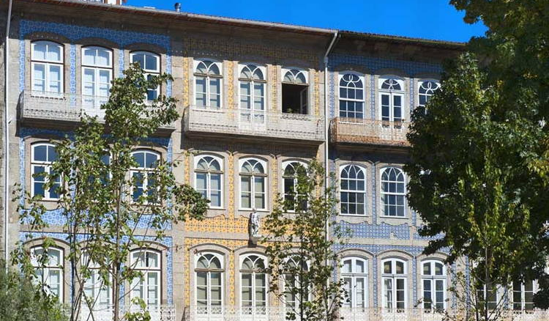
Historic Centre of Guimarães
Associated with the emergence of the Portuguese national identity in the 12 century
Authentic example of the evolution of a medieval settlement into a modern town
Rich building typology (15 to 19 century)
Traditional building materials and techniques
Ducal Palace

Slide 8
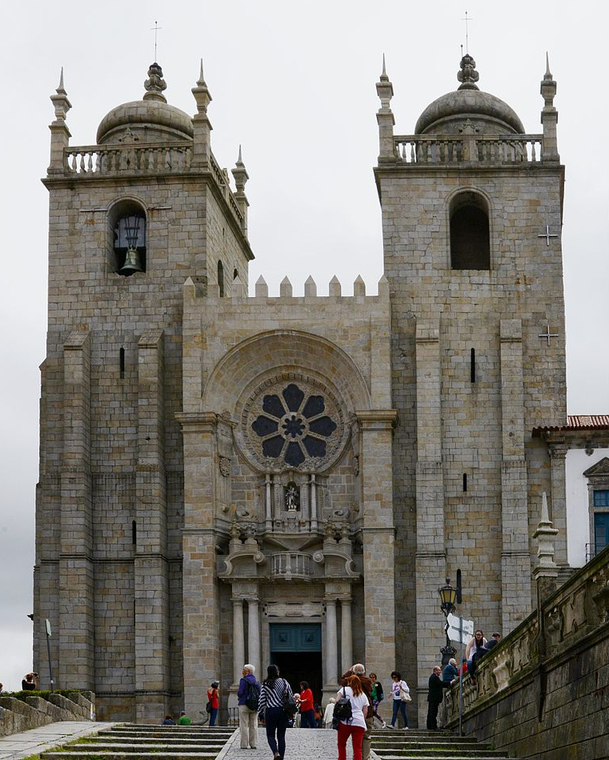
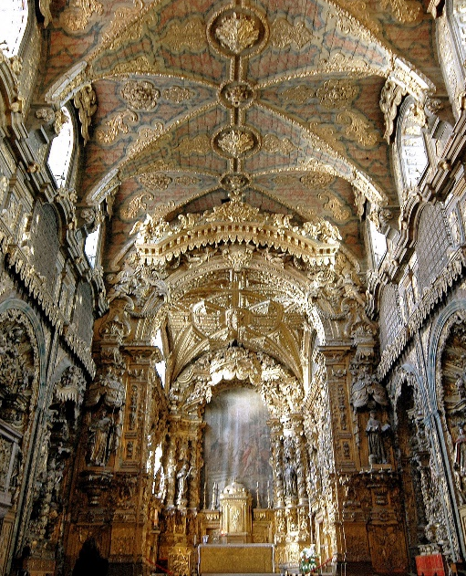
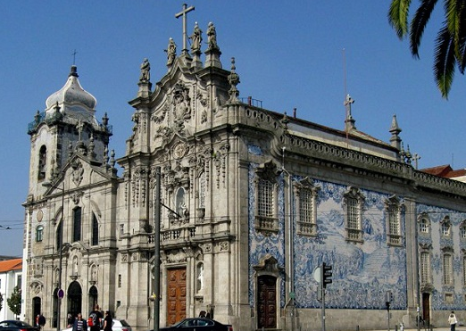
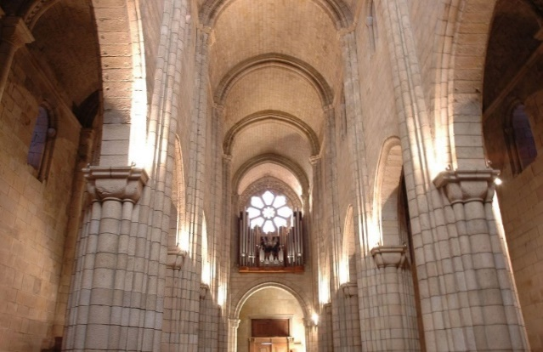
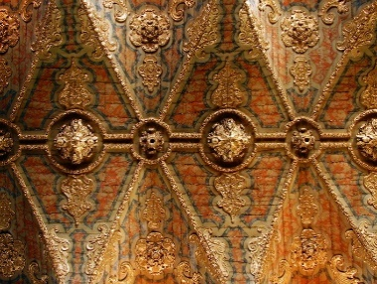
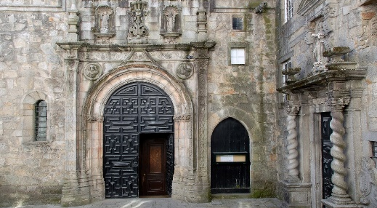
Historic Centre of Oporto
Hillsides above Douro River
2,000 year history
Romans called it Portus (port)
Cathedral
Santa Clara
Manueline style

Slide 9
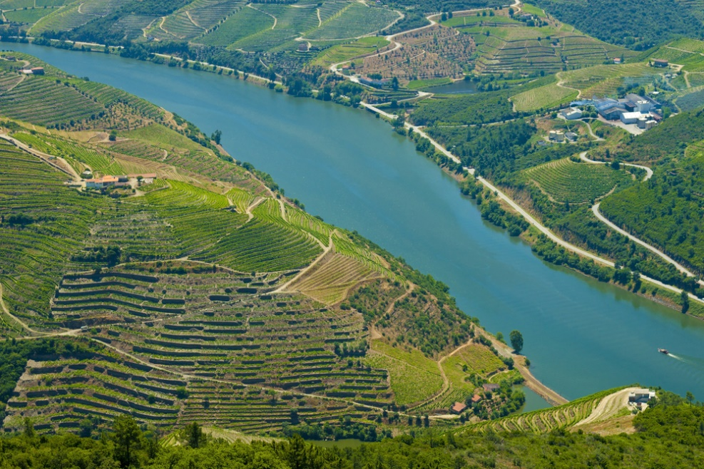
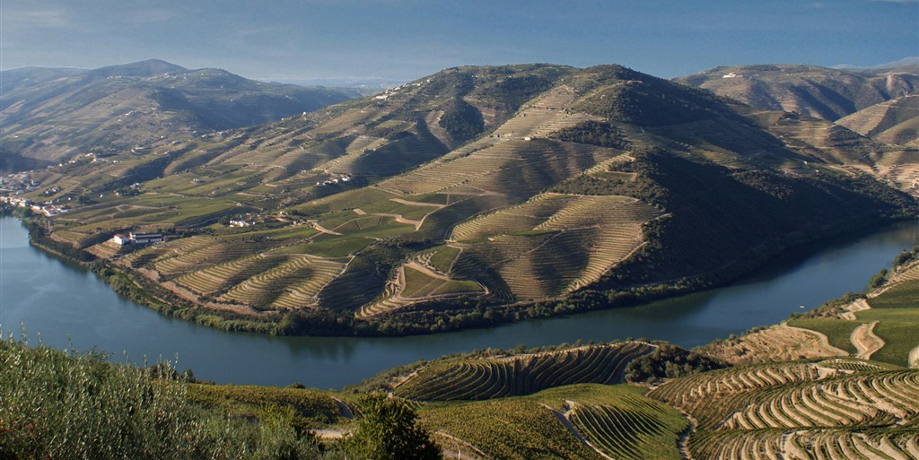
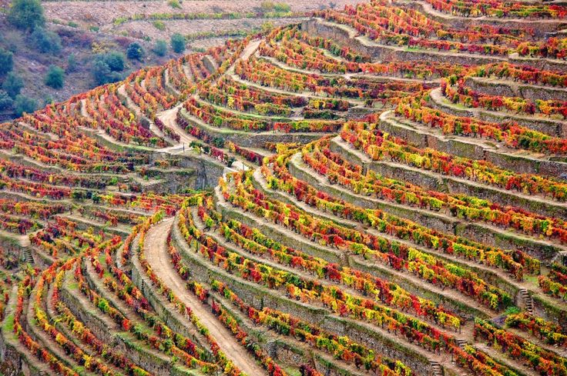
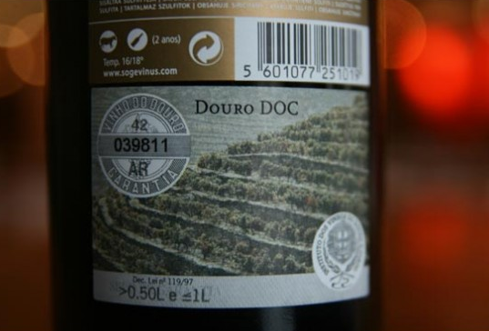
Alto Douro Wine Region
Wine produced for about 2,000 years, terraced vineyards
Port wine world famous for its quality since the 18 century
Long tradition of viticulture → cultural landscape of outstanding beauty

Slide 10
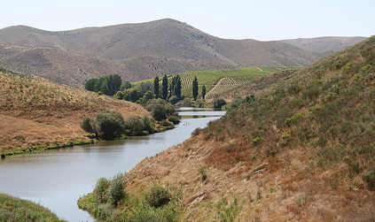
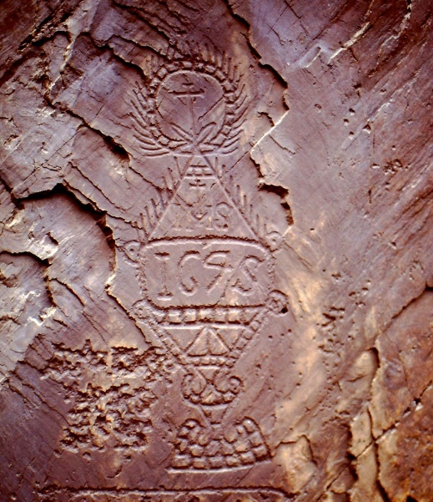
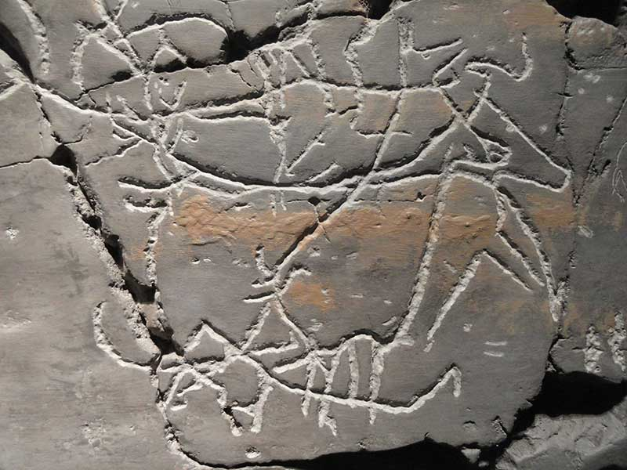
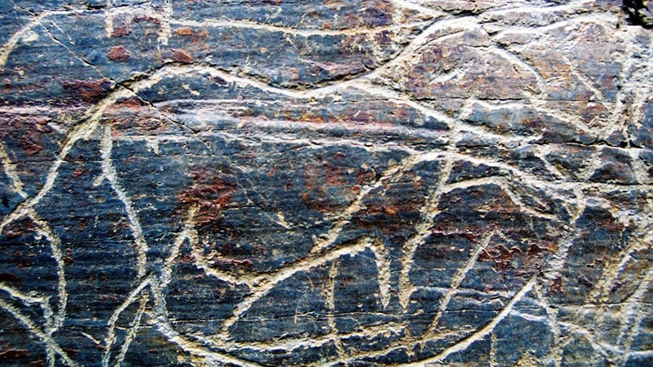
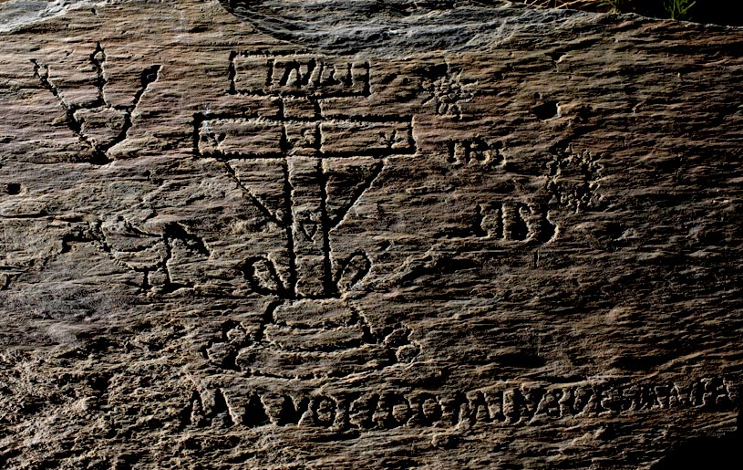
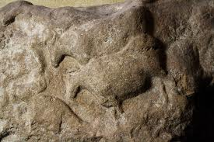
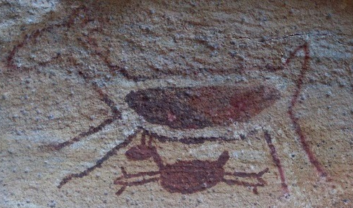
Prehistoric Rock Art Sites in the Côa Valley and Siega Verde (Spain)
On the banks of the rivers Agueda and Côa
Continuous human settlement from the Palaeolithic Age
Hundreds of panels with thousands of animal figures
5,000 in Côa Valley, around 640 in Siega Verde
Carved over several millennia

Slide 11
University of Coimbra – Alta and Sofia
Founded in 1290
On a hill overlooking the city
Evolved over more than seven centuries
Integrated university city
Cathedral of Santa Cruz (12 c)
Chapel of Saint Michael
Royal Palace of Alcáçova
Colleges of Jesus, Holy Trinity, Saint Jerome…
Joanine Library, Botanical Garden, laboratories…
Royal Palace
Chapel
Cathedral

Slide 12
Convent of Christ in Tomar
Designed as symbol of Reconquista
Templar Knights of (12 century)
Knights of the Order of Christ (14 century)
Romanesque, Gothic, Renaissance & Manueline*
*Style of architectural ornamentation of the first decades of the 16 century, combines elements of Late Gothic with Spanish, Mudejar (Islamic tradition), Italian & Flemish elements

Slide 13
Monastery of Batalha
Dominican Monastery
Built to commemorate the victory over the Castilians in 1385

Slide 14
Monastery of Alcobaça
Cistercian Monastery of Santa Maria de Alcobaça
First Gothic building in Portugal (mid-12 century)

Slide 15
Cultural Landscape of Sintra
First centre of European Romantic architecture (19 c)
Ruined monastery → castle
Gothic, Egyptian, Moorish & Renaissance elements
Park – local & exotic tree

Slide 16
Monastery of the Hieronymites and Tower of Belém in Lisbon
Monastery – entrance to harbour (1502)
Tower – commemorates the expedition of Vasco da Gama
Manueline architecture

Slide 17
Historic Centre of Évora
Roman times
Golden age – residence of king (15 c)
Whitewashed houses with azulejos* & wrought-iron balconies
*Painted tin-glazed ceramic tilework

Slide 18
Garrison Border Town of Elvas and its Fortifications
Extensively fortified from the 17 to 19 centuries
Largest bulwarked dry-ditch system in the world
Barracks, military buildings, churches & monasteries
Amoreira aqueduct – enable to withstand long sieges

Slide 19
Laurisilva of Madeira
Outstanding relict of previously widespread forest type
Series of very steep V-shaped valleys
Largest surviving area of primary laurel forest in Europe

Slide 20
Central Zone of the Town of Angra do Heroismo in the Azores
Angra on the island of Terceira
Obligatory port of call (15 – 19 century)
San Sebastião & San João Baptista fortifications
400 year old

Slide 21
Landscape of the Pico Island Vineyard Culture
Volcanic island of Pico
Almost 10 km²
Walls protect from wind and seawater

Slide 22
Thank you for attention

