Slide 1
Breakthrough of 1989. Formation of a New Political System and the European Course of the Third Republic
Prof. Radosław Domke

Slide 2
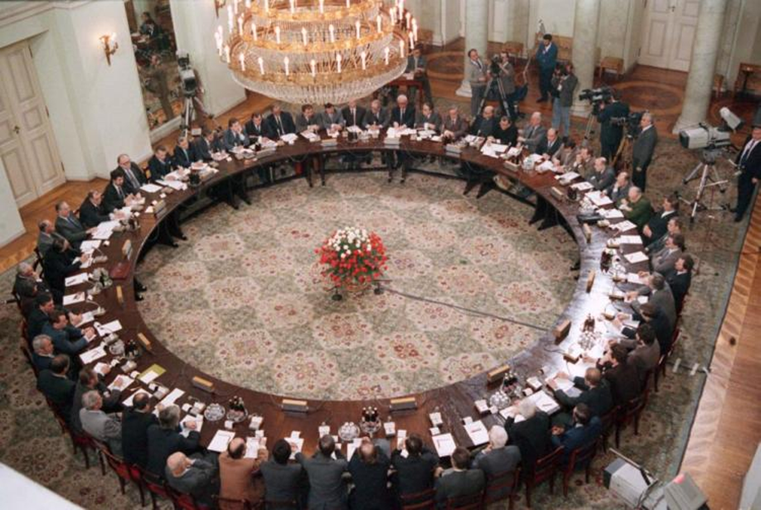
The round table (1989)

Slide 3
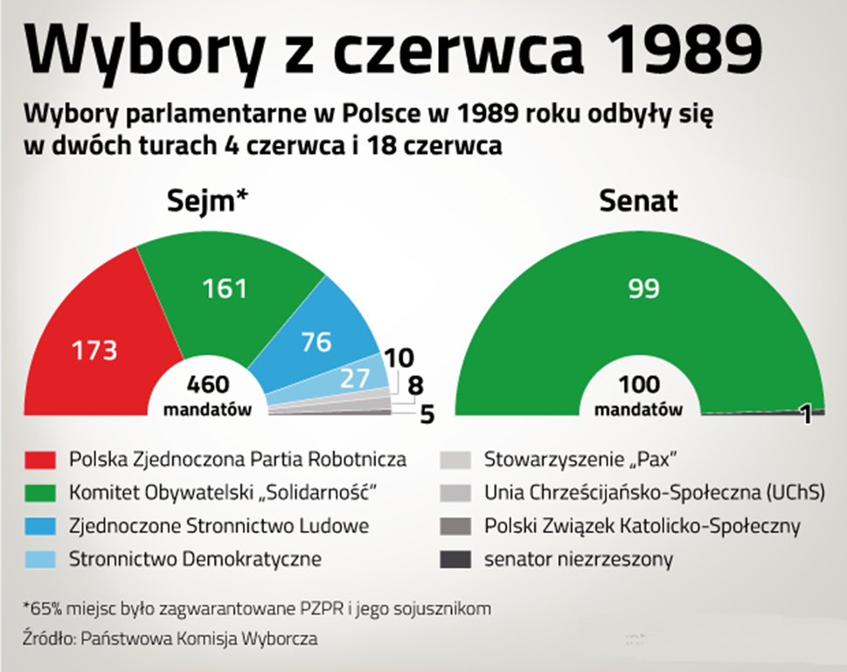
June elections (1989)

Slide 4
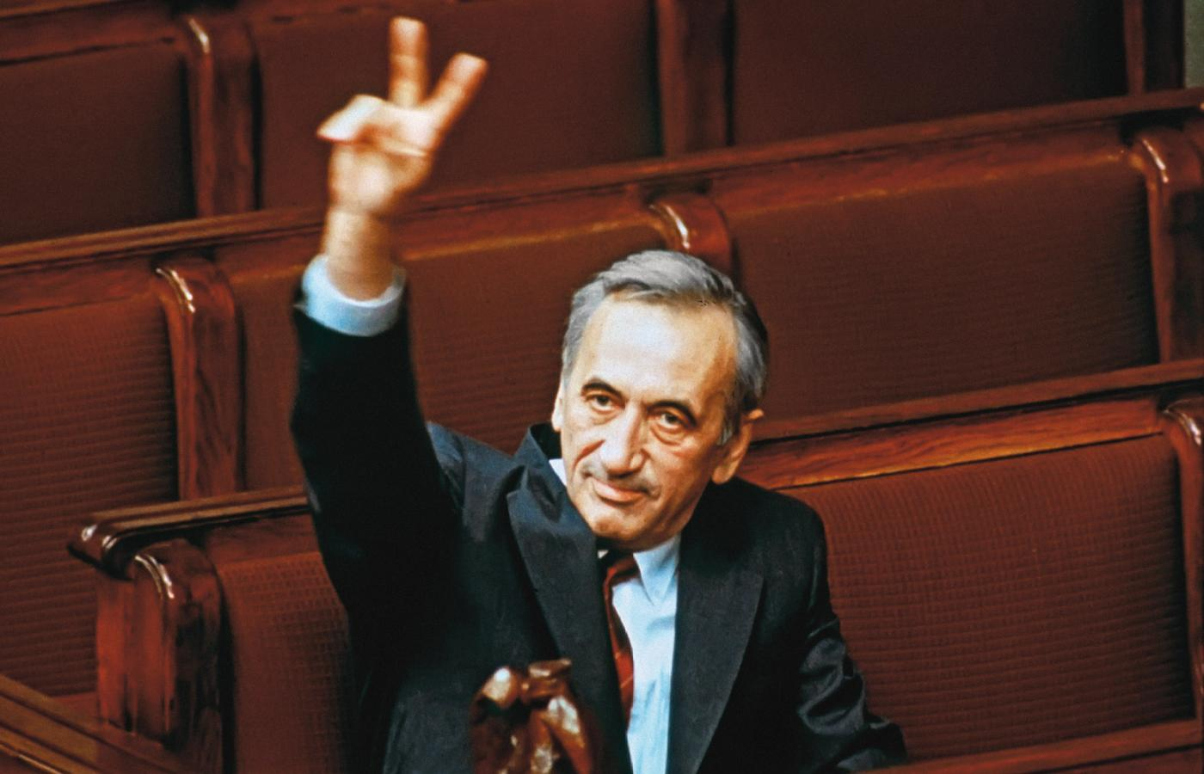
First democratic Prime Minister (1989) – Tadeusz MAzowiecki

Slide 5
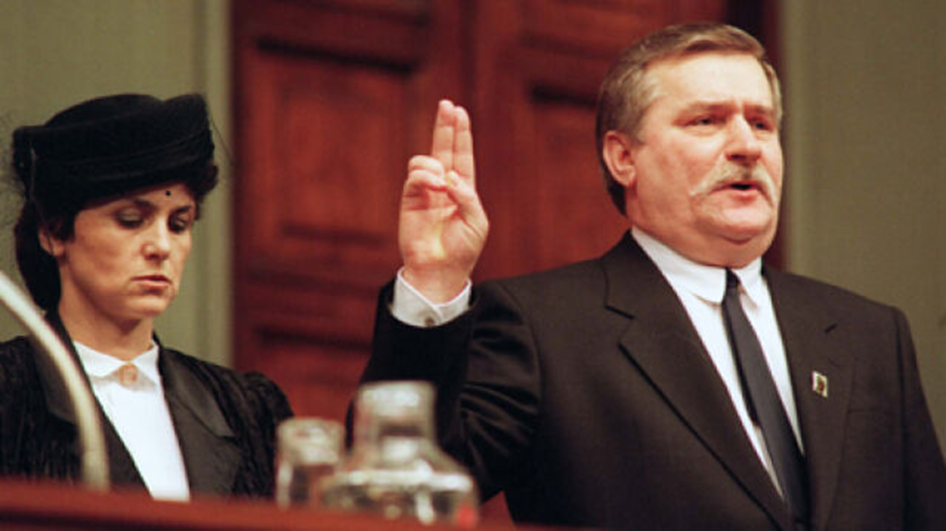
First democratic president (1990)– Lech Wałęsa

Slide 6
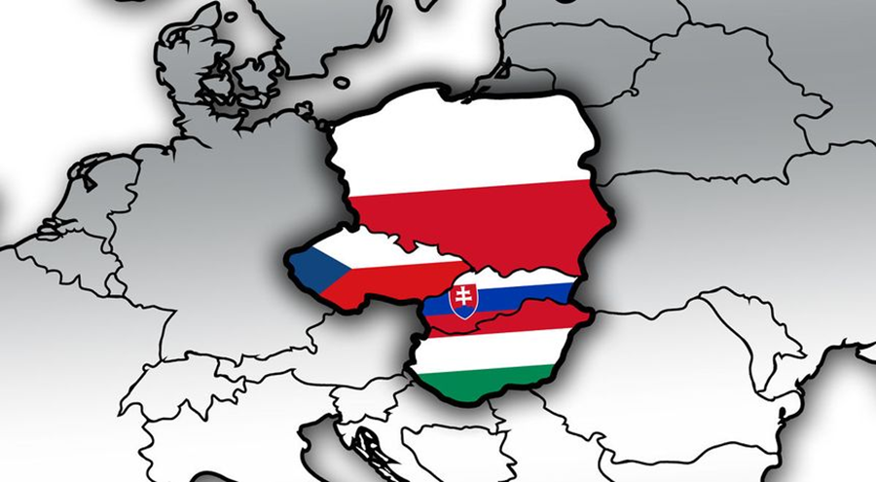
Visegrádská skupina

Slide 7
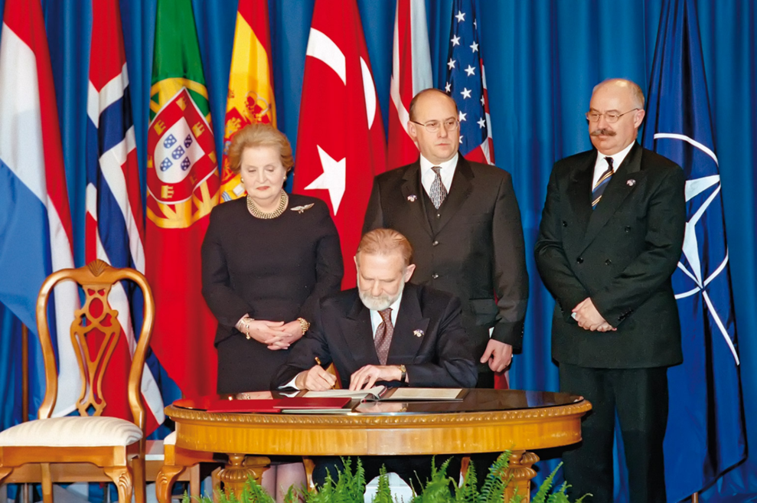
Poland in NATO (1999)

Slide 8
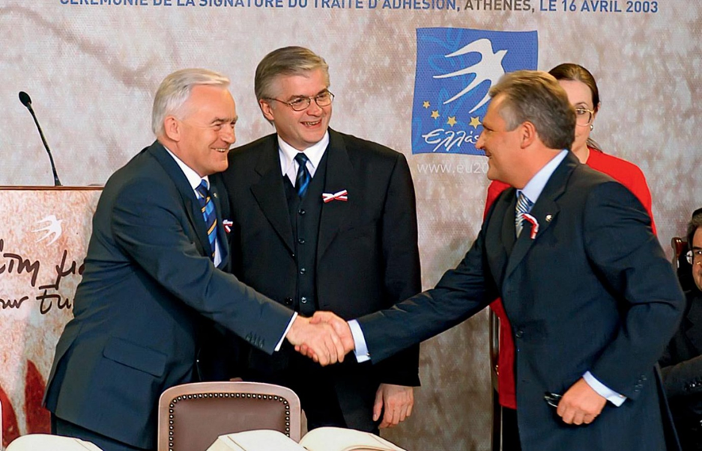
Poland in EU (2004)

Slide 9
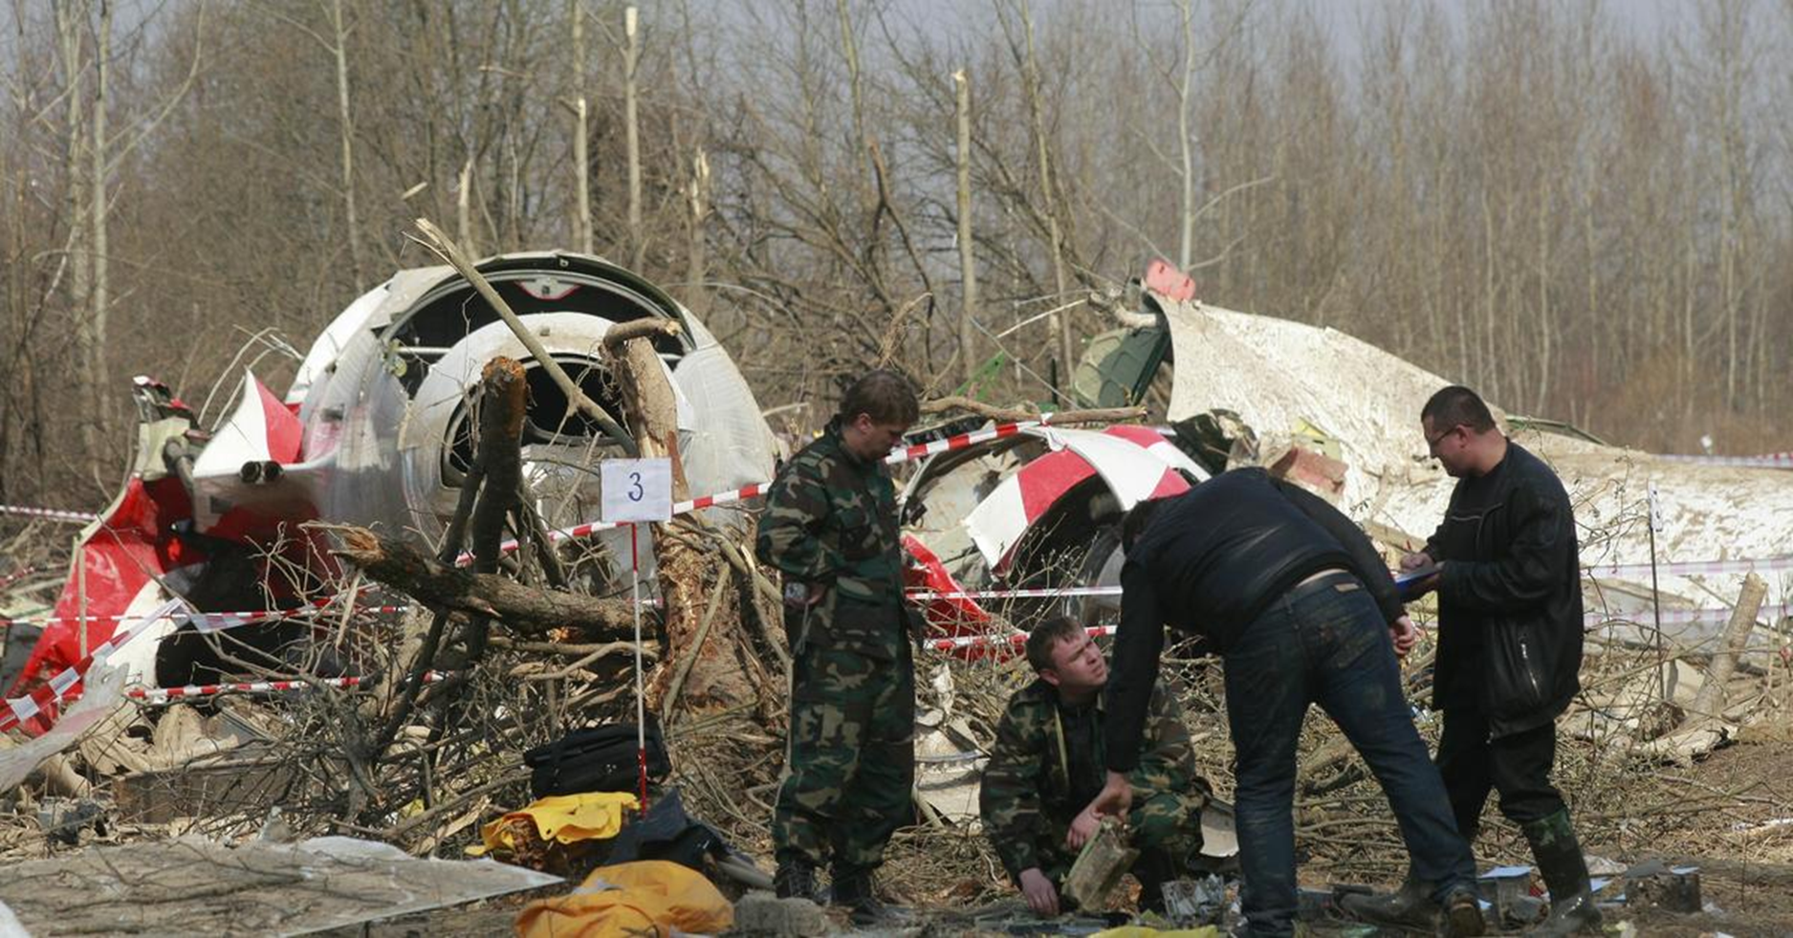
Smoleńsk (2010) – the end of some era…

Slide 10
recommended literature
NODL, M. - FRIEDL, J. - ŘEZNÍK, M. Dějiny Polska. Praha, 2016. info
Kosman, M. Dějiny Polska. Praha: Karolinum, 2011. ISBN 978-80-246-1842-5. info
CHWALBA, A. Polsko 1989-2008: dějiny současnosti. Brno, 2009. info

Slide 11
Thank you for the whole semester : )

