Slide 1
The Economic and Social situation of Poland 1944-1949
Radosław Domke

Slide 2
War damage
No war has devastated Poland as much as World War II
The Germans turned some cities into fortresses and they were completely destroyed as a result of the Red Army offensive (Wrocław, Kostrzyn)
Some cities, such as Kraków, escaped major destruction, but most were left in ruins
The rich former German lands were also robbed because the Russians treated them as war spoils.

Slide 3
Warsaw Uprising
At this point it is worth mentioning the most destroyed city.
In August 1944, an uprising broke out in Warsaw, directed militarily against Germany and politically against the USSR.
Adolf Hitler issued an order to raze Warsaw to the ground
After more than two months of heroic fighting, the insurgents succumbed to the terrifying enemy forces

Slide 4
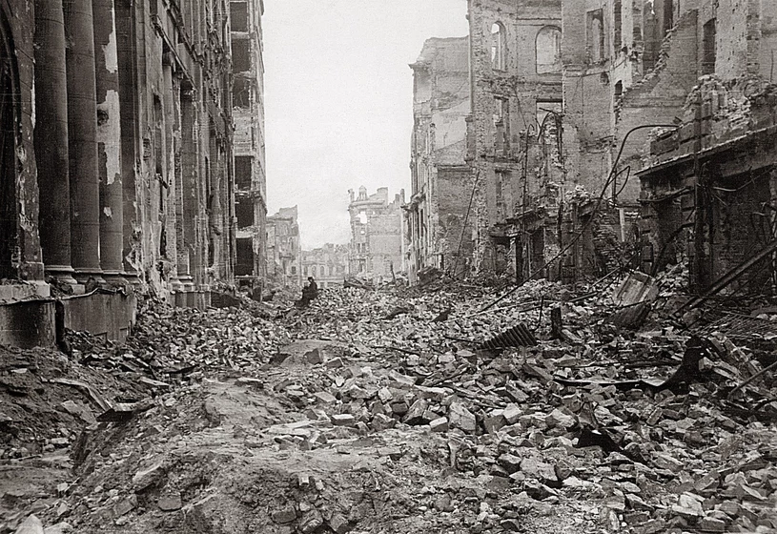

Slide 5
Three-year plan
In the years 1946-1949, a three-year economic reconstruction plan was implemented
It ended with success (the only one in all of communist Poland)
This was related to, among others, With the great enthusiasm of a nation that wanted to rebuild its homeland

Slide 6
Rebuilding the country
Work on the reconstruction of roads, bridges, cities and factories was intensified throughout Poland
Sometimes the urban fabric was even recreated from scratch

Slide 7
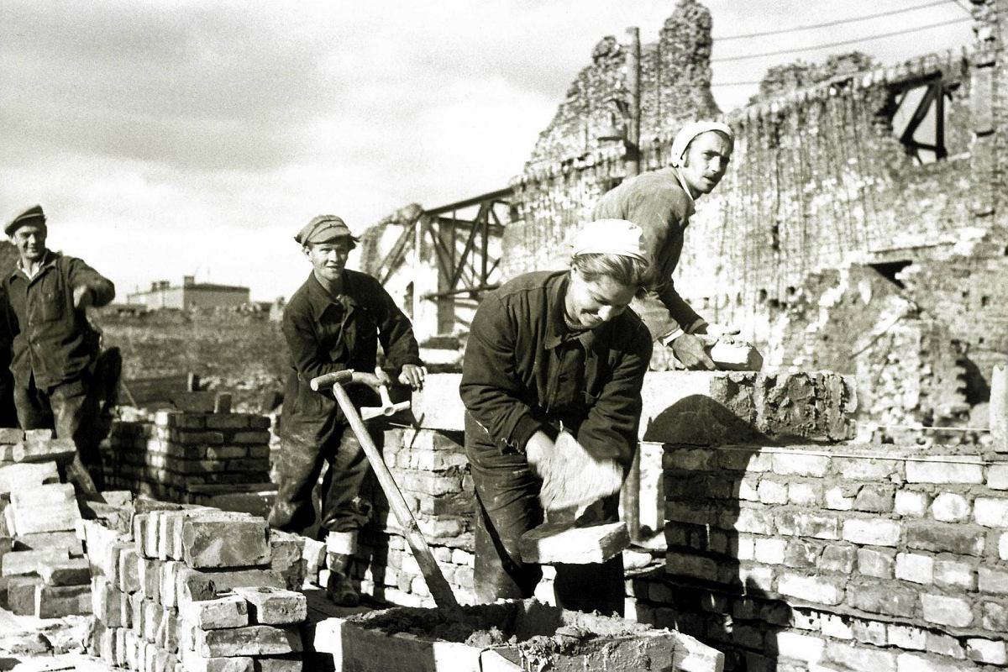

Slide 8
Reconstruction of Warsaw
Particular attention was paid to rebuilding the capital, which was completely destroyed
Unfortunately, it was at the expense of bricks that were not used to rebuild other Polish cities
Warsaw was to become a showcase, proof of Polish patriotic and economic deed

Slide 9
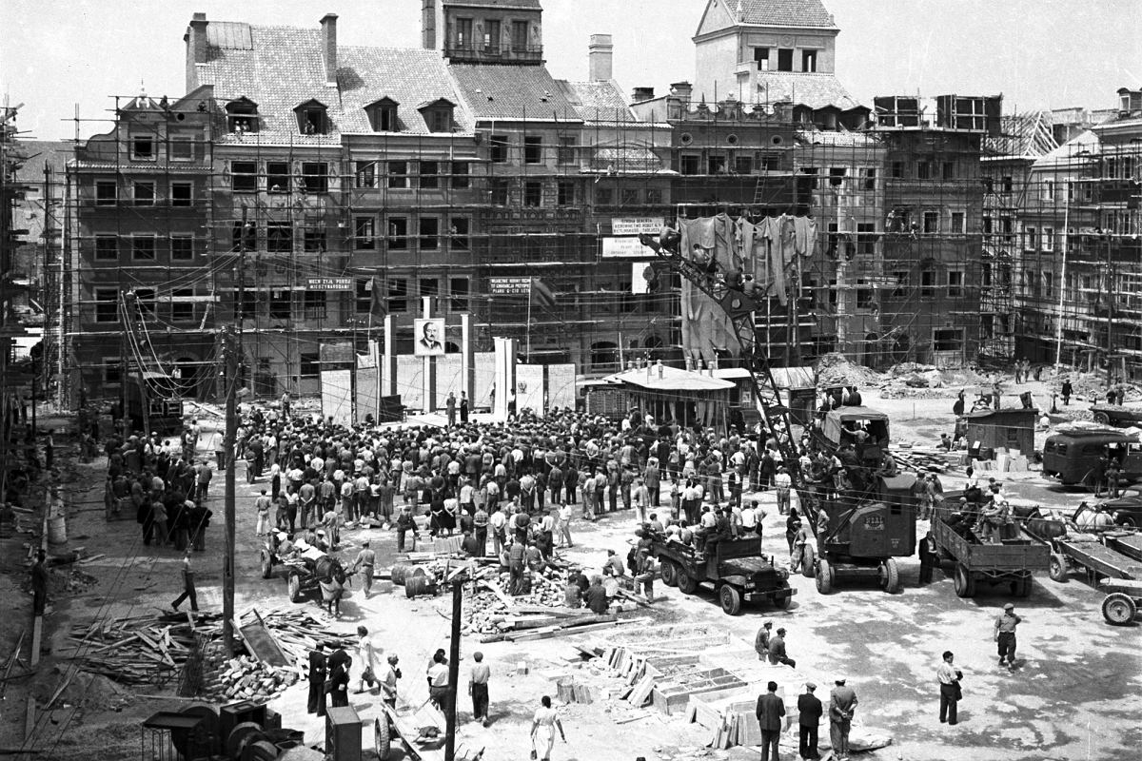

Slide 10
Nationalization of industry
By decree of 1946, Polish industry was nationalized
Larger plants became state property without compensation
Nationalization for compensation concerned specific types of mining and industrial enterprises (including mines, ironworks, waterworks, sugar refineries and coking plants), as well as other enterprises that were able to employ more than 50 workers in production per shift.

Slide 11
An attempt to collectivize agriculture
Already in 1944, the long-announced agrarian reform (even before the war) began
The decree on agrarian reform established the State Land Fund, which took over all land properties with an area larger than 50 ha. In several voivodeships the limit is set at 100 ha.
People "gifted" with land by the reform repaid it by providing quotas of rye or its equivalent in cash at a predetermined price.
The state created state farms (equivalents of state farms) and production cooperatives (equivalents of kolkhozes) from larger areas.
Polish agriculture was therefore not completely collectivized, even in later years

Slide 12
Universal free education
Already on September 1, 1945, the first children went to school in post-war Poland, and in October, Polish students started the academic year
The situation was difficult, there was a shortage of teaching staff that needed to be trained quickly
The educational program was completely free, as a propaganda trick and a valuable tool in the hands of the authorities

Slide 13
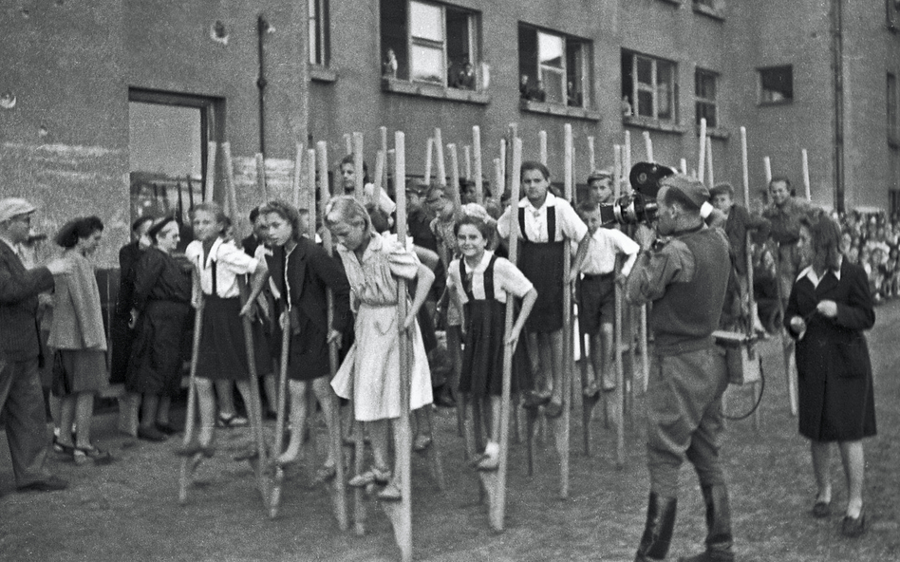

Slide 14
Fight against illiteracy
A significant percentage of Poles remained illiterate or semi-illiterate
The state's intensified action to combat this phenomenon has brought spectacular results
Within a few years, illiteracy was reduced to a negligible percentage

Slide 15
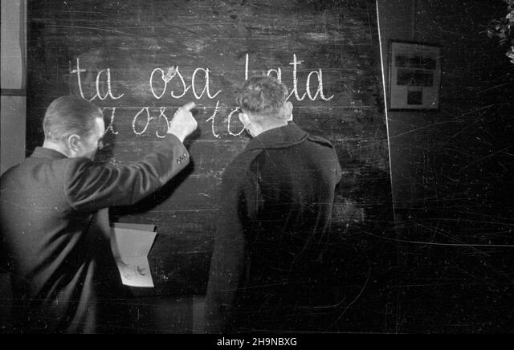

Slide 16
Development of youth organizations
At the beginning, they were created in the spirit of diversification and democratism
It can be said that each social group had its own youth organization
ZWM, the Rural Youth Union of the Republic of Poland "Wici", the Youth Organization of the Workers' University Society and the scouting organization (ZHP) were established

Slide 17
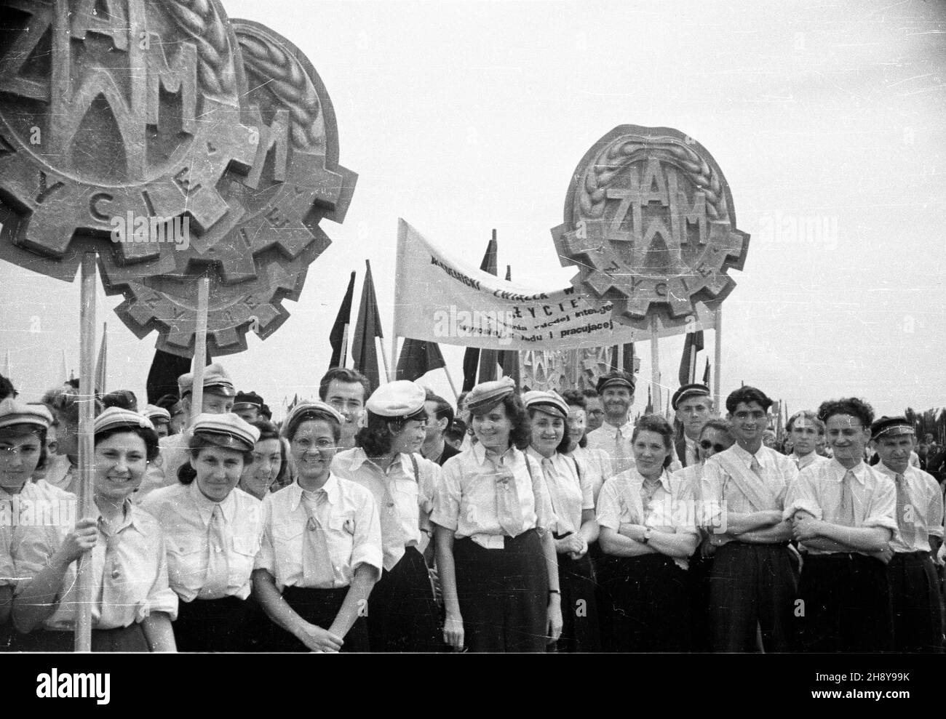

Slide 18
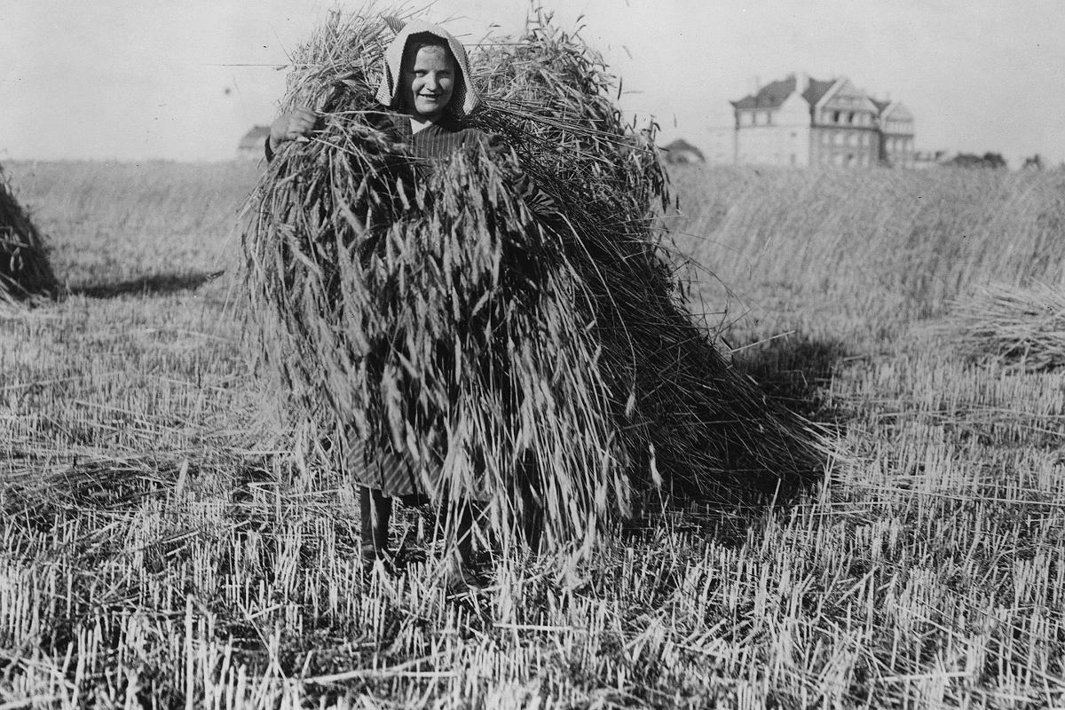
Gradual reconstruction of the social structure
Polish society remained peasant in its structure
Industry had to be built and corporations had to be changed to benefit workers

Slide 19
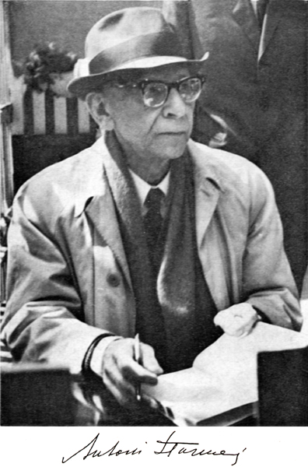
The decline of the importance of the intelligentsia and the bourgeoisie
The intelligentsia and traders were pushed into the background, as relics of the bourgeois world
Battle of Trade (1947)

Slide 20
Worker-peasant propaganda
The entire country was full of slogans and posters promoting the alliance of peasants and workers
In this respect, the propaganda of the USSR was followed
"Working people of cities and villages"
"Proletarians of all countries and nations - unite"

Slide 21
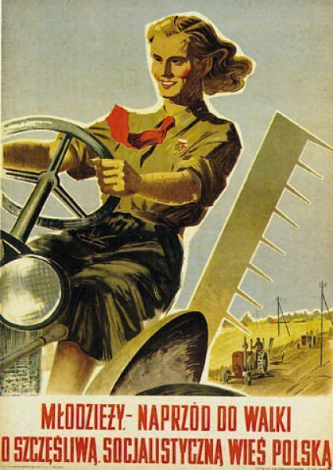
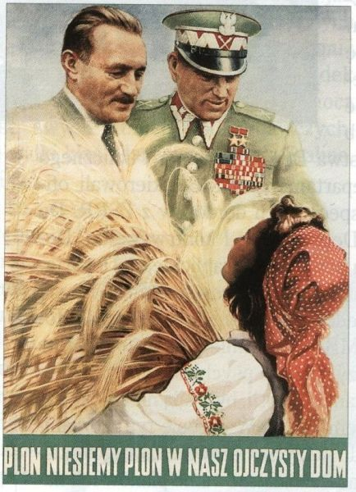

Slide 22
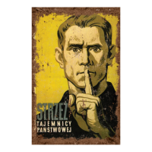
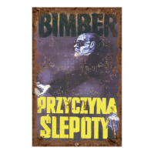
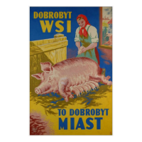

Slide 23
Marxism-Leninism the official ideology
Although various philosophical schools, even those related to Catholicism, were not defended, the ideology of Marxism-Leninism was increasingly promoted.
Matter was promoted at the expense of spirit
It was agreed that the socialist revolution should be achieved through the dictatorship of the proletariat

Slide 24
A temporary "alliance" with the Church
In order not to alienate society, the Catholic Church, which was the main religious center in the country, was not attacked in the initial period.
Priests had enormous authority, role models in society, and their attack could not simply be liquidated and the churches closed
To avoid being recognized, even Bolesław Bierut knelt during processions organized by the Church

Slide 25
Integration of the Recovered Territories with the rest of the country
The Western and Northern Territories of Poland (former German lands, Recovered Territories) were associated with German material culture
Architecturally, they were significantly different from Polish cities
The structure of farms was also different
This huge territory (100,000 km2) had to be integrated with the rest of the country (over 200,000 km2)
Poland gained the rich areas of Lower Silesia and the return of the entire Upper Silesia, wide access to the sea and numerous agglomerations (Wrocław, Gdańsk, Szczecin, Opole, Olsztyn, Zielona Góra, Gliwice)

Slide 26
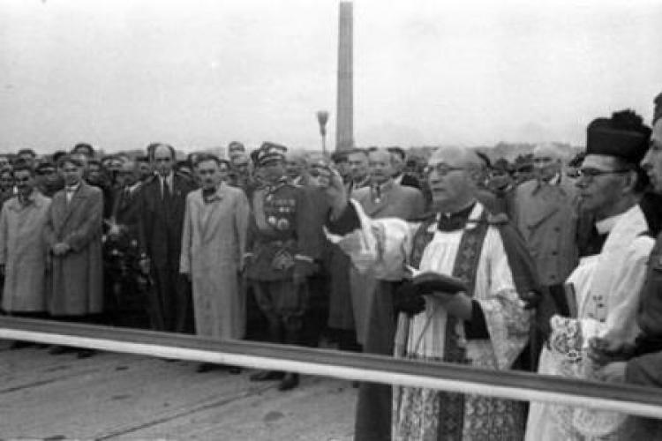

Slide 27
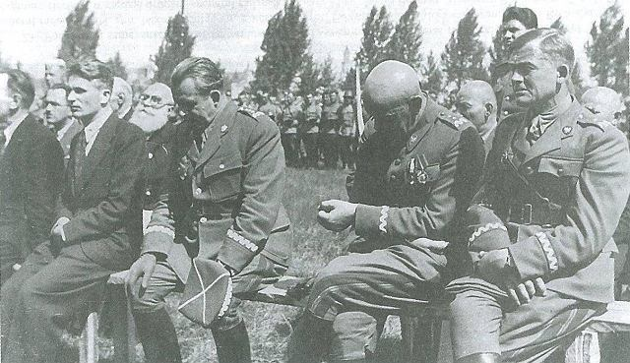

Slide 28
Mass migrations
The lands in the west were virtually depopulated
The Germans fled or were killed
Millions were forcibly relocated to Germany's occupation zones (only a handful of essential specialists left behind)
Poles from the Eastern Borderlands left the USSR and settled in the new Poland (repatriates)
Reemigrants were returning from the West
People were looking for places for a new, better life

Slide 29
The threat of German revisionism...?
In 1946, American Secretary of State James Byrnes questioned the legality of Poland's western borders
This caused more or less real fears about the return of the Germans to the Oder and Neisse
People feared another war, this time viewing the Germans as possible allies of the West
All this pushed Poland even further into the hands of the Soviets, as the only guarantors of the border in the West

Slide 30
Conflict with Czechoslovakia over Kłodzko and other territories
Historically, Kłodzko was almost not Polish at all
However, due to the historical Prussian-Austrian border, these areas remained outside Czechoslovakia in the interwar period.
World War II created opportunities for the Czechs to claim their former heritage
Let us remember that the border in the south was not marked at the conferences of the Big Three, with the hopes that the allies would reach an agreement on this issue.
However, no one risked war, and Stalin did not openly support any of the sides in the conflict

Slide 31
Stalin first promised Kłodzko to the Czechs and then to the Poles
The Czechs made claims to the Kłodzko land and the counties of Prudnik, Głubczyce, Racibórz and Koźle
In June 1945, there was a one-day mutual shelling of positions.

Slide 32
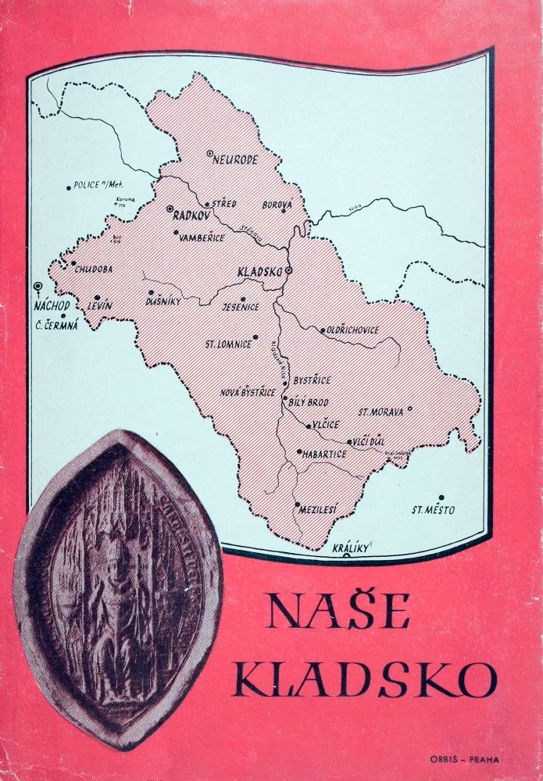

Slide 33
Polish-Czechoslovak negotiations were planned for February 1946 in Prague on the course of the border line.
However, during the negotiations in Prague (February 16–25, 1946), no exchange could be agreed and the above Polish proposals remained only on paper.
Due to pressure from Moscow, Czech troops withdrew behind the Opava River.

Slide 34
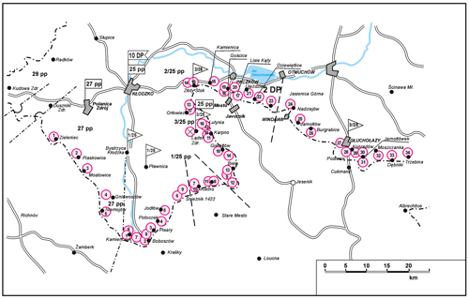

Slide 35
On March 10, 1947, under pressure from Moscow, a friendship treaty was signed between Poland and Czechoslovakia, but the border issues (Kłodzko Land, Zaolzie) were left unsettled.
Only on June 13, 1958, the governments of the Polish People's Republic and the CSR signed an agreement closing the border disputes:
in Cieszyn Silesia, the Polish-Czech border from 1920
in Spisz and Orawa, a line established in 1924
in the remaining part, the pre-1938 border line with the Kłodzko Land on its northern - then already Polish - side
border correction with Czechoslovakia in 1958.

Slide 36
Polarization of Polish society
In the first post-war years, Polish society was divided into supporters of the new order and those who dreamed of the return of the old, pre-war world.
Millions of people with nothing to lose, often lower classes wanting advancement, supported the communist government
The historical division into the left and the right took on a different meaning, as the left was now associated only with the alliance with the Soviet Union and the right with the Sanation and the Polish government in London.

Slide 37
