Slide 1
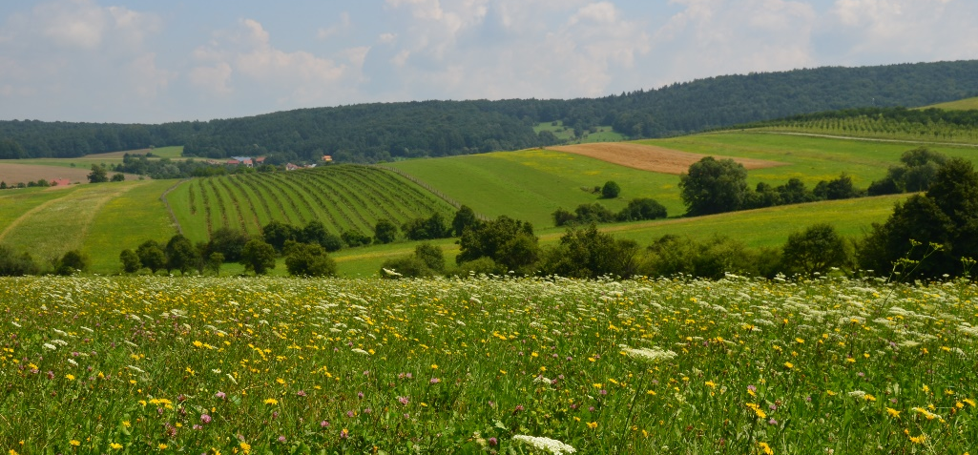
Natural Heritage
Majestic mountains, peaceful hilly areas, deep forests, clear rivers, water reservoirs, romantic valleys, mysterious underground spaces
Increasing interest of tourists → natural scenery change → nature protection, laws introduced → careful use of resources, protection of biodiversity & natural habitats
Natural heritage – natural features, geological and physiographical formations and natural sites of outstanding universal value from the point of view of natural beauty, science and/or conservation
UNESCO Convention Concerning the Protection of the World Cultural and Natural Heritage
Often habitats of threatened animal & plant species, can be listed World Heritage Site
CR – no area on UNESCO List of World Cultural and Natural Heritage as natural site

Slide 2
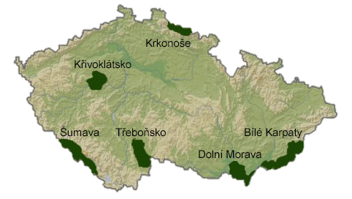
Man and the biosphere programme
Run by UNESCO, started 1971
Aim – balanced relationship between mankind & nature, sustainable development
World Network of Biosphere Reserves
Biosphere Reserve – ecosystem with plants & animals of unusual scientific & natural interest
Proposed by residents, ratified by national committee & designated by UNESCO
Sustainable use of natural resources
2015 – 651 Biosphere Reserves in 120 countries, including 15 transboundary sites
Křivoklátsko – 1977
Třeboň Basin – 1977
Lower Morava – 2003 (former Pálava – 1986, extended & renamed 2003)
Šumava – 1990
Krkonoše – 1992
Bílé Karpaty – 1996

Slide 3
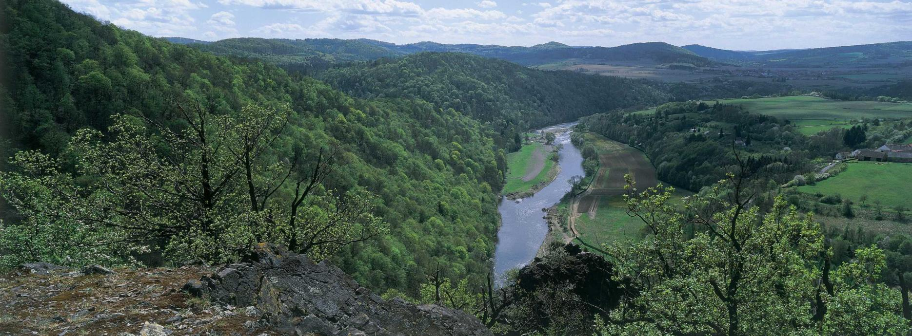
KŘIVOKLÁTSKO – KŘIVOKLÁT Region
1977 – Biosphere Reserve, 1978 – Protected Landscape Area
628 km², predominantly forested highland region
Broad-leafed & mixed coniferous forest ecosystems, grasslands, pastures, valley meadows & agricultural land
Berounka River valley – deep canyons, floodplains, terraces, steep slopes & cliffs
1,800 plant species, 84 native species of trees & shrubs
Hunting grounds for royalty → limited deforestation & human interference
24 nature reserves & monuments
listnatý, jehličnatý

Slide 4
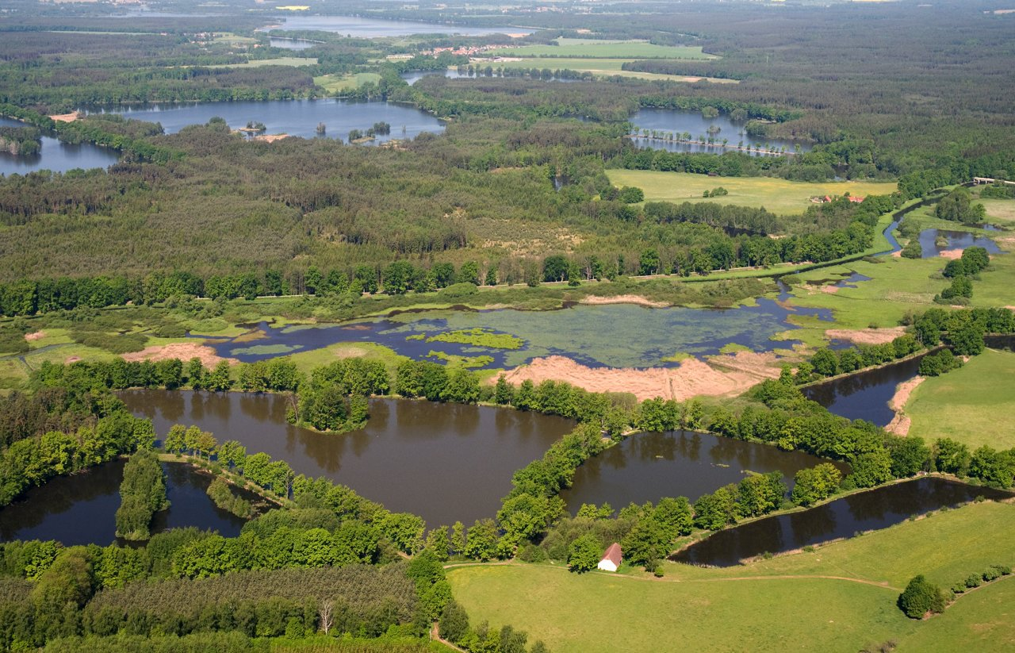
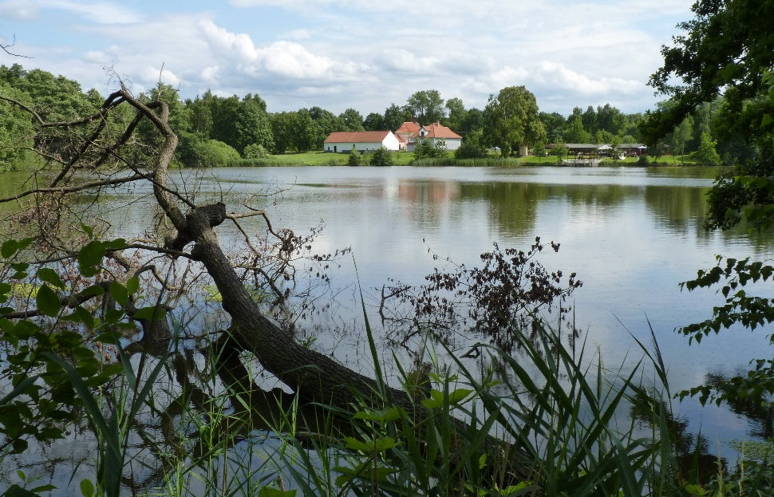
TŘEBOŇSKO – TŘEBOŇ Basin/Region
1977 – Biosphere Reserve, 1979 – Protected Landscape Area
700 km², predominantly shallow, flat or slightly rolling region, app 50 % – forests
Extensive system of fishponds (shallow artificial lakes, 0.1 to 500 ha), app 460, most built in 15 & 16 centuries, interconnected by system of canals & ditches & Lužnice River
Various types of wetlands, reed and sedges belts, marshes, alder & willow covers, wet meadows, floodplain forests, swampland
Important bird area for water birds nesting & migration
33 nature reserves & monuments + two Ramsar sites
strouha, rákos, ostřice/šáchor/vodní rákos, močál/bažina/mokřad, olše, vrba

Slide 5
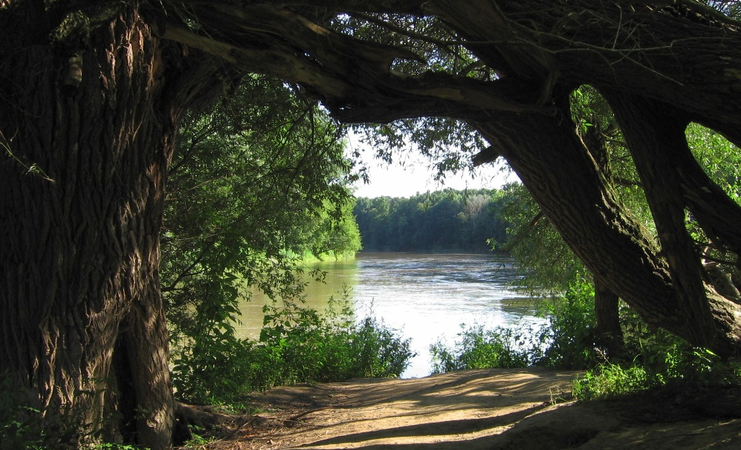
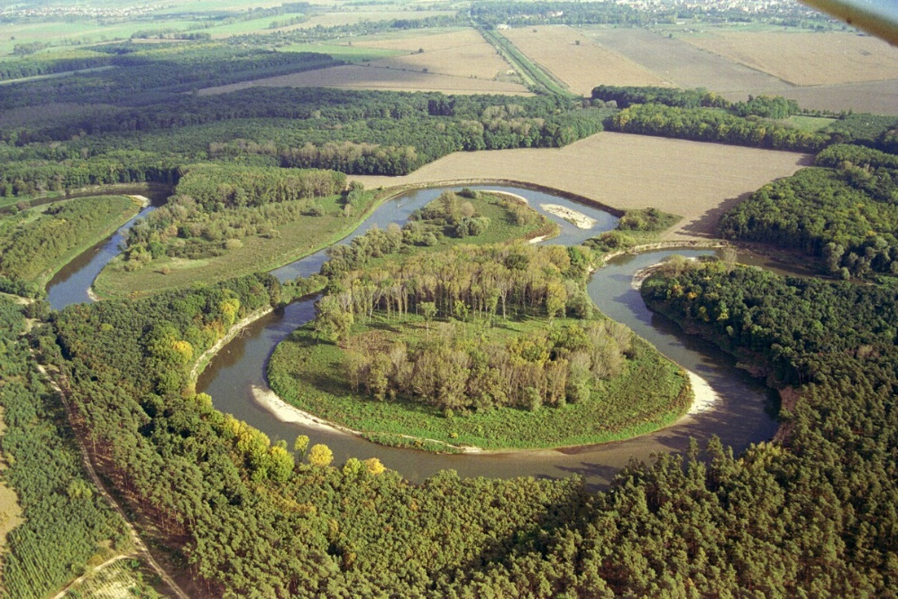
Dolní Morava – Lower Morava
1976 – Protected Landscape Area
1986 – Pálava Biosphere Reserve
2003 – extended & renamed
354 km², Pavlov Hills – limestone cliffs & steep slopes covered with steppes, forests & grasslands, remnants of floodplain meadows & forests, considerable part – arable land & vineyards
24 nature reserves & monuments + two Ramsar sites
vápenec

Slide 6
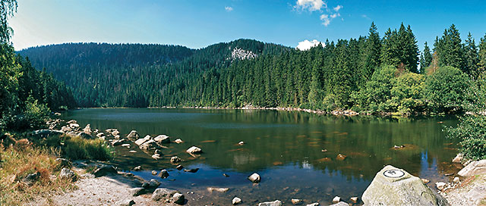
Šumava – Šumava Mountains
1977 – Biosphere Reserve, 1979 – Protected Landscape Area
1991 – National Park
1,671 km², mountain range, primeval mountain forests, plains, glacial lakes, peat bogs, rivers & canyons, beech & mountain spruce
Spring area of the Blanice River – most important site for River Pearl Mussel
89 nature reserves & monuments + Ramsar site
rašeliniště, buk, smrk

Slide 7
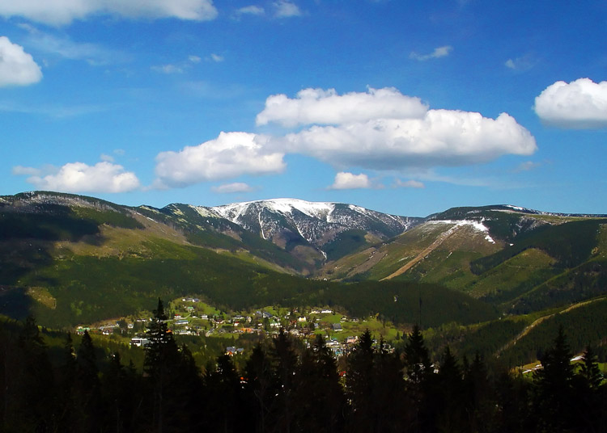
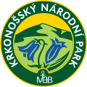
Krkonoše/Karkonosze – Giant Mountains
1963 – declared National Park, 1992 – Biosphere Reserve
Mixed mountain & highland system
Shared by CR & Poland, 548 km² (total area 604 km²)
Four vegetation belts (submontane, montane, subalpine, alpine)
Arctic & alpine ecosystems, flower rich mountain meadows, mountain spruce forest, mixed beech-spruce forest, Alpine tundra, subarctic peat bogs, dwarf pine covers, glacial kettles
smrk, buk, rašeliniště

Slide 8
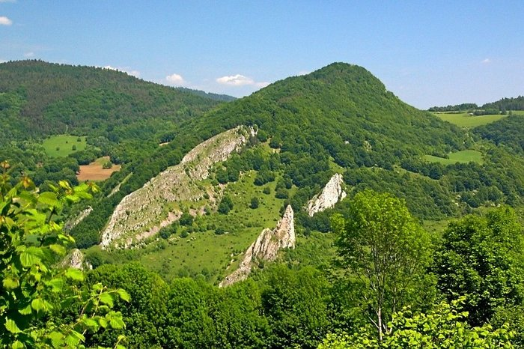
Bílé Karpaty – White Carpathians
1980 – Protected Landscape Area, 1996 – Biosphere Reserve
715 km², hills & uplands, orchid & other rare species rich grasslands, near-natural temperate broad-leaved forests, old meadow orchards & solitary fruit trees of different old & local fruit cultivars
52 nature reserves

Slide 9
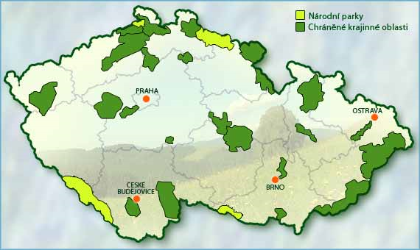
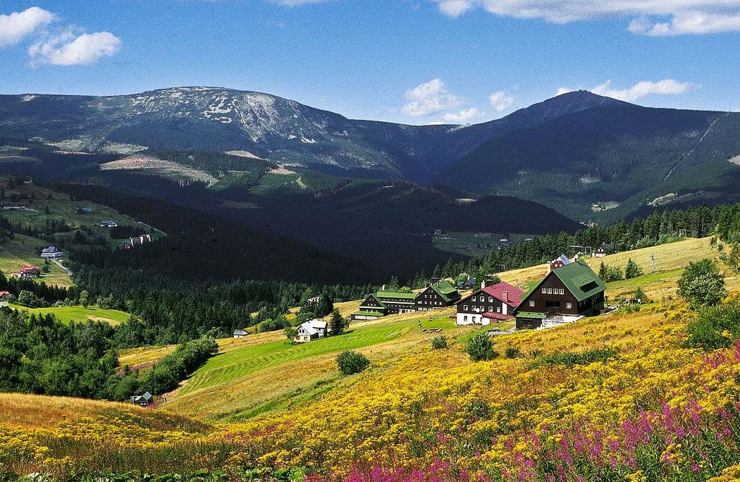
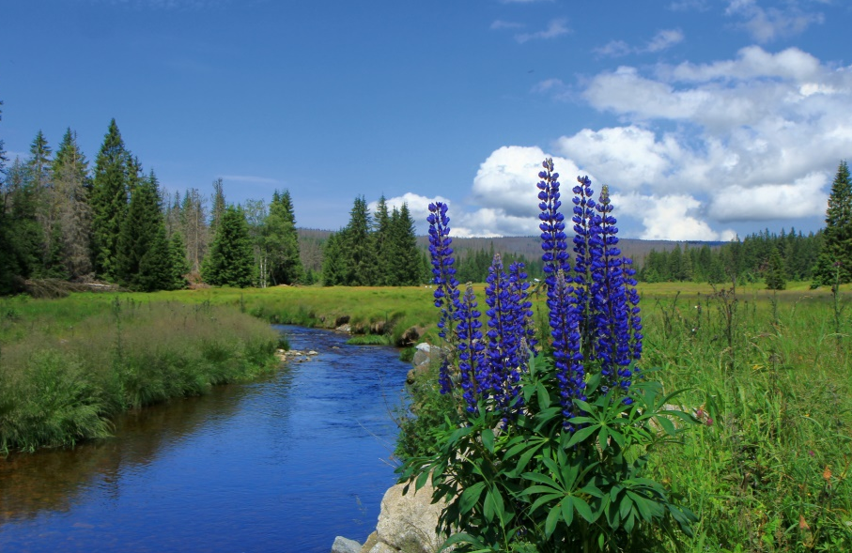
NATIONAL PARKS
Four Parks – established to protect rare & unique plant & animal species
System of protection – three zones/belts, the strictest – the first zone (prohibition of camping, making fire outside designated areas, road building, entering outside marked paths, etc.)
Giant Mountains (1963, oldest)
Šumava Mountains (690 km², largest, 1991)

Slide 10
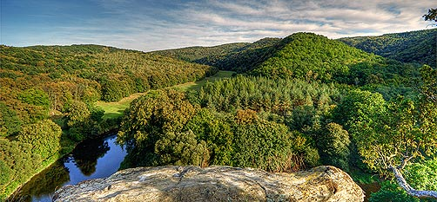
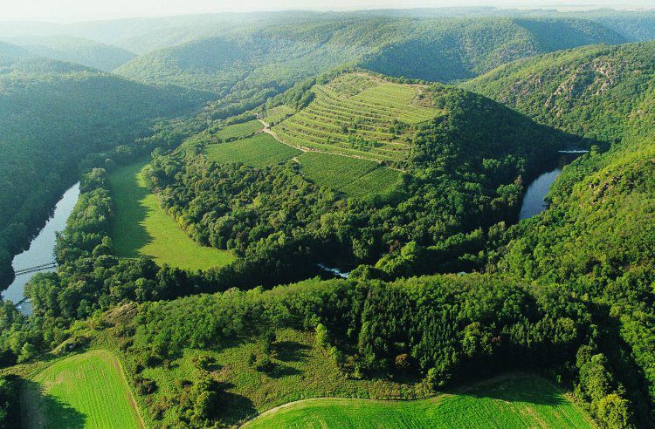
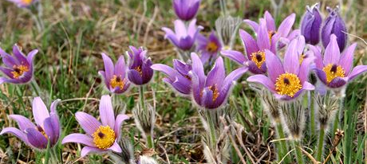
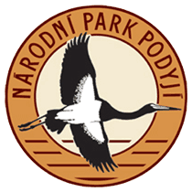
NATIONAL PARKS
Valley of the River Dyje (63 km², smallest, 1991)
Stone fields & wetlands
77 types of protected plants (velvet plant (verbascum), Greater Pasqua flower)
Protected animals (European otter, black stork)
divizna, koniklec velkokvětý, vydra říční, čáp černý

Slide 11
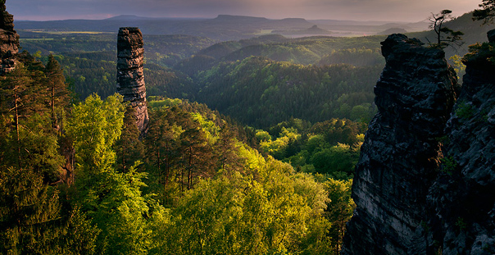
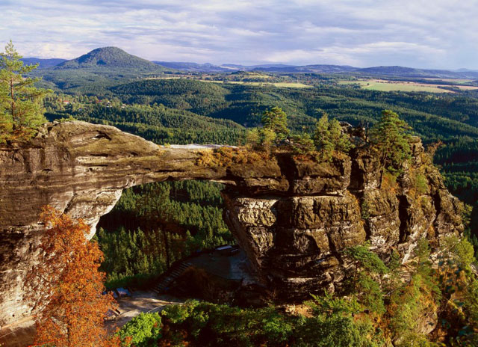
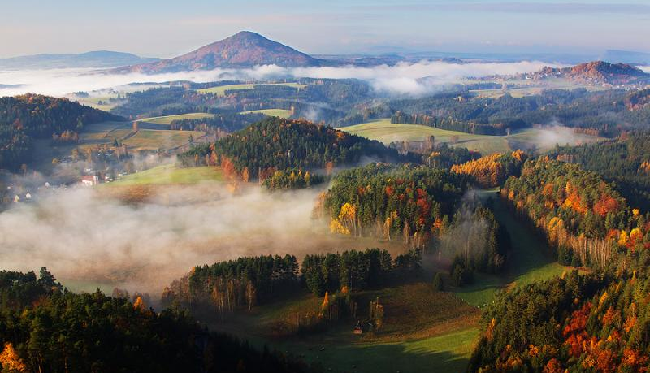
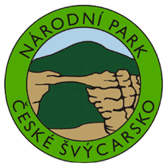
NATIONAL PARKS
Bohemian Switzerland (2000, youngest)
Sandstone formations on the River Elbe & their biotope are protected
Largest population of peregrine falcon in central Europe
sokol stěhovavý

Slide 12
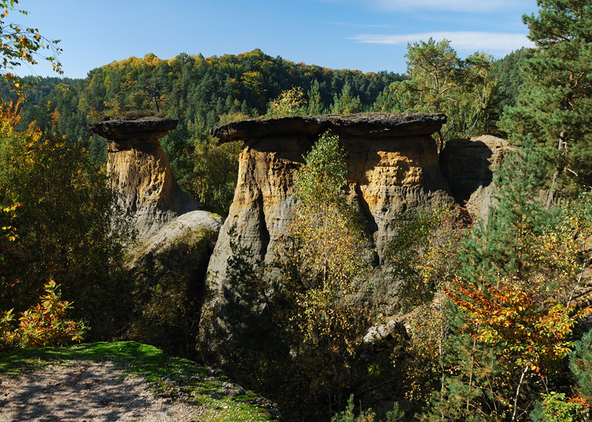
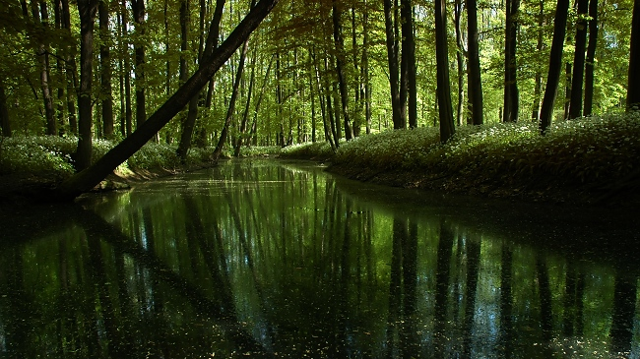
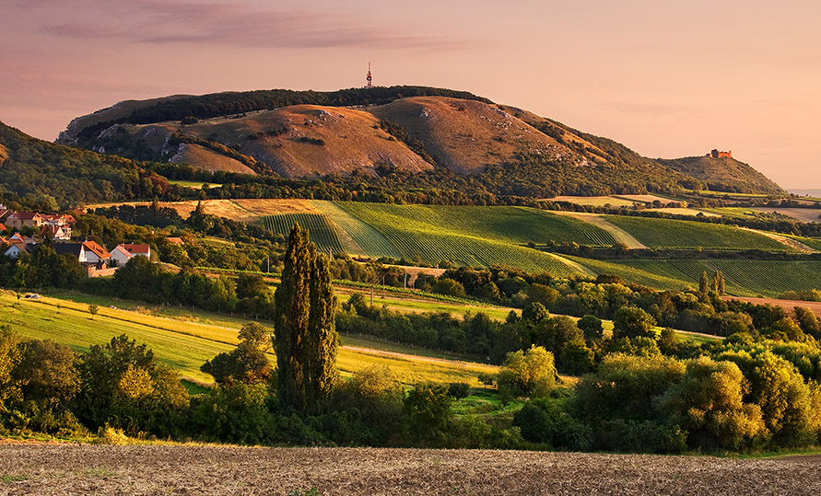
PROTECTED LANDSCAPE AREAS
26 Areas, harmonic landscape with typical relief
White Carpathians, Blansko Forest, Litovelské Pomoraví, Broumov Region, Central Bohemian Uplands, Bohemian Karst, Jeseníky Mountains, Jizera Mountains, Křivoklát Region, Lusatian Mountains, Elbe sandstone Formations, Šumava Mountains, Kokořín/Mácha Region, Pálava, Eagle Mountains, Poodří, Slavkov Forest, Žďár Uplands, Moravian Karst, Třeboň Region & Iron Mountains
Kokořín
Poodří
Pálava

Slide 13
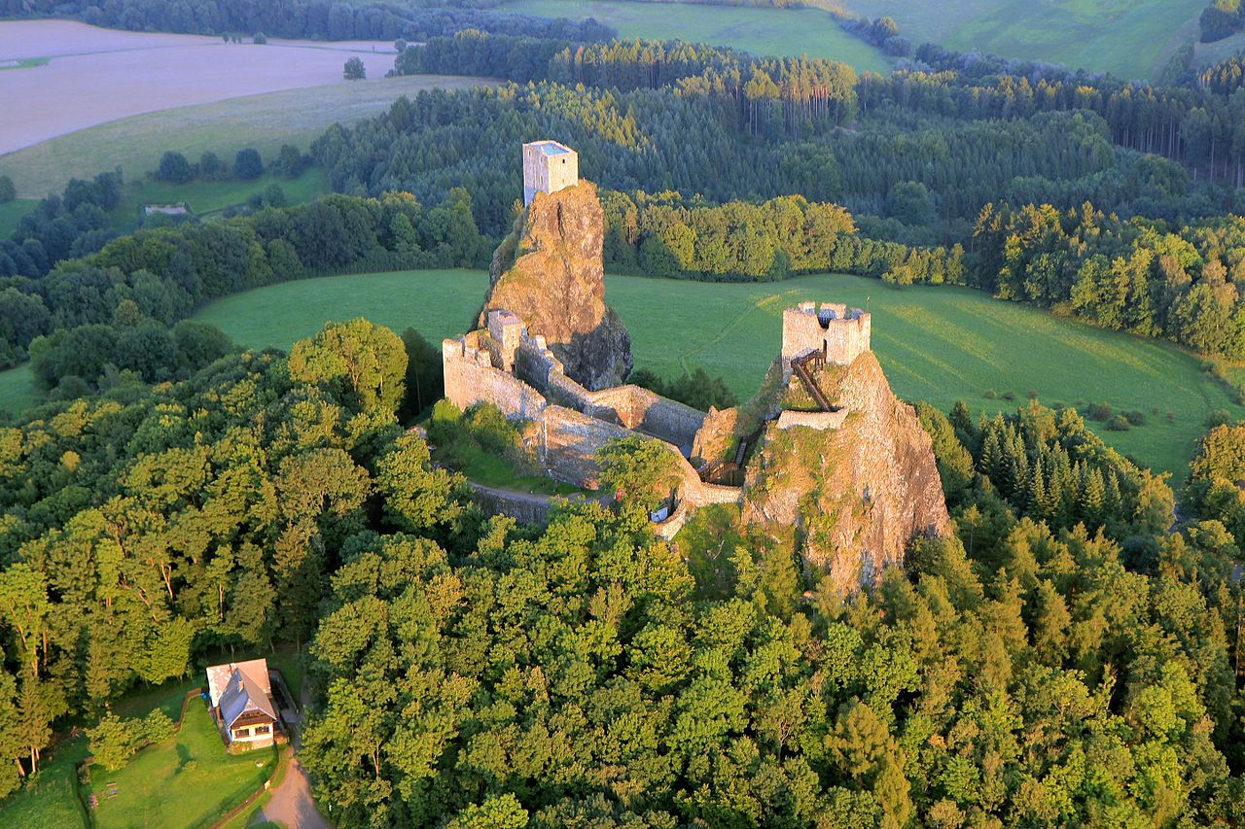
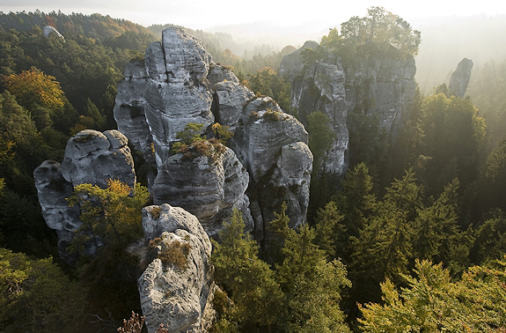
Bohemian Paradise
1955 – oldest Protected Landscape
2002 – extended with Malá Skála & Prachov Rocks areas
2005 – member of the Global Geoparks Network
Rock towns, caves & precious stones/gemstones

Slide 14
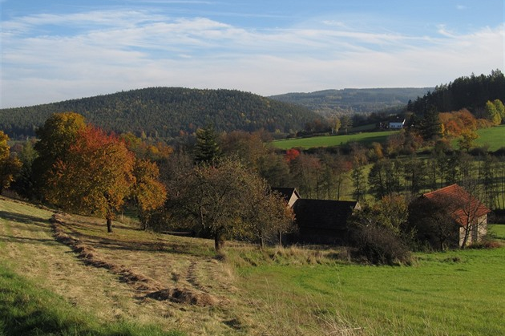
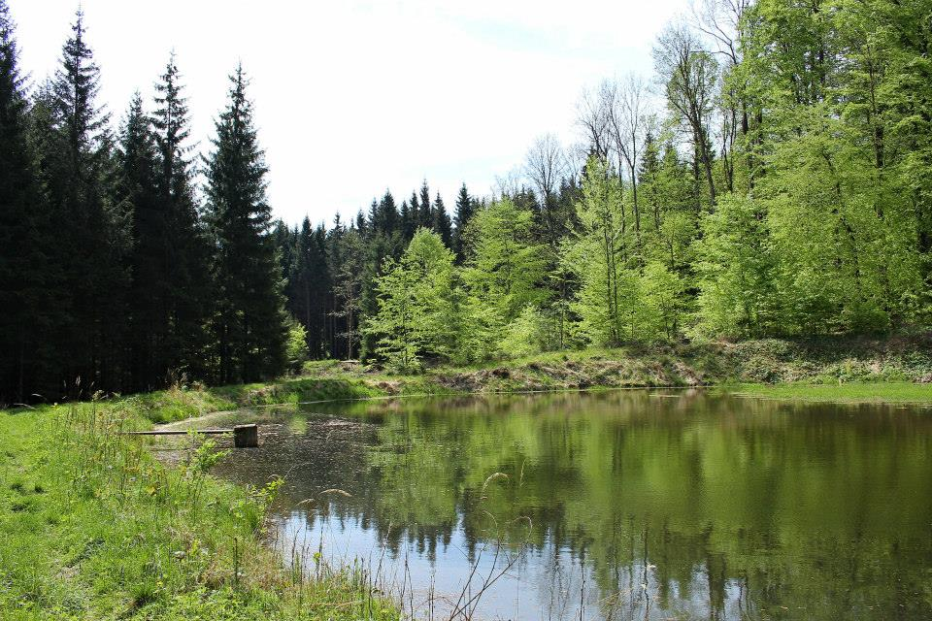
Brdy
2016 – youngest Protected Landscape
On the territory of former military district
Valuable forest covers, meadows, wetlands, moorlands & tens of brooks
mokřad, vřesoviště

Slide 15
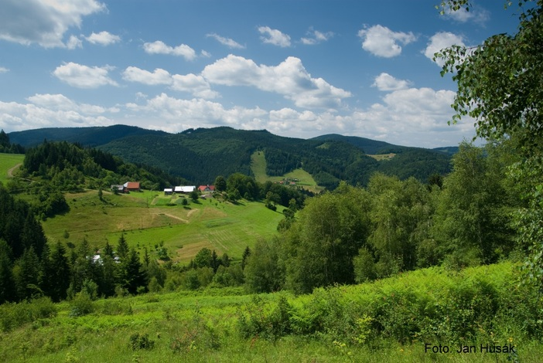
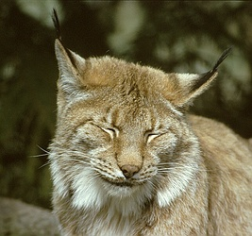
Beskydy Mountains
1973 – largest (1,160 km²)
Primeval forests, species rich meadows & pastures, pseudo-karst elements, hamlets
Stable population of lynxes, bears & wolves
70 per cent covered with forests
osada, rys

Slide 16
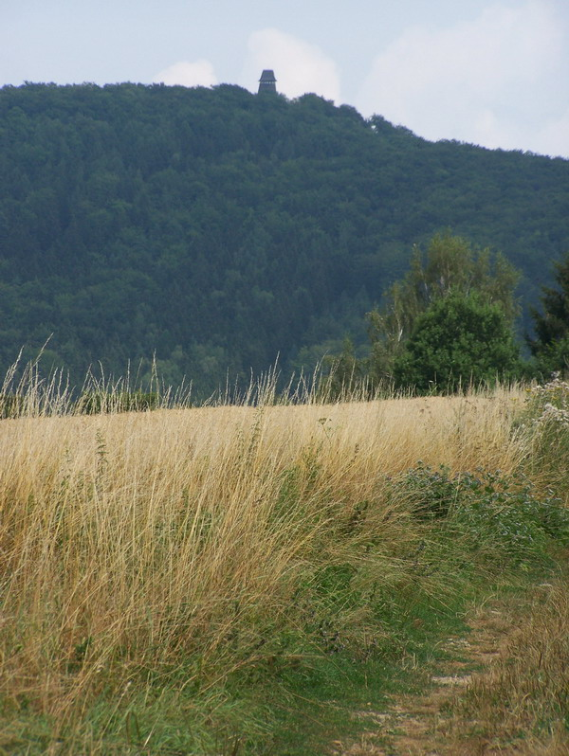
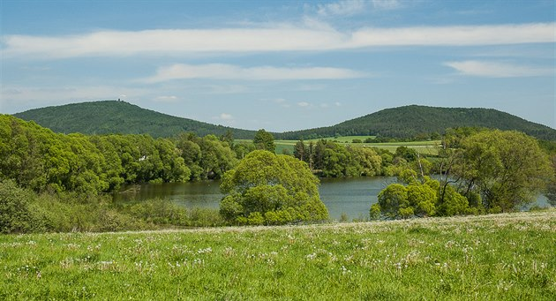
Blaník
1981 – smallest (40 km²)
Well-preserved natural & cultural heritage
30 percent covered with forests, mainly spruce (57 %) & pine (20 %)
smrk

Slide 17
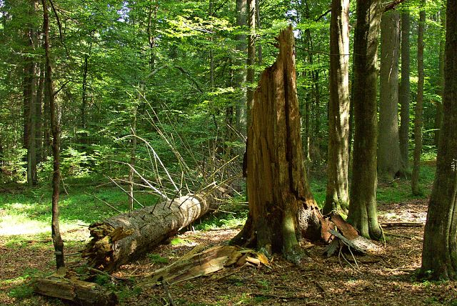
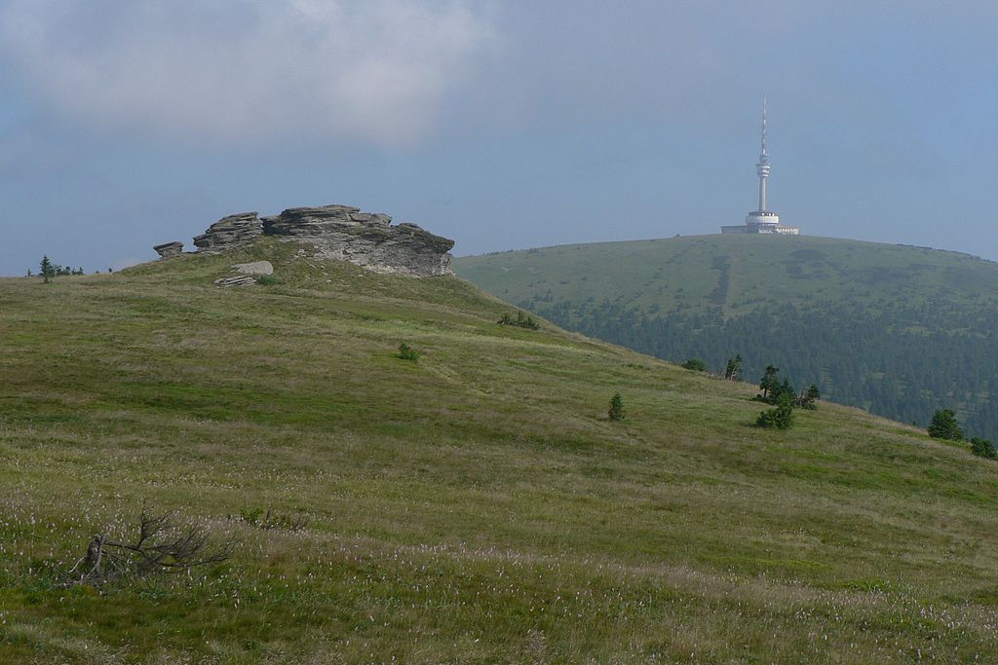
NATIONAL NATURE RESERVES
More than hundred
Small-scale areas with valuable nature of national or international importance
1838 – Žofín Virgin Forest, oldest
1933 – Adršpach-Teplice Rocks, Boubín Virgin Forest, Black & Devil Lakes, Javorina, Mionší, or Razula
Praděd – complex of natural forest associations & pastures (largest, about 20 km²)
Bohdaneč pond, Milešovka, Radhošť, Rejvíz, or Soos
Žofín
Praděd

Slide 18
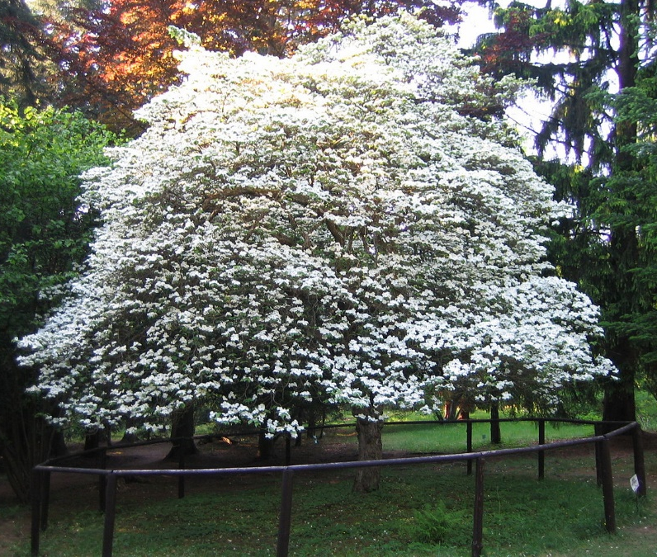
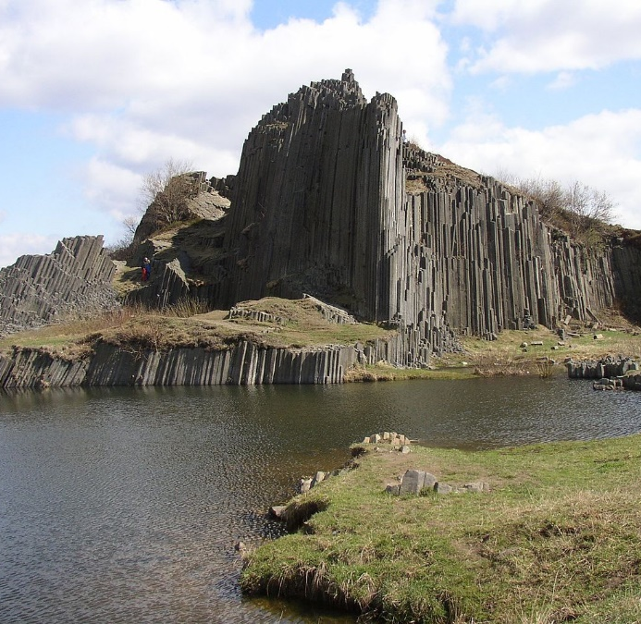
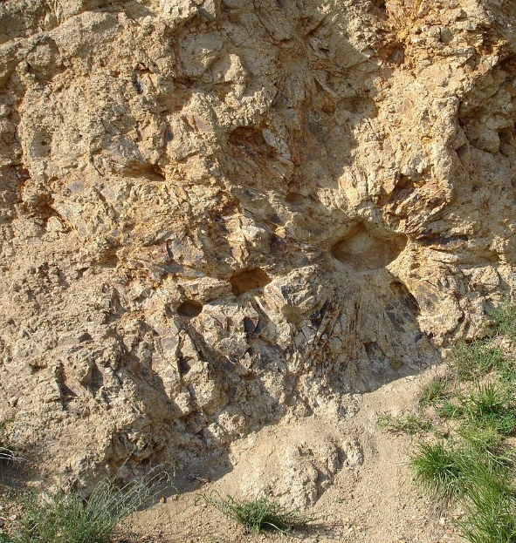
NATIONAL NATURE MONUMENTS
More than hundred
Smaller natural structures (geological formation, mineral deposits, endangered species habitats…) of national or international scientific, ecological or aesthetic importance
Grandmother’s Valley, Barrandov Rocks, Bozkov Dolomity Caves, Pomezí Cave, Kalendář věků, Kamenná slunce, Landek, Pravčice Gate, Rešov waterfalls, Skalky skřítků, Svatoš Rocks, Venus Bowls (Venušiny misky), or Zbrašov Aragonit Caves
American Garden
Kamenná slunce
Panská skála

Slide 19
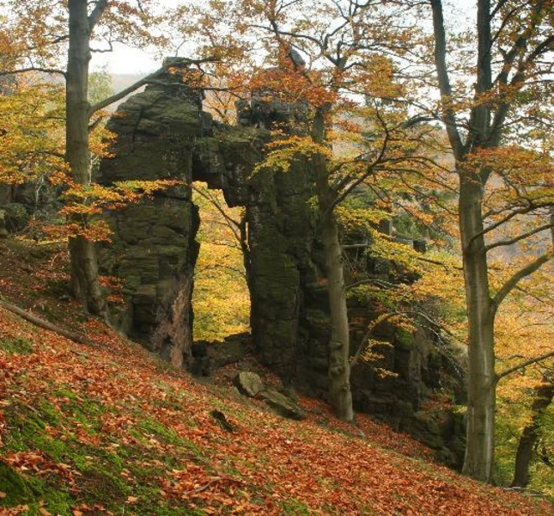
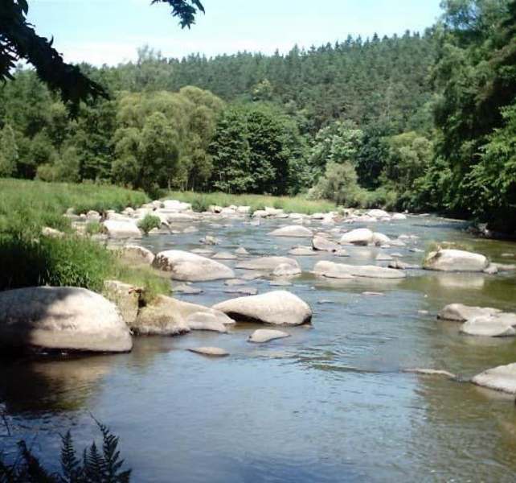
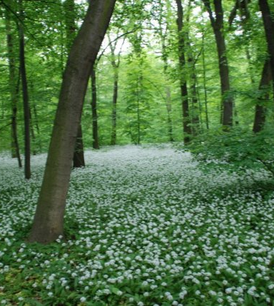
NATURE reserves & MONUMENTS
Countless Nature Reserves (small-scale areas of regional importance)
Countless Nature Monuments (smaller natural structures of regional importance)
Jezerka NR
Stvořidla NR
Království NR

Slide 20
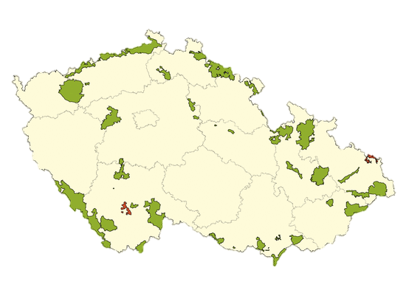
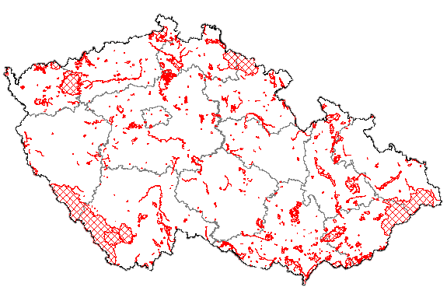
NATURa 2000
Network of nature protection areas on territory of European Union
Special Protection Areas (Bird areas)
Křivoklátsko, Třeboňsko, Lednice ponds, Poodří, Libavá
Sites of Community Importance (Locality of European importance)
2015 – 41 Bird Areas & 1,075 Localities of European Importance (on our territory)
Bird Areas
Localities of European Importance

Slide 21
Thank you for attention

