Slide 1
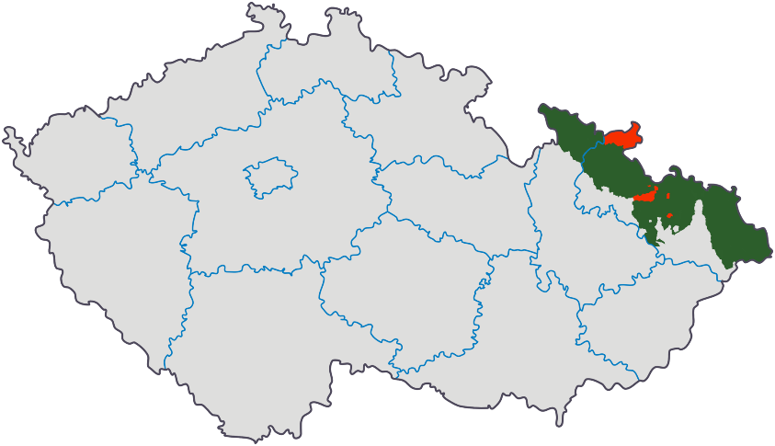
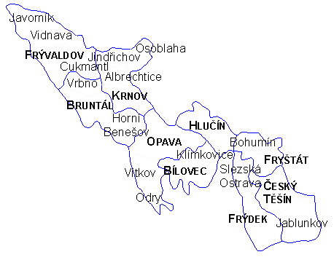
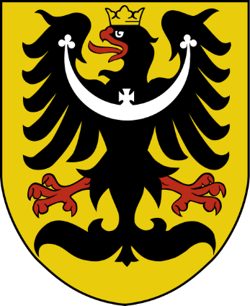
CULTURAL HERITAGE
OF Czech SILESIA

Slide 2
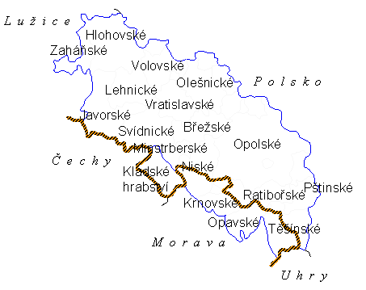
Silesia
Complex area with regions where
traditional ties severed due to radical & not natural change of inhabitants
culture & everyday life of original population forgotten & replaced by culture of new residents
new culture became heritage of new settlers, their descendants, region & country
→ Silesia – area where cultures met for centuries & replaced each other in recent decades
Concept & perception of cultural heritage of Silesia → result of historical & cultural development + of complicated destines of its inhabitants in previous generations
Repeated splitting (1742, 1918-1920) → Czech Silesia only app 1/6 of historical territory

Slide 3
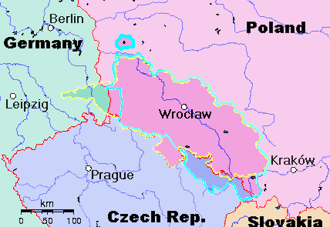
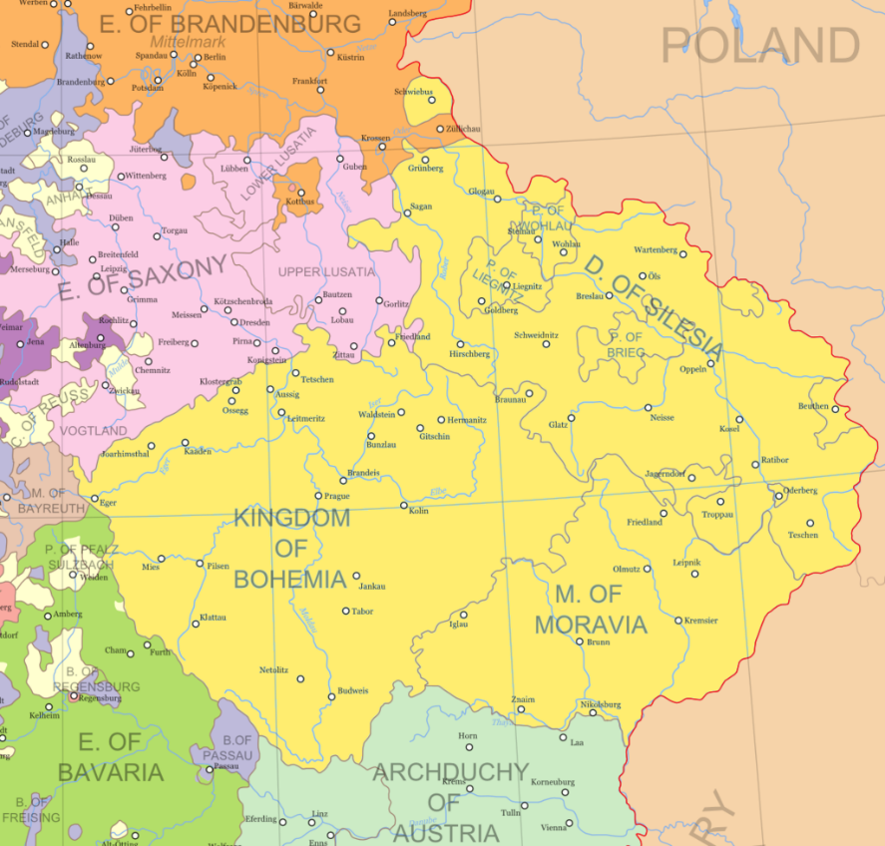
Silesia
Crown of Bohemia 1618
Prussian Silesia yellow (1871); Silesia blue (1740)
Lands of the Crown of Bohemia before 1742
Charles IV

Slide 4
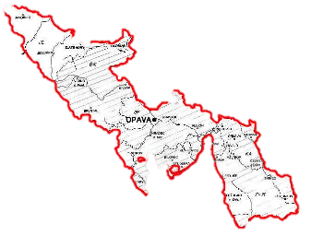
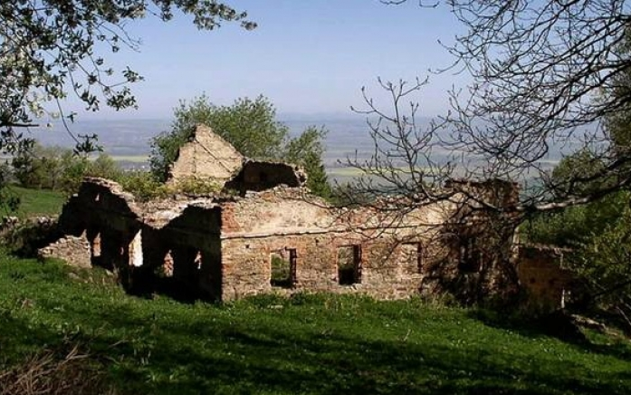
western part of Czech Silesia
Bruntál, Krnov & Jeseník regions
Germans expelled → new settlers of uneven social & cultural level
Czechs from inland of different social background
Greeks (who left homeland from political reasons
Gypsies
All brought their own culture, lifestyle, customs & traditions – quickly submitted to modern influences & were not interested in following pre-war German traditions
Urban centres settled without major problems
Rural villages in mountainous areas & smaller towns – lack of population

Slide 5
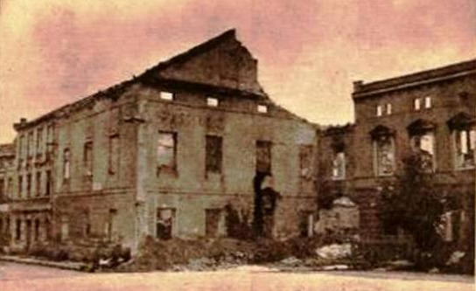
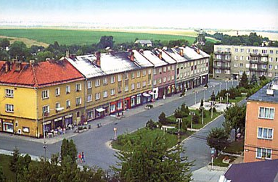
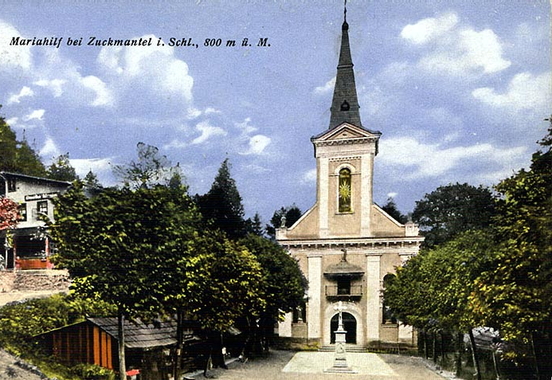
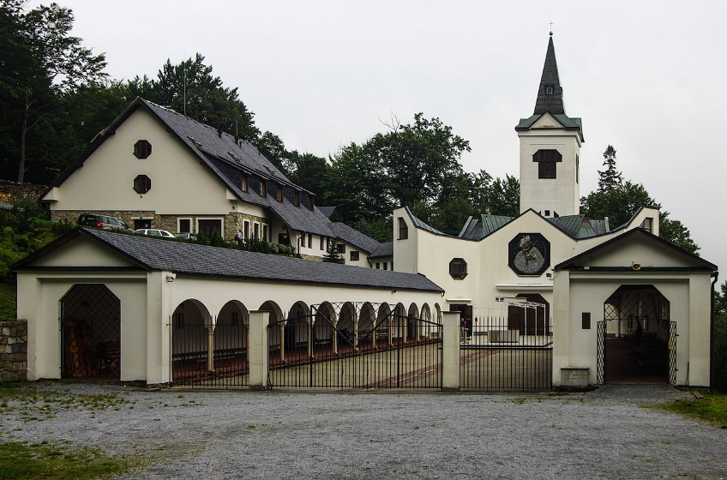
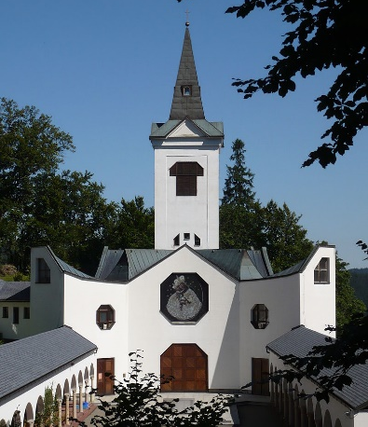
western part of Czech Silesia
Numerous historical sites – neglected, damaged, demolished
Osoblaha (WWWII – damaged, Germans expelled) → left to its destiny → demolished
Pilgrimage Church of Virgin Mary the Helpful at Zlaté Hory (demolished 1973)
Calvary on the Uhlířský vrch (near Bruntál, etc)

Slide 6
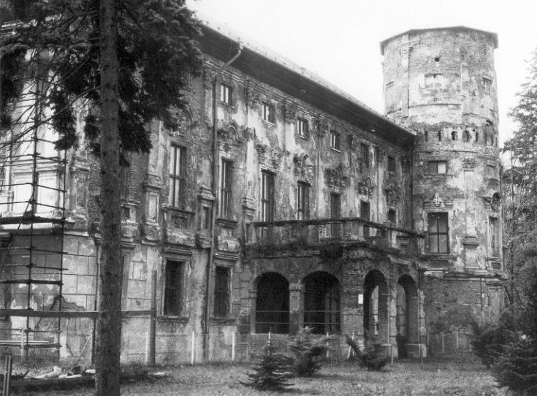
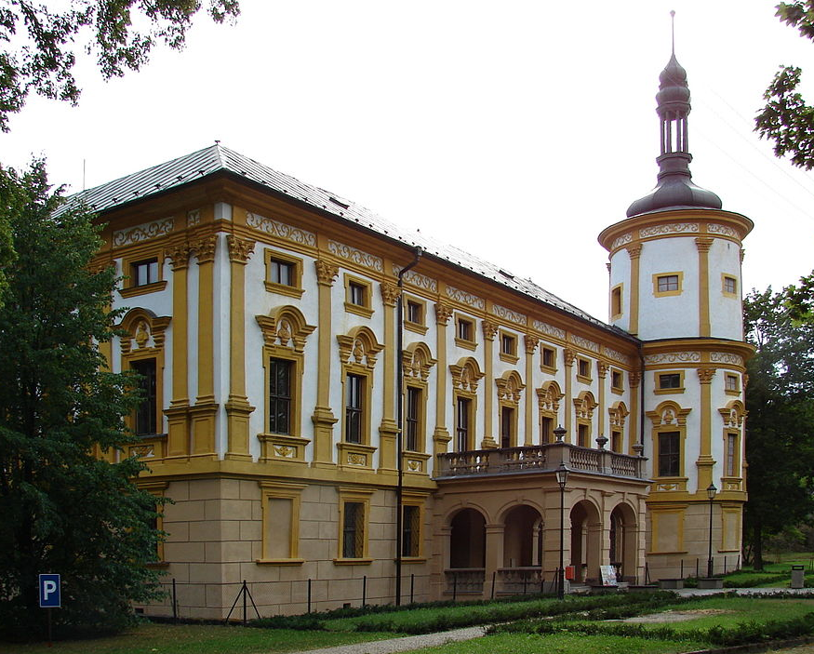
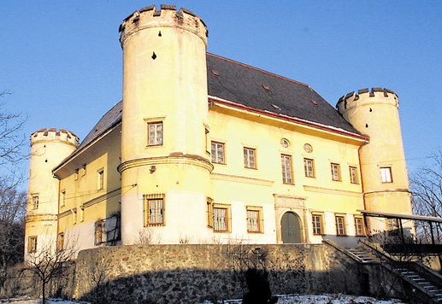
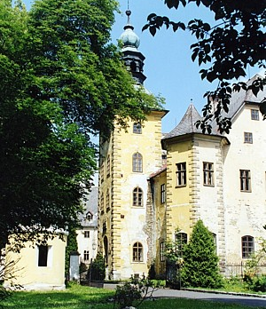
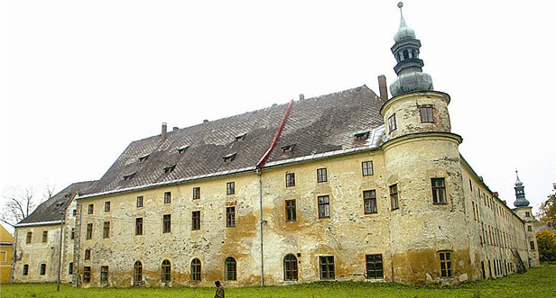
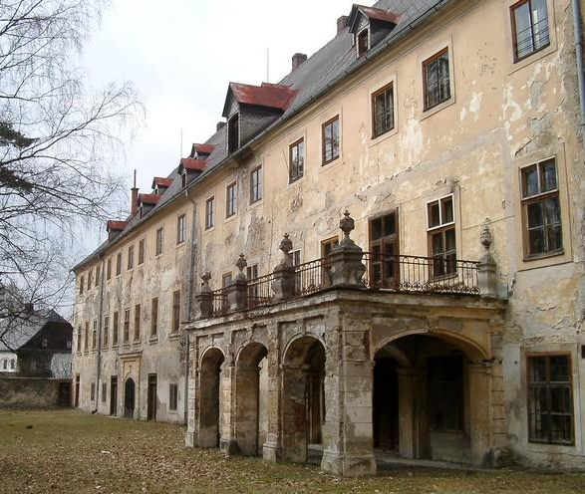
western part of Czech Silesia
Many castles & mansions → fell into disrepair (Dívčí Hrad, Janovice, Linhartovy → storehouses, granaries; Bílá Voda → institution of health and social care)
Village houses rebuilt into weekend cottages (losing original appearance & function)
Some of expelled villages (Osoblaha, Zlaté Hory regions) – not resettled → preserved
Linhartovy
Dívčí Hrad
Janovice

Slide 7
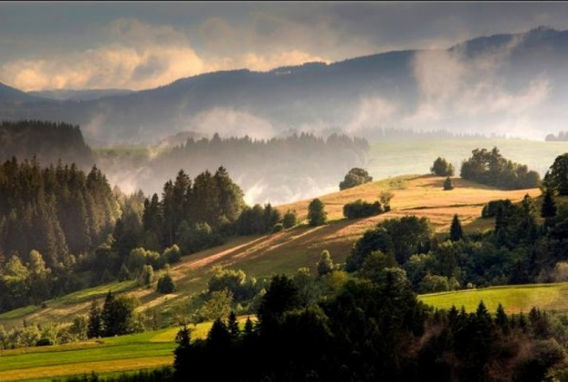
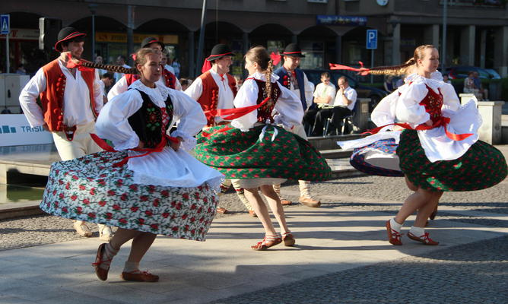
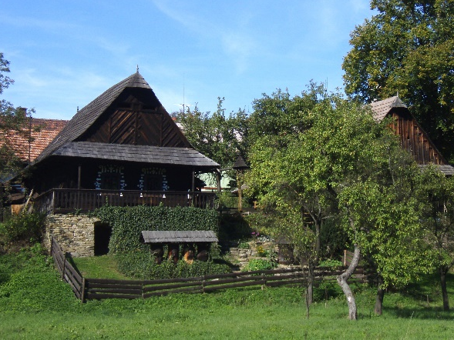
eastern part of Czech Silesia
Těšín region (mainly Frýdek & Jablunkov districts)
Czech majority & Polish minority
Industrialisation of region
Transformation of rural foothill lifestyle into suburban
BUT
Substantial replacement did not take place → society developed rather continuously → elements of traditional culture survived (holidays, anniversaries, feast, etc.)
Traditional dishes, some rituals & customs – still alive
Folk songs, music & dance – kept by numerous folk associations
Specific Těšín dialect has survived
BUT
Many mansions left to their destinies & destroyed due to mining activities or unconcern

Slide 8
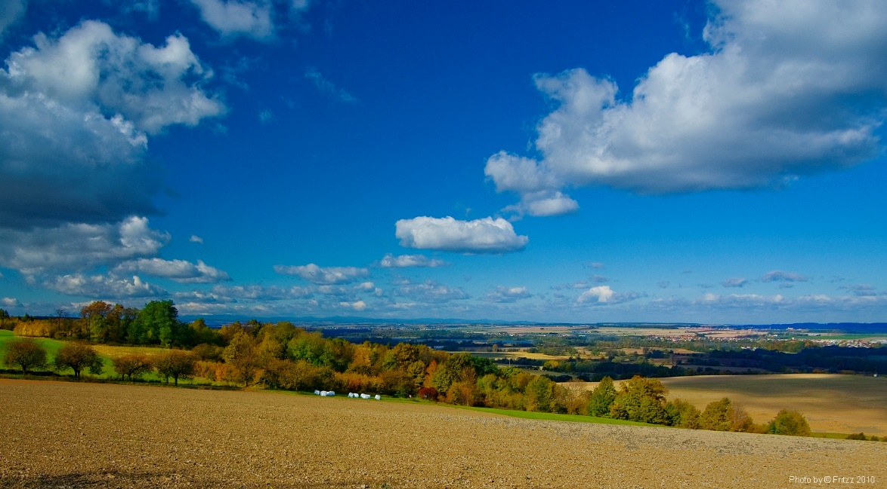
Opava region
Mixed region in cultural social context
Before WWII – settled by Czechs (countryside, Hlučín district) & by Germans (towns)
Expulsion of German majority → loss of their traditions
Some customs, traditions, folk festivities & culinary culture of Czechs preserved

Slide 9
Development of cultural heritage of Silesia also influenced by
Urbanisation & development of large cities
Industrialisation & development of new towns (on place of rural settlements)
→ extinction of rural lifestyle, loss of many cultural traditions & customs
Influx of workers, officers & entrepreneurs (from surroundings & farther countries)
→ transfer of cultural elements, manners, traditions & change of everyday life
Socialist era – heavy industry development, urban & architectural concepts (sorela)
Late 1940s – Havířov (mining housing estate) built on territory of 7 villages
1950s – Poruba (entrance arched gate, extensive boulevard & modern residential houses for mine & steelwork workers) built on territory of noble large farm estate
Havířov & Ostrava-Poruba – declared protected town zones
Residential & shopping complex Věžičky (sgraffito decoration) in Poruba & House of culture in Havířov – cultural monuments
Wars, industrialisation, mining, urbanisation, expulsion & resettlement
→ part of tangible heritage destroyed & most intangible heritage forgotten

Slide 10
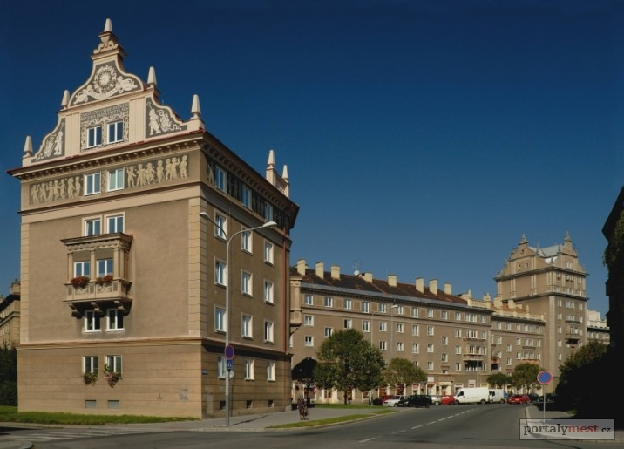
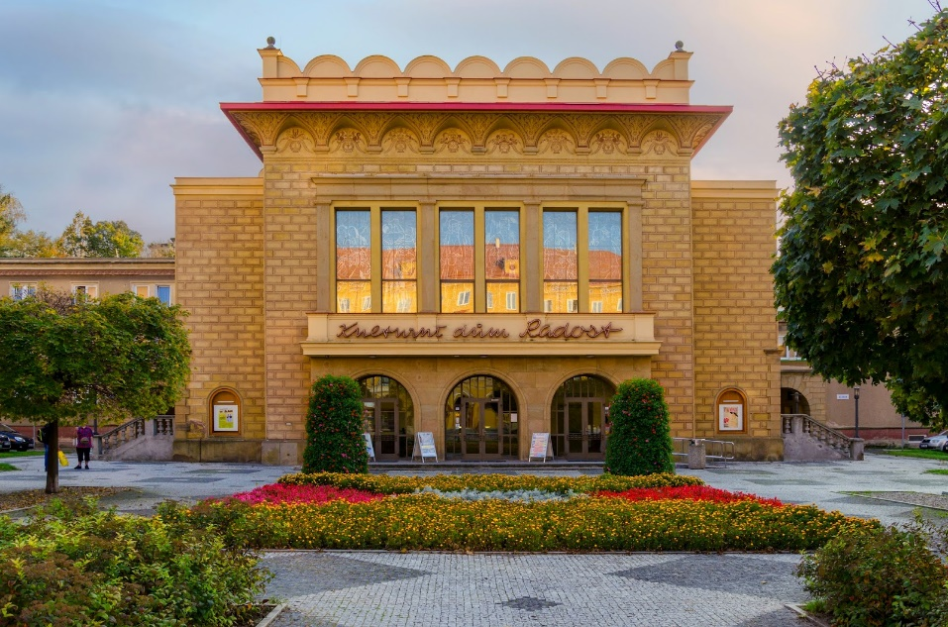
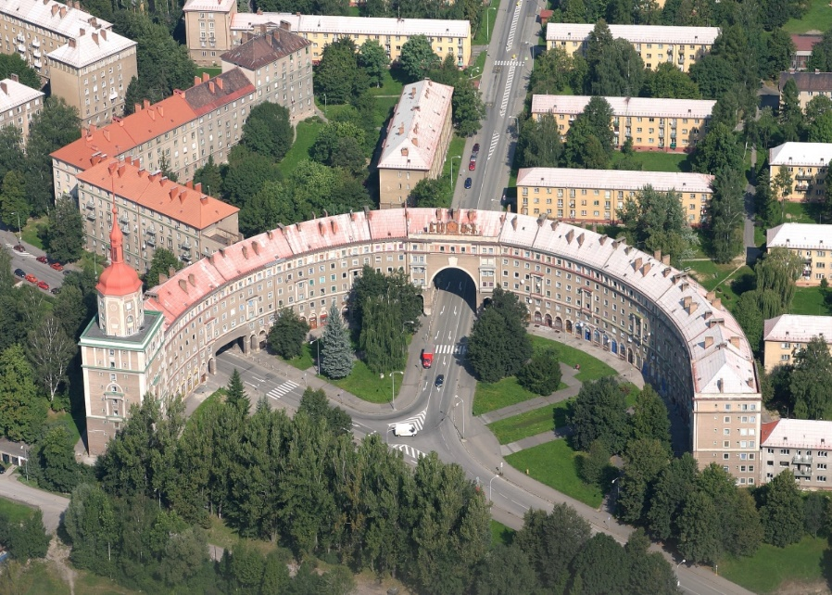
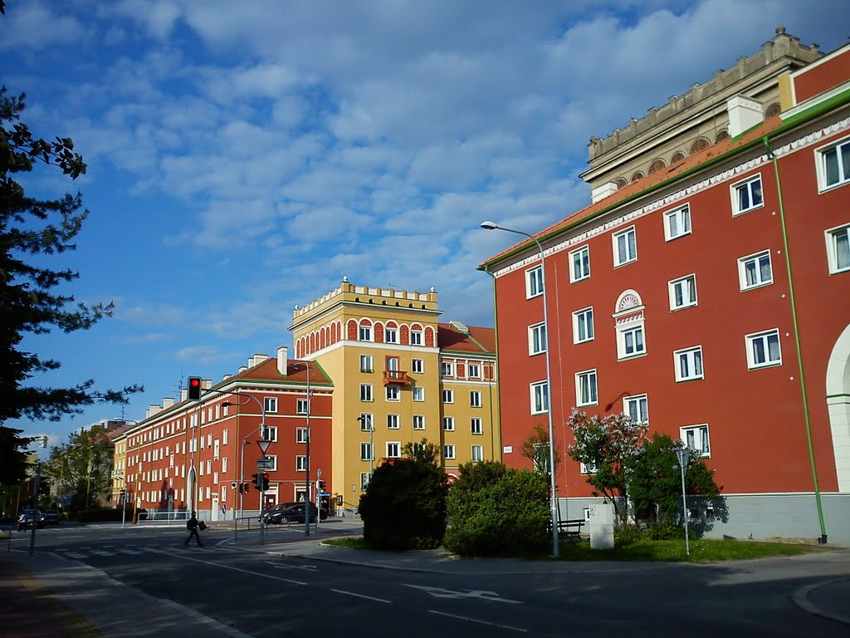
Poruba & Havířov
Věžičky
House of culture

Slide 11
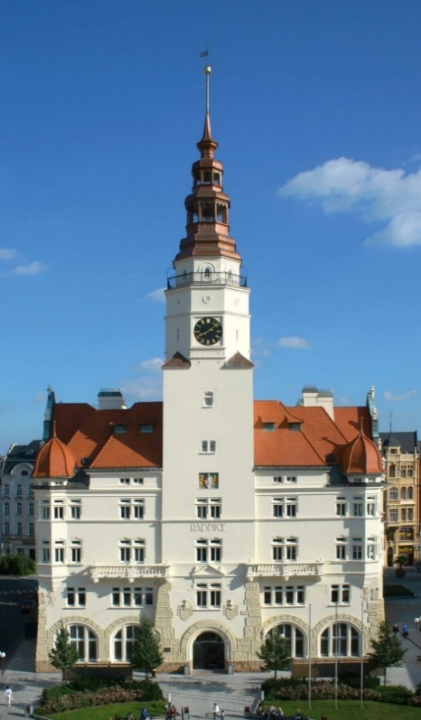
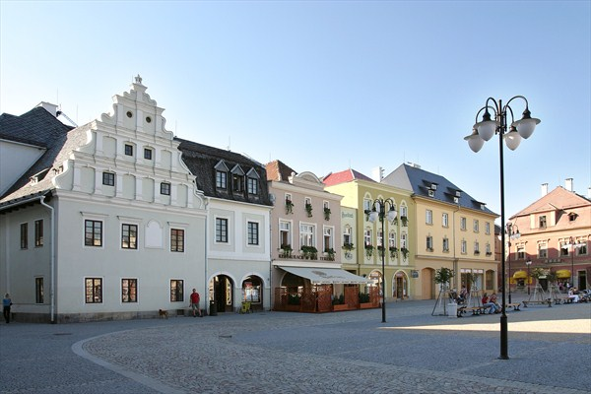
TANGIBLE CULTURAL HERITAGE
Wars, industrialisation, mining, urbanisation, expulsion & resettlement
→ part of tangible heritage destroyed & most intangible heritage forgotten
Three larger historical town centres – Opava, Krnov, Bruntál
Modern industrial towns – Ostrava, Karviná, Orlová & their surroundings
Less populated mountain & foothill areas of Beskydy & Jeseníky Mountains
2015 – Czech Silesia – eleven National Cultural Monuments; 3 castles, 2 religious objects, 2 industrial sites, 2 WWII monuments, 2 solitaire samples

Slide 12
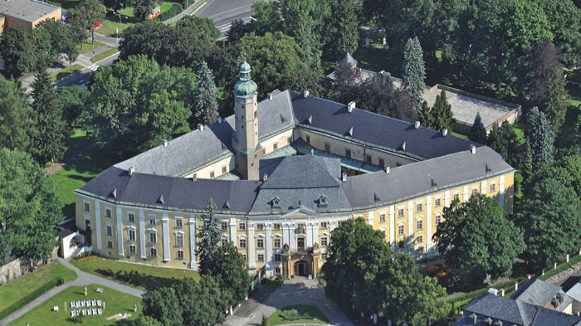
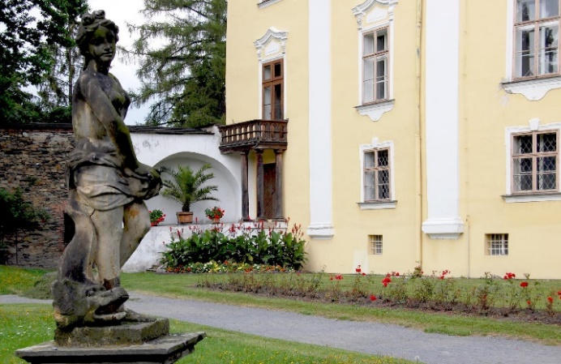
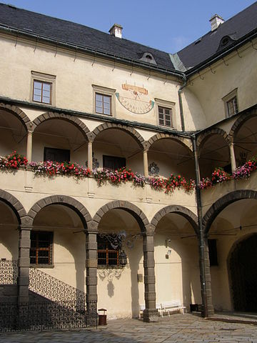
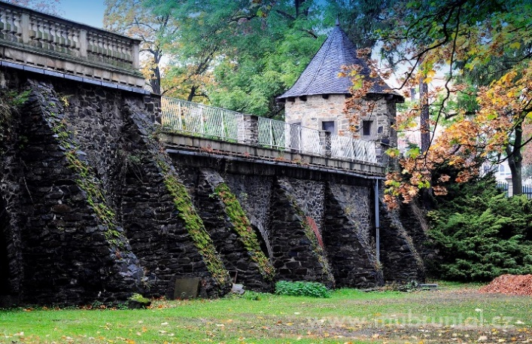
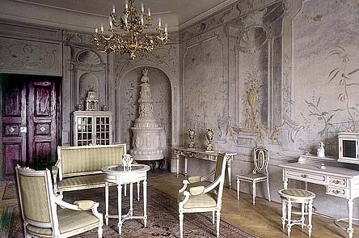
Castles & chateaux
seats of wealthy & influential owners
Chateau Bruntál (Freudenthal)
15 century, 16 century rebuilt Renaissance
18 century – Baroque adaptation
Picture gallery, library, armoury, Rococo paintings
Arcade gallery around triangle courtyard
Park (16 century), remains of town walls with bastion
Sala Terrena
Teutonic Order/German Order (1621-1945)
National Cultural Monument, 2001

Slide 13
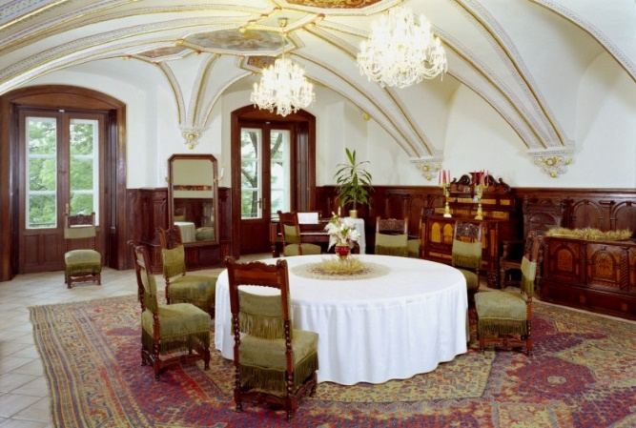
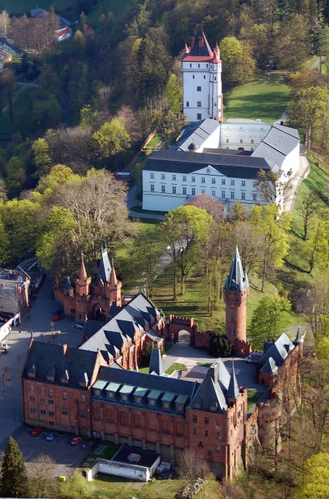
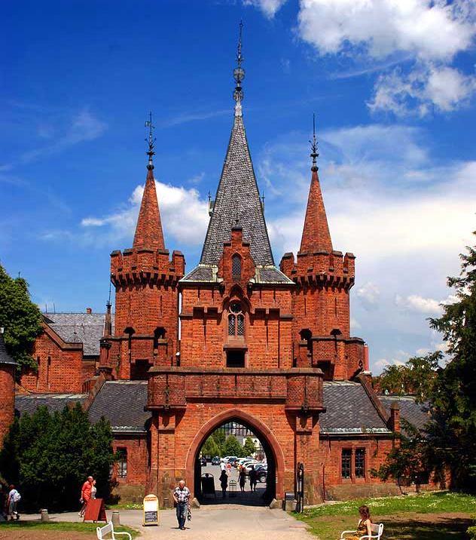
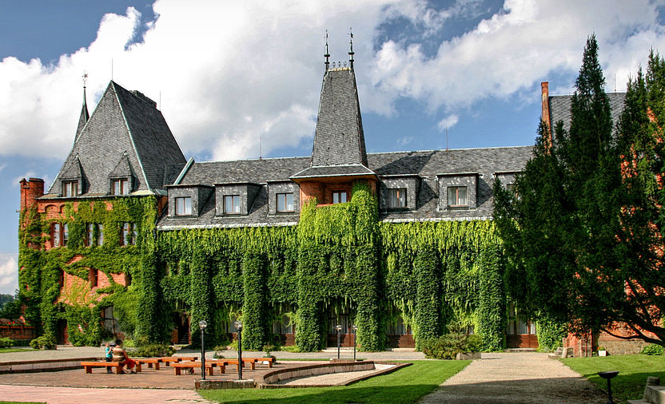
Castles & chateaux
Chateau Hradec nad Moravicí (Grätz)
1060 – first mention, 13 century – royal castle →
Passed to Nicholas I, Duke of Opava (Mikuláš I Opavský)
White Chateau – on the site of Přemyslid castle
16 century – rebuilt Renaissance, 1796 – rebuilt Empire
White Tower & Red Chateau – Neo-Gothic, 19 century
Landscape park (19 century)
Lichnowsky family – until 1945
National Cultural Monument, 2001
Queen-widow Kunigunda settled here after death of Ottokar II (Marchfeld, 1278), lived here with Zavis of Falkenstein

Slide 14
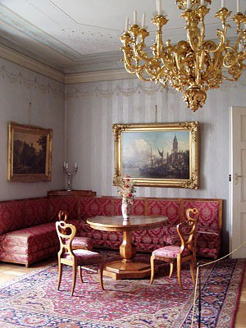
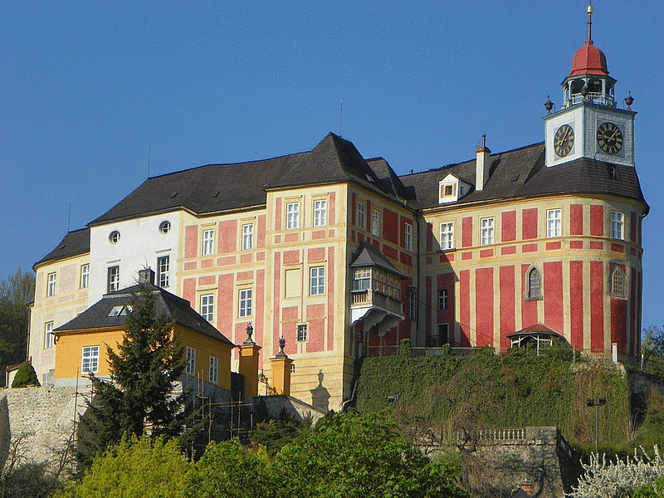
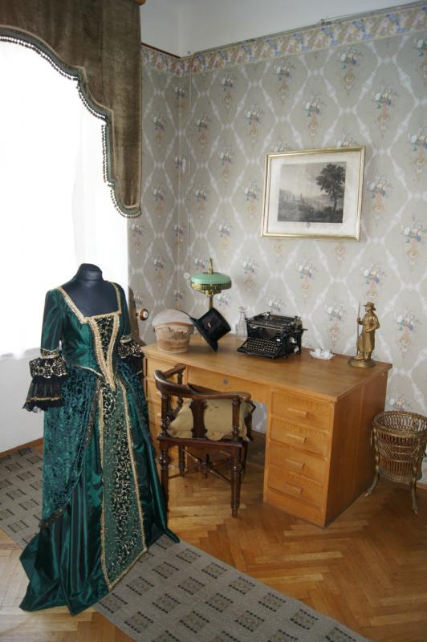
Castles & chateaux
Chateu Jánský vrch (Schloß Johannesberg)
On hill above Javorník (Jauernig; part of Duchy of Nysa)
13/14 centuries, Prince Bolko I of Svídnik (Świdnica)
From beginning of 16 century – Prince-bishops of Breslau
15/16 centuries – rebuilt Renaissance
18 century – rebuilt Baroque
National Cultural Monument, 2002

Slide 15
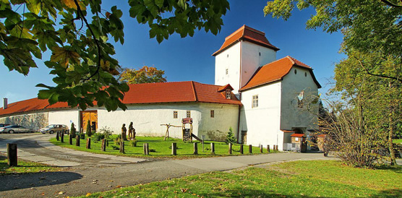
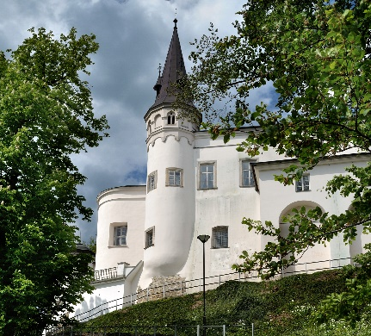
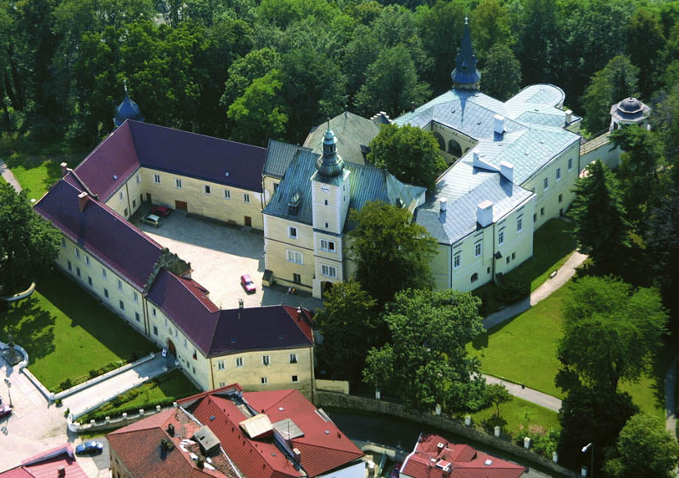
Castles & chateaux
Silesian Ostrava Castle
13 century – guarding castle on border with Moravia
Dukes of Opole
16 century – rebuilt Renaissance style
1714-1945 – Wilczek von Guttenland
(Vlčkové z Dobré Zemice) →
Mining – Castle dropped 16 metres → became ruin*
Torso of original palace, Baroque gate & adjoining wings
survived
Frýdek Castle
14 century – Casimir I Duke of Těšín (Teschen, Cieszyn)
To protect trade route from Moravia to Silesia
16 & 17 century – rebuilt Renaissance
19 century – rebuilt Classicist
1918 – possession of Czechoslovakia
Seat of Museum of Beskydy Region
* Demolition assessment 1954; recently restored & completed with modern imitation of castle premises

Slide 16
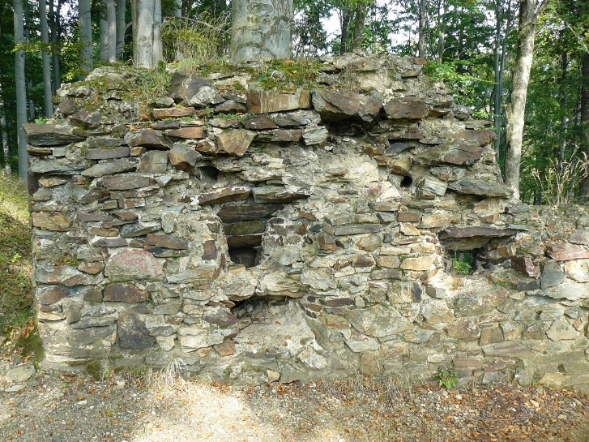
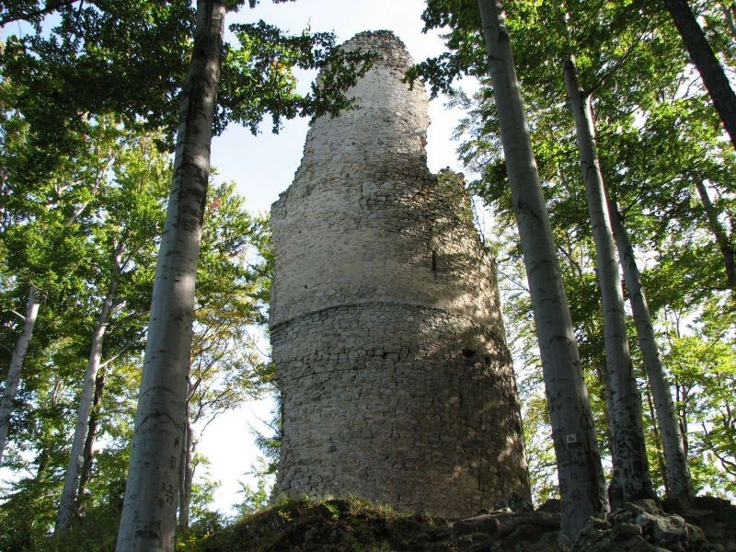
ruins of castles
Edelštejn (Edelstein; at Cukmantl)
First mentioned 1281, built by Bohemian king
To protect Moravian-Silesian border & silver mines
Repeatedly pledged
15 century – Hussite base against Catholic Silesia →
Seized & demolished by Bishop of Breslau
Kaltenštejn (Kaltenstein; Schwarzwasser – Černá Voda)
First mentioned 1295
Possession of Bishop of Breslau
Repeatedly pledged
Not maintained from 15 century
Partly demolished in 16 century
Bergfried (free-standing tower)

Slide 17
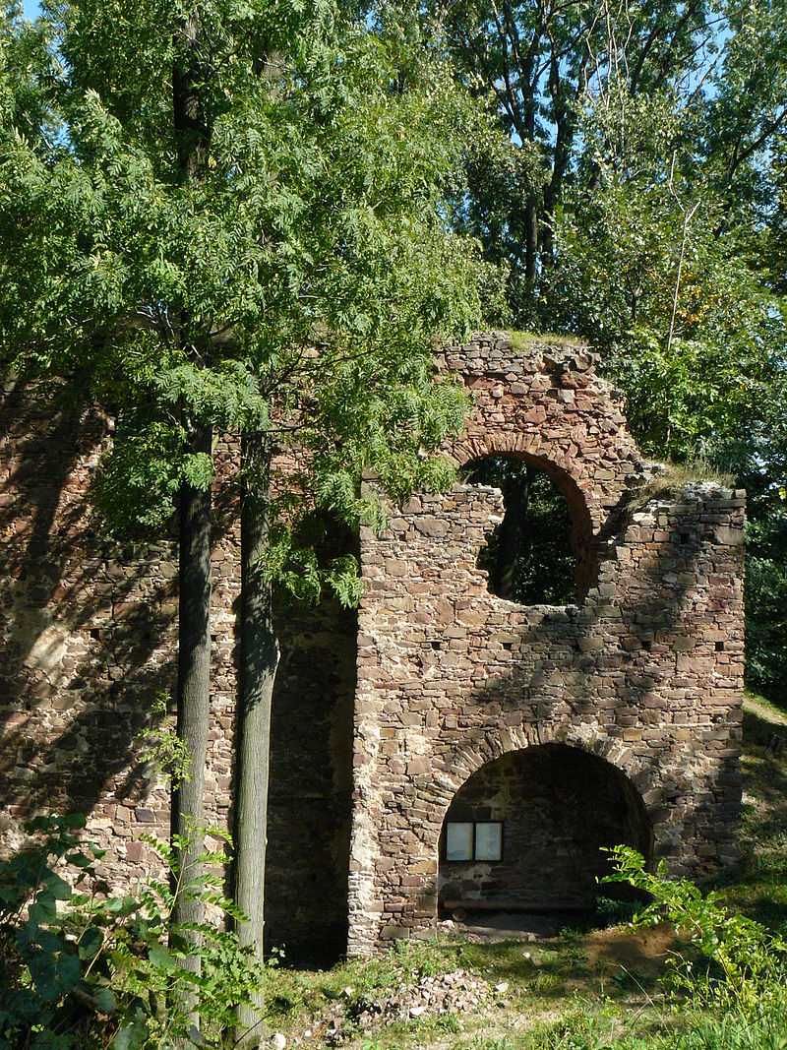
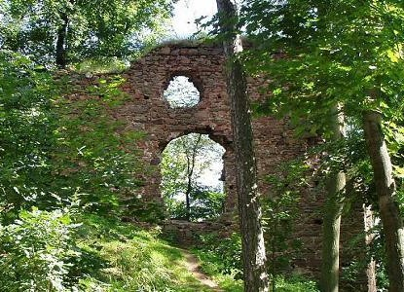
ruins of castles
Fulštejn (Füllstein until 1950; Bohušov near Bruntál)
Built in 1255
Bishop of Olomouc, handed it over to Herbort
→ founder of Fulštejn family (owned it until 16century)
1648 – base of Swedish army
→ blew it up afterwards

Slide 18
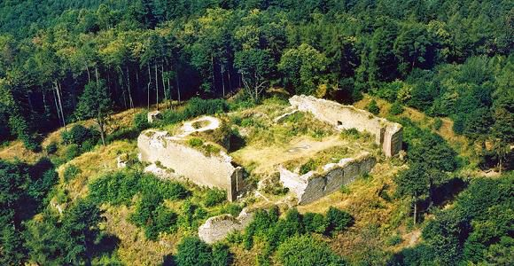
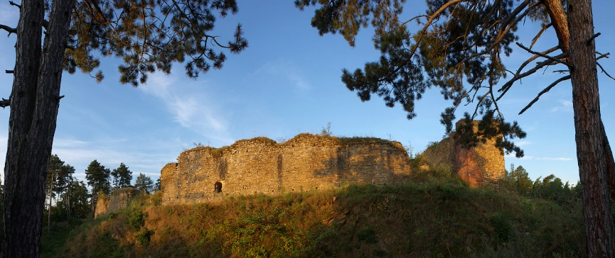
ruins of castles
Cvilín (Schellenburg; Jägerndorf)
Originally royal castle, Dukes of Opava
First mentioned 1253
Repeatedly pledged
After Thirty Years’ War* → fell into ruin
Vikštejn (Wiegstein; near Wigstadtl – Vítkov)
First mentioned 1377
Lords of Kravaře (Herren von Krawarn)
Repeatedly seized, destroyed & restored
Finally abandoned in 18 century
* 1618-1648

Slide 19
fortresses, smaller castles & manors
Jeseník (Freiwaldau; called Frývaldov until 1947)
Water stronghold, 15 century
Residential fortified tower surrounded by moat
18 century – rebuilt Baroque
Bishops of Breslau – until the 20 century
Museum of Jeseník Region
Kravaře (Krawarn)
Baroque castle, on site of former stronghold
18 century (beginning)
Eichendorffs
Museum of Hlučín Region
Šilheřovice (Schillersdorf)
Classicist castle with Neo-Baroque elements
18 century (end)
Eichendorffs

Slide 20
fortresses, smaller castles & manors
Raduň (Radun)
Renaissance stronghold, 16 century
19 century – adapted into Empire chateau
Johann Graf Larisch von Mönnich
Landscape park, decorative gardens, orangery, ponds
1912 – passed on Blücher family
(interiors taken away by Blüchers before WWII)

Slide 21
Vanished castles & manors
Hrabyně
Ráj
Orlová
Třebovice
Dobroslavice

Slide 22
Religious monuments
The Church of the Assumption of Virgin Mary in Opava
13 century, Gothic, German Order
Late-Baroque marble epitaph of Karl of Liechtenstein
Renaissance & Baroque gravestones
1993 – elevated into co-cathedral
National Cultural Monument, 1995
The Chapel of the Holy Cross in Opava
1400, Přemek I, the Duke of Opava, Swedish Chapel
Silesian brick Gothic on octagon plan
Thirteen late-Gothic frescoes
National Cultural Monument, 1995

Slide 23
Religious monuments
Bílá Voda (Weißwasser)
Piarist college, founded 1723
Jakob Ernst von Liechtenstein-Kastelkorn
close to Church of the Annunciation (1604)
Trivial & grammar school, theological college, philosophical studies
Reform 1818 – only ordinary school & parish administration
1876 – Poor Clerics of the Mother of God resettled from Wrocław
Kindergarten, primary & economic school for girls, dormitory, shelter for elderly nuns
1950 – abolishment of convents → detention & internment convent
The pilgrimage Baroque Church of Our Lady of Sorrows and the Exaltation of the Cross (Panny Marie Sedmibolestné a Povýšení svatého Kříže)
On Cvilín Hill
1722-1728
19 century – 14 chapels of Calvary
1870s – stairway to the Church
(222 steps)
Cultural Monument

Slide 24
Religious monuments
The pilgrimage Church of the Visitation of Virgin Mary*
Frýdek
1777 – on place where miraculous statue
of Virgin Mary was found (mid-17c)
1999 – elevated into basilica minor
The Church of the Assumption of Virgin Mary
Hrabyně (Hrabin)
1723-1731, on place of wooden chapel
(mentioned 1497)
Pilgrimage to Virgin Mary of Hrabyně
(Matka Boží Hrabyňská).
The pilgrimage Church of Virgin Mary the Helpful
Uhlířský Hill (Köhler Berg) near Bruntál
1756-1765, on place of wooden pilgrimage chapel (from 1653)
1766-1770 – linden alley planted, connects Church with town
* Navštívení Panny Marie; Mary visited Elizabeth, Mary pregnant with Jesus & Elizabeth with John the Baptist

Slide 25
Religious monuments
The Church of Saint Martin
Bohušov (until 1950 Fulštejn, Füllstein)
Late 13 century, on place of older burial site
Herbord von Fülme (later Füllstein) & his sons
19 century – rebuilt after fire
1999-2000 – reconstruction →
Burial ground discovered below presbytery
Tombstones of bishop Heinrich von Fulstein
(Jindřich Sup z Fulštejna; Sup/Herbord family)
Erik von Fulstein (Erik Sup z Fulštejna)
Wenceslas Sedlnitzky von Choltitz →
unique documents of Silesian Gothic sculpture
The Church of Saint Peter of Alcantara
Karviná-Doly
1732-1736, Baroque Church
Mining → terrain dropped 32 m →
Church leans at angle of 6.8 degrees

Slide 26
Religious monuments
Pilgrimage Church of Virgin Mary the Helpful
Zlaté Hory (Cukmantl)
Mid-18 century – Maria Hilf, on place of forest chapel
Completed with chapels, Calvary & pilgrimage house
Interwar period – 100 thousand pilgrims annually
1945 – expulsion of Germans →
fall into disrepair, pilgrimages forbidden →
1973 Church blasted away
1995 – built anew (financial help of the displaced)
Pilgrimage of three nations every September
Church of Saint Joseph in Žulová (Friedberg; Frýdberk)
19 century, Classicist Church
Integrates parts of original Gothic castle (around 1300)
Castle rebuilt Renaissance
1636 – burnt down & partly demolished by Swedish
Preserved stone bergfried →
church tower with small bell tower added
Cultural Monument

Slide 27
Wooden Churches
Těšín region – group of old wooden sacral structures – local folk gorol architecture
Functioning churches in their original locations
Church of Corpus Christi in Guty
1563 → probably oldest wooden church
Interior – appearance from 17 & 18 centuries
Preserved bell – 1565
Pilgrimage Church of Saint Anthony of Padua
1640, top of Malá Prašivá Hill
Georg von Oppersdorff
Sacristy* & choir** – 18 century
Organ – 1801
Church of All the Saints in Sedliště
One of largest of its kind in CR
1624-1638
probably on place of older predecessor
Many original elements
* Room for keeping robes, sacred vessels, etc. ** kůr; area that provides seating for clergy & church choir

Slide 28
Jewish monuments
Czech Silesia – not many → complicated attitude of locals towards Jewish minority +
Demolition of synagogues after 1938
Jewish Synagogue in Krnov
1871-1872, Neo-Romanesque
Interior – Moorish
Converted into market hall →
protected from destruction during WWII
After War – archives
Nowadays – cultural-social centre

Slide 29
town zones
Most towns damaged at end of WWII → restored & completed → no locality preserved in original historical form → NO town reserve BUT 14 town zones (out of 253 in CR)
Seats of historical dominions, preserved in original urban arrangement
Bílovec
Fulnek
Hlučín
Odry

Slide 30
town zones
Vidnava
Javorník
Zlaté Hory
Karviná

Slide 31
town zones
Opava (Troppau) – capital of Principality of Opava Duchy/of Opava (Herzogtum Troppau) & Austrian Silesia (1742-1928)
Oldest mention 1201, town rights around 1220
Destruction of historical core (1945)
Arma – military headquarters
Hláska – trade centre (14c)
Joy Adamson
U mouřenína (13c)
U bílého koníčka (16c)

Slide 32
town zones
Church of the Holy Spirit (17c) & Minorite Monastery (13c)
Church of the Assumption (14c)
Franciscan Church of Saint Wenceslas (13c)

Slide 33
town zones
Church of St Adalbert & Jesuit college (17 c); Land Government, Land Archives
Silesian Museum(1814)
Blücher Palace (18c)
Sobek Palace (18c)
Silesian Theatre (1804)

Slide 34
town zones
Bruntál (Freudenthal)
1210, first mention 1223
Middle Ages – gold, silver & ore mining
1621 – property of German Order
30 cultural monuments
Chateau & burgher houses
Church of the Assumption (beg 14c)
Piarist monastery with Church of Our Lady of Consolation (18c)
Seminarium puerorum Petrinium (1920s)
Baroque statue of Saint John of Nepomuk
Holy Trinity Column
Panna Marie Těšitelka; chlapecký seminář Petrinium

Slide 35
town zones
Frýdek (Friedek)
14 century, Casimir I, Duke of Cieszyn
From 16 century – centre of state country
19 century –development of textile industry
Well-preserved urban whole, number of CM
Castle, Pilgrimage Church of the Visitation
Church of Saint Judoc (Saint Joyce)
Church of Saint John the Baptist
Remains of town walls
Burgher houses (40; 16-20c)
Art Nouveau house with restaurant Radhošť
stavovské panství; svatý Jošt

Slide 36
traditional folk buildings
Up to 19 century – predominant part of population settled in the countryside
Process of industrialisation + consequent urbanisation → only few remainders of traditional folk buildings preserved (predominantly in western part of country)
Kosárna in Karlovice (Karlsthal; Bruntál region)
Smithy, unique monument
Built 1600, adapted 1759
Walled ground floor, wooden first floor, carved gallery & columns
High saddle roof (typical foothill building of western Czech Silesia)
National Cultural Monument, 2014

Slide 37
Village reserves
Heřmanovice (Hermannstadt, Bruntál district)
First mentioned 1339, gold (Middle Ages), ore (Modern period)
Preserved houses of east-Sudeten type (14 protected )
Ground-floor timbered houses
Stone foundation wall
Saddle shingle, later slate, roof
Gable boarding, front facade →
three wooden framed windows,
whitewashed walls
Church of Saint Andrew
Drachenburg (Drakov) & Quinburk (Hrad Sokolí)
kamenná podezdívka, šindel, břidlice, chlév, prkenný štít

Slide 38
Village reserves
Lipina (Lippein; Opava district)
First mentioned 1377
Abandoned & resettled Germans in 1783
Basis of protected complex of folk homesteads
Gabled walled buildings of east-Sudeten type
Partly preserved interiors
usedlost, štítový, zděný

Slide 39
village zones
Eight protected village zones – three in Jeseník, six in Bruntál & one in Frýdek district
Horní & Dolní Údolí (Ober Grund, Nieder Grund; until 1949 Horní & Dolní Grunt)
Hamlets first mentioned 1450
Archaeological findings → 13 century
Originated in connection with gold mining
Several wooden folk buildings
Cultural monuments of Horní Údolí
Church of Saint John the Baptist with cemetery
Ruin of Koberštejn Castle

Slide 40
village zones
Karlova Studánka (Karlsbrunn, or Bad Karlsbrunn)
First mentioned 1554
Mineral waters known from mid-17 century
1880s – German Order established spa centre
Small wooden houses around healing springs
Core of zone – complex of wooden spa buildings
Silesian House (Lothringen, Lotrinský)
Drinking Pavilion (Pitný pavilion; Wilhelmsquelle)

Slide 41
village zones
Malá Morávka (Klein Mohrau; Bruntál district)
First mentioned 1594
Fifty village houses or farmsteads
Church of the Holy Trinity
Presbytery, vogt house,
Kapličkový Hill →
Chapel of the Holy Trinity
(private museum)
usedlost, fara, rychta

Slide 42
village zones
Petrovice (Petersdorf; Osoblaha district)
First mentioned 1267
Development – typical example
Highly developed settlement – textile production
Disruption of economic contacts (1742)
Decline resulting from industrialisation of towns
Expulsion of German population
1869 – 1,300; 1910 – 1,025; 1930 – 800; 2001 – 142
Complex of log houses
Hall Church of Saint Roch (Classicist, mid-19c)
roubenka

Slide 43
village zones
Rejvíz (Reihwiesen)
Originally pastoral & logging hamlet
Part of National Natural Reserve (peatbog eco-system)
Great Moss Lake – glacial origin
1794 – colonisation activities – Gotthard von Schaffgotsch*
* Bishop of Breslau

Slide 44
village zones
Komorní Lhotka (Kameral Ellgoth; Frýdek district)
Climatic spa with wooden folk architecture
Carpathian log buildings (typical for Těšín area)
Toleration church
Originally prayer room (1782)
Rebuilt in 19 century
furnished with galleries, completed with tower

Slide 45
Industrial National Cultural Monuments
Textile factory in Krnov, 2010
Complex of buildings of “Alois Larisch and sons” factory (later Karnola)
Former spinning mill & weaving mill (machines from 19 & beg of 20c)
Sample workshop – archives, sample books, samples of fabrics, bobbins, etc.
National Cultural Monument, 2010
přádelna, tkalcovna, špulka

Slide 46
Industrial National Cultural Monuments
Mine Michal in Ostrava-Michálkovice, 1995
Complex of buildings & technical devices
19 century, modernised 1915
Complex of electrical mining machines
& compressors (beg of electrification)
Works terminated 1994

Slide 47
Industrial Cultural Monuments
Mine Anselm in Petřkovice
1830 – established → oldest drift mine; 1843 – Rotchilds
1945 – nationalised, 1991 – mining terminated →
Museum – expositions above & below the ground
Part of Landek Park – archaeological, natural & mining area
National Natural Monument, 1993
Mine Alexander in Kunčičky
1896 – established
Above-ground complex →
Form of Neo-Baroque court of honour
2 headframes, 2 shaft buildings,
“garage for carriages”, administrative building
boiler house, chimney
štola, těžní věž, jámová budova, kočárovna, kotelna

Slide 48
change of the cultural landscape
Underground mining → substantial change of cultural landscape & environment →
Industrial complexes, new type of residential buildings & complexes
Frequent manifestations of under-mining →
Disruption & demolition of built-up areas
particular objects, whole settlements & districts
(Orlová, Karviná)
New elements – pit heaps created of gangue
Pit Heap Ema (Ema-Terezie)
One of natural landmarks of Silesian Ostrava
Reaches 315 metres above sea level
Tourist path
halda, hlušina

Slide 49
Places of Memory
Cultural heritage created also by historical events & memory connected with them
Two objects commemorating events of WWII → List of National Cultural Heritage
Monument to guerrilla movement “Noční přechod” in Morávka
Sculptural group of three partisans, Miloš Zet, 1968
Commemorates fights of partisans in Beskydy area
Also dedicated to locals who supported them
December 1944 – Nazis captured guerrilla group
Supporters – 14 executed, 10 to concentration camp
NCM – 1978
Monument to the Životice tragedy
Victims of Nazi terror in Životice (part of Havířov)
Gunfight between Gestapo & partisans
in local pub (August 1944)
36 people shot
31 to concentration camps
NCM – 1989

Slide 50
monuments connected with the War
Czechoslovak military fortification
Built 1935-1938 to line Czechoslovak-German border in Silesia (now Czech-Polish)
Hlučín-Darkovičky Czechoslovak Fortification Complex
Part of Silesian Land Museum
Five different fortifications
in condition & fitting in 1938
in condition at the end of War
Cultural Monument

Slide 51
monuments connected with the War
Monuments connected with Ostrava Operation
March to May 1945, Red Army & First Czechoslovak Army Corps (General Svoboda)
To break into Moravia from north
Front ran from Nisa via Krnov & Opava towards Český Těšín)
Second World War Memorial in Hrabyně
Czechoslovak tank in Sudice
First Czechoslovak Army Corps Tank
Ostrava, Silesian bank of Ostravice

Slide 52
Specific Places of Memory
Ostrá hůrka – Chabičov (Chabitschau; part of Háj ve Slezsku, Freiheitsau)
Important site of Silesian revival
First gathering – 1867 (August)
Bohemian Crown Jewels from Vienna to Prague
1869 – first mass public meeting to support
Silesian rights & against Germanisation
More than 15 thousand participants
Claimed state unity with Moravia & Bohemia
21 September 1918 – to support Czechoslovakia
25 September 1938 – call to protect country against imminent occupation & war
23 September 1945 – for equality of Silesia…
tábor lidu; since 1990 – place of meetings on significant political & social events

Slide 53
Specific Places of Memory
Landek – Petřkovice on Moravian-Silesian border
Forested hill, confluence of Odra & Ostravice
Evidence of history from prehistoric until modern times
Settlement of mammoth hunters on top (Venus; coal used as fuel)
Middle Ages
Fortified Slavonic settlement (8-10 century)
Castle – Ottokar II (13 century, to protect Amber Route & land border)
Black coal seams running on surface are noticeable at the foot
1782 – coal mining started (mine Anselm)
sloj

Slide 54
Specific Places of Memory
Archaeopark Chotěbuz-Podobora
Reconstruction of Slavic hillfort from 9 century
On authentic place →
most significant & best documented archaeological locality in Těšín region
Exact copy of wooden palisade fortified area with hall structure & half-dugouts
polozemnice

Slide 55
MOVEABLE CULTURAL HERITAGE
Silesian Land Museum in Opava
Collects, preserves, studies & presents cultural heritage of Silesia
1814 – Grammas School Museum (Gymnaziální museum) →
1882 – Silesian Land Museum for Arts and Crafts (Schlesisches Lansdesmuseum für Kunst und Gewerbe)
1884 – Muzeum of Matice opavská (Silesian Association) & Opavian City Museum
1945 – took over their ↑ collections
Historical, archaeological, ethnographic & folklore collections
Museum of Těšín Region (Muzeum Těšínska), Český Těšín, Karviná, Havířov, Petřvald
Collection of historical, ethnographic & iconographic character
History & traditions of Těšín region society
Museum of Beskydy Region (Muzeum Beskyd), Frýdek-Místek
Historical, cultural & social development of Frýdek-Místek district
Collections of archaeology, crafts, art crafts & cast iron, photographs
Open-Air Museum of Folk Traditions and Crafts in Bolatice (Hlučín region)
Documents of rural everyday life in authentic environment
litina

Slide 56
most attractive & valuable items
The Venus of Petřkovice – Venus of Landek
Headless torso of female, 4.6 cm
Carved from hematite*
Found 1953; 23,000 years
Uniqueness – depicts young & slim woman
Ducat of Přemek I, the Duke of Opava
Gold coin of Duke Přemek I (1365/1381-1433)
Only surviving specimen – National Museum in Prague
Obverse/head – ruler in robe with attributes & inscription DUX OPPAVIA
Reverse/tails – Duchy of Opava emblem & inscription PRSEMISLAVS DEI GRACIA
* iron mineral – black, steel-grey, brown, red, reddish brown

Slide 57
most attractive & valuable items
Rifle “těšínka”
Hunting single-barrel gun with wheellock & outer spring
Těšín gunsmiths, 16 century
Butt – rich intarsia from horn, mother of pearl, brass, etc. (animals, hunting scenes…)
Owned by leading European aristocrats including Habsburg rulers
Conciliation crosses
Stone crosses in villages or countryside
Places where murder or accident happened
16-18 century, Polanka nad Odrou, Stará Ves, Bartultovice, Nová Véska, Zlaté Hory…
Dobroslavice
Javorník
Horní Udolí
Vidnava
H. Benešov
Dobroslavice
Budišovice
jednohlavňová, kolečkový zámek, vnější napínací péro

Slide 58
most attractive & valuable items
Těšín costume jewellery
Wrought & filigree silver women’s belts, buckles
Double hooks (hočky) for lacing (šnurování)
Necklaces of several connected rows of chains (orpanty)
Chains with pendants (in garland way) hung on bodices (lancušky or přodky)
Men’s buttons (gombíky) for waistcoats (brucfleky) & coats (kamizole)
imitated noble Renaissance jewellery
Těšín & Jablunkov regions
Oldest documented in 16 century
tepaný, spona, přívěsky

Slide 59
most attractive & valuable items
Land coats of arms – symbolises particular historical lands, originated in Middle Ages
Silesia – black eagle with silver perisonium, golden crown & red armour, golden field
Originally – family coat of arms of (Lower-)Silesian Piasts
Later – coat of arms of whole Silesia
Nowadays – third field of quartered shield of Coat of arms of CR
Duchy of Opava – pale shield, silver & red
Duchy of Teschen – golden eagle with red armoury in blue field
Duchy of Nisa – six silver fleur-de-lis (stylised lily) in red field
rodový znak, polcený štít

Slide 60
INTANGIBLE CULTURAL HERITAGE
Includes language, tradition, customs, rituals, oral tradition, music, singing, knowledge, experience & collective memory
Silesia – melting pot of German, Polish, Czech & Yiddish (jüdisch) →
Local/regional language varieties (dialects) developed
Becoming extinct & replaced by common Czech & Polish
Gwara cieszyńska (po našymu; the way we speak) – Těšín region
Lach dialect – Opava & Hlučín regions
German – larger towns (until mid-20 century)
German in local dialects – Krnov, Bruntál & Nisa (Jesenicko) regions + partially in Opava region (Opava, Odry, Bílovec & surroundings; until end of WWII)
https://www.youtube.com/watch?v=itCMk4PaSt8
http://www.jareknohavica.cz/jaromir-nohavica-v-jednom-dumku/
http://www.ceskatelevize.cz/ivysilani/1102732990-folklorika/413236100141001-s-prajzaky-ke-korenum-moravstiny/titulky
1:12-3:00; 3:45-6:25-7:50, 9:20-10-11:20, 18:10; 19:55-20:40; 20:35-22:40; 23:05
Čeść, stary. Dobrý den. Idź do dupy. Děkuji vám. Niemów gupie, bo dostanieš po pysku. Nejsi-li tázán, mlč. Doniyś nóm dwa piwa. Dal bych si jedno frappé, prosím. Kurdebele, jo se na to wyserym. Jsem již unaven. Niedřystej! Nemluv hlouposti. Ty pierune! Šarlatáne!

Slide 61
INTANGIBLE CULTURAL HERITAGE
Folklore – folk customs, rituals, songs & dances
Holidays of liturgical year (Christmas, Easters, Advent, Shrovetide), connected with local church (Kermesse), family events (christening, wedding, funeral), agricultural year (dozhinki; wine festival)
Uniform customs (carolling, contrabass funeral, walking the bear, egg painting, etc.)
Specific customs – Easter riding procession
riders in festive costumes, sing, ride around village in front of the faithful (Lukavec)
https://www.youtube.com/watch?v=5aBlkKeUkIk (7:45)

Slide 62
INTANGIBLE CULTURAL HERITAGE
Gorolski Święto (Highlander’s Festival)
First weekend in August, Jablůnkov (1947)
Ethnographic festival & international folklore meeting
Bal Gorolski
https://www.youtube.com/watch?v=GxrOXluE9xc
Silesian days
September, Dolní Lomná
International folklore festival
Folk ensembles & traditional crafts
Lomňanský jarmark (Annual Fair)
October, Dolní Lomná
Folk ensembles
Folk natural healing, offer of regional dishes & products

Slide 63
INTANGIBLE CULTURAL HERITAGE
Healing methods & procedures of Vincenz Priessnitz (1799-1851)
Founder of natural healing → father of modern hydrotherapy
Based on personal experience →
Started treatment using water & cold wrapping →
1837 – spa in Gräfenberk
near Frývaldov (Freiwaldau; Jeseník)
Spa tradition lasting up to now
Petr Bezruč (1867-1958)
Native of Opava (connected with Frýdek)
Silesian Songs
one of fundamental books of Czech poetry
Rise from roots of Silesia
Describe its traditions & present days
Testimony of particular time & society

Slide 64
Thank you for attention

