Slide 1
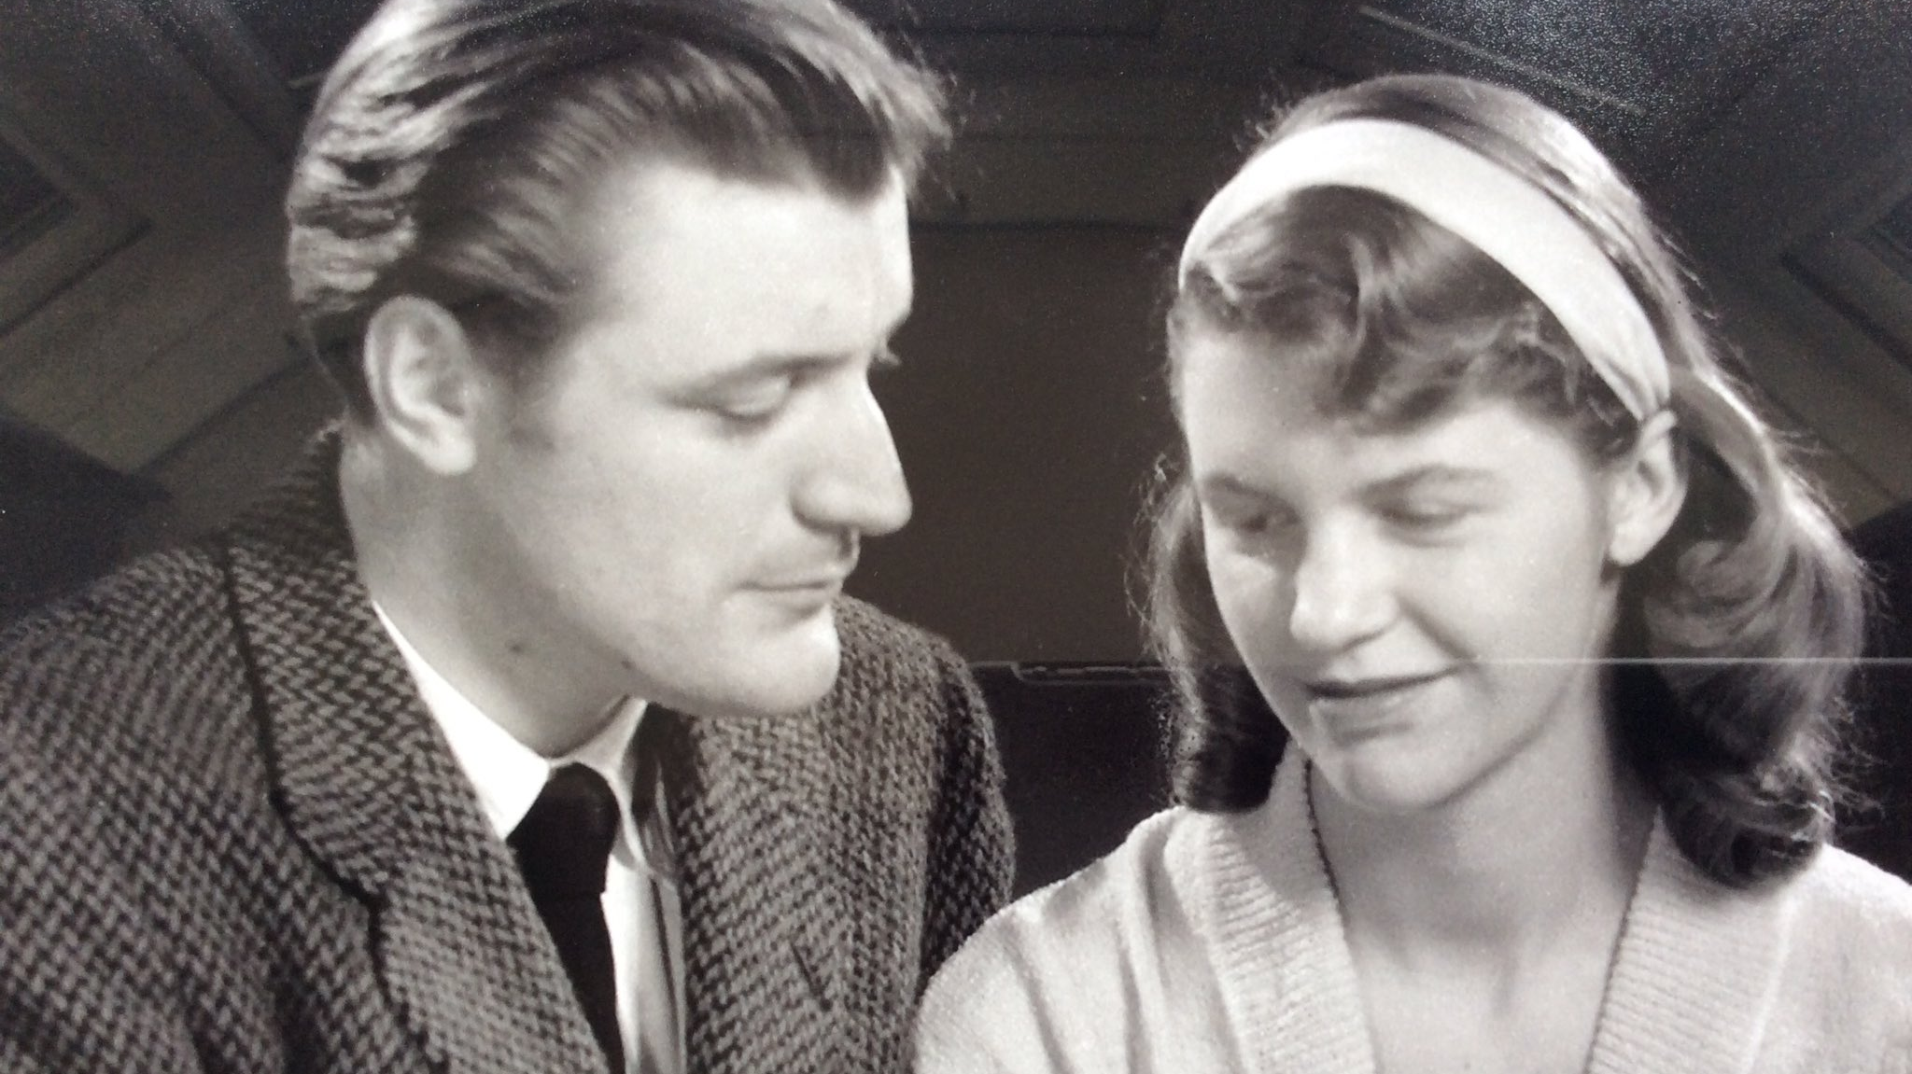
Daddy
by Sylvia Plath

Slide 2
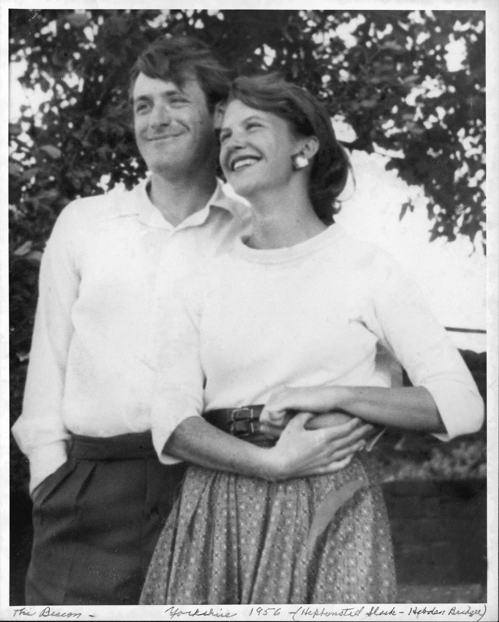
Sylvia Plath
Born in 1932 in Massachusetts
Confessional Poetry
Her father – German immigrant, professor
Committed suicide
Poetry collection – 'Ariel'
Notable Works: 'The Bell Jar', 'The Colossus‘,

Slide 3
Plot
Dialogue with deceased father
Holocaust and Nazi metaphors
From victim to empowered individual
Symbolic 'killing' of the father figure

Slide 4
Themes
Patriarchal Oppression
Identity and Rebellion
Death and Memory

Slide 5
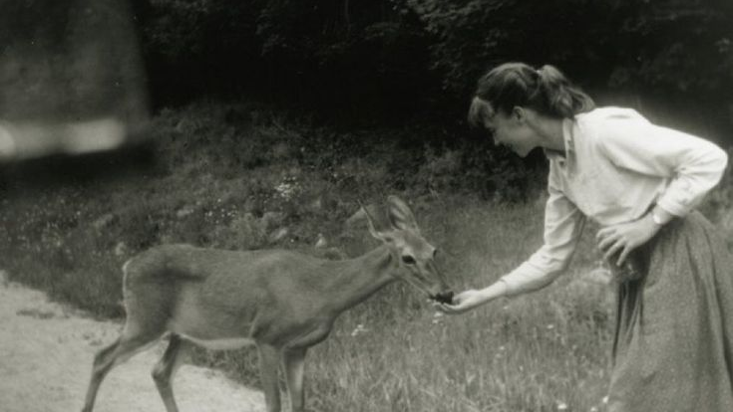
Questions
I have always been scared of you,
With your Luftwaffe, your gobbledygoo.
Not God but a swastika
So black no sky could squeak through.

