Slide 1
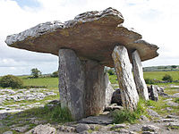
Megalithic constructions in Europe– religious rituals

Slide 2
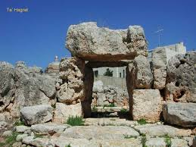
Megalithic constructions
England, Ireland, France
The most common type in Britain – a stone circle
Stonehenge
Astronomical connections with the sun and the moon
Solstice

Slide 3
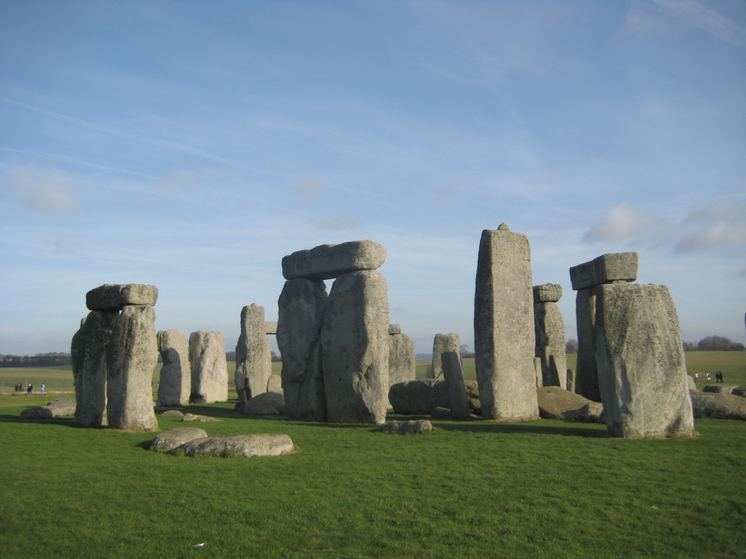

Slide 4
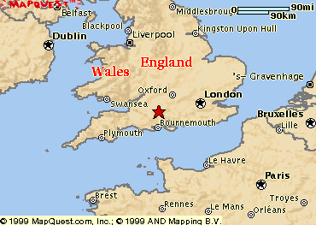
Stonehenge

Slide 5
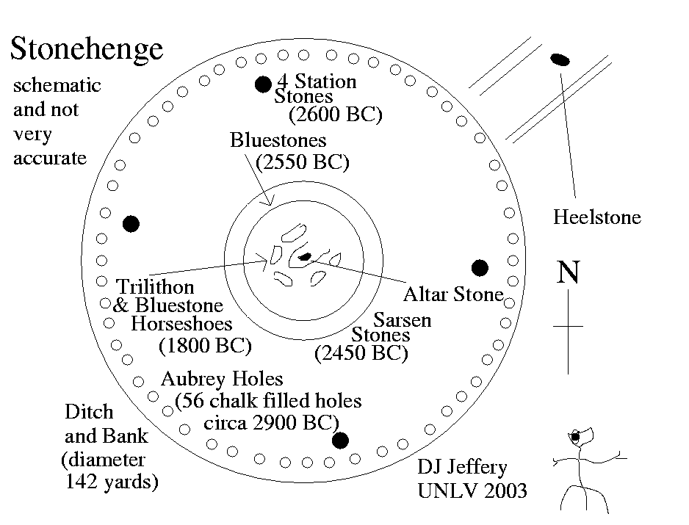
Structure

Slide 6
History
Built between 3000 – 2000 BC – various purposes - civilisation with no written records
legends
burial ground
solstice and equinox points - rituals
a midsummer's morning - the sun rose and the sun's first rays went directly into the centre of the monument

Slide 7
Construction
Transport - prehistoric people - without the aid of the wheel - river
ground - creating a track of logs - large stones were rolled
a type of sleigh running on a track greased with animal fat
experiment - 1995 - a 40-ton stone– 100 workers
the 18-mile journey - from the river transport - successful

Slide 8
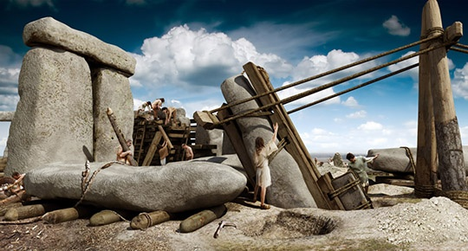

Slide 9
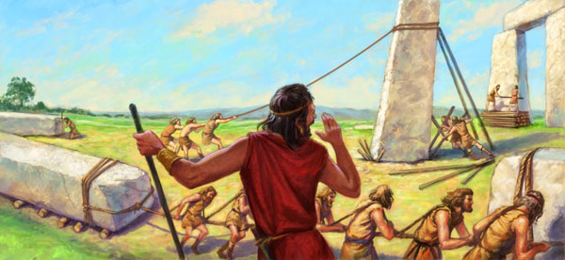

Slide 10
Legends
Stonehenge - bluestone
Legend - King Arthur – sent Merlin – 5th century and 15,000 knights to move the stones from a distant place
not successful
Merlin – special skills - stones removed from Ireland
sent to Britain

Slide 11
Significance
the purpose – mystery – 1000 years significance
Hypotheses:
strong archaeological evidence - a burial site
ceremonial site
a religious pilgrimage destination
a final resting place for royalty
a memorial erected to honor and perhaps spiritually connected with distant ancestors

Slide 12
Astronomical calendar – a new hypothesis
In the 1960s - the astronomer Gerald Hawkins
megalithic stones - an astronomical calendar
phenomena -solstices, equinoxes and eclipses
critics - Stonehenge’s builders – no knowledge
England’s dense cloud cover – difficult observing
Recent theory – archeologists – signs of illness and injury in the human remains - bones
a place of healing- bluestones were thought to have curative powers

Slide 13
https://www.youtube.com/watch?v=4YNNkVzumhA
https://www.youtube.com/watch?v=wf7xwHFuH2o

Slide 14
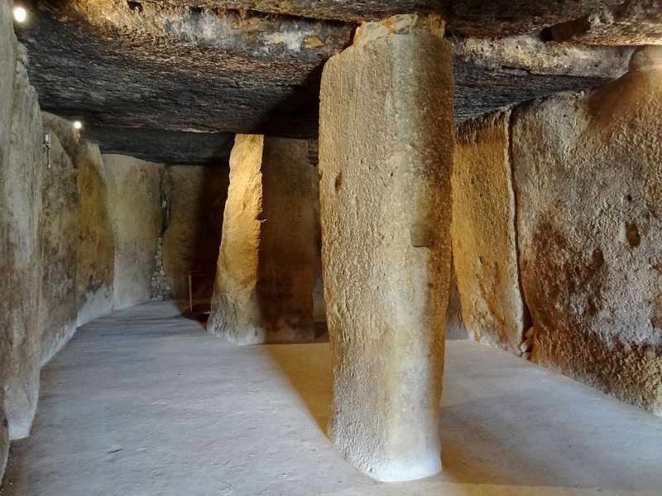
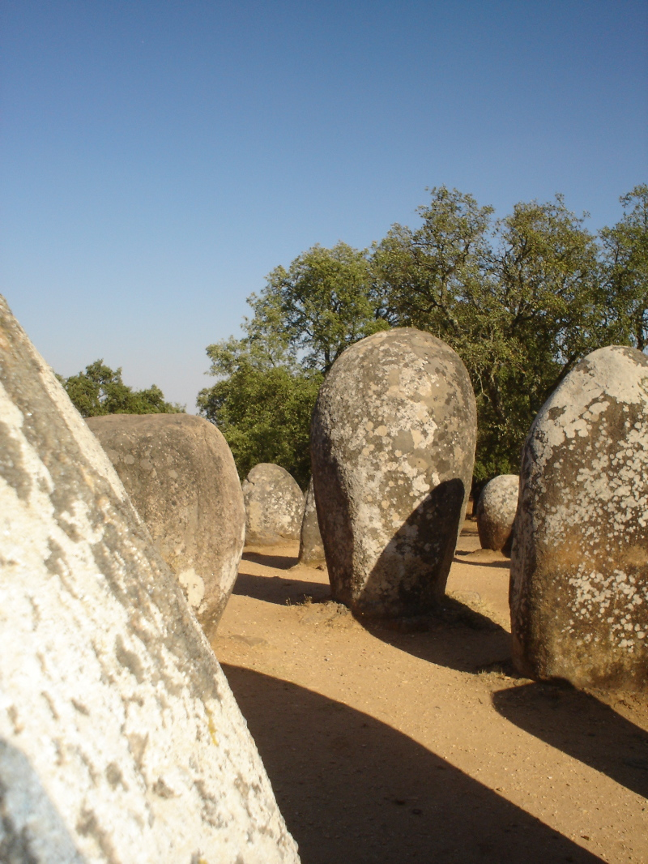
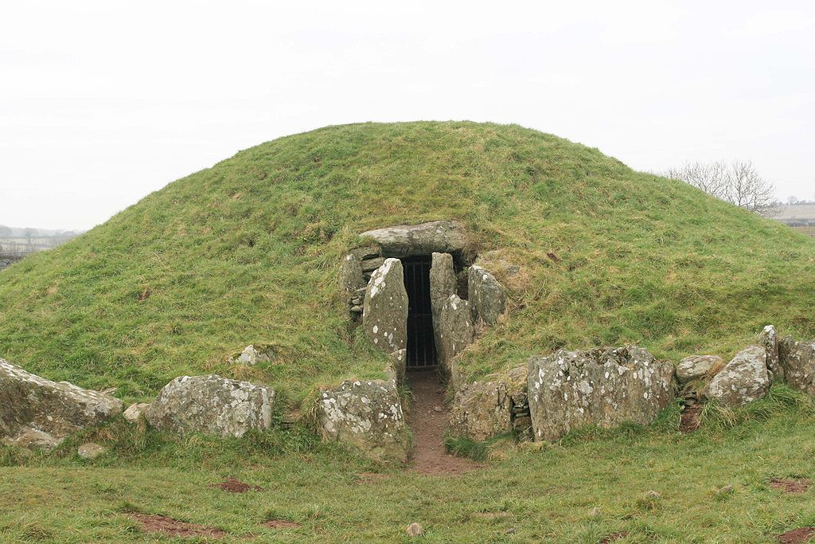
Other megalithic constructions

