Slide 1
Interesting places in the Czech Republic

Slide 3
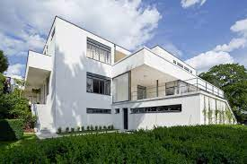
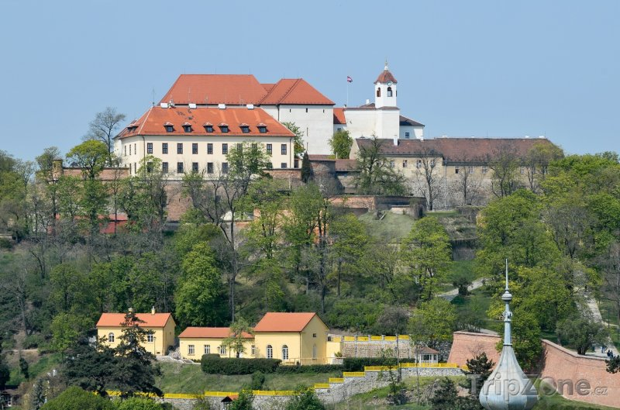
Brno

Slide 5
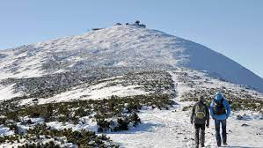
Sněžka – the highest mountain

Slide 7
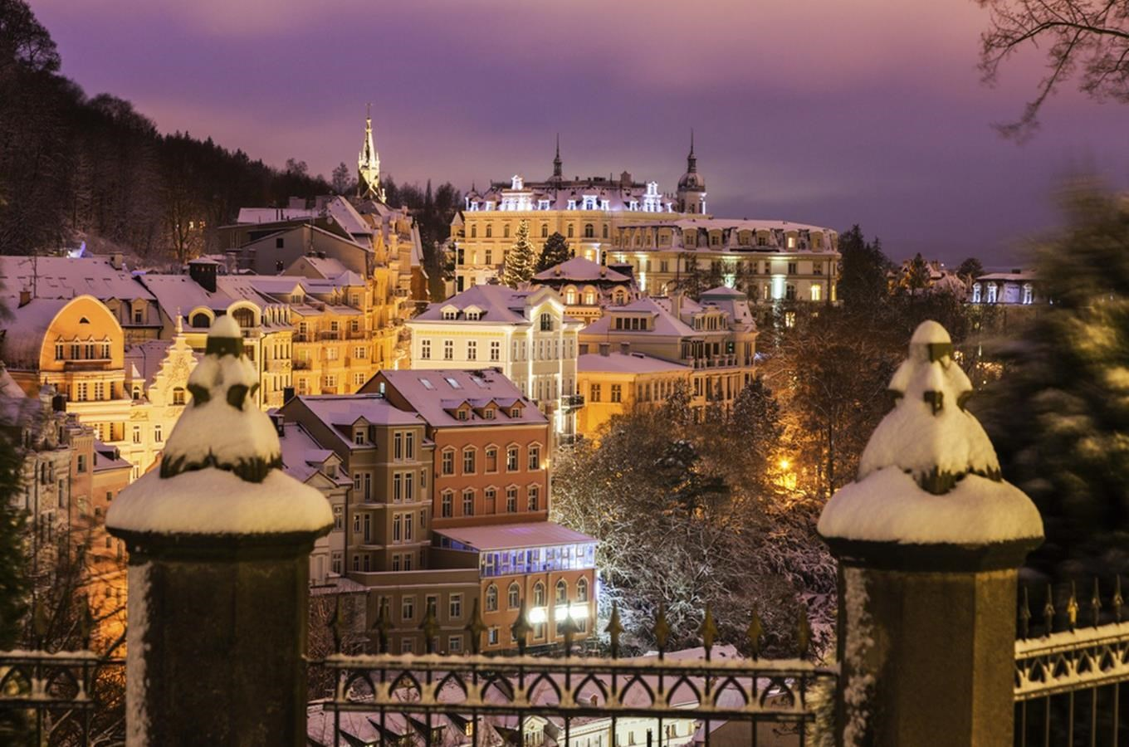
Karlovy Vary

Slide 9
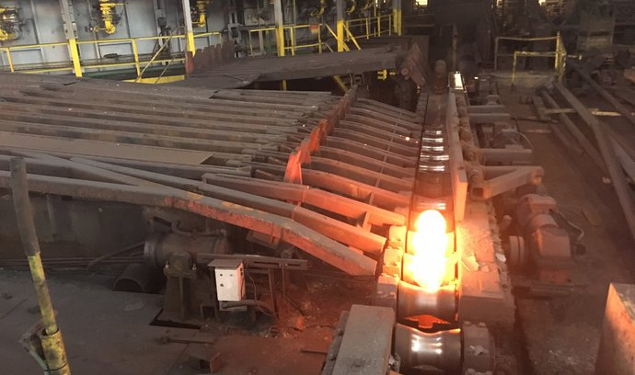
Ostrava - Steel works

Slide 11
PRAGUE – the capital

Slide 13
Hradčany Castle

