Slide 1

THE SIMPLE KEYNESIAN MODEL
TWO SECTORS
LESSON II
Dr. Ingrid Majerová
MACROECONOMICS/EVS/NAMAB

Slide 2
TWO-SECTOR NATIONAL MODEL
Outline of the lecture
Two-Sector National Model
Equilibrium Income
Consumption, Investment and Savings Function
Output – Expenditure Approach

Slide 3
TWO-SECTOR NATIONAL MODEL
MACROECONOMICS
EXOGENOUS AND ENDOGENOUS VARIABLES
National income, general price level, inflation rate, unemployment rate, interest rate and the exchange rate are the economic measures to be explained in the macroeconomic models / theories.
Exogenous Variable
  the value is determined by forces outside the model
  any change is regarded as autonomous
  I, G, X (Micro: Income/Population)
Endogenous Variable
  the value is determined inside the model
  factor to be explained in the model
  Y, C, M ( Micro: Price/Quantity)

Slide 4
TWO-SECTOR NATIONAL MODEL
LINEAR FUNCTION
A function specifies the relationship between variables
y is the dependent variable
x is the independent variable
y=f(x)
y=c+mx
m, c are exogenous variables
y, x are endogenous variables

Slide 5
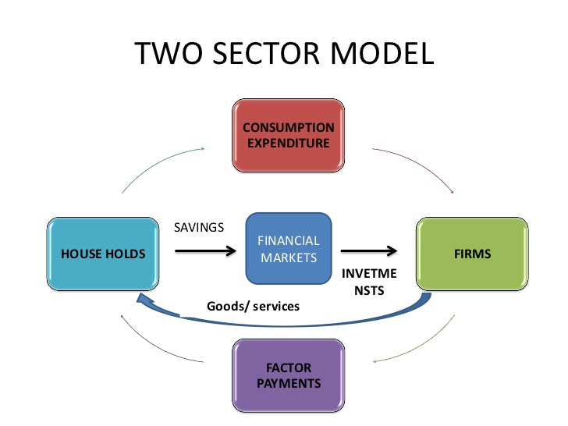

TWO-SECTOR NATIONAL MODEL

Slide 6
TWO-SECTOR NATIONAL MODEL
ASSUMPTIONS
National income Y is defined as the total real output Q
A constant level of full national income Yf
Serious unemployment, i.e., there are many idle or unemployed factors of production
Income / output can be raised by using currently idle factors without biding up prices
Price rigidity or constant price level
There are only households and firms (2-sector). No government and foreign trade.

Slide 7
TWO-SECTOR NATIONAL MODEL
IDENTITIES
An identity is true for all values of the variables
In a 2-sector economy, expenditure consists of spending either on consumption goods C OR investment goods I.
Aggregate expenditure (AE OR E) is ,by definition, equal to C plus I
E = C + I
National income Y received by households, by definition, is either saved S OR consumed C.
Y = C + S

Slide 8
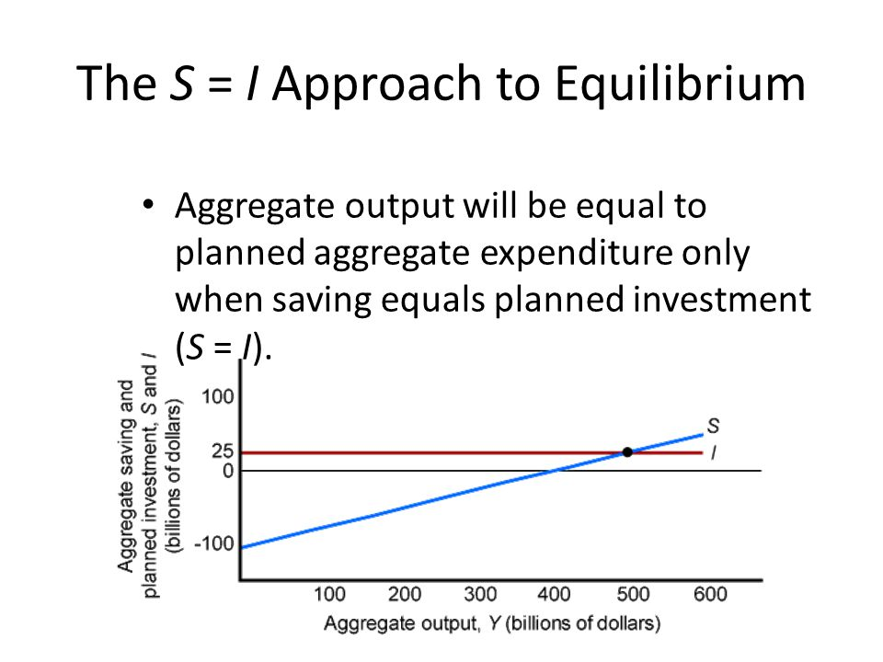
TWO-SECTOR NATIONAL MODEL
IDENTITIES
Aggregate expenditure E is, by definition, equal to national income Y
Y = E
C + S = C + I
S = I

Slide 9

TWO-SECTOR NATIONAL MODEL
EQUILIBRIUM INCOME
Equilibrium is a state in which there is no internal tendency to change.
It happens when:
  firms and households are just willing to purchase everything produced Y = E (v.s. Micro: Qs = Qd)
  Income-Expenditure Approach
  planned saving is equal to planned investment S = I
  Injection-Withdrawal Approach

Slide 10
TWO-SECTOR NATIONAL MODEL
EQUILIBRIUM INCOME
Ex-ante Y > E Excess supply
planned output > planned expenditure
  unexpected accumulation of stocks OR
  unintended inventory investment OR
  involuntary increase in inventories
In national income accounting, this amount Y-E is treated as (unplanned) investment by firms

Slide 11
TWO-SECTOR NATIONAL MODEL
EQUILIBRIUM INCOME
Ex-ante Y < E Excess Demand
planned output < planned expenditure
  unexpected fall in stocks OR
  unintended inventory dis-investment OR
  involuntary decrease in inventories
However, in national income accounting, this amount E - Y consumed is not currently produced

Slide 12
TWO-SECTOR NATIONAL MODEL
EQUILIBRIUM INCOME
Ex-ante Y= E Equilibrium
There is no unintended inventory investment OR dis-investment

Slide 13
TWO-SECTOR NATIONAL MODEL
EQUILIBRIUM INCOME
Ex-post Y= E
Actual (Realised) = Planned + Unplanned
Expenditure Expenditure Investment
Actual (Realised) Output = Actual Expenditure
Firms will reduce output

Slide 14
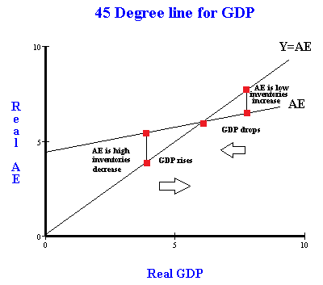

TWO-SECTOR NATIONAL MODEL
MODEL
When there is excess supply, i.e., planned output > planned expenditure, firms will reduce output to restore equilibrium
When there is excess demand, i.e., planned expenditure > planned output, firms will increase output to restore equilibrium

Slide 15
TWO-SECTOR NATIONAL MODEL
CONSUMPTION FUNCTION
the 1st component of the aggregate expenditure E = C + I is C - consumption
Empirical evidence shows that consumption C is positively related to disposable income Yd
Yd = Y since it is a 2-sector model
C = C’ + cY
Autonomous Consumption C’
It exists even if there is no income. This can be done by dis-saving, i.e., using the past saving
Then, saving will be negative when income is zero.
It is totally determined by forces outside the model.

Slide 16
TWO-SECTOR NATIONAL MODEL
MARGINAL PROPENSITY TO CONSUME
Marginal Propensity to Consume MPC = c
It is defined as the change in consumption per unit change in income
MPC = ΔC / ΔY
It is the slope of the tangent of the consumption function
For a linear function, MPC is a constant
It is assumed that 0 < MPC < 1

Slide 17
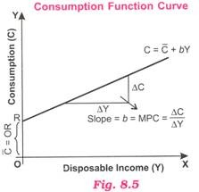
TWO-SECTOR NATIONAL MODEL

Slide 18
TWO-SECTOR NATIONAL MODEL
AVERAGE PROPENSITY TO CONSUME
Average Propensity to Consume APC
It is defined as the ratio of total consumption C to total income Y
APC = C / Y
It is the slope of ray of the consumption function
When C = C’ OR C = C’ + cY, APC decreases when Y increases.
When C = cY, APC = MPC = c = constant

Slide 19
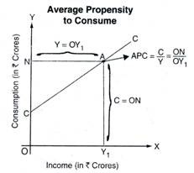
TWO-SECTOR NATIONAL MODEL
APC ↓ when Y ↑

Slide 20
TWO-SECTOR NATIONAL MODEL
INVESTMENT FUNCTION
the 2nd component of the aggregate expenditure E = C + I is Investment
An investment function shows the relationship between planned investment I and national income Y.
It can be a linear function or a non-linear function.
Autonomous Investment
I= I’
investment is thought to be correlated with interest rate r, instead of Y

Slide 21
TWO-SECTOR NATIONAL MODEL
INVESTMENT FUNCTION
Marginal Propensity to Invest
It is defined as the change in investment I per unit change in income Y
MPI = ΔI / ΔY
MPI would not correlate with Yd
It is the slope of tangent of I
It is also determined by forces outside the model

Slide 22
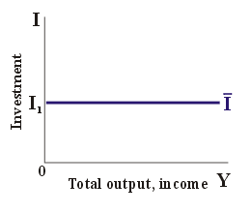
TWO-SECTOR NATIONAL MODEL

Slide 23
TWO-SECTOR NATIONAL MODEL
AGGREGATE EXPENDITURE FUNCTION
Given E = C + I
C = C’ + cY I = I’
E = I’ + C’ + cY
E = E’ + cY
Autonomous Change
When C’↑ or I’ ↑ → E’ ↑ → shift upward
When c ↑ → slope of E steeper → rotate
Induced Change
When Y ↑ → E ↑ → move along the curve

Slide 24

TWO-SECTOR NATIONAL MODEL
OUTPUT-EXPENDITURE APPROACH
Y = planned E
Y = I’ + C’ + Cy
Y = E’ + cY
(1-c)Y = E’
Equilibrium condition:
Y = $\frac{1}{1−c}$E’
Expenditure Multiplier

Slide 25
TWO-SECTOR NATIONAL MODEL
SAVINGS FUNCTION
We have Y = C + S
Saving function can simply be derived from the consumption function
S = Y – C if C = C’ + Cy
S = Y – C’ – cY
S = -C’ + (1-c) Y
S = S’ + sY S’= -C’ s = 1 – c
S’ < 0 if C’ >0 S’ = 0 if C’ = 0

Slide 26
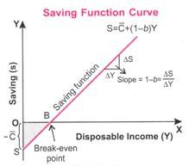
TWO-SECTOR NATIONAL MODEL

Slide 27

TWO-SECTOR NATIONAL MODEL
SAVINGS FUNCTION
Autonomous Saving S’
Since S= -C’ + (1-c)Y
If C’=0 when C= cY
S = (1-c)Y S’ = 0
If C’=0 when C = C’ + cY
S = -C’ + (1-c)Y S’ –ve
If Y= 0 S’ = -C’ Dis-saving

Slide 28
TWO-SECTOR NATIONAL MODEL
SAVINGS FUNCTION
Marginal Propensity to Save MPS = s
It is defined as the change in saving per unit change in disposable income Yd OR income Y (in a 2-sector model)
MPS = ΔS/ ΔY
It is the slope of tangent of the saving function
MPS is a constant if the consumption / saving function is linear

Slide 29
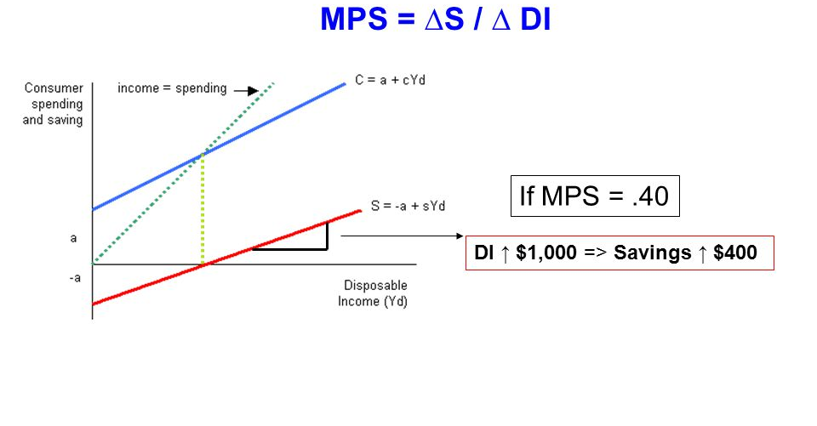
TWO-SECTOR NATIONAL MODEL
SAVINGS FUNCTION
Marginal Propensity to Save MPS = s

Slide 30


TWO-SECTOR NATIONAL MODEL
SAVINGS FUNCTION
Average Propensity to Save APS
It is defined as the total saving divided by total income
APS = S/Y
It is the slope of ray of the saving function
When S= sY
APS = MPS = s = constant
When S=S’+ sY
APS ↑ when Y ↑

Slide 31
TWO-SECTOR NATIONAL MODEL
SAVINGS FUNCTION
Y = C + S Differentiate wrt. ΔY
ΔY/ΔY=ΔC/ΔY + ΔS/ΔY
1= MPC + MPS
1 = c + s
S = S’ + sY Divided by Y
S/Y = S’/Y + s
APS=S’/Y+MPS

Slide 32
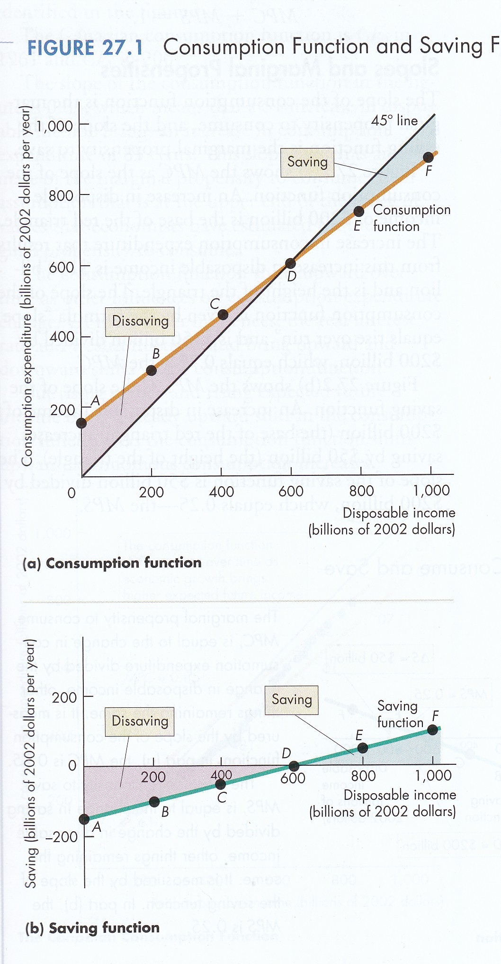
TWO-SECTOR NATIONAL MODEL
Consumption and Saving Function

Slide 33
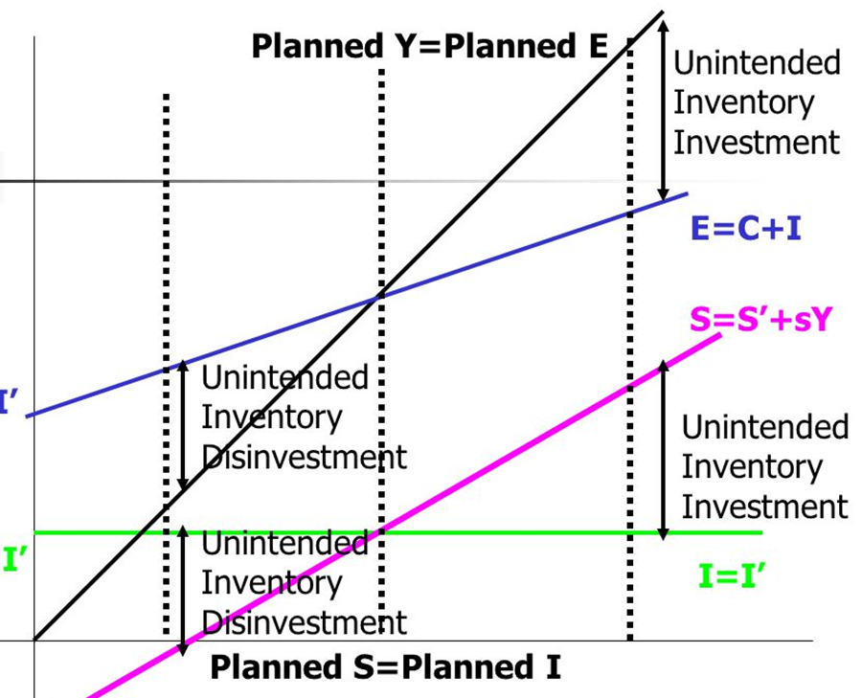
TWO-SECTOR NATIONAL MODEL
Consumption and Saving Function
Remember the national income identity S = I
The equilibrium income happens when planned Y= planned E as well as planned S = planned I

Slide 34
TWO-SECTOR NATIONAL MODEL
THANK YOU FOR YOUR ATTENTION…

