Slide 1

FOUR SECTOR NATIONAL INCOME MODEL
LESSON IV
Dr. Ingrid Majerová
MACROECONOMICS/EVS/NAMAB

Slide 2
FOUR SECTOR NATIONAL INCOME MODEL
Outline of the lecture
Four-Sector Model
Import Function
Export Function
Net Export Function
Output-Expenditure Approach: Equilibrium National Income
Crowding Out Effect

Slide 3
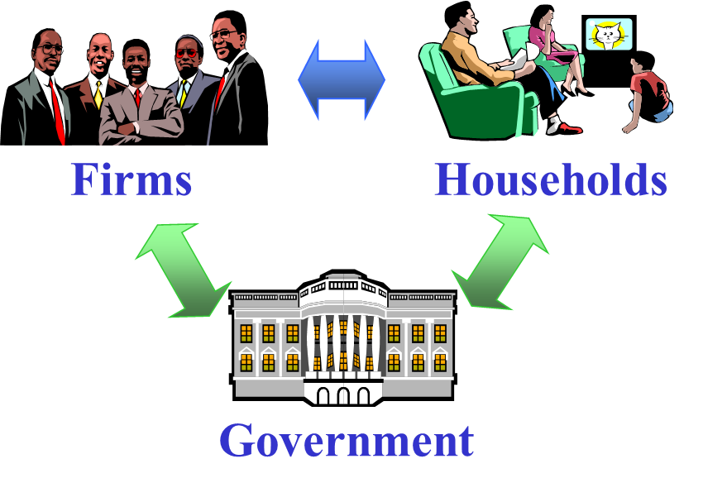

FOUR-SECTOR NATIONAL MODEL

Slide 4
FOUR-SECTOR NATIONAL MODEL
VARIABLES
With the introduction of the government sector (i.e. together with households C, firms I, government expenditure G) aggregate expenditure E consists of one more component, net exports X- M.
E = C + I + G + (X - M)
Still, the equilibrium condition is
Planned Y = Planned E

Slide 5
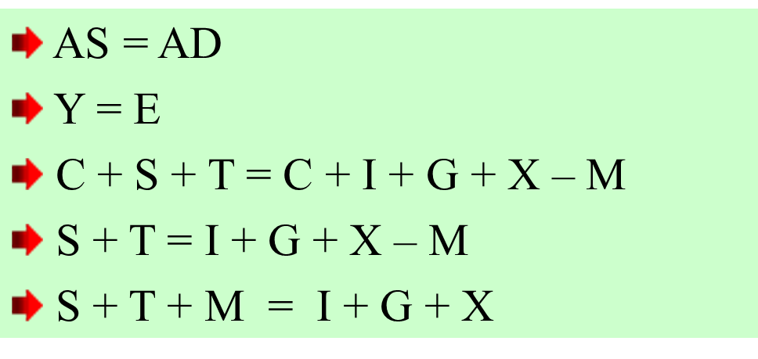





FOUR-SECTOR NATIONAL MODEL
EQUILIBRIUM INCOME

Slide 6
FOUR-SECTOR NATIONAL MODEL
IMPORT FUNCTION
Imports M is usually assumed to be a function of national income Y.
M = M’
M = mY
M = M’ + mY
M and Y are assumed to be positively correlated.
M = M’ + mY is the typical form being used

Slide 7
FOUR-SECTOR NATIONAL MODEL
IMPORT FUNCTION
Autonomous Imports M’
  this is the y-intercept of the import function
M’ is an exogenous variable, i.e., independent of the income level Y and is determined by forces outside the simple Keynesian 4-sector model
Marginal Propensity to Import MPM = m
  this is defined as the change in imports per unit change in income Y, i.e., m = △M / △Y
  it is the slope of tangent of the import function
  it is usually assumed to be a constant
  m ≥ 0
  MPM is also an exogenous variable

Slide 8
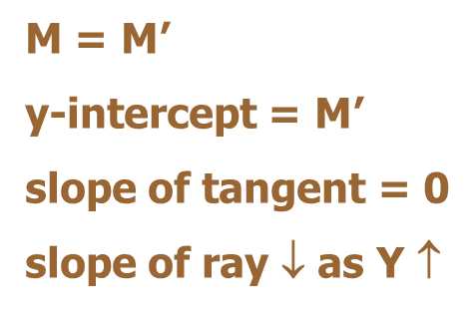
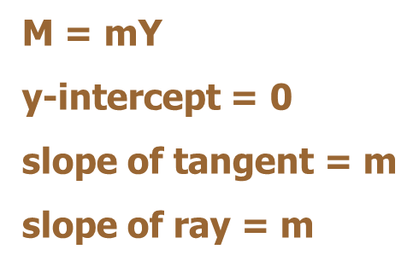
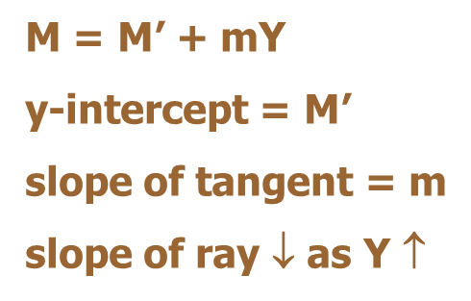
FOUR-SECTOR NATIONAL MODEL
IMPORT FUNCTION
Average Propensity to Import APM
  it is the ratio of total imports to total income, i.e., APM = M / Y
  it is the slope of ray of the import function
  APM ↓ when Y ↑
  except M = mY when MPM = APM = m

Slide 9
FOUR-SECTOR NATIONAL MODEL
EXPORT FUNCTION
X = f (Y)
this is a relationship between the amount of exports X and national income Y
it is usually assumed to be an exogenous function X = X’
we always consider the amount of net exports, i.e., X – M
Net exports = X - M = X’ - M’ - mY

Slide 10
FOUR-SECTOR NATIONAL MODEL
NET EXPORTS
When net exports is positive, i.e., when X > M,
the external sector BOP is in surplus
When net exports is negative, i.e., when X < M,
the external sector BOP is in deficit
When net exports is zero, i.e., when X = M,
the external sector BOP is in balance

Slide 11
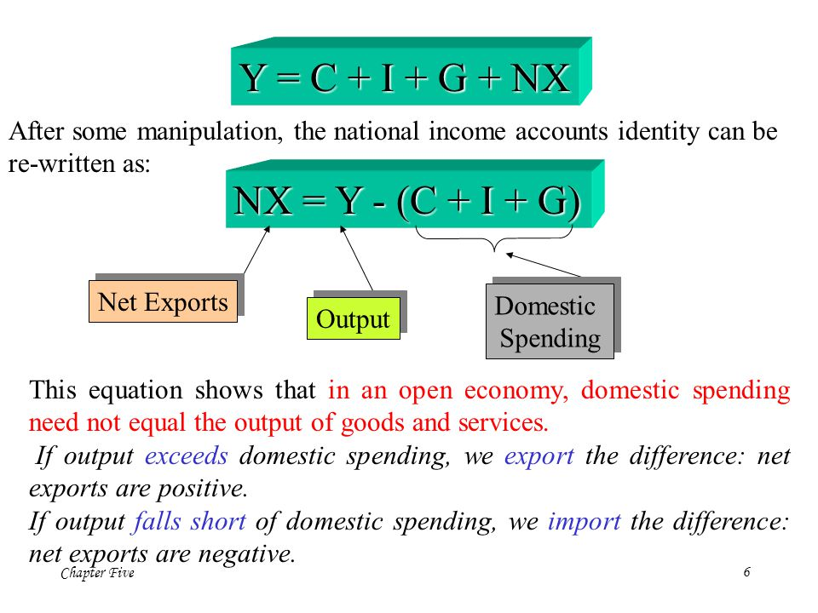
FOUR-SECTOR NATIONAL MODEL
NET EXPORTS

Slide 12
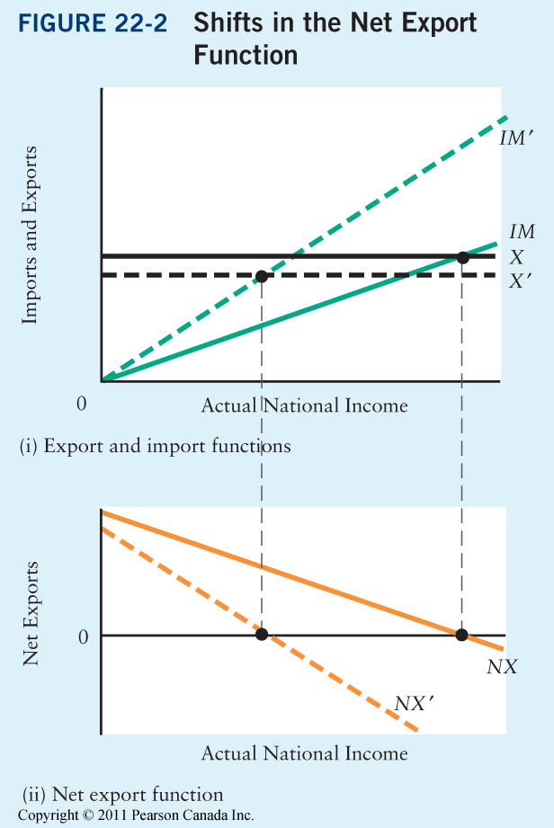
SHIFTS IN THE NET EXPORTS
FOUR-SECTOR NATIONAL MODEL

Slide 13
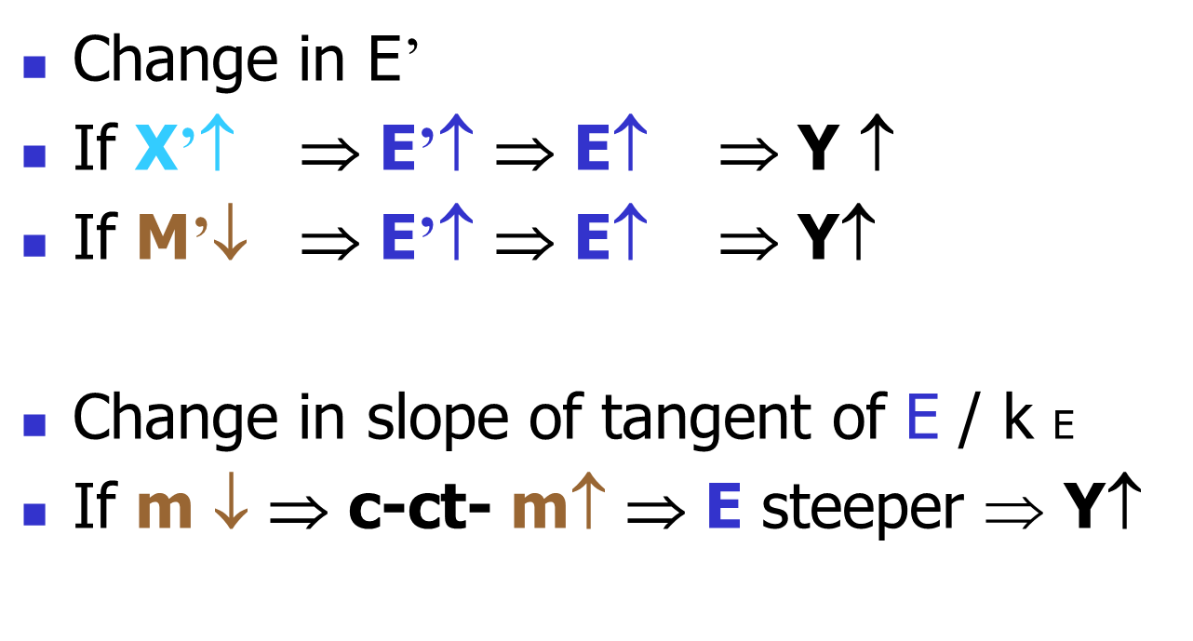
FOUR-SECTOR NATIONAL MODEL
FACTORS AFFECTING Ye

Slide 14
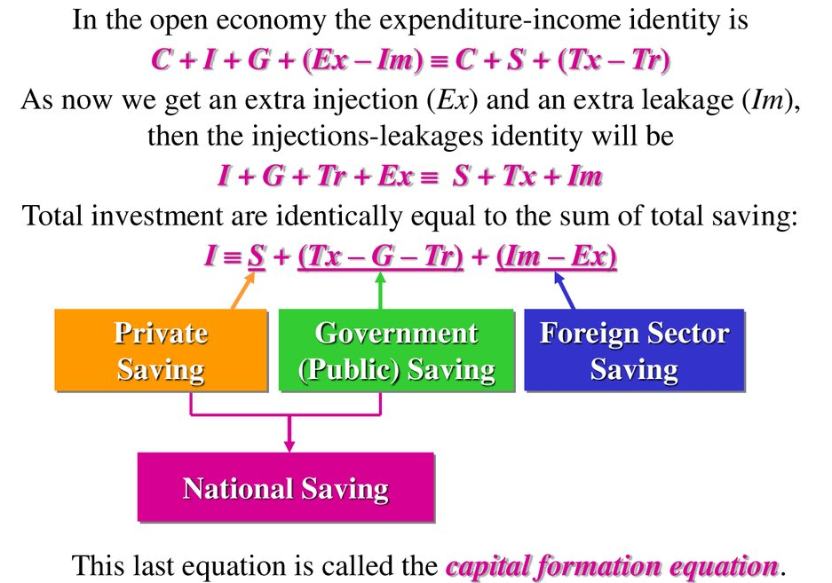
FOUR-SECTOR NATIONAL MODEL

Slide 15
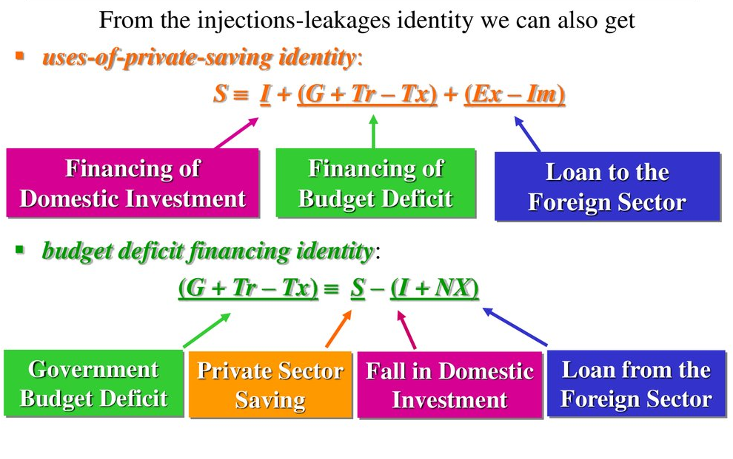
FOUR-SECTOR NATIONAL MODEL
IMPORTANT IDENTITIES

Slide 16
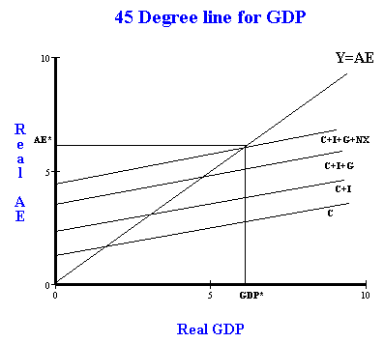
FOUR-SECTOR NATIONAL MODEL

Slide 17
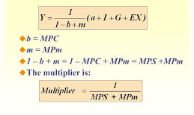
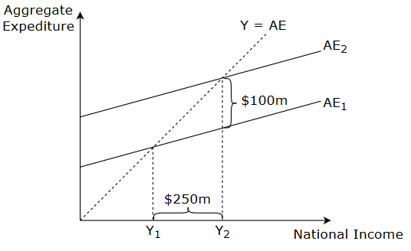
FOUR-SECTOR NATIONAL MODEL
MULTIPLIER OF OPEN ECONOMY

Slide 18
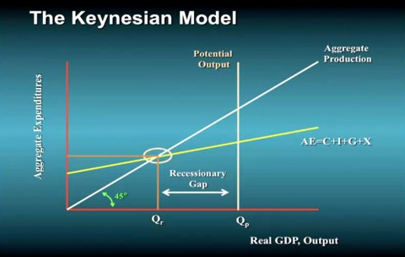
FOUR-SECTOR NATIONAL MODEL
RECESSIONARY GAP

Slide 19
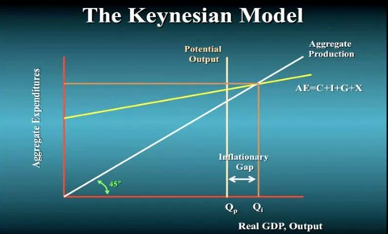
FOUR-SECTOR NATIONAL MODEL
INFLATIONARY GAP

Slide 20

FOUR-SECTOR NATIONAL MODEL
CROWDING OUT EFFECT
A phenomenon that occurs when increased government involvement in a sector of the market economy substantially affects the remainder of the market, either on the supply or demand side of the market.
One type is when expansionary fiscal policy reduces investment spending by the private sector.
  The Government is "crowding out" investment because it is demanding more Loanable Funds and it is increasing interest rates from the borrowing.

Slide 21
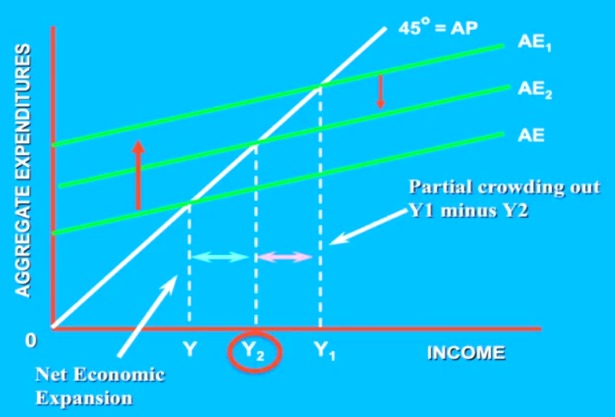
FOUR-SECTOR NATIONAL MODEL
FISCAL POLICY – CROWDING OUT EFFECT

Slide 22
PRODUCTION AND TECHNOLOGY CHOICE
THANK YOU FOR YOUR ATTENTION…

