Slide 1

International Financial Environment
Ing. Jana Šimáková, Ph.D.
simakova@opf.slu.cz

Slide 2

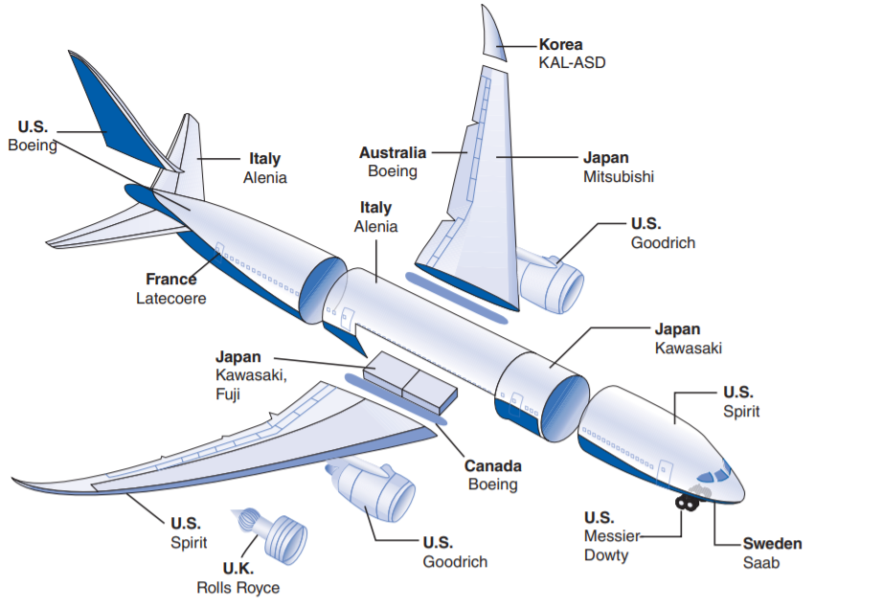
Boeing 787 Dreamliner
International Financial Environment

Slide 3
Questions and Applications
???What is the financial system???
International Financial Environment

Slide 4
Definition of Financial System
Financial system is system that allows transfer money between savers and borrowers
Functions
  to channel funds from lenders to borrowers
  to create a payment and clearing mechanism
International Financial Environment

Slide 5
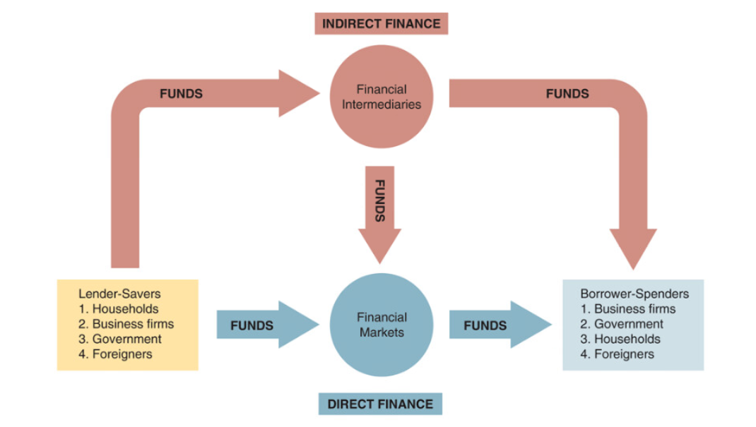

Slide 6
Types of Financial System
M-System
  based on capital markets
  USA, Great Britain
B-System
  based on financial intermediaries (banks)
  Czech Republic, Germany, Austria
International Financial Environment

Slide 7
Questions and Applications
???What about financial system in your country???
Compare the financial system in your home country with one typical B-based system and one typical M-based system.
International Financial Environment

Slide 8
Statistics
domestic credit provided by financial sector (% of GDP)
http://data.worldbank.org/indicator/FS.AST.DOMS.GD.ZS
market capitalization of listed companies (% of GDP)
http://data.worldbank.org/indicator/CM.MKT.LCAP.GD.ZS
International Financial Environment

Slide 9
Definition of the International Monetary System
Complex system of international arrangements, rules, institutions, policies in regard to exchange rates, international payments and international capital flows
Institutional framework within which
  International payments are made
  Movements of capital are accommodated
  Exchange rates are determined
International monetary system has evolved over time as international trade/business/finance have changed, technology has improved and political systems have changed
International Financial Environment

Slide 10
Questions and Applications
???
When government of Greece experienced problems in meeting its debt obligation in 2010, some investors became concerned that the crisis would spread to other European countries. Explain why integrated European financial markets might allow a debt crisis in one European country to spread to other countries in Europe.
???
International Financial Environment

Slide 11
Questions and Applications
???What is the money, why money came into existence???
International Financial Environment

Slide 12
Definition of the Money
Money is any good that is widely accepted for the purposes of the exchange and in the repayments of debts
Functions
  medium of exchange
    money is used to intermediate the exchange of goods and services
    it solves the problem of the double coincidence of wants
  unit of account
    money measures the market value of goods, services, and other transactions
    it decreases number of prices (in barter: 4 types of goods = 6 prices, 100 types of goods = 495 prices)
  store of value
    money is a way to keep some of our wealth in a readily spendable form for future needs
International Financial Environment

Slide 13
Questions and Applications
???Can we consider Bitcoin or other cryptocurrencies as money???
International Financial Environment

Slide 14
Evolution of the International Monetary System
Bimetallism (before 1850s – 1870)
Classic Gold Standard (1870s – 1914)
Interwar period (1918 – 1939)
Bretton Woods system (1945 – 1972)
System of floating exchange rates (1972 – present)
International Financial Environment

Slide 15
Present International Monetary System
Variety of exchange rate regimes
  Selection depends on a country’s preferences and specifics
Three most important currencies (USD, EUR, JPY)
  Discussions on the role of GBP and CNY
Evidences on monetary integration with the Eurozone as the most advanced example
Financial crises as a phenomena of current system
  Crises in Latin America
  Crises in South-East Asia
  Global financial crisis
Discussions on controls and regulation of international capital flows
International Financial Environment

Slide 16
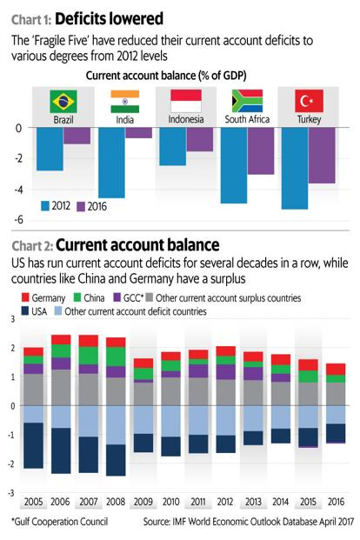
Balance of Current Account in Selected Countries
International Financial Environment

Slide 17
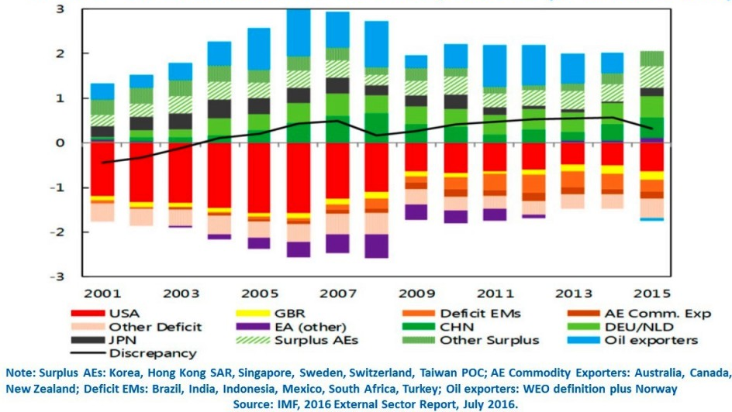
Current Account Imbalances (% of World GDP)
International Financial Environment

Slide 18
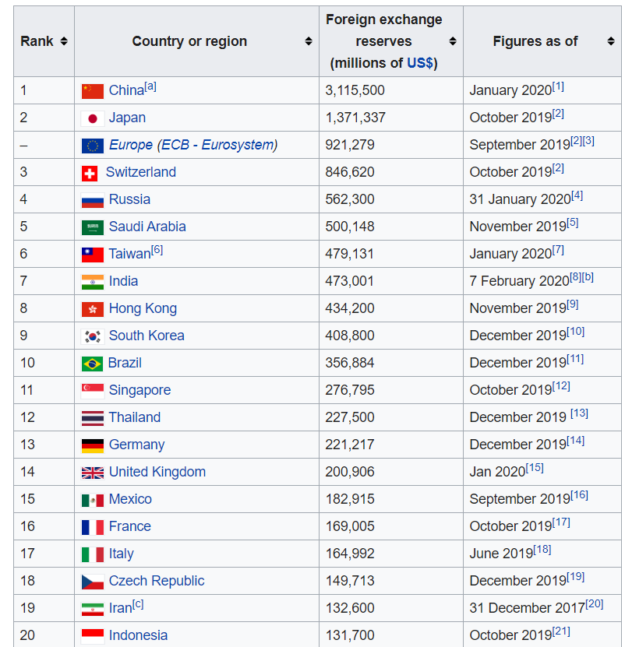
Top 20 Countries According to Foreign Exchange Reserves
International Financial Environment

Slide 19
Key International Financial Institutions
International financial institutions are integral part of the international monetary system as they built up the institutional framework
Several institutions with global or remarkably international influence
  International Monetary Fund
  World Bank and World Bank Group
  Central banks of major economic centers (Federal Reserve System, European Central Bank, Bank of Japan, Bank of England)
  Regional development banks
  Bank for International Settlements
  European Investment Bank
Listed institutions differ in size as well as objective
International Financial Environment

Slide 20
Economic and monetary union (EMU)
Final stage of long-lasting process of economic integration in Europe
EMU has been a long standing objective since late 1960s
Euro area with single currency and monetary policy emerged in 1999
Economic and monetary union involves
  Policy harmonization to remove obstacles to factor mobility
  A more marked and wider range of common policies, especially in relation to macroeconomic policy
  Irrevocably fixed exchange rates or, as in the case of the EU, a single currency
  A common monetary policy – that is, one interest rate and exchange rate policy determined by a single Central Bank
  Some pooling of foreign exchange reserves
  Possible inter-state transfers to offset economic distortions arising from EMU
International Financial Environment

Slide 21
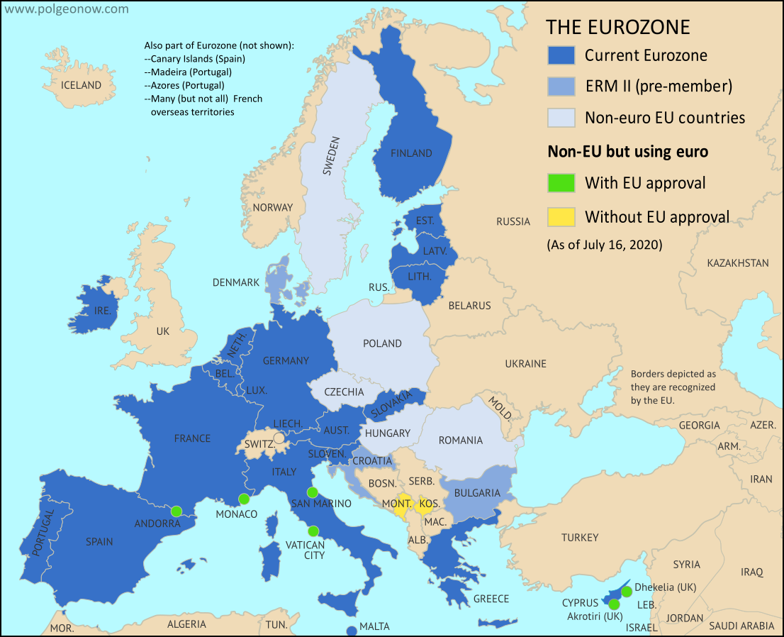
European Union and Euro Area (Eurozone)
International Financial Environment

Slide 22
Why Some EU Members do not Have the Euro?
United Kingdom (GBP)
  Before Brexit: „opt-out“ clause and five economic tests by Gordon Brown
  Brexit left United Kingdom outside the EU
Denmark (DKK)
  „Opt-out“ clause
  Adoption of Euro refused by referendum
Sweden (SEK)
  Referendum + political decision to not fulfill one criterion
BG, CZ, HR, HU, PL, RO
  Convergence criteria must be fulfilled first
  Political will to accept the euro must exist
International Financial Environment

Slide 23
Three Stages for the EMU Implementation
Stage One (July 1, 1990 – December 31, 1993)
  Exchange controls were abolished, capital movements liberalized
  Set up of formal convergence
Stage Two (January 1, 1994 – December 31, 1998)
  Name of the new currency decided
  Practical framework for the euro adoption defined
  European Central Bank established
Stage Three (January 1, 1999 – continuing)
  11 countries joined Euro Area (Greece two years later)
  Single monetary policy came into effect
  Euro coins and notes introduced in early 2002
International Financial Environment

Slide 24
Convergence is Key in the EMU
Nominal convergence
  Five convergence criteria (Maastricht criteria) for countries joining the Euro Area
Real convergence
  Economic cycle, structure of economy
  Real exchange rates, productivity, labor costs
  International trade, international investments
Institutional convergence
  Legal institutions and legal acts
  Shareholders‘ and creditors‘ rights, investor protection
  Market regulations
  State capacity on enforcing contracts and tax collection
International Financial Environment

Slide 25
Maastricht Convergence Criteria
What is measured | Price stability | Sound public finances | Sustainable public finances | Durability of convergence | Exchange rate stability
How it is measured | Consumer price inflation rate | Government deficit as % of GDP | Government debt as % of GDP | Long-term interest rate | Deviation from a central rate
Convergence criteria | Not more than 1.5 percentage points above the rate of the three best performing Member States | Reference value: not more than 3% | Reference value: not more than 60% | Not more than 2 percentage points above the rate of the three best performing Member States in terms of price stability | Participation in ERM II for at least 2 years without severe tensions
International Financial Environment

Slide 26
Costs and Benefits of EMU
Benefits
  elimination of intra-EU transaction costs lower interest rates
  uniform interest rates
  removal of exchange rate uncertainty in intra-EMU trade
  removes the option of competitive devaluations between EU states
  financial integration
  economic cushioning from domestic political instability
  creates a new international currency to represent the EU’s combined economic weight
Costs
  short term deflation
  loss of the exchange rate as a tool of national economic policy
  loss of power to set interest rates and control the supply of money
  potential problems related to a lack of ‘real’ convergence and potential policy conflicts
  the inappropriateness of one monetary policy for so many states
International Financial Environment

Slide 27
European Central Bank (ECB)
ECB is the central bank with responsibility for conducting monetary policy for the euro area
European System of Central Banks (ESCB) comprises the ECB and the national central banks of all EU Member States whether they have adopted the euro or not
Eurosystem comprises the ECB and the the national central banks of those countries that have adopted the euro
  The Eurosystem and the ESCB will co-exist as long as there are EU Member States outside the euro area
Euro area consists of the EU countries that have adopted the euro
International Financial Environment

Slide 28
Objective and instruments of the ECB monetary policy
The primary objective is to maintain price stability in the euro area
Price stability defined as a year-on-year increase in the Harmonized Index of Consumer Prices (HICP) for the euro area of below 2%
Operational framework consists of the following instruments
  Open market operations
    Main refinancing operations
    Longer-term refinancing operations
    Fine-tuning operations
    Structural operations
  Standing facilities
    Marginal lending facility
    Deposit facility
  Minimum reserve requirements to credit institutions
International Financial Environment

Slide 29
Have a Nice Day J

