Slide 1

International Economic Activities
Ing. Jana Šimáková, Ph.D.
simakova@opf.slu.cz

Slide 2

Questions and Applications
??? What do you consider as a multionational corporation???
???What is the most common aim of any company???
International Economic Activities

Slide 3
Multinational Corporation
multinational corporation (MNC) can be defined as a corporation engaged in any form of international economic activities (Madura, 2017).
The main goal of MNC
  Maximization of the MNC‘s value
  for MNC operating as stock company traded on stock exchanges - the goal of maximizing the value of MNC while maximizing shareholder assets, thus maximizing share prices.
Basis of the international financial mangement
  successfully develop business and financial strategies in more than one national business environment
Note: For purposes of this course, we abstract from other possible targets of MNC, such as meeting the needs of governments, lenders, employees etc. MNC will be seen as a stock company traded on the stock exchange. Therefore the MNC‘s goal can be specified as maximizing the shareholder property. MNC management is supposed to make decisions followed by maximization of the share price.
International Economic Activities

Slide 4
Questions and Applications
Two years ago, Seattle Co. (based in the United States) established a subsidiary in Singapore so that it could expand its business there. It hired a manager in Singapore to manage the subsidiary. During the last two years, the sales generated by the subsidiary have not grown. Yet, the manager of the subsidiary has hired several employees to do the work that he was assigned. The managers of the parent company in the United States have not closely monitored the subsidiary because they trusted the manager of the subsidiary and because the subsidiary is so far away. Now they realize that there is an agency problem. The subsidiary is experiencing losses every quarter, so they need to more closely monitor the management of the subsidiary.
???What is the agency problem? How can be agency problem solved???
International Economic Activities

Slide 5
Agency Problem
conflict between goals of managers and goals of shareholders
based on information asymmetry in the MNC
  managers have an access to information from the operational business of the company/subsidiary
  shareholders have very limmited access to it
managers tend to maximize their own benefit not the goal of the company
  for example, through maximizing the size of the company, increasing managerial responsibilities and powers, securitization of their positions, growth management benefits and rewards to promote its own social objectives, growth in prestige, etc.
agency costs
  the costs of ensuring that managers maximize shareholder wealth
  normally larger for MNCs than for purely domestic firms
International Economic Activities

Slide 6
Prevention of the Agency Problem
suitable method of control
  proper governance
  clear communication of MNC goals
  compensation plans for managers (reward, options to buy the MNC stock)
  setting regular business and control processes in MNC
  effect of stock market
International Economic Activities

Slide 7
Questions and Applications
Solution of the Seattle Co.:
When Seattle Co. recognized the agency problems with its Singapore subsidiary, it created incentives for the manager of the subsidiary that were aligned with the parent’s goal of maximizing shareholder wealth. Specifically, it set up a compensation system so that the annual bonus paid to the manager would be based on the level of earnings at the subsidiary.
International Economic Activities

Slide 8
Structure of the Multinational Financial Management
Centralized management
Decentralized management
A combination of centralized and decentralized management
International Economic Activities

Slide 9
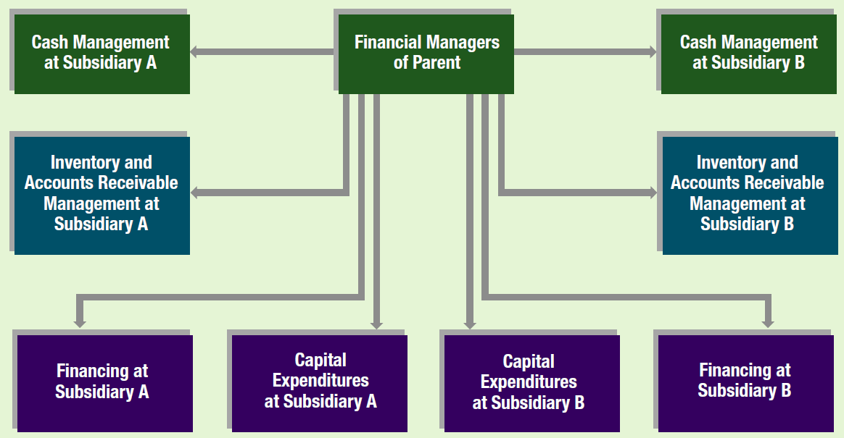
Centralized Multinational Financial Management
International Economic Activities

Slide 10
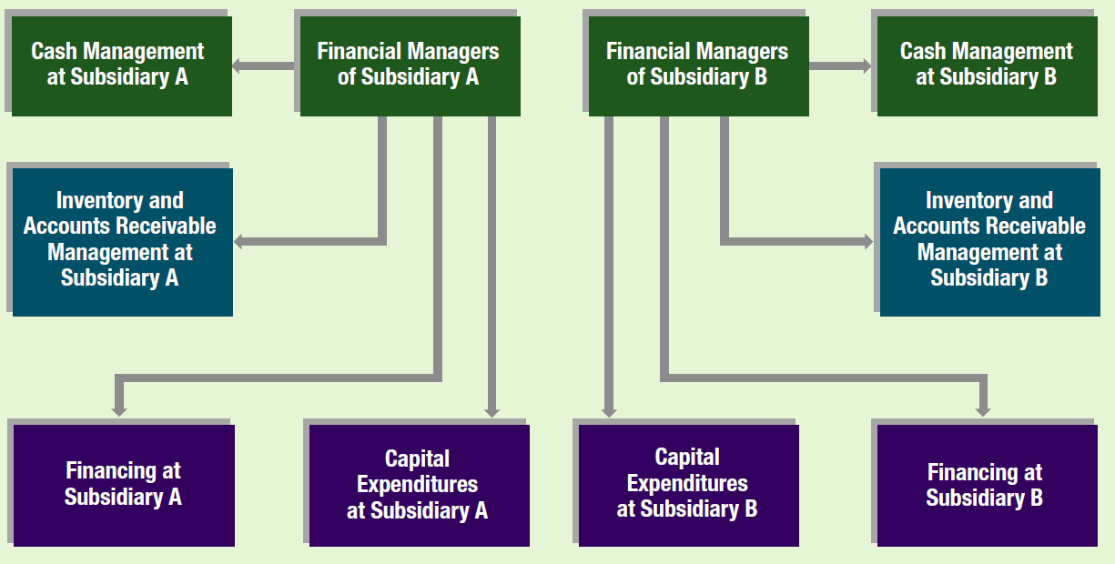
Decentralized Multinational Financial Management
International Economic Activities

Slide 11
Questions and Applications
???Which type of multinational financial management brings higher agency cost???
???Why???
International Economic Activities

Slide 12
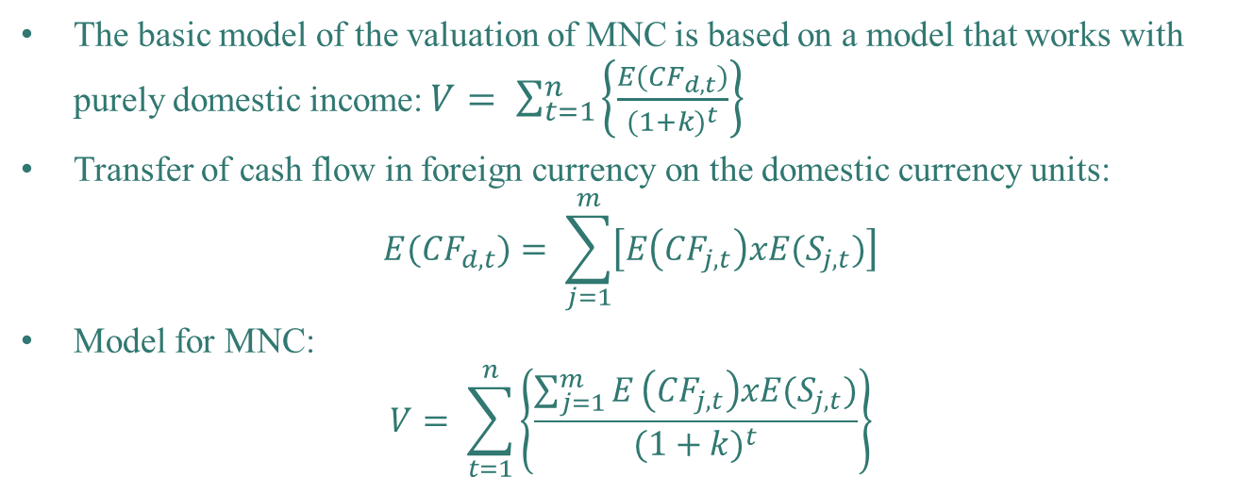
MNC Pricing Model
The basic model of the valuation of MNC is based on a model that works with purely domestic income:$V= \sum_{t=1}^{n}{\left\{\frac{E({CF}_{d, t})}{{(1+k)}^{t}}\right\}}$
Transfer of cash flow in foreign currency on the domestic currency units:
$${E(CF}_{d,t})= \sum_{j=1}^{m}{\left[E\left({CF}_{j,t}\right)xE(S_{j,t})\right]}$$
Model for MNC:
$$V= \sum_{t=1}^{n}{\left\{\frac{\sum_{j=1}^{m}{E}\left({CF}_{j,t}\right)xE(S_{j,t})}{{(1+k)}^{t}}\right\}}$$
V Value of MNC
E(CF_{t}) expected cash flow in given period (CF_{d,t} in domestic currency, CF_{j,t}
n period of expected cash flow
k the weighted average cost of capital (WACC), including he required rate of return for shareholders and creditors
CF_{j} cash flow denominated in the relevant currencies j
S_{j,t} expected exchange rate at which the currency can be converted into local currency at the end of period t
International Economic Activities

Slide 13
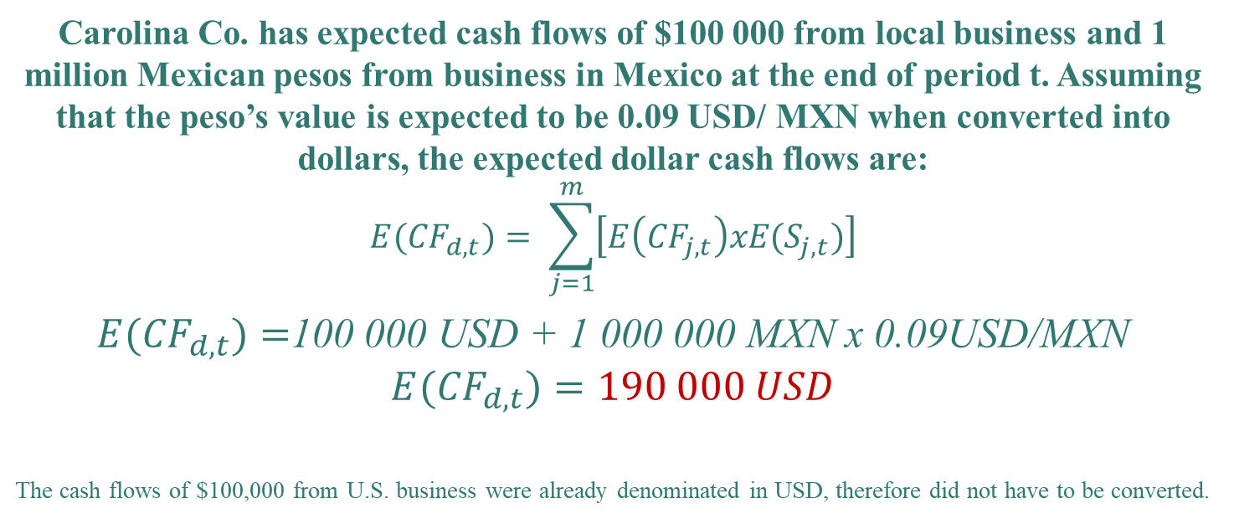
Questions and Applications
Carolina Co. has expected cash flows of $100 000 from local business and 1 million Mexican pesos from business in Mexico at the end of period t. Assuming that the peso’s value is expected to be 0.09 USD/ MXN when converted into dollars, the expected dollar cash flows are:
$${E(CF}_{d,t})= \sum_{j=1}^{m}{\left[E\left({CF}_{j,t}\right)xE(S_{j,t})\right]}$$
${E(CF}_{d,t})=$100 000 USD + 1 000 000 MXN x 0.09USD/MXN
$${E(CF}_{d,t})=190 000 USD$$
The cash flows of $100,000 from U.S. business were already denominated in USD, therefore did not have to be converted.
International Economic Activities

Slide 14
Questions and Applications
??? What are the reasons of involvement of the company into international economic activities????
International Economic Activities

Slide 15
Factors Motivating MNC to Start International Activities
new resources
new markets
international diversification to reduce risk
multionality leading to profitability
economies of scale
flexibility
effect of learning and acquiring specific assets
…
International Economic Activities

Slide 16
Questions and Applications
???What forms of engaging MNC in international business do you know???
???Can you order them according to the risk???
International Economic Activities

Slide 17
Forms of International Economic Activities
International trade
Licensing
Franchising
Joint ventures
Acquisitions of existing operations
Establishing new foreign subsidiaries
International Economic Activities

Slide 18
International Trade
International trade is a relatively conservative approach that can be used by firms to penetrate markets
  by exporting – to penetrate markets
  by importing - to obtain low-cost or unavailable supplies
This approach entails minimal risk because the firm does not place any of its capital abroad. (in comparison to other international economic activities)
If the firm experiences a decline in its exporting or importing, it can normally reduce or discontinue this part of its business at a relatively low cost.
International Economic Activities

Slide 19
Licensing
Licensing obligates a firm to provide its technology (copyrights, patents, trademarks, or trade names) in exchange for fees or some other specified benefits.
  Licensing allows firms to use their technology in foreign markets without a major investment in foreign countries and without the transportation costs that result from exporting.
  A major disadvantage of licensing is that it is difficult for the firm providing the technology to ensure quality control in the foreign production process.
Examples:
  Starbucks has licensing agreements with SSP (an operator of food and beverages in Europe) to sell Starbucks products in train stations and airports throughout Europe.
  Sprint Nextel Corp. has a licensing agreement to develop telecommunications services in the United Kingdom.
  IGA, Inc. has a licensing agreement to operate supermarkets in China and Singapore.
International Economic Activities

Slide 20
Franchising
Franchising obligates a firm to provide a specialized sales or service strategy, support assistance, and possibly an initial investment in the franchise in exchange for periodic fees.
Like licensing, franchising allows firms to penetrate foreign markets without a major investment in foreign countries.
Examples:
  McDonald’s, Pizza Hut, Subway Sandwiches, Blockbuster Video, and Dairy Queen have franchises that are owned and managed by local residents in many foreign countries.
International Economic Activities

Slide 21
Joint Ventures
A joint venture is a venture that is jointly owned and operated by two or more firms.
  Many firms penetrate foreign markets by engaging in a joint venture with firms that reside in those markets.
  Most joint ventures allow two firms to apply their respective comparative advantages in a given project.
Examples:
  General Mills, Inc., joined in a venture with Nestlé SA so that the cereals produced by General Mills could be sold through the overseas sales distribution network established by Nestlé.
  Xerox Corp. (USA) and Fuji Co. (Japan) engaged in a joint venture that allowed Xerox Corp. to penetrate the Japanese market and allowed Fuji to enter the photocopying business.
  Sara Lee Corp. and AT&T have engaged in joint ventures with Mexican firms to gain entry to Mexico’s markets.
International Economic Activities

Slide 22
Acquisitions of Existing Operations
Firm acquire other firm in foreign countries as a way to penetrate abroad
  acquisitions allow firms to have full control over their foreign businesses and to quickly obtain a large portion of foreign market share.
An acquisition of an existing corporation is subject to the risk of large losses.
  the large investment required
  if the foreign operations perform poorly, it may be difficult to sell it at a reasonable price.
Some firms engage in partial international acquisitions in order to obtain a stake in foreign operations.
  requires a smaller investment than full international acquisitions => less risk.
  the firm will not have complete control over foreign operations that are only partially acquired.
Example – Google, Inc. - acquizitions to expand business and improve technology
  Australia and Brazil (search engines), Canada (mobile browser), Finland (micro-blogging), Germany (mobile software), Russia (online advertising), South Korea (weblog software), Spain (photo sharing), etc.
International Economic Activities

Slide 23
Establishing New Foreign Subsidiaries
Firms can penetrate foreign markets by establishing new operations in foreign countries to produce and sell their products.
  This method requires a large investment (the risk of large losses).
  Establishing new subsidiaries may be preferred to foreign acquisitions because the operations can be tailored exactly to the firm’s needs.
  a smaller investment may be required than would be needed to purchase existing operations.
The firm will not reap any rewards from the investment until the subsidiary is built and a customer base established.
International Economic Activities

Slide 24
Questions and Applications
???What are examples of presented methods of penetration to foreign markets in your home country???
Find other examples of international trade, licencing, franchising, joint venture, acquizition of foreign operations, and establishing new foreign subsidiary. Explain, why firms use these methods for the foreign market.
International Economic Activities

Slide 25
THANK YOU FOR YOUR ATTENTION
J

