Slide 1
Exchange Rate Risk Management
Ing. Jana Šimáková, Ph.D.
simakova@opf.slu.cz

Slide 2
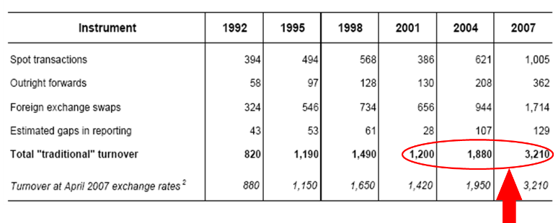
Trends in FX Market
Exchange Rate Risk Management

Slide 3
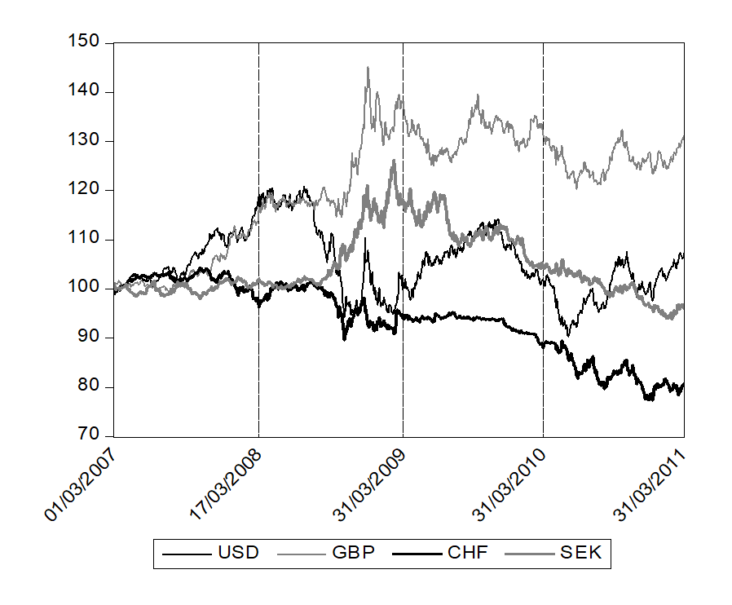
FX Market during Financial Crisis (1)
Exchange Rate Risk Management

Slide 4
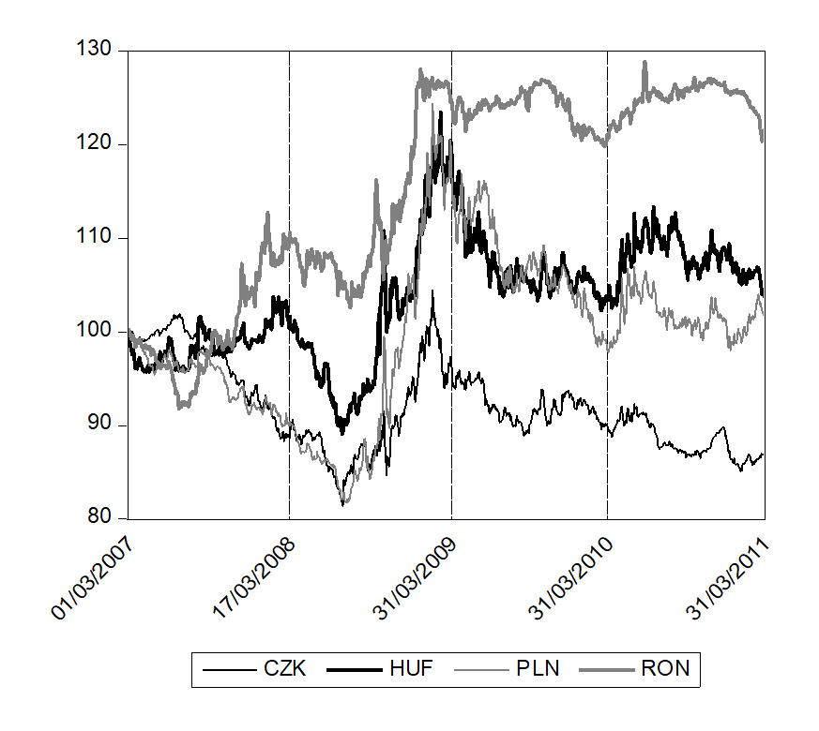
FX Market during Financial Crisis (2)
Exchange Rate Risk Management

Slide 5
Exchange Rate Risk
Exchange rate risk can be broadly defined as the risk that a company’s performance will be affected by exchange rate movements.
since exchange rate movements can affect an MNC‘s cash flow, they can affect an MNC’s performance and value.
MNCs should closely monitor their operations to determine how they are exposed to various forms of exchange rate risk.
Financial managers must understand how to measure the exposure of their MNCs to exchange rate fluctuations so that they can determine whether and how to protect their operations from that exposure.
Exchange Rate Risk Management

Slide 6
Questions and Applications
Consider a U.S. firm whose business is to import products and sell them in the United States. It pays 1 million euros at the beginning of each quarter. If it does not hedge, the dollar value of its payables changes in line with the value of the euro. When the euro was weak (such as in 2006), the firm’s expenses were low. However, when the euro was strong (such as in 2008), its expenses were high. From the first quarter of 2006 to the second quarter of 2008, the euro appreciated by 34 percent, so the firm’s expense (in dollars) to obtain the 1 million euros in order to purchase imports increased by 34 percent.
??? Assume that the U.S. firm was an exporter instead, and received 1 million euros every quarter and converted them to dollars. What will be the consequences of the euro exchange rate development???
Exchange Rate Risk Management

Slide 7
Questions and Applications
??? Assume that the U.S. firm was an exporter instead, and received 1 million euros every quarter and converted them to dollars. What will be the consequences of the euro exchange rate development???
Situation would be the same except that the dollars would represent the firm’s revenue (in dollars) instead of expenses. This firm would have generated much higher revenue in 2008 when the euro was strong than in 2006 when the euro was weak.
Exchange Rate Risk Management

Slide 8
Foreign Exchange Exposure
Since MNCs recognize that exchange rate risk is relevant, they may consider hedging their positions.
They must determine how they are exposed before they can hedge their exposure.
Firms are commonly subject to the following forms of exchange rate exposure:
Transaction exposure
Economic exposure
Translation exposure
Exchange Rate Risk Management

Slide 9
Transaction Exposure
The sensitivity of the firm’s contractual transactions in foreign currencies to exchange rate movements is referred to as transaction exposure.
To assess transaction exposure, an MNC needs to
(1) estimate its net cash flows in each currency
(2) measure the potential impact of the currency exposure.
Exchange Rate Risk Management

Slide 10
Estimating “Net” Cash Flows in Each Currency
To measure transaction exposure, MNC needs to project the consolidated net amount in currency inflows or outflows for all its economic activities, subsidiaries, branches, etc., categorized by currency.
One foreign subsidiary may have expected cash inflows of a foreign currency while another has cash outflows of that same currency. In that case, the MNC’s net cash flows of that currency overall may be negligible.
The consolidated net cash flows per currency is a useful first step when assessing an MNC’s exposure because it helps to determine the MNC’s overall position in each currency.
Exchange Rate Risk Management

Slide 11
Example of Consolidated Net Cash Flow Assessment
Exchange Rate Risk Management

Slide 12
Example of Estimating the Range of Net Inflows/Outflows
Exchange Rate Risk Management

Slide 13
Cash Flow and Correlation Effects on Exposure
Exchange Rate Risk Management

Slide 14
Economic Exposure
The sensitivity of the firm’s cash flows to exchange rate movements is referred to as economic exposure (also sometimes referred to as operating exposure).
The value of a firm’s cash flows can be affected by exchange rate movements if it executes transactions in foreign currencies, receives revenue from foreign customers, or is subject to foreign competition.
Transaction exposure is a subset of economic exposure. But economic exposure also includes other ways in which a firm’s cash flows can be affected by exchange rate movements.
Exchange Rate Risk Management

Slide 15
Economic Exposure to Exchange Rate Fluctuations
Exchange Rate Risk Management

Slide 16
Questions and Applications
???Can be purely domestic firms affected by economic exposure???
If no, give the explanation. If yes, give an example.
Exchange Rate Risk Management

Slide 17
Questions and Applications
???Can be purely domestic firms affected by economic exposure???
YES
Barrington is a U.S. manufacturer of steel that purchases all of its supplies locally and sells all of its steel locally. Because its transactions are solely in the local currency, Barrington is not subject to transaction exposure. It is subject to economic exposure, however, because it faces foreign competition in its local markets. If the exchange rate of the foreign competitor’s invoice currency depreciates against the dollar, customers interested in steel products will shift their purchases toward the foreign steel producer. Consequently, demand for Barrington’s steel will likely decrease, and so will its net cash inflows. Thus, Barrington is subject to economic exposure even though it is not subject to transaction exposure.
Exchange Rate Risk Management

Slide 18
Measuring Economic Exposure
Use of Sensitivity Analysis
separately considering how sales and expense categories are affected by various exchange rate scenarios
Use of Regression Analysis
applying regression analysis to historical cash flow and exchange rate data
Exchange Rate Risk Management

Slide 19
Example of Impact of Possible Exchange Rates on Cash Flows
Exchange Rate Risk Management

Slide 20
Translation Exposure
The exposure of the MNC’s consolidated financial statements to exchange rate fluctuations is known as translation exposure.
An MNC creates its financial statements by consolidating all of its individual subsidiaries’ financial statements. A subsidiary’s financial statement is normally measured in its local currency. To be consolidated, each subsidiary’s financial statement must be translated into the currency of the MNC’s parent.
In particular, subsidiary earnings translated into the reporting currency on the consolidated income statement are subject to changing exchange rates.
An MNC’s degree of translation exposure is dependent on the following:
proportion of its business conducted by foreign subsidiaries
locations of its foreign subsidiaries
accounting methods that it uses
Exchange Rate Risk Management

Slide 21
Questions and Applications
British subsidiary of Providence, Inc., earned £10 mil. in year 1 and £10 mil. in year 2. When these earnings are consolidated along with other subsidiary earnings, they are translated into U.S. dollars at the weighted average exchange rate in that year. Assume the weighted average exchange rate is $1.70 in year 1 and $1.50 in year 2. The translated earnings for each reporting period in U.S. dollars are determined as follows:
Notice that even though the subsidiary’s earnings in GBP were the same each year, the translated consolidated USD earnings were reduced by $2 million in year 2. The discrepancy here is due to the change in the weighted average of the GBP exchange rate. The drop in earnings is not the fault of the subsidiary but rather of the weakened GBP that makes its year 2 earnings look small (when measured in USD).
Exchange Rate Risk Management

Slide 22
Steps to Control Exchange Rate Risk (1)
Review operating cycle
Review your business operating cycle to learn where FX risk exists. This will help you determine your profit margin’s sensitivity to currency fluctuations.
Measure and manage exposure to currency risk
This should include the risk exposure before a deal, purchase or transaction is agreed upon and the actual risk that exists after a completed transaction. When you have a sense of pre- and post-transaction risk, you will be able to decide on your needed level of hedging
Hedge currency risk
Hedging means that you use financial instruments to lock in the currency rate so that it remains the same over a specified period of time.
Exchange Rate Risk Management

Slide 23
Steps to Control Exchange Rate Risk (2)
Create an FX policy and stick to it
An effective FX policy begins with a clear corporate strategy and clarity on corporate objectives. The policy should identify key metrics – be it cash flow, EBITDA, asset values, debt- and interest-coverage ratios. In addition, the policy should include some form of measurement of your company’s risk tolerance.
Accept that you have unique currency flows
Every business is unique and that is reflected in your currency flows, but also in the structure of your assets and liabilities. It is key to understand that currency fluctuations may have an impact and the decision to hedge or not is not as simple as a roll of the dice.
Exchange Rate Risk Management

Slide 24
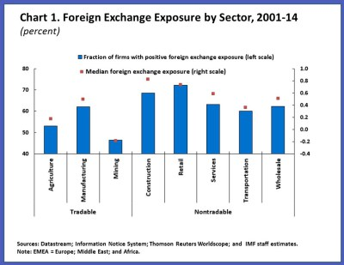
Exchange Rate Risk by Sector
Exchange Rate Risk Management

Slide 25
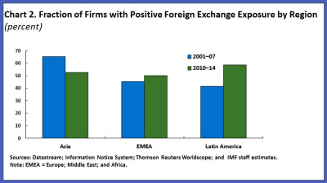
Exchange Rate Risk by Region
Exchange Rate Risk Management

Slide 26
THANK YOU FOR YOUR ATTENTION J

