Slide 1

Exchange Rate Risk Decreasing
Ing. Jana Šimáková, Ph.D.
simakova@opf.slu.cz

Slide 2

Methods of Exchange Rate Risk Decreasing
External
  Forwards
  Futures
  Options
  Currency swaps
  Money market
Internal
  Leading
  Lagging
  Netting
  Currency diversification
  Natural hedging
Exchange Rate Risk Decreasing

Slide 3
Currency Forwards
The most common type of derivative used to hedge against exchange rate risk.
The foreign exchange rate can be fixed to the future and then used for the purchase or sale of the foreign currency, regardless of the current developments and the current exchange rate on the spot FX market.
  Within the forward, financial institution undertakes to sell or purchase an agreed amount of funds in one currency to the client for an agreed amount in another currency in a exact negotiated future term for a pre-agreed forward rate.
  The client, on the contrary, undertakes to purchase or sell the contractual amount of funds from the financial institution.
MNC‘s cost is either a fee in the amount of a certain percentage of the contract value or a forward rate determination that covers the risk and profit for the financial institution.
  The resulting costs of both methods are approximately the same.
Exchange Rate Risk Decreasing

Slide 4
Positions in the Forward Contract
If you have agreed to buy the respective asset (forward or spot), you are „long“
If you have agreed to sell the respective asset (forward or spot), you are „short“
If you have agreed to buy currency via FX forward, you are long in this currency
If you have agreed to sell currency via FX forward, you are short in this currency
Exchange Rate Risk Decreasing

Slide 5
Payoff Profiles of the Forward Contract
profit
long position
If, in 180 days the spot price rises the short loses and the long makes a profit
If, in 180 days the spot price falls the short makes profit and the long loses
The short entered into the forward agreeing to sell USD in 180 day at USD/CAD 1.27 and the long to buy USD at the same price
0
S₁₈₀(USD/CAD)
F₁₈₀(USD/CAD) = 1.27
loss
short position
Exchange Rate Risk Decreasing

Slide 6
Payoff Profiles of the Forward Contract
profit
long position
If, in 180 days the spot price rises to USD/CAD 1.31 the short position losses and the long position makes a profit
profit
S₁₈₀(USD/CAD) = 1.31
0
S₁₈₀(USD/CAD)
loss
F₁₈₀(USD/CAD) = 1.27
loss
short position
Exchange Rate Risk Decreasing

Slide 7
Questions and Applications
Assume the Czech MNC importing inputs for production from Slovakia. The total price of the delivery that the MNC must pay to the Slovak supplier is 1 million EUR and the maturity is 30 days. Due to concerns about the appreciation of EUR, the Czech MNC decides to fix the total cost of imports in CZK using forward and not to speculate on the depreciation of EUR or appreciation of CZK, which would reduce the cost of delivery expressed in CZK. The contracted forward rate is 26.50 CZK/EUR. Hence, total fixed cost of purchase of 1 mil. EUR is 26.5 million CZK for the payment of the supply. The comparison of the hedged and unhedged foreign exchange position of the Czech MNC is shown in the following chart.
Exchange Rate Risk Decreasing

Slide 8
Questions and Applications
When the spot exchange rate at the time of transaction is higher than the forward rate of 26.5 CZK/EUR, the forward transaction will benefit the MNC because it buys the EUR in better exchange rate than on the spot market, i.e. a hypothetical profit from the futures transaction arises. However, when the spot rate is lower than the forward rate , the Czech MNC could purchase the EUR cheaper on the spot market, creating a hypothetical loss from the forward transaction.
Exchange Rate Risk Decreasing

Slide 9
Foreign Currency Futures
A foreign currency futures contract is an alternative to a forward contract
It is standardized contract
It calls for future delivery of a standard amount of currency at a fixed time and price
These contracts are traded on exchanges with the largest being the International Monetary Market located in the Chicago Mercantile Exchange
Exchange Rate Risk Decreasing

Slide 10
Contract Specifications of Foreign Currency Futures
Size of contract
  Called the notional principal, trading in each currency must be done in an even multiple
Method of stating exchange rates
  “American terms” are used; quotes are in US dollar cost per unit of foreign currency, also known as direct quotes
Maturity date
  Contracts mature on the 3rd Wednesday of January, March, April, June, July, September, October or December
Last trading day
  Contracts may be traded through the second business day prior to maturity date
Exchange Rate Risk Decreasing

Slide 11
Contract Specifications of Foreign Currency Futures (1)
Collateral and maintenance margins
  The purchaser or trader must deposit an initial margin or collateral; this requirement is similar to a performance bond
  At the end of each trading day, the account is marked to market and the balance in the account is either credited if value of contracts is greater or debited if value of contracts is less than account balance
Settlement
  Only 5% of futures contracts are settled by physical delivery, most often buyers and sellers offset their position prior to delivery date
Exchange Rate Risk Decreasing

Slide 12
Contract Specifications of Foreign Currency Futures (2)
Commissions
  Customers pay a commission to their broker to execute a round turn and only a single price is quoted
Use of a clearing house as a counterparty
  All contracts are agreements between the client and the exchange clearing house. Consequently clients need not worry about the performance of a specific counterparty since the clearing house is guaranteed by all members of the exchange
Marked-to-Market
  The value of the contract is revalued using the closing price for the day
  The value of the contract is marked to market daily, and all changes in value are paid in cash daily
Exchange Rate Risk Decreasing

Slide 13
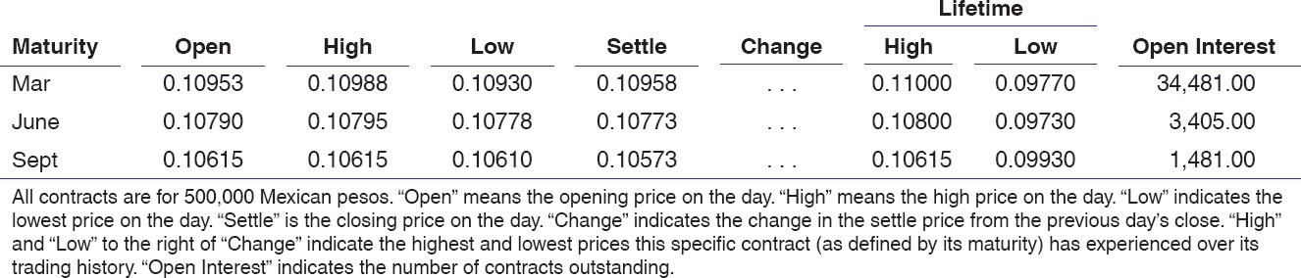
Mexican Peso (CME) -- MXN 500,000; $ per 10MXN
Exchange Rate Risk Decreasing

Slide 14
Example of Short Position in a Futures Contract
If a MNC believes that the Mexican peso will fall in value versus the U.S. dollar by March, MNC could sell a March futures contract, taking a short position
  By selling a March contract, MNC locks in the right to sell 500,000 Mexican pesos at a set price
  If the price of the peso falls by the maturity date as MNC expects, MNC has a contract to sell pesos at a price above their current price on the spot market, making a profit
Value at maturity (Short position) = −Notional principal × (Spot − Futures)
Exchange Rate Risk Decreasing

Slide 15
Example of Long Position in a Futures Contract
If a MNC believes that the Mexican peso will rise in value versus the U.S. dollar by March, MNC could buy a March futures contract, taking a long position
  By buying a March contract, MNC locks in the right to buy 500,000 Mexican pesos at a set price
  If the price of the peso rises by the maturity date as MNC expects, MNC has a contract to buy pesos at a price below their current price on the spot market, making a profit
Value at maturity (Long position) = Notional principal × (Spot − Futures)
Exchange Rate Risk Decreasing

Slide 16
Questions and Applications
???What are the main differences between forwards and futures???
???Which of these two kinds of hedging is more used by small and medium-sized companies? Why???
Exchange Rate Risk Decreasing

Slide 17
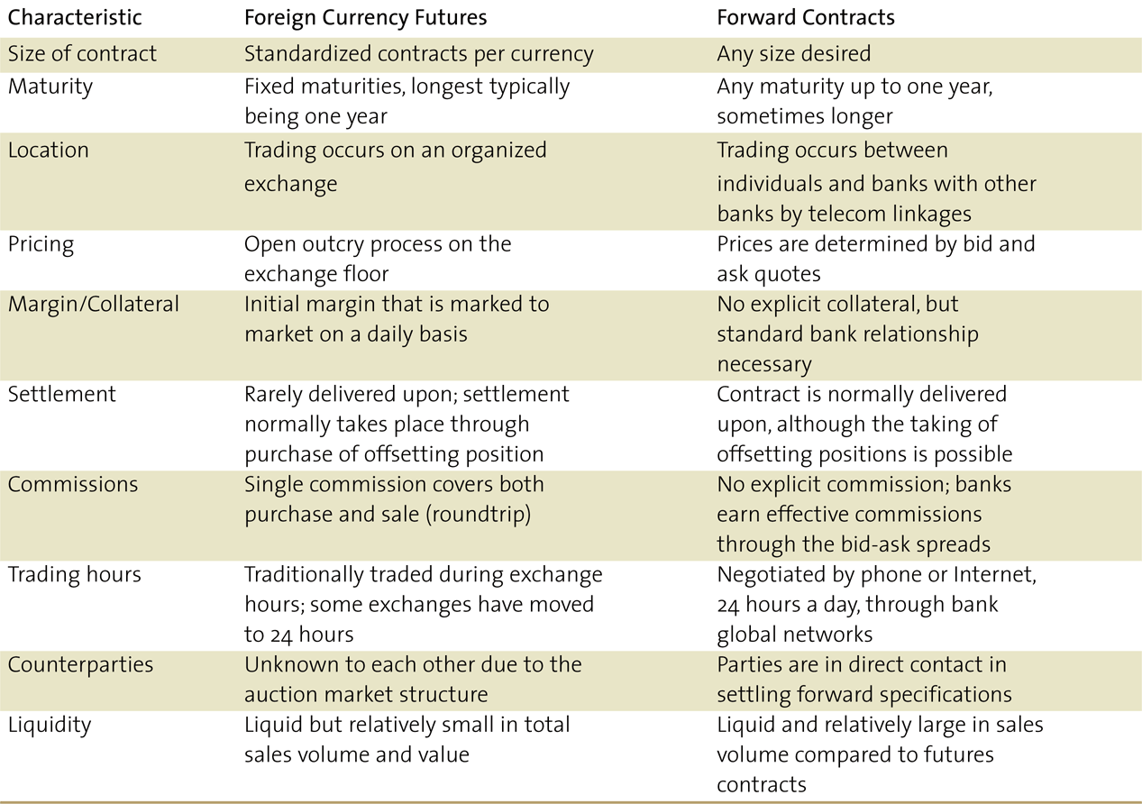
Currency Futures and Forwards Compared
Exchange Rate Risk Decreasing

Slide 18
Foreign Currency Options
A contract giving the option purchaser (the buyer) the right, but not the obligation, to buy or sell a given amount of foreign exchange at a fixed price per unit for a specified time period (until the maturity date)
  The most important part of clause is the “right, but not the obligation” to take an action
Two basic types of options, calls and puts
  Call – buyer has right to purchase currency
  Put – buyer has right to sell currency
Buyer of the option is the holder and the seller of the option is termed the writer
  The option writer must always accept the owner's decision.
  As the holder of the option has the „right“ and the writer has the „obligation“, the position of the holder and the writer is asymmetrical, therefore, as compensation serves the option premium, which the option holder must pay to the writer when buying the option.
Exchange Rate Risk Decreasing

Slide 19
Foreign Currency Options Terminology
Every option has three different price elements
  The strike or exercise price is the exchange rate at which the foreign currency can be purchased or sold
  The premium, the cost, price or value of the option itself paid at time option is purchased
  The underlying or actual spot rate in the market
There are two types of option maturities
  American options may be exercised at any time during the life of the option
  European options may not be exercised until the specified maturity date
Exchange Rate Risk Decreasing

Slide 20
Foreign Currency Options Markets
The increased use of currency options has lead the creation of several markets where financial managers can access these derivative instruments
Over-the-Counter (OTC) Market – OTC options are most frequently written by banks for USD against GBP, CHF, JPY, CAD and EUR
  Main advantage is that they are tailored to purchaser
  Counterparty risk exists
  Mostly used by individuals (MNC) and banks
Organized Exchanges – similar to the futures market, currency options are traded on an organized exchange floor
  The Chicago Mercantile and the Philadelphia Stock Exchange serve options markets
  Clearinghouse services are provided by the Options Clearinghouse Corporation (OCC)
Exchange Rate Risk Decreasing

Slide 21
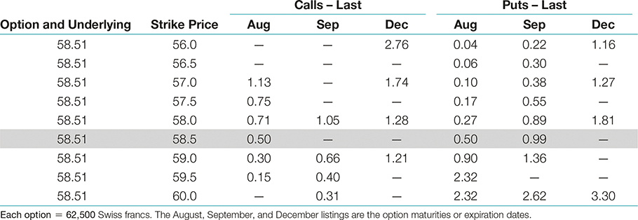
Swiss Franc Option Quotations (U.S. Cents/CHF)
Exchange Rate Risk Decreasing

Slide 22
Cost and Profit of the Option
What the holder, or buyer of an option loses, the writer gains
The maximum loss that the holder of the option can make is limited to the premium of the option
  This is the maximum profit for the writer
Exchange Rate Risk Decreasing

Slide 23
Swaps
Swaps are contractual agreements to exchange or swap a series of cash flows
A swap serves to alter the firm’s cash flow obligations, as in changing floating-rate payments into fixed-rate payments associated with an existing debt obligation
Swap Structures
  Interest Rate Swap
    Plain-vanilla Swap
  Currency Swap
    Cross-currency Swap
Exchange Rate Risk Decreasing

Slide 24
Cross-Currency Swaps
The usual motivation for a currency swap is to replace cash flows scheduled in an undesired currency with flows in a desired currency
The desired currency is often the currency in which the firm’s future operating revenues will be generated but they may find capital costs in another specific currency attractively priced to them
Exchange Rate Risk Decreasing

Slide 25
Money Market Hedging
Hedging on the money market differs for revenue and expenditure.
  Money market hedging of expenditure involves accepting a position on the money market to cover a future commitment.
    If the company has excessive cash, it can create a simplified hedging mechanism on the money market. However, many MNC prefers to ensure their commitments without using their cash balances. Money market hedging can also be used for this situation, but it requires two positions: (1) Borrowing funds in the domestic currency and (2) short-term investment in a foreign currency.
  In the case of revenue, it is possible to borrow in the currency that will be received and subsequently this income use to pay the loan.
    If the MNC does not need funds to support existing economic operations, it can transfer funds from the loan to the domestic currency and invest them in the money market.
Exchange Rate Risk Decreasing

Slide 26
Questions and Applications
???How can MNC hedge against exchange rate risk if there are no available external hedging instruments in the respective currency???
Exchange Rate Risk Decreasing

Slide 27
Cross-Currency Hedging
If a foreign currency cannot be effectively hedged (e.g. because of the absence of currency derivatives in that currency), then it is possible to apply a cross-hedging strategy.
  This type of hedge is sometimes referred to as a proxy hedge because the hedged position is in a currency that serves as a proxy for the currency in which the MNC is exposed.
  The effectiveness of this strategy depends on the degree to which these two currencies are positively correlated. The stronger the positive correlation, the more effective will be the cross-hedging strategy.
Exchange Rate Risk Decreasing

Slide 28
Leading and Lagging
Leading and lagging strategies involve adjusting the timing of a payment request or disbursement to reflect expectations about future currency movements.
  In some countries, the government limits the length of time involved in leading and lagging strategies so that the flow of funds into or out of the country is not disrupted.
Exchange Rate Risk Decreasing

Slide 29
Questions and Applications
Corvalis Co. is based in the United States and has subsidiaries dispersed around the world. The focus here will be on a subsidiary in the United Kingdom that purchases some of its supplies from a subsidiary in Hungary. These supplies are denominated in Hungary’s currency (the forint). If Corvalis Co. expects that the pound will soon depreciate against the forint, it may attempt to expedite the payment to Hungary before the pound depreciates. This strategy is referred to as leading.
As a second scenario, assume that the UK subsidiary expects the pound to appreciate against the forint soon. In this case, the British subsidiary may attempt to stall its payment until after the pound appreciates. In this way it could use fewer pounds to obtain the forint needed for payment. This strategy is referred to as lagging.
Exchange Rate Risk Decreasing

Slide 30
Currency Diversification
Currency diversification can limit the potential effect of any single currency’s movements on the value of an MNC.
  Some MNCs, such as The Coca-Cola Co., PepsiCo, and Altria, claim that their exposure to exchange rate movements is significantly reduced because they diversify their business among numerous countries.
The value of future inflows in foreign currencies will be more stable in domestic currency terms if the foreign currencies received are not highly positively correlated.
Exchange Rate Risk Decreasing

Slide 31
Netting
Netting represents the combining of future cash receipts and payments to determine the net amount to be owed by one subsidiary to another.
  bilateral netting system - netting method used for transactions between two units.
  multilateral netting system - complex interchange for netting between a parent and several subsidiaries.
MNC uses netting to reduce transaction costs. The system is usually centralized and controlled by the parent company.
Exchange Rate Risk Decreasing

Slide 32
Natural Hedging
In natural hedging, MNC naturally generates closed foreign-exchange positions.
  For example, the MNC, which on the one hand regularly receives revenues in euros, on the other hand, pays the supply of production inputs or loan instalments also in euros.
  The position in this case is unlikely to be completely closed (expenses and revenues may vary slightly in amount or in time of payment), but if, as a result of the company's normal business activity, a substantial part of the foreign currency assets are covered by the liabilities in that currency with approximately similar maturity, the exchange rate risk of the MNC is largely eliminated.
Exchange Rate Risk Decreasing

Slide 33
THANK YOU FOR YOUR ATTENTION
J

