Slide 1

Country Risk Analysis
Ing. Jana Šimáková, Ph.D.
simakova@opf.slu.cz

Slide 2

Country Risk
Country risk is the potentially adverse impact of a country’s environment on an MNC’s cash flows and therefore its value.
  Country risk analysis can be used to monitor countries where the MNC is currently doing business. If the country risk level of a particular country begins to increase, the MNC may consider divesting its subsidiaries located there.
  MNCs can also use country risk analysis as a screening device to avoid conducting business in countries with excessive risk.
  Country risk analysis is not restricted to predicting major crises. An MNC may also use this analysis to revise its investment or financing decisions in light of recent events.
Country risk can be:
  Political
  Econonomic and financial
Country Risk Analysis

Slide 3
Forms of Political Risk (1)
Attitude of consumers in the host country
  a tendency of residents to purchase only locally produced goods.
Actions of the host government
  A host government might impose pollution control standards and additional corporate taxes, as well as withholding taxes and fund transfer restrictions.
Blockage of fund transfers
  A host government may block fund transfers, which could force subsidiaries to undertake projects that are not optimal (just to make use of the funds).
Currency inconvertibility
  Some governments do not allow the home currency to be exchanged into other currencies.
Country Risk Analysis

Slide 4
Forms of Political Risk (2)
War
  Conflicts with neighboring countries or internal turmoil can affect the safety of employees hired by an MNC’s subsidiary or by salespeople who attempt to establish export markets for the MNC
Inefficient bureaucracy
  Bureaucracy can delay an MNC’s efforts to establish a new subsidiary or expand business in a country.
Corruption
  Corruption can occur at the firm level or with firm-government interactions. Transparency International has derived a corruption index for most countries (see www.transparency.org).
Country Risk Analysis

Slide 5
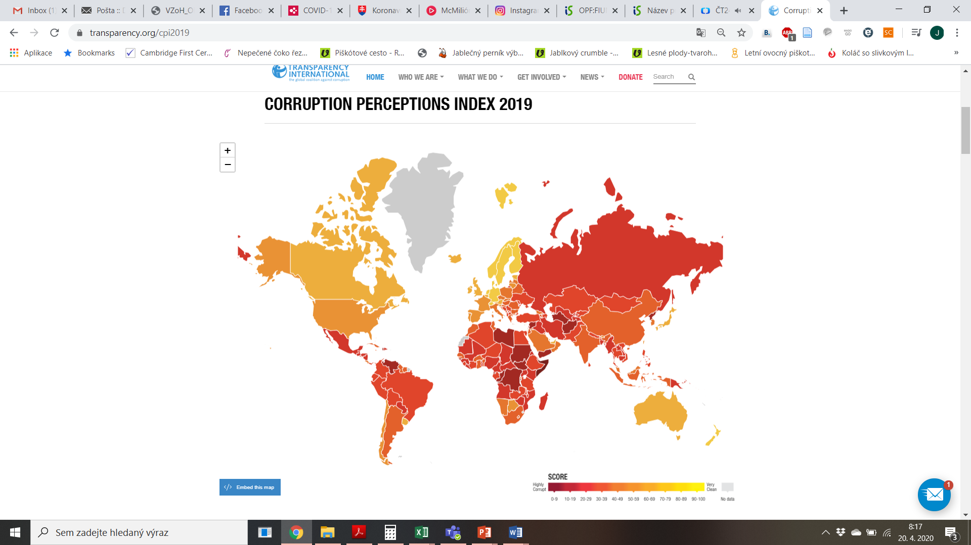
Corruption Perceptions Index
https://www.transparency.org/cpi2019
Country Risk Analysis

Slide 6
Economic and Financial Risks
A group of economic and financial risks involves the risks of the economy, the financial system or business partners in the host country.
The macroeconomic environment covers mainly:
  Economic growth
  Interest rates
    higher interest rates tend to slow growth and reduce demand for MNC products
  Exchange rates
    strong currency may reduce demand for the country’s exports, increase volume of imports, and reduce production and national income.
  Inflation
    inflation can affect consumers’ purchasing power and their demand for MNC goods.
Country Risk Analysis

Slide 7
Methods of Country Risk Analysis in MNC
Checklist approach
  ratings assigned to various factors
Delphi technique
  collection of independent opinions without group discussion
Quantitative analysis
  use of models such as regression analysis
Inspection visits
  Meetings with government officials, business executives, and consumers to clarify risk.
Combination of techniques
  many MNCs have no formal method but use a combination of methods.
Country Risk Analysis

Slide 8
Macro Assesment of Country Risk
The country's macroeconomic risk estimate is the country's overall risk assessment and includes an assessment of all the variables that affect the country's risk, with the exception of those unique to a particular company or industry.
  This type of assessment is appropriate in the sense that it remains the same for the country, irrespective of the company or industry concerned.
Country Risk Analysis

Slide 9
Micro Assesment of Country Risk
The country's microeconomic risk estimate includes the country's assessment of the specific type of MNC business.
  A specific form of country risk may affect the MNC in different ways and therefore a country risk microassessment is needed.
Country Risk Analysis

Slide 10
External Sources of Information
Statistical databases
Reports by international organisations
Information from representative offices
Information from specialised information agencies
Information from enterprises engaged in international economic activities
Information from banks, insurance companies and other entities providing funding and risk insurance
Country Risk Analysis

Slide 11
Rating
Globalization and the need to analyze the country's risk have also led to the development of information services and specialized institutions that provide rating services.
Rating agencies regularly analyze the factors influencing the political and economic situation of the countries and some of their business and non-business entities and assess their credit.
The most important credit rating agencies are:
  Moody's (www.moodys.com)
  Standard & Poor's (www.standardandpoors.com)
  Fitch (www.fitchratings.com)
Country Risk Analysis

Slide 12
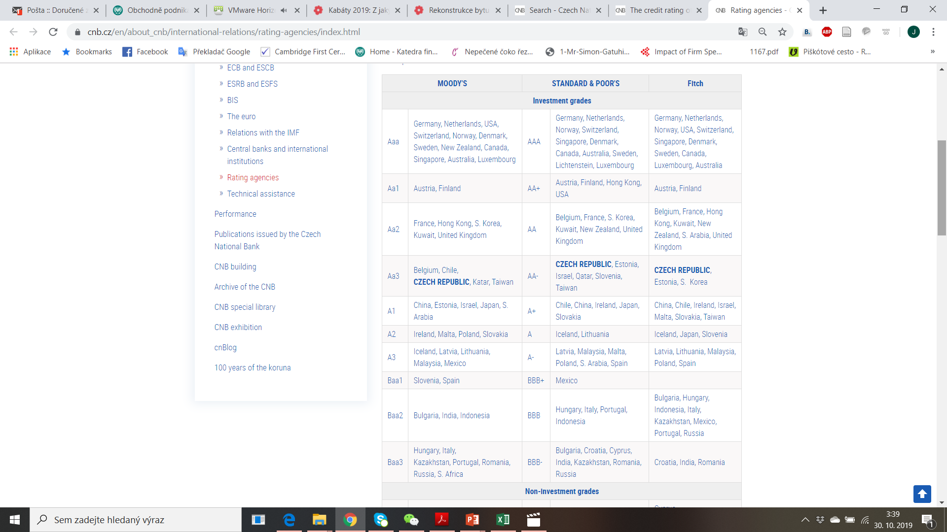
Rating Evaluation of Individual Countries
Country Risk Analysis

Slide 13
Rating Evaluation of Individual Countries
Country Risk Analysis

Slide 14
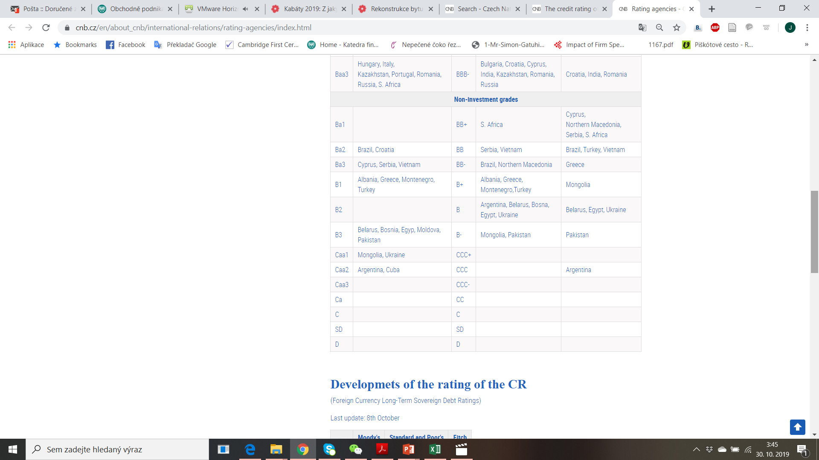
Rating Evaluation of Individual Countries
Country Risk Analysis

Slide 15
Country Risk Classification by OECD
A group of country risk experts from Export Credit Agencies meets several times a year to update the list of country risk classifications.
  These meetings are organised so as to guarantee that every country is reviewed whenever a fundamental change is observed and at least once a year.
  The list of country risk classifications is publically available and published on the OECD website after each meeting; however the meetings themselves and the exchanges and deliberations that take place are strictly confidential.
  Most recent data are available here:
  http://www.oecd.org/trade/topics/export-credits/arrangement-and-sector-understandings/financing-terms-and-conditions/country-risk-classification/
Country Risk Analysis

Slide 16
Country Risk Classification Methodology by OECD
The Country Risk Classification takes place through the application of a two-step methodology:
  A quantitative model constructed specifically for this purpose: The Country Risk Assessment Model (CRAM) produces a quantitative assessment of country credit risk based on three groups of risk indicators (the payment experience reported by the Participants, the financial situation and the economic situation based primarily on IMF indicators).
  A qualitative assessment of the CRAM results by country risk experts from OECD Members in order to integrate factors not fully taken into account by the model. This could lead to an adjustment (upwards or downwards) of a country compared to the CRAM results. Any adjustment has to attract a consensus among Experts. More information available in the operational procedures for the Country Risk Experts Group (December 2017 revision).
Country Risk Analysis

Slide 17
Questions and Applications
Check the most recent data provided by international institutions to describe the country risk in one European, one Asian, one American, one African country.
Country Risk Analysis

Slide 18
An Overall Country Risk
An overall country risk rating using a checklist approach can be developed from separate ratings for political and financial risk.
  The political factors are assigned values within some range
  These political factors are assigned weights. The assigned values of the factors times their respective weights can then be summed to derive a political risk rating.
  The process is repeated to derive the financial risk rating.
  Once the political and financial ratings have been derived, a country’s overall country risk rating as it relates to a specific project can be determined by assigning weights to the political and financial ratings according to importance.
Country Risk Analysis

Slide 19
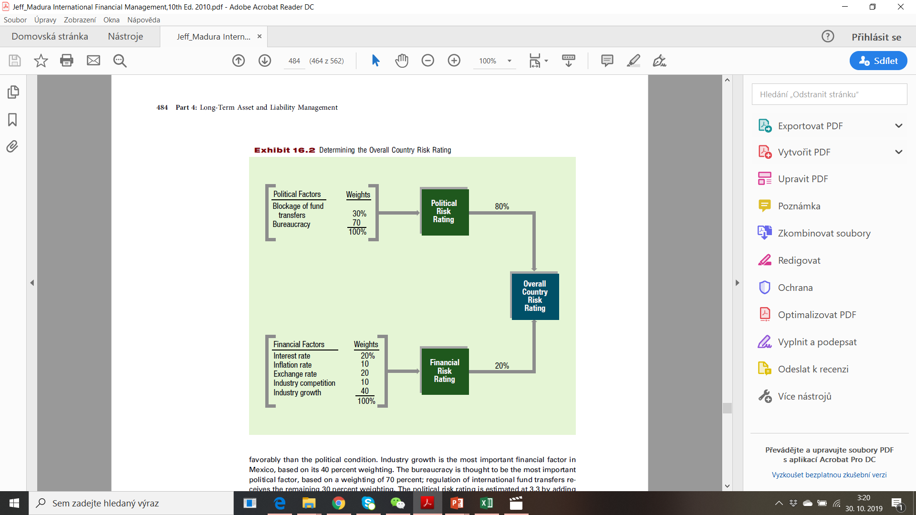
Determining the Overall Country Risk
Note: The importance of political risk and financial risk varies with the intent of the respective MNC. For instance, MNC considering foreign direct investment to attract demand in that country must be highly concerned about financial risk. MNC establishing a foreign manufacturing plant and
planning to export the goods from there should be more concerned with political risk.
Country Risk Analysis

Slide 20
Preventing Host Government Takeovers
Use a short-term horizon
Rely on unique supplies or technology
Hire local labor
Borrow local funds
Purchase insurance
Use project finance
Country Risk Analysis

Slide 21
Governance of the Country Risk Assessment
MNCs need a proper governance system to ensure that managers fully consider country risk when assessing potential projects.
One solution is to require that major long-term projects use input from an external source (such as a consulting firm) regarding the country risk assessment of a specific project and that this assessment be directly incorporated in the analysis of the project.
Country Risk Analysis

Slide 22
Comparing Political and Financial Ratings
One approach to comparing political and financial ratings among countries is a foreign investment risk matrix (FIRM) that displays the financial (or economic) and political risk by intervals ranging across the matrix from “poor” to “good.”
  Actual Country Risk Ratings across Countries - MNCs need to periodically update their assessments of each country where they do business.
  Impact of the Credit Crisis - Many countries experienced a decline in their country risk rating due to the credit crisis in 2008. Countries especially reliant on international credit were adversely affected when credit was difficult to access.
Country Risk Analysis

Slide 23
Incorporating Risk in Capital Budgeting
Adjustment of the discount rate
  lower risk rating implies higher risk and higher discount rate.
Adjustment of the estimated cash flows
  adjust estimates for the probability that cash flows may not be realized.
Assessing Risk of Existing Projects
  review country risk periodically after project has been implemented.
Country Risk Analysis

Slide 24
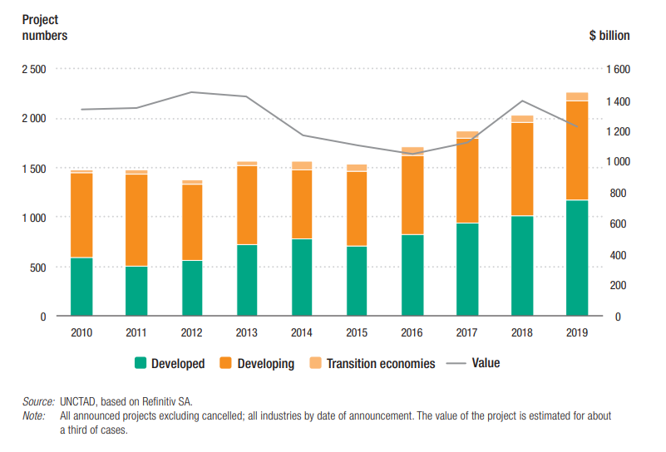
Project Financing by Country Development
Country Risk Analysis

Slide 25
THANK YOU FOR YOUR ATTENTION
J

