Slide 1
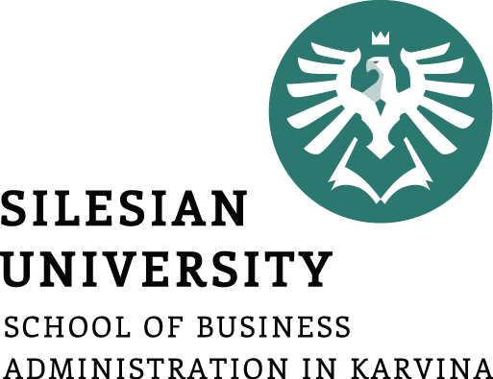
What is Management?
Introduction to Management
Pavel Adámek
Management

Slide 2

Outline of the lecture
The importance of management
Essential Managerial Tasks
Levels and Skills of Managers
Recent Changes in Management Practices

Slide 3
Learning objectives
After studying this chapter, you should be able to:
Describe what management is, why management is important, what managers do, and how managers use organizational resources efficiently and effectively to achieve organizational goals.
Distinguish among planning, organizing, leading, and controlling (the four principal managerial tasks), and explain how managers’ ability to handle each one affects organizational performance.
Differentiate among three levels of management, and understand the tasks and responsibilities of managers at different levels in the organizational hierarchy.
Distinguish among three kinds of managerial skill, and explain why managers are divided into different departments to perform their tasks more efficiently and effectively.
Discuss some major changes in management practices today that have occurred as a result of globalization and the use of advanced information technology (IT).

Slide 4
The importance of management
Management is an unpredictable process.
Making the right decision is often difficult, and even successful managers often make mistakes.
But the most effective managers learn from their mistakes and continually try to find ways to improve their companies’ performance.
Managing a company is a complex activity, and effective managers face many challenges from within and outside their organizations.

Slide 5
What is management?
When you think of a manager, what kind of person comes to mind?
Do you think of an executive helps direct company?
Or do you see a manager at a fast-food restaurant, who deals directly with employees and customers, or the person you answer to if you have a part-time job?
What do all these people have in common?

Slide 6
What is management?
Firstly, they all work in organizations!
Organizations are collections of people who work together and coordinate their actions to achieve a wide variety of goals or desired future outcomes.
Second, as managers, they are the people responsible for supervising and making the most of an organization’s human and other resources to achieve its goals.
Management, then, is the planning, organizing, leading, and controlling of human and other resources to achieve organizational goals efficiently and effectively.
  An organization’s resources include assets such as people and their skills, know-how, and experience; machinery; raw materials; computers and information technology; and patents, financial capital, and loyal customers and employees.

Slide 7
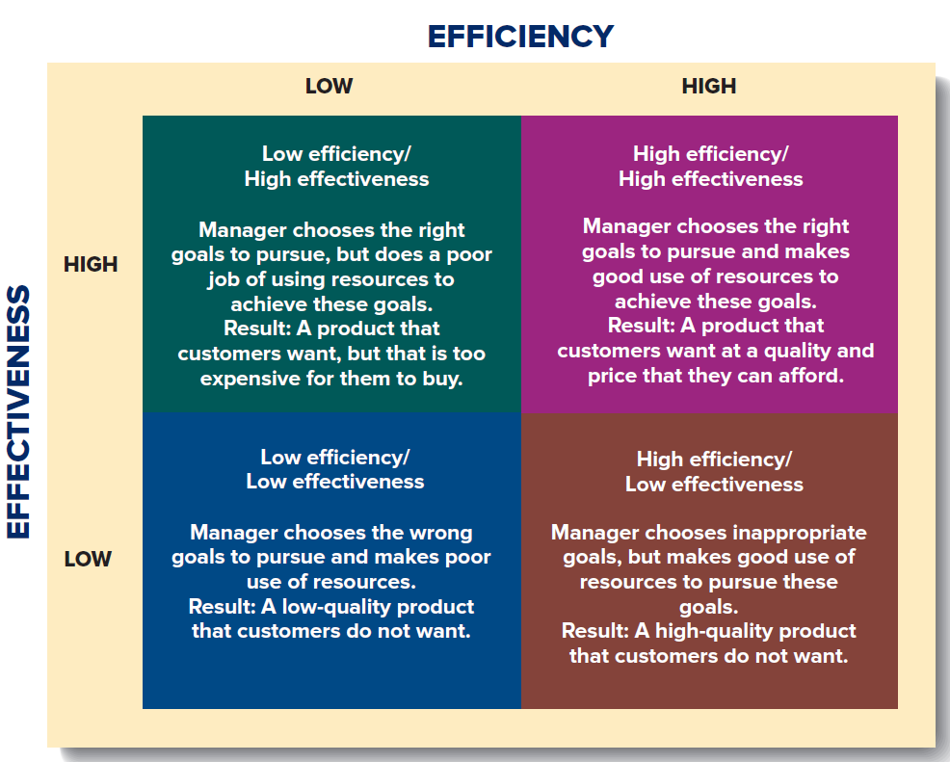
Achieving High Performance: A Manager’s Goal
Efficiency, Effectiveness, and Performance in an Organization
High-performing organizations are efficietnt and effective.
Source: G. R. Jones, J. M. George, 2019. Contemporary Management, p. 5

Slide 8
Achieving High Performance: A Manager’s Goal
Efficiency is a measure of how productively resources are used to achieve a goal.
Organizations are efficient when managers minimize the amount of input resources (such as labor, raw materials, and component parts) or the amount of time needed to produce a given output of goods or services.
  For example, Burger King develops ever more efficient fat fryers that not only reduce the amount of oil used in cooking, but also speed up the cooking of french fries.
  UPS develops new work routines to reduce delivery time, such as instructing drivers to leave their truck doors open when going short distances.

Slide 9
Achieving High Performance: A Manager’s Goal
Effectiveness is a measure of the appropriateness of the goals that managers have selected for the organization to pursue and the degree to which the organization achieves those goals.
Organizations are effective when managers choose appropriate goals and then achieve them.
  Some years ago, for example, managers at McDonald’s decided on the goal of providing breakfast service to attract more customers. The choice of this goal has proved smart. Over recent years, sales of breakfast food accounted for more than 30% of McDonald’s revenues. In 2015, in an effort to increase sales, McDonald’s management decided to offer breakfast items all day long, a strategy that has been successful and well received by customers.
  !!!Effective managers are those who choose the right organizational goals to pursue and have the skills to utilize resources efficiently!!!

Slide 10
Why study management?
The dynamic and complex nature of modern work means that managerial skills are in demand.
Organizations need individuals like you who can understand this complexity, respond to environmental contingencies, and make decisions that are ethical and effective. Studying management helps equip individuals to accomplish each of these tasks.
By studying management in school, you are exposing yourself to the lessons others have learned. The advantage of such social learning is that you are not bound to repeat the mistakes others have made in the past.
By studying and practicing the behaviours of good managers and high-performing companies, you will equip yourself to help your future employer succeed.
The economic benefits of becoming a good manager are also impressive. (In the United States, general managers earn a median annual wage of $97,730, with a projected growth rate in job openings of 5% to 8% between now and 2024.)
Finally, learning management principles can help you make good decisions in nonwork situations. If you’re coaching a child’s soccer team, organizing a charity, planning your financial budget, or starting a new business, good management principles will help you understand others, make quality decisions, and improve your overall personal success.

Slide 11
Essential Managerial Tasks
How do managers accomplish this objective?
They do so by performing four essential managerial tasks: planning, organizing, leading, and controlling.
French manager Henri Fayol first outlined the nature of these managerial activities around the turn of the 20th century in General and Industrial Management, a book that remains the classic statement of what managers must do to create a high-performing organization.
The job of management is to help an organization make the best use of its resources to achieve its goals.

Slide 12
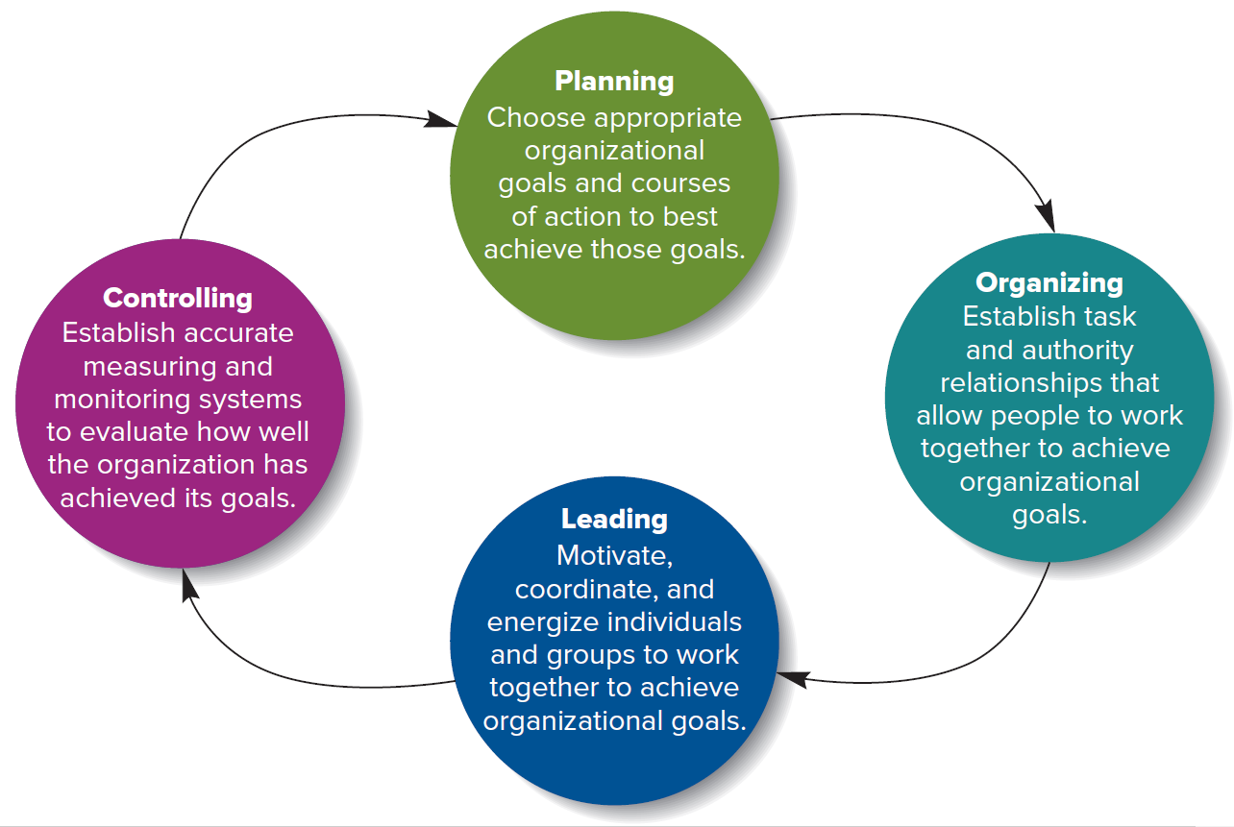
Essential Managerial Tasks
The arrows linking these
tasks in Figure suggest the sequence in which managers typically perform them.
4 Tasks of Management
Source: G. R. Jones, J. M. George, 2019. Contemporary Management, p. 5

Slide 13
Essential Managerial Tasks - Planning
To perform the planning task, managers identify and select appropriate organizational goals and courses of action; they develop strategies for how to achieve high performance.
The three steps involved in planning are (1) deciding which goals the organization will pursue, (2) deciding what strategies to adopt to attain those goals, and (3) deciding how to allocate organizational resources to pursue the strategies that attain those goals.
How well managers plan and develop strategies determines how effective and efficient the organization is—its performance level.
Planning strategy is complex and difficult, especially because planning is done under uncertainty when the result is unknown so that either success or failure is a possible outcome of the planning process. Managers take major risks when they commit organizational resources to pursue a particular strategy.

Slide 14
Essential Managerial Tasks - Organizing
Organizing is structuring working relationships so organizational members interact and cooperate to achieve organizational goals.
Organizing people into departments according to the kinds of job-specific tasks they perform lays out the lines of authority and responsibility between different individuals and groups.
Managers must decide how best to organize resources, particularly human resources.
The outcome of organizing is the creation of an organizational structure, a formal system of task and reporting relationships that coordinates and motivates members so they work together to achieve organizational goals.

Slide 15
Essential Managerial Tasks - Leading
An organization’s vision is a short, succinct, and inspiring statement of what the organization intends to become and the goals it is seeking to achieve—its desired future state.
In leading, managers articulate a clear organizational vision for the organization’s members to accomplish, and they energize and enable employees so everyone understands the part he or she plays in achieving organizational goals.
Leadership involves managers using their power, personality, influence, persuasion, and communication skills to coordinate people and groups so their activities and efforts are in harmony.
Leadership revolves around encouraging all employees to perform at a high level to help the organization achieve its vision and goals. Another outcome of leadership is a highly motivated and committed workforce.

Slide 16
Essential Managerial Tasks - Controlling
In controlling, the task of managers is to evaluate how well an organization has achieved its goals and to take any corrective actions needed to maintain or improve performance. For example, managers monitor the performance of individuals, departments, and the organization as a whole to see whether they are meeting desired performance standards.
The outcome of the control process is the ability to measure performance accurately and regulate organizational efficiency and effectiveness.
  To exercise control, managers must decide which goals to measure—perhaps goals pertaining to productivity, quality, or responsiveness to customers—and then they must design control systems that will provide the information necessary to assess performance—that is, determine to what degree the goals have been met.
The controlling task also helps managers evaluate how well they themselves are performing the other three tasks of management—planning, organizing, and leading—and take corrective action.

Slide 17
We differentiate managers according to their level or rank in the organization’s hierarchy of authority.
The three levels of managers are first-line managers, middle managers, and top managers—arranged in a hierarchy.
Typically first-line managers report to middle managers, and middle managers report to top managers.
Organizations group managers into different departments (or functions) according to their specific job-related skills, expertise, and experiences, such as a manager’s engineering skills, marketing expertise, or sales experience.
Levels and Skills of Managers
To perform the four managerial tasks efficiently and effectively, organizations group or differentiate their managers in two main ways—by level in hierarchy and by type of skill.

Slide 18
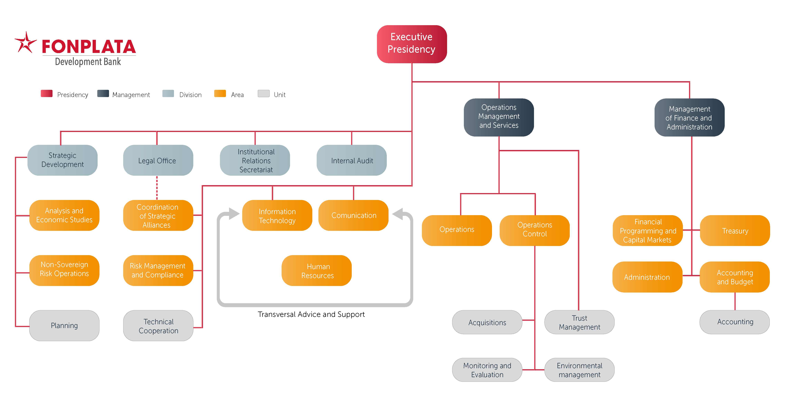
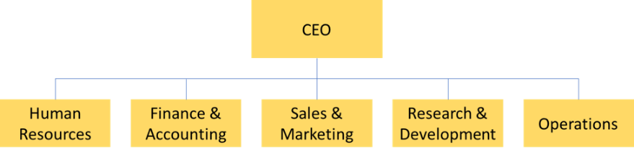
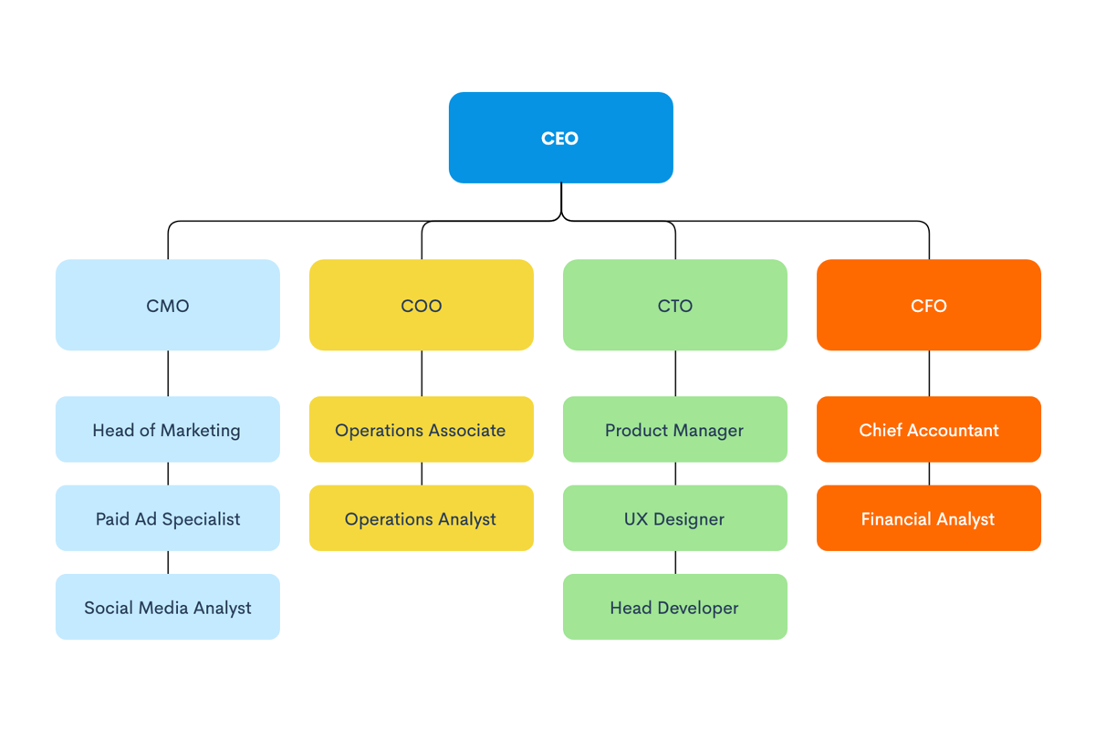
Levels and Skills of Managers
A department, such as the manufacturing, accounting, engineering, or sales department, is a group of managers and employees who work together because they possess similar skills and experience or use the same kind of knowledge, tools, or techniques to perform their jobs. Within each department are al three levels of management.

Slide 19
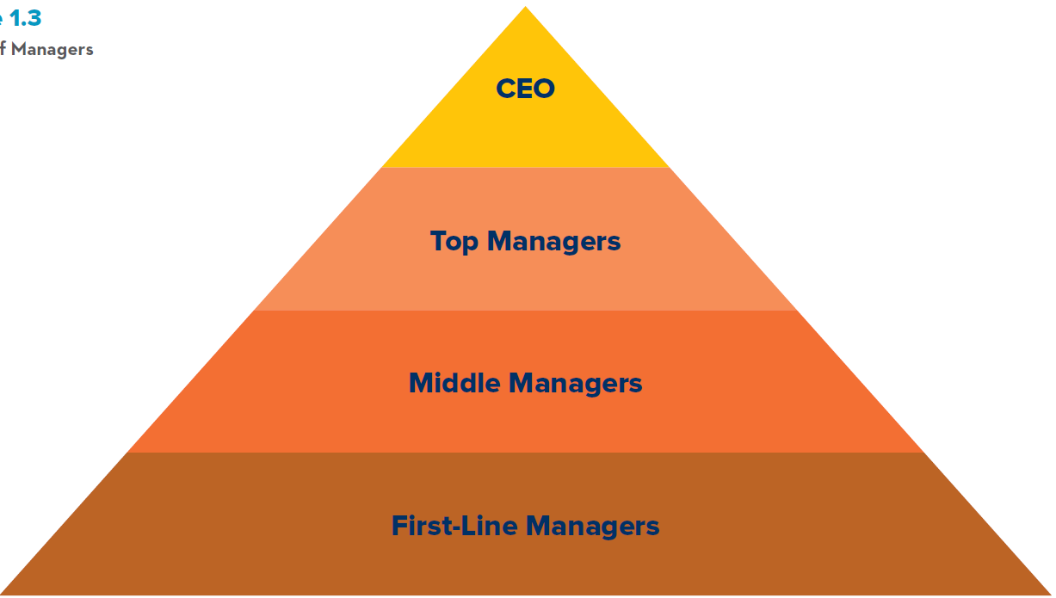
Levels and Skills of Managers
Organizations normally have three levels of management:
first-line managers,
middle managers, and
top managers.
Levels of Managers
Source: G. R. Jones, J. M. George, 2019. Contemporary Management, p. 5

Slide 20
Levels and Skills of Managers
Managers at each level have different but related responsibilities for using organizational resources to increase efficiency and effectiveness.
At the base of the managerial hierarchy are first-line managers, often called supervisors. They are responsible for daily supervision of the nonmanagerial employees who perform the specific activities necessary to produce goods and services. Firstline managers work in all departments or functions of an organization.
  Examples of first-line managers include the supervisor of a work team in the manufacturing department of an auto plant, the head nurse in the obstetrics department of a hospital, and the chief mechanic overseeing a crew of mechanics in the service function of a new car dealership.
Supervising the first-line managers are middle managers, responsible for finding the best way to organize human and other resources to achieve organizational goals. To increase efficiency – to find ways for better use resources. A major part of the middle manager’s job is developing and fine-tuning skills and know-how.
  Which first-line supervisors should be chosen for this particular project?
  Where can we find the highest quality resources? How should employees be organized to allow them to make the
  best use of resources?

Slide 21
Levels and Skills of Managers
Top managers are responsible for the performance of all departments. They have cross-departmental responsibility.
Top managers establish organizational goals, such as which goods and services the company should produce; they decide how the different departments should interact; and they monitor how well middle managers in each department use resources to achieve goals.
Top managers are ultimately responsible for the success or failure of an organization, and their performance is continually scrutinized by people inside and outside the organization, such as other employees and investors.

Slide 22
Levels and Skills of Managers
The chief executive officer (CEO) is a company’s most senior and important manager, the one all other top managers report to.
Today the term chief operating officer (COO) refers to the company’s top manager, such as Tim Cook, who was groomed by Steve Jobs to take over as Apple’s CEO.
Together the CEO and COO are responsible for developing good working relationships among the top managers of various departments (manufacturing and marketing, for example); usually these top managers have the title “vice president.”

Slide 23
Managerial Skills
Both education and experience enable managers to recognize and develop the personal skills they need to put organizational resources to their best use.
Research has shown that education and experience help managers acquire and develop three types of skills: conceptual, human, and technical.
Conceptual skills are demonstrated in the general ability to analyze and diagnose a situation and to distinguish between cause and effect. Top managers require the best conceptual skills because their primary responsibilities are planning and organizing.
  Formal education and training are important in helping managers develop conceptual skills.
  Today continuing management education and training, including training in advanced IT, are an integral step in building managerial skills because theories and techniques are constantly being developed to improve organizational effectiveness, such as total quality management, benchmarking, and cloud computing and virtual business-to-business (B2B) networks.
  In addition, organizations may wish to develop a particular manager’s abilities in a specific skill area—perhaps to learn an advanced component of departmental skills, such as international bond trading, or to learn the skills necessary to implement total quality management.

Slide 24
Managerial Skills
Human skills include the general ability to understand, alter, lead, and control the behavior of other individuals and groups. The ability to communicate, to coordinate, and to motivate people, and to mold individuals into a cohesive team distinguishes effective from ineffective managers.
  Human skills can be learned through education and training, as well as be developed through experience.
  To manage personal interactions effectively, each person in an organization needs to learn how to empathize with other people—to understand their viewpoints and the problems they face.
  One way to help managers understand their personal strengths and weaknesses is to have their superiors, peers, and subordinates provide feedback about their job performance.
Technical skills are the job-specific skills required to perform a particular type of work or occupation at a high level. Examples include a manager’s specific manufacturing, accounting, marketing, and increasingly, IT skills. Managers need a range of technical skills to be effective.
  Managers and employees who possess the same kinds of technical skills typically become members of a specific department and are known as, for example, marketing managers or manufacturing managers.

Slide 25
Managerial Skills
!!!Managers are grouped into different departments because a major part of a manager’s responsibility is to monitor, train, and supervise employees so their job-specific skills and expertise increase!!!

Slide 26
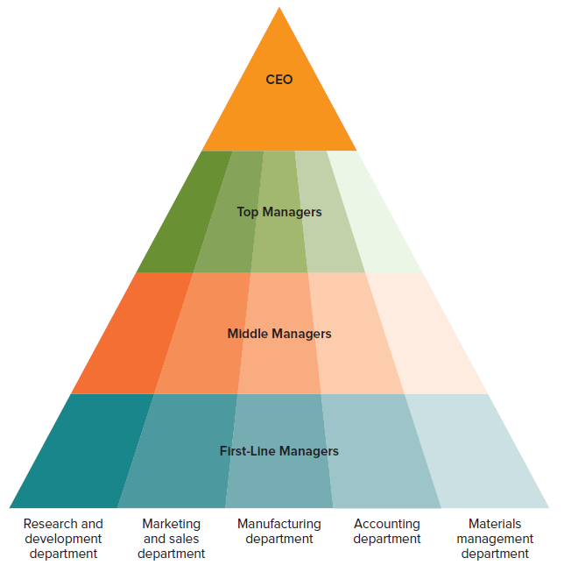
Managerial Skills
Today the term core competency is often used to refer to the specific set of departmental skills, knowledge, and experience that allows one organization to outperform its competitors.
In other words, departmental skills that create a core competency give an organization a competitive advantage.
  Dell, for example, was the first PC maker to develop a core competency in materials management that allowed it to produce PCs at a much lower cost than its competitors—a major source of competitive advantage.
  Google is well known for its core competency in research and development (R&D) that allows it to innovate new products at a faster rate than its competitors. From computerized glasses to self-driving cars, Google continues to pioneer the development of technology for the masses.
Types and Levels of Managers
Source: G. R. Jones, J. M. George, 2019. Contemporary Management, p. 16

Slide 27
Managerial Skills
Effective managers need all three kinds of skills—conceptual, human, and technical—to help their organizations perform more efficiently and effectively. The absence of even one type of managerial skill can lead to failure.
One of the biggest problems that people who start small businesses confront, for example, is their lack of appropriate conceptual and human skills. Someone who has the technical skills to start a new business does not necessarily know how to manage the venture successfully.
Developing new and improved skills through education and training has become a priority for both aspiring managers and the organizations they work for.
Many people are enrolling in advanced management courses; but many companies, such as Microsoft, GE, and IBM, have established their own colleges to train and develop their employees and managers at all levels.

Slide 28
Top managers are encouraging lower-level managers to look beyond the goals of their own departments and take a cross-departmental view to find new opportunities to improve organizational performance.
Technology gives managers at all levels and in all areas access to more and better information and improves their ability to plan, organize, lead, and control.
IT also gives employees more job-related information and allows them to become more skilled, specialized, and productive.
Recent Changes in Management Practice
Two major factors that have led to these changes are global competition and advances in information technology.

Slide 29
Recent Changes in Management Practice
To utilize IT to increase efficiency and effectiveness, CEOs and top management teams have been restructuring organizations and outsourcing specific organizational activities to reduce the number of employees on the payroll and make more productive use of the remaining workforce.
Restructuring involves simplifying, shrinking, or downsizing an organization’s operations to lower operating costs, as companies such as Microsoft and Macy’s have been forced to do.
  The global recession of 2008–2010 forced most companies—large and small, profit and nonprofit—to find ways to reduce costs because their customers were spending less money, so overall revenues decreased.
  Restructuring can be done by eliminating product teams, shrinking departments, and reducing levels in the hierarchy, all of which results in the loss of large numbers of jobs of top, middle, or first-line managers, as well as nonmanagerial employees.
  IT makes it possible for fewer employees to perform a particular work task. IT increases each person’s ability to process information and make decisions more quickly and accurately.
  Restructuring, however, can produce some powerful negative outcomes. It can reduce the morale of remaining employees, who worry about their own job security.

Slide 30
Recent Changes in Management Practice
Outsourcing involves contracting with another company, usually in a low-cost country abroad, to have it perform a work activity the organization previously performed itself, such as manufacturing, marketing, or customer service.
Outsourcing increases efficiency because it lowers operating costs, freeing up money and resources that can be used in more effective ways—for example, to develop new products.
  Low-cost global competition dramatically increased outsourcing at the beginning of 2000. In 2015, nearly 2.4 million U.S. jobs were outsourced to other countries. India, Indonesia, and China were rated as the best outsourcing countries.
  Large for-profit organizations today typically employ 10% to 20% fewer people than they did 10 years ago because of restructuring and outsourcing. Ford, IBM, AT&T, and DuPont are among the thousands of organizations that have streamlined their operations to increase efficiency and effectiveness.
  At the same time, many companies continue to experience outsourcing problems in Asia, including increasing wages in that part of the world. Automakers, in particular, are looking for venues that offer both skilled workers and low wages.

Slide 31
Empowerment and Self-Managed Teams
The second principal way managers have sought to increase efficiency and effectiveness is by empowering lower-level employees and moving to self-managed teams.
Empowerment is a management technique that involves giving employees more authority and responsibility over how they perform their work activities.
  The way in which John Deere, the well-known tractor manufacturer, empowered its employees - who assemble Deere’s vehicles possess detailed knowledge about how Deere products work.
  Deere’s managers realized these employees could become persuasive salespeople if they were given training. So groups of these employees were given intensive sales training and sent to visit Deere’s customers and explain to them how to operate and service the company’s new products. While speaking with customers, these newly empowered “salespeople” also collect information that helps Deere develop new products that better meet customers’ needs.
  Often companies find that empowering employees can lead to so many kinds of performance gains that they use their reward systems to promote empowerment.

Slide 32
Empowerment and Self-Managed Teams
IT also facilitates the use of a self-managed team, a group of employees who assume collective responsibility for organizing, controlling, and supervising their own work activities.
Using IT designed to give team members real-time information about each member’s performance, a self-managed team can often find ways to accomplish a task more quickly and efficiently.
Moreover, self-managed teams assume many tasks and responsibilities previously performed by first-line managers, so a company can better utilize its workforce.
  First-line managers act as coaches or mentors whose job is not to tell employees what to do but to provide advice and guidance and help teams find new ways to perform their tasks more efficiently.
  Using the same IT, middle managers can easily monitor what is happening in these teams and make better resource allocation decisions as a result

Slide 33
RECAP
Organizations are collections of people who work together and coordinate their actions to achieve a wide variety of goals or desired future outcomes.
The four managerial tasks—planning, organizing, leading, and controlling—are essential parts of a manager’s job. At all levels in the managerial hierarchy, and across all jobs and departments in an organization, effective management means performing these four activities successfully—in ways that increase efficiency and effectiveness.
Efficiency is a measure of how productively resources are used to achieve a goal.
Effectiveness is a measure of the appropriateness of the goals that managers have selected for the organization to pursue and the degree to which the organization achieves those goals.
Managers do by performing four essential managerial tasks: planning, organizing, leading, and controlling.
Both education and experience enable managers to recognize and develop the personal skills they need to put organizational resources to their best use.

Slide 34
RECAP
Research has shown that education and experience help managers acquire and develop three types of skills: conceptual, human, and technical.
Managers are grouped into different departments because a major part of a manager’s responsibility is to monitor, train, and supervise employees so their job-specific skills and expertise increase.
Two major factors that have led to these changes are global competition and advances in information technology.
Recent Changes in Management Practice: outsourcing, empowerement, self-managed Teams.

