Slide 1

Leadership and management
Ing. Žaneta Rylková, Ph.D.
Silesian Univerzity in Opava, School of Business Administration in Karvina
Czech Republic
Department of Business Economics and Management
rylkova@opf.slu.cz

Slide 2

Outline of the lecture
Leadership and management
Leader and manager

Slide 3
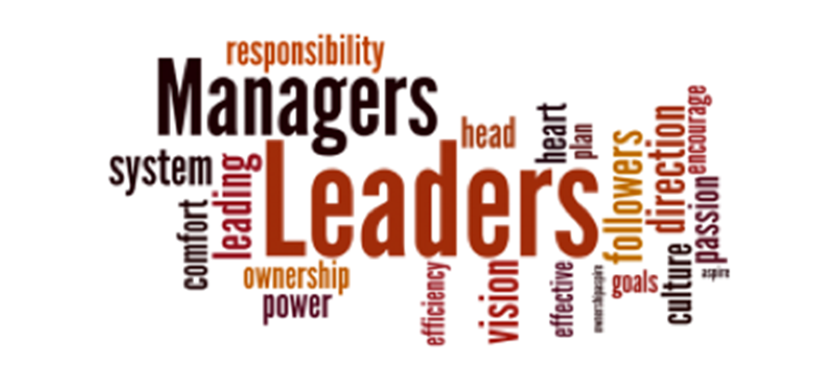
Questions
What is a leader? What is a manager?

Slide 4
Introduction
A vital and, some argue, incerasingly dominant, aspect of organisation is the role of management and leadership.
Research, academic and practitioner interest in management and in leadership has blossomed in recent decades.
As interest in and concern about organisational diversity, technological change, competitiveness and globalisation have grown, the role of management and leadership has been emphasised.

Slide 5
Introduction
What does it mean management?

Slide 6
Differentiating leadership from management
There are many definitions of management, but put simply, we can say it´s the organisation and coordination of functions and activities.
Managers perform functions in organisations and hold a particular, formal, title and/or fulfill a role. A typical example is a marketing manager, responsible for the marketing of a product range in a geographical territory, or a HRM manager responsible, for example, for the recruitment and selection of staff for a single site organisation. These managers have a title, a role and a series of functions to perform, including the management of subordinates and of physcial and financial resources. They are responsible for the performance and the productivity of their subordinates.
What is a manager?

Slide 7
Managers
Managers need to reflect on their own strengths, styles and capabilities and assimilate the responses of others to their activities in an attempt to learn about themselves and to explore self-development opportunities.
Individuals need to recognise that the frame in which they operate influences their understanding, attitudes and behaviour, recognition of this fact is a prerequisite for personal development and growth.

Slide 8
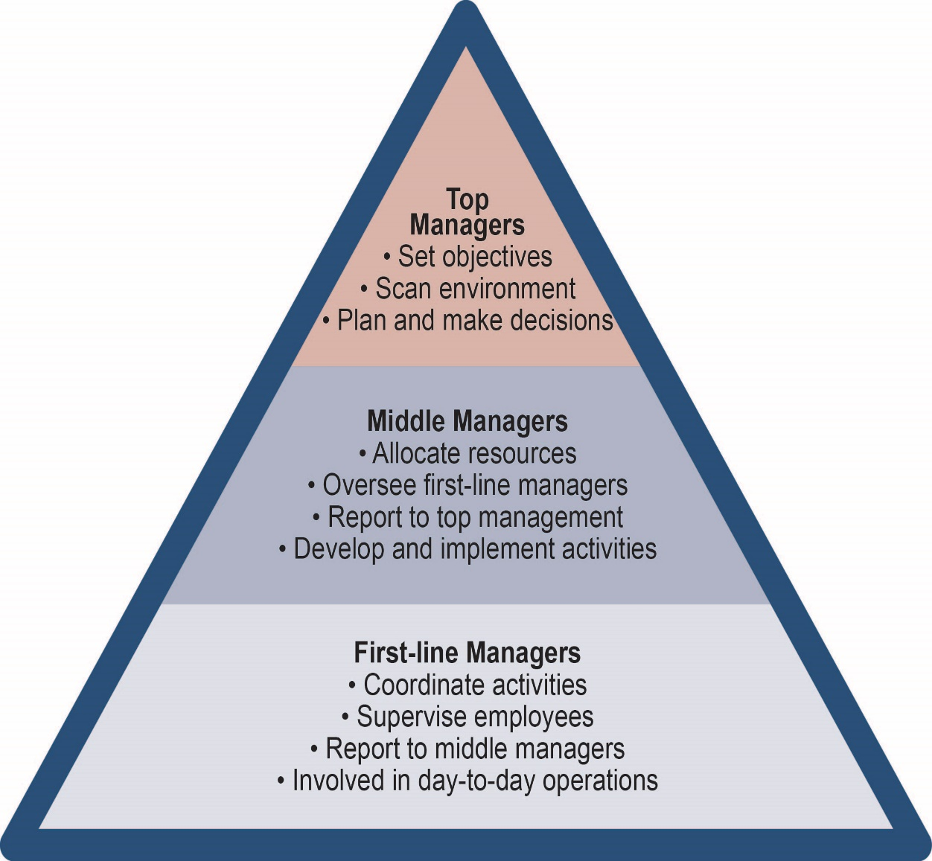
Levels of management

Slide 9
Differentiating leadership from management
Leadership aims to influence and guide others into pursuing particular objectives or visions of the future and to stimulate people into wanting to follow.
Leadership is often a dynamic activity concerned with changing attitudes, so leadership is more inspirational and involves greater emotional input than management.
Leaders are strategists giving clarity of direction to organisations and its people.

Slide 10
Differentiating leadership from management
Manager and leader
Manager | Leader
Avoids difficulties | Shows charisma and vision
Plans, organises and controls | Instills trust, pride and respect
Rewards depend on performance | Demonstrates string mental toughness and ambition for the organisation
Focus deviations, form rules | Inspires and sets high expectations
Intervenes when standards, plans are not achieved | Promotes creative problem solving
 | Gives personal attention, considers individuals, coaches

Slide 11
Leaders on leadership
Gary Hoffman, who has had a successful career in the banking industry, distilled what he considers to be the nine qualities and roles of a leader:
  Protector of brand and reputation
  Creator and champion of ambitions
  Inspirer of shared sense of purpose
  Champion of customers and colleagues
  Creator of commitment and trust
  Provider of clear direction
  Creator and facilitator of teamworking
  Coach/builder of skills
  Role model of behaviours

Slide 12
Leadership vs. Management
Leadership & management are distinct, yet complementary systems of action
Effective leadership
produces useful change
Effective management controls complexity
Effective leadership + good management = healthy organizations

Slide 13
Management Process
Reduces uncertainty
Provides stability
Components
  Planning & budgeting
  Organizing and staffing
  Controlling & problem
  solving
Manager –
Most often an advocate for stability and the
status quo
Notes:
4

Slide 14
Leadership Process
Creates uncertainty
Creates change
Components
  Setting organizational direction
  Aligning people with the direction via communication
  Motivating people to action
    Empowerment
    Gratify needs
Leader –
an advocate for
change and new approaches to
problems
Notes:
5

Slide 15
Manager vs. Leader
Manager | Leader
maintains | develops
focuses on systems and structure | focuses on people
relies on control | inspires trust
prefers a short-range view | prefers a long-range perspective
asks how and when | asks what and why
has his or her eye always on the bottom line | has his or her eye on the horizon
imitates | originates
accepts the status quo | accepts changes and challanges
is the classic good soldier | is his or her own person
does things right | does the right things

Slide 16
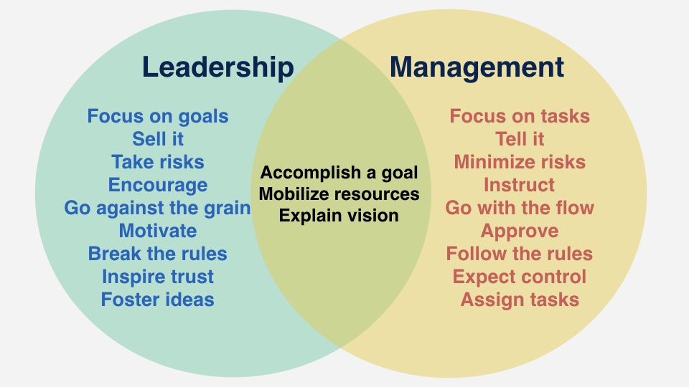
Conclusions
It is possible to differentiate between management and leadership.
Contemporary research on leadership has explored a range of leadership paradigms which define the scope of thinking and action available to individual leaders.

Slide 17
Next week
Case study 1: on Tuesday 16th March, time 11:30 till 13:00
I am sending the Case study to your email adress

