Slide 1
Essentials of communication
Janusz Karpeta
Corporate communication
Subject code

Slide 2
Outline of the lecture
The first lecture will introduce you to the following aspects of corporate communication:
Definition of communication
Definition of communication process
Definition of transactional model of communication
Definition of constructivist model of communication
Summary of the key aspects of communication.

Slide 3
1. Essentials of communication
Communication itself is one the most traditional disciplines in the history of our mankind.
In communication discussions many theories have been proposed to describe, predict, and understand the behaviors and phenomena of which communication consists.
The root of the word communication in Latin is communicare, which means to share, or to make common.

Slide 4
1. Essentials of communication
Communication is defined as:
‘The process of understanding and sharing meaning.’ Pearson, Nelson (2000).
At the center of our study of communication is the relationship that involves interaction between participants.
This definition serves us well with its emphasis on the process, which we’ll examine in depth across this text, of coming to understand and share another’s point of view effectively.

Slide 5
1. Essentials of communication
The first key word in this definition is process.
According to Pearson and Nelson:
‘A process is a dynamic activity that is hard to describe because it changes’ Pearson, Nelson (2000).
There are eight essential components of communication.
In order to better understand the communication process, we can break it down into a series of eight essential components:

Slide 6
1. Essentials of communication
There are as follows:
1. Source
2. Message
3. Channel
4. Receiver
5. Feedback
6. Environment
7. Context
8. Interference

Slide 7
1. Essentials of communication
1. Source
The source imagines, creates, and sends the message.
In a public speaking situation, the source is the person giving the speech.
He or she conveys the message by sharing new information with the audience.
The speaker also conveys a message through his or her tone of voice, body language, and choice of clothing.
The speaker begins by first determining the messages - what to say and how to say it.

Slide 8
1. Essentials of communication
The second step involves encoding the message by choosing just the right order or the perfect words to convey the intended meaning.
The third step is to present or send the information to the receiver or audience.
Finally, by watching for the audience’s reaction, the source perceives how well they received the message and responds with clarification or supporting information.

Slide 9
1. Essentials of communication
2. Message
As McLean states:
‘The message is the stimulus or meaning produced by the source for the receiver or audience’. McLean (2005).
When you plan to give a speech or write a report, your message may seem to be only the words you choose that will convey your meaning.
However, that is just the beginning.

Slide 10
1. Essentials of communication
The words are brought together with grammar and organization.
You may choose to save your most important point for last.
The message also consists of the way you say it— in a speech, with your tone of voice, your body language, and your appearance—and in a report, with your writing style, punctuation, and the headings and formatting you choose.
In addition, part of the message may be the environment or context you present it in and the noise that might make your message hard to hear or see.

Slide 11
1. Essentials of communication
3. Channel
As stated by McLean:
‘The channel is the way in which a message or messages travel between source and receiver.’ McLean (2005).
When you speak or write, you are using a channel to convey your message.
We can distinguish different types of channels.

Slide 12
1. Essentials of communication
Spoken channels include the following:
Face-to-face conversations, speeches, telephone conversations and voice mail messages, radio, public address systems, and voice over Internet protocol (VoIP).
Written channels include the following:
Letters, memorandums, purchase orders, invoices, newspaper and magazine articles, blogs, e-mail, text messages, tweets, and so forth.

Slide 13
1. Essentials of communication
4. Receiver
In line with the words of McLean:
… ‘The receiver receives the message from the source, analyzing and interpreting the message in ways both intended and unintended by the source’. McLean (2005).
As a receiver you listen, see, touch, smell, and/or taste to receive a message.
Your audience ‘sizes you up,’ much as you might check them out long before you take the stage or open your mouth.

Slide 14
1. Essentials of communication
The nonverbal responses of your listeners can serve as clues on how to adjust your opening.
By imagining yourself in their place, you anticipate what you would look for if you were them.
You too can recognize the interaction between source and receiver in a business communication context.
All of this happens at the same time, illustrating why and how communication is always changing.

Slide 15
1. Essentials of communication
5. Feedback
When you respond to the source, intentionally or unintentionally, you are giving feedback.
Leavitt and Mueller point out that:
‘Feedback is composed of messages the receiver sends back to the source. Verbal or nonverbal, all these feedback signals allow the source to see how well, how accurately (or how poorly and inaccurately) the message was received.’ Leavitt, Mueller (1951).

Slide 16
1. Essentials of communication
Feedback, as we know, also provides:
An opportunity for the receiver or addressees to demand an explanation,
To agree or disagree,
Or to indicate that the source could make the message more interesting.
What results from that is that as the amount of feedback increases, the accuracy of communication also increases.

Slide 17
1. Essentials of communication
6. Environment
The environment is ‘the atmosphere, physical and psychological, where you send and receive messages’. McLean (2005).
The environment can include the tables, chairs, lighting, and sound equipment that are in the room.
E.g. the room itself is an example of the environment.
The environment can also include factors like formal dress that may indicate whether a discussion is open and caring or more professional and formal.

Slide 18
1. Essentials of communication
People may be more likely to have an intimate conversation when they are physically close to each other, and less likely when they can only see each other from across the room.
In that case, they may text each other, itself an intimate form of communication. The choice to text is influenced by the environment.
As a speaker, your environment will impact and play a role in your speech.
It’s always a good idea to go check out where you’ll be speaking before the day of the actual presentation.

Slide 19
1. Essentials of communication
7. Context
According to McLean:
…‘the context of the communication interaction involves the setting, scene, and expectations of the individuals involved.’ McLean (2005).
A professional communication context may involve business suits (environmental cues) that directly or indirectly influence expectations of language and behavior among the participants.

Slide 20
1. Essentials of communication
9. Interference
Interference, also called noise, can come from any source.
According to the definition:
‘Interference is anything that blocks or changes the source’s intended meaning of the message’. McLean (2005).
Psychological noise is what happens when your thoughts occupy your attention while you are hearing, or reading, a message.

Slide 21
1. Essentials of communication
Noise interferes with:
Normal encoding and
Decoding of the message carried by the channel between source and receiver.
Not all noise is bad, but noise interferes with the communication process.

Slide 22
1. Essentials of communication
Two Models of Communication
Researchers have observed that when communication takes place, the source and the receiver may send messages at the same time, often overlapping.
You, as the speaker, will often play both roles, as source and receiver.
You’ll focus on the communication and the reception of your messages to the audience.

Slide 23
1. Essentials of communication
The audience will respond in the form of feedback that will give you important clues.
While there are many models of communication.
Here we will focus on two that offer perspectives and lessons for business communicators.

Slide 24
1. Essentials of communication
Rather than looking at the source sending a message and someone receiving it as two distinct acts, researchers often view communication as a transactional process with actions often happening at the same time.
(See Figure 1 "Transactional Model of Communication").
The distinction between source and receiver is blurred in conversational turn-taking, for example, where both participants play both roles simultaneously.

Slide 25
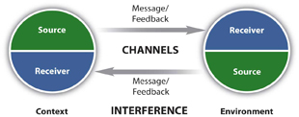
1. Essentials of communication
Figure 1 Transactional model of communication

Slide 26
1. Essentials of communication
In the constructivist model (Figure 2 "Constructivist Model of Communication"), we focus on “the negotiated meaning, or common ground, when trying to describe communication”
In order to communicate, one has to realize what the term means to the other person, and establish common ground, in order to fully understand the request and provide an answer.
Because we carry the multiple meanings of words, gestures, and ideas within us, we can use a dictionary to guide us, but we will still need to negotiate meaning.

Slide 27
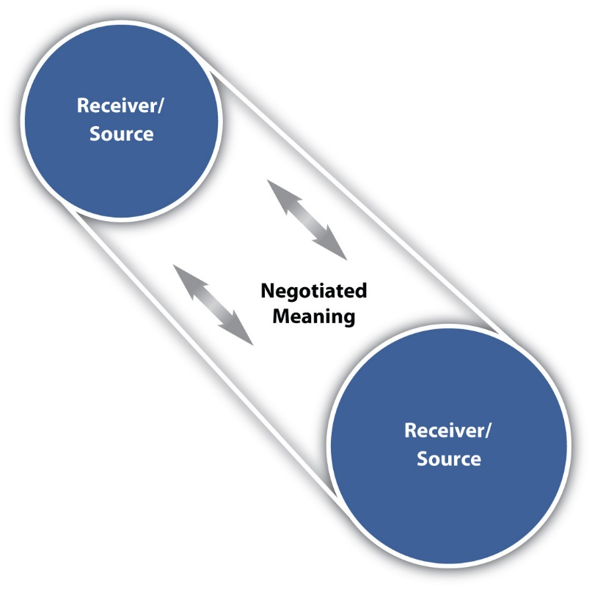
1. Essentials of communication
Figure 2 Constructivist model of communication

Slide 28
Summary of the lecture
The first lecture has updated you on the following aspects of communication:
Definition of communication
Definition of communication process
Definition of transactional model of communication
Definition of constructivist model of communication
Summary of the key aspects of communication.

Slide 29
Summary of references and literature used
Leavitt, H., & Mueller, R., (1951). Some effects of feedback on communication. Human Relations, 4, 401–410.
McLean, S., (2005). The basics of interpersonal communication. Boston, MA: Allyn & Bacon.
Pearson, J., & Nelson, P., (2000). An introduction to human communication: Understanding and sharing (p. 6). Boston, MA: McGraw-Hill.

