Slide 1

External Business Environment
Macroenvironment
2. lecture
Ing. Šárka Zapletalová, Ph.D.
Department of Business Economics and Management
BUSINESS ENVIRONMENT

Slide 2

Outline of the lecture
External environment
Macroenvironment
Concept of sustainable development

Slide 3
Introduction
Organizations don´t operate in vacuum. Each organization operates within a specific environment.
Environment of each organization is unique to it and no two organizations operate in exactly the same environment. Thus the business environment is situational. We are talking about environmental uniqueness.
An external environment is composed of all the outside factors or influences that impact the operation of business.
The business must act or react to keep up its flow of operations. All outside factors that may affect an organization make up the external environment.
The external environment can be broken down into two types: macroenvironment and task environment.

Slide 4
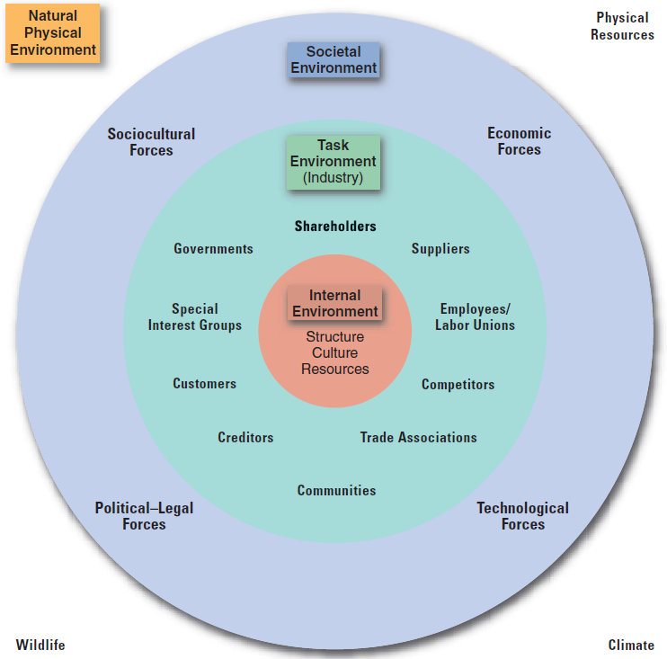
External Environment

Slide 5
External Environment
An external environment is composed of all the outside factors or influences that impact the operation of business.
The business must act or react to keep up its flow of operations. All outside factors that may affect an organization make up the external environment.
The external environment can be broken down into two types:
Macroenvironment – this environment has a secondary and more distant effect upon the organization. Indirectly interactive forces may impact one organization more than another simply because of the nature of a particular business.
Task environment (microenvironment, market environment) – this environment has an immediate and firsthand impact upon the organization. Directly interactive forces include owners, customers, suppliers, competitors, employees, employee unions, and public. Management has a responsibility to each of these groups.

Slide 6
External Environment: Macroenvironment
Macroenvironment consists of large-scale fundamental forces that shape opportunities and pose threats to the organization. These forces are largely uncontrollable but must be monitored for purposes of both short- and long-term planning.
Macroenvironment concerns events and systems that operate on a large scale and form a backdrop to day-to-day business decisions. The macro environment also contains issues and events which are beyond the capacity of individual organizations to influence or control. The macro environment is affecting all organizations in the economy/industry and over which no individual organization has much (if any) influence or control.
These forces affect companies and are as follows:
  economic forces;
  technological forces;
  political forces;
  legal forces;
  social forces
  natural forces;
  demographic forces;
  cultural forces.

Slide 7
Macroenvironment
Economic Environment
The nature of the economic environment is a complex mix of economic, social and political factors.
Change and uncertainty are at the heart of the economic environment and this has been seen in the dynamic changes that have occurred in both the domestic and global economic environments over time.
The economic environment is the source of these resources which can be grouped together into four categories:
  Labor – proportion of the population engaged in production;
  Land – refers to all natural resources;
  Capital – resources in the form of machinery, tools and factories;
  Enterprise – entrepreneur is the key person without whom production would not take place.

Slide 8
Macroenvironment
Economic Environment: Framework of economic environment
Economic system
  Economic structure of the country;
  Nature of economic planning in the country.
Economic policy
  Industrial policy;
  Fiscal policy;
  Monetary policy;
  FDI norms.
Economic indices
  National income, distribution of income, per capita income;
  Rate of growth of GNP;
  Value of imports and exports.
State of economic infrastructure
Strength of money and capital markets

Slide 9
Macroenvironment
Economic Environment: Economic System
Economic system is a social organism through which people earn their living. A modern economic system is complex.
Kinds of economic systems:
  Free enterprise economy – this economic system works on the principle of the least interference by the government or any external force. The primary role of the government is to ensure free working of the economy by removing obstacles to free competition.
  Government controlled economy – economies are controlled, regulated and managed by the government agencies.
  Mixed economy – is one in which there exist both government and private economic systems. A mixed economy has both public sector (the government economy) and private sector (the private economy).

Slide 10
Macroenvironment
Economic Environment: Business and economic system (economic problems)
The allocation problem
  If there are insufficient resources to satisfy every need or want then decisions have to be made as to what to produce.
  When any decision is being made about resource use, the full range of options has to be considered.
The production problem
  How does the economy organize the production of the chosen commodity?
  We need to carefully examine the economic environment that would lead to such productive efficiency.
The distribution problem
  We ought to have a clear set of criteria for judging distributive efficiency or what can be variously described as equity, fairness or justice.

Slide 11
Macroenvironment
Demographic Environment
The demographic environment includes factors like:
  Size, density and location of human populations;
  Distribution of a particular market in terms of age, gender, race, occupation;
  Other statistical information.
These factors have a considerable impact on the business as they determine the size of the market for different types of products and services and also influence the cost of serving that market.

Slide 12
Macroenvironment
Demographic Environment: Demographic trends
In the environment we will focus on the following dimensions of the population and demographic change:
  population size;
  population structure.
Population change (growth or decline) is determined by the combined effects of:
  natural changes resulting from birth and death rates;
  net migration.
Ageing population means that there is a growing number and proportion of people at the top end of the age structure, particularly those who are above retirement age.

Slide 13
Macroenvironment
Political Environment
Political environment describes the political system prevailing in the country and also deals with the regulations and legislations, government programs and other similar problems.
Political environment determines the rules under which we live together and creates a „good society“. Political environment refers to the influence exerted by political institutions in shaping, directing, developing and controlling business activities.
Politics is an important element of the external business environment, but it also has an internal dimension. Politics and governance operate on a number of levels or spatial scales.
The relationship between business and politics is a key aspect of the complex business environment, including social, technological and other dimensions.

Slide 14
Macroenvironment
Political Environment: Types of political systems
We can classify political systems into broad types, which allows us to see the most important differences and group countries with similar political systems together.
Types of political systems:
  Liberal democracy – the form of government that combines democratic procedures with forms of individual freedom and equity.
  Non-democratic systems
    Communist regimes;
    Dictatorships.

Slide 15
Macroenvironment
Political Environment: Government-Business Relationships
Politics and business are not separate but interdependent. In some ways business depends on government and government in some ways depends on business.
The basic task of government in all societies is to determine the rules within which people live, including rules governing business behavior.
Law or regulation and taxation are key elements of the government and business relationship.
Business has an important stake in these and other areas of government activity.
Government is the principal customer for some organizations and industries.

Slide 16
Macroenvironment
Political Environment: Role of Government
The role of government in relations to business can be examined by identifying three models
  minimal state;
  developmental state;
  social-democratic state.
Government:
  determines the legal framework within which business operates;
  influences or determines the scope of market relationships and the balance or mix between the market and other sectors;
  relates to private sector business as a major customer;
  relates to private sector business as a provider of services and resources;
  relates to private sector business as a tax collector;
  manages the macroeconomic environment;
  represents business interests overseas, in relation to foreign governments and international organizations.

Slide 17
Macroenvironment
Legal Environment
Legal environment is a dynamic part of the business environment. The law changes on a daily basis and adds to the complexity of the business environment.
Legal environment determines the parameters within which businesses can operate.
The law is shaped by a number of factors such as social, economic and political. The law cannot be seen in isolation and in particular it is closely linked to the political environment.
Legal systems operate within geographical boundaries or jurisdictions. The law in different nation states will therefore vary.

Slide 18
Macroenvironment
Legal Environment: Legislative Systems
There are four major bases for legislative systems:
  Common law – found in the UK, the USA, Canada and other countries under the English influence. Common law is employed by the greatest number of people in the world;
  Islamic law – derived from the Koran and applied in Islamic States;
  Commercial legal system – found in socialist economies and states like China and the former Soviet Union;
  Civil (also known as Continental European) or Code law – found in Germany, France and other European countries, Japan and non-Islamic and non-socialist countries. Civil law is the most widespread by landmass.

Slide 19
Macroenvironment
Legal Environment: Law and Business Activities
The law plays an important role in creating markets and enabling them to operate.
The law determines the different structures a business can adopt.
The law does not exist in a vacuum and therefore is strongly influenced by the prevailing values within society. These values reflect different competing interests.
In modern society the law affects all aspects of business activity:
  Relations with employees (employee protection);
  Relations with consumers (consumer protection);
  Competitive behaviors and relationships (competition policy);
  Impacts on third parties and the environment (planning law).

Slide 20
Macroenvironment
Cultural Environment
Culture refers to the specific learned norms of a society based on attitudes, values, beliefs, and frameworks for processing information and tasks.
Cultural environment deals with values, norms and accepted behavioral patterns.
An important aspect of the cultural environment is related to the values that consumers hold. These values revolve around a number of fundamental concerns like time, quality, health, environment, home, personal finance and diversity. Any shift in the values of a society directly or indirectly influences business.

Slide 21
Macroenvironment
Cultural Environment: Cultural Environment and Business
People´s attitude towards business and work is strongly influenced by the culture in which they are born and brought up.
The extent of collectivism and individualism in the thinking and behavior of people is strongly influenced by their culture. This further affects the behavior of individuals as consumers.
Concern for environmental pollution, attitude towards consumerism, use of mass media and the role of business in society are strongly influenced by the culture of a society.

Slide 22
Macroenvironment
Social Environment
Social environment describes the people, their attitudes, social behavior and impact of education, knowledge explosion and public opinion.
A person´s interaction with the society he or she lives in shapes, refines and even alters his or her beliefs, values and norms which in turn define his or her tastes and preferences and even prompts him or her to absorb a world view of things.
The social environment greatly influences the nature of consumer demand, the consumer decision-making etc. The environment strongly influences the behavior of the individuals of a group, which further has an impact on the practices adopted by business organizations.

Slide 23
Macroenvironment
Social Environment: Impact of Social Environment on Business
Social environment creates or influences the attitude, personality, thought process and behavior of the people who are part of it.
It determines of influences consumption patterns and demand for goods and services in a society.
It includes the awareness about the rights and the work ethics of the members of society.
Parameters of social division too have an impact on the attitudes and thinking of people as consumers of goods and services.

Slide 24
Macroenvironment
Technological Environment
Technological environment can be seen as encompassing both the creation of new knowledge and its application to improve business efficiency and, in so doing, improve the standards of living and the quality of life.
Technological environment is conducive to the development and implementation of technological improvement. Technology alters the business environment by providing new opportunities.
Globalization is rapidly combining with the new technologies to transform the external business environment. Technological change is rapid and no business can afford to stand still in the face of this change.
There is a range of political, economic and social conditions that need to be present in the external environment if technological change is to be supported.

Slide 25
Macroenvironment
Technological Environment: Technology
Technology is application of knowledge to production and this can happen in a variety of ways.
Invention – completely new ideas about products or ways of producing things arise.
Innovation – improves or enhances original inventions (product innovation) or develops production processes (process innovation).
How this technology is used or applied fundamentally depends on the wider political, economic, and socio-cultural environment and the way in which people within business seek to exploit its commercial potential.

Slide 26
Macroenvironment
Technological Environment: The Impact of Technology on Business
Technological change can improve the competitiveness of the organization and add value to the organization.
Technology cannot be ignored by business and it can either boost an organization´s individual position or improve the profitability of the industry in which it operates.
It is important for an organization to adopt a technology strategy that enables it to respond to external changes as well as to develop a consistent approach in relation to its goals.
Finally, the impact of technology in a business can potentially reduce costs, improve quality and productivity, and enable new products to be developed and differentiated.

Slide 27
Macroenvironment
Natural Environment
The natural environment is a term which covers a series of fairly obvious categories such as climate and weather conditions, natural resources and topography. These may affect an organization on a purely local level or there may be global implications.
Business in its activities has a major impact on the natural environment, but this impact can strike back at business.
The current global environmental problems are:
  Global warming;
  Pollution;
  Resource depletion.

Slide 28
Concept of Sustainable Development
The idea and strategy of sustainable development is put forward as a way of ensuring that we collectively live within the constrains of our resources, and the capacity of the environment to absorb the effects of our presence on the planet.
Sustainable development involves cooperative action at global, national and local level.
Governments at all levels may set frameworks of laws and regulations involving a variety tools:
  Market based policy;
  Non-market based policy.

