Slide 1
Analytical Methods of Business Environment 1
Lecture 7
Lucie Reczková

Slide 2
Learning objectives
Industry and market
Industry structure
Industry concentration
Porter’s Five Forces model
Strategic groups
Customer analysis
Market analysis
Marketing research

Slide 3
Introduction
Analysing industries involves building up a detailed knowledge of the competing organizations in the industry and the products (goods and services) they are selling.
A market is a group of customers for specific goods or services that are essentially the same. Analyzing market involves building up a detailed knowledge of the customer and customer groups.
Basic tool for market analysis is market research.
The goal of market analysis is to determine the attractiveness of a market and to understand its evolving opportunities and threats of the organization.

Slide 4
Introduction
An industry is any group of organizations that supplies a market.
Markets are rarely homogeneous.
Industry comprises of a number of markets or more precisely, market segments.
Competition within these segments can vary as well as the profitability of individual companies within this industry.
Analysing industries involves building up a detailed knowledge of the competing organizations in the industry and the products (goods and services) they are selling.
Key questions to ask:
1. What is our company´s industry?
2. What are the characteristics of the industry?
3. How stable are these characteristics?

Slide 5
Introduction
Industry structure
Industry structure is determined by the number and relative strength of organizations in the industry. There is a variety of industry structure:
Perfect competition;
Monopoly;
Monopolistic competition;
Oligopoly.
Industry structure can be influenced:
By the costs incurred by business;
By behaviour of companies in the industry and the nature and intensity of competition;
By company performance.

Slide 6
Introduction
Industry concentration
The distribution of power among organizations in an industry is assessed by the level of industry concentration. Industry concentration gives an indication of the competitive pressures in a industry.
Industry concentration can be measured by looking at the market share of organizations in the industry. High concentration levels usually indicate low intensity competition.
There are various ways of measuring industry concentration. The most straightforward methods are the following:
Concentration rate – calculated by taking the share of the largest organizations in industry sales or output by value or by volume;
Herfindahl-Hirschmann index – calculated by summing the squares of the individual market shares of all the organizations in the industry.

Slide 7
Porter’s Five Forces Analysis
Author - Michael Porter from Harvard Business School
Five Forces Model (1979) offers explanation of the sources of competition in industries.
The model is based on determination of competitive intensity and attractiveness of a market.
It contains 5 main forces: competitive rivalry, threat of new entry, supplier power, buyer power, and threat of substitution.
Companies use this model to analyse the external environment and external forces such as competition, government policies, and social and cultural forces (Vining, 2011).
Arshed, N., McFarlane, J., & MacIntosh, R. (Eds.). (2016). Enterprise and its business environment. Goodfellow Publishers, Limited.

Slide 8
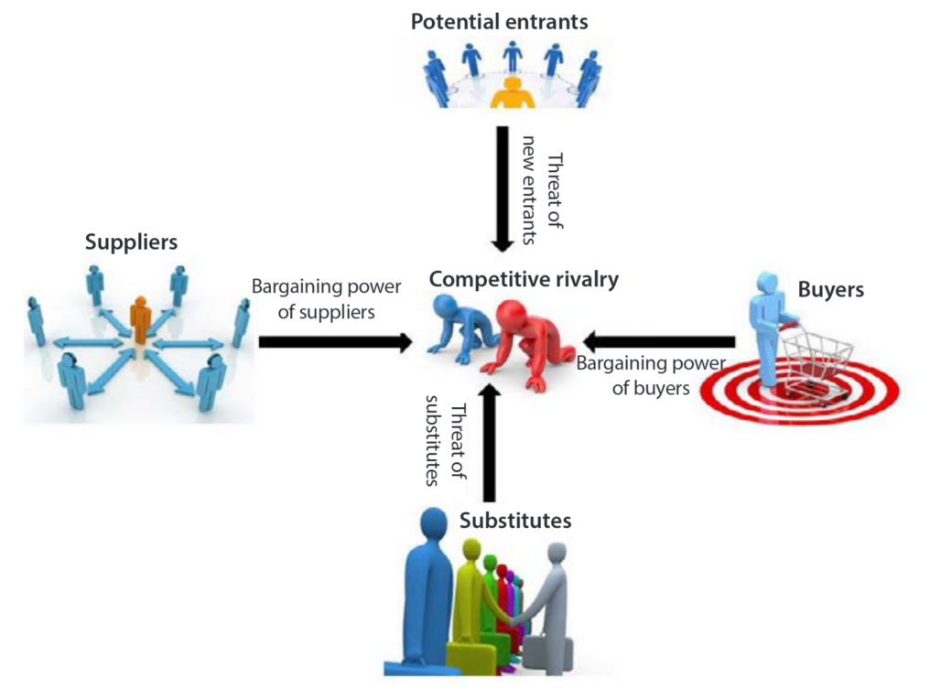
Porter’s Five Forces Analysis
Arshed, N., McFarlane, J., & MacIntosh, R. (Eds.). (2016). Enterprise and its business environment. Goodfellow Publishers, Limited.

Slide 9
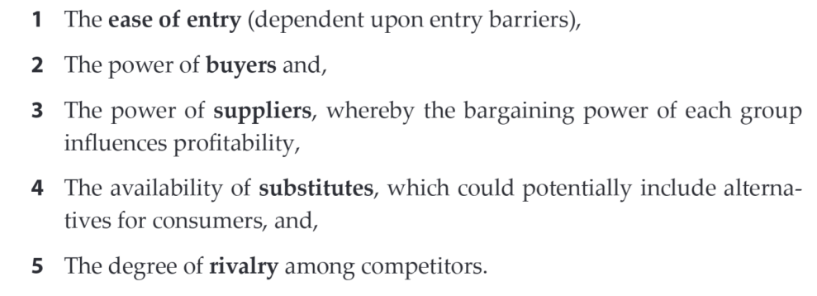
Porter’s Five Forces Analysis
Arshed, N., McFarlane, J., & MacIntosh, R. (Eds.). (2016). Enterprise and its business environment. Goodfellow Publishers, Limited.

Slide 10
Porter’s Five Forces Analysis – Competitive Rivalry
It describes the degree of competitiveness amongst companies.
There are three main benefits of competitive rivalry:
1. Gaining of a larger market share
2. Companies will lower prices due to many choices available to their consumers
3. Driving the economic growth
The intensity of competitive rivalry is determined by many factors:
Arshed, N., McFarlane, J., & MacIntosh, R. (Eds.). (2016). Enterprise and its business environment. Goodfellow Publishers, Limited.

Slide 11
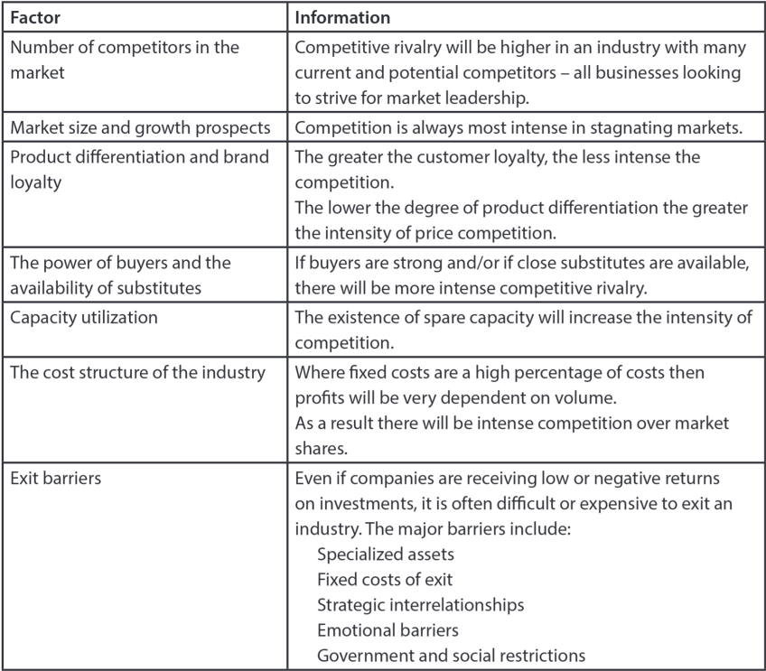
Porter’s Five Forces Analysis – Competitive Rivalry
Arshed, N., McFarlane, J., & MacIntosh, R. (Eds.). (2016). Enterprise and its business environment. Goodfellow Publishers, Limited.

Slide 12
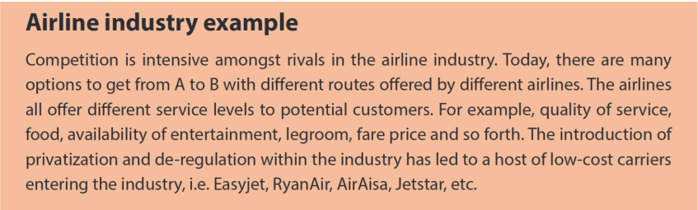
Porter’s Five Forces Analysis – Competitive Rivalry

Slide 13
Porter’s Five Forces Analysis – The threat of new entry
The attractiveness of an industry is the main reason for new entry, alongside the size of the customer base.
Organisations entering into an industry to gain market share and therefore the competition will intensify.
There are six barriers to entry: Economies of scale, Product differentiation, Capital requirements, Cost disadvantages, Access to distribution, Government.
Arshed, N., McFarlane, J., & MacIntosh, R. (Eds.). (2016). Enterprise and its business environment. Goodfellow Publishers, Limited.

Slide 14
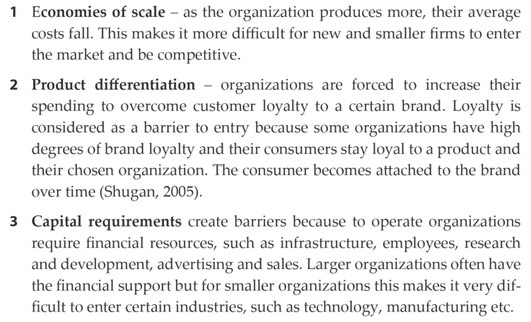
Porter’s Five Forces Analysis – The threat of new entry
Arshed, N., McFarlane, J., & MacIntosh, R. (Eds.). (2016). Enterprise and its business environment. Goodfellow Publishers, Limited.

Slide 15
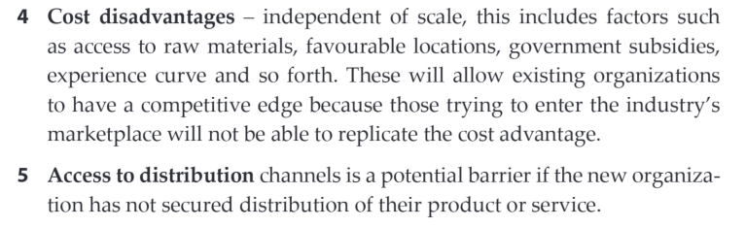
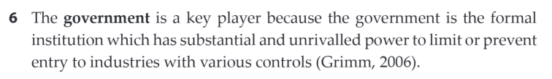
Porter’s Five Forces Analysis – The threat of new entry
Arshed, N., McFarlane, J., & MacIntosh, R. (Eds.). (2016). Enterprise and its business environment. Goodfellow Publishers, Limited.

Slide 16
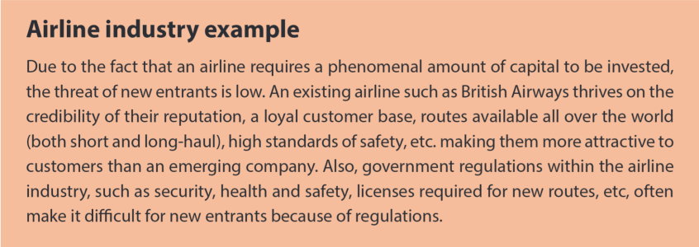
Porter’s Five Forces Analysis – The threat of new entry
Arshed, N., McFarlane, J., & MacIntosh, R. (Eds.). (2016). Enterprise and its business environment. Goodfellow Publishers, Limited.

Slide 17
Porter’s Five Forces Analysis – Buying power
It involves customers who collectively formed a group.
A powerful group of customers exert pressure to either drive the prices down or
increase the quality of goods for the same price, and thus
reduces the profits in the industry.
Arshed, N., McFarlane, J., & MacIntosh, R. (Eds.). (2016). Enterprise and its business environment. Goodfellow Publishers, Limited.

Slide 18
Porter’s Five Forces Analysis – Buying power
Factors determining the bargaining power of customers:
Goods or services bought in large quantities.
The goods being purchased are standard or undifferentiated, so customers can ‘shop around’ for better deal.
The buyers are large and supplier small.
Substitutes available from related industry.
Threats of vertical integration – if demand not met by the suppliers, buyers threaten to provide their own supplies.
Arshed, N., McFarlane, J., & MacIntosh, R. (Eds.). (2016). Enterprise and its business environment. Goodfellow Publishers, Limited.

Slide 19
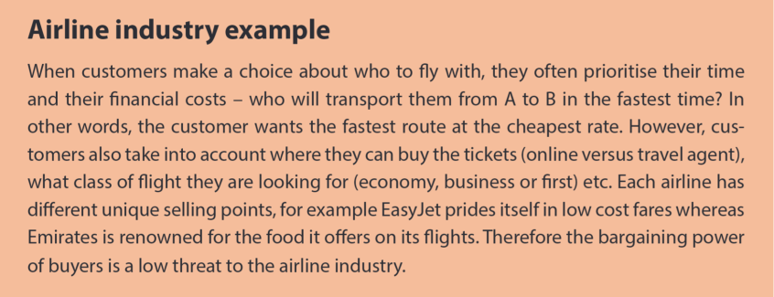
Porter’s Five Forces Analysis – Buying power
Arshed, N., McFarlane, J., & MacIntosh, R. (Eds.). (2016). Enterprise and its business environment. Goodfellow Publishers, Limited.

Slide 20
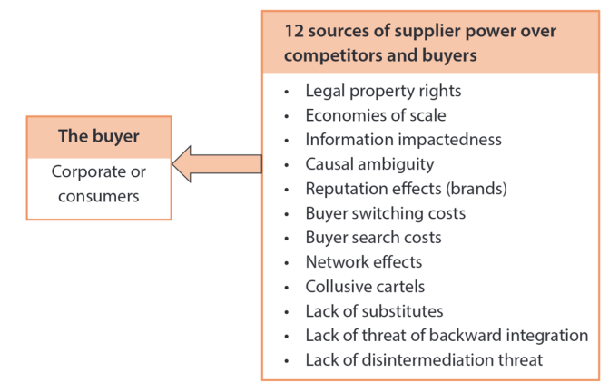
Porter’s Five Forces Analysis – Supplier power
The suppliers have power to sell their products at higher prices.
Example is fast food
restaurants suppliers.
Factors determining
the power of suppliers
Arshed, N., McFarlane, J., & MacIntosh, R. (Eds.). (2016). Enterprise and its business environment. Goodfellow Publishers, Limited.

Slide 21
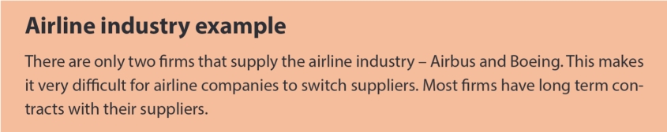
Porter’s Five Forces Analysis – Supplier power
Arshed, N., McFarlane, J., & MacIntosh, R. (Eds.). (2016). Enterprise and its business environment. Goodfellow Publishers, Limited.

Slide 22
Porter’s Five Forces Analysis – Threat of substitutes
Substitutes are goods or services produced by organizations in an apparently different industry, and
delivering same or a similar service to the customer by different function.
Substitutes are easy to overlook, because they may look very different from the industry´s product.
Substitutes nearly always exist.
Arshed, N., McFarlane, J., & MacIntosh, R. (Eds.). (2016). Enterprise and its business environment. Goodfellow Publishers, Limited.

Slide 23
Porter’s Five Forces Analysis – Threat of substitutes
The extent of the substitutes’ threat depends on the following:
1. Switching costs – if there are no switching costs, chances to move to a more attractive substitute is higher. Example is consumer switching from reading hardcopies of books to reading books online, they can do it without any additional fees or costs for the switch.
2. Product price – if the price of substitutes is lower or at a fairer rate.
3. Product quality – if the substitute is of higher quality than any other product in the market, then consumers switch to that substitute.
Arshed, N., McFarlane, J., & MacIntosh, R. (Eds.). (2016). Enterprise and its business environment. Goodfellow Publishers, Limited.

Slide 24
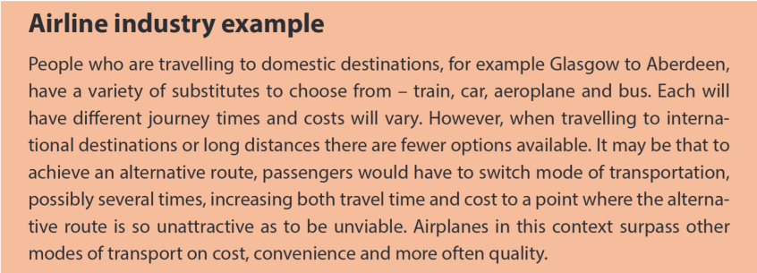
Porter’s Five Forces Analysis – Threat of substitutes
Arshed, N., McFarlane, J., & MacIntosh, R. (Eds.). (2016). Enterprise and its business environment. Goodfellow Publishers, Limited.

Slide 25
Porter’s Five Forces Analysis – Complementors – the sixth force
Complementors are companies that sell or offer goods or services that are compatible with, or complementary to, the goods or services produced and sold in a given industry.
Complementary goods offer more value to the consumer together than apart.
When one product or service complements another there exists a condition called complementarity; a sort of commercial symbiosis.
Complementors are often considered the sixth force of Porter’s industry analysis framework and can benefit or hurt the companies competing in the industry.
https://strategiccfo.com/articles/accounting/complementors-sixth-force-of-porters-five-forces/

Slide 26
Porter’s Five Forces Analysis – Criticism
It doesn’t help to identify and leverage unique sustainable advantages (unique process, a patent, specialist skills) for companies.
The model does not focus on why some companies are able to get an advantageous position.
It overstress competition over the cooperation of companies.
The model does not adapt to the ever-changing and evolving environment.
https://strategiccfo.com/articles/accounting/complementors-sixth-force-of-porters-five-forces/

Slide 27
Strategic groups
Strategic groups are organizations within an industry or sector with similar strategic characteristics, following similar strategies or competing on similar bases.
Strategic characteristics are different from those in other strategic groups in the same industry or sector.
There are many different characteristics that distinguish between strategic groups.
Strategic groups can be mapped onto two dimensional maps – positioning maps – an useful analysis tool.

Slide 28
Strategic groups - Characteristics for identifying strategic groups
Scope of activities
Extent of product diversity;
Extent of geographical coverage;
Number of market segments served;
Distribution channels used.
Resource commitment:
Extent of branding;
Marketing effort;
Extent of vertical integration;
Goods and services quality;
Technological leadership;
Size of organizations.

Slide 29
Strategic groups - Uses of strategic groups analysis
Understanding competition – enables focus on direct competitors within a strategic group, rather than on the whole industry.
Analysis of strategic opportunities – helps to identify attractive strategic spaces (gaps) within an industry.
Analysis of mobility barriers – obstacles to a movement from one strategic group to another. These barriers can be overcome to enter more attractive groups. Barriers can be built to defend an attractive position in a strategic group. (You can read more: https://ceopedia.org/index.php/Mobility_barriers)

Slide 30
Customer Analysis
Customers needs and wants and buying motives are usually not obvious.
To gain deep and fresh insights into customers needs and wants we need good marketing information.
Customer analysis provides the collection and evaluation of data associated with customer needs and market trends, through market research, customer satisfaction measurement, field testing etc.
Customer analysis helps to understand of how each of the market segments behave, analyse customer motivations, and explores their unmet needs.

Slide 31
Market Analysis
A market is the set of actual and potential buyers of a product or service. These buyers share a particular need or want that can be satisfied through exchange relationships.
Analyzing market involves building up a detailed knowledge of the customer and customer groups.
Basic tool for market analysis is marketing research.
The goal of market analysis is to determine the attractiveness of a market and to understand its evolving opportunities and threats for the organisation.
Dimensions of a market analysis:
  Market size;
  Market growth rate;
  Market profitability;
  Market trends.

Slide 32
Marketing research
Marketing research is the systematic design, collection, analysis, and reporting of data relevant to a specific marketing situation facing an organization
Companies use marketing research to have insights into customer motivations, purchase behaviour, and satisfaction.
Marketing research helps companies to assess market potential and share or measure the effectiveness of pricing, product, distribution and promotion activities.

Slide 33

Marketing research
Steps in the Marketing Research Process
https://www.youtube.com/watch?v=JOlYEzpLDbU

Slide 34
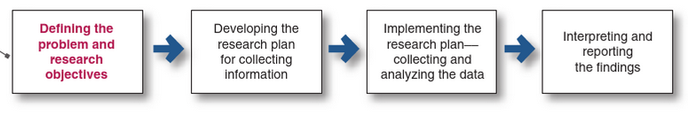
Marketing research process
Defining the problem and research objectives
  Determine and clarify management´s information needs;
  Redefine the decision problem as a research problem;
  Establish research objectives.
Development the research plan for collecting information
  Determine the research design and data sources;
  Determine the sample plan and sample size;
  Determine the measurement issues and scales.
Implementing the research plan
  Collecting and processing data;
  Analysing data;
  Transforming data structures into information.
Interpreting and reporting the findings (results)
Armstrong, G., & Armstrong, G. (2020). Principles of marketing, ebook, global edition. Pearson Education, Limited.

