Slide 1
Analytical Methods of Business Environment 2
Lecture 8
Lucie Reczková

Slide 2
Learning objectives
Value chain analysis
VRIO analysis
McKinsey 7S model
Stakeholders analysis
Portfolio analysis
SWOT analysis

Slide 3
Introduction
The analysis of the business internal environment assists a company to define its business strategy and asses its performance, and its internal strengths and weaknesses.
To analyse the company’s internal environment, we can use following methods:
1. Porter Model of Value Chain Analysis;
2. McKinsey 7S;
3. VRIO method;
4. Stakeholders analysis;
5. Portfolio analyses – ABC method, BCG matrix, GE matrix.
6. SWOT analysis

Slide 4
Value chain
Companies create value by taking materials or ideas and produce them to create something for which they can charge a price that covers the costs of the conversion.
The value chain is the way that materials enter the company and move through each stage while increasing the product in value.

Slide 5
Porter’s Value chain analysis
It identifies 9 generic activities into four support activities and five primary activities.
Support activities: firm’s infrastructure, human resource management, technology development, and procurement.
Primary activities: inbound logistics, operations, outbound logistics, marketing and sales, and customer service.
The main goal is to realize a suitable margin form the activities the company undertakes to deliver their products or services to the customer.
Presutti, W. D. & Mawhinney, J. (2013). Understanding the dynamics of the value chain. Business Expert Press

Slide 6
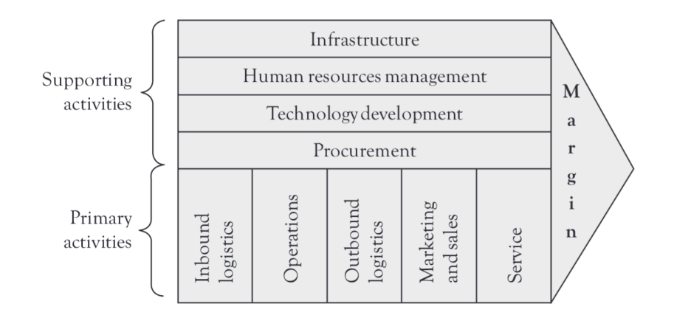
Porter’s Value chain analysis
Presutti, W. D. & Mawhinney, J. (2013). Understanding the dynamics of the value chain. Business Expert Press

Slide 7
Porter’s Value chain analysis
This model emphasize the importance of linkages.
The linkages are horizontally among companies' internal activities and
Vertically among suppliers, channel members, and customers.
The linkages represent relationships between the way one value activity is performed and the cost or performance of another.
Presutti, W. D. & Mawhinney, J. (2013). Understanding the dynamics of the value chain. Business Expert Press

Slide 8
Porter’s Value chain analysis
Value chain analysis involves the following three steps:
1. Examine each product line’s value chain in terms of the various activities involved in producing that product or service.
2. Examine the “linkages” within each product line’s value chain: Linkages are the connections between the way one value activity (for example, marketing) is performed and the cost of performance of another activity (for example, quality control).
3. Examine the potential synergies among the value chains of different product lines or business units: Each value element, such as advertising or manufacturing, has an inherent economy of scale in which activities are conducted at their lowest possible cost per unit of output. If a particular product is not being produced at a high enough level to reach economies of scale in distribution, another product could be used to share the same distribution channel.
Presutti, W. D. & Mawhinney, J. (2013). Understanding the dynamics of the value chain. Business Expert Press

Slide 9
VRIO analysis
VRIO analysis was developed by Barney (1995) to identify strategically valuable resources.
The VRIO Model is part of the Resource-Based View (RBV), which is a perspective that examines the link between a company’s internal characteristics and its performance.
The analysis builds on the basic ideas of the resource-based view (RBV).
Resources are valuable for the organization if they contribute to sustain competitive advantage and these resources are the acronyms of VRIO:
V for value – able to create customer value
R for rarity – resources are rare
I for imitability – imperfectly imitable and substitutable
O for organization – company has to be organized in such a way that it can fully exploit the potential of its strategic resources.
Grünig, R., & Kühn, R. (2015). Strategieplanungsprozess : Analysen, optionen, projekte : analyses, options, projects. Springer.
https://www.business-to-you.com/vrio-from-firm-resources-to-competitive-advantage/

Slide 10
VRIO analysis
Types of resources used in VRIO analysis
Tangible assets – plants, computer hardware, financial resources
Intangible assets – information, legal rights (brands, patents, licences etc.), image of the company name and brand, company reputation
Processes – production processes, development process
Individual human resources – knowledge and skills of managers and employees
Collective human resources – features of corporate culture, quality competencies, procurement and marketing competencies.
Grünig, R., & Kühn, R. (2015). Strategieplanungsprozess : Analysen, optionen, projekte : analyses, options, projects. Springer.
https://www.business-to-you.com/vrio-from-firm-resources-to-competitive-advantage/

Slide 11
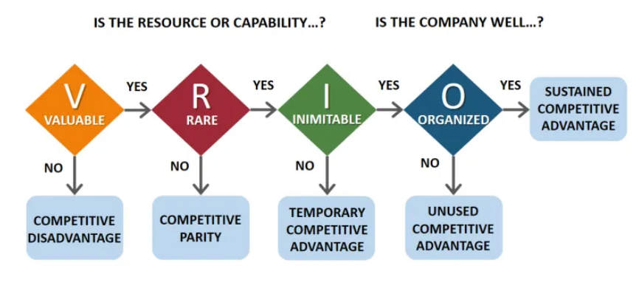
VRIO analysis
https://www.business-to-you.com/vrio-from-firm-resources-to-competitive-advantage/

Slide 12
McKinsey 7s framework
Developed by McKinsey consultancy company as an indicator of the health of the company
The model is useful to carry out an audit of the company to find out where its weaknesses and strengths lie.
It points to where the focus of attention should lie and it is considered as a step beyond SWOT analysis.
It consists of 3 hard elements, that are easier to define or identify and management can directly influence them – strategy, structure and systems, and
4 soft elements, these can be more difficult to describe, because are less tangible and more influenced by culture – skills, style, staff and shared values.
Hague, P. (2019). The business models handbook : Templates, theory and case studies. Kogan Page, Limited.

Slide 13
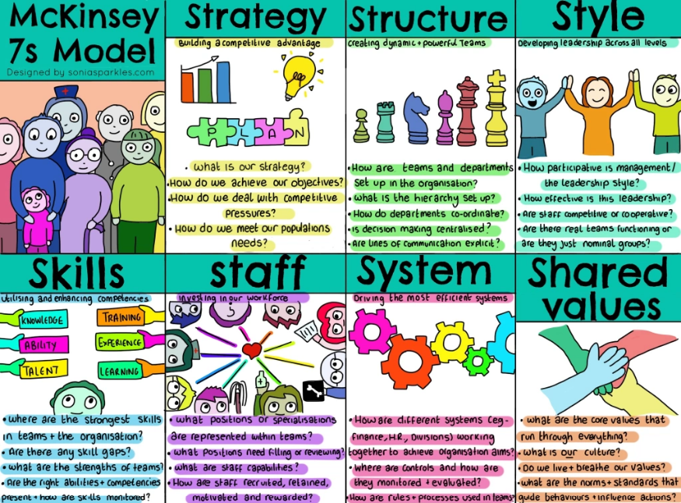
McKinsey 7s framework
https://soniasparkles.com/2018/05/08/mckinsey-7s-model/

Slide 14
Stakeholders analysis
Stakeholder is any individual or a group of individuals that is affected by a business decision. Stakeholders have the capacity to affect business performance through their decisions and behaviour.
Internal stakeholders are all internal members of a organization:
Employees; Directors; Shareholders.
External stakeholders include:
Customers; Suppliers; Competitors; Politicians; Policy-makers; Community; General public

Slide 15
Stakeholders analysis
In terms of environmental analysis, organizations need to have an understanding of steps in analysis:
Who are stakeholders of the organization;
Identification nature of interests of stakeholders;
Nature and level of their interest in the organization;
Consider whether there are any conflicts between the interests of different stakeholders;
Power of stakeholders to exert influence – consider in what way and to what extent, each stakeholder exercises power of influence.

Slide 16
Portfolio analysis
Definitions:
Portfolio analysis could be defined as a set of techniques that help to make strategic decisions with regard to individual products or business in a organization´s portfolio.
Portfolio analysis is a major activity in strategic planning whereby management evaluates the products and businesses that make up the company
Objective:
The objective of the analysis is to determine how to allocate resources to each of the product or business in the organization´s portfolio.
It is primarily used for competitive analysis and corporate strategic planning in multiproduct and multi-business organizations.
The analysis of products or business can be performed by using these methods:
1. Boston Consulting Group Matrix - BCG matrix;
2. General Electric Matrix - GE matrix.

Slide 17
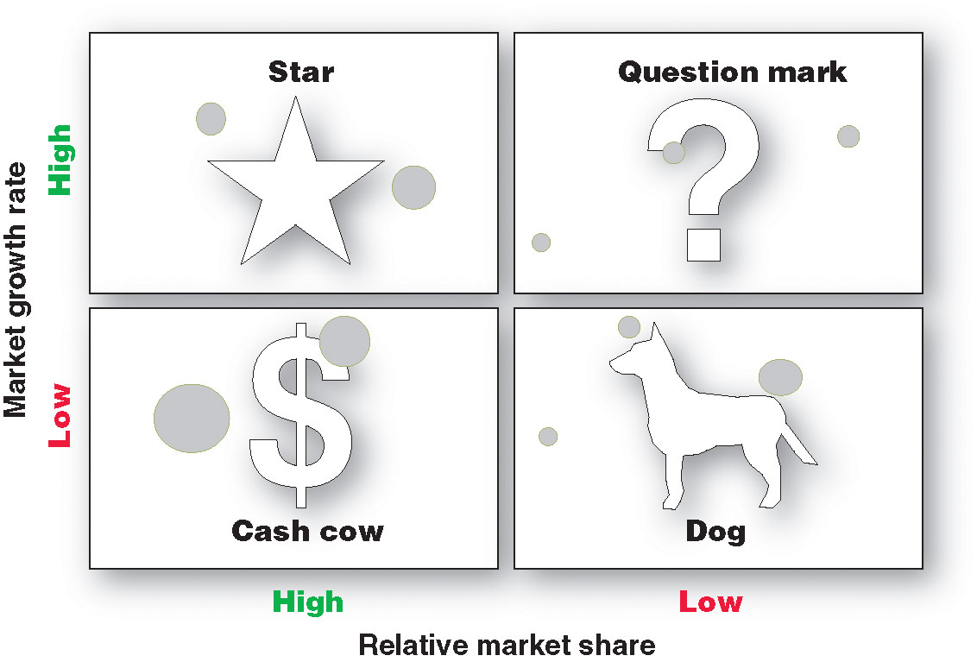
Boston Consulting Group Matrix - BCG matrix
Back in 1968 a clever chap from Boston Consulting Group (BCG), Bruce Henderson, created this chart to help organisations with the task of analysing their product line or portfolio.

Slide 18
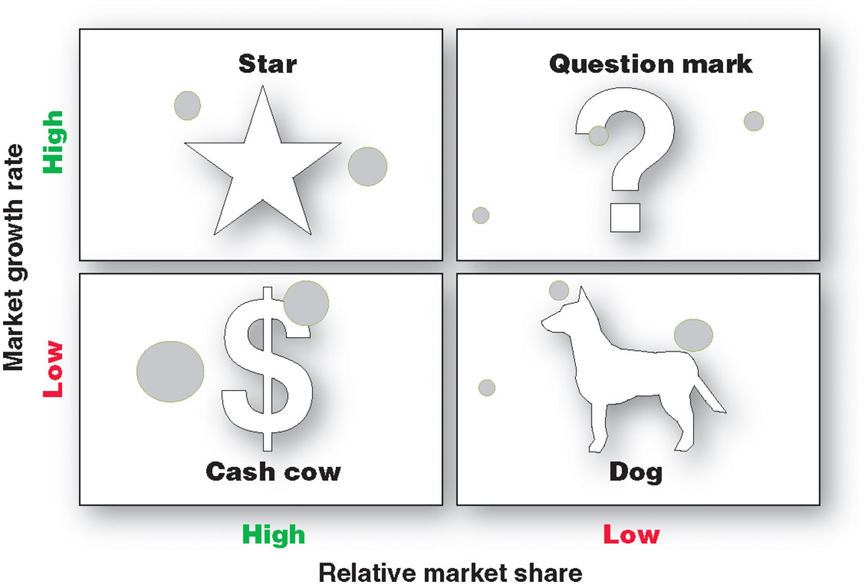
Boston Consulting Group Matrix - BCG matrix
Stars are high-growth, high-share businesses or products requiring heavy investment to finance rapid growth. They will eventually turn into cash cows.

Slide 19
Boston Consulting Group Matrix - BCG matrix
Cash cows are low-growth, high-share businesses or products that are established and successful SBUs requiring less investment to maintain market share.

Slide 20
Boston Consulting Group Matrix - BCG matrix
Question marks are low-share business units in high-growth markets requiring a lot of cash to hold their share.

Slide 21
Boston Consulting Group Matrix - BCG matrix
Dogs are low-growth, low-share businesses and products that may generate enough cash to maintain themselves but do not promise to be large sources of cash.

Slide 22
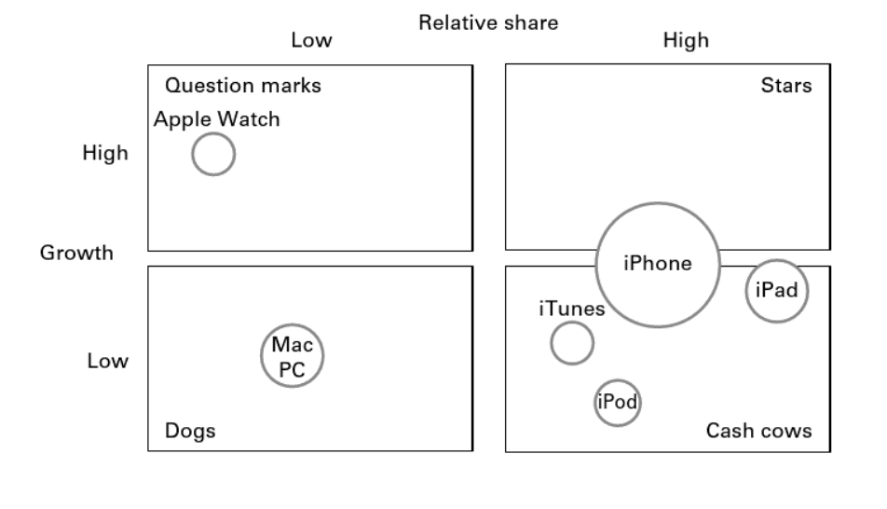
Boston Consulting Group Matrix - BCG matrix
Apple’s portfolio in the BCG matrix (for illustration only)
Hague, P. (2019). The business models handbook : Templates, theory and case studies. Kogan Page, Limited.

Slide 23
Boston Consulting Group Matrix - BCG matrix
Read case study:
Case study applied on BCG Matrix attached as pdf file
Grünig, R., & Kühn, R. (2015). Strategieplanungsprozess : Analysen, optionen, projekte : analyses, options, projects. Springer.

Slide 24
General Electric McKinsey matrix – GE McKinsey matrix
GE McKinsey matrix is very similar to BCG matrix and as a strategy tool it is used to evaluate business unit portfolio and helps to prioritise the investment needed for each business unit.
GE matrix is a nine cell matrix and is more sophisticated the BCG matrix – the matrix has multicriterial character.
The organization´s products or business units are evaluated on two axes: Industry attractiveness and Competitive strength.
There are three groups of boxes (three fields) in GE matrix:
Investment/growth;
Selectivity/earnings;
Harvest/divest boxes.
https://strategicmanagementinsight.com/tools/ge-mckinsey-matrix/

Slide 25
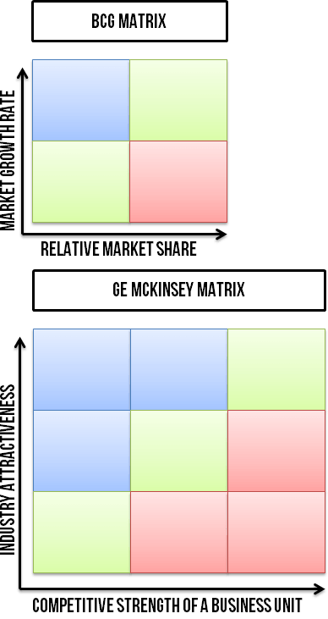
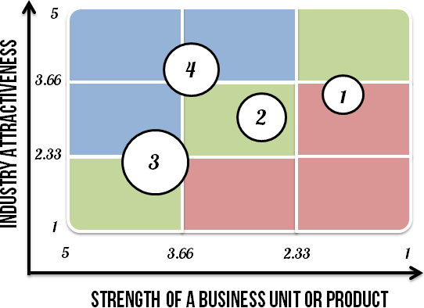
General Electric McKinsey matrix – GE McKinsey matrix
Difference between BCG and GE McKinsey matrixes
Business unites plotted on the matrix
https://strategicmanagementinsight.com/tools/ge-mckinsey-matrix/

Slide 26
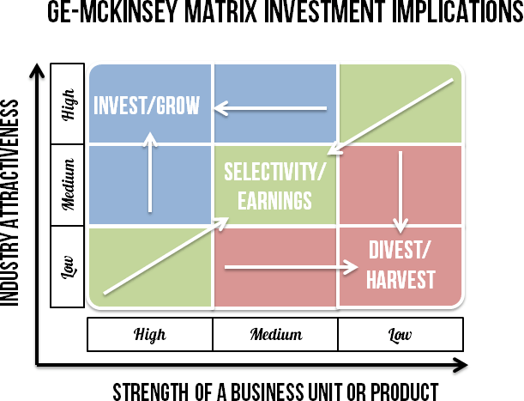
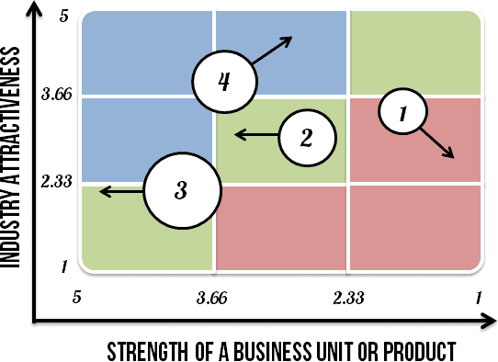
General Electric McKinsey matrix – GE McKinsey matrix
Analysing the information
Prioritise the investments
https://strategicmanagementinsight.com/tools/ge-mckinsey-matrix/

Slide 27
General Electric McKinsey matrix – GE McKinsey matrix
Industry attractiveness indicates how hard or easy it will be for an organization to compete in the market and earn profit.
Industry attractiveness consists of many factors that collectively determine the competition level in it. There´s no definite list of which factors should be included to determine industry attractiveness, but the following are the most common:
Long run growth rate;
Industry size;
Industry profitability (entry barriers, exit barriers etc.);
Industry structure;
Product life cycle changes;
Changes in demand;
Trend of prices;
Macro environment factors;
Seasonality;
Availability of labour;
Market segmentation.
https://strategicmanagementinsight.com/tools/ge-mckinsey-matrix/

Slide 28
General Electric McKinsey matrix – GE McKinsey matrix
Competitive strength measures how strong, in terms of competition, a particular business unit (or product) is against its rivals. Managers try to determine whether a business unit has a sustainable competitive advantage.
The following factors determine the competitive strength of a business unit:
Total market share;
Market share growth compared to rivals;
Brand strength;
Profitability of the organization;
Customer loyalty;
Resources or capabilities;
Business unit strength in meeting industry´s critical success factors;
Strength of a value chain;
Level of product differentiation;
Production flexibility.
https://strategicmanagementinsight.com/tools/ge-mckinsey-matrix/

Slide 29
General Electric McKinsey matrix – GE McKinsey matrix
Steps for performing of GE matrix
1. Determine industry attractiveness of each business unit
Make a list of factors, assign weights, rate the factors, calculate the total scores.
2. Determine the competitive strength of each business unit
Make a list of factors, assign weights, rate the factors, calculate the total scores.
3. Plot the business units on a matrix
4. Analyse the information
Invest/grow box – organizations should invest into the business units that fall into these boxes.
Selectivity/earning box – manager should invest into these business units only if manager has the money left over the investments in invest/grow business units group.
Harvest/divest box – business unit that are operating in unattractive industries.
5. Identify the future direction of each business unit
6. Prioritize investments
https://strategicmanagementinsight.com/tools/ge-mckinsey-matrix/

Slide 30
General Electric McKinsey matrix – GE McKinsey matrix
Advantages and disadvantages of GE matrix
Advantages
Helps to prioritize the limited resources in order to achieve the best returns.
Managers become more aware of how their products or business units perform.
Identifies the strategic steps the organization needs to make to improve the performance of its business portfolio.
Disadvantages
Requires a consultant or a highly experienced person to determine industry´s attractiveness and business unit strength as accurately as possible.
It is costly to conduct.
It doesn´t take into account the synergies that could exist between two or more business units.
https://strategicmanagementinsight.com/tools/ge-mckinsey-matrix/

Slide 31
SWOT Analysis
SWOT analysis combines internal and external analyses of the Strengths and Weaknesses of the organizations coupled with the Opportunities and Threats in the external business environment.
Benefits of SWOT analysis:
Simplicity;
Lower costs;
Flexibility;
Integration and synthesis;
Collaboration.
Criticisms against SWOT analysis:
It allows companies to create lists without serious consideration of the issues;
It often becomes a sterile academic exercise of classifying data and information.

Slide 32
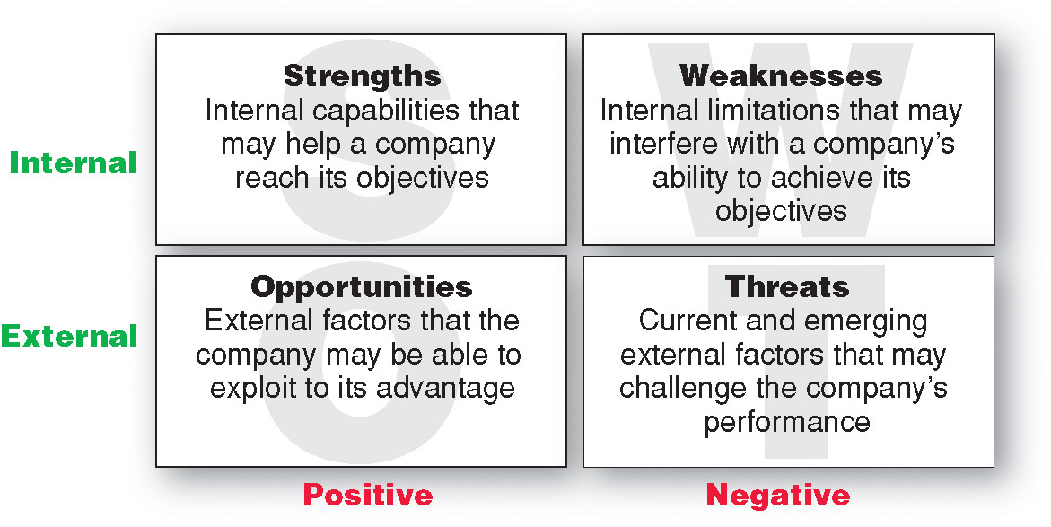
SWOT Analysis

