Slide 1
Analytical Methods of Business Environment
Analytical Methods of Internal Environment
8. lecture
Ing. Šárka Zapletalová, Ph.D.
Department of Business Economics and Management
BUSINESS ENVIRONMENT

Slide 2
Outline of the lecture
Value chain analysis
VRIO analysis
McKinsey 7S model
Stakeholders analysis
Portfolio analysis
SWOT analysis

Slide 3
Introduction
Internal business environment is constituted by the organization itself.
The analysis of internal business environment refers to the analysis of the business internal environment to assist business strategy and performance, the internal strengths and weaknesses of the organization.
Among the analyses of internal business environment the following methods can be ranked:
Porter Model of Value Chain Analysis;
McKinsey 7S;
VRIO method;
Stakeholders analysis;
Portfolio analyses – ABC method, BCG matrix, GE matrix.

Slide 4
Value Chain Analysis
A value chain is a linked set of value-creating activities that begin with basic raw materials coming from suppliers, moving on to a series of value-added activities involved in producing and marketing a product or service, and ending with distributors getting the final goods into the hands of the ultimate consumer.
The focus of value-chain analysis is to examine the corporation in the context of the overall chain of value-creating activities, of which the firm may be only a small part.
Typical Value Chain for a Manufactured Product

Slide 5
Porter´s Model of Value Chain Analysis
Value chain analysis proposes a system view of the organization composed of stages in a transformation process with inputs and outputs to each of the distinct stages.
Value, according to Michael Porter, is the price that a costumer is prepared to pay for an offering. Profit is the difference between this value and total costs to the enterprise of providing that offering.
Value chain analysis divides an enterprise into a chain of activities and each element in the value chain delivers a part of the total value to the customer and contributes part of the total profit.
The purpose of value chain analysis is to measure the value delivered and the profit contributed by each link of the chain.

Slide 6
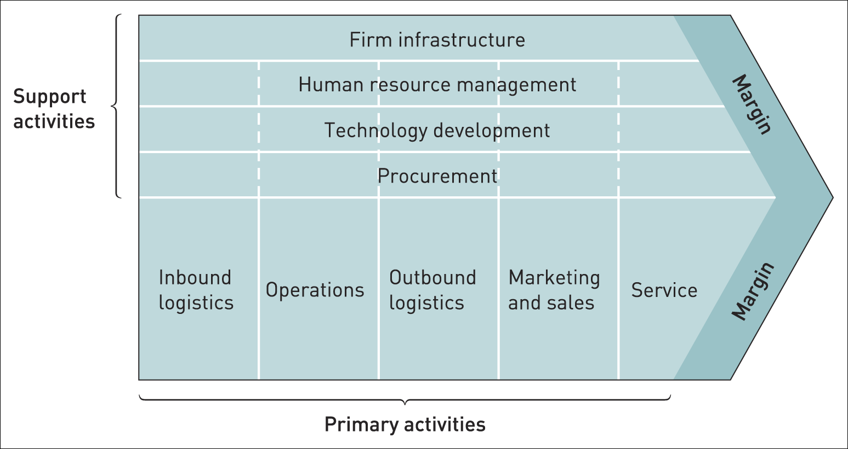
Porter´s Model of Value Chain Analysis

Slide 7
Porter´s Model of Value Chain Analysis
Porter´s value chain model describes five values that are generating primary activities and support activities.
Primary activities:
Inbound logistics;
Operations;
Outbound logistics;
Marketing and sales;
Service.
Support activities:
Procurement;
Technology development;
Human resource management;
Firm infrastructure.

Slide 8
Porter´s Model of Value Chain Analysis
Value chain analysis involves the following three steps:
Examine each product line’s value chain in terms of the various activities involved in producing that product or service.
Examine the “linkages” within each product line’s value chain: Linkages are the connections between the way one value activity (for example, marketing) is performed and the cost of performance of another activity (for example, quality control).
Examine the potential synergies among the value chains of different product lines or business units: Each value element, such as advertising or manufacturing, has an inherent economy of scale in which activities are conducted at their lowest possible cost per unit of output. If a particular product is not being produced at a high enough level to reach economies of scale in distribution, another product could be used to share the same distribution channel.

Slide 9
VRIO Analysis
VRIO analysis was developed by Barney (1995) to identify strategically valuable resources. The analysis builds on the basic ideas of the resource-based view RBV.
Resources that are subjects of VRIO analysis are:
Tangible (physical) and intangible;
Human;
Financial.
The term VRIO stands for the initials of four questions that can be asked whether the resource is:
Valuable?
Rare?
Imitable?
Organised for usage?

Slide 10
Applying the VRIO
V
R
I
O
Sustainable Competitive Advantage
Competitive Disadvantage
Competitive Parity
Temporary Competitive Advantage
Temporary Competitive Advantage
Prostor pro doplňující informace, poznámky

Slide 11
McKinsey 7S Model
The McKinsey 7S framework was first published by Waterman and others in 1980. The McKinsey consultants argue that in looking at an organization as a whole, seven variables are important, but the essential thing about them is that they are inter-linked.
The model can be used in a wide variety of situations where an alignment perspective is useful to help organizations:
Improve the performance of a organization;
Examine the likely effects of future changes within a organization;
Align departments and processes during a merger or acquisition;
Determine how best to implement a proposed strategy.

Slide 12
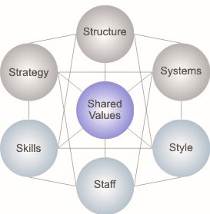
McKinsey 7S Model

Slide 13
McKinsey 7S Model
The McKinsey 7S model involves seven interdependent factors which are categorized as either hard or soft elements.
Hard elements – are easier to define or identify and management can directly influence them. These are:
Strategy;
Structure;
Systems.
Soft elements – can be more difficult to describe and are less tangible and more influenced by culture. These are:
Shared values;
Skills;
Style;
Staff.

Slide 14
Stakeholders Analysis
Stakeholder is any individual or group that is affected by business decision. Stakeholders have the capacity to affect business performance through their decisions and behavior.
Internal stakeholders are all internal members of a organization:
Employees;
Directors;
Shareholders.
External stakeholders include:
Customers;
Suppliers;
Competitors;
Politicians;
Policy-makers;
Community;
General public

Slide 15
Stakeholders Analysis
In terms of environmental analysis, organizations need to have an understanding of steps in analysis:
Who are stakeholders of the organization;
Identification nature of interests of stakeholders;
Nature and level of their interest in the organization;
Consider whether there are any conflicts between the interests of different stakeholders;
Power of stakeholders to exert influence – consider in what way and to what extent, each stakeholder exercises power of influence.

Slide 16
Portfolio Analysis
Portfolio analysis could be defined as a set of techniques that help strategists in taking strategic decisions with regard to individual products or business in a organization´s portfolio.
The objective of the analysis is to determine how to allocate resources to each of the product or business in the organization´s portfolio.
It is primarily used for competitive analysis and corporate strategic planning in multiproduct and multi-business organizations.
The analysis of products or business can be performed by using these methods:
Boston Consulting Group Matrix BCG matrix;
General Electric Matrix GE matrix.

Slide 17
Portfolio Analysis
BCG matrix
Boston Consulting Group matrix BCG matrix provides a graphic representation for a organization to examine the different businesses in a organization´s portfolio on the basis of their relative market shares and industry growth rates.
Vertical axis denotes the rate of growth in sales, in percentage, for a particular industry.
Horizontal axis represents the relative market share, which is the ratio of organization´s sales to the sales of the industry´s largest competitor or market leader.
The result of combining the industry growth rate and the relative market share in a four-cell matrix.

Slide 18
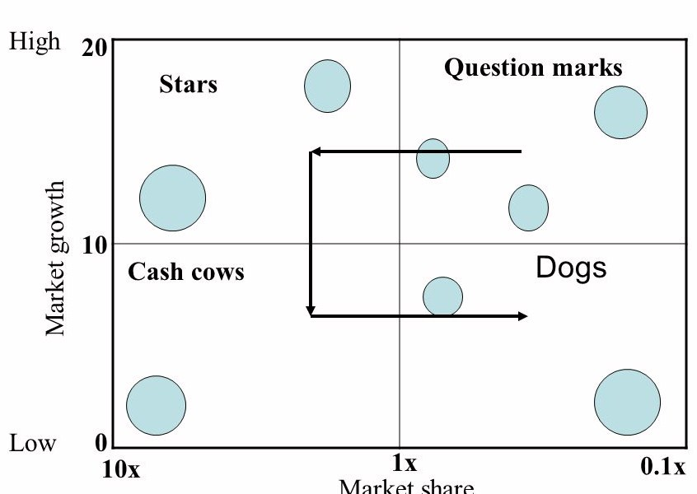
Portfolio Analysis
BCG matrix
Market growth is expressed in percentage terms.

Slide 19
Portfolio Analysis
BCG matrix
Question marks (problem children) – businesses with high industry growth but low market share for a organization. They are usually new products which have a good commercial potential.
Stars – are businesses with high industry growth and high market share for a organization. A organization generally pursues an expansion strategy to establish a strong competitive position with regard to a star business.
Cash cows – are businesses which generate high market share but their rate of market growth is slow as cash cow businesses lose their attractiveness and tend towards a decline.
Dogs – are businesses with related slow industry growth and have a low relative market share. They neither generate nor require large amount of cash.

Slide 20
Portfolio Analysis
GE McKinsey matrix
General Electric McKinsey matrix is very similar to BCG matrix. GE matrix is used to analyze organization´s product or business unit portfolio and facilitate the investment decisions.
GE matrix is a nine cell matrix. It is a more sophisticated business portfolio framework than the BCG matrix – the matrix has multicriterial character.
The organization´s products or business units are evaluated on two axes:
Industry attractiveness;
Competitive strength.
There are three groups of boxes (three fields) in GE matrix:
Investment/growth;
Selectivity/earnings;
Harvest/divest boxes.

Slide 21
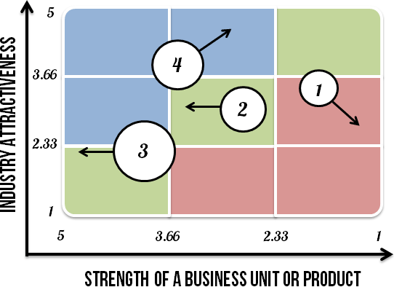
Portfolio Analysis
GE McKinsey matrix

Slide 22
Portfolio Analysis
GE McKinsey matrix
Industry attractiveness indicates how hard or easy it will be for a organization to compete in the market and earn profit.
Industry attractiveness consists of many factors that collectively determine the competition level in it. There´s no definite list of which factors should be included to determine industry attractiveness, but the following are the most common:
Long run growth rate;
Industry size;
Industry profitability (entry barriers, exit barriers etc.);
Industry structure;
Product life cycle changes;
Changes in demand;
Trend of prices;
Macro environment factors;
Seasonality;
Availability of labor;
Market segmentation.

Slide 23
Portfolio Analysis
GE McKinsey matrix
Competitive strength measures how strong, in terms of competition, a particular business unit (or product) is against its rivals. Managers try to determine whether a business unit has a sustainable competitive advantage.
The following factors determine the competitive strength of a business unit:
Total market share;
Market share growth compared to rivals;
Brand strength;
Profitability of the organization;
Customer loyalty;
Resources or capabilities;
Business unit strength in meeting industry´s critical success factors;
Strength of a value chain;
Level of product differentiation;
Production flexibility.

Slide 24
Portfolio Analysis
GE McKinsey matrix: Steps for performing of GE matrix
Determine industry attractiveness of each business unit
Make a list of factors, assign weights, rate the factors, calculate the total scores.
Determine the competitive strength of each business unit
Make a list of factors, assign weights, rate the factors, calculate the total scores.
Plot the business units on a matrix
Analyze the information
Invest/grow box – organizations should invest into the business units that fall into these boxes.
Selectivity/earning box – manager should invest into these business units only if manager has the money left over the investments in invest/grow business units group.
Harvest/divest box – business unit that are operating in unattractive industries.
Identify the future direction of each business unit
Prioritize investments

Slide 25
Portfolio Analysis
GE McKinsey matrix: Advantages and diasadvantages of GE matrix
Advantages
Helps to prioritize the limited resources in order to achieve the best returns.
Managers become more aware of how their products or business units perform.
Identifies the strategic steps the organization needs to make to improve the performance of its business portfolio.
Disadvantages
Requires a consultant or a highly experienced person to determine industry´s attractiveness and business unit strength as accurately as possible.
It is costly to conduct.
It doesn´t take into account the synergies that could exist between two or more business units.

Slide 26
SWOT Analysis
SWOT analysis combines internal and external analyses – the Strengths and Weaknesses of the organizations coupled with the Opportunities and Threats in the external business environment.
Benefits of SWOT analysis
Simplicity;
Lower costs;
Flexibility;
Integration and synthesis;
Collaboration.
Criticisms against SWOT analysis:
It allows companies to create lists without serious consideration of the issues;
It often becomes a sterile academic exercise of classifying data and information.

Slide 27
SWOT Analysis
 | Strengths | Weaknesses
Opportunities | S-O strategy maxi – maxi Aggressive strategy | W-O strategy mini – maxi Turnaround strategy
Threates | S-T strategy maxi – mini Diversification strategy | W-T strategy mini – mini Defensive strategy

