Slide 1

Topic of the lecture
Identification of key characteristics of entrepreneurial opportunities and mapping those against values, skills, ethics and definitions of success; and planning for professional and personal development.

Slide 2
Key Characteristics of Entrepreneurial Opportunities
Market demand: One of the most important characteristics of a successful entrepreneurial opportunity is market demand. An opportunity with high market demand means that there is a large and growing market for the product or service, and that customers are willing to pay for it. We could provide examples of businesses that have succeeded by identifying and capitalizing on market demand, such as Uber or Airbnb.
Potential for growth: Another important characteristic is the potential for growth. This means that the opportunity has the potential to scale and grow over time, providing increasing returns on investment. We might provide examples of businesses that have grown rapidly, such as Facebook or Amazon, and explain how they identified and pursued opportunities for growth.

Slide 3
Key Characteristics of Entrepreneurial Opportunities
Low competition: Opportunities with low competition can also be attractive to entrepreneurs, as they may be able to capture a larger share of the market and establish themselves as leaders in the industry. We could provide examples of businesses that have succeeded by entering industries with low competition, such as Tesla in the electric vehicle market.
Unique value proposition: Finally, an entrepreneurial opportunity with a unique value proposition can be particularly attractive. This means that the product or service offers something different or better than what is currently available in the market. We could provide examples of businesses that have succeeded by offering a unique value proposition, such as Netflix or Tesla.

Slide 4
Key Characteristics of Entrepreneurial Opportunities
Mapping the key characteristics of entrepreneurial opportunities against values, skills, and ethics
Values:
If you value social impact and sustainability, you might be interested in entrepreneurial opportunities that focus on green energy, sustainable agriculture, or waste reduction.
If you value innovation and creativity, you might be interested in entrepreneurial opportunities in emerging technologies, such as artificial intelligence, blockchain, or virtual reality.

Slide 5
Key Characteristics of Entrepreneurial Opportunities
Skills:
If you have expertise in software development, you might be interested in entrepreneurial opportunities that involve building software applications or platforms for businesses or consumers.
If you have experience in marketing and sales, you might be interested in entrepreneurial opportunities that involve creating and selling products or services to consumers.

Slide 6
Key Characteristics of Entrepreneurial Opportunities
Ethics:
If you prioritize ethical considerations such as fair labor practices and supply chain transparency, you might be interested in entrepreneurial opportunities that involve producing goods or services in a socially responsible and environmentally sustainable manner.
If you prioritize ethical considerations such as data privacy and security, you might be interested in entrepreneurial opportunities that involve developing technology solutions that protect user data and maintain user privacy.

Slide 7
Definitions of success
Success is a key criterion for performance evaluation of an entrepreneur. In words of
business economics, the role of each business is to maximize profits. It means also that minority entrepreneurs when want to be successful therefore, a successful business is one that is profitable. The financial rewards could be a motivating entrepreneur to work hard and take on risks (Tyler, 2017).

Slide 8

What is success?

Slide 9
Success in minority entrepreneurship
Success in minority entrepreneurship can be defined in different ways, depending on the individual's goals and values.
Financial success - Many entrepreneurs see financial success as a key indicator of success. This can include achieving profitability, generating revenue, and building wealth for themselves and their families.
Job creation - For many minority entrepreneurs, success means creating job opportunities for members of their community. This can help to reduce unemployment and increase economic opportunities for individuals and families.

Slide 10
Success in minority entrepreneurship
Social impact - Some minority entrepreneurs are driven by a desire to make positive impact on their communities. Success in this context can mean creating products or services that address social problems, such as poverty, inequality, or environmental sustainability.
Work-life balance - Success can also be defined in terms of work-life balance. For some minority entrepreneurs, success means achieving a balance between their work and personal lives, leading to greater happiness, fulfillment, and overall well-being.
Personal fulfillment - Success can also be defined in terms of personal fulfillment and satisfaction. This can include achieving personal goals, pursuing one's passions, and living a fulfilling and meaningful life.

Slide 11
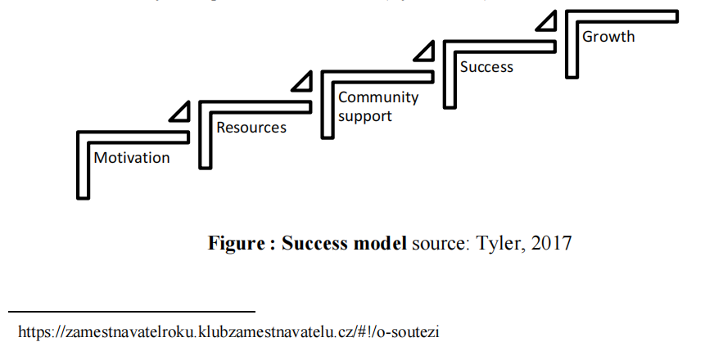
The Entrepreneur’s Success Model

Slide 12
Quick metric to measure success
The break-even point
Leads generated and leads converted
Sales indicators
Net income ratio/profit
Customers (new, repeat and referrals)
Employee satisfaction
Your satisfaction

Slide 13
The social benefit of success
PERSONAL SATISFACTION
When a business is successful, it can lead to personal satisfaction for the owner or entrepreneur. This can have a positive impact on their mental health and well-being, which can translate into better relationships with family, friends, and the community. It can also inspire others to pursue their own entrepreneurial goals, which can lead to more innovation and economic growth.
CUSTOMER SATISFACTION
A successful business is likely to have a high level of customer satisfaction, which can lead to a number of social benefits. Satisfied customers are more likely to return to a business and recommend it to others, which can lead to increased sales and revenue. Additionally, satisfied customers are more likely to leave positive reviews and feedback, which can help attract new customers and build a positive reputation for the business.

Slide 14
The social benefit of success
EMPLOYEE SATISFACTION
When a business is successful, it can lead to higher levels of employee satisfaction. This can result in a more positive work environment and increased employee morale, which can lead to greater productivity and efficiency. Satisfied employees are also more likely to stay with a company for a longer period of time, reducing turnover and the costs associated with hiring and training new employees. Additionally, satisfied employees are more likely to provide excellent customer service, which can lead to higher levels of customer satisfaction and increased sales and revenue.

Slide 15
Professional and personal development for success
KNOW YOUR MINORITY BUSINESS
Successful businesspeople know what they are doing. They have a deep knowledge Support about the industry in which they run (both as it stands today and where it is headed), and success they know who their competitors are. They know how to attract their customers and who the best suppliers and distributors are, and they understand the impact of technology on their business.
KNOW THE BASICS OF BUSINESS MANAGEMENT
You might be able to understand the functional areas of business—accounting, finance management, marketing, and production. You need to be a salesperson, as well as a decision maker and a planner, in the start.

Slide 16
Professional and personal development for success
HAVE THE PROPER ATTITUDE
When you own a business, you are the business person. If you have given the time and energy needed to transform an idea into a successful venture, you need to have a passion for your work. You should believe in what you are doing and make a strong personal commitment to your business.
GET ADEQUATE FUNDING
It takes a lot of money to start a business and guide it through the start-up phase (which can last for over a year). If you run out of cash, your career as a business owner could be brief. Plan for the long term and work with lenders and investors to ensure that you will have enough funds to get open, stay open during the start-up phase, and, ultimately, expand.

Slide 17
Professional and personal development for success
MANAGE YOUR MONEY EFFECTIVELY
You will be under constant pressure to produce the money to meet payroll and pay your other bills. You need to control costs and collect money that has owed you, and, generally, you need to know how to gather the financial information that you need to run your business.
MANAGE YOUR TIME EFFICIENTLY
If you want to grow a business and have some type of no work life at the same time, you will have to give up some control—to let others take overcome of the work. Thus, you must develop time-management skills and learn how to delegate responsibility.

Slide 18
Professional and personal development for success
KNOW HOW TO MANAGE PEOPLE
Hiring, keeping, and managing good people are crucial to business success. You need to develop a positive working relationship with them, train them properly, and motivate them to supply quality goods or services.
SATISFY YOUR CUSTOMERS
You might attract customers through impressive advertising campaigns, but you will
keep them only by supplying quality goods or services. Commit yourself to satisfying—or even exceeding—customer needs.

Slide 19
Professional and personal development for success
KNOW HOW TO COMPETE
Find your niche in the marketplace, keep an eye on your competitors, and be prepared to react to changes in the marketplace. The history of business (and much of life) can be summed up in three words: “Adapt or perish”.

Slide 20
Professional and personal development for success
Some other developments for success
Seek out mentors : Find mentors who have experience in your industry or who have faced similar challenges as a minority entrepreneur. Their advice and guidance can be invaluable in helping you navigate the ups and downs of entrepreneurship.
Network : Attend events and join groups where you can connect with other minority entrepreneurs. This can help you build relationships, find new opportunities, and learn from others who have been in your shoes.
Focus on education : Continuously learning and staying up to date with industry trends and best practices can help you stay ahead of the curve. Look for educational opportunities such as conferences, webinars, or online courses.

Slide 21
Professional and personal development for success
Develop your leadership skills : As a minority entrepreneur, you may be called upon to be a leader in your community or industry. Develop your leadership skills by seeking out opportunities to take on leadership roles, whether it's within your business or in community organizations.
Seek out opportunities : Minority entrepreneurs may face additional challenges in accessing funding for their businesses. Look for organizations or programs that specifically support minority entrepreneurs and can provide funding, mentorship, or other resources.
Build a support network : Surround yourself with a support network of family, friends, and fellow entrepreneurs who can offer encouragement, advice, and support when you need it most.

Slide 22
Summary
Before starting a minority-owned business, the most important thing is for the entrepreneur to be motivated. This means they have personal plans and goals for their business that they believe in and are committed to achieving. It's also important for their goals to be realistic and achievable. Having support from family, friends, or investors is helpful, especially for minority entrepreneurs. To be successful, the business idea must be viable and have potential to succeed in the market. However, success in minority entrepreneurship may be measured differently than in other types of businesses.

