Slide 1
Logistics
-
stores
The aim of the lecture is to discuss importance of storage and different types of stores
.
Šárka Čemerková
lecturer

Slide 2
Logistics
-
Stores
Importance of the storage Strategic and operational decisions in the storage Types of stores Stock operations
.
Structure of the lecture

Slide 3
Importance of storage
integral part of the logistics system - the link between production processes and the customer
influence on the quality of CS
modern store = competitive advantage
importance of IT and automation in materials handling

Slide 5
Why to store?
Efforts to achieve transport cost savings
Efforts to achieve savings in production
Use quantity discounts or purchases to stockpile
Efforts to maintain a supply source
Business strategy support in customer service

Slide 6
Responding to changing market conditions
Bridging time and spatial differences between producer and consumer
Just in Time support at the suppliers or customers
Efforts to provide customers with a comprehensive range of products
Temporary storage of materials to be disposed of or recycled

Slide 7
store
general concept
all kinds of products
acceptance, storage, dispatching and loading
classic store does not carry out operations adding value
batch data collection
minimizing operating costs

Slide 8
Distribution centre
special kind of warehouse
only goods with high demand
only acceptance and dispatching
high share of value added operations
real-time data
profit maximization by meeting requirements

Slide 9
Storage alternatives of enterprises
direct deliveries from the manufacturer to the shops - elimination of local sales warehouses
catalog sellers - central storage facilities at the point of dispatch of goods
distribution mixing centers

Slide 10
Strategic storage decisions
allocation of logistics resources in the longer term in accordance with the overall strategy of the company and its general objectives:
choice of a logistics system type
unification of branch warehouses into a single regional distribution center

Slide 11
use of own capacities vs. leased capacities
transferring storage processes to logistics service providers (outsourcing)
investment in new handling equipment
increase in the number of labour force, etc.

Slide 12
Operational decisions in storage
management or control of logistics performance
usually decisions of a routine nature
short time horizon
higher degree of certainty than strategic decisions

Slide 13
Stock operations
storage process has three basic operations:
material and product transfer
storage of materials and products
transfer of information on stored materials and products

Slide 14
Material and product transfer
Acceptance:
physical unloading or unpacking from the means of transport
updating of stock records (stock database)
condition check (damage)
recheck of the physical number of items with data on the accompanying documentation

Slide 15
Transfer and storage:
physical transfer of products to the store
storage
transfers to special services (e.g. consolidation and shipping)

Slide 16
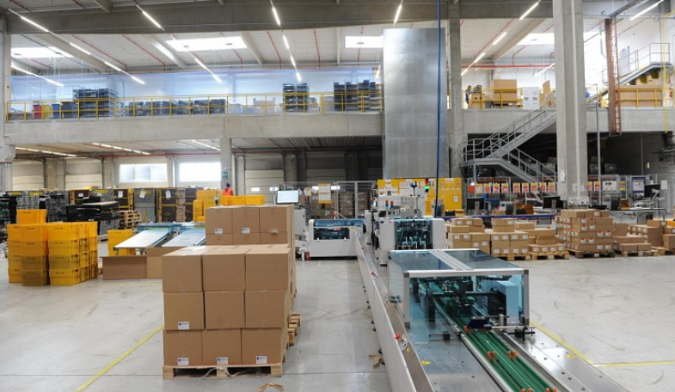
Assembly according to orders:
regrouping in relation to the assortment and quantity required by the customer
creation of wrapping sheets

Slide 17
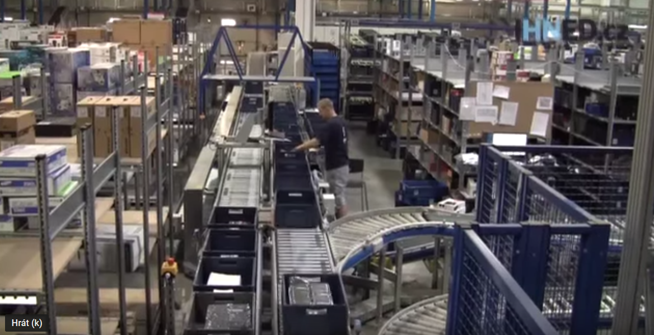
Transhipment:
bypassing the product storage function
goods are transferred from the place of receipt directly to the place of dispatch

Slide 18
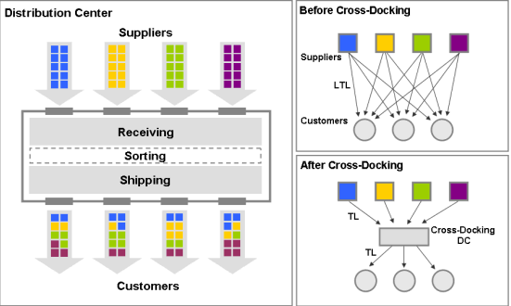

Slide 19
When can we consider cross-docking?
customer is already known when goods are received in the warehouse
customers are ready to receive the goods immediately
more than 70% of the goods can be transported on the belt
we accept large amounts of separate items
goods we accept are already labelled
some types are time sensitive items
our distribution centre is busy almost to full capacity

Slide 20
Dispatch:
packaging
physical loading into a means of transport

Slide 21
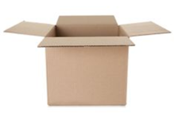
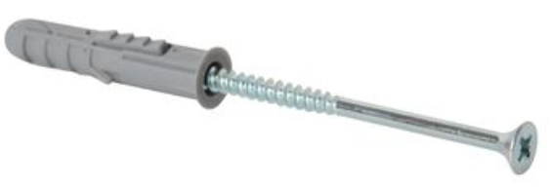
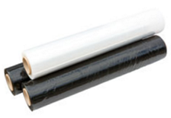
Four basic types of stored stock
raw materials, components and parts (supply phase)
stocks of goods in production (production phase)
finished products and packaging (distribution phase)
materials for disposal or recycling (mostly small share of total stock)

Slide 22
Types of stores
choice on the basis of important financial and CS aspects
private store
public store
customs store
own store vs. contractual storage

Slide 23
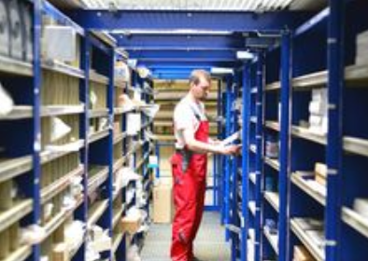
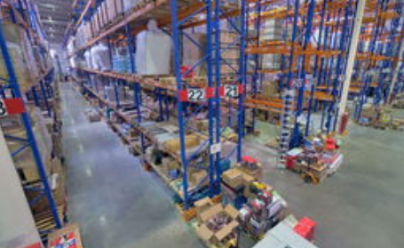
General commercial warehouses:
the most common type
for manufacturers, distributors or customers
for almost all kinds of packaged products

Slide 24
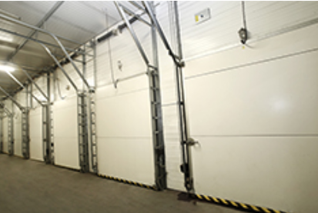
Temperature controlled warehouses:
Deep freezing tunnels
freezing up to -35 ° C
suitable for all food of animal or vegetable origin (finished products, semi-finished and raw materials)

Slide 25
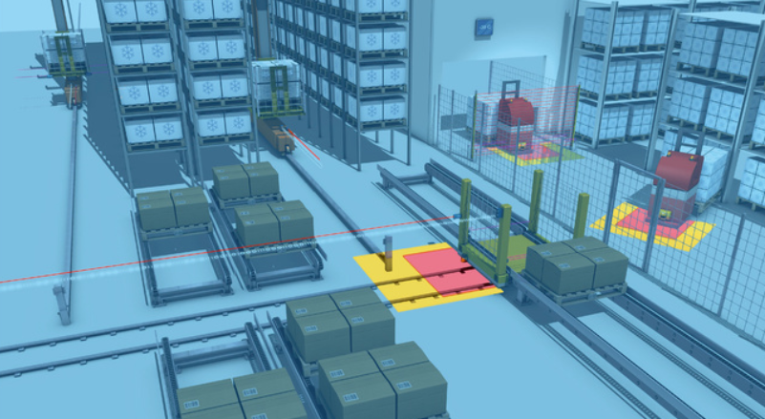
Freezing warehouses
controlled freezing temperature from -18 ° C to -27 ° C
frozen foods, some pharmaceuticals, photo paper and camera films, furs, archival materials

Slide 26
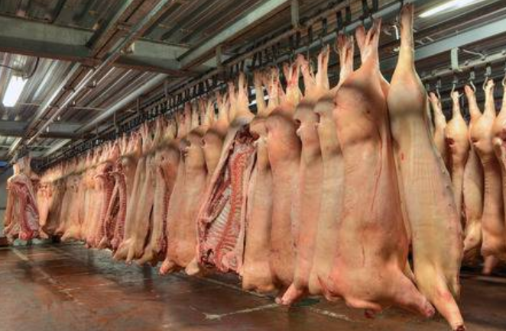
Refrigerated warehouses
rooms with temperature control from 0 ° C to + 15 ° C
perishable goods such as fruits and vegetables, meat, dairy products

Slide 27
Customs store
their facilities and spaces are supervised by a representative of the Ministry of Finance
customs duties and excise duties are paid only after sale
goods are controlled by the state until they are distributed to the market (e.g. tobacco products, alcoholic beverages, etc.)

Slide 28
Stores for the public
storage of private property, not goods
storage options:
open space (in open area of store)
private room
safe
container

Slide 29
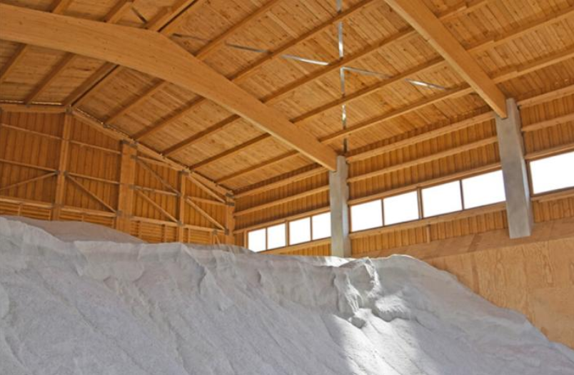
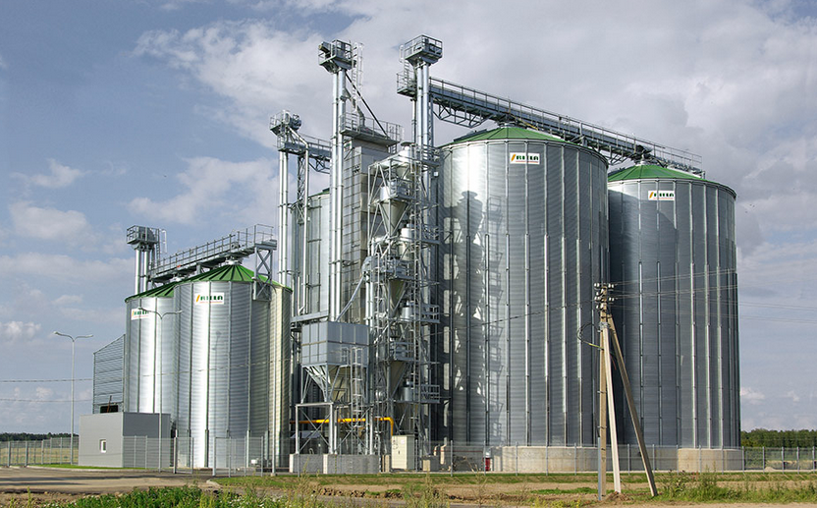
Special commodity stores:
specific agricultural products (grain, wool, cotton,…)
usually one store = one type of product + special services related to the nature of the product

Slide 30
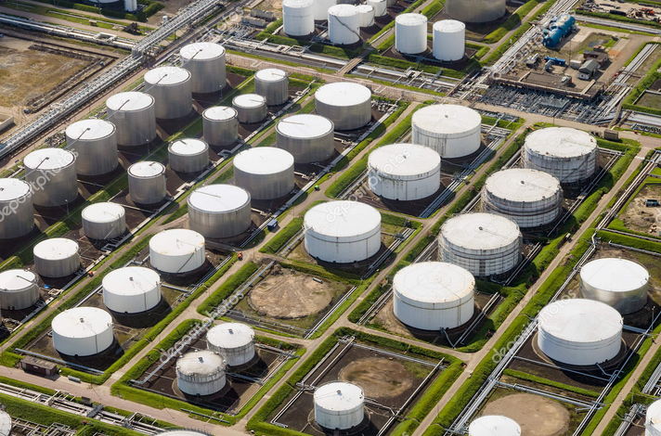
Storage of bulk substrates:
liquid products (e.g. chemicals, oil,…) in tanks and loose substrates (e.g. coal, sand) in an open or covered place
another services:
filling of barrels (from tanks)
production of new compounds and mixtures by mixing different kinds of chemicals

Slide 31
https://www.youtube.com/watch?v=-LDls7EvAKg
https://www.youtube.com/watch?v=1p2ITDbuJj4

Slide 32
Summary of the lecture
You can:
Explain the importance of the storage
Describe strategic and operational decisions in the storage
Distinguish between classic store and distribution center
Explain the essence of Cross-Docking
Describe types of stores
Characterize stock operations
Notes:
Charakterizovat

