Slide 1

Logistics
-
Stores
part 2
The aim of the lecture is to discuss performance of stock operations and handling technology
.
Šárka Čemerková
lecturer

Slide 2
Logistics
-
Stores
Part 2
Measurement and evaluation of stock operation productivity
Information support of storage
Financial aspects of storage
Materials handling equipment
.
Structure of the lecture

Slide 3
  Measurement and evaluation of stock operation productivity
productivity - workload - performance
"You cannot control what is not measured„
most important measurement areas:
  CS
  data accuracy
  capacity utilization
  labour productivity

Slide 4
Syndromes of inefficient storage function
excessive handling
low utilization of store area and space
excessive maintenance costs and outages due to obsolete equipment
outdated ways of receiving and dispatching goods
obsolete methods of computer processing of routine transactions

Slide 5
  Financial aspects of storage
storage = risk
need to track costs by activity
problem of lack of financial data
small production series = low stock volume vs. costs of frequent reset of the production line
economies of scale = larger stocks and increased storage requirements

Slide 6
Productivity improvement programs
Method-based programs
Technology-based programs
System-oriented programs
Programs based on motivation / training

Slide 7
Transmission of information on stored materials and products
along with moving and storing products
need for up-to-date information
importance of IT in all storage functions
introduction of IT has significant benefits

Slide 8
Computer data files
Storage activity
Computer output
Goods receipt and quality control
Stock updates
Requirements
Stock levels
Storage
Stock location
Number of cycles
Deployment of stocks
Picking up goods
Pickup lists
Pending orders
Sorting and packaging
Labels, stock updates
Normal logistics procedure
Dispatching
Transport plans
Labour standards
Productivity reports
Productivity reports

Slide 9
Materials handling equipment
supporting elements of storage
one of the major capital investments
classification by the function:
  storage
  picking up goods
  transport and sorting
  dispatching of goods

Slide 10
Manual systems
high degree of flexibility - using the most flexible handling system – people
people = errors
less investment intensive

Slide 11
Equipment for storage and picking up of goods
racks
shelf systems
pull-out shelf systems
mechanical equipment with operator (e.g. fork-lift trucks)

Slide 12
Equipment | Type of material | Benefits | More information
Classic pallet racks | Goods on pallets | Good stocking density, good security of goods | Storage density can be increased by placing two pallets in a row
Entrance pallet racks | Goods on pallets | Fork-lift trucks can be used, good storage density | Lift trucks can only be accessed from one direction
Passage pallet racks | Goods on pallets | Fork-lift trucks can be used, good storage density | Lift trucks can be accessed from both sides
High-rise rack stackers | Goods on pallets | Very high storage density | Used in combination with an automated storage and retrieval system
Cantilever racks | Goods of long length or in rolls | Suitable for storing goods with problematic shape (exhausts,…) | Each item can be stored in a separate rack

Slide 13
Pallet stacking structures | Special shapes or breakable parts | Unstackable products can also be stacked | They can be disassembled
Stacking racks | Special shapes or breakable parts | Unstackable products can also be stacked | They can be folded and stacked
Gravity racks | Individually packaged products / boxes | High storage density, goods are shifting by gravity | Material flow in the FIFO or LIFO system
Shelf systems | Individually packaged products / boxes | Low cost | Can be combined with pull-out shelf for greater flexibility
Pull-out shelf systems | Small parts and tools | All parts are easy to access, good goods security | The system can be divided into many types of stock items
Sliding rack or shelf systems | Goods on pallets, bulk materials, boxes | It can reduce the required storage area by up to half | Comes equipped with safety equipment

Slide 14
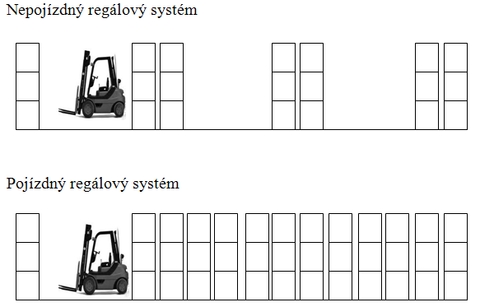
Stationary rack system
Sliding (mobile) rack system

Slide 15
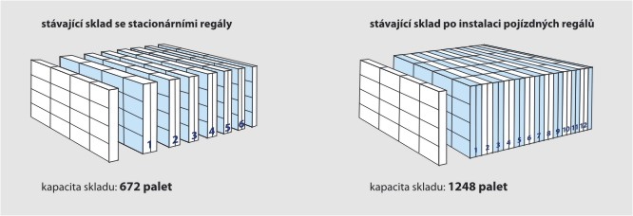

Slide 16
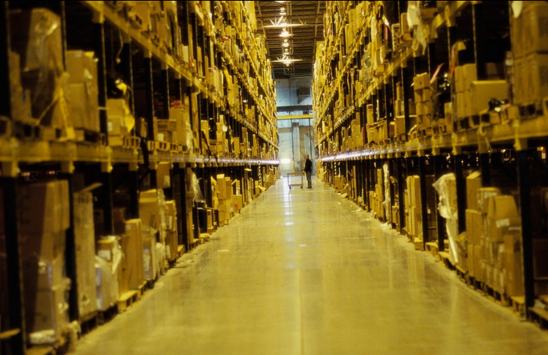
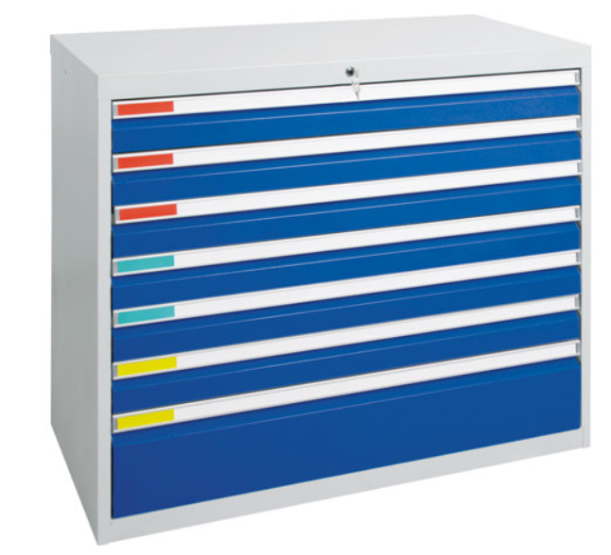
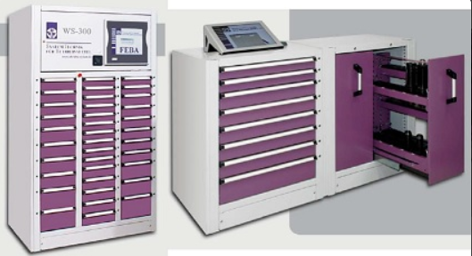

Slide 17
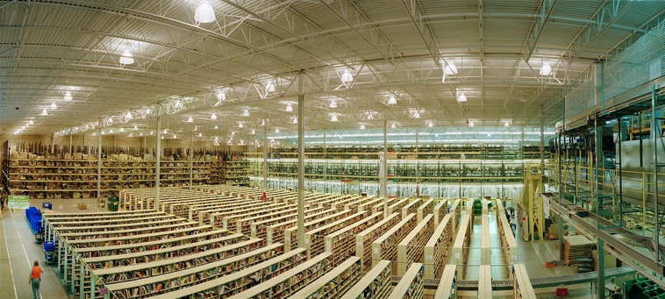

Slide 18
Equipment for transport and sorting
motor or non-motorized equipment (fork-lifts, platform trucks, cranes, various hand trucks)
manual sorting of items:
  consolidation and deconsolidation of items based on specific customer orders
  physical inspection and loading on a pallet or in a box / container intended for a specific consignment
  time-consuming process subject to human error
  efforts to minimizing

Slide 19
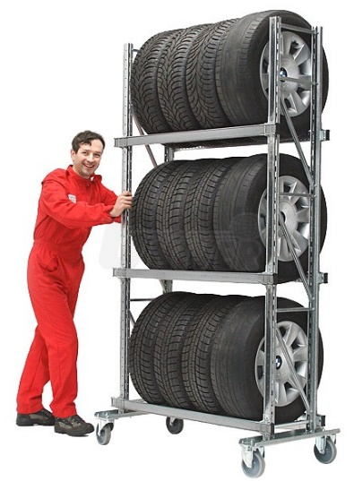
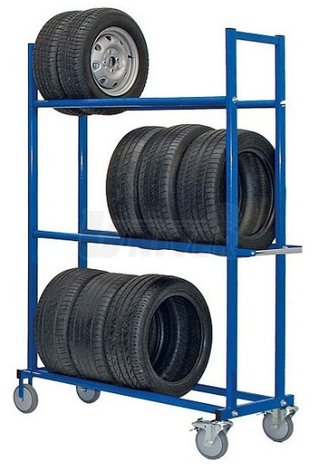
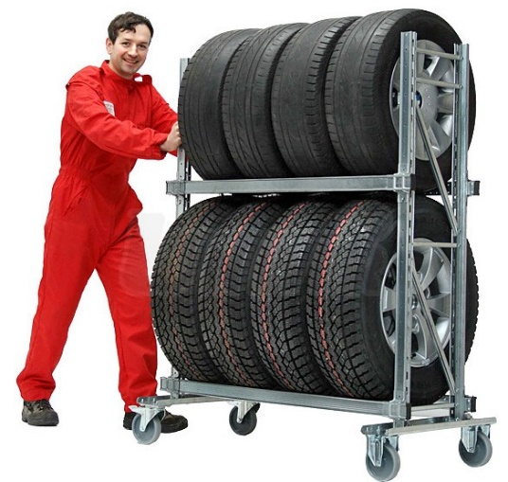
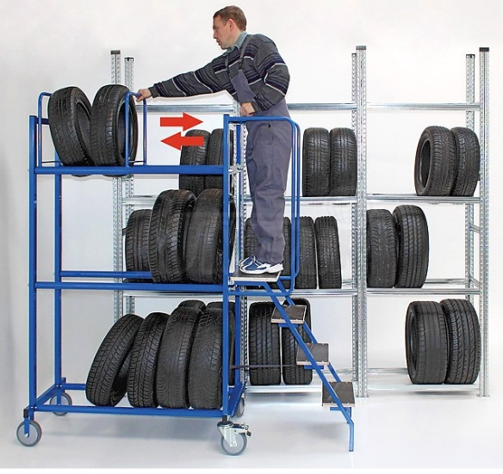
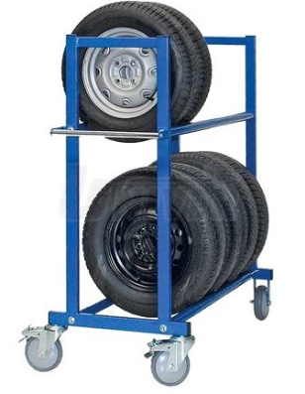
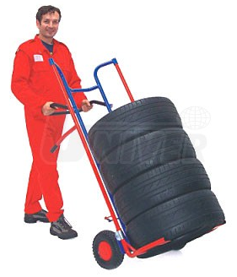


Slide 20
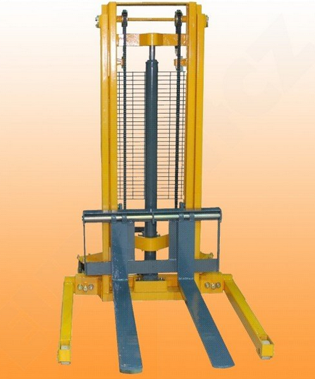
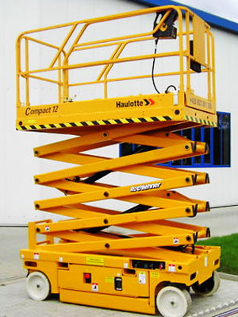
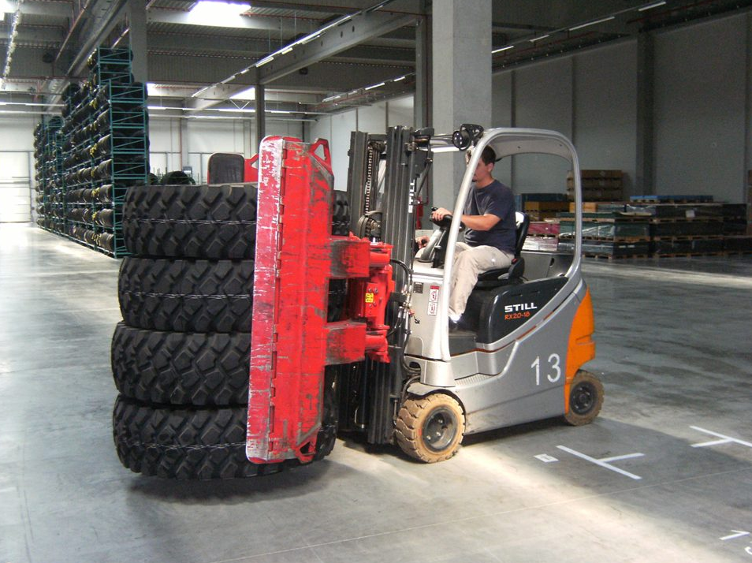
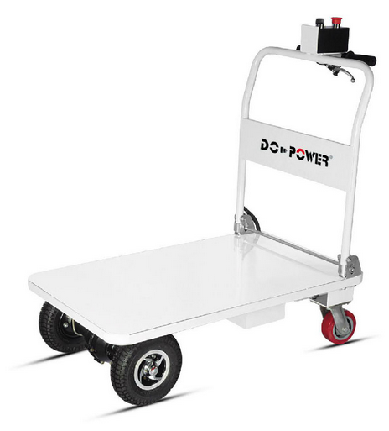
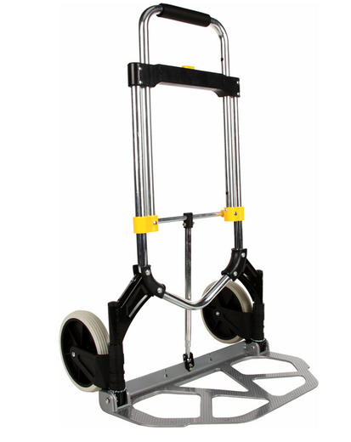

Slide 21
Dispatching of goods
  preparing goods for shipment
  loading of goods into means of transport - equipment for handling output and input means of transport
  motor or non-motorized equipment described above + pallets, palletisers or various packaging equipment

Slide 22
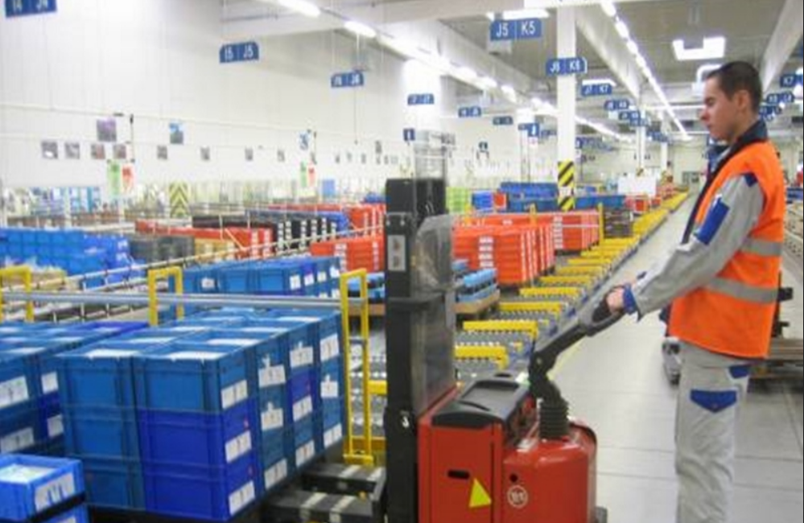

Slide 23
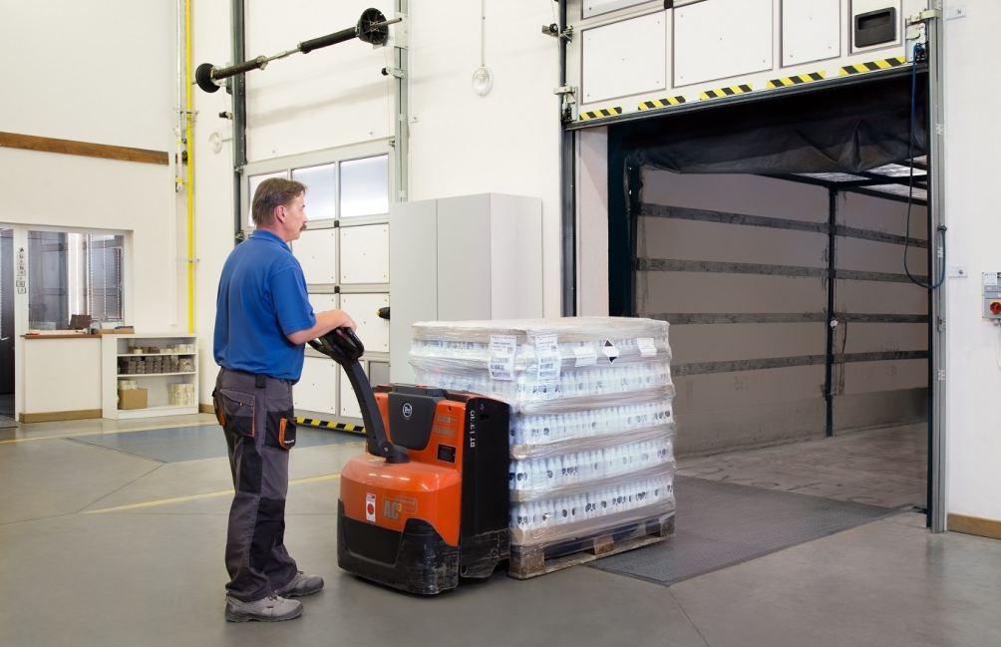
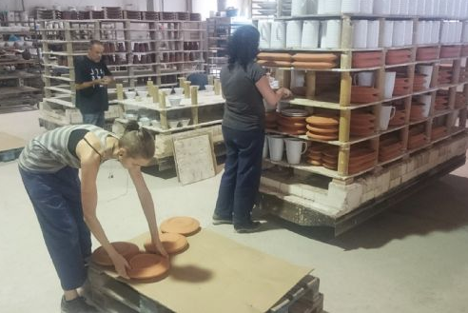
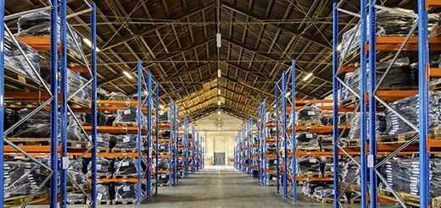

Slide 24
Automated systems
types:
  systems of automatic storage and search of goods (AS / RS)
  rotary containers (carousels)
  equipment for picking up boxes or items
  belt conveyors
  robots and scanning systems
common part of modern storage facilities
can be divided into the same categories as manual devices

Slide 25
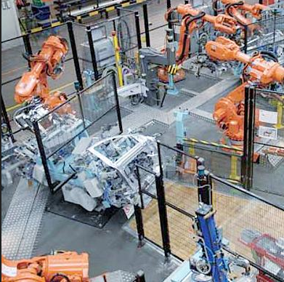

benefits:
  increase in the productivity of the process of order processing
  decrease in product damage
  improving the level of accuracy of stock information
  improving customer service
  less need for staff

Slide 26

shortcomings:
  initial capital costs
  outages or unreliability due to equipment interruption or maintenance
  SW related problems
  capacity problems

Slide 27
  lack of flexibility to respond to the environmental change
  high maintenance costs
  user interfaces and user training
  adoption of the system by workers
  obsolescence

Slide 28
Equipment | Type of material | Benefits | More information
Systems of automatic storage and search of goods (AS / RS) | Palletized goods, wide selection of sizes and shapes | Very high storage density, computer control
Automatically guided vehicles (AGV systems) | Palletized goods and other compact loading units | Very high storage density | In warehouses and production
Minisystem AS/RS | Small parts | Very high storage density, computer control | Multiple configurations can be installed to increase flexibility
Horizontal carousels | Small parts | Easy access to goods, relatively inexpensive system | Can be stacked more on top of each other

Slide 29
Vertical carousels | Small parts and tools | High storage density | In multi-storeyed equipment it can perform a dual function - storage and delivery
Human-controlled machines | Small parts | Very flexible | Can be used on high shelf systems or modular pull-out shelf systems

Slide 30
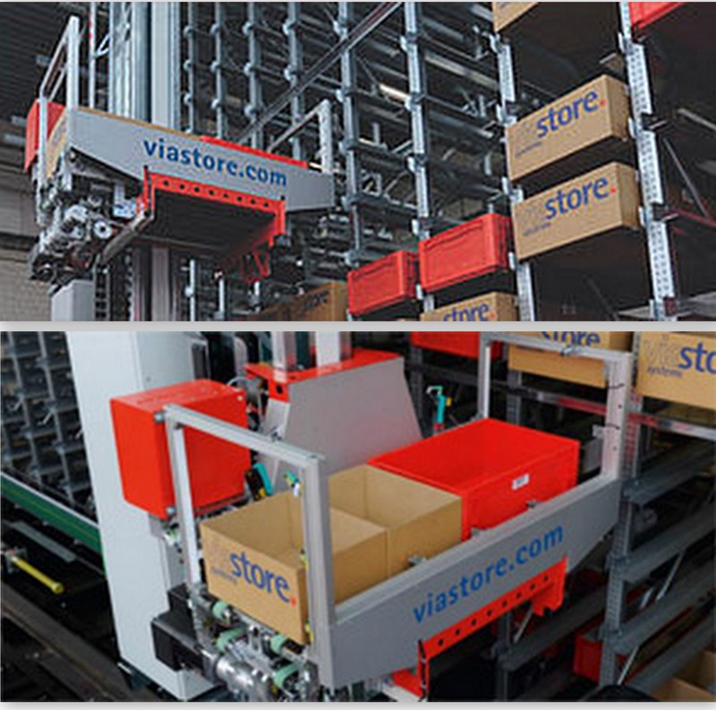
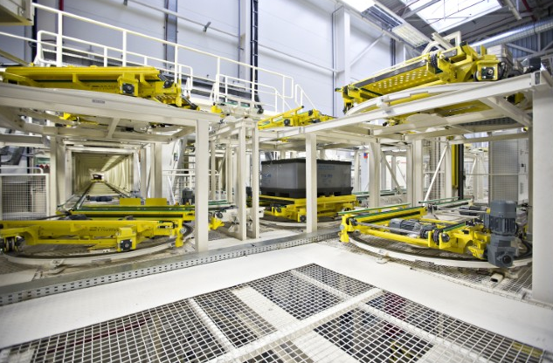
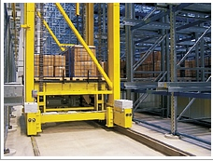

Slide 31
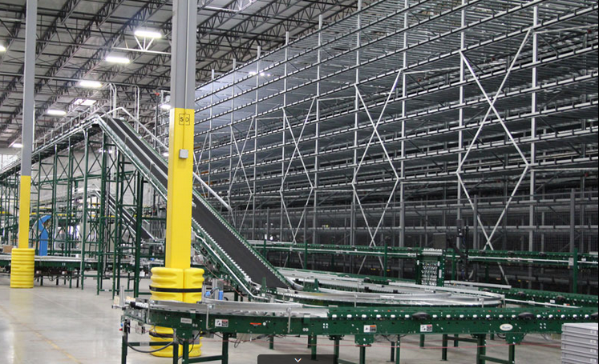
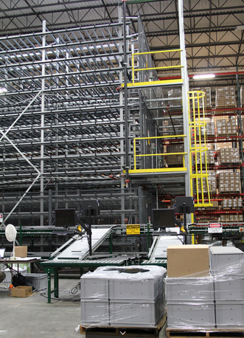
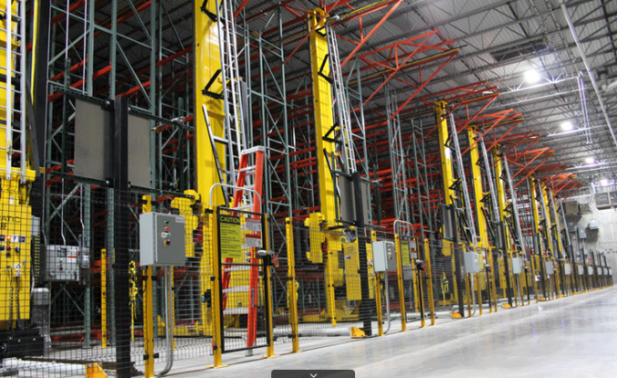

Slide 32
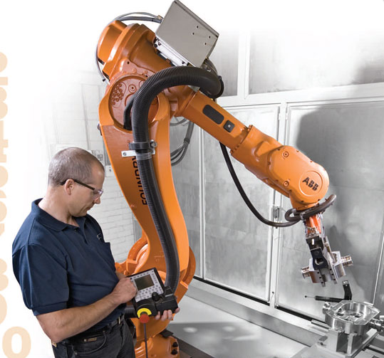
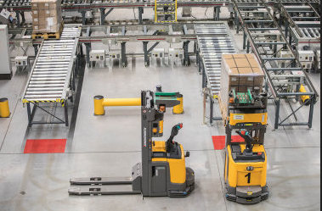
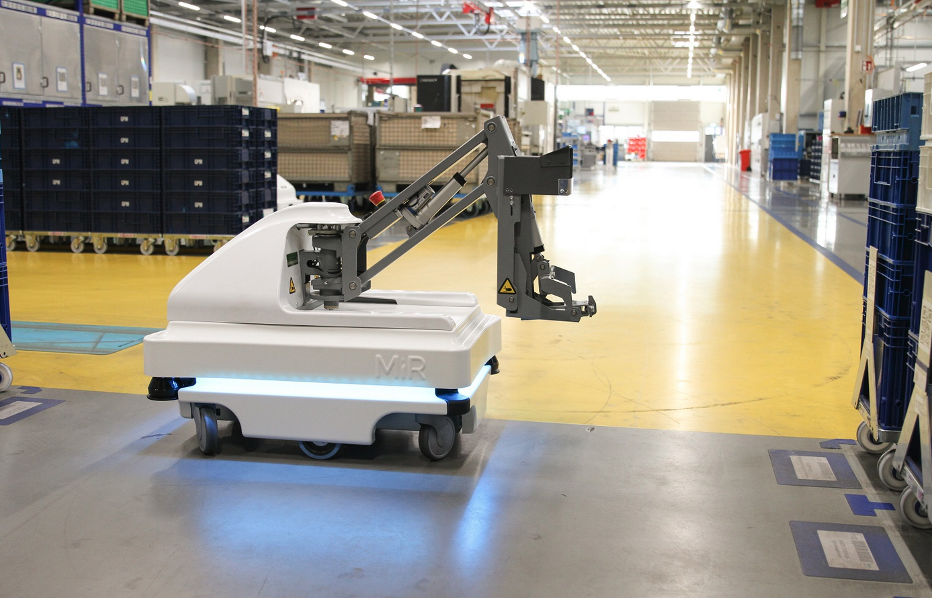
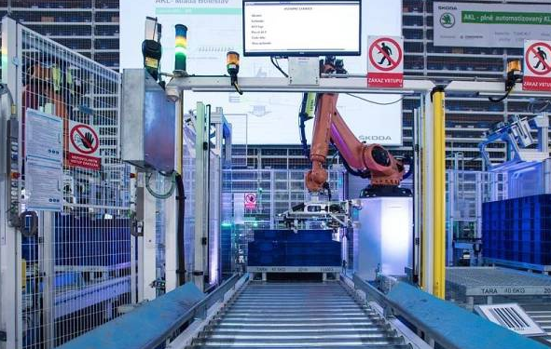

Slide 33
Summary of the lecture
You can:
Explain the reasons for measuring and evaluation of the productivity of storage operations
Briefly characterize the information security of storage operations
Describe manual systems for handling
Characterize automated handling equipment

