Slide 1
Logistics
-
Packaging, reverse logistics
The aim of the lecture is to discuss the logistics role of packaging and reverse logistics
.
Šárka Čemerková
lecturer

Slide 2
Logistics
-
Packaging, reverse logistics
Logistics function of the packaging
Reverse logistics at different angles Examples of recycling of selected wastes Green logistics
.
Structure of the lecture

Slide 3
packaging
component of the storage and material handling
close relation to overall quality, storage efficiency and performance
packaging processes have an impact on marketing and logistics
relationship between packaging and costs has often been underestimated

Slide 4
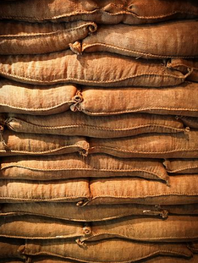
Logistics function of the packaging
1. product closure
environmental protection
product will not be damaged
product is not lost

Slide 5
2. product protection
against damage or loss due to external influences:
Humidity
Dust
Insect
Infecting

Slide 6
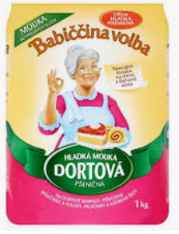
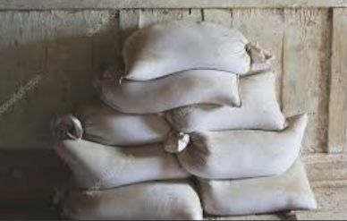
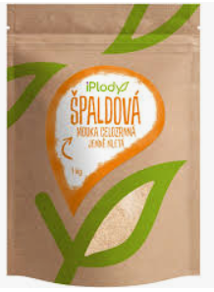
3. product division
reducing the output of industrial production to consumer size

Slide 7
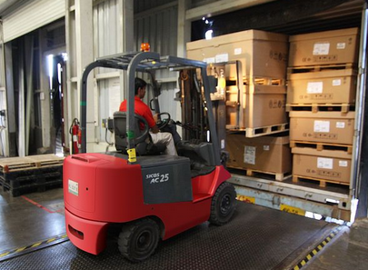
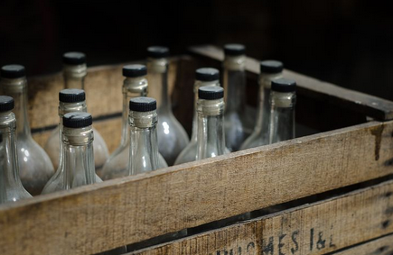
4. unification of the sizes
associating primary packages into secondary packages having a uniform standardized size
reducing the number of handling required

Slide 8
5. consumer suitability
customer does not have to spend too much time and effort to get to the product

Slide 9
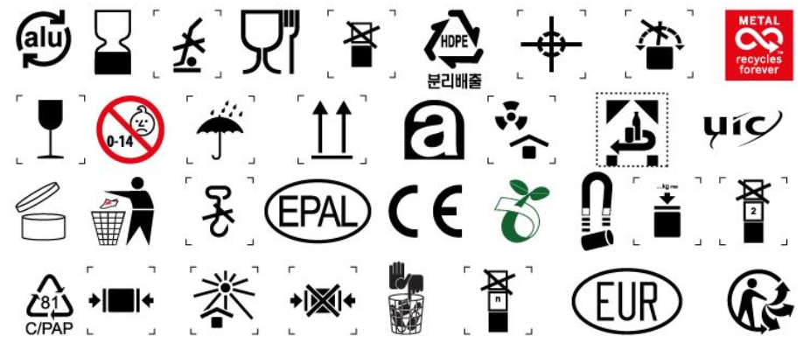
6. communication
using clear, easy-to-understand symbols
bar codes

Slide 10
Positives of quality and well-chosen packaging:
lower transport costs
better utilization of storages and means of transport
decrease of the degree of goods damage and special handling requirements
reduction of the material disposal costs
reduction of waste products (returnable packaging)

Slide 11
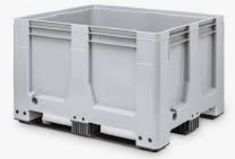
Factors affecting packaging
standardization
prices / costs
product or packaging adaptability
protection level
handling ability
ability of the product to be packaged
reusability and recyclability

Slide 12
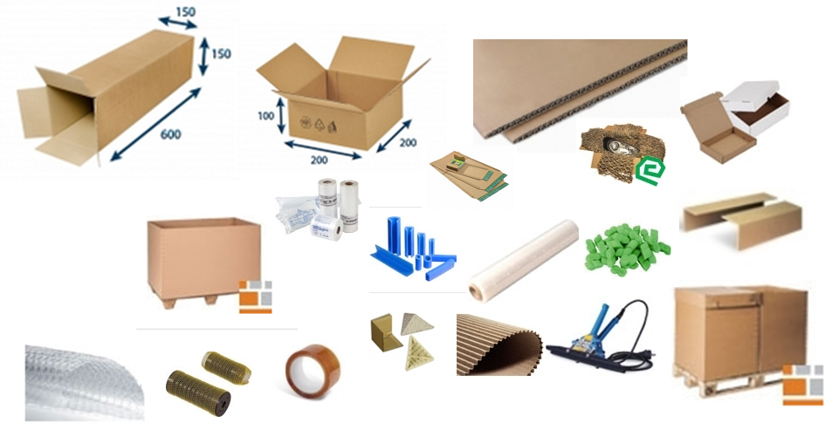

Slide 13
Reverse logistics
initially neglected, today the subject of interest
need to deal with the flow of products from the end-use point back to the point of origin (in the reverse direction)
originally associated only with the recycling of products and packaging
deals with the flows of used products, packaging and waste materials that originate from the consumer

Slide 14
waste removal in the form of consumed products and returned (claimed) goods
support of the alternative uses of the products and packaging that have already been used or cannot be sold
any product activity following the point of sale

Slide 15
3 narrow concepts of reverse logistics:
repacking and resale activities of the returned goods
set of activities supporting material recycling
organization and management of more complicated ways of recovering old products

Slide 16
http://www.amertranslogistics.com/services/reverse-logistics/

Slide 17
General definition:
The main purpose of reverse logistics is the collection, sorting, dismantling and processing of the used products, components, by-products, surplus stock and packaging material in order to ensure their reuse or material recovery in an environmentally friendly and economically attractive way.

Slide 18
Reverse logistics tools
push tools:
state intervention
civic initiative protests
sectoral union directives
guidelines for the granting of loans and grants
environmental awareness of the employees
environmental behavior of the competition

Slide 19
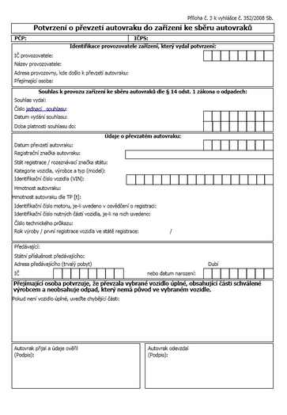
Example:
some entreprises are required by law to take back their products, such as batteries, and to dispose of them in an environmentally friendly manner

Slide 20
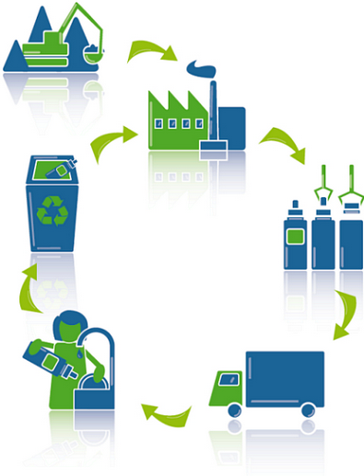
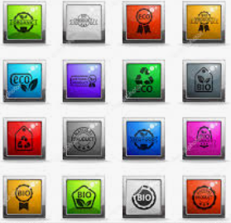
2. pull tools:
consumer pressure on manufacturers
eco-awarding, eco-labeling
subsidy programs for environmental activities

Slide 21
Eco-consumer:
types:
active
activatable
passive
influence of the education and upbringing

Slide 22
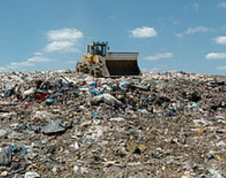
Basic reasons why to deal with reverse logistics
use of functional parts of destroyed products
reduction of landfill charges
complaints, such as feedback revealing design deficiencies
customer expectations or helpful claims handling as a competitive advantage

Slide 23
in the future, the importance of reverse logistics will grow:
resource efficiency
protection of the nature
development of e-commerce (need to eliminate hasty impulsive decisions of the customer)
lack of attention = costs for the society but also for the company itself

Slide 24
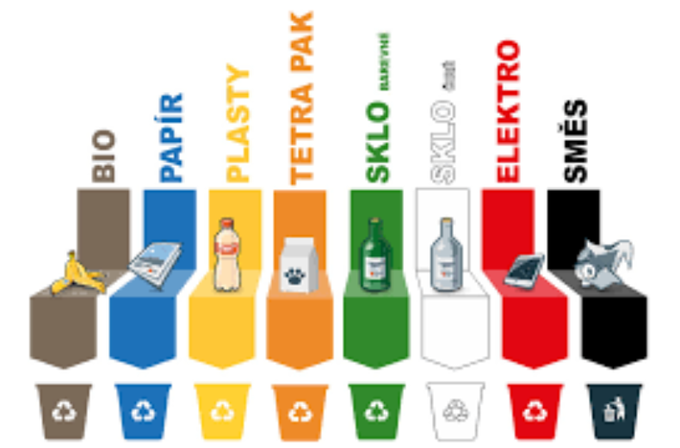
Source: cz.depositphotos.com

Slide 25
Source: https://www.andritz.com/products-en/group/recycling/electronic-scrap

Slide 26
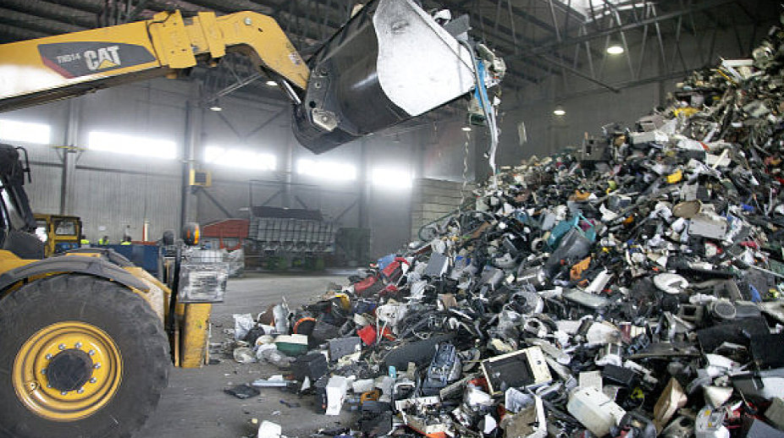
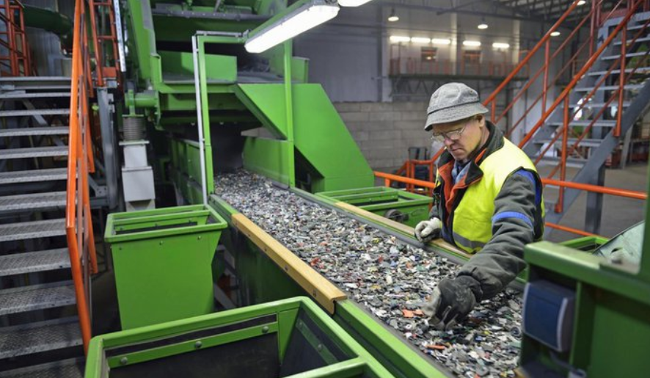

Slide 27
Source: https://www.statista.com/chart/2283/electronic-waste/

Slide 28
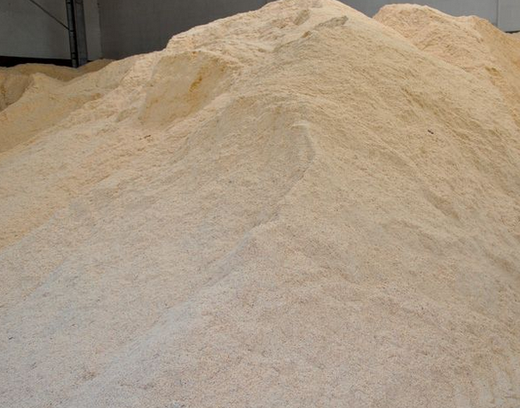
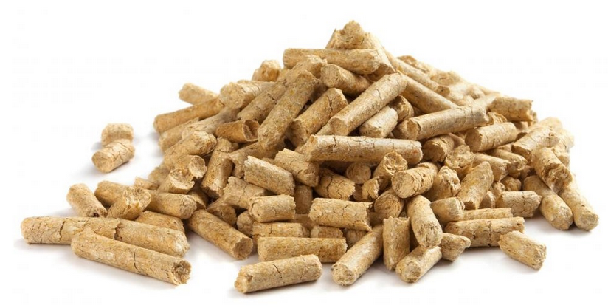
Example: wood waste from sawmill production (sawdust, shavings, etc.):
before transport to the dump or used by small breeders and gardeners
today the input material for the production of pellets

Slide 29
green logistics
sustainable ecological orientation of logistics = to meet the needs of today's generation without putting at risk the possibilities of future generations
ecological, economic and social aspects
optimizing the use of energy and resources in logistics
green logistics is often limited to transport logistics

Slide 30
Fraunhofer Institute for Material Flow and Logistics:
in in-house logistics systems, on average, around 40% of total costs are spent on energy
up to 1/3 of these costs can be saved
five areas of action:
market and product
structure and planning
processes, management and measurement
technology and resources
workers, customers, suppliers and service providers
Source: https://logistika.ihned.cz/

Slide 31
Example: the amount of CO² emissions per transported quantity unit is affected by:
packaging volume and weight
use of means of transport
number of pieces in the transport equipment
number of rides
used storage and handling equipment
IT

Slide 32
Summary of the lecture
You can:
Explain the logistics function of packaging
Describe the positives of good packaging
Define reverse logistics
Explain material recycling on selected examples
Clarify the essence of green logistics

