Slide 1

Logistics
-
Logistics methods and techniques - JIT
The aim of the lecture is to discuss JIT technology
.
Šárka Čemerková
Lecturer

Slide 2
Logistics
-
Logistics methods and techniques - JIT
JIT
JIS
Kanban
Hub and spoke
CROSS Docking
QR
ECR
.
Structure of the lecture

Slide 3
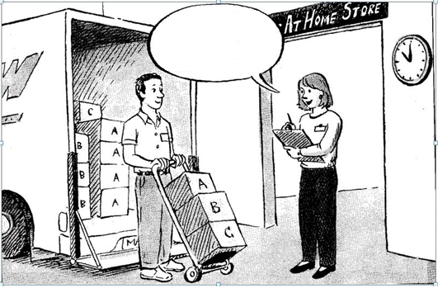
thank you, this is exactly what we ordered and just in time
Just-in-Time (JIT)

Slide 4
business philosophy, not technical guidance on how to manage production
after the WWII Taichii Ohno was studying supermarkets - the system to buy as many goods as I need - can this be used directly at the production site?
Ohno's solution: total elimination of prodigality
JIT term was first used by Kiichiro Toyoda
the greatest boom of JIT in the 1980s in Japan and the US

Slide 5
with the implementation of JIT, storage becomes unnecessary
ideal economic order quantity equals to one unit, safety stock is considered unnecessary and any stock in a store should be excluded
JIT based on reversing existing practices (overproduction problem)

Slide 6
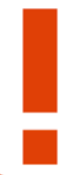
Definition JIT:
JIT is a philosophy based on the principle of getting the right materials to the right place, at the right time, in the right quantity, in the required quality and at the required price based on the customer´s request.

Slide 7

Characteristics of the JIT system
philosophy of total elimination of all losses
no losses for machines, equipment and workers
trouble-free and smooth flow of materials
automation with human factor
production plan must be uniform
let us produce even the smallest items in the smallest number
let us make only what is needed
autonomy of workplaces
optimization of production process = problem solving

Slide 8
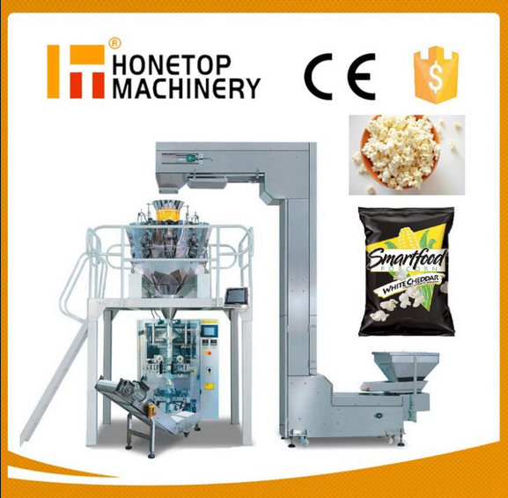
Reducing the share of human labour
human factor is the most common source of errors
task wage is more motivational than the time wage
idle worker brings a loss
unused machinery capacity does not
represent a loss
use of machines to adapt to people
trap of automation
labour saving vs. saving people

Slide 9
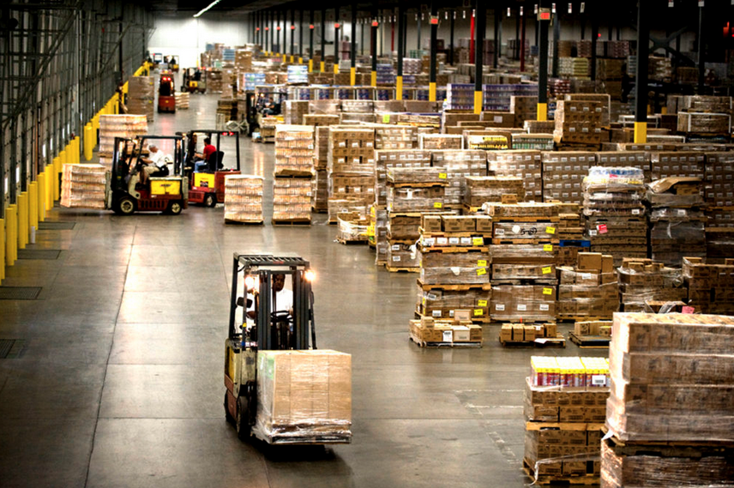
Stock status
zero stock - ideal condition
having no stock is impossible for industrial production
effort to reduce stock should
never be stopped

Slide 10

Response to changes
introduction of JIT is associated with dramatic changes in the existing structure of production processes
unlocking of the capacities is not a positive benefit of the improvement process and cannot be accepted as a result
importance of feedback
ability and willingness to be flexible

Slide 11
Characteristics of production management | Traditional approach | JIT
Manufacturing program | Wide | Limited
Product design | Effort to satisfy the customer as much as possible | Application of standardization, construction adapted to production
Production process and inter-operational transport | Operational arrangement | Process arrangement
Workforce and workstyle | Narrowly specialized workforce, individualized work, changes in the work process enforced rather by command | Wide qualified flexible workforce, teamwork and cooperation, changes in the work process promoted by consensus

Slide 12
Production planning | Complicated production flows, long setup times, large production batches, long running times, very little computer planning support | Short set-up times, small batches, shorter lead times, computer support focused on production progress
Stock management | Large in-process stock, in-process stores | Small in-process stock, storage of work in progress at the workshops
Subcontractors | A large number with competitive relationships | Limited number with cooperative relationships
Production quality control | In critical areas, focused on products | Continuous, focused on critical points of the production process
Production facility maintenance | After failure, performed by specialists | Preventive to proactive, performed by operators

Slide 13
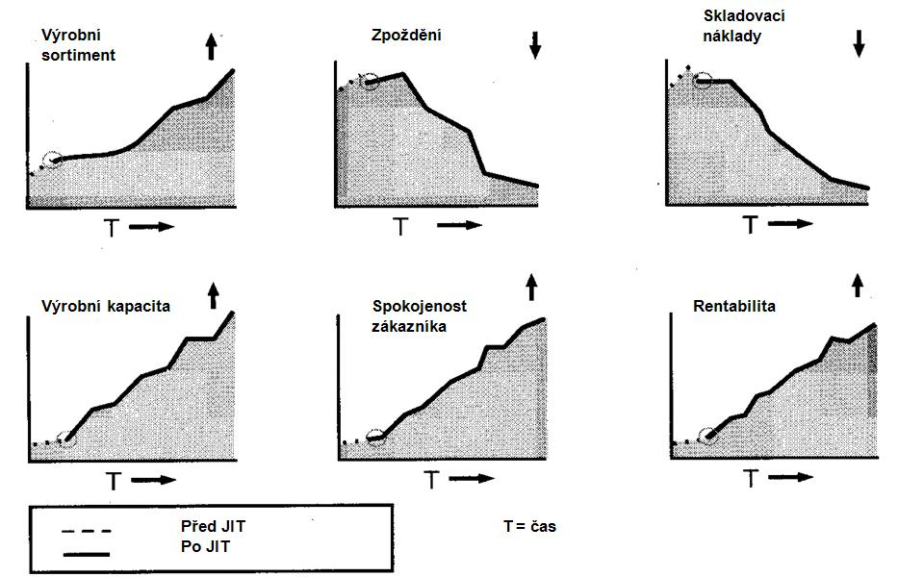
production assortment
storage costs
delay
production capacity
customer satisfaction
profitability
before JIT
after JIT
time

Slide 14
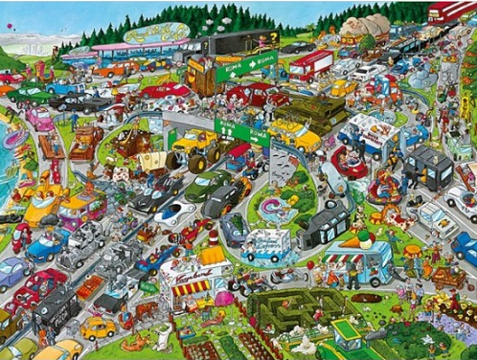
Negative consequences of the introduction of JIT
the minimum stock requirement is offset by an increase in traffic:
  increasing traffic on the roads
  emissions, noise, traffic accidents
  problems with keeping timetables

Slide 15
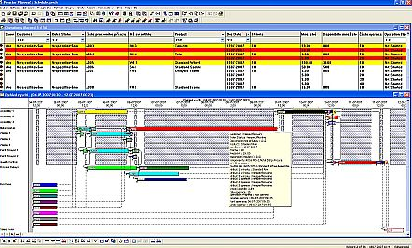
complications in production management:
  production planning of the plant
  supplier production plans
  deployment of suppliers

Slide 16

resistance from employees
insufficient support of business systems
inability to define service level
insufficient planning and transfer of stock to suppliers

Slide 17
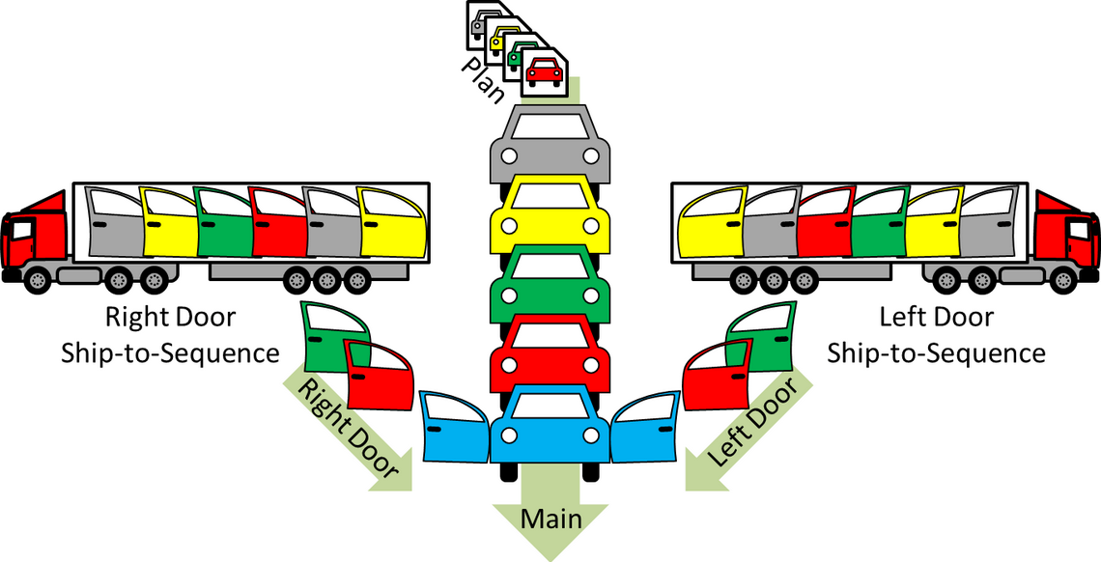
Just-in-Sequence (JIS)
entire product assortment produced on a single line
parts are delivered in sequences, i.e. in order in which
they travel to the line according
to product assembly

Slide 18
high demands on delivery accuracy:
  time aspect
  right order
supplier's range usually does not exceed 50 km
sometimes the supplier has his warehouse located directly at the manufacturer's plant - here he sequences the components directly to the assembly lines
importance of ICT

Slide 19
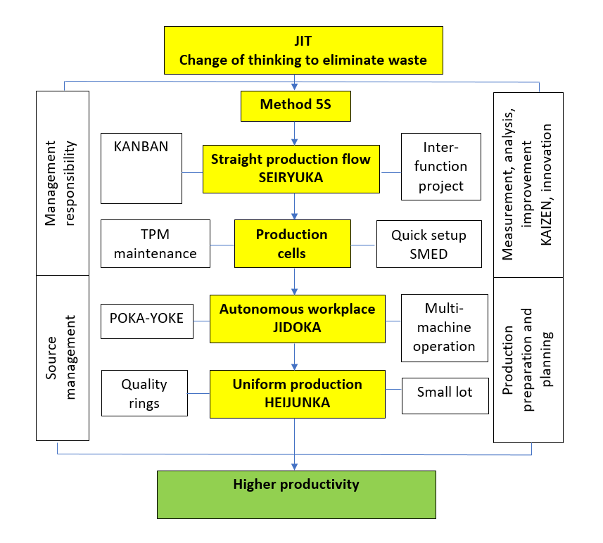

Slide 20
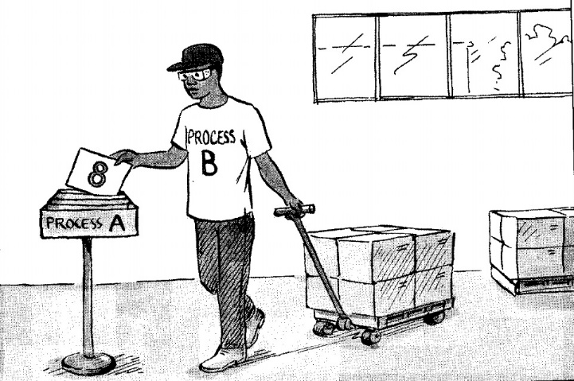
KANBAN
for production and material flows between processes coordination
kanban = card (direction indicator)
kanban cards are used to visualize material flows
allows controlled pull

Slide 21
Types of kanban
transfer: authorizes the process to get parts from the previous process
manufacturing: authorizes the previous process to manufacture other parts
supplier (external): authorizes the external supplier to deliver additional parts

Slide 22
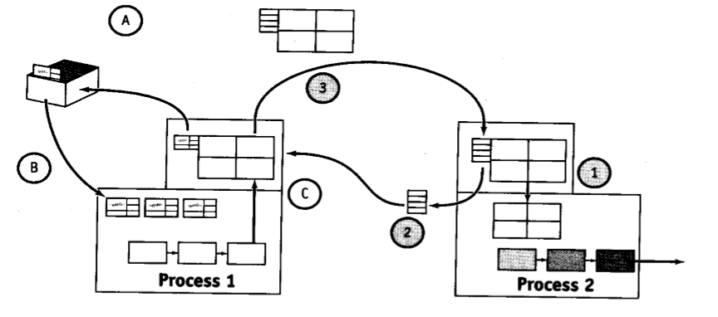
Kanban circles

Slide 23
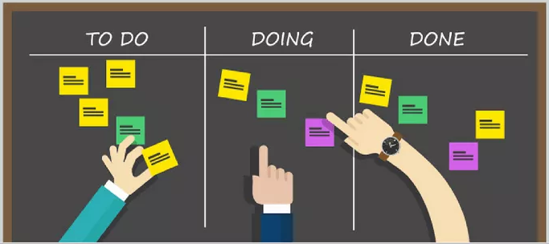
Kanban rules
The subsequent process turns to the previous one for taking only when it needs it
The previous process only produces the amount needed to replace what has been taken

Slide 24
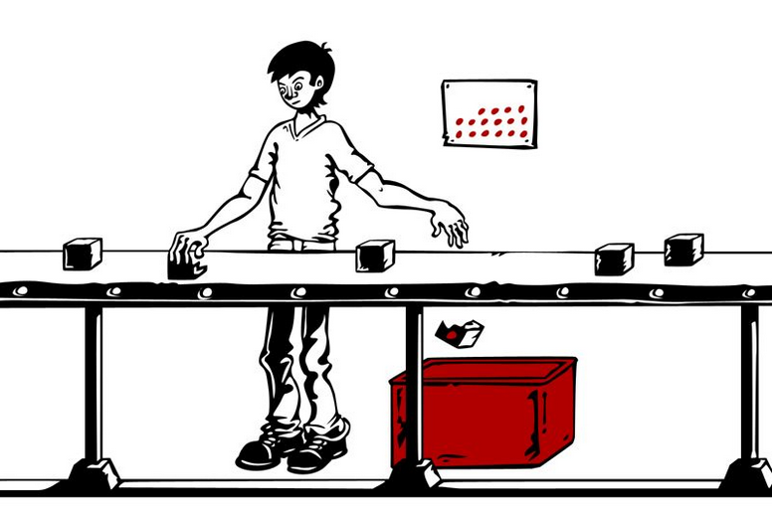
Scrap will never be sent to the following process
Kanban must always be accompanied by series production
Production must be
staggered into levels
Using kanban to tune
production schedule
Stabilization,
rationalization,
process simplification

Slide 25
Benefits of Kanban
decrease in stock
ensuring a systemic flow of information throughout the production process
support of production continuity while increasing assortment and reducing planning effort
openness of the management system
significant reduction of the effort spent on processes with minimal added value
overall reduction in the cost of transporting information
possibility to delegate responsibilities directly to the staff on lines

Slide 26
Quick Response – QR
from1986 at Milliken & Company
core customer-oriented supply chain technology
identifying demand as quickly and accurately as possible, including ensuring the satisfaction of each link in the supply chain
deployment of the computerization tools

Slide 27
  Effective Consumer Response – ECR
referred to as the successor of QR
first time in the US food industry in the early 90s
main focus on the customer as a link in the supply chain
demand and supply synchronization using joint planning, forecasting and replenishment techniques

Slide 28
  cooperation instead of competition
  4 core processes that create added value in the supply chain:
  efficient replenishment of stocks
  effective shop assortment management
  effective promotion
  effective introduction of new products on the market

Slide 29
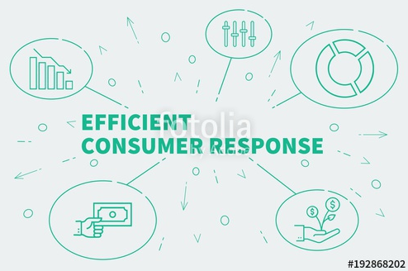
  Professional ECR technology alternatives:
  EHCR (Efficient Healthcare Consumer Response) in the pharmaceutical market
  EFCR (Efficient Food Service Consumer Response) in gastronomy
  EPCR (Efficient Packaging Consumer Response) in the packaging industry

Slide 30
Potential benefits of using ECR technology
supplier / manufacturer | distributor / wholesale | customer / retail
reducing demand uncertainty growth of continuity and elasticity of production processes growth of long-term relationships and offered brands | stabilization of relations between suppliers and customers information on current levels of supply and demand reduction of stocks and their maintenance costs | improving the quality of delivery service at a lower price of products wide range of fresh products risk reduction reducing transaction costs improving the continuity of funding

Slide 31
  Hub-and-Spoke
system of consolidation of smaller consignments into larger units, which are transported to central warehouses and subsequently sorted into individual consignments according to customer requirements
associated with the deregulation of air transport in the USA (1978)

Slide 32
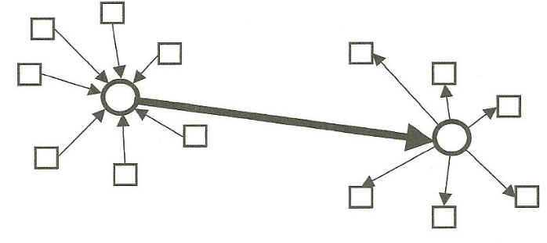
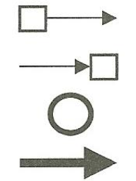
HUB-AND-SPOKE principle
Consignor
Consignee
Place of consignment consolidation and deconsolidation
Transport distance of consolidated consignment

Slide 33
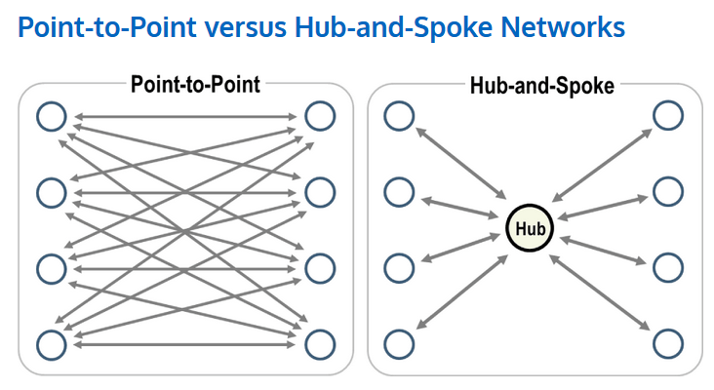
Source: https://transportgeography.org/?page_id=653

Slide 34
  Outsourcing
long-term transfer of an activity that the company has carried out itself to an external provider
initially understood as "handing care" to another entity, on a commercial basis, a "thing" owned by the customer
currently moving in two directions:
  outsourcing of services instead of „care“
  softening of outsourcing

Slide 35
Reasons for outsourcing
responding flexibly to customers' wishes
trying to get to the world level quickly or stay there
focusing on the main activities of the company
increasing or maintaining competitiveness
permanent recruitment and involvement of experts
reduction of operational and investment costs
predictability of costs in the area
simplifying work organization
risk reduction
synergic effect

Slide 36
Outsourcing in logistics
Logistics services providers are specialized enterprises involved in to logistics chains as a organisational legal and economic independent external partners
Services used in logistics outsourcing:
  storage (in the form of distribution centre, public and customs store)
  Store management (+ store information management software)

Slide 37
  palletizing of goods, packaging, labelling
  completing of promotional items
  customs services, security of customs debt
  goods insurance in the warehouse and in transport
  distribution of goods
  return information about delivered shipments
  transhipment of goods
  creating directional sets
  material handling
  transportation
  supply chain planning, management and control

Slide 38
logistics chain providers by role sizes in the logistics chain:
  carriers and operators
  shippers and courier providers
  Third Party Logistics Providers (3PL)
  logistics companies (4PL)

Slide 39
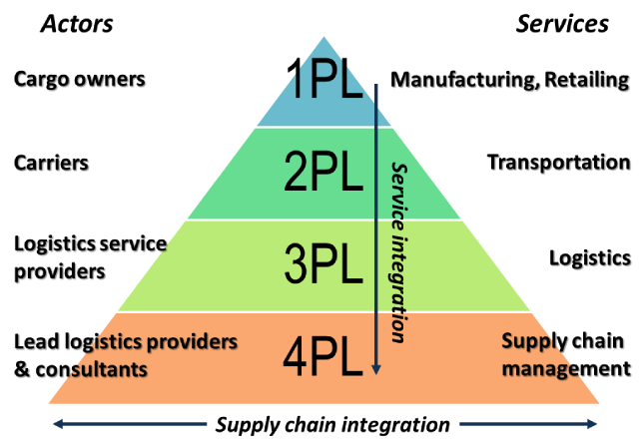

Slide 40
  Third party logistics – 3pl
  entrusting transport, storage and related activities to a third company - transport, storage and handling of goods
  the biggest differences between providers are not in the area of logistics services, but in the level of their IT equipment - the choice of a provider who, with the help of control computer systems, can guarantee their processes without human error

Slide 41
  Fourth party logistics – 4pl
providers of logistics services that have crossed the imaginary boundaries of transport and storage
also marked as 3PL new generation, 3PL plus
integration of supply chain management to connect and manage the resources, capabilities and technology of other logistics, information and consulting services to deliver a comprehensive and a parameterized customer solution

Slide 42
integrated 4PL solution effects:
  improving the quality of supply services
  economies of scale in the supply chain up to 15% of production costs
  decrease in stock held
  reduction in the volume of fixed assets
  ability to create value for the client at every point in the supply chain

Slide 43
Logistics centres
incorporates into one space transport and forwarding companies, logistics providers, customs, veterinary, phyto technical and sanitary administration, industrial and commercial enterprises, leasing, insurance and banking companies
point at which different means of transport meet - optimal conditions for the creation of combined transport chains

Slide 44
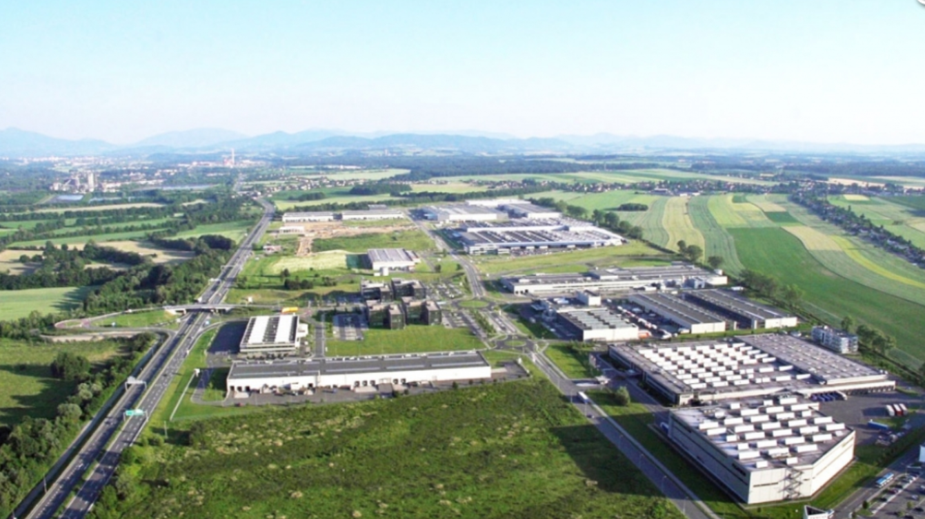
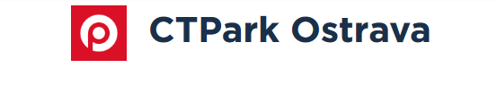
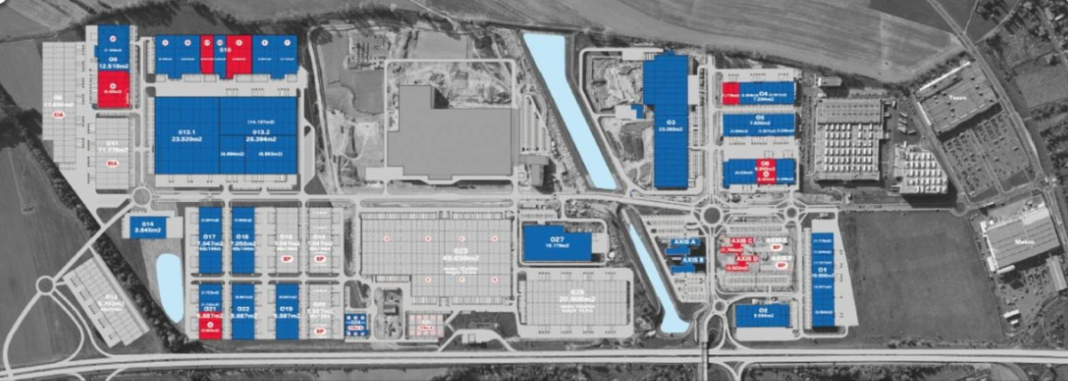
Source: https://www.ctp.eu

Slide 45
Summary of the lecture
You can:
Explain the essence of JIT philosophy
Describe the positives and negatives of JIT
Clarify JIS
Describe the nature of Kanban
List the benefits of kanban

