Slide 1
TOPIC individuals in the organization comunicaiton
Ing. Pavel Adámek, Ph.D.
adamek@opf.slu.cz

Slide 2
Content
Communication – key terms and learning outcomes
Dimensions of social intelligence, and explain the importance of these capabilities, especially for manager
The main components of the interpersonal communication process
The main barriers to effective interpersonal communication
Nature and significance of non-verbal communication
Organizational communication

Slide 3
Why study communication?
Communication is central to understanding organizational behaviour for several reasons:
communication affects organizational performance and individual career prospects;
very few people work alone, and the job of most managers involves interacting with other people, often for more than 90 per cent of their time;
communication is seen as a problem in many organizations;
in an increasingly diverse multicultural society, sensitivity to the norms and expectations of other cultures is vital to effective cross-cultural communication;
new technology is radically changing our patterns of communication.

Slide 4
Why study communication?
Everything significant that happens in an organization involves communication: hiring and training staff, providing feedback, purchasing supplies, solving problems, dealing with customers, deciding strategy.
However, communication is often interrupted by hierarchical structures, power and status differences, the design of jobs, the nature of (part-time, temporary) employment, physical layouts, and rules.
Henry Mintzberg (2009) emphasizes the need for managers to have ‘information competencies’, or a range of communication skills.

Slide 5
Why study communication?
Are you able to ‘feel’ what others are feeling?
Can you ‘read’ what’s happening in complex social settings?
Do you use that understanding to manage your relationships?
If so, then you have social intelligence.
Social intelligence the ability to understand the thoughts and feelings of others and to manage our relationships accordingly.

Slide 6
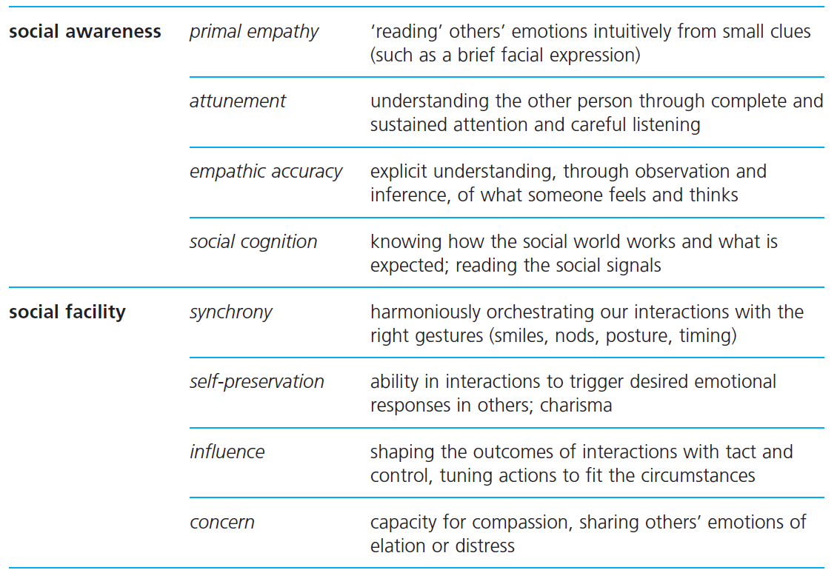
Why study communication?
Social intelligence

Slide 7
Interpersonal communication
Normally, as soon as one person stops talking, another takes their turn.
The currency of conversation is information. We ask you the time. You tell us the time. Information has been transmitted. Interpersonal communication has been achieved.
We do not receive communication passively. We have to interpret or decode the message.
To the extent that we interpret communication from others in the manner they intended, and they in turn interpret our messages correctly, then communication is effective. However, communication is an error-prone process.

Slide 8
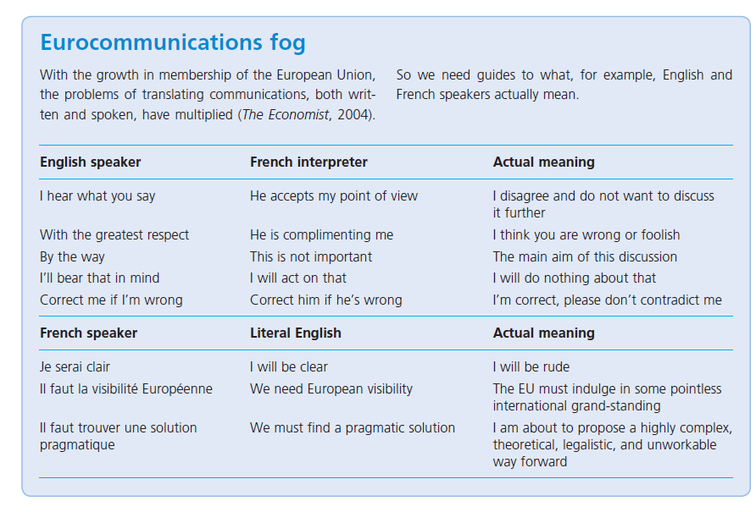
Interpersonal communication

Slide 9
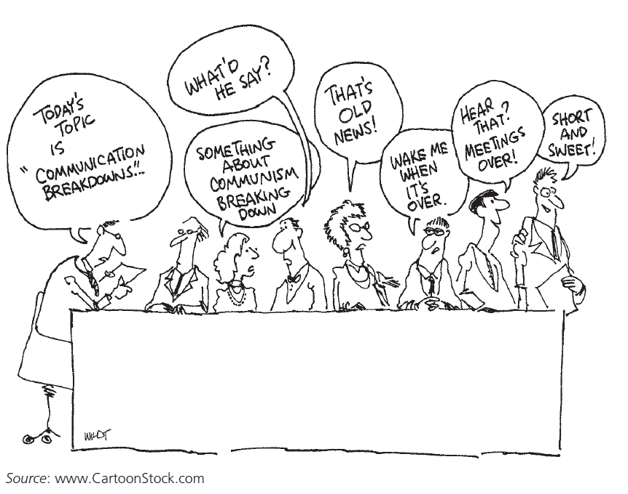
Interpersonal communication
Noise factors outside the communication process which interfere with or distract attention from the transmission and reception of the intended meaning.

Slide 10
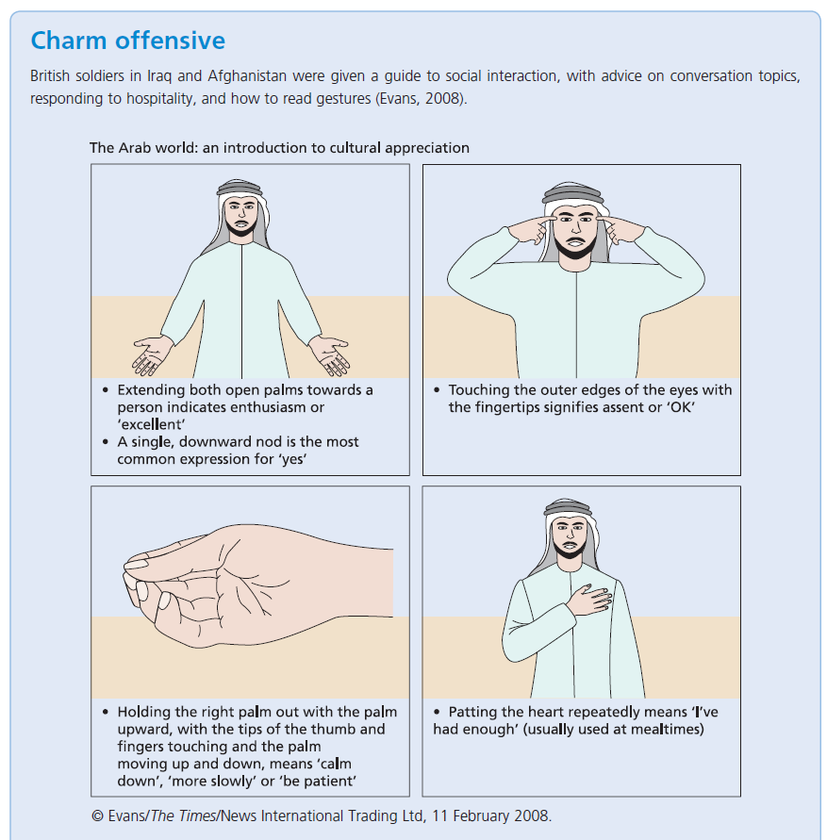
Interpersonal communication
Troops were given the following advice to avoid causing offence in the Arab world:
gestures - Avoid the ‘OK’ sign which widely means the ‘evil eye’.
shaking hands - It is disrespectful for a man to offer his hand to a woman.
social interaction - There is no ‘personal space’; Arab culture stresses the need to ‘share the breath’ of a companion.
conversation - Men should not question other men about the women in their family.

Slide 11
Interpersonal communication
We assume that organizations function better where
communications are open,
relationships are based on mutual understanding and trust,
interactions are based on cooperation rather than competition,
people work together in teams, and
decisions are reached in a participative way.

Slide 12
Interpersonal communication
The main barriers to effective organizational communication are:
power differences - Research consistently shows that employees distort upward communication, and that superiors often have a limited understanding of subordinates’ roles, experiences and problems.
gender differences - Men and women use different conversational styles which can lead to misunderstanding; men tend to talk more and give information while women tend to listen and reflect more.
physical surroundings - Room size and layout influence our ability to see others and our readiness to participate in conversations and discussions.
language - Even within one country, variations in accent and dialect can make communication difficult.
cultural diversity - Different cultures have different norms and expectations concerning formal and informal conversations; lack of awareness of those norms creates misunderstanding.

Slide 13
Interpersonal communication
Maureen Guirdham (2002) offers this advice for improving our communications:
face-to-face - When we are able to speak with someone directly, we can use the feedback constantly to check the coding and decoding processes, and to correct mistakes and misunderstanding.
reality checks - We should not assume that others will necessarily decode our messages in the way we intended, and we should check the way in which our messages have been interpreted.
place and time - The right message delivered in the wrong place or at the wrong time is more likely to be decoded incorrectly, or even ignored, so choose the time and place with sensitivity and care.
empathetic listening- See things from the other person’s point of view, consider the thinking that may have led to their behaviour, decode the message the way they might decode it, listen attentively to feedback.

Slide 14
Verbal communication
Verbal means ‘in words’, which can be either spoken or written. ‘Verbal agreement’ and ‘verbal warning’ can thus refer either to oral or to written communication, and both are contrasted with non-verbal communication.
Most conversations involve exchanges of information or meaning. How do we get the information we want? We achieve this through a range of questioning techniques.
The first basic distinction in questioning strategy is between closed and open questions.
Closed questions invite a factual statement in reply, or a simple yes or no response.
Open questions, in contrast, invite the person responding to disclose further information.
Predict the differences in response to these two questions:
Will you have dinner with me this evening?
What are you doing this evening?

Slide 15
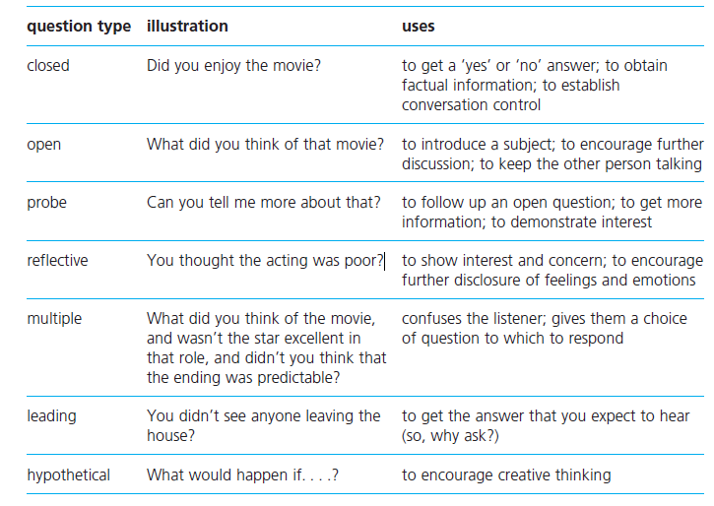
Questioning techniques

Slide 16
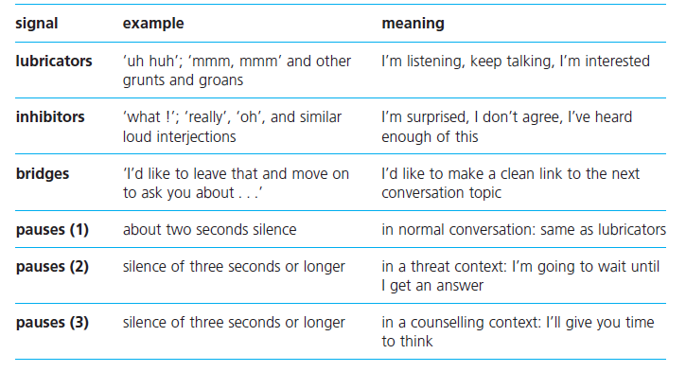
Conversation control signals

Slide 17
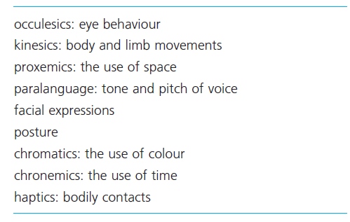
Non-verbal communication
When we interact with others face-to-face, we are constantly sending and receiving messages through our signs, expressions, gestures, postures, and vocal mannerisms.
In other words, non-verbal communication accompanies our verbal communication.
Non-verbal communication is popularly known as body language.

Slide 18
Non-verbal communication
Typical male courtship gestures involving non-verbal communication include:
preening (straightening tie, smoothing hair),
thumbs-in-belt (pointing towards genitals),
turning his body to face a female,
pointing his foot towards her, holding her gaze,
hands on his hips, dilated pupils, and the ‘leg spread’ (crotch display).

Slide 19
Non-verbal communication
Women, on the other hand, have a much richer repertoire of non-verbal courtship behaviour which includes:
• preening gestures such as touching hair, smoothing clothing;
• one or both hands on hips;
• foot and body pointing towards the male;
• extended eye contact or ‘intimate gaze’;
• thumbs-in-belt, but often only one, or thumb protruding from pocket or handbag;
• flushed appearance;
• the head toss, to flick hair away from face (used even by women with short hair);
• exposing the soft smooth skin on the wrists to the male;
• exposing the palms of the hands;

Slide 20
Non-verbal communication
Women, on the other hand, have a much richer repertoire of non-verbal courtship behaviour which includes:
• the sideways glance with drooped eyelids (‘you caught me looking at you’);
• wet lips, mouth slightly open;
• fondling cylindrical objects (stem of wine glass, a finger);
• the knee point, one leg tucked under the other, pointing to the male, thighs exposed;
• the shoe fondle, pushing the foot in and out of a half-on half-off shoe;
• crossing and uncrossing the legs slowly in front of the man;
• gently stroking the thighs (indicating a desire to be touched).

Slide 21
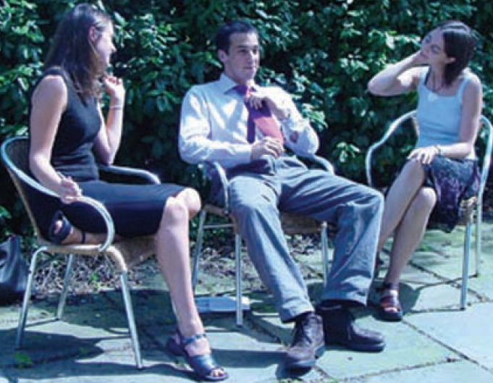
How many of these non-verbal courtship gestures, male and female, are illustrated here?
straightening tie, smoothing hair
leg spread
foot and body pointing towards the male
extended eye contact or ‘intimate gaze’
the head toss, to flick hair away from face
the sideways glance with drooped eyelids
wet lips, mouth slightly open
the knee point, one leg tucked under the other, pointing to the male, thighs exposed
gently stroking the thighs (indicating a desire to be touched)

Slide 22
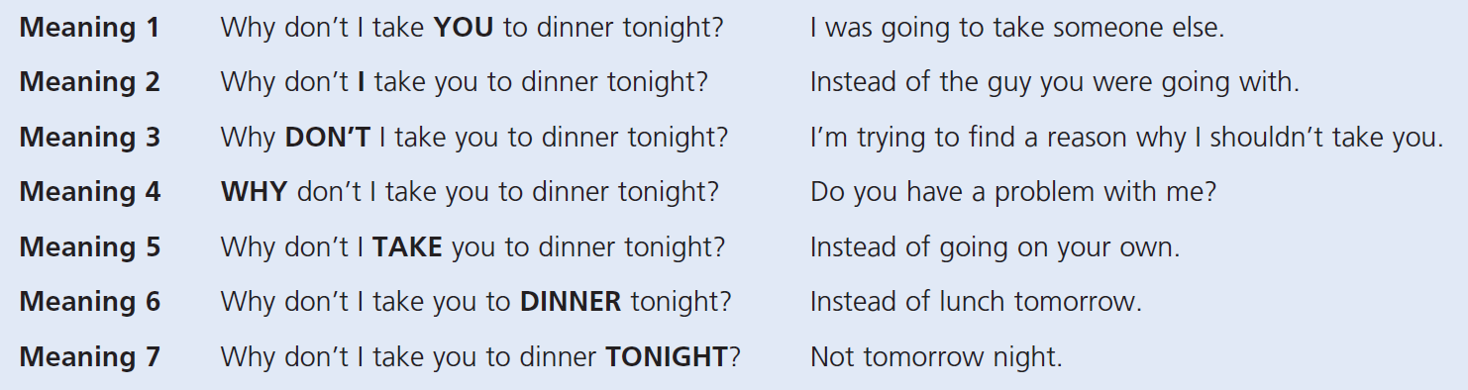
Aspect of non-verbal communication is ‘paralanguage’

Slide 23
Emotional intelligence
Non-verbal communication is one way in which we display emotion.
While often embarrassing, an open show of emotion can sometimes be desirable.
Emotions are a key source of motivation. Inability to display and share feelings can be a handicap.
Emotional intelligence the ability to identify, integrate, understand, and reflectively manage one’s own and other people’s feelings.

Slide 24
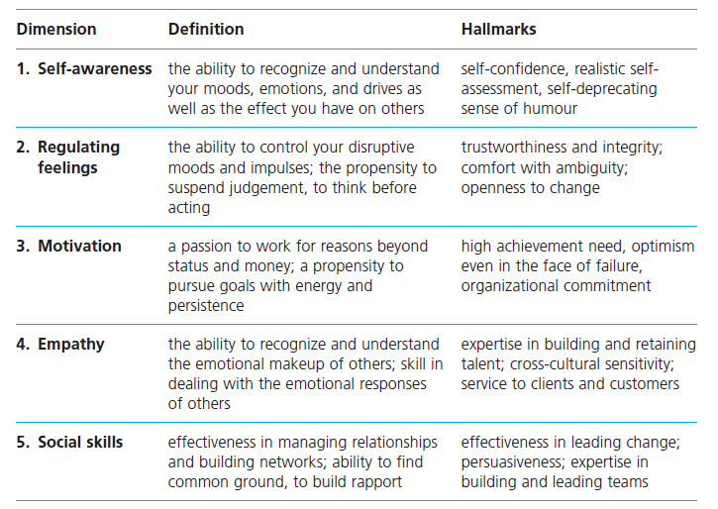
The five dimensions of emotional intelligence

Slide 25
Organizational communication
Those are traditionally one-way-top-down modes of communication.
Organizations use a range of mechanisms for communicating with employees, such as
• the management chain of command;
• regular meetings with senior and/or middle managers;
• in-house newspapers and magazines;
• company intranet;
• noticeboards;
• videos and in-house television;
• conferences and seminars;
• employee reports;
• team briefings;
• email, intranet, blogs, podcasts.

Slide 26
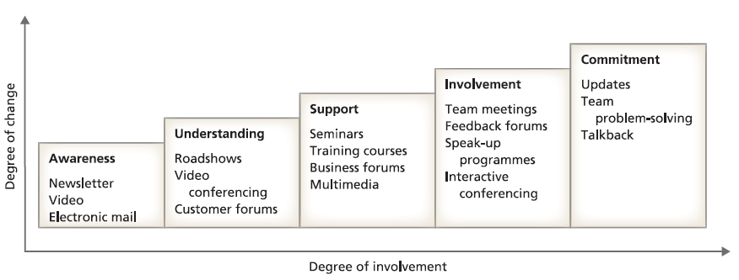
Organizational communication
Two-way exchanges are more effectively achieved through methods such as:
• ‘speak out’ programmes in which problems are taken to counsellors;
• suggestion or ‘bright ideas’ schemes;
• open door policies;
• the appraisal system;
• quality circles;
• attitude surveys;
• interactive email (where managers guarantee to reply).

Slide 27
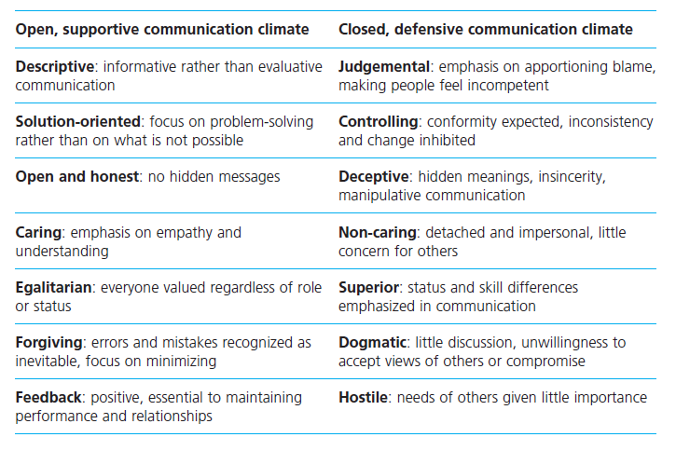
Open and closed communication climates

Slide 28
RECAP
The capabilities that make up social intelligence involve a combination of awareness – what we sense about others – and facility – how we act on that awareness.
Managers spend a lot of time interacting with others, and it becomes more important to understand the thoughts and feelings of others in a more culturally diverse population.
Communication involves an exchange of meaning, achieved through the processes of coding, transmission, decoding, and feedback.
Face-to-face communication allows instant feedback; coding and decoding problems arise with other forms of communication where feedback is delayed or absent.
The main barriers to effective communication include power and gender differences, physical surroundings, language variations, and cultural diversity.
Barriers can be overcome through face-to-face communication, by checking decoding, by paying attention to context, and by seeing things the way the other person does.

Slide 29
RECAP
Getting appropriate information from someone else involves the effective use of different questioning methods: open, closed, probe, hypothetical, and reflective.
Effective communication involves the use of a range of simple conversation controls: lubricators, inhibitors, bridges, and pauses.
Active listening involves a range of verbal and nonverbal skills.
Communication methods differ between high context and low context cultures.
Non-verbal communication includes facial expressions, eye behaviour, gesture and posture, distance between ourselves and others, and paralanguage.
If the verbal and non-verbal messages which we are sending are inconsistent, the verbal will be discounted and the non-verbal accepted.
Emotional intelligence concerns the ability to identify, integrate, understand, and reflectively manage one’s own feelings and the feelings of other people.
As with social intelligence, understanding your own emotions and the emotions of others is a key skill for all of us, particularly for managers, and its importance is heightened in culturally diverse organizational settings.

Slide 30
We can share our thoughts and ask questions
☺
Pavel Adámek
adamek@opf.slu.cz

