Slide 1
12. TOPIC
MANAGING GLOBALY
Ing. Pavel Adámek, Ph.D.
adamek@opf.slu.cz

Slide 2

How the lecture will be conducted?
We use MS Teams, a shared whiteboard for your engagement and reactions, brainstorming ideas and for sharing answers.
The lecture is completed by quizzes in Vevox, the link is always in the presentation.

Slide 3
Contents
The links between globalization, organizations and business
Managing globaly – local preferences and global standardization
The role of multinational and global companies
Analysing the organization’s Environment – Ethical behaviour

Slide 4
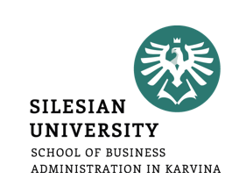
Learning outcomes
Acquire competences and knowledge to analyse the global environment that shapes the organizational behaviour.
As a future managers you need to gain knowledge about current trends in ethic business and Corporate Social Responsibility approaches.

Slide 5
Key readings
You can find support in the following sources:
Book – Jones, G. R. and J. M. George (2019). Essentials of Contemporary Management, Chapter 4, p. 122

Slide 6
Managing Globaly
As the globalization of business continues, organizations must be analyzed and managed in a new way.
Simply considering how office workers behave and perform at Apple headquarters in Cupertino, California, and then attempting to generalize findings and conclusions and apply them to office workers at Lenovo Group (which purchased IBM’s PC business in 2005) in Beijing, China, is not sufficient.
American office workers and Chinese office workers definitely think and behave in different ways. Behavior, structure, and processes are all crucial to the successful operation of an enterprise.
There will be no national products or technologies, no national corporations, no national industries.
If development of people is vital on a national level, it is certainly vital on an organizational level.

Slide 7
Managing Globaly
Today, however, economic and business activity includes global strategic alliances, worldwide production and distribution, and regional integration agreements such as the European Union, Asia-Pacific Economic Cooperation, and North American Free Trade Agreement.
The multinational corporation conducts its business in various countries, adapting its products and practices to local conditions by customizing products for specific markets.
In contrast, the global corporation avoids the high relative costs of the multinational corporation by offering universal standardized products for a homogeneous world market.

Slide 8
Managing Globaly
Developing successful global strategies and approaches to managing diverse workers has become a new requirement for managers.
It is often the case that management practices in an organization relate to the nationality of its ownership rather than to the particular locations of its facilities.
However, it is no longer enough to simply assume that a motivational approach, job design technique, or performance review system will have similar results for all workers in all settings.

Slide 9
Challenges for Management in a Global Environment
Today managers who make no attempt to learn from and adapt to changes in the global environment find themselves reacting rather than innovating, and their organizations often become uncompetitive and fail.
Five major challenges stand out for managers in today’s world:
building a competitive advantage
maintaining ethical standards
managing a diverse workforce
utilizing new technologies
practicing global crisis management

Slide 10
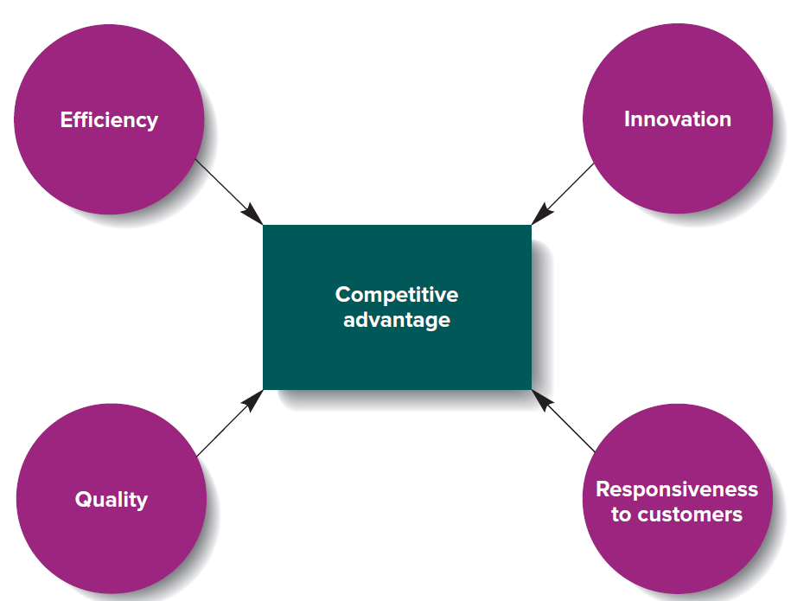
Challenges for Management in a Global Environment
Today managers who make no attempt to learn from and adapt to changes in the global environment find themselves reacting rather than innovating, and their organizations often become uncompetitive and fail.
Five major challenges stand out for managers in today’s world:
building a competitive advantage
maintaining ethical standards
managing a diverse workforce
utilizing new technologies
practicing global crisis management

Slide 11
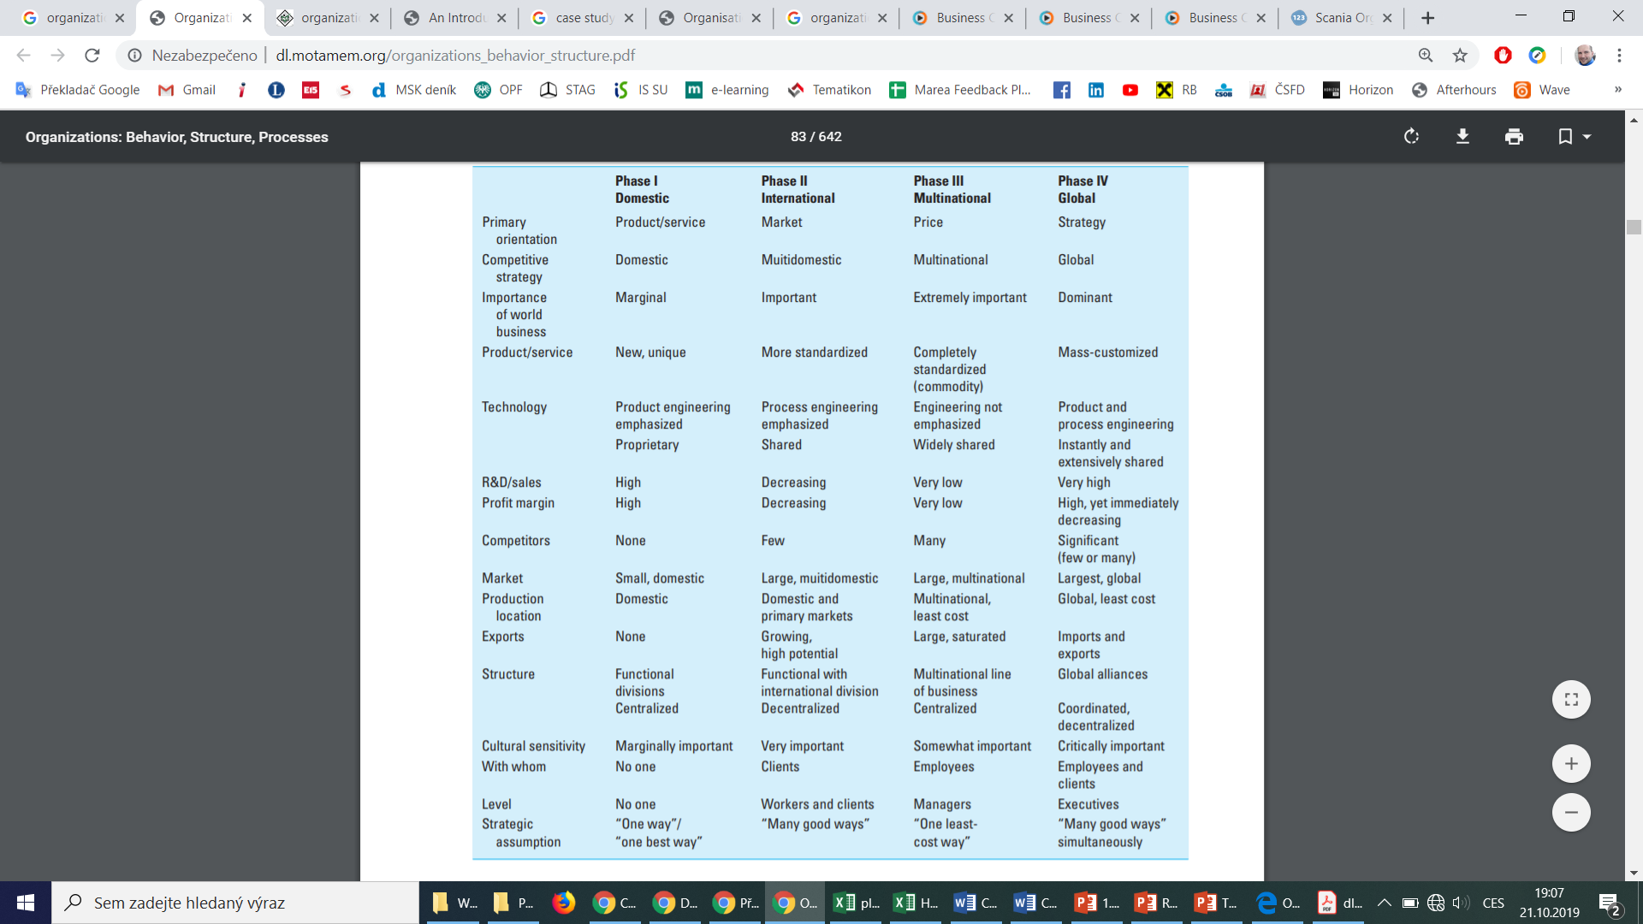

Corporate and Cross-Cultural Evolution

Slide 12
Managing Globaly
The Ford Motor Company, which was founded in 1903. Although it enjoyed widespread success in the U.S. domestic market, it was not until the 1960s that the company evolved from phase I to phase II by aggressively pursuing international expansion.
In 1967, Ford of Europe was established, which eventually helped Ford to enter phase III of corporate evolution, the multinational stage.
Phase IV of evolution, the global stage, emphasizes that firms need to understand their customers’ and other stakeholders’ needs, quickly translate them into products and services on a least-cost basis, and market them effectively. Ford is attempting to accomplish this by selling off its luxury brands (i.e., Jaguar, Land Rover, and Volvo) so that it can meet tougher carbon emission guidelines in different countries.
The ability to diagnose customers’ and stakeholders’ needs, manage cross-cultural transactions, manage multinational teams, and form and manage effective global alliances is crucial to succeeding in the fourth phase.

Slide 13
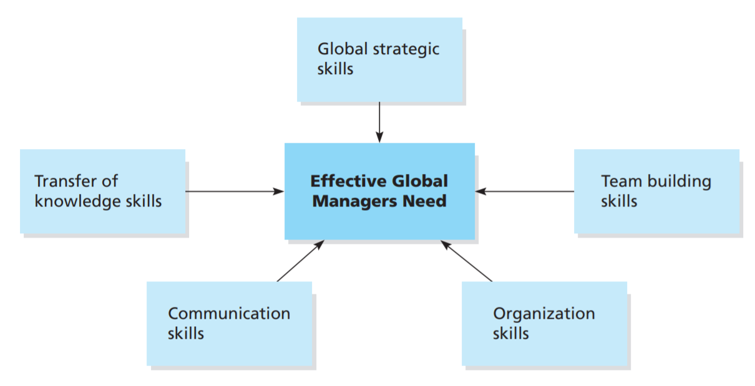
Managing Globaly – Global Manager
The global manager is a person who views markets, production, service, and opportunities globally and who seeks higher profits for the firm on a global basis.
The truly global manager is at home anywhere in the world. He or she is considered open to national ideas and free of prejudices or attachments to one community, country, or culture.
This awareness and understanding is acquired by observation, learning, participation, and involvement with people from many different countries and cultures.

Slide 14
Managing Globaly – Global Strategic Skills
Managers operating in a globally shifting work environment will need a working knowledge of international relationships and foreign affairs, including global financial markets, international law, and exchange rate movements.
Understanding global economies of scale, work ethics of employees, and host government policies and procedures will be required to formulate feasible, fair, legal, and effective strategies.

Slide 15
Managing Globaly – local preferences and global standardization
Procter & Gamble’s liquid detergent failed in Europe when it was introduced because European washing machines were not equipped for liquid detergent. Modifications to the detergent were made and sales subsequently improved.
Kellogg’s Corn Flakes were eaten primarily as a snack when introduced in Brazil. With educational advertising, Corn Flakes gained acceptance as a breakfast food.
L’Oréal markets its hair care and cosmetic products in more than 100 countries. It has adopted and implemented a strategy to produce local products adapted to local markets, while it reaps world economies of scale in research and development, raw materials sourcing, and productivity balancing.
Nestlé has tailored products to what the Chinese consumer wants and needs—instant noodles, seasonings for Chinese cuisine, mineral water, and a popular live-lactobacillus health drink.
Examples suggest that global success requires striking a balance between capitalizing on resources and needs within a nation and capturing a vision of a globalizing world. Local requirements such as customer satisfaction must be met.

Slide 16
Analysing the organization’s Environment - demographics
Demographic changes pose some of the most significant challenges for management in the twenty-first century.
The workforce in industrialized economies is ageing.
The proportion of the population who have retired from employment is growing relative to the proportion of the population still in work.
An ageing population is one consequence of people living longer and having fewer children.

Slide 17
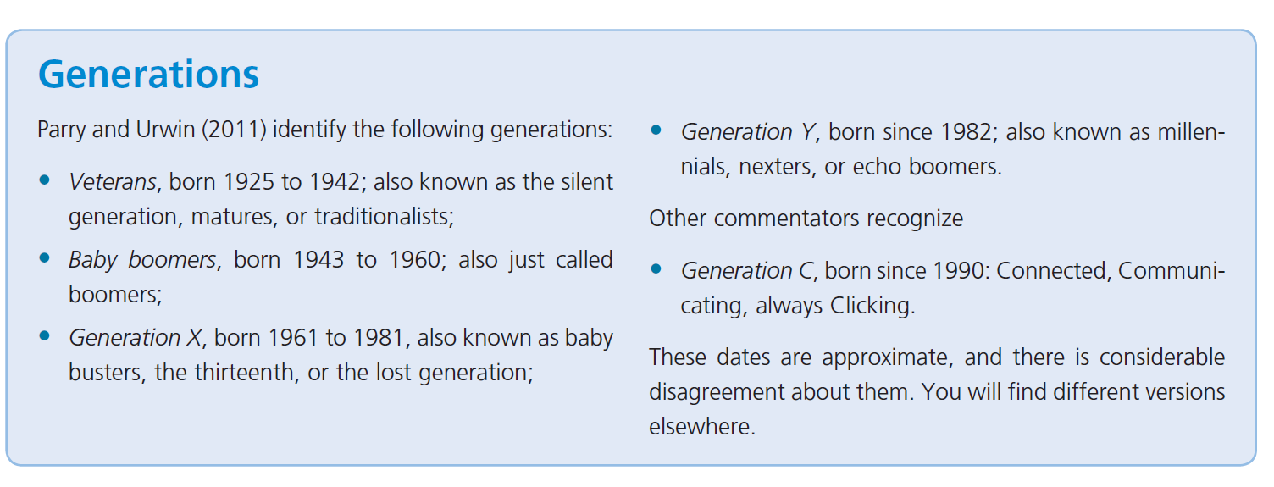
Analysing the organization’s Environment - demographics

Slide 18
Analysing the organization’s Environment - demographics
Governments have been trying to raise retirement ages in order to reduce the drain on welfare budgets and pension systems.
How will organizations fill the gaps as boomers retire, taking their knowledge and experience with them, while the proportion of skilled youngsters in the workforce is shrinking?
Will older workers adapt to new technologies and working practices, and take management orders from youngsters?
A recent survey of over 1,000 managers found that most organizations had not yet developer their age management policies. Younger managers find it difficult to manage older workers, who have different drives, and need flexibility (to care for elderly parents and grandchildren, for example).

Slide 19
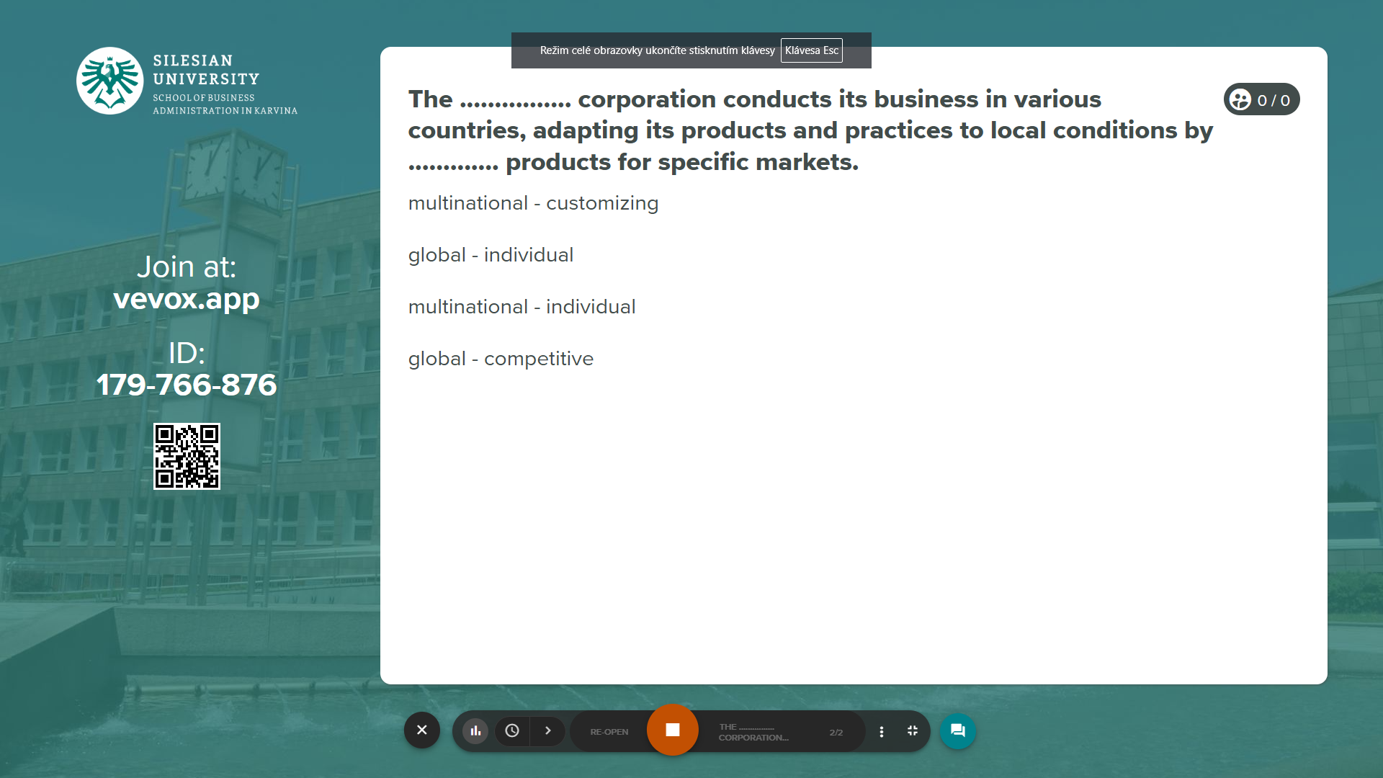
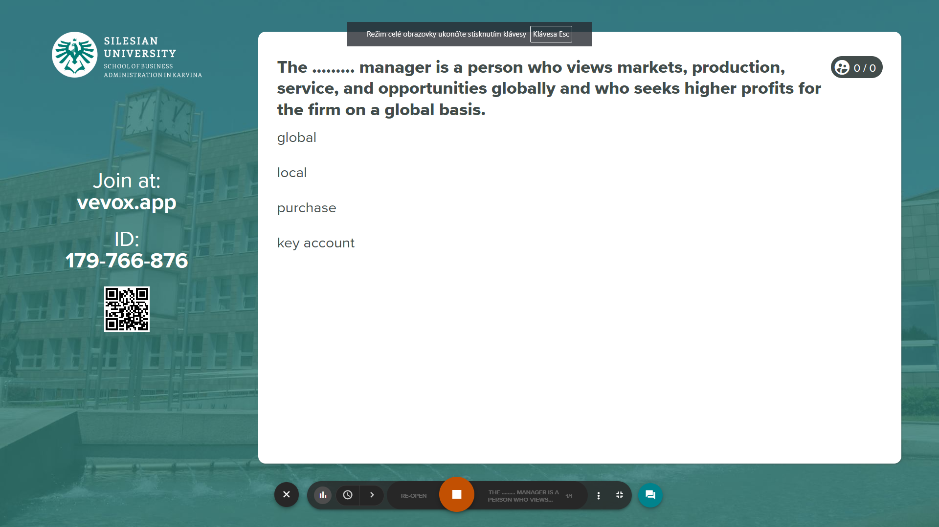
Vevox questions
https://silesianuniversity.vevox.com/#/meeting/450591/polls

Slide 20
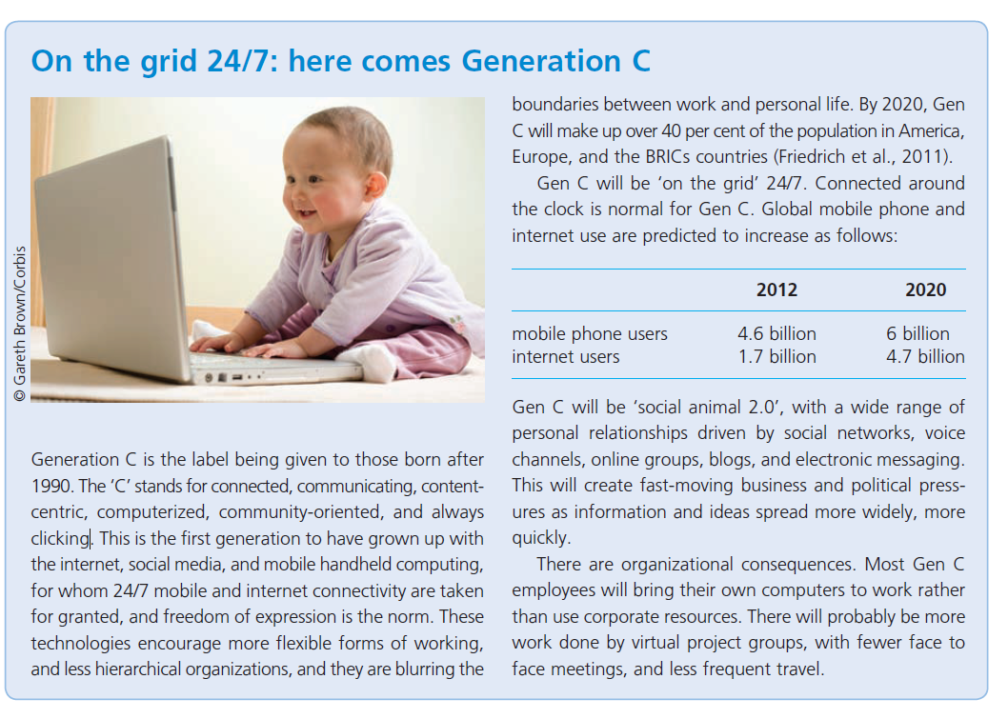

Analysing the organization’s Environment - demographics

Slide 21
Analysing the organization’s Environment - demographics
Other demographic trends that will affect many organizations include global migration, triggered in part by wars, improved communications and transport, and in Europe new rules concerning harmonization and labour mobility.
This contributes to a richer ethnic, cultural, and religious mix in a given workforce, and puts a premium on the ability to manage this diversity of values, needs, and preferences.
Further trends include the development of ‘the hourglass economy’, divided between educated and skilled knowledge workers, who are in demand, and poorly educated, untrained and poorly paid manual and clerical workers, for whom there are fewer job opportunities.
Lifestyles and values are changing, affecting the formation and composition of households, patterns of living and consumption, trends in leisure and education, and preferences in working patterns.

Slide 22
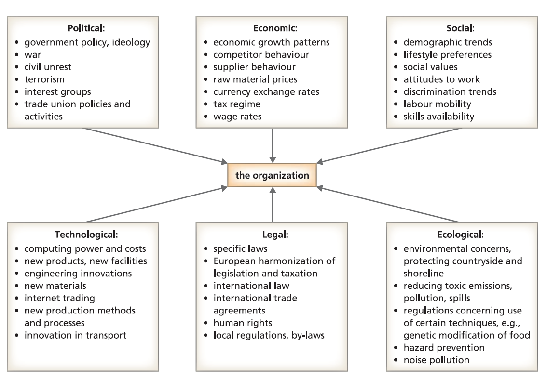

Analysing the organization’s Environment – PESTLE analyis

Slide 23
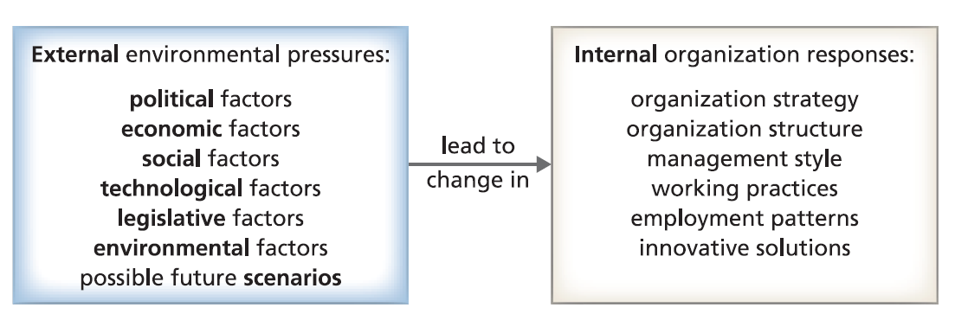
Analysing the organization’s Environment – PESTLE analyis

Slide 24
Analysing the organization’s Environment – Ethical behaviour
Organizations and managers are expected to behave ethically. The emphasis on this aspect of organizational behaviour has increased in the twenty-first century, for two reasons.
The first concerns a number of high-profile corporate scandals (Enron, Worldcom).
The second concerns increasing media scrutiny of organization and management practices, focusing on environmental issues and the use of low-cost labour.
Video: UNDP – SDGs https://www.undp.org/content/undp/en/home/sustainable-development-goals/background.html

Slide 25
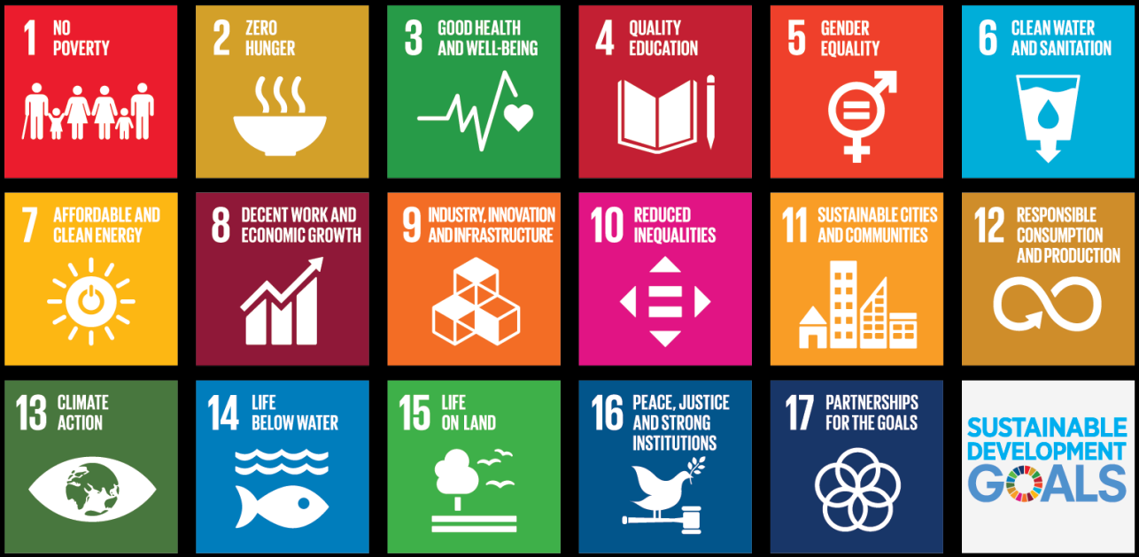
Analysing the organization’s Environment – Ethical behaviour
Organizations and managers are expected to behave ethically. The emphasis on this aspect of organizational behaviour has increased in the twenty-first century, for two reasons.
The first concerns a number of high-profile corporate scandals (Enron, Worldcom).
The second concerns increasing media scrutiny of organization and management practices, focusing on environmental issues and the use of low-cost labour.

Slide 26
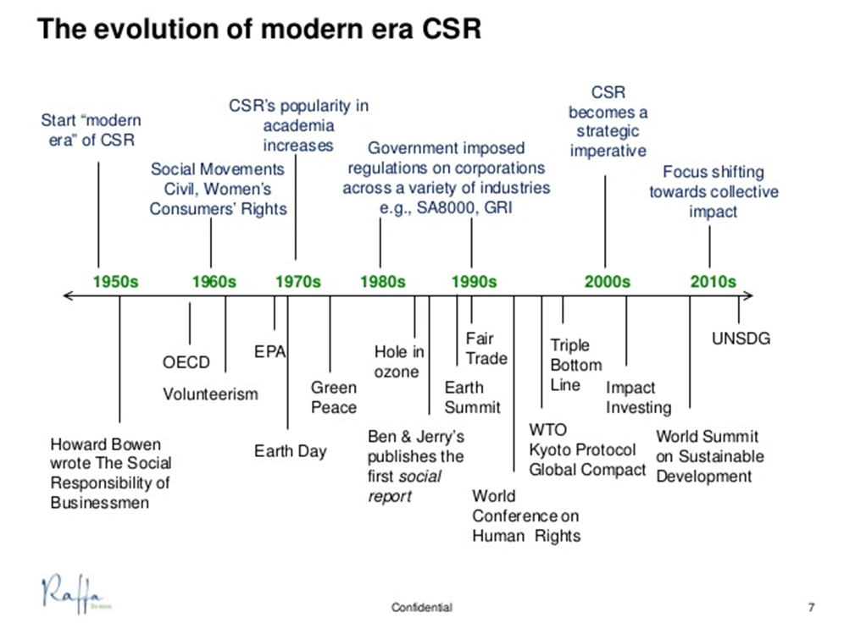
Analysing the organization’s Environment – Ethical behaviour
Organizations and managers are expected to behave ethically. The emphasis on this aspect of organizational behaviour has increased in the twenty-first century, for two reasons.
The first concerns a number of high-profile corporate scandals (Enron, Worldcom).
The second concerns increasing media scrutiny of organization and management practices, focusing on environmental issues and the use of low-cost labour.

Slide 27
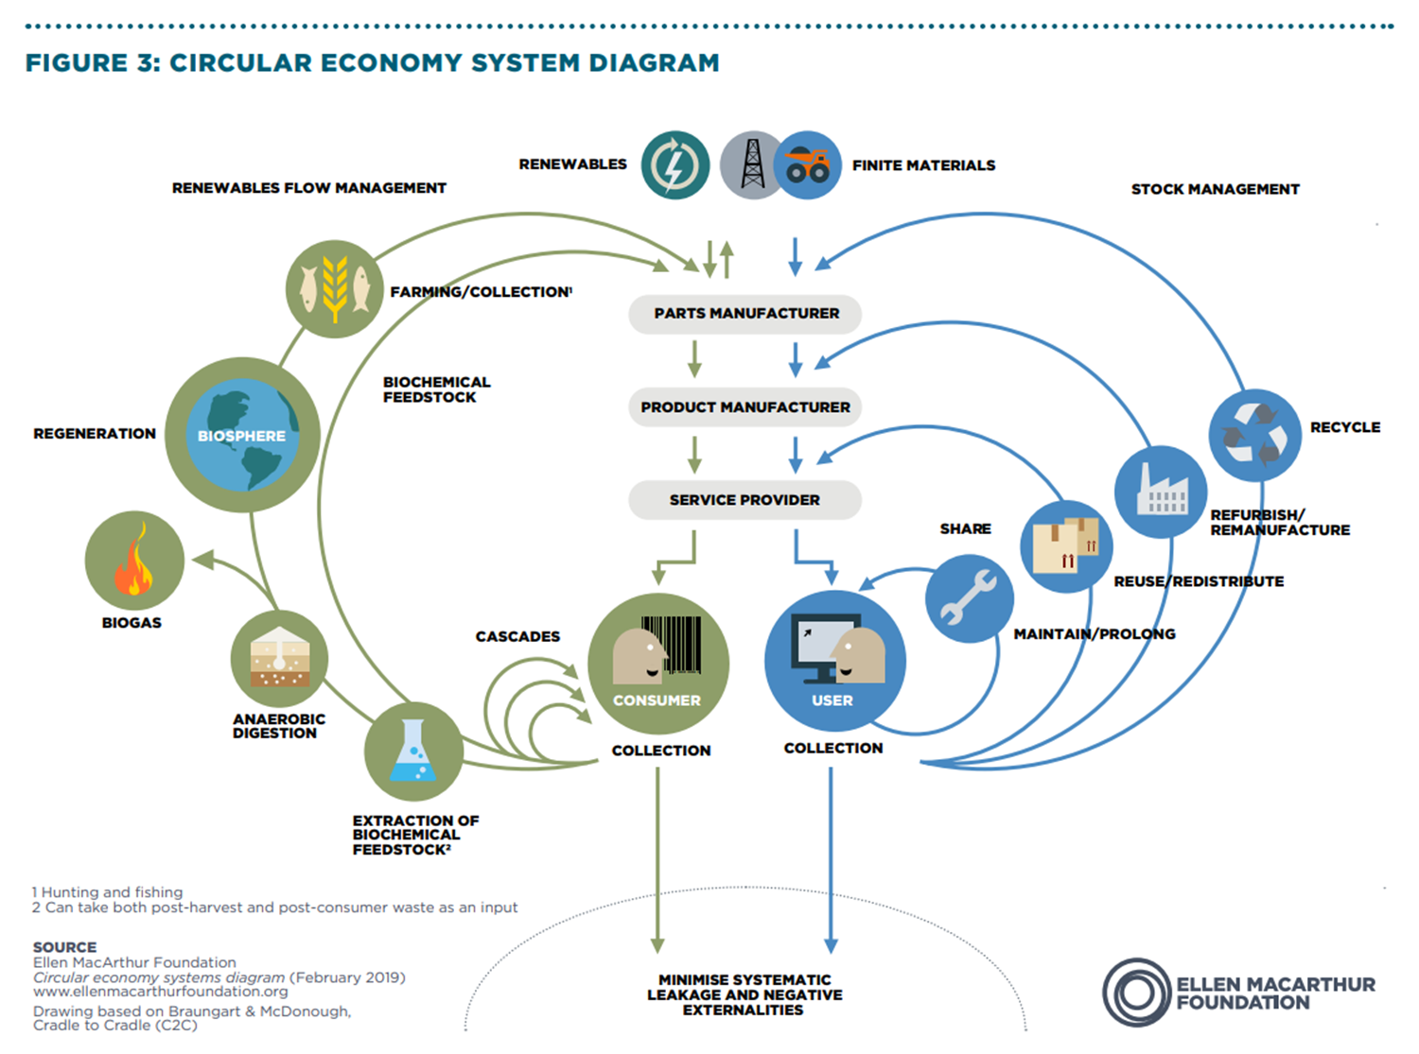

Slide 28
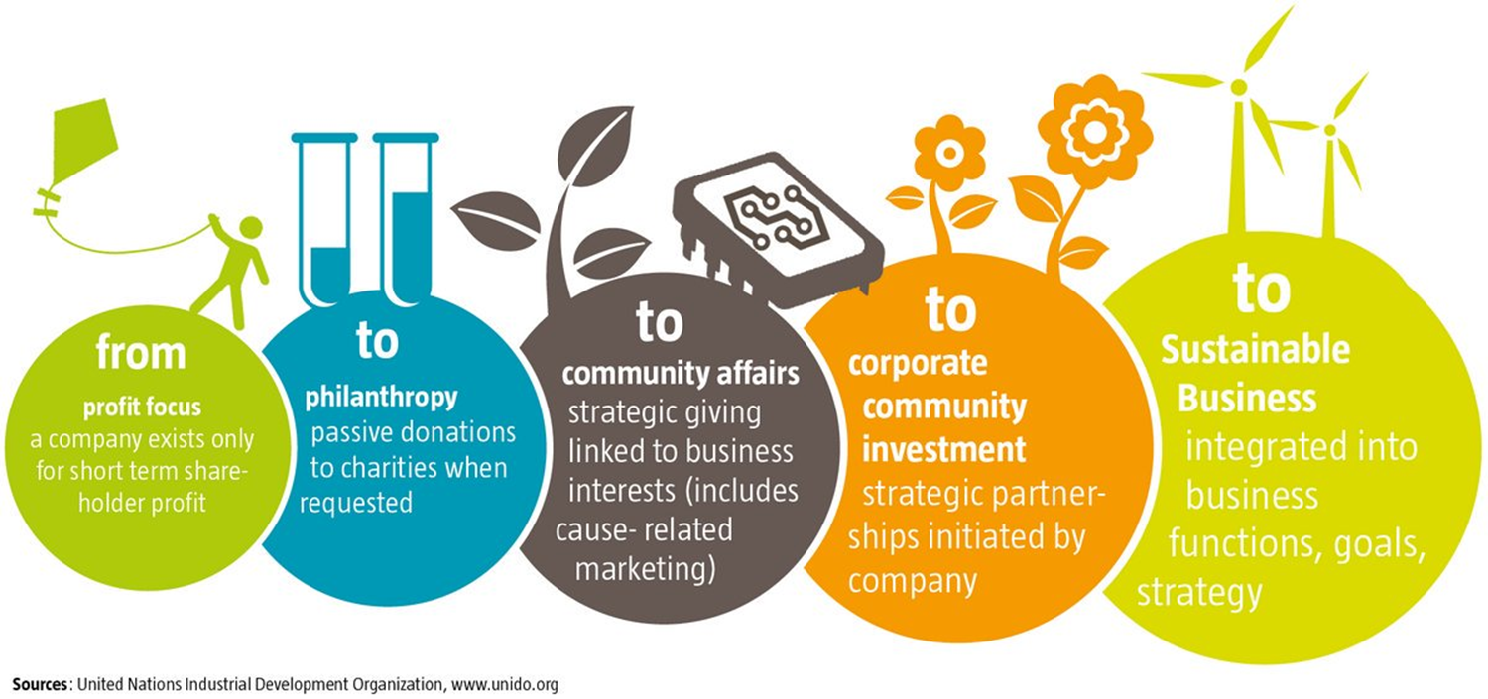
Analysing the organization’s Environment – Ethical behaviour
Organizations and managers are expected to behave ethically. The emphasis on this aspect of organizational behaviour has increased in the twenty-first century, for two reasons.
The first concerns a number of high-profile corporate scandals (Enron, Worldcom).
The second concerns increasing media scrutiny of organization and management practices, focusing on environmental issues and the use of low-cost labour.

Slide 29
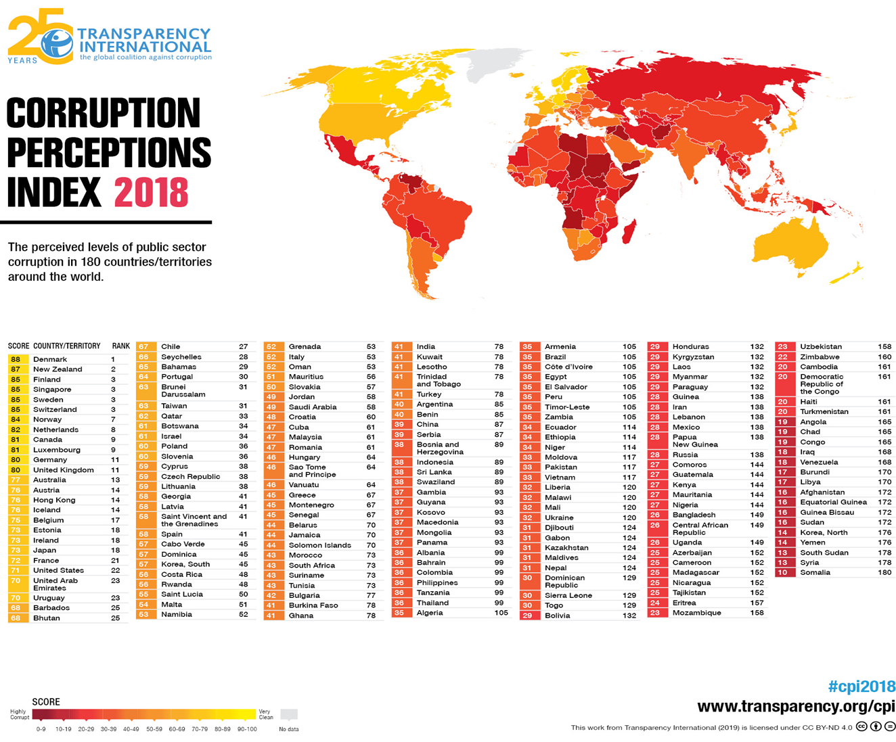
Analysing the organization’s Environment – Ethical behaviour
Organizations and managers are expected to behave ethically. The emphasis on this aspect of organizational behaviour has increased in the twenty-first century, for two reasons.
The first concerns a number of high-profile corporate scandals (Enron, Worldcom).
The second concerns increasing media scrutiny of organization and management practices, focusing on environmental issues and the use of low-cost labour.

Slide 30
Analysing the organization’s Environment – Ethical behaviour
Three-level framework which includes the ethics of the individual manager, the organization’s ethical stance, and the organization’s approach to corporate social responsibility.
Level 1, individual ethics, concerns the decisions and actions of individual managers, and the ethical principles behind their behaviour;
Level 2, the organization’s ethical stance, concerns the extent to which the organization’ minimum obligations to stakeholders and to society at large will be exceeded;
Level 3, corporate social responsibility, focuses on how the organization puts its ethical stance into practice, by addressing different stakeholder interests.
Ethics the moral
principles, values, and
rules that govern our
decisions and actions
with respect to what is
right and wrong, good
and bad.

Slide 31

Analysing the organization’s Environment – Ethical behaviour
Video: Fair Trade introduction -Fair Trade – video: https://www.fairtrade.net/standard/spo

Slide 32
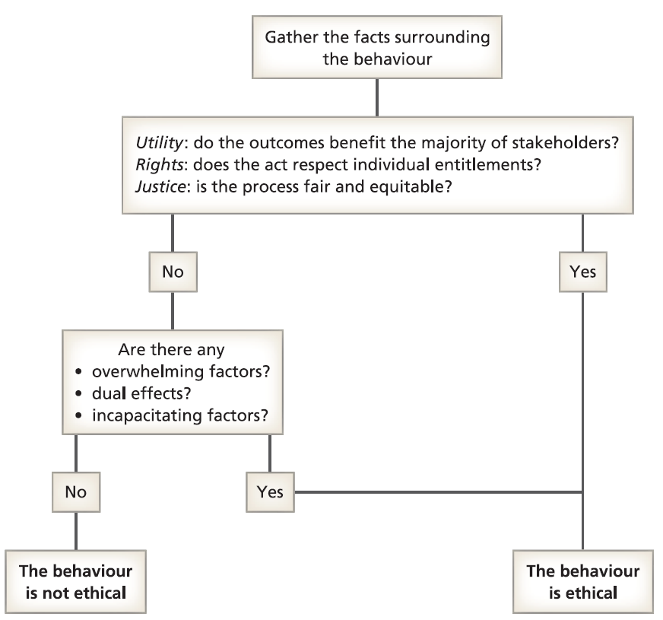
The ethical decision tree

Slide 33
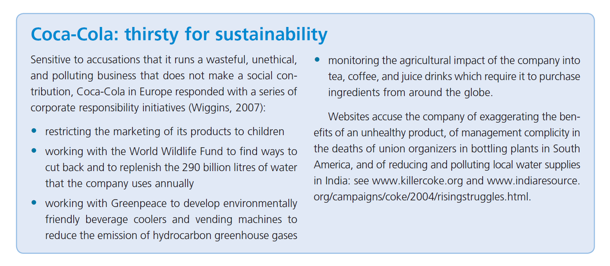

Slide 34
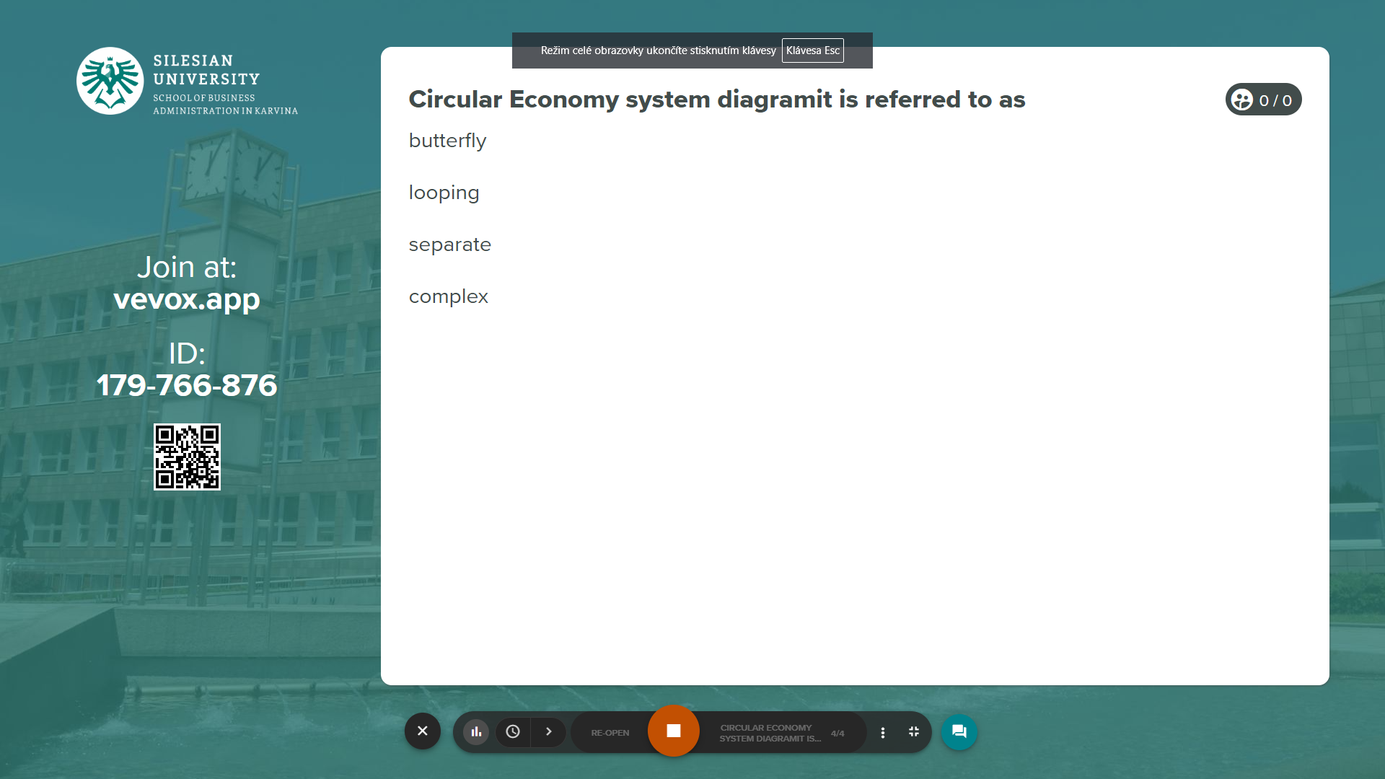

Vevox questions
https://silesianuniversity.vevox.com/#/meeting/450591/polls

Slide 35
RECAP
Managers operating in a globally shifting work environment will need a working knowledge of international relationships and foreign affairs, including global financial markets, international law, and exchange rate movements.
Understand the concept of corporate social responsibility, and the practical and ethical implications of this concept for organizational behaviour.
Businesses and their managers are expected to act in responsible and ethical ways, contributing to social and environmental outcomes as well as making profit.
Responsible practices include, for example, the business contribution to the community, the Sustainable use of resources, ethical behaviour in relationships with suppliers and customers, and the impact of the business on all stakeholders.
Critics argue that it is government’s job to deal with social and environmental issues, that the role of business is to maximize profits while operating within the law, and that managers who donate company funds to ‘good causes’ give away shareholders’ money.

Slide 36
We can share our thoughts and ask questions
☺
Pavel Adámek
adamek@opf.slu.cz

