Slide 1

Introduction
Marketing of services

Slide 2
Question no.0
Who am I?

Slide 3


About me

Slide 4



















Marketing consultant

Slide 5
About me
Business Gate – advisory board
  Providing students with real business experiences
Ph.D.
  Marketing communication of brands on social networks
Associate professorship
  How e-stores grow?
Research projects and publications blah blah blah…

Slide 6
Question no.1
Who are you?

Slide 7
Question no.2
What do you know about marketing?

Slide 8
Process
Delivering value to the customer at a profit

Slide 9
Question no.3
What is value?

Slide 10
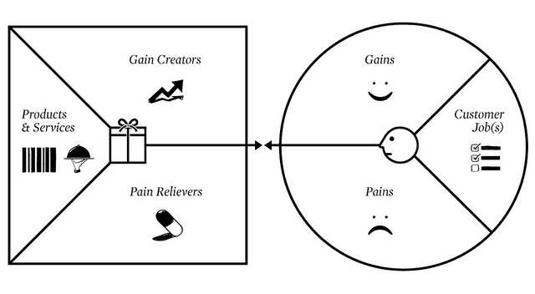
Question no.4
What is value proposition?
See Alex Ostervalders model

Slide 11
Question no.5
What is need?

Slide 12
Question no.6
What is wish?

Slide 13
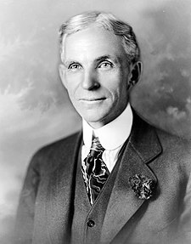
Henry Ford
“If I’d asked my customers what they wanted, they’d have said a faster horse.”

Slide 14
Question no.7
What is demand?

Slide 15
Evolution of marketing thoughts
Production
Product
Promotion
Marketing

Slide 16
Production focus 1930s
Profit driver - Production methods
Demand exceeded supply. Little competition in each market. Product design reflected production requirements more than customer requirements. Economies of scale.

Slide 17
Product focus 1950s
Profit driver: Quality of the product
A firm would also assume that as long as its product was of a high standard, people would buy and consume the product

Slide 18
Promotion focus 1960s
Profit driver: Selling methods
Such an orientation may suit scenarios in which a firm holds dead stock, or otherwise sells a product that is in high demand, with little likelihood of changes in consumer tastes diminishing demand.

Slide 19
Marketing focus 1980s
Profit driver - Needs and wants of customers
Firm would employ market research to gauge consumer desires, use R&D to develop a product attuned to the revealed information, and then utilize promotion techniques to ensure persons know the product exists.

Slide 20
Question no.8
What type of markets do we know?

Slide 21
Markets
B2C
B2B
B2G

Slide 22
Question no.9
What type of products do we know?

Slide 23
Type of products
Goods vs. Services

Slide 24
Type of products
Goods | Services
A physical commodity | A process or activity
Tangible | Intangible
Homogenous | Heterogeneous
Production and distribution are separated from the consumption | Production, distribution and consumption are simultaneous processes
Can be stored | Cannot be stored
Transfer of ownership is possible | Transfer of ownership is not possible

Slide 25
Type of products
Exapmles?

Slide 26
Examples
Health care – hospital, medical practice, dentistry, eye care.
Professional services – accounting, legal, architectural.
Financial services – banking, investment advising, insurance.
Hospitality – restaurant, hotel, bed & breakfast, ski resort, rafting.
Travel – air lines, travel agencies, theme park
Others – hair styling, pest control, lawn maintenance, counseling services.

Slide 27
Question no.10
What is marketing mix?
Old one: 4P – product, price, promotion, place
New one: 4C – customer, costs, communication, convenience
Extension for services: processes, people, physical evidence

Slide 28
Summary
We all know now what is:
Marketing, value, need, wish, demand, goods and services, marketing mix.

Slide 29
The end

