Slide 1
International Business Law
The Concept of Law and Legal Systems
Tomáš Gongol

Slide 2
What is Law?
system of rules
characteristics of any legal rule
foreseen by law
enforceable by the means foreseen by law
X Not legal rules:
traditions, moral rules, ordinary customs, rules of sport, rules of the game, religious rules or non-legal agreements between friends and family (invitation for a cup of coffee).
Law is a system of rules that people are supposed to follow in a country or society. Law as a system can be broken (e.g. break the law) - that means to do something against the law, or something that is illegal. On the other hand, we can also use a term enforce the law - which means to make sure that the law is not broken, and to ensure obedience to the law.

Slide 3
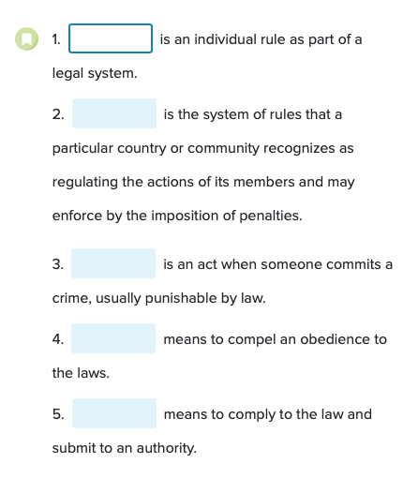
LAW, OBEDIENCE, LAW-BREAKING, TO ENFORCE THE LAW

Slide 4
Functions of law
to set and maintain order in society and achieve justice
to define the limits of acceptable behaviour
the constitutional principle of what is not prohibited, is permitted
to define the consequences of certain behaviour
(sanctions for breaching legal rules )
to give authority to agents of the state to take actions against citizens
for example police has a legal right to use force
executors have a right to enter the property of the debtor

Slide 6
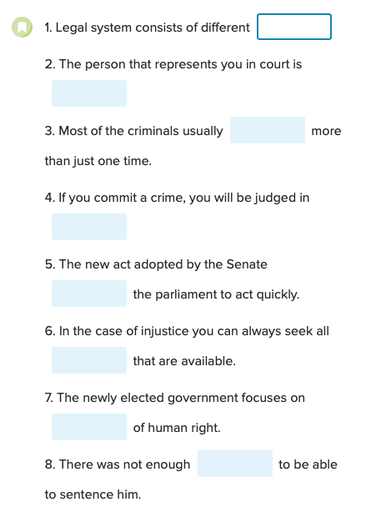
Branches of law
Legal remedies
Enforcement
Breach the rules
Advocate
Binds
Evidence
Court of Justice

Slide 7
Law and legal systems
Law is implemented through legal systems.
five basic legal systems used around the world.
Which legal system is used in each country depends on the tradition, history, inclination to specific legal culture
The five legal systems are the
civil law systems,
common law systems,
customary law systems,
religious legal systems
mixed legal systems
Bodies of law ( common law system, civil law system) Sources of law
There are two most internationally important bodies of law – common law and civil law. In common law jurisdictions, such as in England, Wales and Northern Ireland or the USA, law comes primarily from customs, usage and earlier court decisions.
By contrast, in civil law jurisdictions (e.g. most of continental Europe) laws come from written legal codes. Much of the world can be neatly divided into these two bodies of law, i.e. common law and civil law, but there are also mixed systems (e.g. India, Iran, China and South Africa).

Slide 8
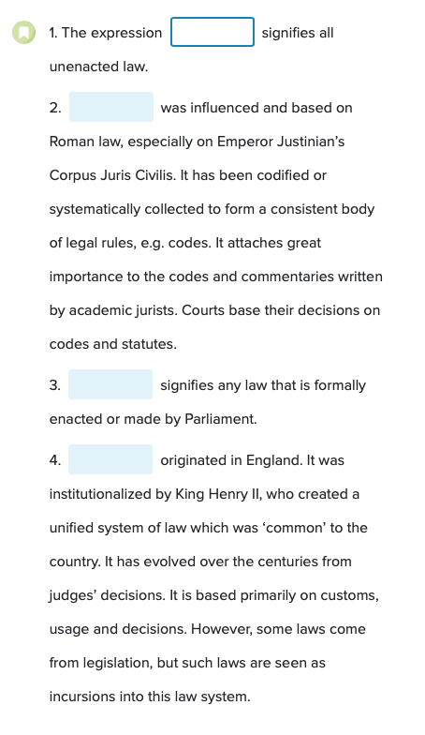
Civil law
Common law
Unwritten law
Written law

Slide 10
Civil law
all Europe (except UK), South America and vast majority of Asian countries
follow the Roman Law tradition
Common characteristics
based on codified statutes which are the dominant source of law (Civil Code, Commercial Code, Criminal Code…)
writen Constitution
More rigid
passed by Parliament
Courts, on the other hand, are the bodies which only interpret and apply rather than create law.
Case law is thus not the official source of law, however, case law of the higher courts has a strong persuasive power

Slide 11
Common Law systems
UK, North America and Australia
dominant source of law are precedents (judge-made law)
principle of stare decisis (principle of following the rules established by previous judicial decision if the facts of the case are comparable)
Common Law countries have also written statutes but they are not a dominant source of law.
These countries can but do not have to have a written constitution (UK does not have a written constitution X US do)

Slide 12
Other law systems
Customary law systems
built on customs accepted and maintained by the whole society.
do not exist in their clear form anymore but rather they can be found as a mixture of civil or common law with these customs
Religious legal systems
based on religious tradition.
a typical example is Islamic law which is based on Quran.
Mixed legal systems combine two or more legal systems

Slide 14
True of false?
Thomas Hobbes believed that if a state is the only one to use violence then it will ensure peace.
Thomas Hobbes's Leviathan has never abused its power.
In that scenario the state controled police and administration.
Solution is to distribute the state's power into four branches.
In Germany, the branches of power are dependent on each other.
Authority is distributed merely at the highest level.
It can be easy to monopolize power.
Due to the separation of powers, everyone is protected from violence.

Slide 15
International and supranational legal systems
international legal system
regulating relations between states or international organizations (UN, NATO etc.)
supranational legal systems
such as EU law which is superior to national laws of the member states.

Slide 16
How the legal system looks like in the CZ?

Slide 17
Formal and material sources of law
Formal sources of law
are the outer forms of legal norms (legal norms are included in statutes, international treaties, case-law, normative agreements etc. which are the formal sources of law).
These forms give the norms their legal force and validity
Example: we know that there is a speed limit in the towns of 50 km per hour (legal norm) and it is binding because it is written in the law no. 361/2000 Coll., on road traffic, as amended (formal source of law).
Material sources of law
are the source of substance for law – the state of society, technological development, economic and cultural level, traditions.
It is an answer to the question, why do we need a specific legal regulation? E.g. the speed limit in the towns and villages was introduced because it is dangerous to drive fast in places with high occurrence of people

Slide 18
Sources of law within the Continental tradition v. the Common law tradition
Continental tradition
dominant source of law legislative texts (written Constitution, codes, statutes)
passed by a formal procedure in the Parliament
The main branches of law are moreover embodied in the written codes (Civil Code, Criminal Code, Business Corporations Act, Labor Code etc.)
Common law tradition
is based on plurality of sources with the precedents dominating over statutes
The role of the courts is dominant because they create law

Slide 19
Formal sources of Czech law
The Czech Constitution and the Bill of the fundamental rights and freedoms (both written)
on the top of the hierarchy of the sources of law
ll other legal acts must be in compliance with them
international treaties
have superiority over the statutes
statutes
passed by the Czech Parliament
derived legislation
regulations and decrees adopted by the government, ministries and other authorities of state administration, and legislative acts of territorial self-governing units

Slide 20
Classification of Law 1. classifivation
National law
relates to a particular nation and governs relations within national territory, national citizens, residents etc.
International law
governs relations between states or parties from different states.
Supranational law
is a legal systems sui-generis standing above the national laws (EU law).

Slide 21
Classification of Law 2. classification
Substantive law
says what the law is, i.e. it defines, describes, regulates and creates legal rights and duties (civil law, commercial law, criminal law etc.).
Procedural law
says how to enforce the substantive law, i.e. it defines the rules for the enforcement of substantive law and establishes the methods of enforcing the rights generated by the substantive law (civil procedural law, criminal procedural law etc).

Slide 22
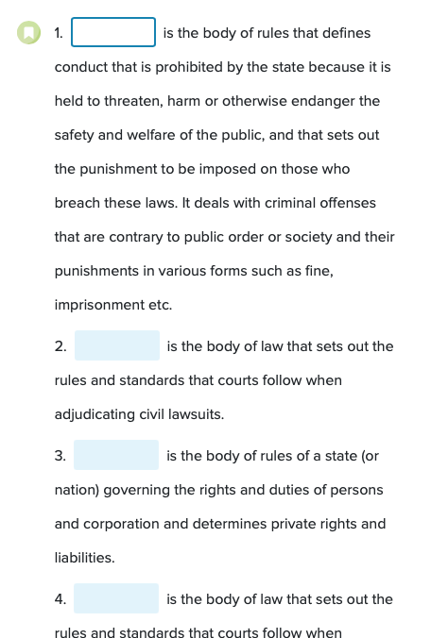
Criminal procedings
Civil law
Civil procedings
Criminal law

Slide 23
Classification of Law 3. classification
Public law
regulates relationships between one public party which is in superior position over the other
The position of the two parties is unequal and the private party must comply with the will of the public party.
There is always a public interest on one side and a private interest on the other (Constitutional law, Administrative law, Criminal law).
Private law
regulates relationships between the parties with equal position
with the rights and duties of individuals, families, business corporations etc. and there is no public interest in the field of private law (civil law, family law, commercial law, most part of labor law).

Slide 24
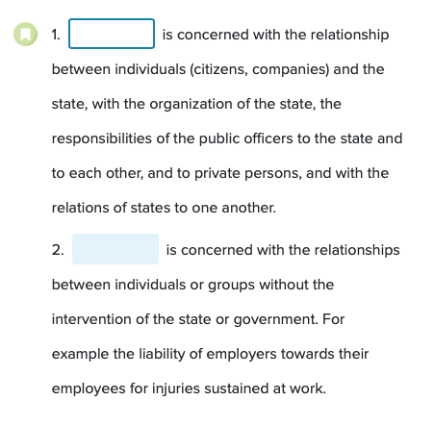
Public law
Private law

Slide 25
Self-assessment questions
What are the characteristics of legal rules?
Why do not rules of the games belong to legal rules?
What legal systems do you know?
Describe the main differences between the common law systems and the civil law systems.
What is the difference between the material and formal sources of law?
Describe the main difference between the public and private law.
What is procedural law for?

