Slide 1

HUMAN RESOURCE MANAGEMENT
Lesson 2
HRM – significance, developement, functions
Ing. Helena Marková, Ph.D.

Slide 2
Content
PERSONALISTIKA PEM SU OPF
personnel management,
human resource management,
personalities of management and personnel management history
human resource approaches

Slide 3
Developement of HRM
HRM PEM SU OPF
It developed differently in the world.
Prior to that…
employers became interested in labor force for efficiency
focused on selection and training employees in manufactures

Slide 4
Developement of HRM
HRM PEM SU OPF
1st stage - people care (care about employees)
1920 - 30
technical aspect of hiring, evaluating, training, compensating
Taylorism, often referred to as Scientific Management, was the first theory of management to focus specifically on analyzing and optimizing workflows.
conflict of managers and employees – motivation/only money
a human was a part of technological process.

Slide 5
Developement of HRM
HRM PEM SU OPF
2nd stage
Personnel administration
explosion of academic research in psychology, anthropology and sociology
human realtions movement
rise of behaviourial, psychological and emotional perspective
divided into processes and technical background is still important

Slide 6
Developement of HRM
HRM PEM SU OPF
3rd stage (1940s – 50s)
Personnel management – developement
specific social needs of a person
comprehensive plans for personal and social development
personnel management (not just administration)
corporate management was both operational and tactical

Slide 7
Developement of HRM
HRM PEM SU OPF
4th stage (1960s – 70s)
Personnel management – maturity
specific social needs of a person
comprehensive plans for personal and social development
personnel management
corporate management was both operational and tactical
employees as a part of the system, increasing role of education, HR generally

Slide 8
Developement of HRM
HRM PEM SU OPF
5th stage (1980s - )
Human resource managment
more strategies
learning and developing people – learning organization
man was seen as a highly individualized
organised and pro-social system
systems are interconnected and processes build on each other
more oriented towards the external environment of the company

Slide 9
TASK 1
HRM PEM SU OPF
Trip to history
4 group of students
Search for information about 4 historical personalities of management:
Henri Fayol Frederick W. Taylor
Peter F. Drucker Tomas Bata
Basic biography
What is their benefit in management, especially HRM?
What is relevant today?
Present it to your co-students.

Slide 10
Key differencies
HRM PEM SU OPF
Personnel Management Human Resource Manag.
employee focused business partner
operational, administrative strategic
reactive proactive
fragmental,ad hoc integrated, coordinated
policies and practises policies and practises
focus on performance focus on added value measurment

Slide 11
Hard x soft HRM
HRM PEM SU OPF
Hard HRM
emphasises on the efficient utilisation of the workforce
employees are the source to achieve organisational goals
Soft HRM
people management practises and activities to gain commitment of employees „emotionaly“ – you want to do that because you believe it…

Slide 12
Hard x soft HRM
HRM PEM SU OPF
Hard HRM Soft HRM
Employees are a resource …they are a source of
utilized competitive advantage
Deployment Developement
Control Commitment
Direction Involvement
Rigidity Flexibility
Performance measurement Performance enabling

Slide 13
Common HR activities
HRM PEM SU OPF

Slide 14
The pillars of HRM
HRM PEM SU OPF
Company culture
Philosophy
HRM Strategy
Policies and procedures

Slide 15
Company culture
HRM PEM SU OPF
Company culture is about the climate in the company, about relationships, behaviour towards employees and clients, respect to each other.
It goes throught strategies and policies.
It is based on philosophy (usually of the founder or owner).
Main values of the company.
CSR – what is it? Is it important? Is it what can company culture be built on? Name some rules…

Slide 16
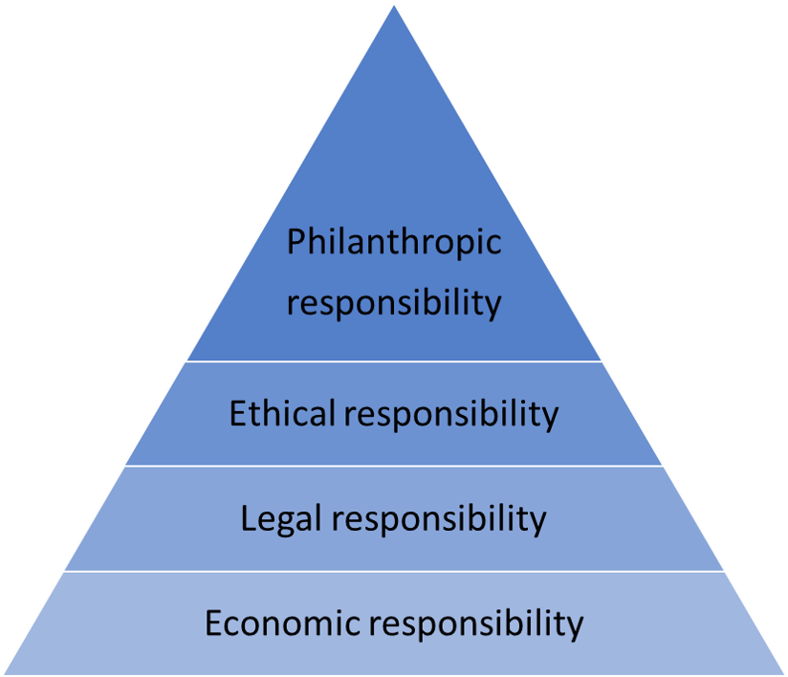
CSR pyramid
HRM PEM SU OPF

Slide 17
CSR in the social area
HRM PEM SU OPF
Social activities of a socially responsible company may include:
philanthropy
communication with stakeholders
strict respect for human rights (holidays, overtime, sick days, benefits, not trying to set a minimum wage saying there are 20 more people waiting outside)
compliance with labour standards
https://digitalmarketinginstitute.com/blog/corporate-16-brands-doing-corporate-social-responsibility-successfully

Slide 18

PERSONALISTIKA PEM SU OPF
Thank you
for your attention.
Děkuji vám za pozornost, přeji příjemný den.

