Slide 1
Call center outsourcing Dealing With Customers’ Complaints Qualities of a successful call center agent Golden rules of customer service
Grammar – questions in English
Grammar - articles
Grammar – Selected phrasal verbs in English

Slide 2
Call center outsourcing
Call center outsourcing is the business practice of contracting out call center services.
Call centers handle all kinds of customer services problems, from your credit cards to appliance warranties.
Companies began outsourcing to save money.
They found it was more cost-effective to locate their call centers in areas with a lower cost of living.

Slide 3
Call center outsourcing
Pros
There are at least four major reasons why a company would want to outsource its call center.
They all have to do with offloading risk to the call center specialist, instead of keeping it inhouse.
Here are some specifics:

Slide 4
Pros
1. Flexibility.
Call center outsourcing allows a company to be flexible to changing needs.
If a business moves into a new market, it is difficult to estimate how many call center employees to add.
The same is true when the firm launches new products.
The company must pay the fixed cost of the call center, even if the expansion does not earn enough revenue.
When it outsources the call center, the company only pays for the time employees spend on the phone.

Slide 5
Pros
2. Expansion to International Markets.
When a company expands to foreign markets, it must have local call centers.
The staff must understand the culture and speak the language.
An outsourced call center can handle that problem on an as-needed basis.
3. Responsivness.
Companies often have spikes in their business, such as those during the holiday season.
It ́s difficult to train, hire, and then lay off workers for those few months when demand is higher.
A company that outsources its call center contracts out those risks.

Slide 6
Pros
4. Customer Service.
The telecommunications infrastructure becomes worn, unreliable, or outdated.
Maintaining it is costly, and replacing it even more so. An outdated system can reduce competitiveness.
An outsourced call center brings with it the latest technology.
The business can then focus on innovation in its goods and services

Slide 7
Cons
Cons The biggest reason why a company would want to keep its call center in-house control.
This is especially critical for a company whose competitive advantage is customer service.
The call center is the interface with the customer.
The brand promise of customer service must be top notch.
A company whose brand promise is innovative must have its call center reflect that image.
For low-cost companies, the following problems aren't so critical.

Slide 8
Cons
1. Communication.
One of the biggest complaints of outsourced call centers is understanding foreign accents.
Foreign call center employees ́ accents kept US customers from understanding them.
2. Culture Shock.
Employees in foreign call centers weren't familiar with common US phrases and slang.
They weren't clear on geographic references. This reduced customers ́trust in their expertise.
3. Product Knowledge.
Foreign call center employees were far removed from the corporate base.
As a result, they weren't as familiar with the company ́s products and services.
This also reduced confidence and resolution of customer problems.
Sometimes outsourcing ́s advantages don ́t outweigh its disadvantages.
Compass Management Consulting found that outsourced call centers lowered production by 60 percent.
That made the 40 percent reduction in costs not worth savings.

Slide 9
Grammar – questions in English

Slide 10
Grammar – questions in English

Slide 11
Grammar – questions in English

Slide 12
Grammar – questions in English

Slide 13
Grammar – questions in English

Slide 14
Grammar - articles

Slide 15
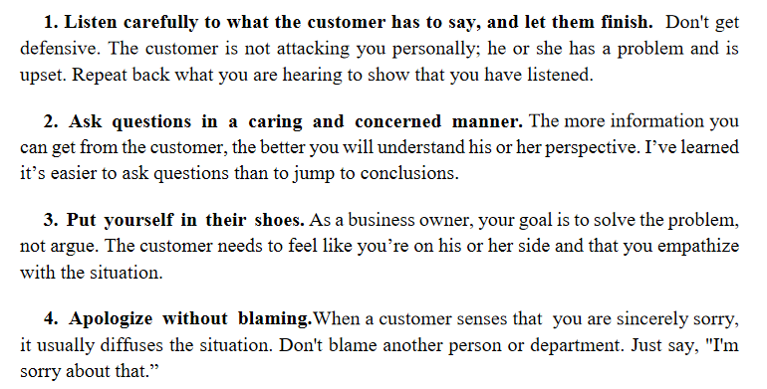
Dealing With Customers’ Complaints
Ben Ridler suggests the following:

Slide 16
Dealing With Customers’ Complaints

Slide 17
Qualities of a successful call center agent

Slide 18
Qualities of a successful call center agent

Slide 20
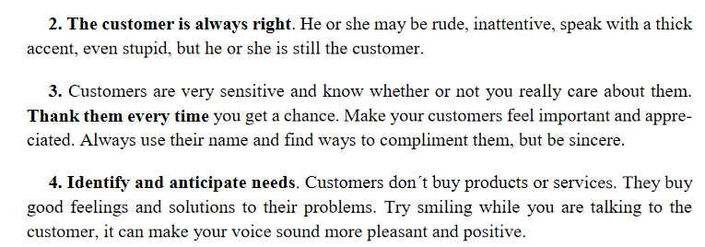
Golden rules of customer service

Slide 21
Golden rules of customer service

Slide 22
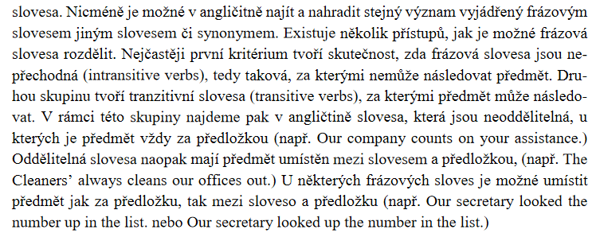
Grammar – selected phrasal verbs in English

Slide 23
Exercises

Slide 24
Exercises

Slide 25
Exercises

