Slide 1

THREE SECTOR NATIONAL INCOME MODEL
LESSON III
Dr. Ingrid Majerová
MACROECONOMICS/EVS/NAMAB

Slide 2
THREE SECTOR NATIONAL INCOME MODEL
Outline of the lecture
Three-Sector Model
Tax Function
Consumption Function
Government Expenditure Function
Aggregate Expenditure Function
Output-Expenditure Approach: Equilibrium National Income

Slide 3
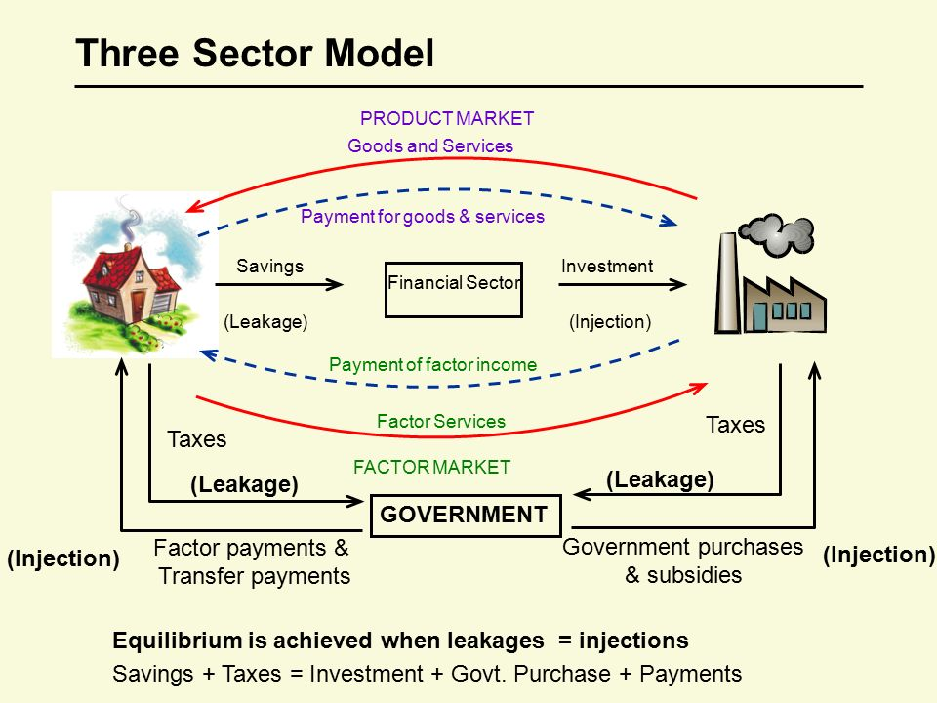
THREE-SECTOR NATIONAL MODEL

Slide 4
THREE-SECTOR NATIONAL MODEL
VARIABLES
With the introduction of the government sector (i.e. together with households C, firms I), aggregate expenditure E consists of one more component, government expenditure G.
E = C + I + G
Still, the equilibrium condition is
Planned Y = Planned E

Slide 5
THREE-SECTOR NATIONAL MODEL
CONSUMPTION FUNCTION
Consumption function is positively related to disposable income Yd
C = f(Yd)
C= C’
C= cYd
C= C’ + cYd

Slide 6

THREE-SECTOR NATIONAL MODEL
NATIONAL INCOME
National Income Personal Income Disposable Personal Income
w/ direct income tax Ta and transfer payment Tr
Yd ≠ Y
Yd = Y - Ta + Tr

Slide 7
THREE-SECTOR NATIONAL MODEL
TRANSFER PAYMENT AND TAXES
Transfer payment Tr can be treated as negative tax
T is defined as direct income tax Ta net of transfer payment Tr
T = Ta – Tr
Yd = Y - (Ta - Tr)
Yd = Y - T

Slide 8
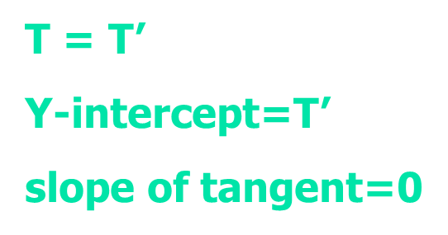
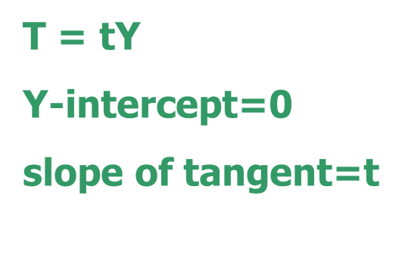
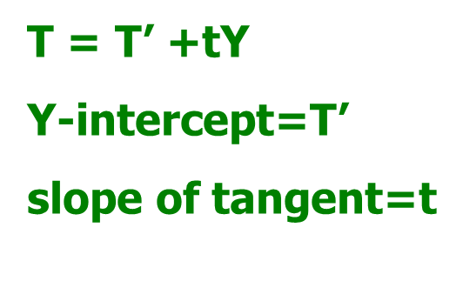
THREE-SECTOR NATIONAL MODEL
TAX FUNCTION
T = f(Y)
T = T’
T = tY
T = T’ + tY

Slide 9
THREE-SECTOR NATIONAL MODEL
TAX FUNCTION
Autonomous Tax T’
this is a lump-sum tax which is independent of income level Y
Proportional Income Tax Ty
  marginal tax rate t is a constant
Progressive Income Tax tY
  marginal tax rate t increases
Regressive Income Tax tY
  marginal tax rate t decreases

Slide 10
THREE-SECTOR NATIONAL MODEL
CONSUMPTION FUNCTION
C = f(Yd)
C = C’
C = cYd
C = c(Y - T)
C = C’ + cYd
C = C’ + c(Y - T)

Slide 11

THREE-SECTOR NATIONAL MODEL
CONSUMPTION FUNCTION
T = T´ C = C’ + c(Y - T’)
C = C’- cT’ + cY slope of tangent = c
T = tY C = C’ + c(Y - tY)
C = C’ + (c - ct)Y slope of tangent = c - ct
T = T’ + tY C = C’+c[Y-(T’+tY)]
C = C’ - cT’ + (c - ct) Y slope of tangent = c - ct

Slide 12
THREE-SECTOR NATIONAL MODEL
CONSUMPTION FUNCTION
T = T´ C = C’ + c(Y - T’)
C = C’- cT’ + cY slope of tangent = c = MPC
T = tY C = C’ + c(Y - tY)
C = C’ + (c - ct)Y slope of tangent = c – ct = MPC (1-t)
T = T’ + tY C = C’+c[Y-(T’+tY)]
C = C’ - cT’ + (c - ct) Y slope of tangent = c - ct= MPC (1-t)

Slide 13
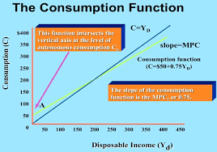

THREE-SECTOR NATIONAL MODEL

Slide 14
THREE-SECTOR NATIONAL MODEL
GOVERNMENT EXPENDITURE FUNCTION
G only includes the part of government expenditure spending on goods and services, i.e. transfer payments Tr are excluded.
Usually, G is assumed to be an exogenous / autonomous function
G = G’
Y-intercept = G’
slope of tangent = 0
slope of ray when Y

Slide 15
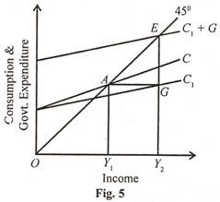
THREE-SECTOR NATIONAL MODEL
MPC ↓ when Y ↑

Slide 16
THREE-SECTOR NATIONAL MODEL
AGGREGATE EXPENDITURE FUNCTION
E = C + I + G
given C = C’ + cYd
T = T’ + tY
I = I’
G = G’
E = C’ + c[Y - (T’+tY)] + I’ + G’
E = C’ - cT’ + I’+ G’ + (c-ct)Y
E = E’ + c(1-t) YG

Slide 17
THREE-SECTOR NATIONAL MODEL
AGGREGATE EXPENDITURE FUNCTION
E = C’ - cT’ + I’ + G’ + (c - ct)Y
E = E’ + (c - ct)Y
given E’ = C’ - cT’ + I’ + G’
E’ is the y-intercept of the aggregate expenditure function E
c - ct is the slope of the aggregate expenditure function E

Slide 18
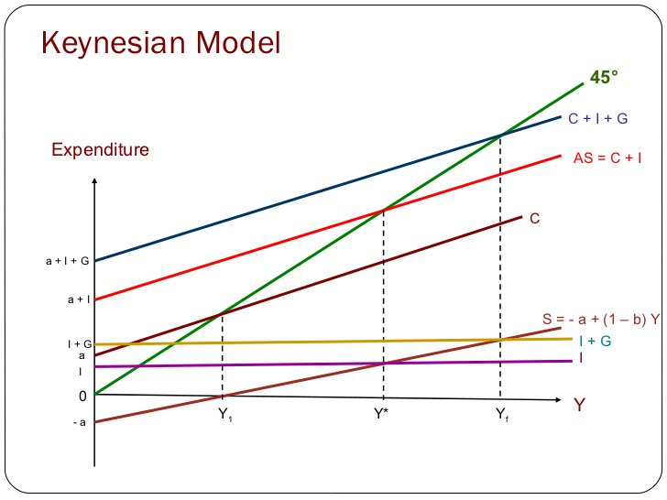
THREE SECTOR NATIONAL INCOME MODEL

Slide 19
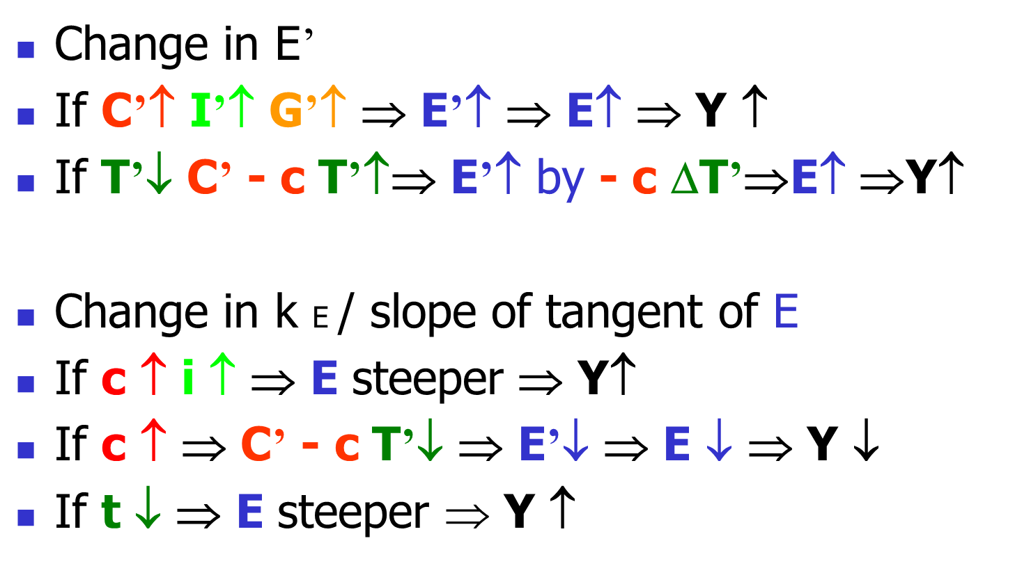
THREE-SECTOR NATIONAL INCOME MODEL
FACTORS AFFECTING Ye

Slide 20
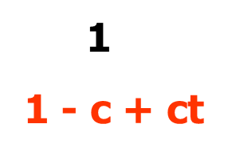

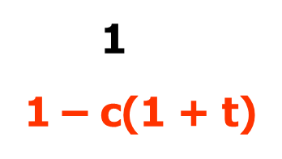
THREE-SECTOR NATIONAL MODEL
I = I´ EXONEOUS FUNCTION
E = E’ + (c - ct) Y
In equilibrium, planned Y = planned E
Y = E’ + (c - ct) Y
(1- c + ct) Y = E’
Y = E’
E’ = C’ - cT’ + I’ + G’
k E = OR

Slide 21
THREE SECTOR NATIONAL INCOME MODEL
MULTIPLIERS
Whenever there is a change in the autonomous spending C’ I’ or G’ the national income Ye will change by a multiple of k E.
It actually measures the ratio of the change in national income Ye to the change in the autonomous expenditure E’
ΔYe/ΔE’ = k E

Slide 22
THREE SECTOR NATIONAL INCOME MODEL
MULTIPLIERS
Any change in the lump-sum tax T’ will lead to a change in the national income Ye by a multiple of k T in the opposite direction since k T takes on a negative value.
Besides, the absolute value of k T is less than the value of k E.

Slide 23




THREE SECTOR NATIONAL INCOME MODEL
MULTIPLIERS
$∆Y=\frac{1}{1−c(1+t)}$ΔG
$∆Y=\frac{1}{1−c(1+t)}$ΔI
$∆Y=\frac{1}{1−c(1+t)}$ΔC
$∆Y=\frac{−c}{1−c(1+t)}$ΔT

Slide 24
THREE SECTOR NATIONAL INCOME MODEL
FISCAL POLICY
The use of government expenditure and taxation to achieve certain goals, such as high employment, price stability.
Discretionary Fiscal Policy
  Expansionary Fiscal Policy (when Yf > Ye)
  Contractionary Fiscal Policy (when Yf < Ye)
Automatic Built-in Stabilizers
  Proportional / Progressive Tax System
  Welfare Schemes

Slide 25
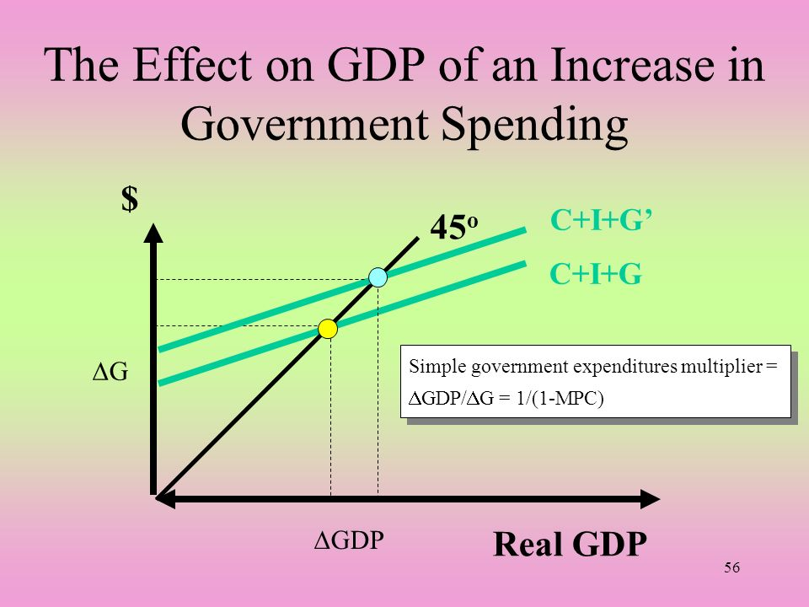
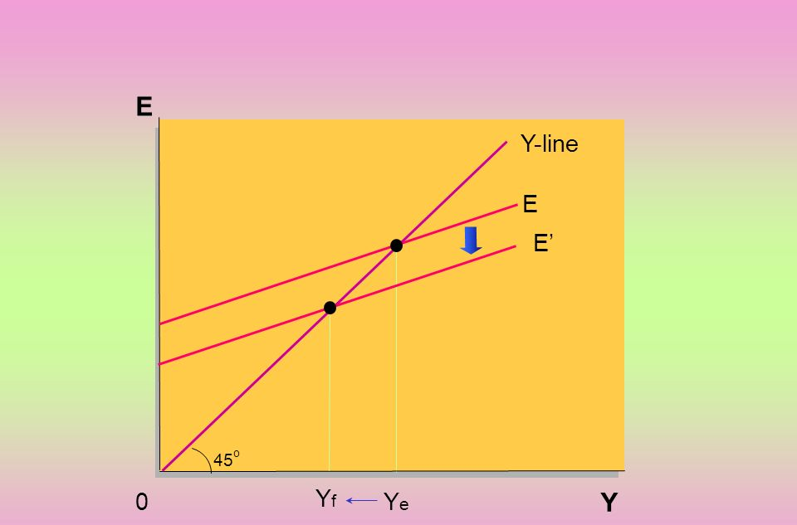
THREE SECTOR NATIONAL INCOME MODEL
The Effect of Contractionary Fiscal Policy

Slide 26
THREE SECTOR NATIONAL INCOME MODEL
AUTOMATIC BUILD-IN STABILIZERS
Proportional /Progressive Tax System
  Recession: government’s tax revenue ↓
  Boom: government’s tax revenue ↑
The more progressive the tax system, the greater is its stabilizing effect. But there will be greater dis-incentives to earn income.
With t, k E ↓ With proportional tax, the multiplying effect of a discretionary change in government expenditure ΔG’ reduces

Slide 27
THREE SECTOR NATIONAL INCOME MODEL
AUTOMATIC BUILD-IN STABILIZERS
Welfare Schemes
Unemployment benefits, public assistance allowances, agricultural support schemes
  Recession: government’s expenditure ↑
  Boom: government’s expenditure ↓
Again, if the welfare schemes are generous, the incentives to work will be weakened.

Slide 28
THREE SECTOR NATIONAL INCOME MODEL
AUTOMATIC BUILD-IN STABILIZERS
If the economy is close to Yf, built-in stabilizers are useful as they can stabilize the economy around Yf or potential income level.
However, if the economy is far below Yf, discretionary fiscal policy is still necessary (Simple Keynesian model).
Another drawback of the built-in stabilizers is they may reduce the speed of recovery as
k E ↓ → ΔY = k E * ΔE’

Slide 29
PRODUCTION AND TECHNOLOGY CHOICE
THANK YOU FOR YOUR ATTENTION…

