Slide 1

ECONOMIC GROWTH
LESSON XI
Dr. Ingrid Majerová
MACROECONOMICS/EVS/NAMAB

Slide 2
ECONOMIC GROWTH
Outline of the lecture
The Factors of Economic Growth
Costs and Benefit of EG
Economic Growth and Production Possibility Frontiers
Economic Growth and Convergence
Empirical Cases of Economic Growth

Slide 3

ECONOMIC GROWTH
FATORS OF ECONOMIC GROWTH
There are 4 factors of production that influence economic growth within a country:
  Natural Resources available
  Investment in Human Capital
  Investment in Capital Goods
  Entrepreneurship
The presence or absence of these 4 factors determine the country’s Gross Domestic Product (GDP) for the year.
  GDP is the total value of all the goods and services produced in that country in one year.
  It measures how rich or poor a country is.
  It shows if the country’s economy is getting better or worse.
  Raising the GDP of a country can improve the country’s standard of living.

Slide 4
ECONOMIC GROWTH
FATORS OF ECONOMIC GROWTH
Natural Resources
All of the things found in or on the earth; “gifts of nature”.
All resources are limited.
Examples: land, water, sun, plants, time, air, minerals, oil, etc.
Important to countries: without them, countries must import the resources they need (costly)
A country is better off if it can use its own resources to supply the needs of its people.
If a country has many natural resources, it can trade or sell them to other countries.

Slide 5
ECONOMIC GROWTH
FATORS OF ECONOMIC GROWTH
Human Capital
This is all of the skills, talents, education, and abilities that human workers possess and the value that they bring to the marketplace.
Examples: computer/reading/writing/math skills, talents in music/sports/acting, ability to follow directions, ability to serve as group leader & cooperate with group members
Nations that invest in the health, education, & training of their people will have a more valuable workforce that produces more goods & services.
People that have training are more likely to contribute to technological advances, which leads to finding better uses of natural resources & producing more goods.

Slide 6
ECONOMIC GROWTH
FATORS OF ECONOMIC GROWTH
Capital Goods
This is all of the goods that are produced in the country and then used to make other goods & services.
Examples: tools, equipment, factories, technology, computers, lumber, machinery, etc.
The more capital goods a country has, the more goods & services they are able to produce.
If a business is to be successful, it cannot let its equipment break down or have its buildings fall apart.
New technology can help a business produce more goods for a cheaper price.
!! Money is NOT a capital good, but rather a medium of exchange!!

Slide 7
ECONOMIC GROWTH
FATORS OF ECONOMIC GROWTH
Entrepreneurship
People who provide the money to start and operate a business are called entrepreneurs.
These people risk their own money and time because they believe their business ideas will make a profit.
They bring together natural, human, and capital resources to produce foods or services to be provided by their businesses.
Entrepreneurship creates jobs and lessens unemployment.
It encourages people to take risks, and in doing so, they’ve created better healthcare, education, & welfare programs.
The more entrepreneurs a country has, the higher the country’s GDP will be.

Slide 8
ECONOMIC GROWTH
ECONOMIC GROWTH
Economic growth in a country is measured by the country’s Gross Domestic Product (GDP) in one year.
It measures only what has been produced within the country--this doesn’t include products that are imported.
It is much better for the economy of a country to produce its own goods and services (this increases the country’s GDP).
Measuring the GDP each year can:
  compare one country’s economy to another
  check a country’s economic progress over time
  show if the economy is growing or not

Slide 9
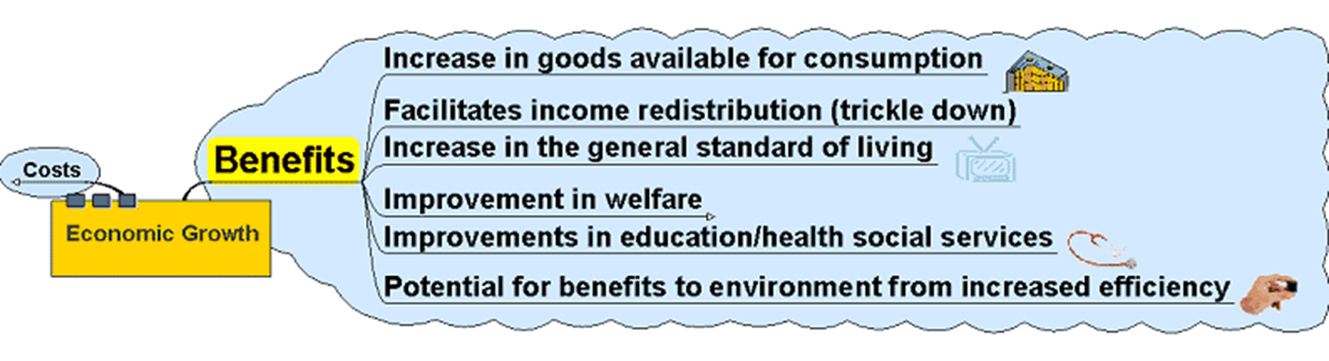
ECONOMIC GROWTH
BENEFITS

Slide 10
ECONOMIC GROWTH
BENEFITS
Increases in economic growth should enable more of everything to be produced
Increases possibility of providing consumer goods for all
More consumer goods, etc. could be equated with an increase in living standards
Wealth generated may eventually ‘trickle down’ to those who are poor by means of income distribution – taxes and benefits, etc.
Improved standards of living associated with increase in the availability of luxury goods
In addition:
  Infrastructure – roads, rail, energy, water, communication networks
  Health and education provision
All associated with a ‘decent’ standard of living.

Slide 11
ECONOMIC GROWTH
BENEFITS – IMPROVEMENT IN WELFARE
Welfare is associated with well-being
Welfare is improved by the provision of support services for those not necessarily able to help themselves – often on the margins of society. Welfare includes:
  Pensions
  Benefits – sickness, disability, etc.
  Support – maternity, holidays,
  Housing
  Infrastructure – homes for the elderly
Such welfare provision often funded through income redistribution – taxes
Providing support for the elderly, homeless, orphaned and disadvantaged is something only wealthy countries can afford to any great extent.

Slide 12
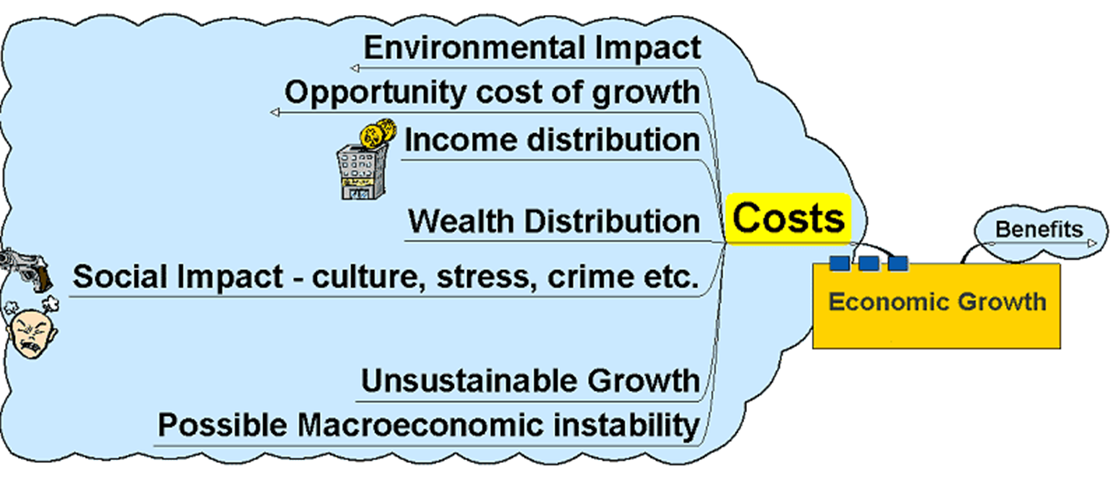
ECONOMIC GROWTH
COSTS

Slide 13
ECONOMIC GROWTH
COSTS
Economic growth can bring with it costs:
  Not all income distributed equally
  Wealth often in the hands of a few
  ‘Trickle down’ does not always seem
  to work in practice
  Corruption may reduce redistribution effects
  Growth funded in part by spending on weapons which do not benefit the population as a whole
Environmental problems
  Expansion and growth brings with it the problems of pollution – often developing countries do not have the infrastructure to cope with the waste generated nor the legislation or regulation to influence those who produce it.

Slide 14
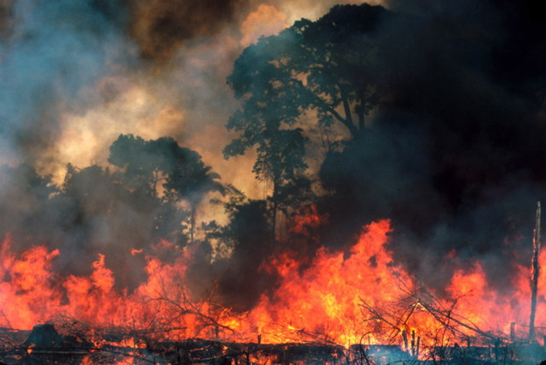
ECONOMIC GROWTH
COSTS – ENVIRONMENTAL IMPACT
Negative Externalities
Pollution – dumping of hazardous waste
Environmental degradation – over farming reduces productivity of the soil, deforestation, damage
to eco-systems and reduction in biodiversity
Non-renewable resources – finite resources
The destruction of the rain forests in Brazil and elsewhere highlight the problems of growth in developing countries.

Slide 15
ECONOMIC GROWTH
OPPORTUNITY COSTS OF GROWTH
Resource allocation
  Consumer Goods?
  Capital Goods?
Necessity of generating growth through allocating resources to the sources of growth – capital goods
Makes population poorer as fewer consumer goods initially available – often these consumer goods represent the basic essentials of life

Slide 16
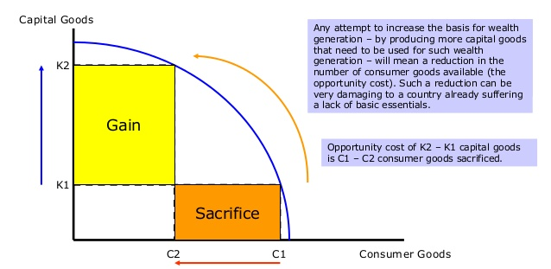
ECONOMIC GROWTH
OPPORTUNITY COST OF GROWTH

Slide 17
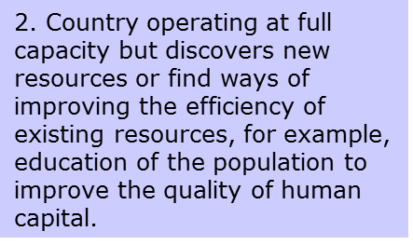
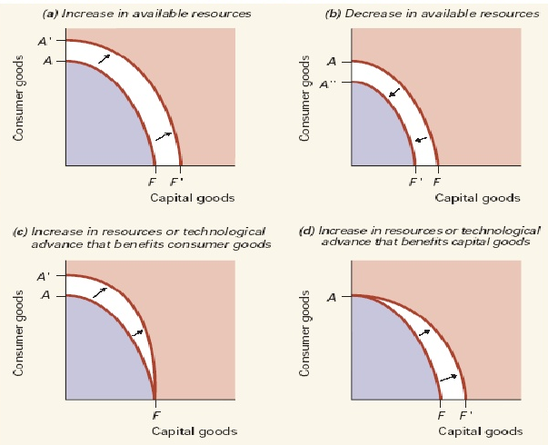
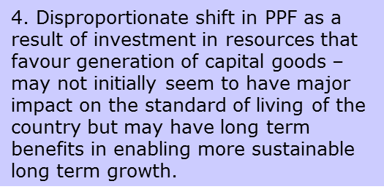
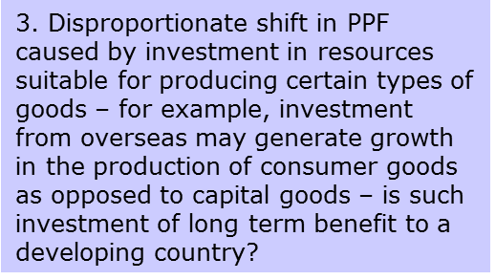
ECONOMIC GROWTH
GROWTH AND PRODUCTION POSSIBILITY FRONTIERS

Slide 18
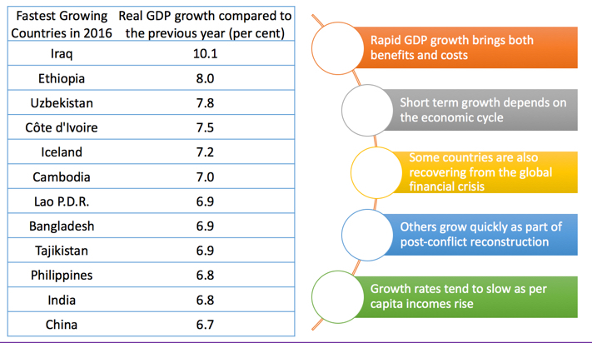
ECONOMIC GROWTH
THE ECONOMIC GROWTH IN 2016

Slide 19


ECONOMIC GROWTH
INCOME PER CAPITA IN USA AND CHINA

Slide 20
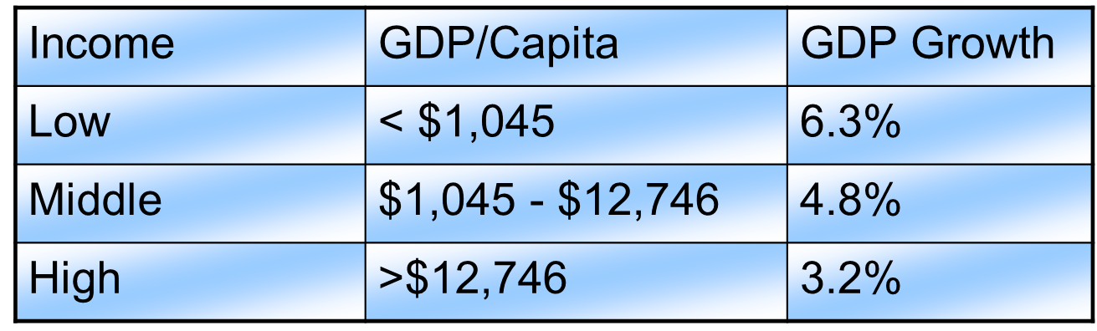
ECONOMIC GROWTH
ECONOMIC GROWTH AND CONVERGENCE
As a general rule, low income (developing) countries tend to have higher average rates of growth than do high income countries
The implication here is that eventually, poorer countries should eventually “catch up” to wealthier countries in terms of per capita income – a concept known as “convergence”

Slide 21


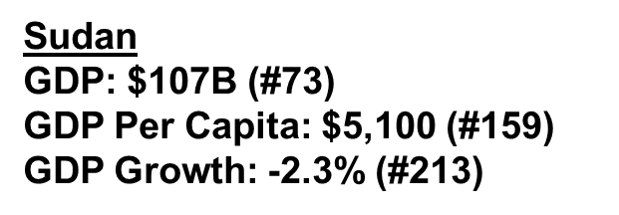
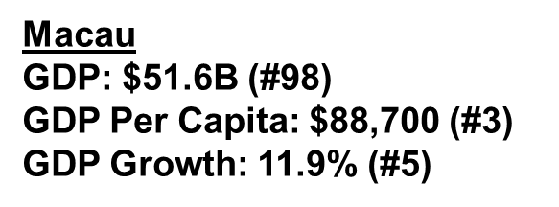
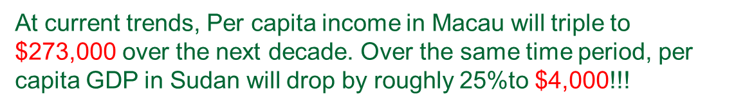
ECONOMIC GROWTH
ECONOMIC GROWTH AND CONVERGENCE

Slide 22









ECONOMIC GROWTH
ECONOMIC GROWTH AND CONVERGENCE
To understand this, let’s look at the sources of economic growth…
Real GDP = Constant Dollar (Inflation adjusted) value of all goods and services produced in the United States
Capital Stock = Constant dollar value of private, non-residential fixed assets
Labor = Private Sector Employment
Productivity = Production unaccounted for by capital or labor

Slide 23
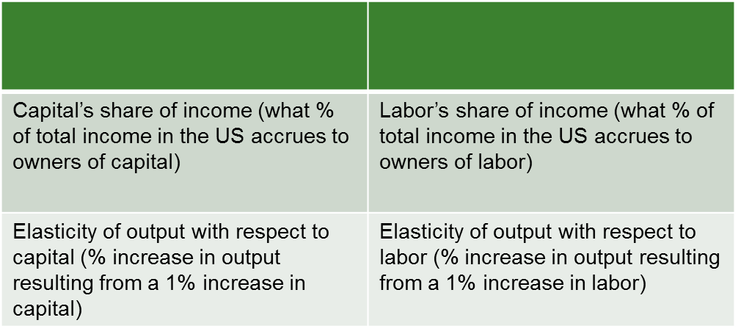
ECONOMIC GROWTH
ECONOMIC GROWTH AND CONVERGENCE
A convenient functional form for growth accounting is the Cobb-Douglas production function. It takes the form:
With the Cobb-Douglas production function, the parameters have clear interpretations:

Slide 24
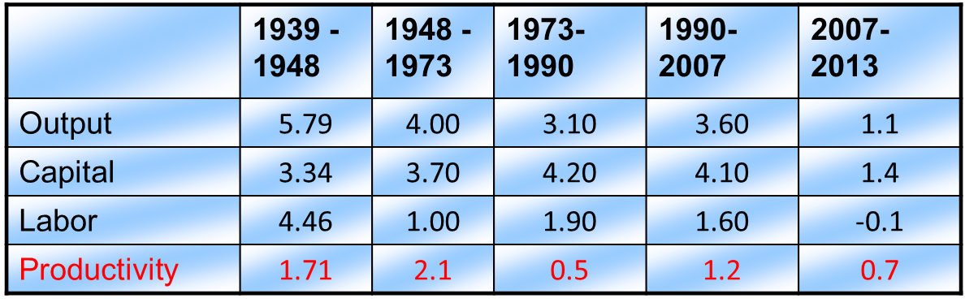
ECONOMIC GROWTH
ECONOMIC GROWTH AND CONVERGENCE
Contributions to growth from capital, labor, and technology vary across time period (case of U.S. economy):
A few things to notice:
  Real GDP growth is declining over time.
  Capital has been growing faster than labor.
  The contribution of productivity is diminishing.

Slide 25
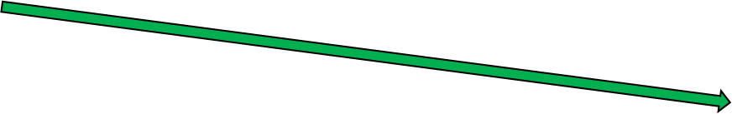
ECONOMIC GROWTH
ECONOMIC GROWTH AND CONVERGENCE
Productivity growth has been declining since WWII

Slide 26
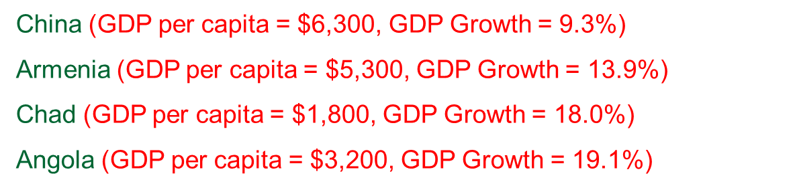
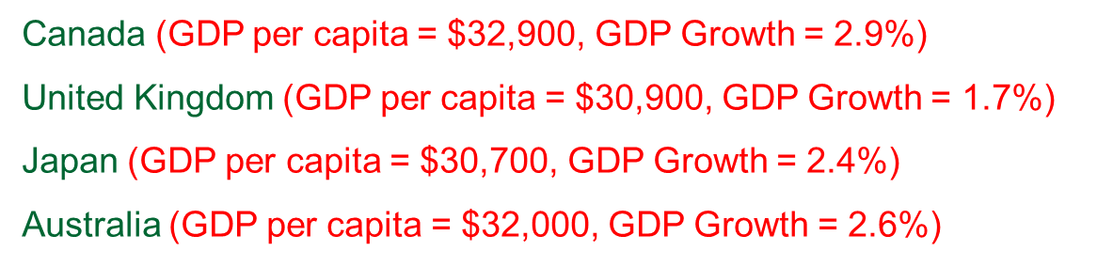
ECONOMIC GROWTH
ECONOMIC GROWTH AND CONVERGENCE
Developing countries are well below their steady state and, hence should grow faster than developed countries who are at or near their steady states – a concept known as absolute convergence
Examples of Absolute Convergence (Developing Countries)
Examples of Absolute Convergence (Mature Countries)

Slide 27
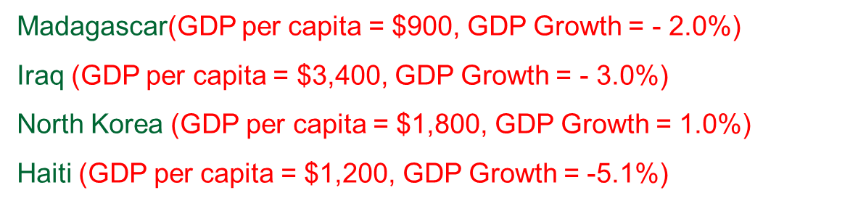
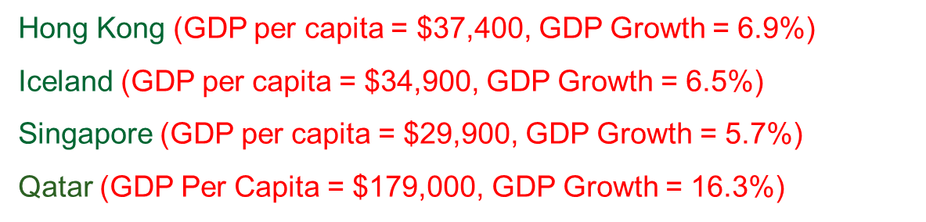
ECONOMIC GROWTH
ECONOMIC GROWTH AND CONVERGENCE
Some countries, however, don’t fit the traditional pattern.
Developing Countries with Low Growth
Developed or Emerging Countries with high Growth

Slide 28
ECONOMIC GROWTH
THANK YOU FOR YOUR ATTENTION…

