Slide 1
Statistics
Lecture 2
Descriptive Statistics:
Qualitative and Quantitative
Data Items
David Bartl
Statistics
INM/BASTA

Slide 2
Bar chart
Histogram
Measures of central tendency (arithmetic mean, mode, median)
Measures of variability (range, variance, coefficient of variation)
Measures of data concentration (skewness, kurtosis)

Slide 3
Statistics
The purpose of statistics is to present data in a comprehensive form.
The goal is to analyse the information and reveal relations hidden in the data.
There are two approaches:
— Descriptive statistics (categorization, characteristics)
→ we shall deal with it now
— Inductive statistics (assumptions about the origin of the data,
probability distributions)
→ we shall deal with it later

Slide 4
Data items = Variables
Variable = data item
Qualitative = categorical
Quantitative = numerical
Ordinal
Nominal
Discrete
Continuous

Slide 5
Example: Employees (a sample of the Dataset)
ID | Gender | Age | Marital Status | Education | Position | Salary per Year | Evaluation
5060 | M | 65 | divorced | secondary | worker | 258800 | 4
1030 | M | 60 | divorced | university | manager | 630000 | 2
3049 | M | 60 | married | primary | operator | 436600 | 5
5047 | M | 60 | widowed | primary+vocational | worker | 240600 | 3
5061 | M | 60 | widowed | primary+vocational | worker | 241800 | 1
5087 | M | 60 | widowed | secondary | worker | 239500 | —
5133 | F | 60 | married | secondary | worker | 241100 | 4
5177 | F | 60 | widowed | secondary | worker | 239600 | 4
3030 | F | 58 | widowed | primary | operator | 422600 | 1
3014 | F | 56 | widowed | university | operator | 303600 | 3
5012 | F | 56 | widowed | primary+vocational | worker | 223100 | 4
5056 | M | 56 | divorced | primary | worker | 225200 | 5
5101 | M | 56 | unmarried | primary+vocational | worker | 224600 | 4
5106 | M | 56 | married | primary+vocational | worker | 226100 | 7
5146 | F | 56 | married | primary+vocational | worker | 224900 | 3
5153 | M | 56 | divorced | secondary | worker | 224500 | 4
5189 | M | 56 | married | primary+vocational | worker | 224600 | 1
5196 | M | 56 | widowed | primary+vocational | worker | 222800 | 3
1031 | M | 55 | married | university | manager | 429000 | —
5016 | M | 55 | divorced | secondary | administrative officer | 259000 | 5
5021 | F | 55 | married | primary+vocational | worker | 220200 | —
5062 | F | 55 | widowed | primary+vocational | worker | 221400 | 5
5107 | M | 55 | divorced | primary+vocational | worker | 220500 | 4
5154 | F | 55 | widowed | primary+vocational | worker | 219200 | 5
5195 | M | 55 | married | primary+vocational | worker | 219400 | 6

Slide 6

Methods to present data in a comprehensive form
For qualitative (categorical) data items:
Bar chart of frequencies
Mode ($\hat{x}$)
For ordinal qualitative (categorical) data items:
Median ($\tilde{x}$)

Slide 7
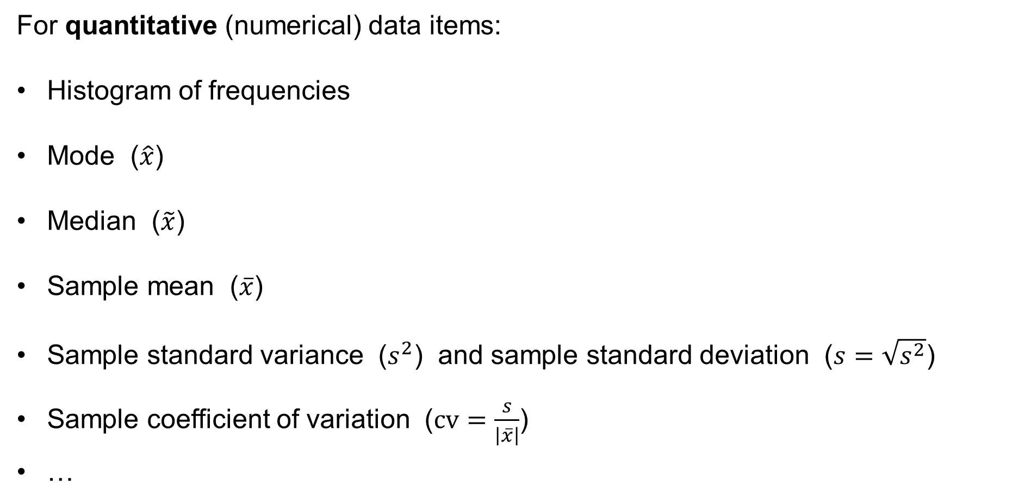
Methods to present data in a comprehensive form
For quantitative (numerical) data items:
Histogram of frequencies
Mode ($\hat{x}$)
Median ($\tilde{x}$)
Sample mean ($\overline{x}$)
Sample standard variance ($s^{2}$) and sample standard deviation ($s=\sqrt{s^{2}}$)
Sample coefficient of variation ($cv=\frac{s}{\left|\overline{x}\right|}$)
…

Slide 8
Bar chart & Histogram of frequencies
Bar chart
— used for qualitative [categorical (nominal or ordinal)] data items
— can also be used for discrete numerical data items
— presents the frequencies of each category by the height of a rectangular bar
(the height is proportional to the frequency)
— there are gaps between the bars, i.e. the bars are not adjacent

Slide 9
Bar chart of frequencies for qualitative data items
Example: The dataset of the employees.
We examine now the nominal data item “Position”:
Table:
Position | Frequency (number) | Relative frequency
manager | 10 | 5.0 %
administrative officer | 11 | 5.5 %
operator | 29 | 14.5 %
worker | 150 | 75.0 %
TOTAL | 200 | 100.0 %

Slide 10
Bar chart of frequencies for qualitative data items
Bar chart – the frequencies (numbers) of the nominal data item “Position”:
Frequency
160
150
140
120
100
80
29
60
40
20
10
11
0
manager
administrative
officer
operator
worker
Position

Slide 11
Bar chart for ordinal qualitative data items
Example: The dataset of the employees.
We examine now the ordinal data item “Evaluation”:
Table:
(rounded to 3 decimal places)
Evaluation | Frequency (number) | Relative frequency
1 — very bad | 19 | 11.243 %
2 — bad | 20 | 11.834 %
3 — rather bad | 47 | 27.811 %
4 — acceptable | 32 | 18.935 %
5 — quite good | 23 | 13.609 %
6 — good | 16 | 9.467 %
7 — very good | 12 | 7.101 %
TOTAL | 169 | 100.000 %

Slide 12
Bar chart of frequencies for qualitative data items
Bar chart – the frequencies (numbers) of the ordinal data item “Evaluation”:
Frequency
50
47
45
40
35
32
30
25
23
19
20
20
16
15
12
10
5
0
1
2
3
4
5
6
7
Evaluation

Slide 13
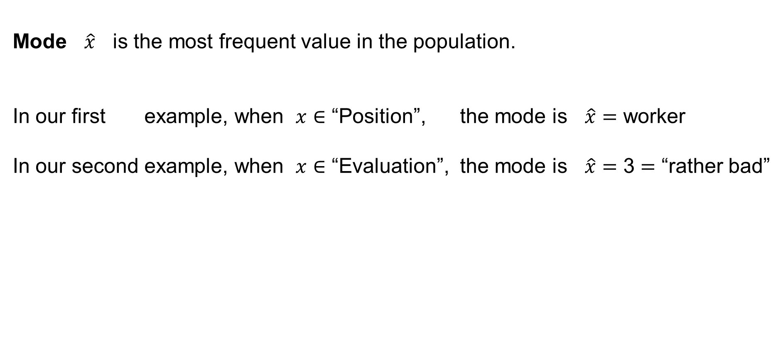
Measures of central tendency of the data item
Mode $\hat{x}$ is the most frequent value in the population.
In our first example, when $x∈$ “Position”, the mode is $\hat{x}=$ worker
In our second example, when $x∈$ “Evaluation”, the mode is $\hat{x}=$ 3 $=$ “rather bad”

Slide 14
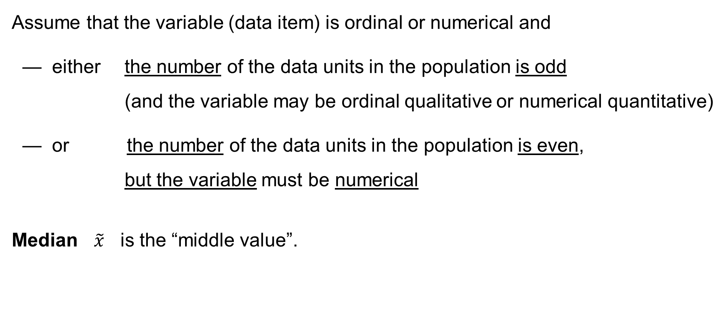
Measures of central tendency of the data item
Assume that the variable (data item) is ordinal or numerical and
— either the number of the data units in the population is odd
(and the variable may be ordinal qualitative or numerical quantitative)
— or the number of the data units in the population is even,
but the variable must be numerical
Median $\tilde{x}$ is the “middle value”.

Slide 15
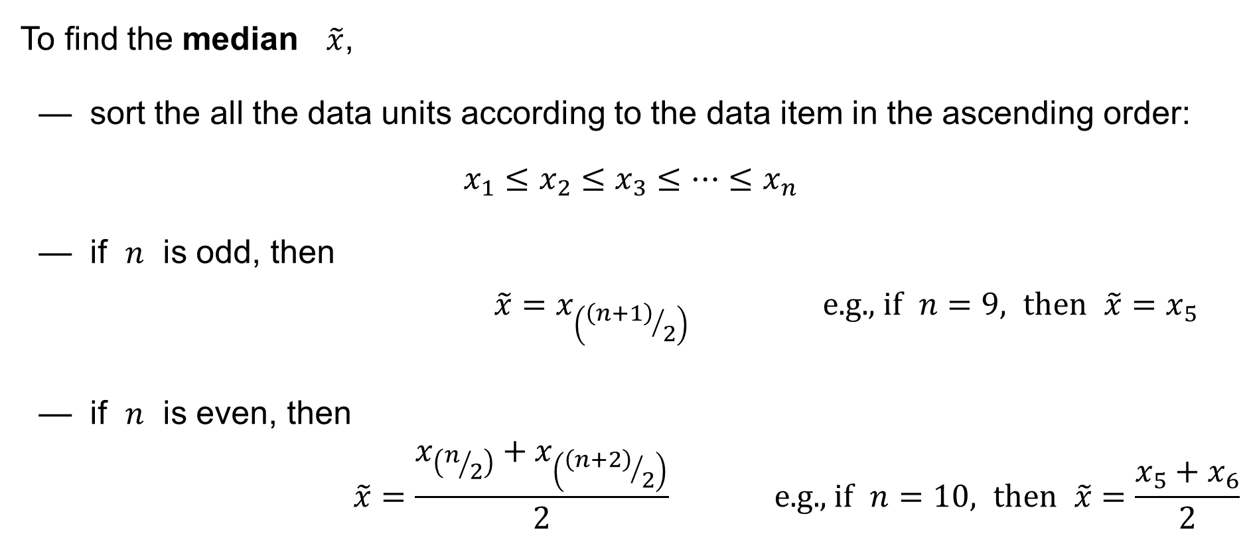
Measures of central tendency of the data item
To find the median $\tilde{x}$,
— sort the all the data units according to the data item in the ascending order:
$$x_{1}≤x_{2}≤x_{3}≤⋯≤x_{n}$$
— if $n$ is odd, then
$$\tilde{x}=x_{\left({\left(n+1\right)}/2\right)} \text{e}\text{.}\text{g}\text{., }\text{if} n=9\text{, }\text{then} \tilde{x}=x_{5}$$
— if $n$ is even, then
$$\tilde{x}=\frac{x_{\left(n/2\right)}+x_{\left({\left(n+2\right)}/2\right)}}{2} \text{e}\text{.}\text{g}\text{., }\text{if} n=10\text{, }\text{then} \tilde{x}=\frac{x_{5}+x_{6}}{2}$$

Slide 16





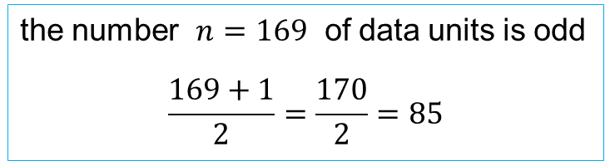



Measures of central tendency of the data item
Median $\tilde{x}$ is the “middle value”.
In our second example, when $x∈$ “Evaluation”, the median is found as follows:
19
20
47
32
23
16
12
$$⋯1⋯$$
$$⋯2⋯$$
$$⋯3⋯$$
$$⋯4⋯$$
$$⋯5⋯$$
$$⋯6⋯$$
$$⋯7⋯$$
169
the number $n=169$ of data units is odd
$$\frac{169+1}{2}=\frac{170}{2}=85$$
The median: $\tilde{x}=x_{85}=$ 3 $=$ rather bad

Slide 17
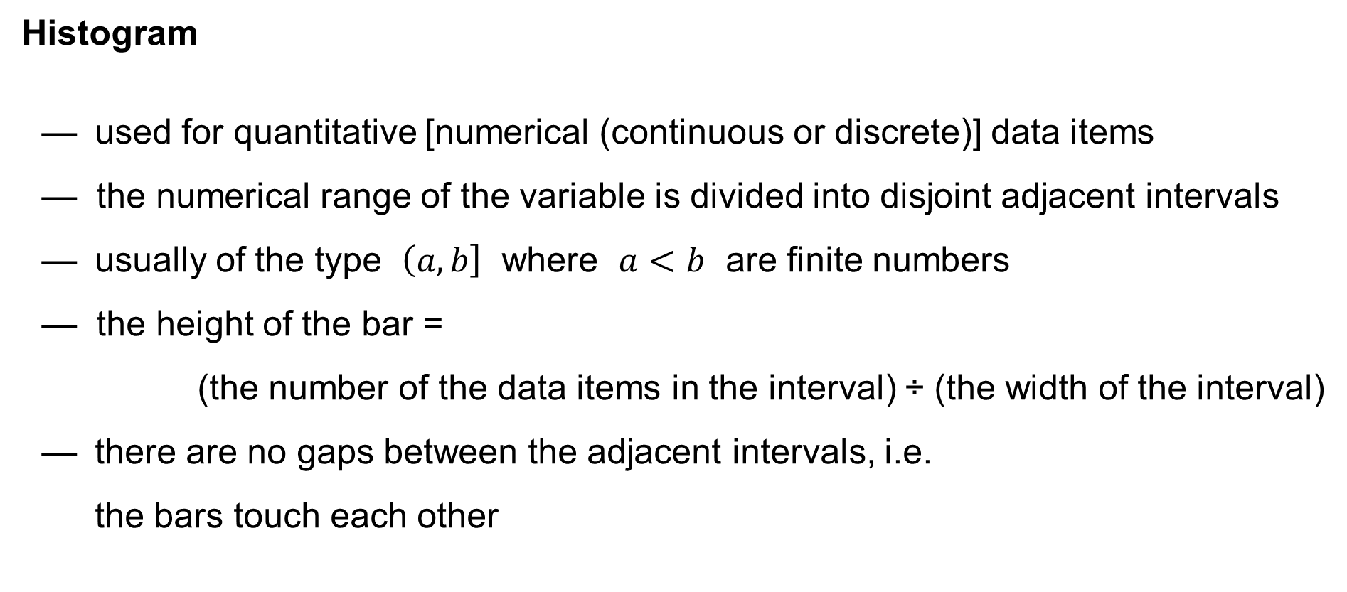
Bar chart & Histogram of frequencies
Histogram
— used for quantitative [numerical (continuous or discrete)] data items
— the numerical range of the variable is divided into disjoint adjacent intervals
— usually of the type $\left(a,b\right]$ where $a<b$ are finite numbers
— the height of the bar =
(the number of the data items in the interval) ÷ (the width of the interval)
— there are no gaps between the adjacent intervals, i.e.
the bars touch each other

Slide 18
Histogram of frequencies for quantitative data items
Example: The dataset of the employees.
We examine now the numerical data item “Age” considered as a continuous value:
Table:
Age interval | Frequency (number) | Cumulative frequency | Relative frequency | Cumulative relative frequency
0 < x ≤ 18 | 6 | 6 | 3.0 % | 3.0 %
18 < x ≤ 23 | 30 | 36 | 15.0 % | 18.0 %
23 < x ≤ 28 | 13 | 49 | 6.5 % | 24.5 %
28 < x ≤ 33 | 40 | 89 | 20.0 % | 44.5 %
33 < x ≤ 38 | 11 | 100 | 5.5 % | 50.0 %
38 < x ≤ 43 | 48 | 148 | 24.0 % | 74.0 %
43 < x ≤ 48 | 16 | 164 | 8.0 % | 82.0 %
48 < x ≤ 53 | 26 | 190 | 13.0 % | 95.0 %
53 < x ≤ 58 | 9 | 199 | 4.5 % | 99.5 %
58 < x ≤ 63 | 0 | 199 | 0.0 % | 99.5 %
63 < x ≤ 99 | 1 | 200 | 0.5 % | 100.0 %

Slide 19
Histogram of frequencies for continuous data items
Histogram – the frequencies (numbers) of the continuous data item “Age”:
Frequency
60
48
50
40
40
30
30
26
20
16
13
11
9
10
6
0
1
0
0
18
23
28
33
38
43
48
53
58
63
Age

Slide 20
Histogram of frequencies for continuous data items
If the (ordinary) histogram is used to display relative frequencies, then
— if the variable is continuous,
the histogram gives an estimate of the underlying probability density
— if the variable is discrete,
the histogram gives an estimate of the underlying probability distribution
If the cumulative histogram is used to display the cumulative relative frequencies and the variable is continuous, then the cumulative histogram gives an estimate
of the cumulative distributive function.

Slide 21
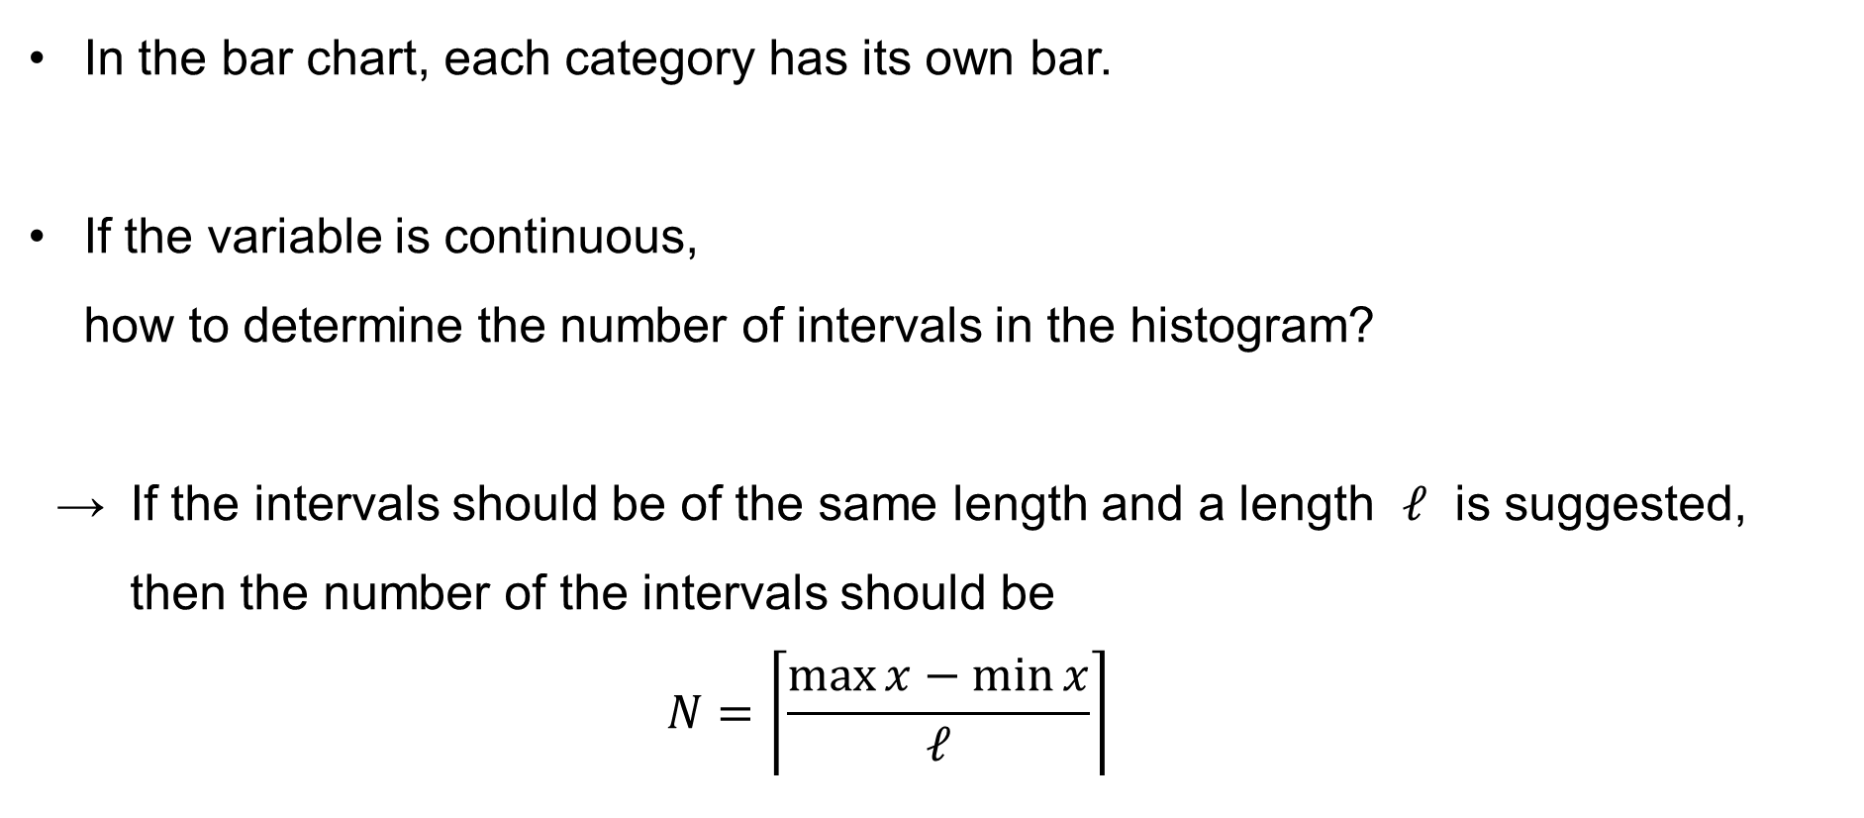
Histogram of frequencies for continuous data items
In the bar chart, each category has its own bar.
If the variable is continuous,
how to determine the number of intervals in the histogram?
→ If the intervals should be of the same length and a length $ℓ$ is suggested, then the number of the intervals should be
$$N=\left\lceil \frac{\max{x}−\min{x}}{ℓ}\right\rceil$$

Slide 22
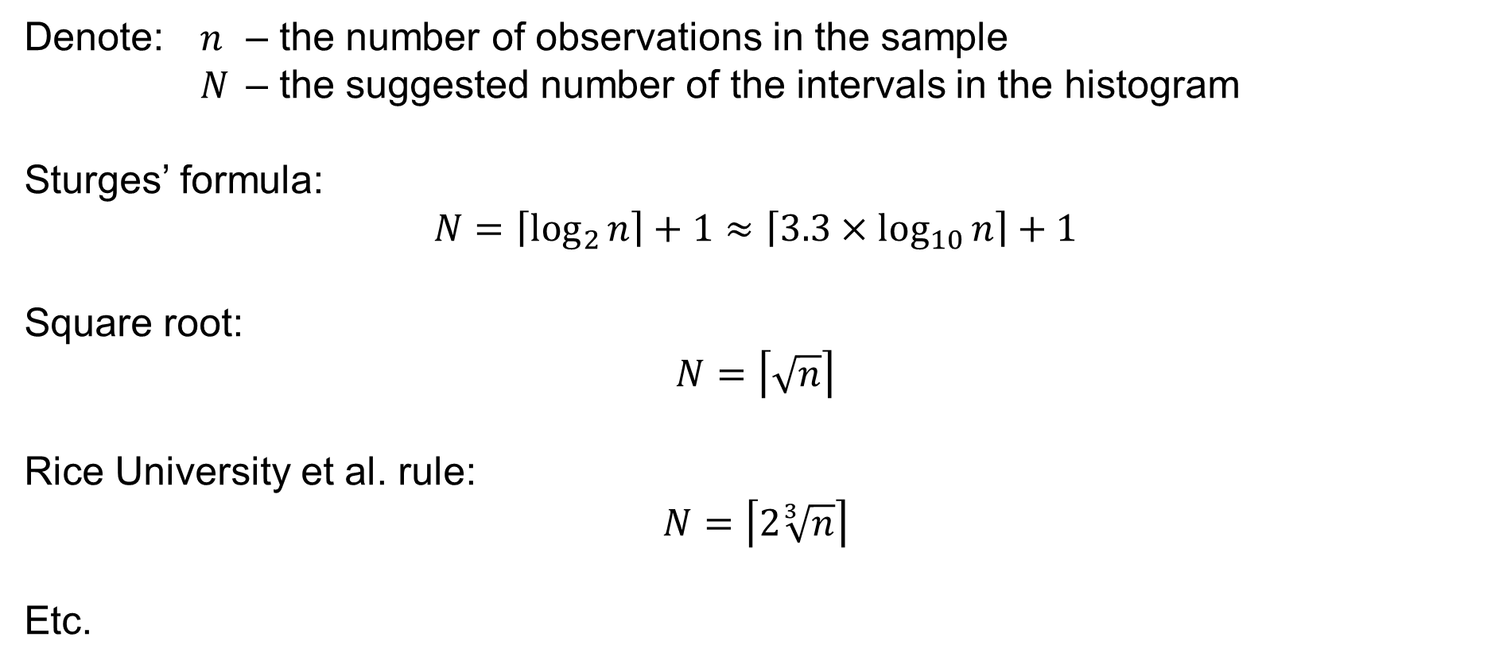
The suggested number of the intervals in the histogram
Denote: $n$ – the number of observations in the sample
$N$ – the suggested number of the intervals in the histogram
Sturges’ formula:
$$N=\left\lceil \log_{2}{n}\right\rceil +1≈\left\lceil 3.3×\log_{10}{n}\right\rceil +1$$
Square root:
$$N=\left\lceil \sqrt{n}\right\rceil$$
Rice University et al. rule:
$$N=\left\lceil 2\sqrt[3]{n}\right\rceil$$
Etc.

Slide 23
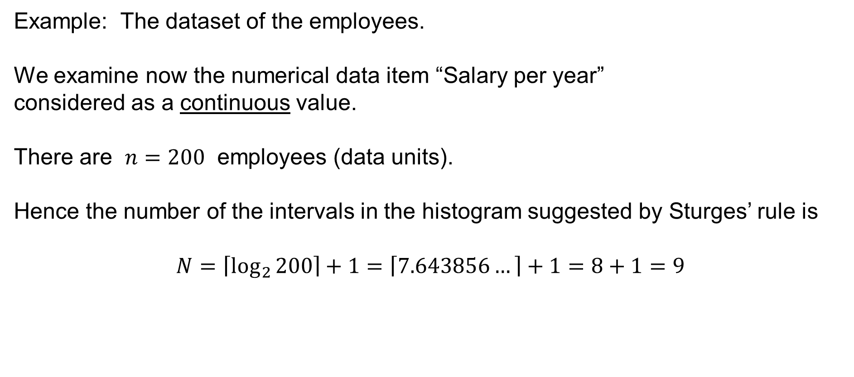
Histogram of frequencies for quantitative data items
Example: The dataset of the employees.
We examine now the numerical data item “Salary per year”
considered as a continuous value.
There are $n=200$ employees (data units).
Hence the number of the intervals in the histogram suggested by Sturges’ rule is
$$N=\left\lceil \log_{2}{200}\right\rceil +1=\left\lceil 7.643856…\right\rceil +1=8+1=9$$

Slide 24
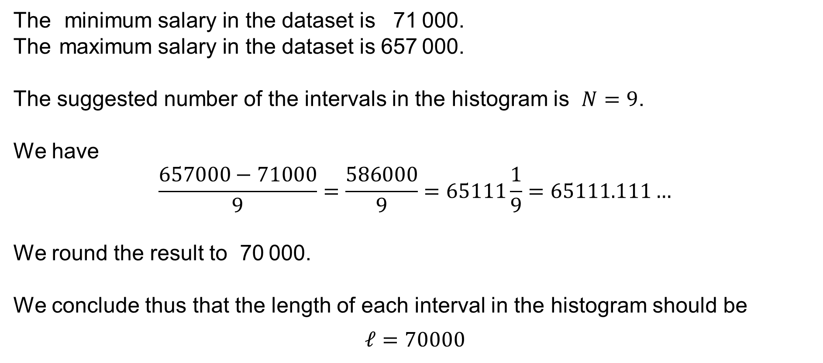
Histogram of frequencies for quantitative data items
The minimum salary in the dataset is 71 000.
The maximum salary in the dataset is 657 000.
The suggested number of the intervals in the histogram is $N=9$.
We have
$$\frac{657000−71000}{9}=\frac{586000}{9}=65111\frac{1}{9}=65111.111…$$
We round the result to 70 000.
We conclude thus that the length of each interval in the histogram should be
$$ℓ=70000$$

Slide 25
Histogram of frequencies for quantitative data items
Salary interval | Frequency (number) | Cumulative frequency | Relative frequency | Cumulative relative frequency
0 < x ≤ 70 000 | 0 | 0 | 0.0 % | 0.0 %
70 000 < x ≤ 140 000 | 60 | 60 | 30.0 % | 30.0 %
140 000 < x ≤ 210 000 | 69 | 129 | 34.5 % | 64.5 %
210 000 < x ≤ 280 000 | 40 | 169 | 20.0 % | 84.5 %
280 000 < x ≤ 350 000 | 15 | 184 | 7.5 % | 92.0 %
350 000 < x ≤ 420 000 | 6 | 190 | 3.0 % | 95.0 %
420 000 < x ≤ 490 000 | 5 | 195 | 2.5 % | 97.5 %
490 000 < x ≤ 560 000 | 2 | 197 | 1.0 % | 98.5 %
560 000 < x ≤ 630 000 | 2 | 199 | 1.0 % | 99.5 %
630 000 < x ≤ 700 000 | 1 | 200 | 0.5 % | 100.0 %
700 000 < x ≤ 999 999 | 0 | 200 | 0.0 % | 100.0 %

Slide 26
Histogram of frequencies for continuous data items
Histogram – the frequencies (numbers) of the continuous data item “Salary”:
Frequency
80
69
70
60
60
50
40
40
30
20
15
10
6
5
0
2
2
1
0
0
0
70000
140000
210000
280000
350000
420000
490000
560000
630000
700000
Salary

Slide 27
Measures of central tendency
Assume that a variable (data item) is numerical, i.e. quantitative, discrete or continuous. We then consider several measures of central tendency of the variable:
— Arithmetic mean
— Mode
— Median

Slide 28
Population & Sample
Assume that we have a set (i.e. a “population”) of values of some phenomenon, which we observe / measure / study / deal with. In practice, this set may be very very large (e.g. some data item, the data units being all the people living on the Earth), thus unknown to us. Another example might be the set of all results of some experiment, yet the instances which we have not done yet.
Assume however, that the set exists (in theory at least) and that the set is finite
(for simplicity).

Slide 29
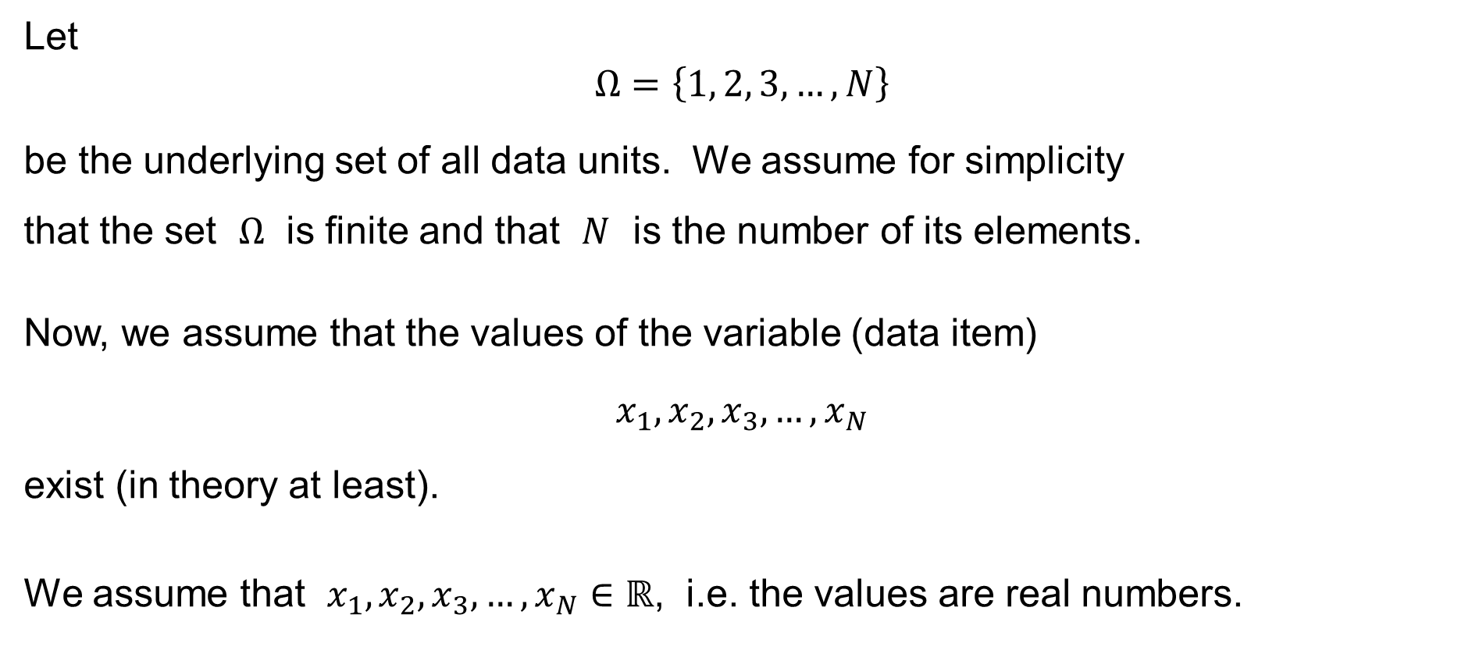
Population & Sample
Let
$$Ω=\left\{1, 2, 3,…,N\right\}$$
be the underlying set of all data units. We assume for simplicity
that the set $Ω$ is finite and that $N$ is the number of its elements.
Now, we assume that the values of the variable (data item)
$$x_{1},x_{2},x_{3},…,x_{N}$$
exist (in theory at least).
We assume that $x_{1},x_{2},x_{3},…,x_{N}∈ℝ$, i.e. the values are real numbers.

Slide 30
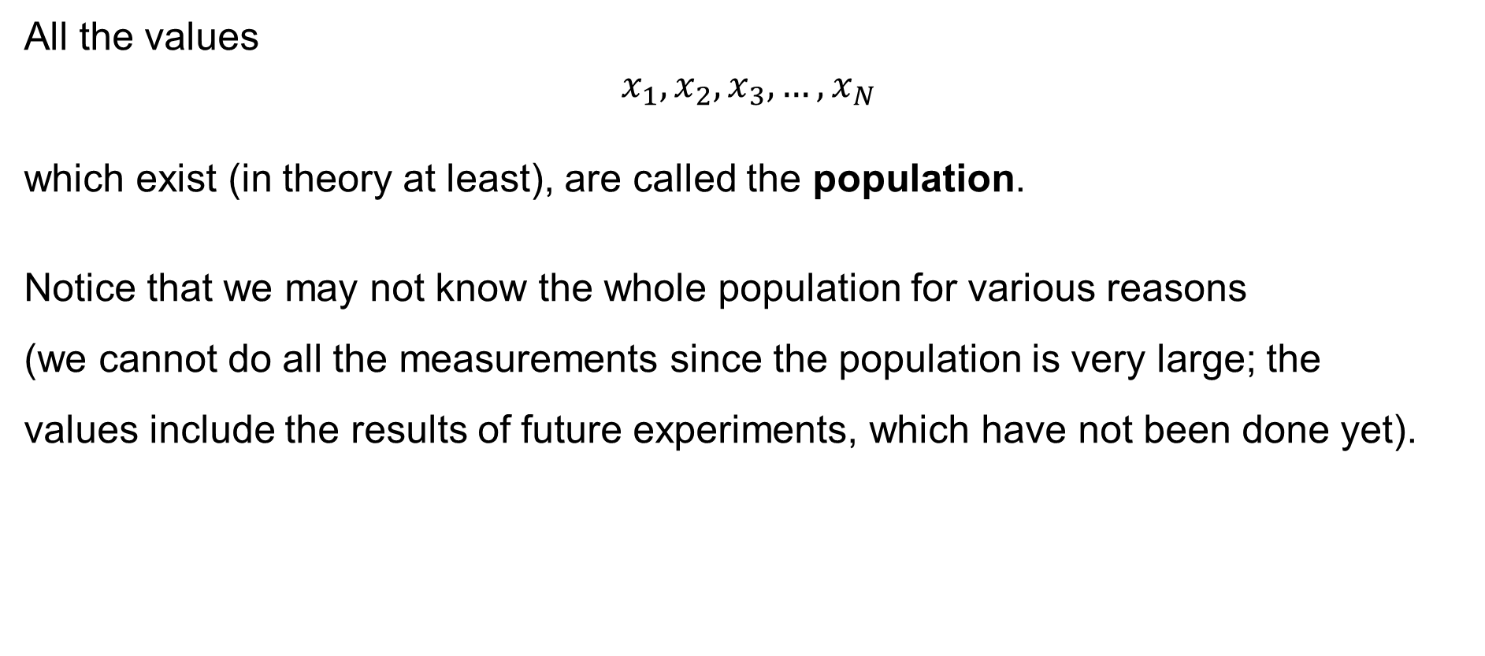
Population & Sample
All the values
$$x_{1},x_{2},x_{3},…,x_{N}$$
which exist (in theory at least), are called the population.
Notice that we may not know the whole population for various reasons
(we cannot do all the measurements since the population is very large; the
values include the results of future experiments, which have not been done yet).

Slide 31
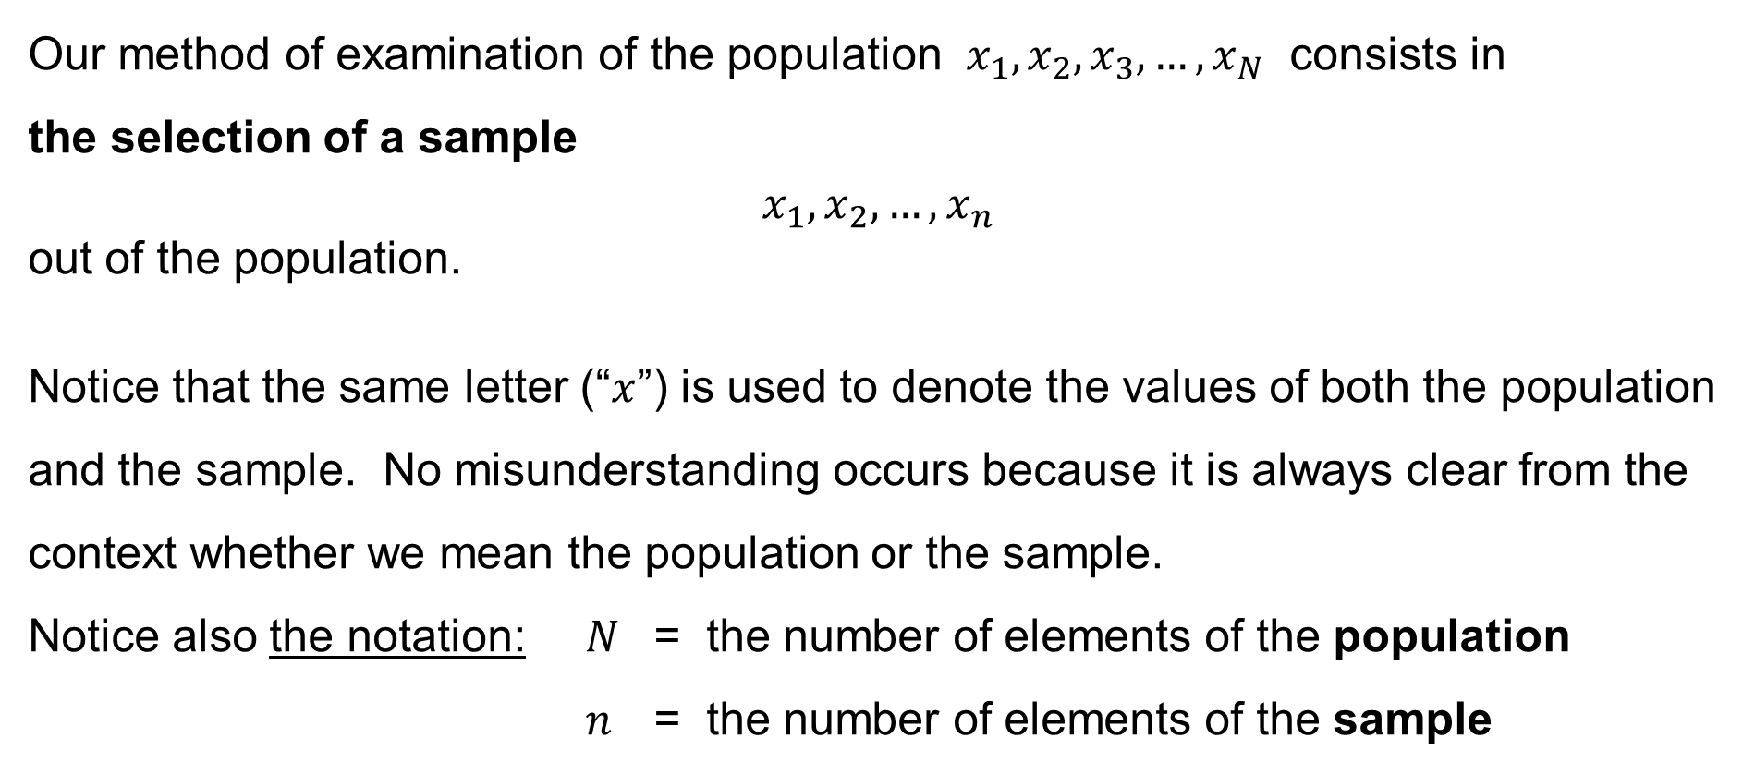
Population & Sample
Our method of examination of the population $x_{1},x_{2},x_{3},…,x_{N}$ consists in
the selection of a sample
$$x_{1},x_{2},…,x_{n}$$
out of the population.
Notice that the same letter (“$x$”) is used to denote the values of both the population and the sample. No misunderstanding occurs because it is always clear from the context whether we mean the population or the sample.
Notice also the notation: $N$ = the number of elements of the population
$n$ = the number of elements of the sample

Slide 32

Arithmetic mean
Population arithmetic mean:
$$μ=\frac{1}{N}\sum_{i=1}^{N}{x_{i}}$$
Sample arithmetic mean:
$$\overline{x}=\frac{1}{n}\sum_{i=1}^{n}{x_{i}}$$

Slide 33
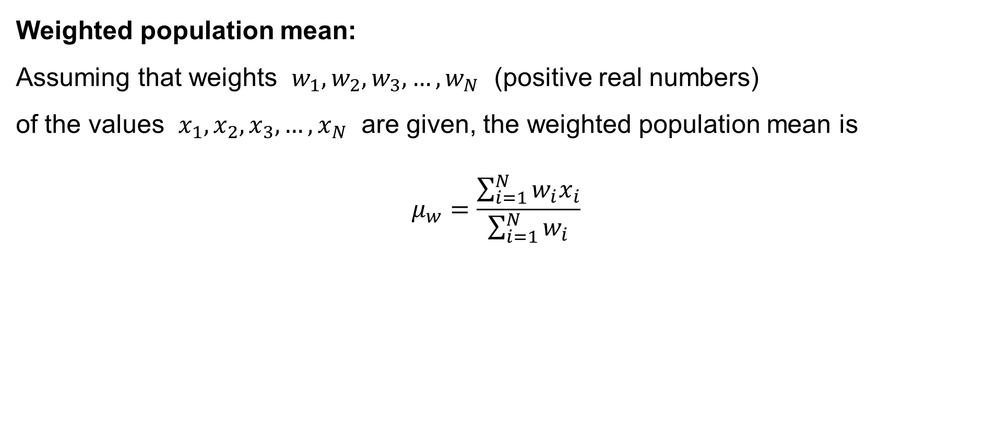
Arithmetic mean
Weighted population mean:
Assuming that weights $w_{1},w_{2},w_{3},…,w_{N}$ (positive real numbers)
of the values $x_{1},x_{2},x_{3},…,x_{N}$ are given, the weighted population mean is
$$μ_{w}=\frac{\sum_{i=1}^{N}{w_{i}x_{i}}}{\sum_{i=1}^{N}{w_{i}}}$$

Slide 34
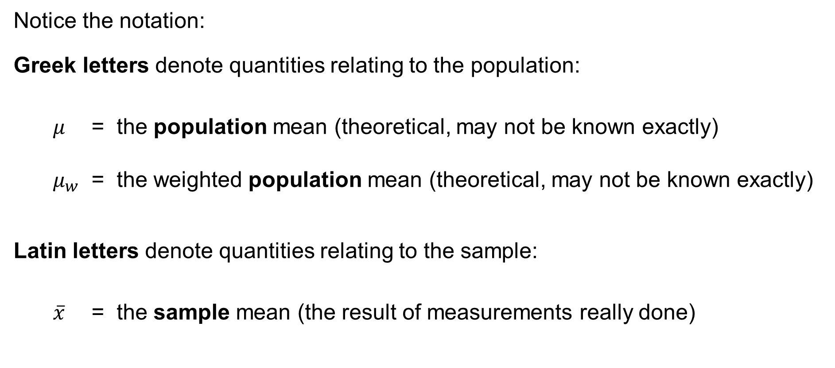
Arithmetic mean
Notice the notation:
Greek letters denote quantities relating to the population:
$μ$ = the population mean (theoretical, may not be known exactly)
$μ_{w}$ = the weighted population mean (theoretical, may not be known exactly)
Latin letters denote quantities relating to the sample:
$\overline{x}$ = the sample mean (the result of measurements really done)

Slide 35
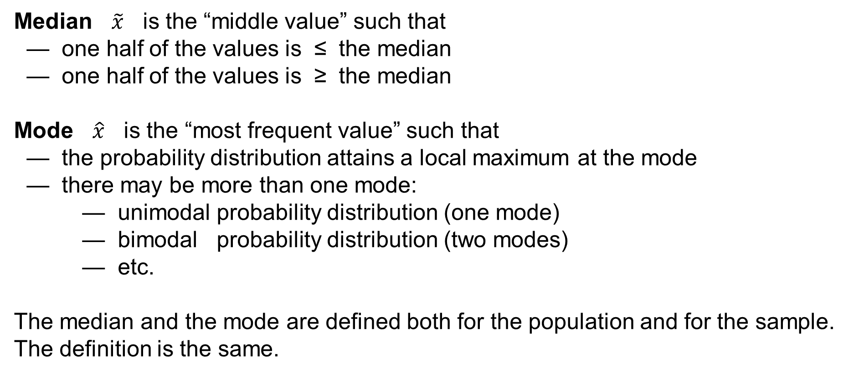
Median & Mode
Median $\tilde{x}$ is the “middle value” such that
— one half of the values is ≤ the median
— one half of the values is ≥ the median
Mode $\hat{x}$ is the “most frequent value” such that
— the probability distribution attains a local maximum at the mode
— there may be more than one mode:
— unimodal probability distribution (one mode)
— bimodal probability distribution (two modes)
— etc.
The median and the mode are defined both for the population and for the sample.
The definition is the same.

Slide 36
Sample Mean / Median / Mode in Excel
In Excel, use the functions:
=AVERAGEA() to calculate the sample arithmetic mean
=MEDIAN() to find the sample median
=MODE.SNGL() to find one of the sample modes
=MODE.MULT() to find many of the sample modes
(matrix function, press “Ctrl-Shift-Enter”)
=MODE() to find one of the sample modes
(the same as =MODE.SNGL(), deprecated)

Slide 37
Example: Employees (a sample of the Dataset)
ID | Gender | Age | Marital Status | Education | Position | Salary per Year | Evaluation
5060 | M | 65 | divorced | secondary | worker | 258800 | 4
1030 | M | 60 | divorced | university | manager | 630000 | 2
3049 | M | 60 | married | primary | operator | 436600 | 5
5047 | M | 60 | widowed | primary+vocational | worker | 240600 | 3
5061 | M | 60 | widowed | primary+vocational | worker | 241800 | 1
5087 | M | 60 | widowed | secondary | worker | 239500 | —
5133 | F | 60 | married | secondary | worker | 241100 | 4
5177 | F | 60 | widowed | secondary | worker | 239600 | 4
3030 | F | 58 | widowed | primary | operator | 422600 | 1
3014 | F | 56 | widowed | university | operator | 303600 | 3
5012 | F | 56 | widowed | primary+vocational | worker | 223100 | 4
5056 | M | 56 | divorced | primary | worker | 225200 | 5
5101 | M | 56 | unmarried | primary+vocational | worker | 224600 | 4
5106 | M | 56 | married | primary+vocational | worker | 226100 | 7
5146 | F | 56 | married | primary+vocational | worker | 224900 | 3
5153 | M | 56 | divorced | secondary | worker | 224500 | 4
5189 | M | 56 | married | primary+vocational | worker | 224600 | 1
5196 | M | 56 | widowed | primary+vocational | worker | 222800 | 3
1031 | M | 55 | married | university | manager | 429000 | —
5016 | M | 55 | divorced | secondary | administrative officer | 259000 | 5
5021 | F | 55 | married | primary+vocational | worker | 220200 | —
5062 | F | 55 | widowed | primary+vocational | worker | 221400 | 5
5107 | M | 55 | divorced | primary+vocational | worker | 220500 | 4
5154 | F | 55 | widowed | primary+vocational | worker | 219200 | 5
5195 | M | 55 | married | primary+vocational | worker | 219400 | 6
sample

Slide 38
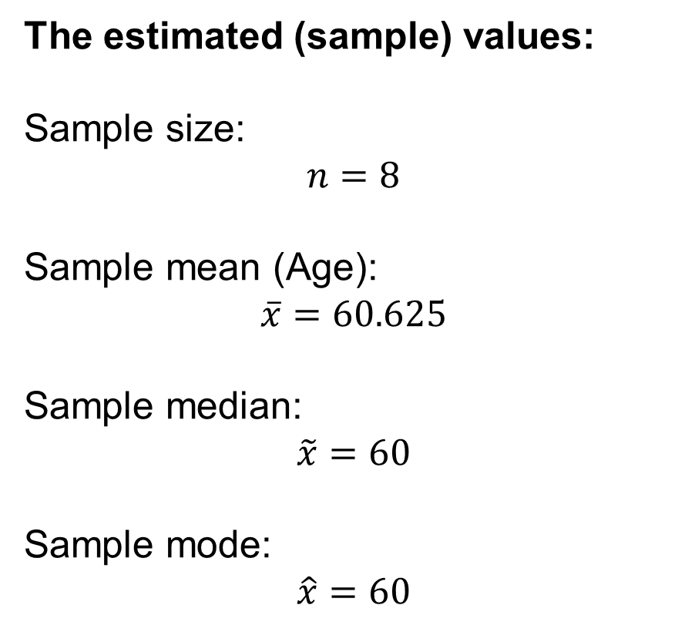
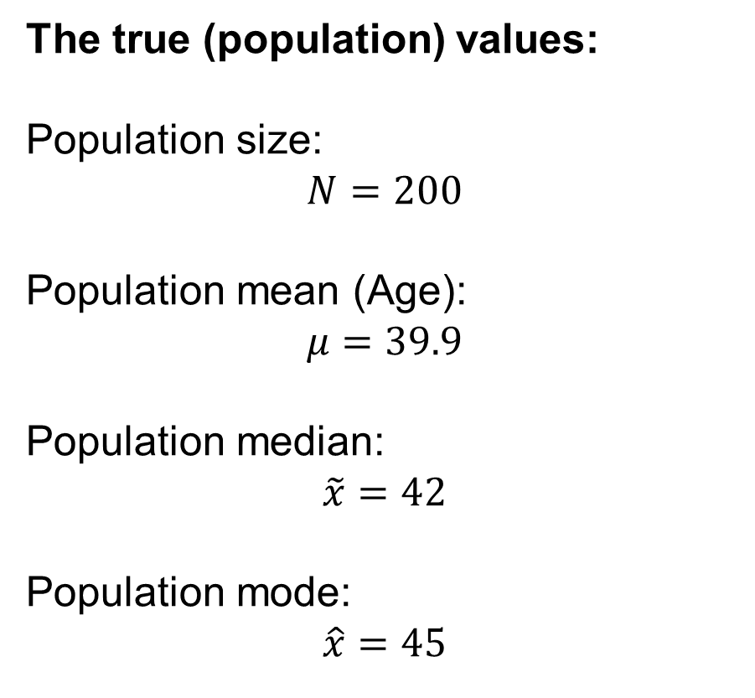
Example: Employees — data item “Age”
The true (population) values:
Population size:
$$N=200$$
Population mean (Age):
$$μ=39.9$$
Population median:
$$\tilde{x}=42$$
Population mode:
$$\hat{x}=45$$
The estimated (sample) values:
Sample size:
$$n=8$$
Sample mean (Age):
$$\overline{x}=60.625$$
Sample median:
$$\tilde{x}=60$$
Sample mode:
$$\hat{x}=60$$

Slide 39
The measures of the central tendency
Which of the measures of the central tendency are the best?
Consider the next example – monthly salaries in 2001 and 2002:
Employee | Salary in 2001 | Salary in 2002
A | 10 | 25
B | 10 | 25
C | 10 | 25
D | 20 | 20
E | 20 | 20
F | 20 | 20
G | 20 | 20
H | 20 | 20
I | 20 | 20
J | 20 | 20
K | 20 | 20
L | 20 | 20
M | 20 | 20
N | 50 | 50
O | 50 | 50
MEAN | 22 | 25
MEDIAN | 20 | 20
MODE | 20 | 20

Slide 40
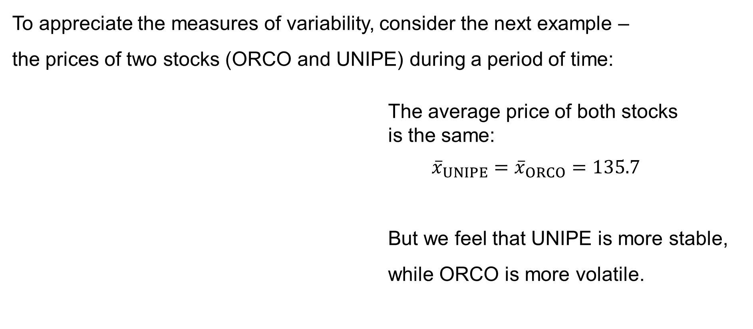
Measures of variability
To appreciate the measures of variability, consider the next example –
the prices of two stocks (ORCO and UNIPE) during a period of time:
The average price of both stocks
is the same:
${\overline{x}}_{UNIPE}={\overline{x}}_{ORCO}=135.7$
But we feel that UNIPE is more stable, while ORCO is more volatile.
135.7

Slide 41
Measures of variability
Assume that a variable (data item) is numerical, i.e. quantitative, discrete or continuous. We then consider several measures of variability of the variable:
— Range
— Variance (dispersion)
— Coefficient of variation

Slide 42

Range
Population range:
$$R=\max_{i=1,…,N}{x_{i}} −\min_{i=1,…,N}{x_{i}}$$
Sample range:
$$R=\max_{i=1,…,n}{x_{i}} −\min_{i=1,…,n}{x_{i}}$$

Slide 43

Variance (dispersion)
Population variance:
$$σ^{2}=\frac{1}{N}\sum_{i=1}^{N}{{\left(x_{i}−μ\right)}^{2}}$$
Sample variance:
$$s^{2}=\frac{1}{n−1}\sum_{i=1}^{n}{{\left(x_{i}−\overline{x}\right)}^{2}}$$

Slide 44
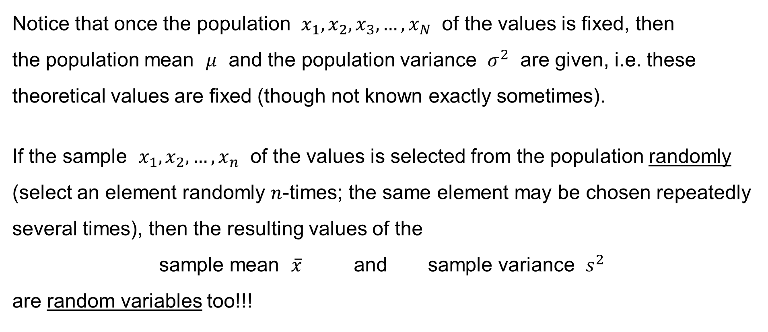
Variance (dispersion)
Notice that once the population $x_{1},x_{2},x_{3},…,x_{N}$ of the values is fixed, then
the population mean $μ$ and the population variance $σ^{2}$ are given, i.e. these theoretical values are fixed (though not known exactly sometimes).
If the sample $x_{1},x_{2},…,x_{n}$ of the values is selected from the population randomly (select an element randomly $n$-times; the same element may be chosen repeatedly several times), then the resulting values of the
sample mean $\overline{x}$ and sample variance $s^{2}$
are random variables too!!!

Slide 45

Variance (dispersion)
Calculating
— the expected value $E\left[\overline{x}\right]$ of the sample mean and
— the expected value $E\left[s^{2}\right]$ of the sample variance,
we obtain that
$$E\left[\overline{x}\right]=μ \text{and} E\left[s^{2}\right]=σ^{2}$$

Slide 46
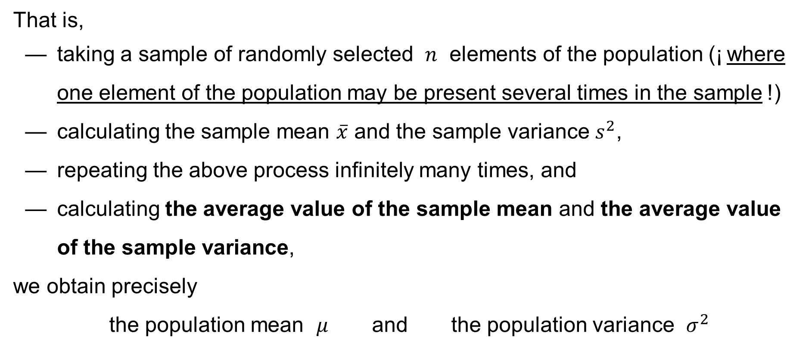
Variance (dispersion)
That is,
— taking a sample of randomly selected $n$ elements of the population (¡ where one element of the population may be present several times in the sample !)
— calculating the sample mean $\overline{x}$ and the sample variance $s^{2}$,
— repeating the above process infinitely many times, and
— calculating the average value of the sample mean and the average value of the sample variance,
we obtain precisely
the population mean $μ$ and the population variance $σ^{2}$

Slide 47
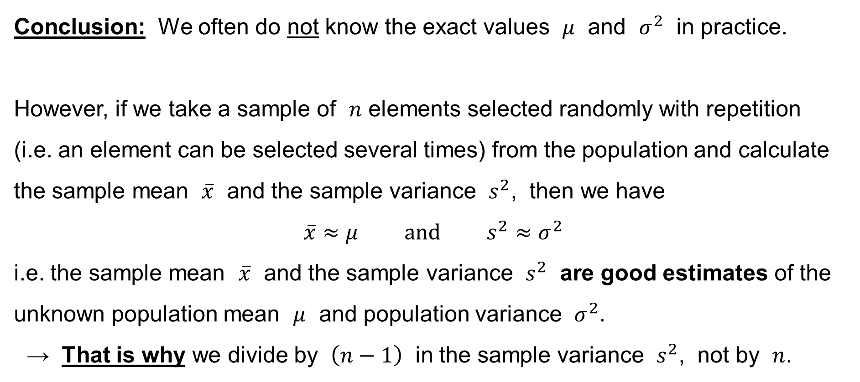
Variance (dispersion)
Conclusion: We often do not know the exact values $μ$ and $σ^{2}$ in practice.
However, if we take a sample of $n$ elements selected randomly with repetition
(i.e. an element can be selected several times) from the population and calculate
the sample mean $\overline{x}$ and the sample variance $s^{2}$, then we have
$$\overline{x}≈μ \text{and} s^{2}≈σ^{2}$$
i.e. the sample mean $\overline{x}$ and the sample variance $s^{2}$ are good estimates of the unknown population mean $μ$ and population variance $σ^{2}$.
→ That is why we divide by $\left(n−1\right)$ in the sample variance $s^{2}$, not by $n$.

Slide 48

Standard deviation
Population standard deviation:
$$σ=\sqrt{σ^{2}}=\sqrt{\frac{1}{N}\sum_{i=1}^{N}{{\left(x_{i}−μ\right)}^{2}}}$$
Sample standard deviation:
$$s=\sqrt{s^{2}}=\sqrt{\frac{1}{n−1}\sum_{i=1}^{n}{{\left(x_{i}−\overline{x}\right)}^{2}} }$$

Slide 49
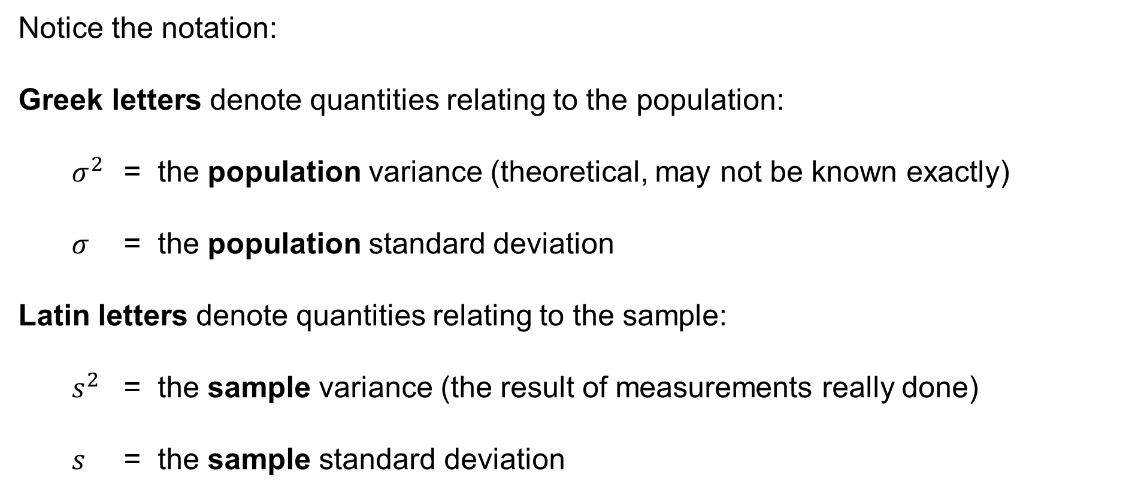
Variance (dispersion) & Standard deviation
Notice the notation:
Greek letters denote quantities relating to the population:
$σ^{2}$ = the population variance (theoretical, may not be known exactly)
$σ$ = the population standard deviation
Latin letters denote quantities relating to the sample:
$s^{2}$ = the sample variance (the result of measurements really done)
$s$ = the sample standard deviation

Slide 50

Coefficient of variation
Coefficient of variation:
$$V=\frac{σ}{\left|μ\right|}$$
Sample coefficient of variation:
$$v=\frac{s}{\left|\overline{x}\right|}$$

Slide 51

Example
We have
$${\overline{x}}_{UNIPE}=135.7 \text{and} s_{UNIPE}=2.09$$
hence
$$v_{UNIPE}=\frac{s_{UNIPE}}{\left|{\overline{x}}_{UNIPE}\right|}=\frac{2.09}{135.7}=0.0154$$
We have
$${\overline{x}}_{ORCO}=135.7 \text{and} s_{ORCO}=3.72$$
hence
$$v_{ORCO}=\frac{s_{ORCO}}{\left|{\overline{x}}_{ORCO}\right|}=\frac{3.72}{135.7}=0.0274$$

Slide 52
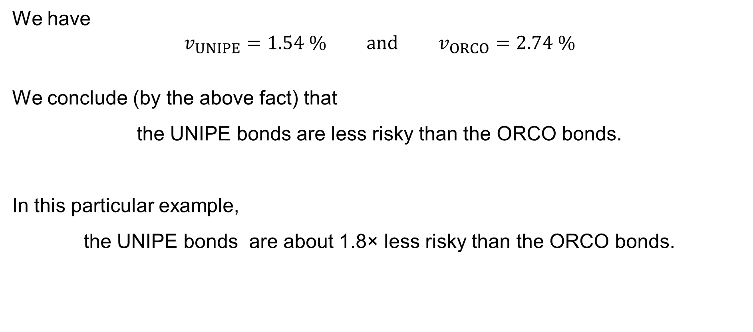
Example
We have
$$v_{UNIPE}=1.54 \% \text{and} v_{ORCO}=2.74 \%$$
We conclude (by the above fact) that
the UNIPE bonds are less risky than the ORCO bonds.
In this particular example,
the UNIPE bonds are about 1.8× less risky than the ORCO bonds.

Slide 53
Sample Variance / Standard deviation
In Excel, use the functions:
=VARA() to calculate the sample variance
=STDEVA() to calculate the sample standard deviation
=VAR.S() to calculate the sample variance (skipping text values)
=VAR() to calculate the sample variance (skipping text values)
(the same as =VAR.S(), deprecated)

Slide 54
Population Variance / Standard deviation
In Excel, use the functions:
=VARPA() to calculate the population variance
=STDEVPA() to calculate the population standard deviation
=VAR.P() to calculate the population variance
(skipping text values)

Slide 55
Measures of data concentration
Assume that a variable (data item) is numerical, i.e. quantitative, discrete or continuous. We then consider several measures of data concentration of the variable:
— Skewness
— Kurtosis

Slide 56
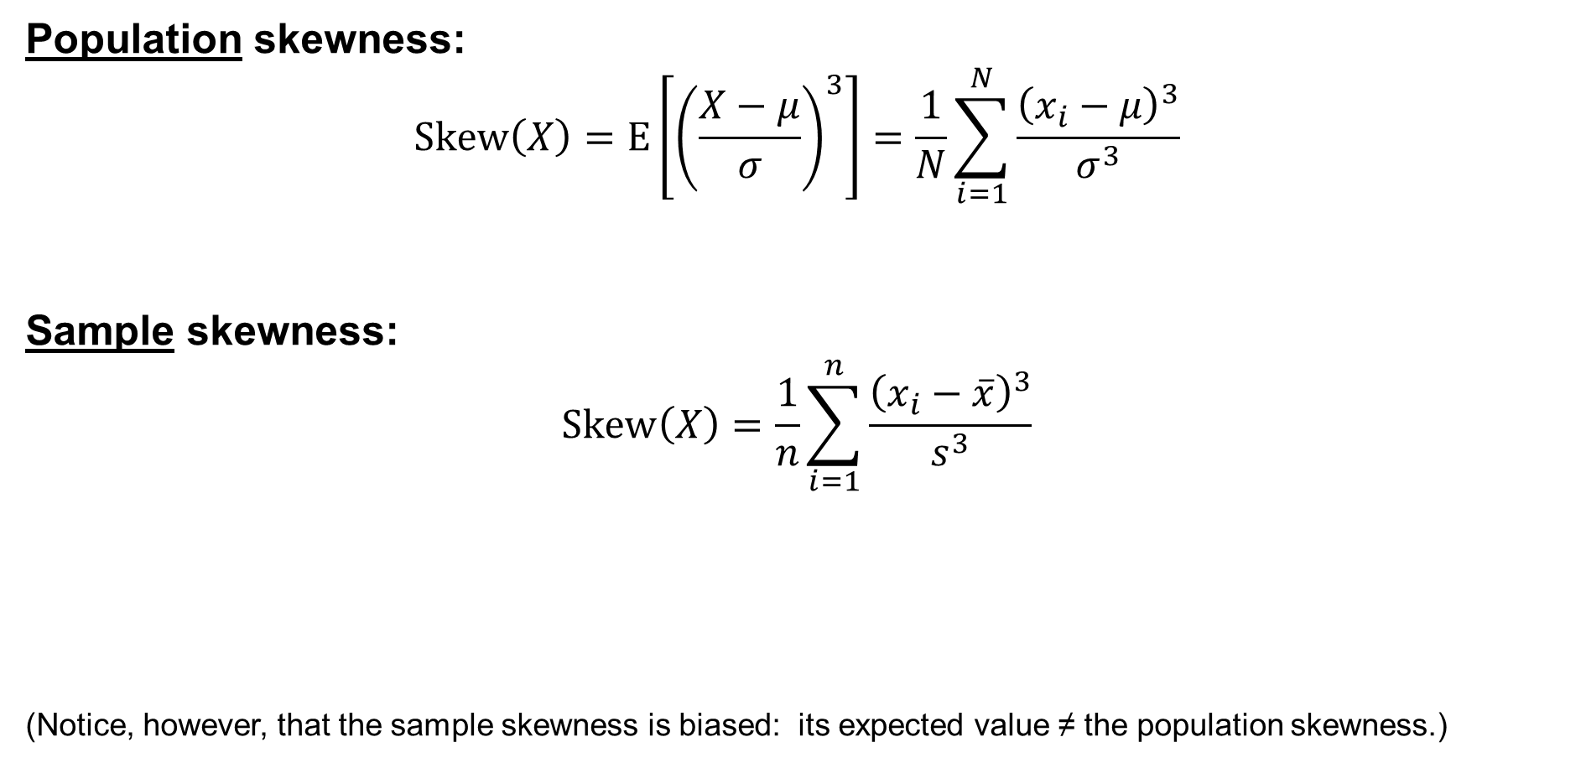
Skewness: Pearson’s moment coefficient of skewness
Population skewness:
$$\text{Skew}\left(X\right)=E\left[{\left(\frac{X−μ}{σ}\right)}^{3}\right]=\frac{1}{N}\sum_{i=1}^{N}{\frac{{\left(x_{i}−μ\right)}^{3}}{σ^{3}}}$$
Sample skewness:
$$\text{Sk}\text{e}\text{w}\left(X\right)=\frac{1}{n}\sum_{i=1}^{n}{\frac{{\left(x_{i}−\overline{x}\right)}^{3}}{s^{3}}}$$
(Notice, however, that the sample skewness is biased: its expected value ≠ the population skewness.)

Slide 57
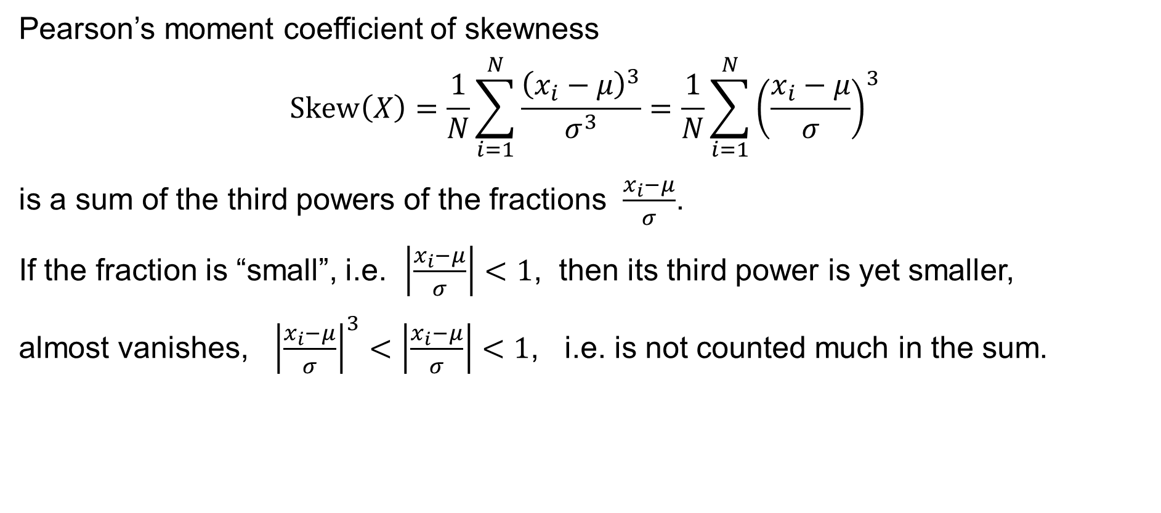
Skewness: Properties and interpretation
Pearson’s moment coefficient of skewness
$$\text{Skew}\left(X\right)=\frac{1}{N}\sum_{i=1}^{N}{\frac{{\left(x_{i}−μ\right)}^{3}}{σ^{3}}}=\frac{1}{N}\sum_{i=1}^{N}{{\left(\frac{x_{i}−μ}{σ}\right)}^{3}}$$
is a sum of the third powers of the fractions $\frac{x_{i}−μ}{σ}$.
If the fraction is “small”, i.e. $\left|\frac{x_{i}−μ}{σ}\right|<1$, then its third power is yet smaller,
almost vanishes, ${\left|\frac{x_{i}−μ}{σ}\right|}^{3}<\left|\frac{x_{i}−μ}{σ}\right|<1$, i.e. is not counted much in the sum.

Slide 58
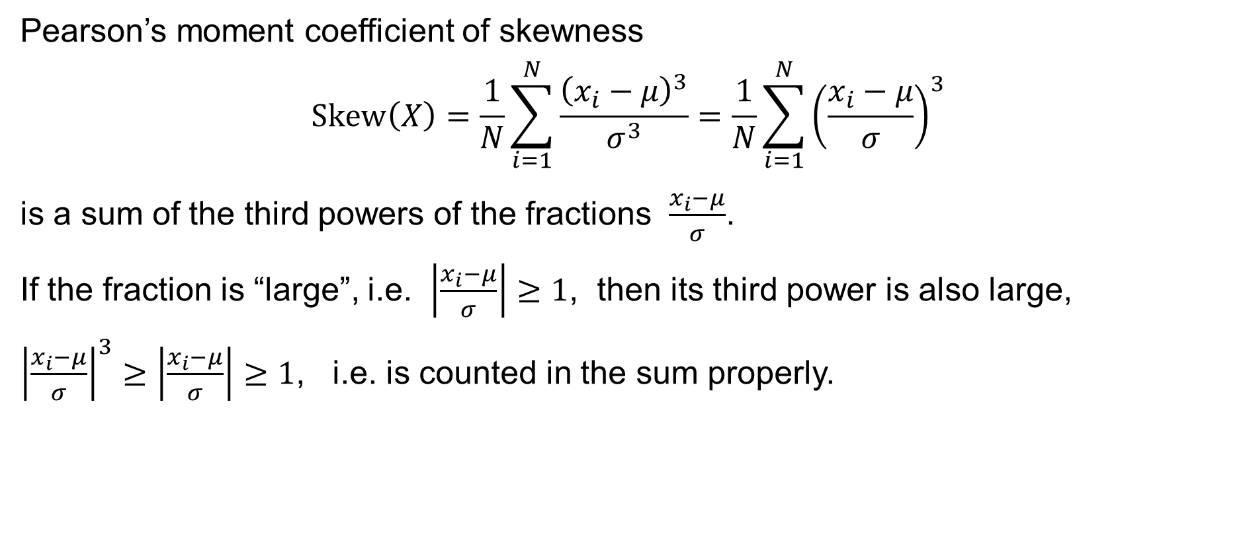
Skewness: Properties and interpretation
Pearson’s moment coefficient of skewness
$$\text{Skew}\left(X\right)=\frac{1}{N}\sum_{i=1}^{N}{\frac{{\left(x_{i}−μ\right)}^{3}}{σ^{3}}}=\frac{1}{N}\sum_{i=1}^{N}{{\left(\frac{x_{i}−μ}{σ}\right)}^{3}}$$
is a sum of the third powers of the fractions $\frac{x_{i}−μ}{σ}$.
If the fraction is “large”, i.e. $\left|\frac{x_{i}−μ}{σ}\right|≥1$, then its third power is also large,
${\left|\frac{x_{i}−μ}{σ}\right|}^{3}≥\left|\frac{x_{i}−μ}{σ}\right|≥1$, i.e. is counted in the sum properly.

Slide 59
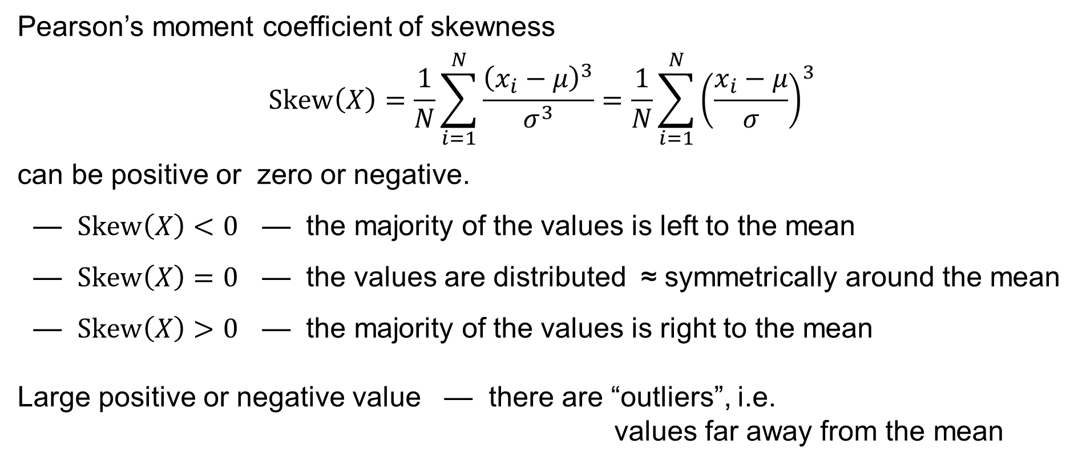
Skewness: Properties and interpretation
Pearson’s moment coefficient of skewness
$$\text{Skew}\left(X\right)=\frac{1}{N}\sum_{i=1}^{N}{\frac{{\left(x_{i}−μ\right)}^{3}}{σ^{3}}}=\frac{1}{N}\sum_{i=1}^{N}{{\left(\frac{x_{i}−μ}{σ}\right)}^{3}}$$
can be positive or zero or negative.
— $Skew\left(X\right)<0$ — the majority of the values is left to the mean
— $Skew\left(X\right)=0$ — the values are distributed ≈ symmetrically around the mean
— $Skew\left(X\right)>0$ — the majority of the values is right to the mean
Large positive or negative value — there are “outliers”, i.e.
values far away from the mean

Slide 60
Skewness in Excel
In Excel, use the functions:
=SKEW.P() to calculate the population skewness
=SKEW() to calculate the sample skewness

Slide 61
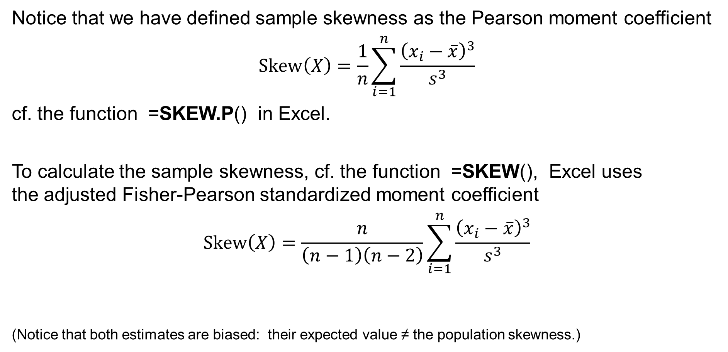
Skewness in Excel
Notice that we have defined sample skewness as the Pearson moment coefficient
$$\text{Skew}\left(X\right)=\frac{1}{n}\sum_{i=1}^{n}{\frac{{\left(x_{i}−\overline{x}\right)}^{3}}{s^{3}}}$$
cf. the function =SKEW.P() in Excel.
To calculate the sample skewness, cf. the function =SKEW(), Excel uses
the adjusted Fisher-Pearson standardized moment coefficient
$$\text{Skew}\left(X\right)=\frac{n}{\left(n−1\right)\left(n−2\right)}\sum_{i=1}^{n}{\frac{{\left(x_{i}−\overline{x}\right)}^{3}}{s^{3}}}$$
(Notice that both estimates are biased: their expected value ≠ the population skewness.)

Slide 62

Kurtosis: Pearson’s moment coefficient of kurtosis
Population kurtosis:
$$\text{Kurt}\left(X\right)=E\left[{\left(\frac{X−μ}{σ}\right)}^{4}\right]=\frac{1}{N}\sum_{i=1}^{N}{\frac{{\left(x_{i}−μ\right)}^{4}}{σ^{4}}}$$
Sample kurtosis:
$$\text{Kurt}\left(X\right)=\frac{1}{n}\sum_{i=1}^{n}{\frac{{\left(x_{i}−\overline{x}\right)}^{4}}{s^{4}}}$$

Slide 63
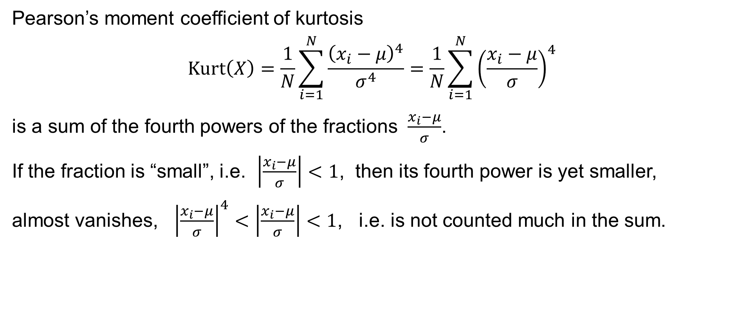
Kurtosis: Properties and interpretation
Pearson’s moment coefficient of kurtosis
$$\text{Kurt}\left(X\right)=\frac{1}{N}\sum_{i=1}^{N}{\frac{{\left(x_{i}−μ\right)}^{4}}{σ^{4}}}=\frac{1}{N}\sum_{i=1}^{N}{{\left(\frac{x_{i}−μ}{σ}\right)}^{4}}$$
is a sum of the fourth powers of the fractions $\frac{x_{i}−μ}{σ}$.
If the fraction is “small”, i.e. $\left|\frac{x_{i}−μ}{σ}\right|<1$, then its fourth power is yet smaller,
almost vanishes, ${\left|\frac{x_{i}−μ}{σ}\right|}^{4}<\left|\frac{x_{i}−μ}{σ}\right|<1$, i.e. is not counted much in the sum.

Slide 64
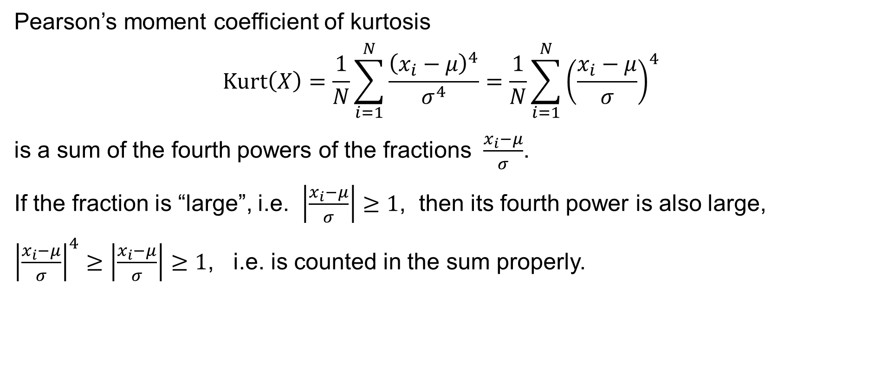
Kurtosis: Properties and interpretation
Pearson’s moment coefficient of kurtosis
$$\text{Kurt}\left(X\right)=\frac{1}{N}\sum_{i=1}^{N}{\frac{{\left(x_{i}−μ\right)}^{4}}{σ^{4}}}=\frac{1}{N}\sum_{i=1}^{N}{{\left(\frac{x_{i}−μ}{σ}\right)}^{4}}$$
is a sum of the fourth powers of the fractions $\frac{x_{i}−μ}{σ}$.
If the fraction is “large”, i.e. $\left|\frac{x_{i}−μ}{σ}\right|≥1$, then its fourth power is also large,
${\left|\frac{x_{i}−μ}{σ}\right|}^{4}≥\left|\frac{x_{i}−μ}{σ}\right|≥1$, i.e. is counted in the sum properly.

Slide 65
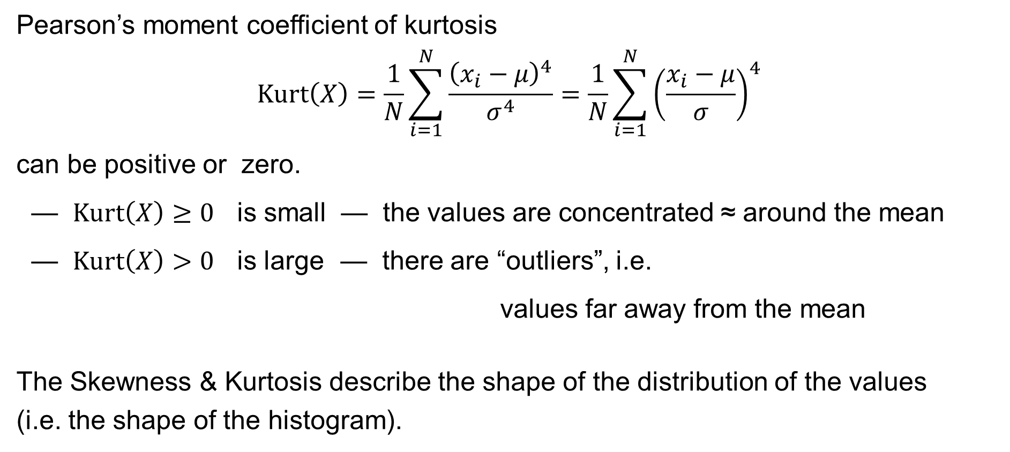
Kurtosis: Properties and interpretation
Pearson’s moment coefficient of kurtosis
$$\text{Kurt}\left(X\right)=\frac{1}{N}\sum_{i=1}^{N}{\frac{{\left(x_{i}−μ\right)}^{4}}{σ^{4}}}=\frac{1}{N}\sum_{i=1}^{N}{{\left(\frac{x_{i}−μ}{σ}\right)}^{4}}$$
can be positive or zero.
— $Kurt\left(X\right)≥0$ is small — the values are concentrated ≈ around the mean
— $Kurt\left(X\right)>0$ is large — there are “outliers”, i.e.
values far away from the mean
The Skewness & Kurtosis describe the shape of the distribution of the values
(i.e. the shape of the histogram).

Slide 66
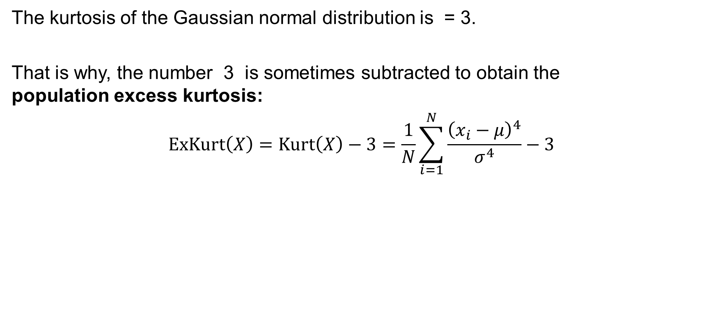
Excess kurtosis
The kurtosis of the Gaussian normal distribution is = 3.
That is why, the number 3 is sometimes subtracted to obtain the
population excess kurtosis:
$$\text{ExKurt}\left(X\right)=\text{Kurt}\left(X\right)−3=\frac{1}{N}\sum_{i=1}^{N}{\frac{{\left(x_{i}−μ\right)}^{4}}{σ^{4}}}−3$$

Slide 67
Kurtosis in Excel
In Excel, use the function:
=KURT() to calculate the sample excess kurtosis

Slide 68
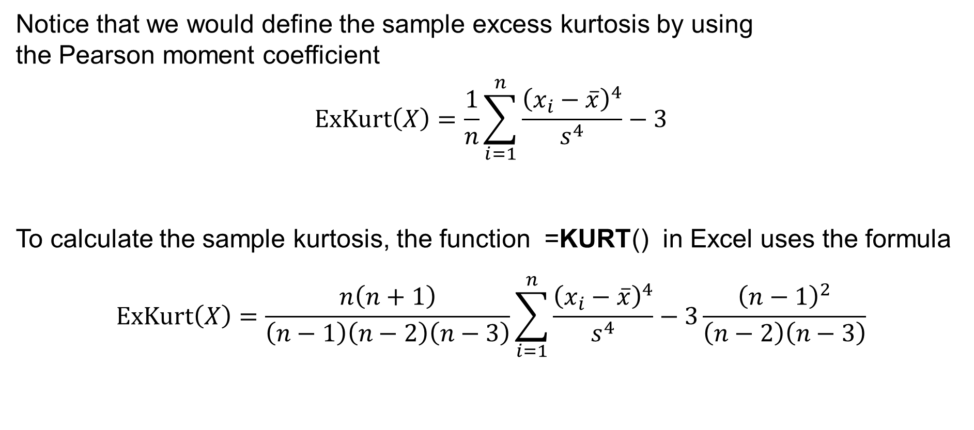
Kurtosis in Excel
Notice that we would define the sample excess kurtosis by using
the Pearson moment coefficient
$$\text{ExKurt}\left(X\right)=\frac{1}{n}\sum_{i=1}^{n}{\frac{{\left(x_{i}−\overline{x}\right)}^{4}}{s^{4}}}−3$$
To calculate the sample kurtosis, the function =KURT() in Excel uses the formula
$$\text{ExKurt}\left(X\right)=\frac{n\left(n+1\right)}{\left(n−1\right)\left(n−2\right)\left(n−3\right)}\sum_{i=1}^{n}{\frac{{\left(x_{i}−\overline{x}\right)}^{4}}{s^{4}}}−3\frac{{\left(n−1\right)}^{2}}{\left(n−2\right)\left(n−3\right)}$$

Slide 69
Example
Population mean $μ=3.686…$ Median $\tilde{x}=3$ Population skewness: $Skew= 0.26…$
Population variation $σ^{2}=2.8188…$ Mode $\hat{x}=3$ Population excess kurtosis: $ExKurt=−0.66…$
Frequency
50
47
45
40
35
32
30
25
23
19
20
20
16
15
12
10
5
0
1
2
3
4
5
6
7
Evaluation

