Slide 1

HUMAN RESOURCE MANAGEMENT
Lesson 5
Multigenerational leadership. Diversity management. Talent managament.
Ing. Helena Marková, Ph.D.

Slide 2
Content
PERSONALISTIKA PEM SU OPF
Vevox test
multigenerational leadership
diversity management
talent management

Slide 3
Multigenerational leadership
HRM PEM SU OPF
Multigenerational leadership refers to the ability to effectively lead and manage teams that include members from different generations, such as Baby Boomers, Gen X, Millennials, and Gen Z.
Each generation has its own unique characteristics, values, and communication styles, and effective multigenerational leaders are able to understand and navigate these differences in order to create a cohesive and productive team.

Slide 4
Skills to be a multigenerational leader
HRM PEM SU OPF
Strong communication skills: to communicate effectively with team members from different generations, to adapt communication style to meet the needs and preferences of each individual.
Cultural competence: to understand the cultural values and beliefs of each generation, and how those values may impact their work style and priorities.
Flexibility: to be flexible and adaptable, and able to adjust their leadership style to meet the needs of each individual and the team as a whole.
Empathy: to be able to put themselves in the shoes of team members from different generations, and understand their perspectives and challenges.
Collaboration: to be able to build bridges between team members from different generations, and foster a sense of collaboration and shared purpose.

Slide 5
Generations and their characteristics
HRM PEM SU OPF
1. Baby Boomers (born 1946-1964): Baby Boomers are often characterized as hardworking, competitive, and goal-oriented. They tend to value stability and security, and may be motivated by opportunities for advancement and recognition.
2. Generation X (born 1965-1980): Gen Xers are often described as independent, self-reliant, and adaptable. They value work-life balance and may be motivated by flexibility and opportunities to learn and grow.
3. Millennials (born 1981-1996): Millennials are often characterized as tech-savvy, socially conscious, and collaborative. They value work that is meaningful and aligned with their values, and may be motivated by opportunities to make a positive impact.
4. Generation Z (born after 1996): Gen Zers are just entering the workforce and are often described as entrepreneurial, creative, and diverse. They tend to value autonomy and opportunities to learn and grow, and may be motivated by the chance to make a tangible impact.

Slide 6
Pros and cons of multigen approach
HRM PEM SU OPF
Pros
Cons/challenges
Diverse perspectives
Improved decision-making
Enhanced learning opportunities
Increased adaptability
Communication challenges
Differing work styles
Conflict resolution challenges
Ageism

Slide 7
Companies with positive multigen approach
HRM PEM SU OPF
IBM has been recognized for its efforts to create an inclusive workplace for employees of all ages. The company offers training programs, mentorship opportunities, and flexible work arrangements to support employees at all stages of their careers.
PwC has implemented a "reverse mentoring" program, where younger employees mentor older employees on new technologies and trends.
BMW has a diversity and inclusion program and encourages cross-generational mentorship and collaboration.
Marriott International has implemented a "Learn from Everyone" program, which encourages employees to learn from colleagues of all ages.

Slide 8
TASK 1 – multigen challenge
HRM PEM SU OPF
Divide students into 4 groups/4 generations.
1. Create the features of the approach to each group of employees (20 minutes)
Work-life Integration
Technology
Continuous Learning
Feedback and Recognition
Team Interaction (Collaboration)
2. Present your findings (5 minutes each group)
Presentation to the rest of the class, key moment.
3. Summary
Summarize the key finding. Good practise.

Slide 9
TASK 1 – gen Babyboomers
HRM PEM SU OPF
Your company is implementing a new flexible work policy that allows employees to work remotely on certain days of the week. However, some Baby Boomer employees are resistant to this change, expressing concerns about productivity and communication. Your task is to lead a discussion with the Baby Boomer group to address their concerns, explore the benefits of flexible work arrangements, and develop strategies to ensure successful implementation while accommodating their preferences for traditional work structures.

Slide 10
TASK 1 – gen X
HRM PEM SU OPF
Your team is working on a project that requires collaboration across different departments and locations. Generation X team members express frustration with the reliance on digital communication tools and prefer face-to-face interactions to build rapport and trust. Your challenge is to facilitate a brainstorming session with the Generation X group to find a balance between digital and in-person communication methods, ensuring effective collaboration while accommodating their preference for personal connections and relationship-building.

Slide 11
TASK 1 – gen Y (Millenials)
HRM PEM SU OPF
Your organization is introducing a new performance feedback system that includes real-time feedback and peer-to-peer recognition platforms. However, some Millennial employees are skeptical about the effectiveness of these tools and express concerns about transparency and fairness. Your task is to lead a discussion with the Millennial group to address their concerns, highlight the benefits of real-time feedback and recognition, and develop strategies to ensure the system is implemented in a way that promotes transparency, equity, and employee engagement.

Slide 12
TASK 1 – gen Z
HRM PEM SU OPF
Your team is tasked with implementing a new technology platform to streamline workflow processes and enhance productivity. However, some Generation Z employees express frustration with the complexity of the system and prefer simpler, more intuitive tools. Your challenge is to lead a brainstorming session with the Generation Z group to identify user-friendly features, provide training and support to enhance their digital literacy, and ensure the successful adoption of the technology platform while accommodating their preference for simplicity and efficiency.

Slide 13
Is Multigen Leadership important?
HRM PEM SU OPF
Let´s summarize todays findings.
Any inspiriational moments?

Slide 14
Diversity management
HRM PEM SU OPF
Diversity management refers to the proactive steps an organization takes to create and maintain a diverse and inclusive workplace.
The goal of diversity management is to ensure that all employees are valued and respected for their unique backgrounds, experiences, and perspectives, and that they are given equal opportunities to succeed.
It is more innovative, productive, and successful approach. By embracing diversity and inclusion, organizations can attract and retain top talent, improve customer satisfaction, and build stronger relationships with the communities they serve.

Slide 15
Diversity management
HRM PEM SU OPF
Different approaches – from liberal to radical.
Government level of measures – quotes for employing women in managerial post, anti-discrimination legal.
Cultural background of inequal conditions, lack of effort to change habits.
Concept of inclusion is spreading in all areas of public life.
Connection between strategic HRM and diversity management – SHRM is more oriented on business goals, DM more on employees, but today diversity approach becomes one of strategic goal of companies.

Slide 16
Diversity management
HRM PEM SU OPF
Significant role of leaders: Finally, effective diversity management requires strong leadership and accountability at all levels of the organization.
Leaders must support inclusive workplace culture and diverse and respectful workplace.
DM is projected into all processes: recruitment and hiring, training and developement programs esp.

Slide 17
Advantages of diversity management
HRM PEM SU OPF
Increased Innovation
Better Decision-Making
Improved Employee Engagement
Enhanced Reputation
Increased Creativity
Expanded Market Reach

Slide 18
Disadvantages / challenges of diversity management
HRM PEM SU OPF
Resistance to Change
Communication Challenges
Potential for Conflict
Misunderstandings
Increased Complexity (Managing a diverse workforce can be more complex and require more resources than managing a homogenous workforce. This can lead to increased administrative costs and logistical challenges.)

Slide 19
Methods of diversity management
HRM PEM SU OPF
Diversity management is the practice of creating and maintaining a workplace that respects and values individual differences. There are several methods of diversity management that can be employed in an organization, including:
Diversity training: This involves educating employees about the benefits of diversity and how to recognize and avoid bias.
Recruitment and hiring practices: Organizations can adopt policies that ensure diverse candidate pools for open positions and use diverse selection committees.

Slide 20
Methods of diversity management
HRM PEM SU OPF
Mentoring and networking: Creating formal and informal mentoring programs that connect employees from different backgrounds can help foster a more inclusive workplace.
Affinity groups: These are employee-led groups that come together based on shared characteristics, such as race, gender, or sexual orientation. These groups can provide support and advocacy for underrepresented employees.
Flexible work arrangements: Offering flexible schedules or remote work options can accommodate diverse needs and help create a more inclusive workplace.

Slide 21
Methods of diversity management
HRM PEM SU OPF
Performance management: Organizations can ensure that their performance evaluations are free of bias and that all employees are given equal opportunities for advancement.
Diversity councils: These are cross-functional teams that can help create and implement diversity initiatives and policies.
Employee resource groups: These are groups of employees who come together to address specific workplace issues, such as disability accommodations or LGBTQ+ rights.

Slide 22
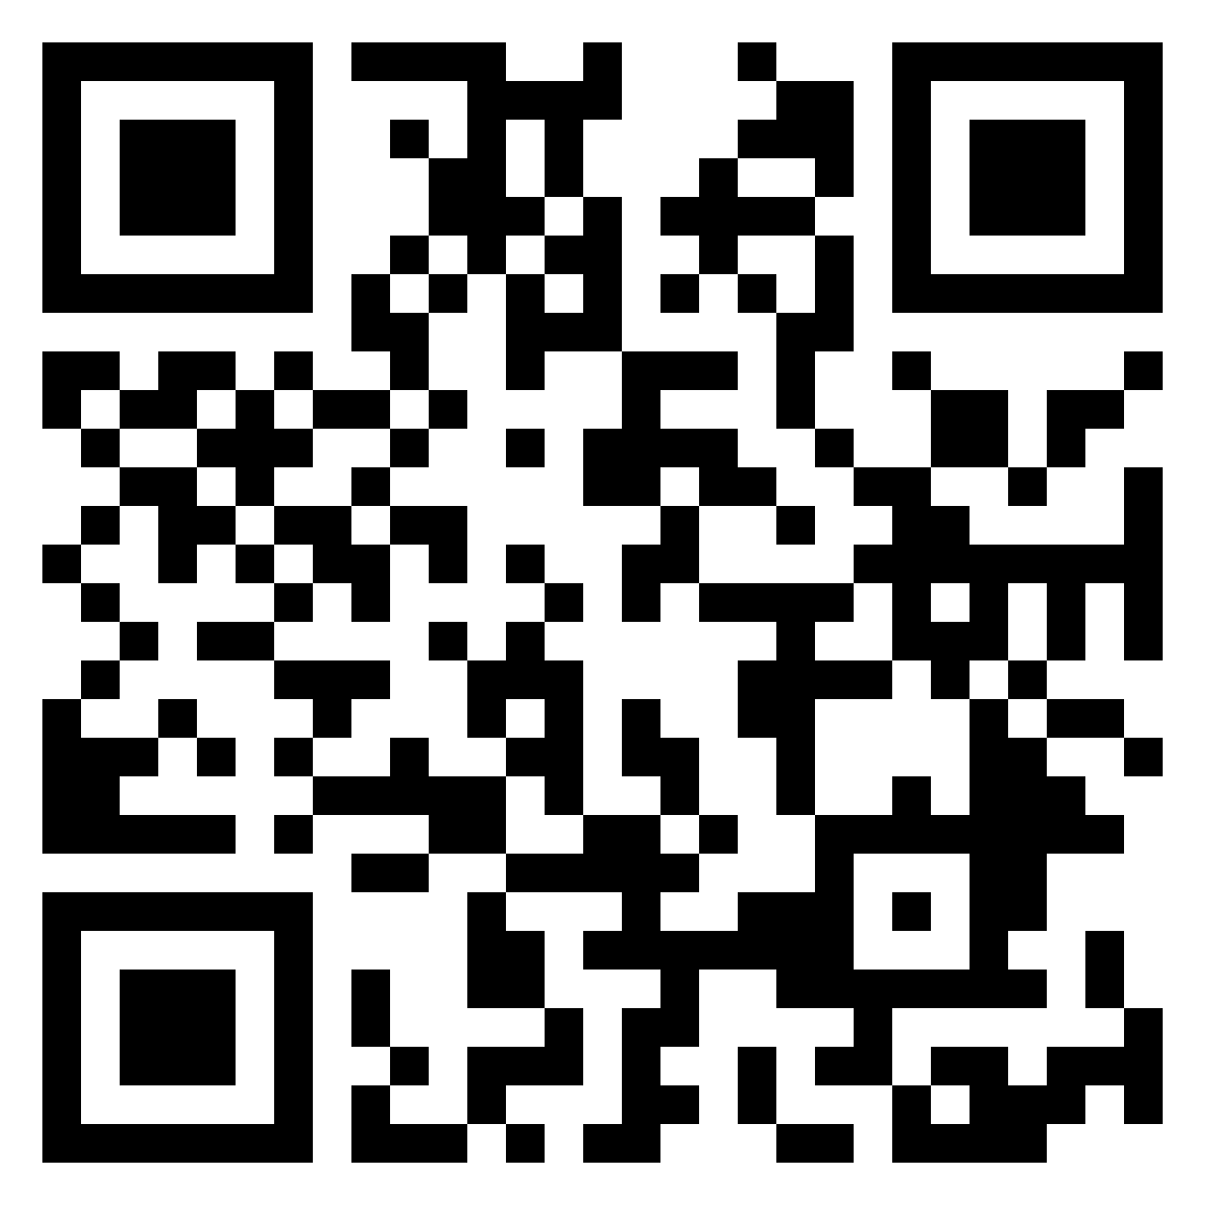
TASK 2
HRM PEM SU OPF
Design issues to include employees:
single parents (or parents as well)
employees with disabilities
religious people
https://padlet.com/markova17/diversity-management-discussion-rpcj4moavhf1ymmq

Slide 23
Talent management
HRM PEM SU OPF
What is it?
Talent management is a company's internal system that deals with the recruitment, retention and development of talent in the organization. It is a long-term strategy whereby the company "trains" and retains quality employees, or handles succession to individual positions.

Slide 24
Talent management
HRM PEM SU OPF
Talent management enables organizations to attract and retain talent in the long term.
It encompasses development opportunities and strategies that motivate teams to be at their best performance.
Why is it important?
The cost of hiring a new employee can range from one-half to two times the employee’s annual salary (by Gallup Institute).

Slide 25
Talent management x Talent aquisition
HRM PEM SU OPF
Talent management and talent acquisition seem interchangeable, but there are some key differences.
While talent management’s aim is to build and retain talent after hiring,
talent acquisition is mainly focused on attracting and recruiting individuals to join your company.

Slide 26
Key Principles of Talent Management
HRM PEM SU OPF
Alignment With Strategy (if corporate strategy changes …adapt your talent approach)
Internal Consistency (regular feedback, evaluation…consistent in all company, competitive and similar compensation in all positions)
Management Involvement (career development programs, job rotations and new assignments. Professional development is the best way to improve company culture.)
Cultural Embeddedness (hiring candidates with the same values, training programmes of comp.culture)
Employer Branding Through Differentiation (employers must differentiate themselves from competitors and increase brand awareness in local communities…launching campaigns in universities that emphasize unique long-term opportunities, benefits and promotions)
Balancing Global and Local Needs (In international companies managers and HR teams may need to adjust their processes based on the cultural and behavioral norms in a particular country.)

Slide 27
Next lesson content
HRM PEM SU OPF
25.3.2024 at 14:45, on-line meeting
Branding. Social media.
Presenters: Daria Wojtkowska, Global Talent Marketing Lead - Early Careers & Social, together with Kavya Kundalia, Social Media Marketing Senior Lead.

Slide 28

PERSONALISTIKA PEM SU OPF
Thank you
for your attention.
Děkuji vám za pozornost, přeji příjemný den.

