Slide 1
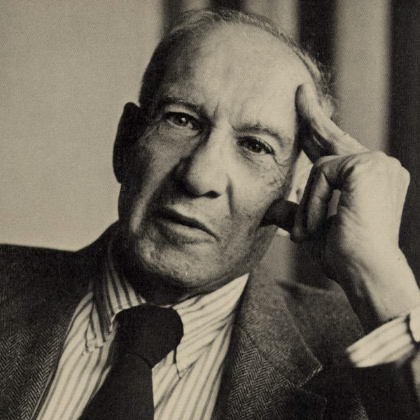
PETER F DUCKER

Slide 2
BASIC BIOGRAPHY
Peter F. Drucker (1909-2005) was an influential Austrian-born American management consultant, educator, and author. He is often regarded as the "father of modern management" for his significant contributions to the field of management theory and practice. Here is a basic biography of Peter F. Drucker:
Birth: Peter Ferdinand Drucker was born on November 19, 1909, in Vienna, Austria.
Education: He studied law and earned a doctorate in international and public law from the University of Frankfurt.
Books: He authored numerous influential books, including "The Practice of Management" (1954), "The Effective Executive" (1966), and "Management: Tasks, Responsibilities, Practices" (1973), which became classics in the field.
Impact on Management Thinking: Drucker's ideas had a profound and lasting impact on management thinking, emphasizing the importance of innovation, entrepreneurship, and effective leadership.
Awards: He received numerous awards during his lifetime for his contributions to management and business literature.
Death: Peter F. Drucker passed away on November 11, 2005, at the age of 95, in Claremont, California.

Slide 3
BENEFITS OF HUMAN RES0URCE MANAGEMENT
Human Capital as a Key Asset:
Drucker believed that people are the most valuable asset of any organization. He argued that the skills, knowledge, and abilities of employees represent the core assets that drive an organization's success.
Strategic Management of People:
Drucker emphasized the strategic management of human resources. He advocated for aligning the skills and capabilities of employees with the overall goals and objectives of the organization.
Employee Development and Continuous Learning:
Drucker recognized the importance of employee development and continuous learning. He stressed the need for organizations to invest in training and development programs to enhance the skills and capabilities of their workforce.
Employee Engagement and Motivation:
Drucker understood the importance of employee engagement and motivation in achieving organizational success. He believed that satisfied and motivated employees contribute to higher productivity and innovation.
Decentralization and Empowerment:
Drucker advocated for decentralization and empowerment of employees. He argued that giving employees more responsibility and decision-making authority can lead to increased job satisfaction, creativity, and overall organizational effectiveness.

Slide 4
RELEVANT TODAY
As of my last knowledge update in January 2022, Peter F. Drucker's principles and ideas remain relevant today across various aspects of business and management. Here are some key areas where Drucker's insights continue to be applicable:
Management by Objectives (MBO):
  Drucker introduced the concept of Management by Objectives, emphasizing the importance of setting clear goals and objectives within an organization. This approach is still widely used today as a framework for performance management and aligning individual and organizational goals.
Knowledge Workers and the Knowledge Economy:
  Drucker foresaw the rise of the knowledge economy and the increasing importance of knowledge workers. In today's tech-driven and information-centric environment, the value of intellectual capital is even more pronounced, and organizations prioritize the development and management of knowledge workers.
Leadership and Effectiveness:
  Drucker's insights on effective leadership, as outlined in his book "The Effective Executive," are timeless. Concepts such as time management, decision-making, and focusing on strengths remain crucial for leaders navigating the complexities of the modern business landscape.
Innovation and Entrepreneurship:
  Drucker's emphasis on innovation and entrepreneurship is highly relevant in today's competitive and rapidly evolving markets. Organizations need to foster a culture of innovation to stay competitive, and his principles guide leaders in managing and promoting innovation.
Customer-Centric Approach:
  Drucker's focus on the importance of understanding and satisfying customer needs is integral to contemporary business strategies. Customer-centricity remains a key principle for businesses aiming to build sustainable relationships and deliver value.

Slide 5
SUMMARY
Summarize the enduring significance of Peter Drucker’s contributions to management theory and practice, particularly in HRM. Emphasize the importance of understanding and applying his principles in navigating contemporary management challenges. Encourage further exploration of Drucker’s works and their application in organizational settings.

