Slide 1
Direct materials budget
Lecture of Corporate Budgeting
Mgr. Tetiana Konieva, Ph.D

Slide 2
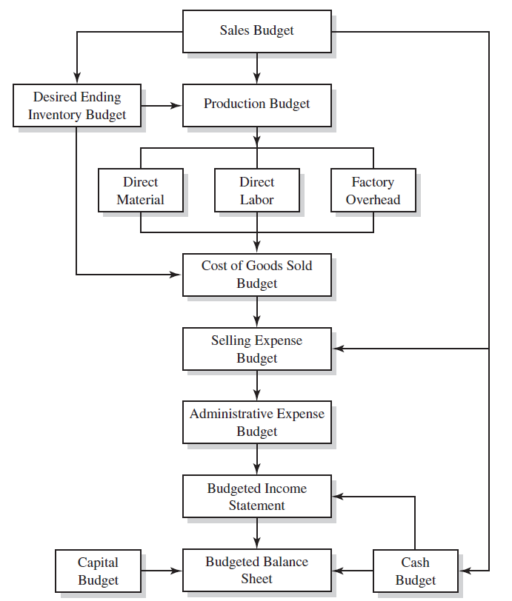
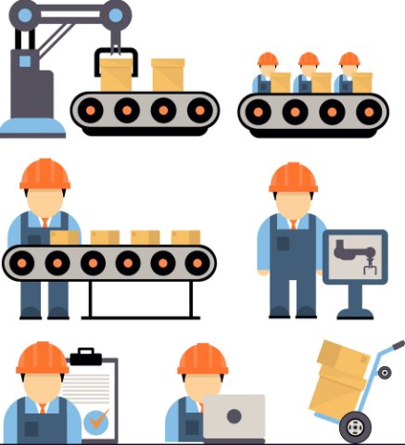
LOGICAL SCHEME OF BUDGETING PROCESS

Slide 3
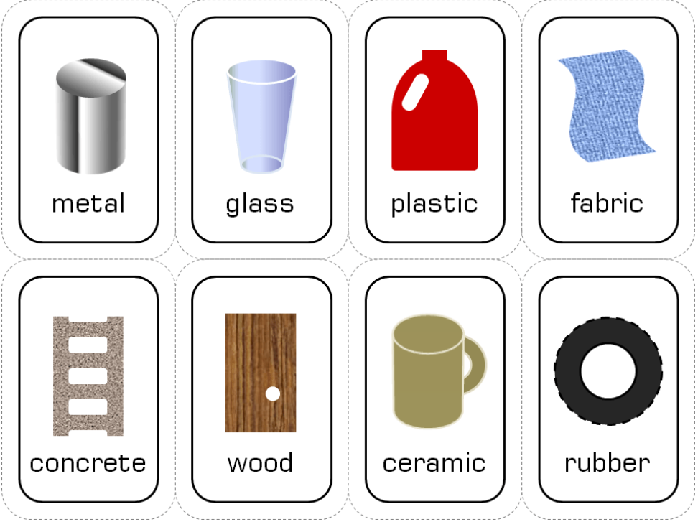
DIRECT MATERIALS BUDGET: DEFINITION
Direct materials budget is one of the operating budgets along with Sales budget, Production budget, Direct labour budget, Budget of other direct and general production costs and Selling and administrative expense budget
Direct materials budget - budget that shows how much material will be required for production and how much material must be bought to meet this production requirement. The purchase depends on both expected usage of materials and inventory levels.
The list of (raw) materials, semi-products, energy, needed for production, depends on technology. Such type of budget is calculated for every of them separately
The materials and inventory budgets in a typical manufacturing firm involve a determination of:
The quantities and cost of raw materials to be used;
The quantities and value of materials to be carried in the inventory. The inventory balance depends on how long it takes to receive raw materials from suppliers after the order is placed.
The quantities and cost of materials to be purchased. The amount to purchase considers expected production and raw material levels. The units of raw material needed equals the raw material usage multiplied by the units of production. In budgeting purchases, consideration should be given to expected price changes, interest cost to finance inventory, volume and cash discounts, desired delivery date, warehousing availability and cost, and obsolescence risk.
The quantity and value of finished goods to be carried in the inventory

Slide 4
RAW MATERIALS
https://www.investopedia.com/terms/r/rawmaterials.asp
Raw materials are the input goods or inventory that a company needs to manufacture its products.
Examples of raw materials include steel, oil, corn, grain, gasoline, lumber, forest resources, plastic, natural gas, coal, and minerals.
Raw materials can be direct raw materials, which are directly used in the manufacturing process, such as wood for a chair.
Indirect raw materials are not part of the final product but are instead used comprehensively in the production process.
The value of direct raw materials inventory appears as a current asset on the balance sheet.
A manufacturer calculates the amount of direct raw materials it needs for specific periods to ensure there are no shortages. By closely tracking the amount of direct raw materials bought and used, an entity can reduce unnecessary inventory stock, potentially lower ordering costs, and reduce the risk of material obsolescence.
Raw materials may degrade in storage or become unusable in a product for various reasons. In this case, the company declares them obsolete. If this occurs, the company expenses the inventory as a debit to write-offs and credits the obsolete inventory to decrease assets.
Direct raw materials are typically considered variable costs since the amount used depends on the quantities being produced.

Slide 5
DIRECT MATERIAL BUDGET
Indicator | Quarters |  |  |  | For the year | Quarters of next year
 | І | ІІ | ІІІ | ІV |  | І | ІІ
1. The required output of finished products*, units | 467.42 | 441.30 | 451.30 | 461.30 | 1821.32 | 471.30 | 0.00
2. Raw material requirements per unit of finished goods**, kg | 3.00 | 3.00 | 3.00 | 3.00 | 3.00 | 3.00 | 3.00
3. Need for materials for the finished goods production, kg (row 1* row 2) | 1402.25 | 1323.90 | 1353.90 | 1383.90 | 5463.95 | 1413.90
4. Raw materials inventories at the end of the period***, kg | 172.11 | 176.01 | 179.91 | 183.81 |  |  | 0.00
5. Total need for materials for the finished goods production, kg (row 3 + row 4) | 1574.36 | 1499.91 | 1533.81 | 1567.71 | 6175.78
6. Raw materials inventories at the beginning of the period*****, kg | ^{157.00****} | 172.11 | 176.01 | 179.91 |  | 183.81 | 0.00
7. Volume of the necessary raw materials purchase in the period, kg (row 5 – row 6) | 1417.36 | 1327.80 | 1357.80 | 1387.80 | 5490.76 |  | 0.00
8. Price of the raw materials unit, CZK. | 5.00 | 5.00 | 5.00 | 5.00
9. Costs of the raw materials purchase, CZK. (row 7*row 8) | 7086.80 | 6639.00 | 6789.00 | 6939.00 | 27453.80
*from production budget **according technology ***as % (for example 13%) from materials, needed for the next quarter
****raw material at the end of previous year in units = raw materials at the end of previous year in units/price of material per unit
***** raw material inventories at the beginning of second quarter = raw material inventories at the end of first quarter……and so on
Row 7 = Volume of the necessary raw materials purchase in the period, unit = Need for materials for the finished goods production + Desired ending inventory - Beginning inventory

Slide 6
COMPONENTS OF DIRECT MATERIAL BUDGET
The materials and inventory budgets in a typical manufacturing firm involve a determination of:
The quantities and cost of raw materials to be used.
The quantities and value of materials to be carried in the inventory. The inventory balance depends on how long it takes to receive raw materials from suppliers after the order is placed.
The quantities and cost of materials to be purchased. The amount to purchase considers expected production and raw material levels. The units of raw material needed equals the raw material usage multiplied by the units of production. In budgeting purchases, consideration should be given to expected price changes, interest cost to finance inventory, volume and cash discounts, desired delivery date, warehousing availability and cost, and obsolescence risk.
The quantity and value of finished goods to be carried in the inventory

Slide 7
HOW TO CALCULATE DIRECT MATERIAL BUDGET
1. Determine the physical units of material required for each items of goods that
is to be produced during the budget period.
2. Accumulate these into total physical units of each material item required for the
production plan.
3. Determine for each item of material the quantity that should be on hand periodically
to provide for the production budget, with a reasonable degree of
safety.
4. Deduct material inventories, which it is expected will be on hand at the beginning of the budget period, to ascertain the total quantities to be purchased. The formula for computation of the purchase is:
Purchase in units = Usage + Desired ending material inventory units – Beginning inventory units
5. Develop a purchase policy that will ensure that quantities will be on hand at the time they are needed. The purchase policy must consider such factors as economic order quantities (EOQ), economy of transportation, quantity discounts,
and possible depletion of inventory.
6. Translate the inventory and purchase requirements into cash form by applying the expected prices of materials to budgeted quantities. The amount of purchases in cash is one of the major cash disbursement items in the cash budget.
The preparation of this Budget can be monthly, quarterly, or yearly.

Slide 8
ADVENTAGES OF DIRECT MATERIAL BUDGET
This budget keeps the inventory always in check. There is no sudden scarcity or abundance of raw materials.
There is no excess inventory cost.
This Budget helps in managing cash flows in a better way. This budget notifies the exact amount and timing of the expected cash flow required in the future.
The preparation of the Direct Materials budget is for every month or quarter. Thus this leads to the identification of any errors or flaws before the financial year-end.

Slide 9
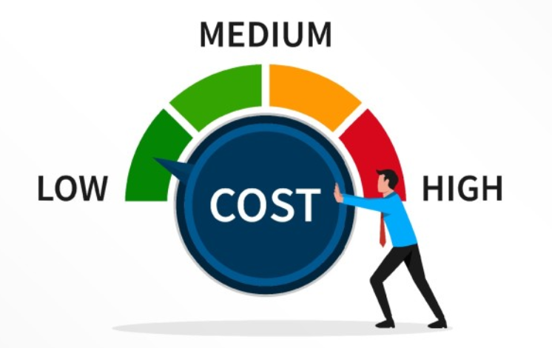
WAYS TO REDUCE MATERIAL COSTS
1. Substitute Lower Cost Materials Where Possible
Products can usually be manufactured utilizing a variety of different materials, depending on marketplace requirements and the practices of the manufacturers. Technology is constantly improving older materials and creating new ones, prices move up and down due to political goals as much as supply and demand, and processing methods change.
2. Reduce Waste. Modifying product designs and altering production methods in order to utilize standard raw material units may reduce excessive scrap and its associated costs.
3. Eliminate Unnecessary Product Features
Custom products cost more to manufacture than mass-produced products, and any non-standard feature requires an additional step in the production process, increasing the expense. Examine your customers’ motives for purchasing your products: Do they buy your products because of their low cost, high quality, unique look, or some other reason? By determining what is important to your customers, you can selectively attack elements which are not as important to reduce cost.
4. Negotiate, Negotiate, Negotiate
The level of your profit depends upon your ability to receive the highest possible price for your products and pay the lowest possible price to your suppliers and vendors. Every participant in the supply chain is looking for business and will take unusual, often extraordinary steps to make or save a sale – this is especially true in a poor economy. Ask for a discount every time you request an estimate or place an order, and keep asking until you actually place the order. If you do not get a reduction in price, ask for favorable financing terms, prepaid freight, or other freebies.
5. Leverage Suppliers
In many cases, a little research will turn up alternative suppliers of similar products available to you. Determine whether there are any different features between suppliers and whether these differentiating features benefit you or your customers. Is it worthwhile, for example, to have a faster delivery time or favorable financing at a slightly higher price? If not, purchase from the supplier offering the product at the lowest cost.

Slide 10
WAYS TO REDUCE MATERIAL COSTS
6. Buy Need, Not Potential
Toyota Motor Company of Japan is considered the father of the “just in time” (JIT) production system. Requiring suppliers to make frequent deliveries eliminates excess inventory and carrying costs.
7. Trade Time for Discounts
The opposite approach to JIT is to purchase and receive materials on the supplier’s schedule, rather than when you will use the material. This means you will incur additional associated costs in excess inventory. However, allowing vendors and suppliers to deliver materials on their cycle times, rather than on your production schedule, may result in a lower price.
8. Buy Bargains
From time to time, unbelievable bargains appear in the market. A vendor may need to dump inventory due to his or her banking relationship, for funds to fill other contracts, or because the company is going out of business. Whenever such opportunities arise, take advantage of them – many times the price will be less than the seller’s actual manufactured cost.
9. Transform Buyers Into Suppliers
If your finished product is a component of an end product, ask the buyer of your component to contract directly with the raw material vendor to furnish raw materials to you for the processing of the component. In all likelihood, your profit margin on the raw materials is considerably less than the margin on your processing labor and overhead. Transferring material supply responsibilities to your buyer will eliminate a significant cost for you without substantially reducing your profit margin.
10. Barter Finished Goods for Raw Materials
If your products or services are used by any of your vendors, selectively approach them about a non-cash trade between your two companies. Usually, the exchange rate for two different products in a barter is the standard retail price of each. If the gross profit margin on your product is considerably higher than the gross profit margin of the exchanged product, it is to your benefit to make the exchange.

Slide 11
WAYS TO REDUCE MATERIAL COSTS
11. Provide Warehouse and Distribution Services
Manufacturers minimize their costs by volume purchasing, assembly line production, and concentrating operations in a single location. As a consequence, shipping and handling become more expensive when they are required to ship long distances to their customers.
If you have excess space, offer your main suppliers a regional warehousing capacity in return for reduced prices on your purchases.
12. Offer Quick Payment for Lower Prices
For many companies, cash flow is more important than profits, particularly in the short-term. During periods of financial stress, companies simply cannot afford to keep excess inventory or allow the payments of accounts receivable to be delayed. Inform your suppliers that you are willing to consider cash purchases in return for low prices. If your operation is financially capable of holding the inventory until it is needed, the use of cash is justified.
13. Enter Into Cooperative Purchase Agreements to Gain Buying Muscle
It is a truism that the larger the purchase, the more attentive the seller. Higher volume buys respect and discounts. Contact other companies that use your suppliers to combine orders, thus increasing the per-order quantity for the supplier. Since most suppliers treat sales and logistics separately, requiring the seller to ship different portions of the order to separate locations should not be an obstacle.
14. Negotiate Long-Term Supply Agreements
While a single order might be small, the total volume of material used over a period of time – a single quarter of the year, multiple quarters, or a full year – will be significantly larger. Offer to use a supplier exclusively for a specific period in return for a set lower price and better terms. While you will lose the opportunity to change suppliers during the contract term, the offsetting benefits of a lower price and a firm supply should compensate for your loss of flexibility.

Slide 12
THANK YOU FOR ATTENTION!

