Slide 1
Budget of the administrative and sales expenses
Lecture of Corporate Budgeting
Mgr. Tetiana Konieva, Ph.D

Slide 2
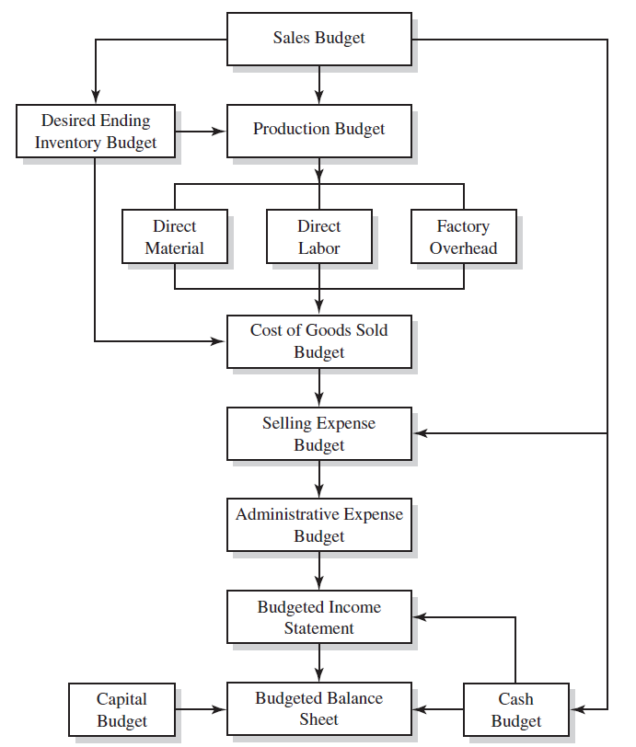
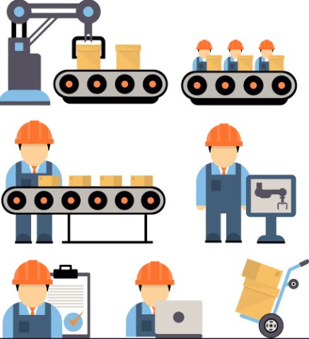
LOGICAL SCHEME OF BUDGETING PROCESS

Slide 3
SELLING AND ADMINISTRATIVE COSTS AS PART OF THE PRICE
Price of the unit of production =
1.cost of production per unit (direct material costs (materials, energy, gas, water, spent for the manufacturing of the production) + direct labor costs (salary of employees, that manufacture the production) + Cost of spoiled production + depreciation of equipment, that takes part in manufacturing process + general production costs (for maintaining the workshop, where production manufactured; salary of the workshop director, workshop cleaners; heating and lightening of the workshop)
+
2.profit (administrative costs (salary of the director, financial services departments, HR department, supply department, depreciation of the administrative fixed assets, representative expenses, audit, etc.), sales costs (packaging, advertising, transportation of products, depreciation of refrigerators, storage of finished products, salary of sales department), profit, tax profit, dividends)
+
3.Excise + 4.custom duty + 5.VAT value added tax

Slide 4
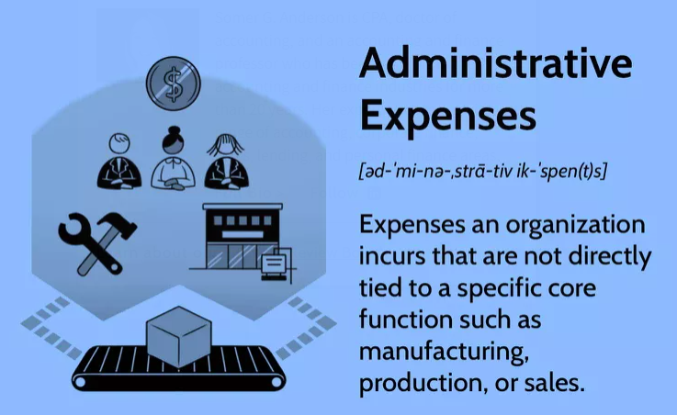
ADMINISTRATIVE EXPENSES
Administrative expenses are costs incurred to support the functioning of a business, but which are not directly related to the production of a specific product or service.
Some level of administrative expenses will always be incurred as a necessary part of operations.
Administrative expenses are often among the first identified for budget cuts, because they do not directly impact a company's main business functions.
Management may allocate administrative expenses to its business units based on a percentage of revenue, expenses, or other measures.
Administrative expenses may include salaries of senior management and the costs associated with general services or supplies; for example, legal, accounting, clerical work, and information technology.
Companies incur administrative expenses in order to perform basic operations (e.g., administer payroll or healthcare benefits), increase oversight and efficiency, and/or comply with laws and regulations. On the income statement, administrative expenses appear below cost of goods sold (COGS) and may be shown as an aggregate with other expenses such as general or selling expenses.
Some administrative expenses are fixed in nature, as they are incurred as part of the foundation of business operations. These expenses would exist regardless of the level of production or sales that occur. Other administrative expenses are semi-variable. Because a business can eliminate administrative expenses without a direct impact on the product it sells or produces, these costs are typically first in line for budget cuts. Management is strongly motivated to maintain low administrative expenses relative to other costs, as this allows a business to utilize leverage more effectively.

Slide 5
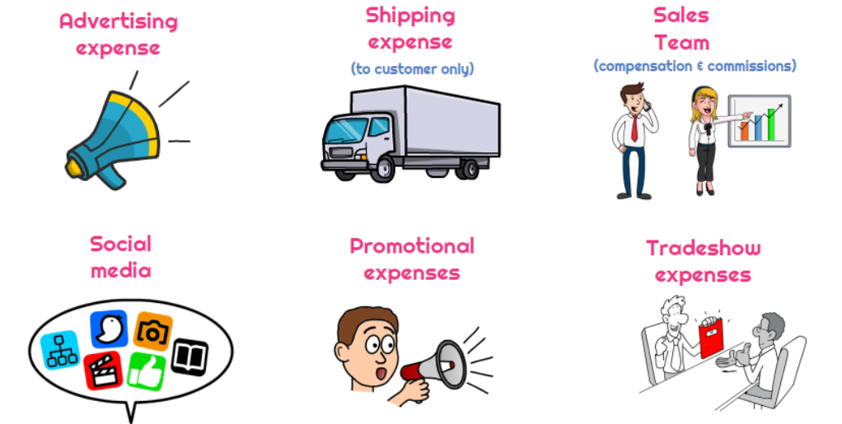
SELLING EXPENSES
Selling expenses include both indirect and direct business costs. Indirect selling expenses include advertising and marketing costs, the company's telephone bills and travel costs, and the salaries of its sales personnel. Such expenses occur throughout the manufacturing process and even after the product is finished.
Direct selling expenses are incurred only when the product is sold and are related to the fulfillment of orders. They include the costs of shipping and shipping supplies, delivery charges, and the payment of sales commissions.

Slide 6
SELLING EXPENSES
Selling expenses are often related to the expenses necessary for the company to directly interface with customers. These types of expenses include:
Sales Expenses. This often includes salaries and wages of salespeople including commissions, payroll taxes, and benefits.
Marketing. This may encompass expenses directly related to a company's product line, services, brand, or image. A company may choose to aggregate marketing costs with advertising costs, though some companies may have enough reason to segregate these costs.
Advertising. This can be any form, and a company can choose to further refine the way it accounts for advertising by using many different general ledger codes.
Travel expenses. This is often related to in-person events or trade obligations such as trade shows or client meetings.
packaging, advertising, transportation of products, depreciation of refrigerators, storage of finished products, salary of sales department

Slide 7
BUDGET OF THE ADMINISTRATIVE AND SALES EXPENSES
Indicator | Quarters |  |  |  | For the year
 | І | ІІ | ІІІ | ІV
1. Sales expenses | 745.52 | 697.93 | 713.79 | 729.66 | 2886.90
2. Administrative expenses | 8081.30 | 8081.30 | 8081.30 | 8081.30 | 32325.20
3. Total (row 1+ row 2) | 8826.82 | 8779.23 | 8795.09 | 8810.96 | 35212.10
4. Depreciation of administrative fixed assets and fixed assets, used for selling | 546.00 | 546.00 | 546.00 | 546.00 | 2184.00
5. Cash outflow for administrative and sales expenses (row 3- row 4) * | 8280.82 | 8233.23 | 8249.09 | 8264.96 | 33028.10
*all calculated budgets will be reflected in Cash plan. As far as depreciation does not entail a cash outflow, it must be deducted from the budget in computing cash disbursement for administrative and sales expenses.

Slide 8
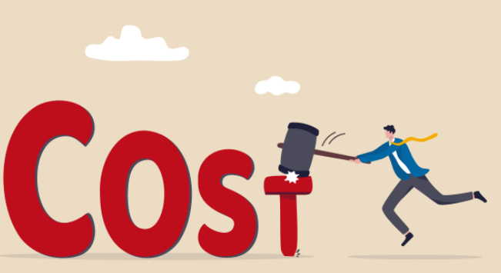
REDUCING ADMINISTRATIVE AND SALES EXPENSES
Overhead costs (administrative, selling expenses) include any expenses related to day-to-day business operations. These are independent of revenue, meaning they must be paid regardless of profit or loss. Overheads include both fixed expenses, like employee salaries and leases, and variable expenses like maintenance and utility bills
Here’s how to reduce some of the most common overhead costs:
1. Rent your office space. A commercial space comprises the bulk of the overhead costs of many businesses. Purchasing an office space could be a good long-term business investment, providing an asset that could grow in value over time. But if you’re looking for a way to reduce overhead costs in the short term, this usually won’t be the best option. Buying property not only ties up your working capital but creates additional overhead costs with building maintenance.
Renting is easier on your accounts, as you’ll usually only need to pay for the deposit and first month’s rent rather than a hefty down payment. It also offers greater flexibility should you need to change locations, upsize or downsize.
2. Subleasing office space: If you have extra space in your office or warehouse, you can rent it out to individuals or other companies to bring in a new revenue stream and offset the cost of the building's administrative cost.
3. Move to a remote working setup
According to one survey, over two-thirds of employees believe they’re more productive when working remotely – and productivity improves your bottom line.

Slide 9
REDUCING ADMINISTRATIVE AND SALES EXPENSES
4. Use eco-friendly alternatives
Look for eco-friendly alternatives to save money. Going paperless, for example, will cut printing, electricity, and paper costs. Switch over to long-lasting LED bulbs and motion-activated sensors that cut lights when not in use.
5. Consider outsourcing
It’s not only your business premises that cost money; there’s also the cost of full-time wages and benefits. Outsourcing certain tasks like tax preparation, accounting, and marketing offer distinct benefits if employing a full-time employee (FTE) doesn’t make sense for your business. Not only do you save by not paying a full-time salary or wages, but you also cut recruitment costs. Outsourcing is particularly valuable if you require narrow expertise for a fixed period of time.
6. Review utility costs
We’ve already mentioned how you can save on energy bills by making your office more efficient and encouraging staff to work remotely. There are additional ways to reduce your utility costs – namely, ensuring you have the most cost-efficient deals. Between electricity, gas, water, phone, and internet services, these costs can add up to significant expenses when left unchecked. Evaluate your contracts and renegotiate terms to save on costs.
7. Automate your customer onboarding process
8. Automate your payments process
9. Decreasing travel: Limiting travel and instead increasing teleconferencing is a good way to bring down administrative costs.

Slide 10
THANK YOU FOR ATTENTION!

