Slide 1
Statistical Methods for Economists
Lecture 10
Fractional Factorial Design
of Experiments
David Bartl
Statistical Methods for Economists
INM/BASTE

Slide 2
Fractional Factorial Design: Motivation & Introduction
One half (½) fraction design
One quarter (¼) fraction design
One eight (⅛) fraction design
For specialists in algebra: The general 2^{−p} fraction design

Slide 3
Fractional Factorial Design: Motivation & Introduction
Consider an observed quantity (such as a measure of quality, filtration rate
in chemistry or production, the lifespan of a product, etc.); we conjecture that
the observed quantity may depend upon the levels of many factors (such as
the day of the week, temperature, material, and so on).
Our purpose is to carry out just a few experiments and to identify those factors
that influence the observed quantity most. (In other words, we wish to identify
the factors with the most dominant effect on the quantity.)
Once the effects are identified, we analyse them in greater detail then.

Slide 4
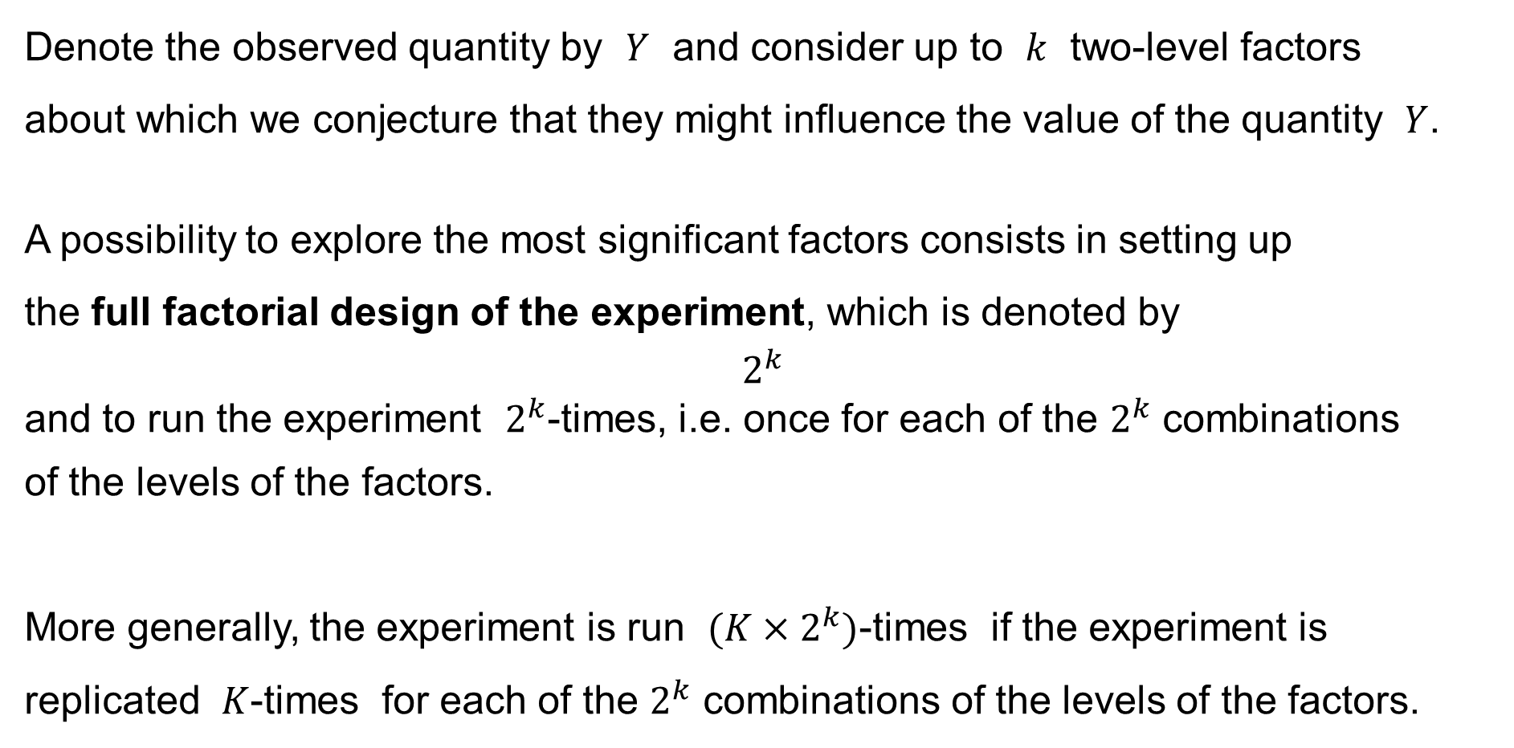
Fractional Factorial Design: Motivation & Introduction
Denote the observed quantity by $Y$ and consider up to $k$ two-level factors
about which we conjecture that they might influence the value of the quantity $Y$.
A possibility to explore the most significant factors consists in setting up
the full factorial design of the experiment, which is denoted by
$$2^{k}$$
and to run the experiment $2^{k}$-times, i.e. once for each of the $2^{k}$ combinations
of the levels of the factors.
More generally, the experiment is run $(K×2^{k})$-times if the experiment is replicated $K$-times for each of the $2^{k}$ combinations of the levels of the factors.

Slide 5
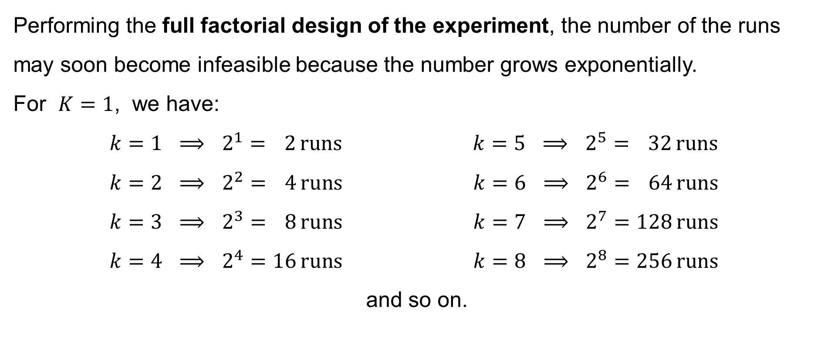
Fractional Factorial Design: Motivation & Introduction
Performing the full factorial design of the experiment, the number of the runs may soon become infeasible because the number grows exponentially.
For $K=1$, we have:
$$k=1 ⟹ 2^{1}= 2 \text{runs} k=5 ⟹ 2^{5}= 32 \text{runs} \\ k=2 ⟹ 2^{2}= 4 \text{runs} k=6 ⟹ 2^{6}= 64 \text{runs} \\ k=3 ⟹ 2^{3}= 8 \text{runs} k=7 ⟹ 2^{7}=128 \text{runs} \\ k=4 ⟹ 2^{4}=16 \text{runs} k=8 ⟹ 2^{8}=256 \text{runs}$$
.and so on.

Slide 6
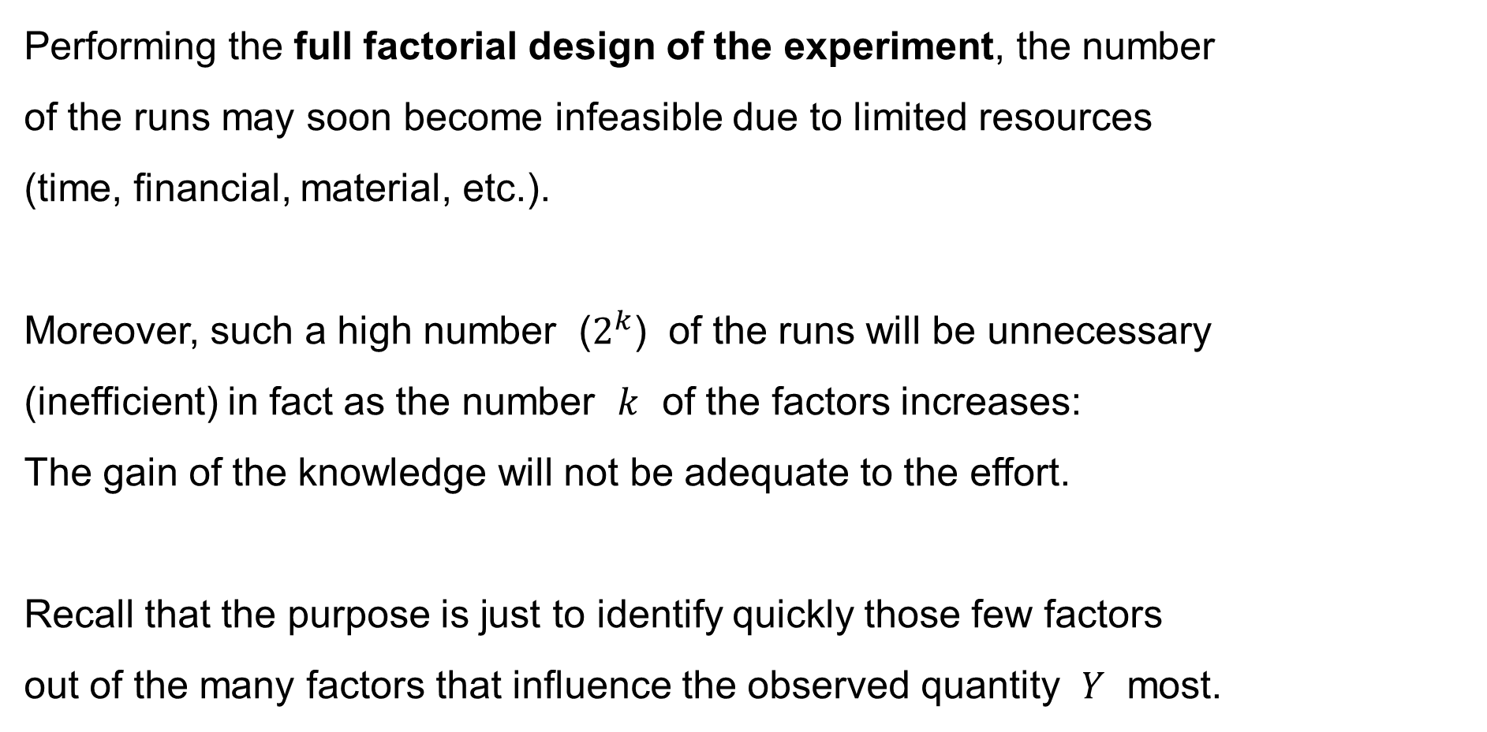
Fractional Factorial Design: Motivation & Introduction
Performing the full factorial design of the experiment, the number
of the runs may soon become infeasible due to limited resources
(time, financial, material, etc.).
Moreover, such a high number ($2^{k}$) of the runs will be unnecessary
(inefficient) in fact as the number $k$ of the factors increases:
The gain of the knowledge will not be adequate to the effort.
Recall that the purpose is just to identify quickly those few factors
out of the many factors that influence the observed quantity $Y$ most.

Slide 7
Fractional Factorial Design: Motivation & Introduction
We actually assume the following three principles:
Hierarchical Ordering Principle
— effects of lower orders are more likely to be important than
effects of higher orders; and
— effects of the same order are equally likely to be important
Effect Sparsity Principle (Pareto Principle)
— the number of relatively important effects in a factorial experiment is small
Effect Heredity Principle
— if an interaction is significant,
then at least one of its parent factors is significant

Slide 8
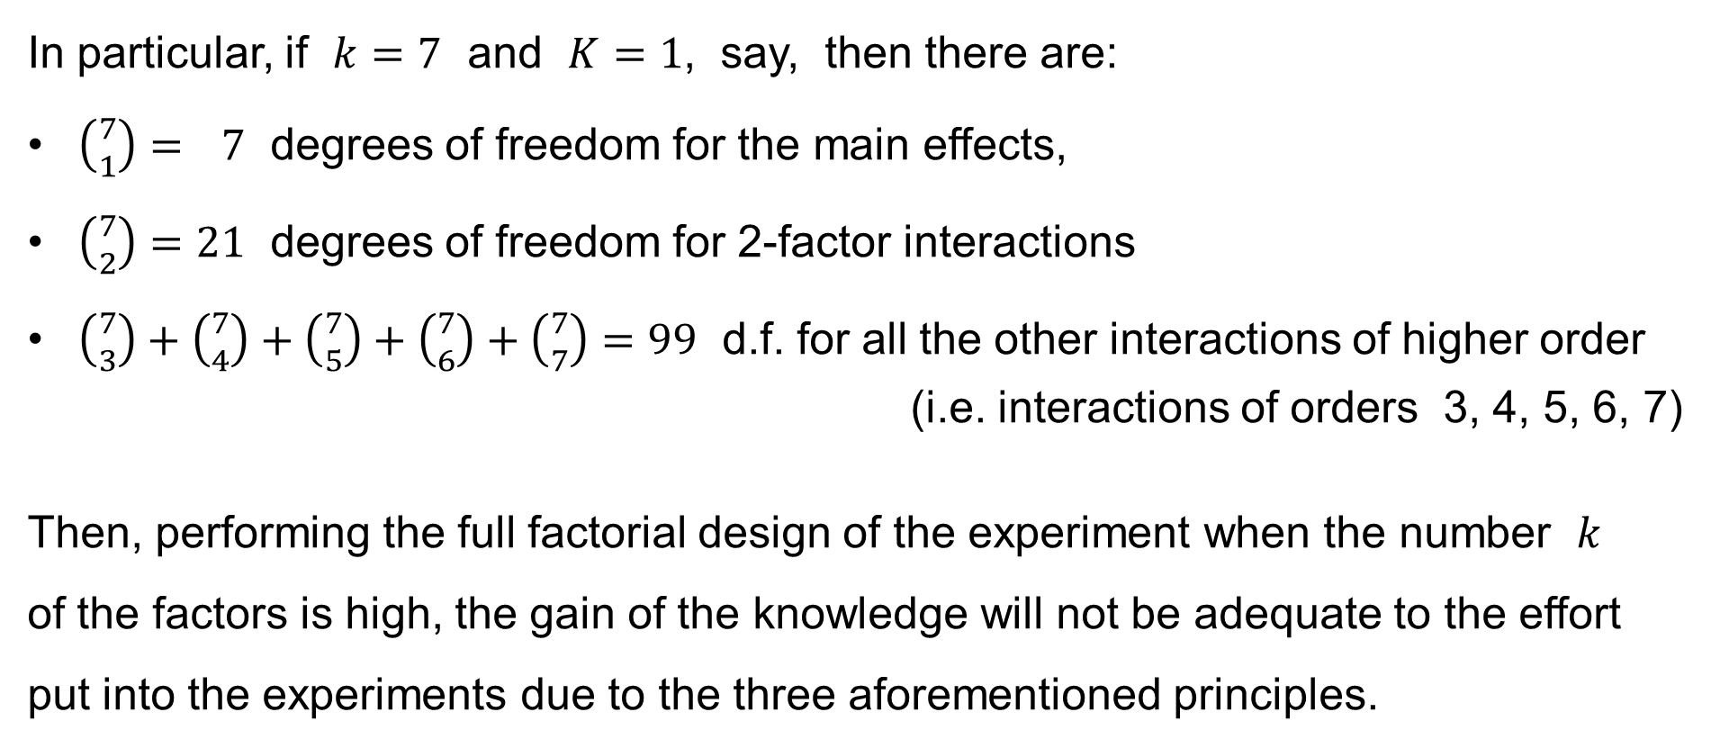
Fractional Factorial Design: Motivation & Introduction
In particular, if $k=7$ and $K=1$, say, then there are:
$\left({7 \atop 1}\right)= 7$ degrees of freedom for the main effects,
$\left({7 \atop 2}\right)=21$ degrees of freedom for 2-factor interactions
$\left({7 \atop 3}\right)+\left({7 \atop 4}\right)+\left({7 \atop 5}\right)+\left({7 \atop 6}\right)+\left({7 \atop 7}\right)=99$ d.f. for all the other interactions of higher order
(i.e. interactions of orders 3, 4, 5, 6, 7)
Then, performing the full factorial design of the experiment when the number $k$
of the factors is high, the gain of the knowledge will not be adequate to the effort put into the experiments due to the three aforementioned principles.

Slide 9
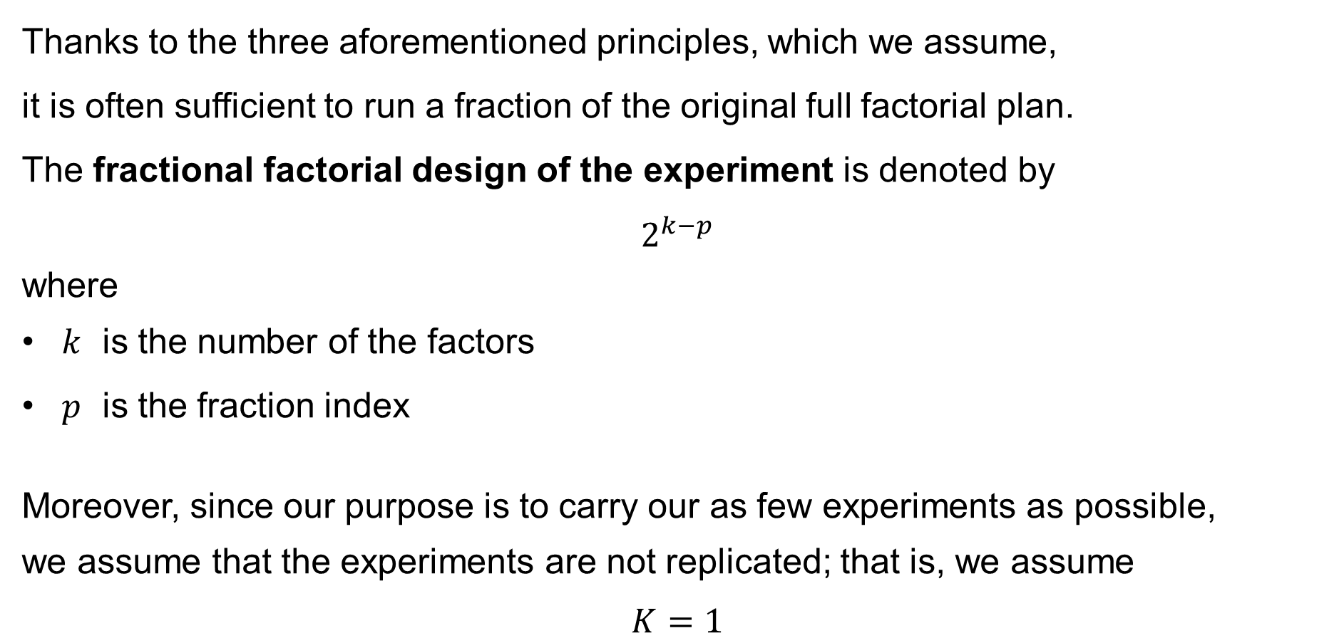
Fractional Factorial Design: Motivation & Introduction
Thanks to the three aforementioned principles, which we assume,
it is often sufficient to run a fraction of the original full factorial plan.
The fractional factorial design of the experiment is denoted by
$$2^{k−p}$$
where
$k$ is the number of the factors
$p$ is the fraction index
Moreover, since our purpose is to carry our as few experiments as possible,
we assume that the experiments are not replicated; that is, we assume
$$K=1$$

Slide 10
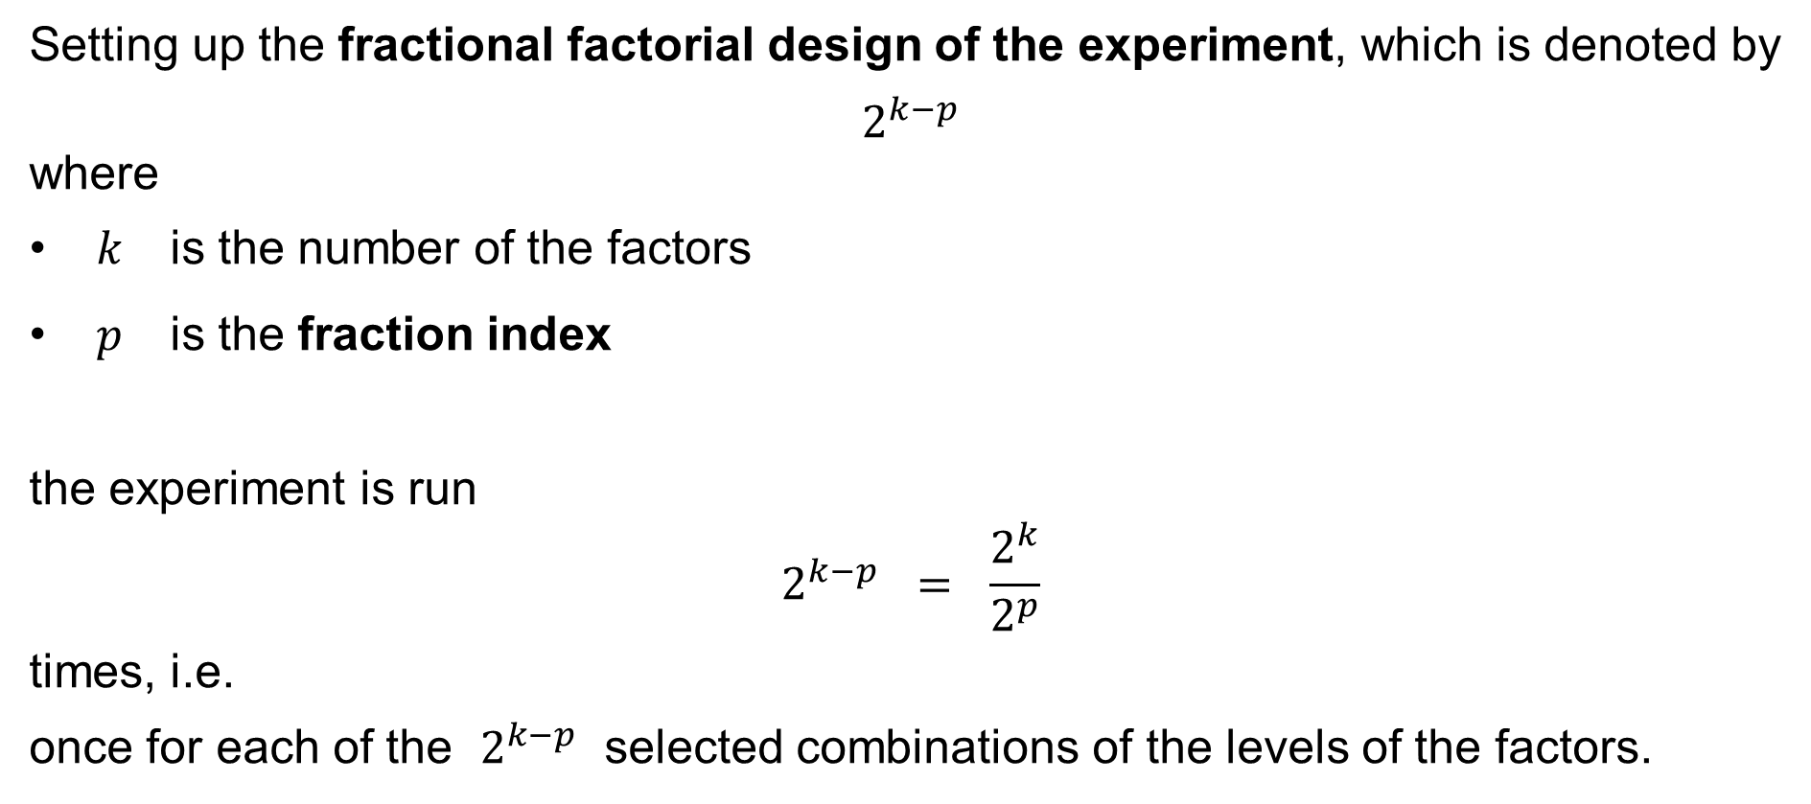
Fractional Factorial Design: Motivation & Introduction
Setting up the fractional factorial design of the experiment, which is denoted by
$$2^{k−p}$$
where
$k$ is the number of the factors
$p$ is the fraction index
the experiment is run
$$2^{k−p} = \frac{2^{k}}{2^{p}}$$
times, i.e.
once for each of the $2^{k−p}$ selected combinations of the levels of the factors.

Slide 11
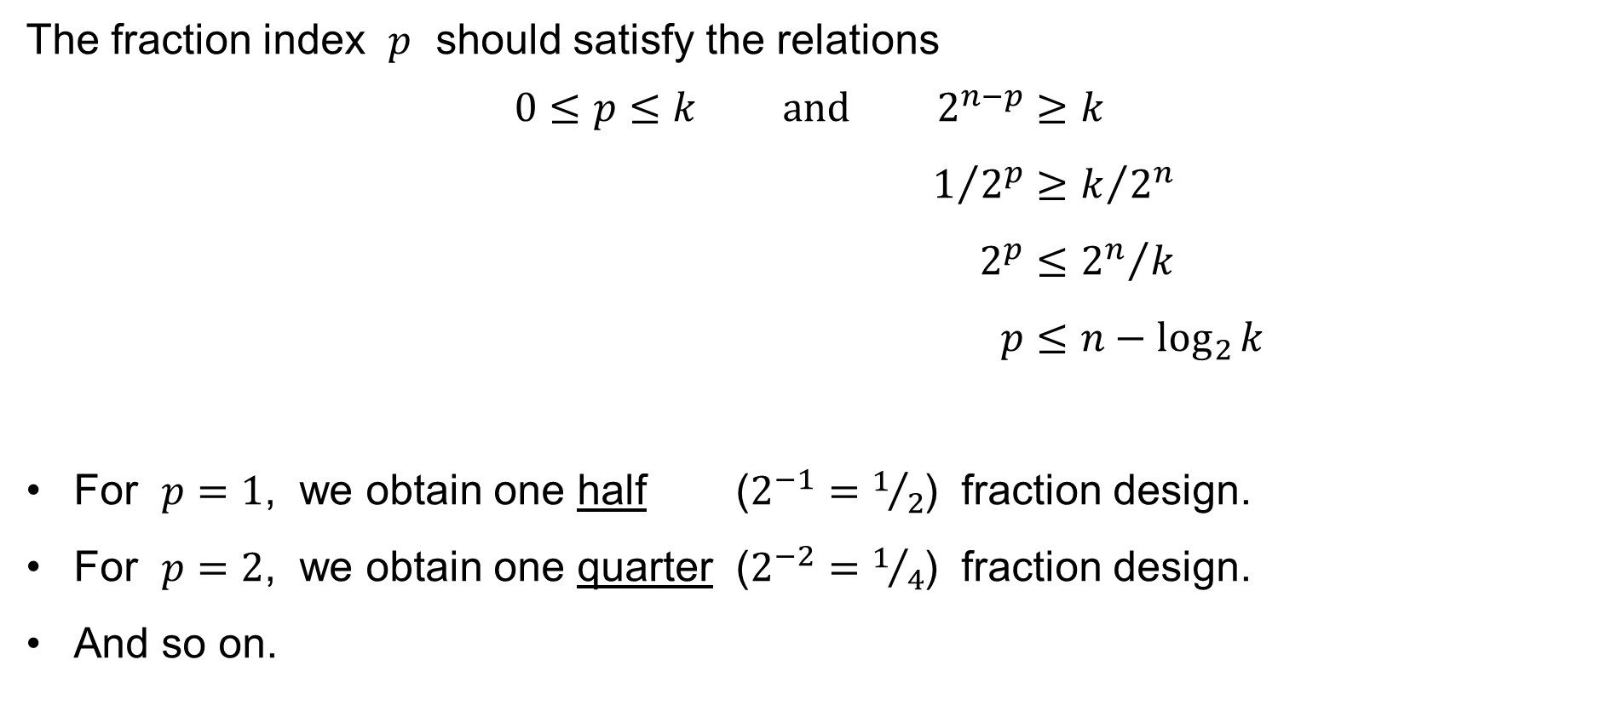
Fractional Factorial Design: Motivation & Introduction
The fraction index $p$ should satisfy the relations
$$0≤p≤k \text{and} 2^{n−p}≥k \\ 1/{2^{p}}≥k/{2^{n}} \\ 2^{p}≤{2^{n}}/k \\ p≤n−\log_{2}{k}$$
For $p=1$, we obtain one half ($2^{−1}=1/2$) fraction design.
For $p=2$, we obtain one quarter ($2^{−2}=1/4$) fraction design.
And so on.

Slide 12
One half (½) fraction design

Slide 13
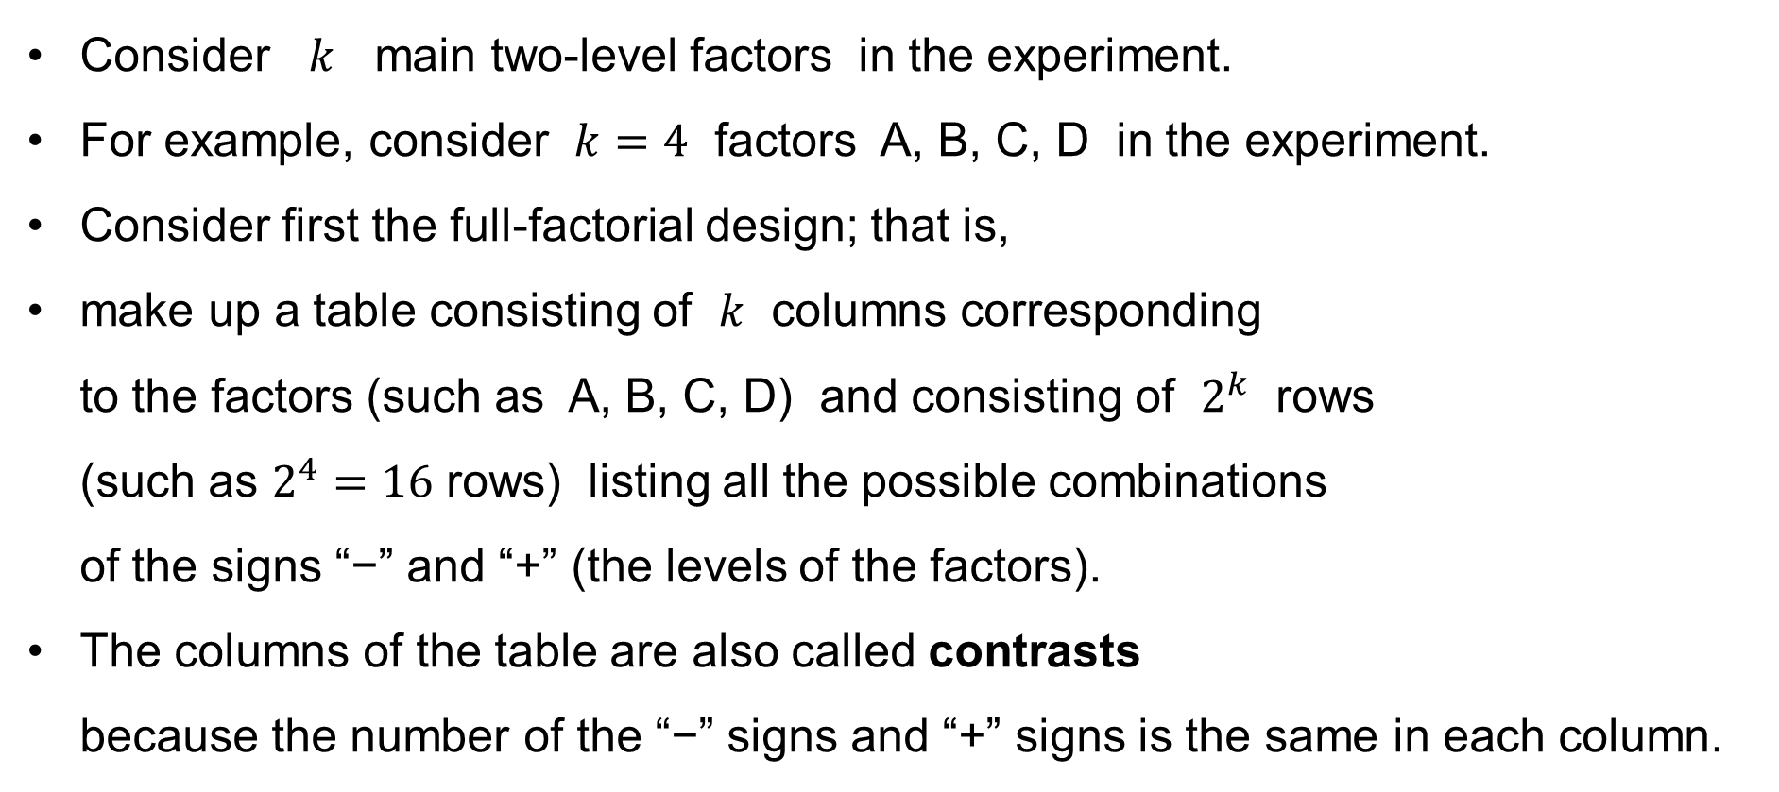
½ fraction design
Consider $k$ main two-level factors in the experiment.
For example, consider $k=4$ factors A, B, C, D in the experiment.
Consider first the full-factorial design; that is,
make up a table consisting of $k$ columns corresponding
to the factors (such as A, B, C, D) and consisting of $2^{k}$ rows
(such as $2^{4}=16$ rows) listing all the possible combinations
of the signs “−” and “+” (the levels of the factors).
The columns of the table are also called contrasts
because the number of the “−” signs and “+” signs is the same in each column.

Slide 14
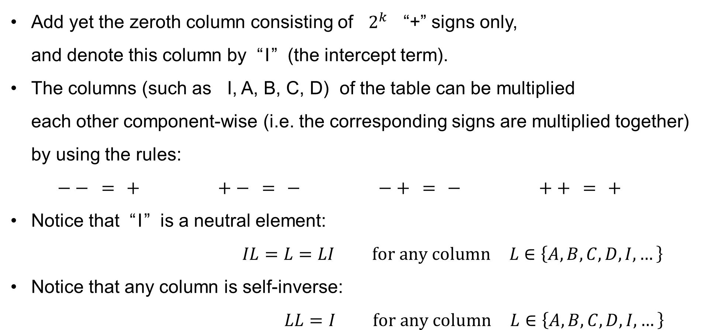
½ fraction design
Add yet the zeroth column consisting of $2^{k}$ “+” signs only,
and denote this column by “ I ” (the intercept term).
The columns (such as I, A, B, C, D) of the table can be multiplied
each other component-wise (i.e. the corresponding signs are multiplied together) by using the rules:
$−− = + +− = − −+ = − ++ = +$
Notice that “ I ” is a neutral element:
$IL=L=LI \text{for} \text{any} \text{column} L∈\left\{A,B,C,D,I,…\right\}$
Notice that any column is self-inverse:
$LL=I \text{for} \text{any} \text{column} L∈\left\{A,B,C,D,I,…\right\}$

Slide 15
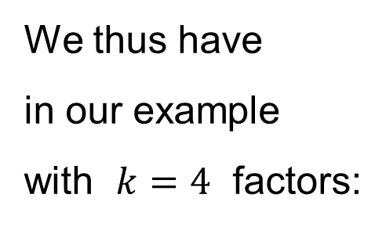
Full design
We thus have
in our example
with $k=4$ factors:
No. | A | B | C | D
1 | − | − | − | −
2 | + | − | − | −
3 | − | + | − | −
4 | + | + | − | −
5 | − | − | + | −
6 | + | − | + | −
7 | − | + | + | −
8 | + | + | + | −
9 | − | − | − | +
10 | + | − | − | +
11 | − | + | − | +
12 | + | + | − | +
13 | − | − | + | +
14 | + | − | + | +
15 | − | + | + | +
16 | + | + | + | +

Slide 16
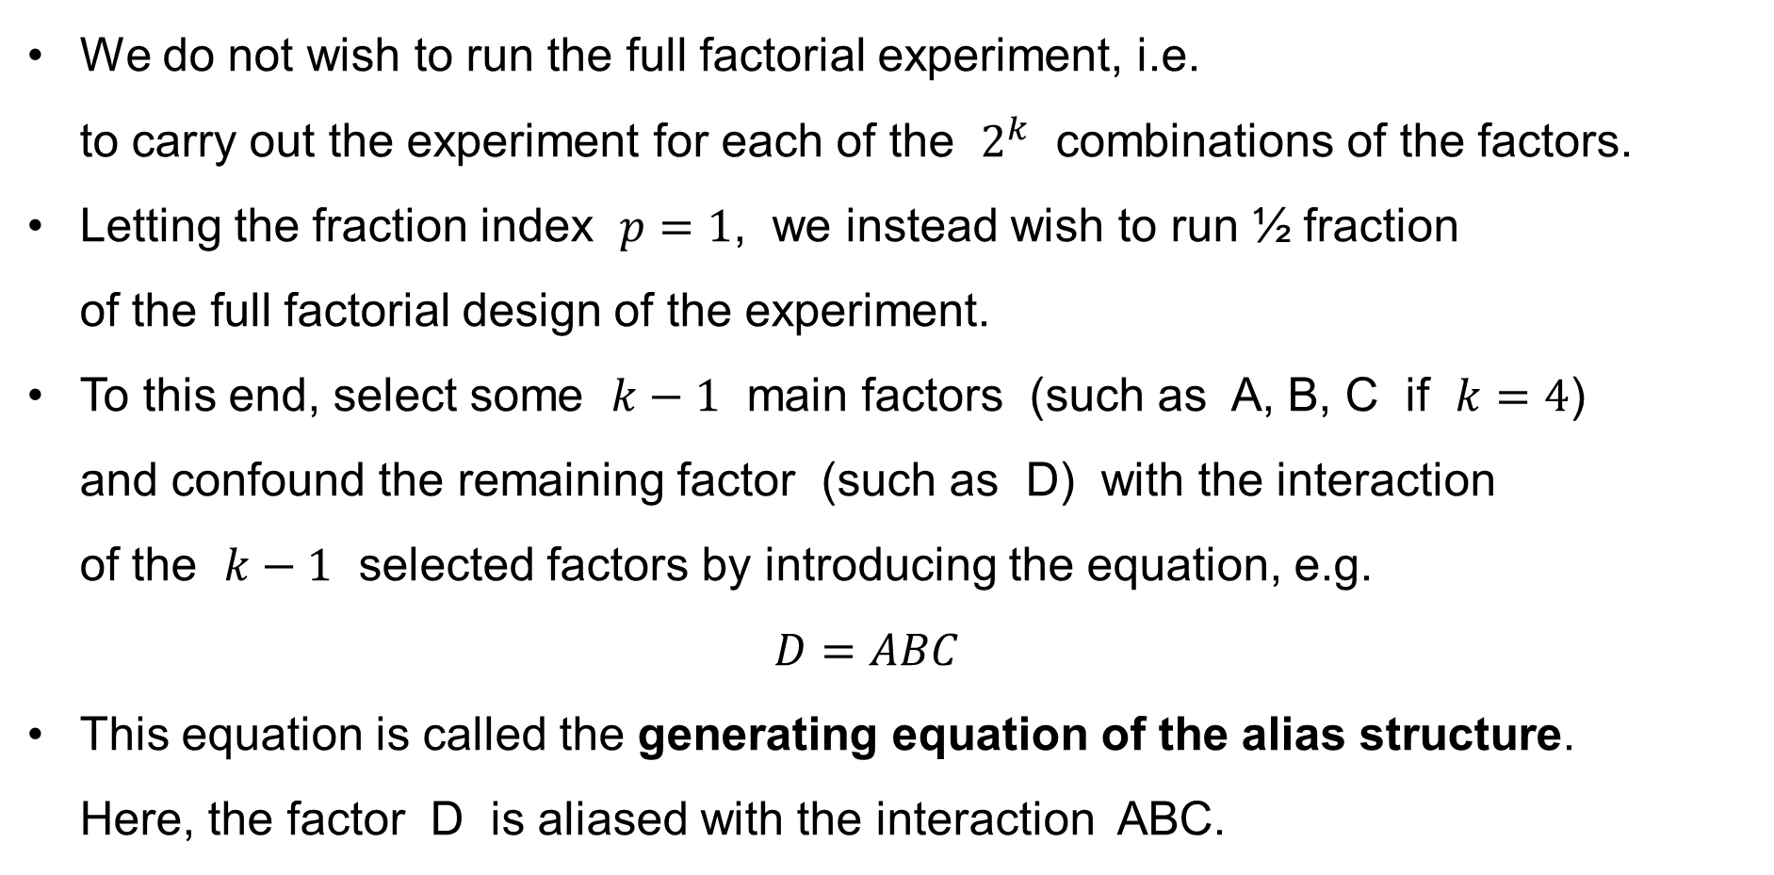
½ fraction design
We do not wish to run the full factorial experiment, i.e.
to carry out the experiment for each of the $2^{k}$ combinations of the factors.
Letting the fraction index $p=1$, we instead wish to run ½ fraction
of the full factorial design of the experiment.
To this end, select some $k−1$ main factors (such as A, B, C if $k=4$)
and confound the remaining factor (such as D) with the interaction
of the $k−1$ selected factors by introducing the equation, e.g.
$D=ABC$
This equation is called the generating equation of the alias structure.
Here, the factor D is aliased with the interaction ABC.

Slide 17
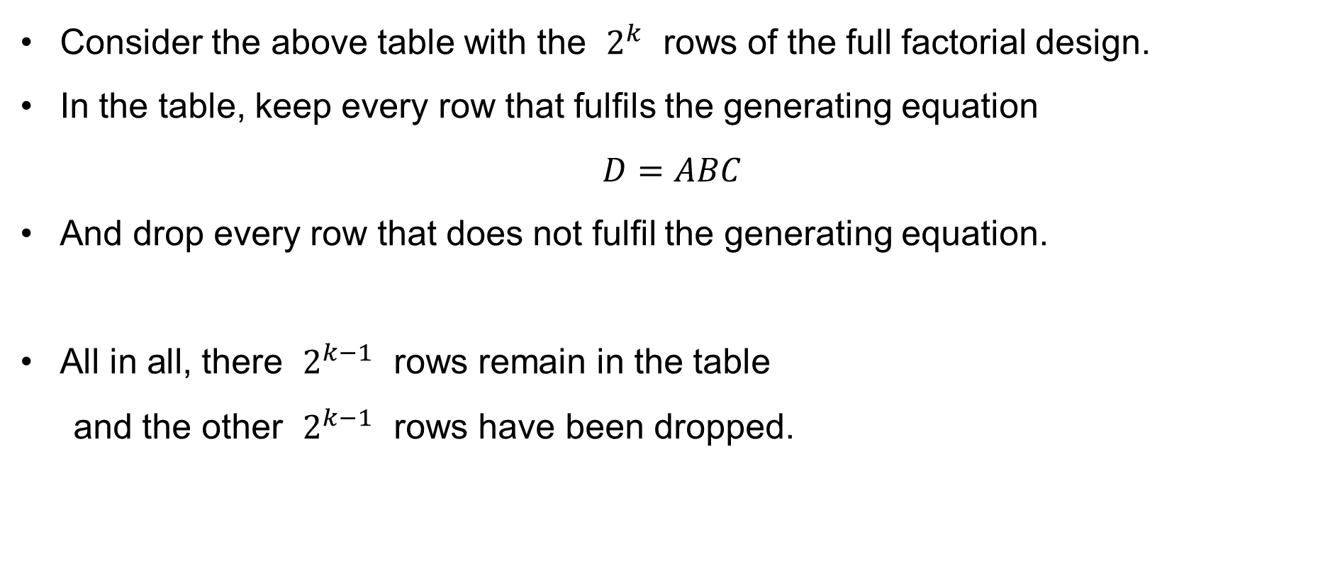
½ fraction design
Consider the above table with the $2^{k}$ rows of the full factorial design.
In the table, keep every row that fulfils the generating equation
$D=ABC$
And drop every row that does not fulfil the generating equation.
All in all, there $2^{k−1}$ rows remain in the table
and the other $2^{k−1}$ rows have been dropped.

Slide 18
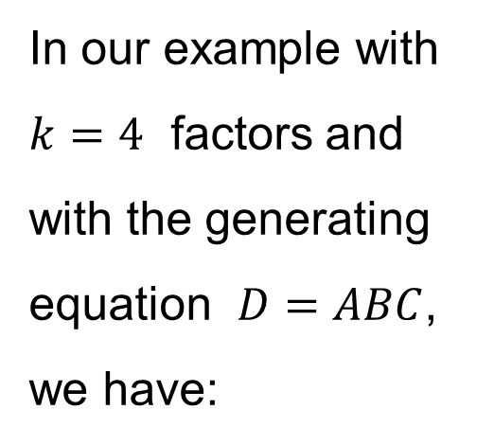
½ fraction design
In our example with
$k=4$ factors and
with the generating
equation $D=ABC$,
we have:
No. | A | B | C | D = ABC
1 | − | − | − | −
2 | + | − | − | +
3 | − | + | − | +
4 | + | + | − | −
5 | − | − | + | +
6 | + | − | + | −
7 | − | + | + | −
8 | + | + | + | +

Slide 19
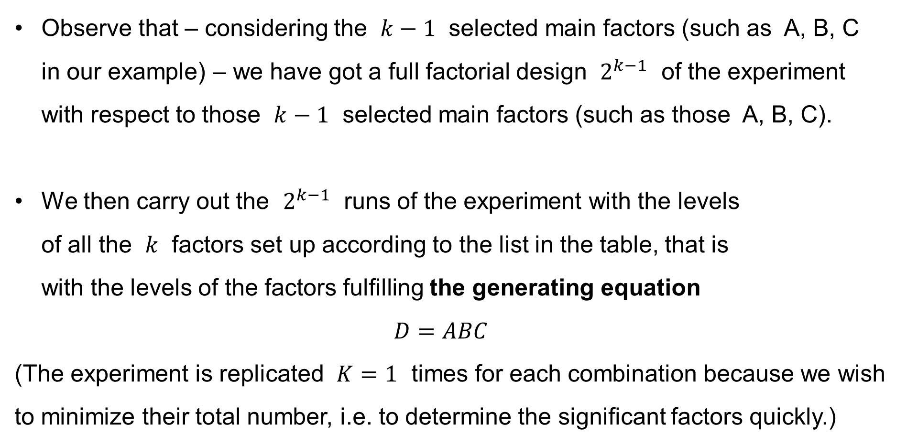
½ fraction design
Observe that – considering the $k−1$ selected main factors (such as A, B, C
in our example) – we have got a full factorial design $2^{k−1}$ of the experiment with respect to those $k−1$ selected main factors (such as those A, B, C).
We then carry out the $2^{k−1}$ runs of the experiment with the levels
of all the $k$ factors set up according to the list in the table, that is
with the levels of the factors fulfilling the generating equation
$D=ABC$
(The experiment is replicated $K=1$ times for each combination because we wish to minimize their total number, i.e. to determine the significant factors quickly.)

Slide 20
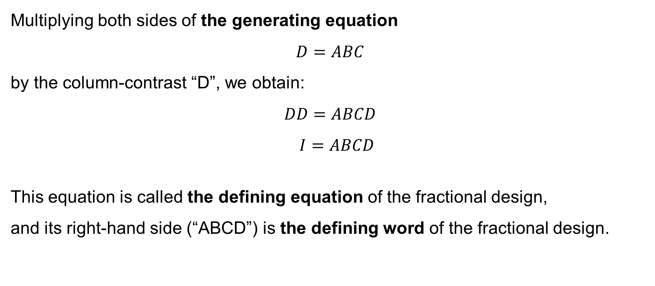
½ fraction design
Multiplying both sides of the generating equation
$$D=ABC$$
by the column-contrast “D”, we obtain:
$$DD=ABCD \\ I=ABCD$$
This equation is called the defining equation of the fractional design,
and its right-hand side (“ABCD”) is the defining word of the fractional design.

Slide 21

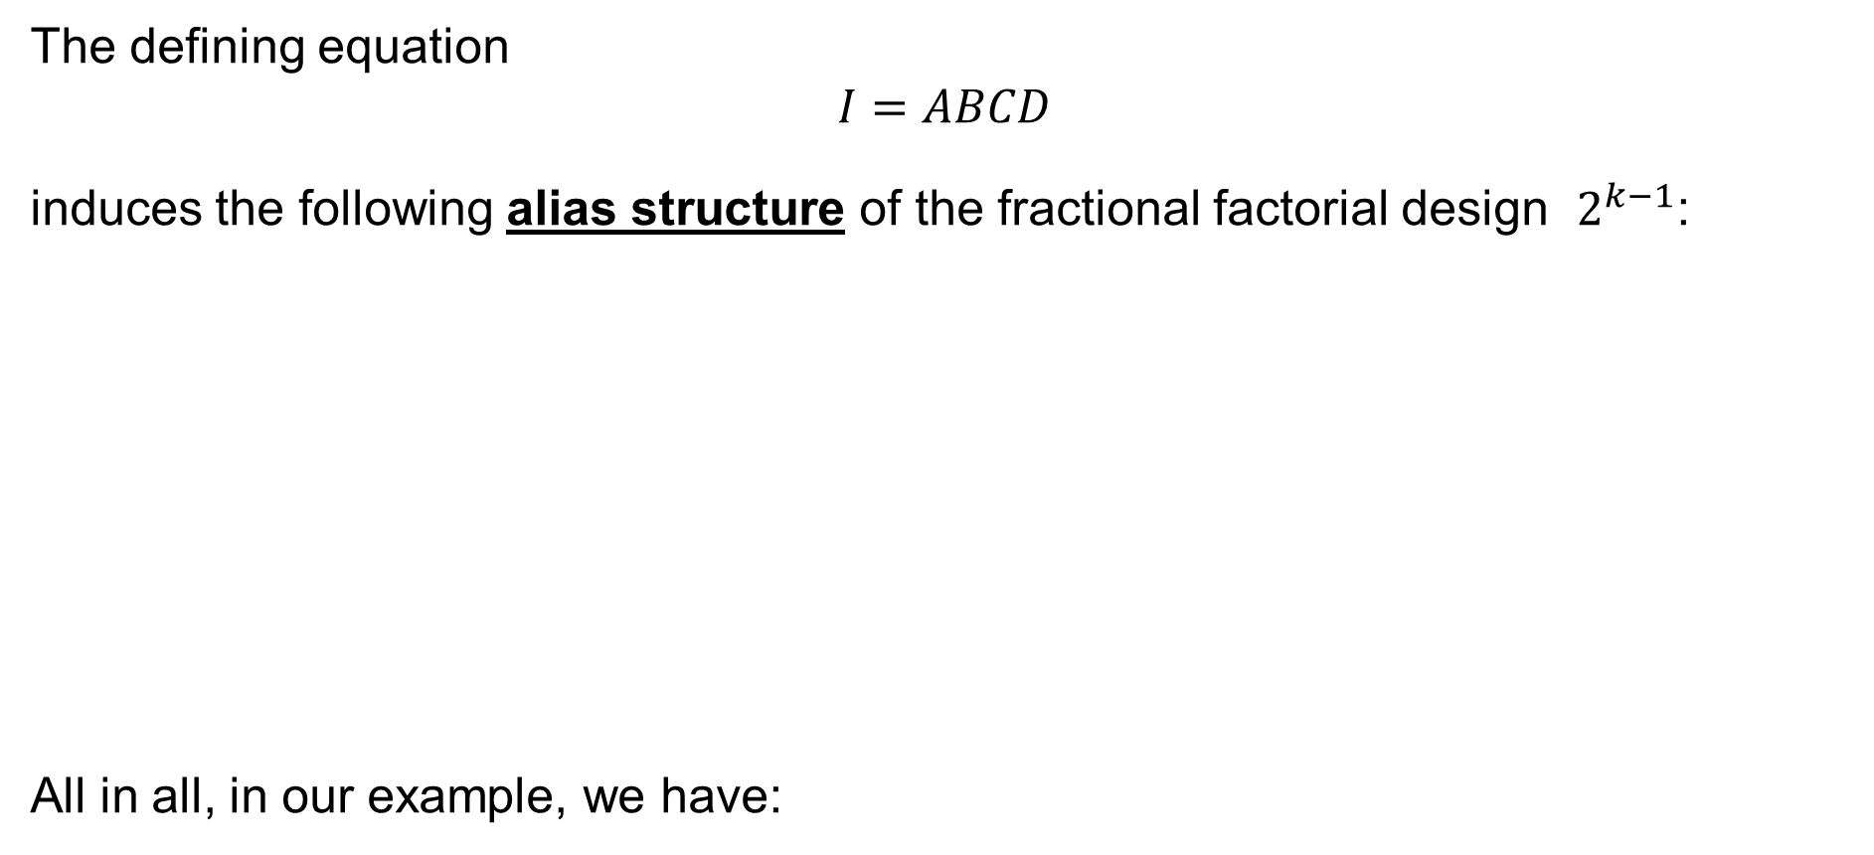


½ fraction design
The defining equation
$$I=ABCD$$
induces the following alias structure of the fractional factorial design $2^{k−1}$:
All in all, in our example, we have:
$$I=ABCD$$
$$A=BCD \\ B=ACD \\ C=ABD \\ D=ABC$$
$$AB=CD \\ AC=BD \\ AD=BC$$

Slide 22
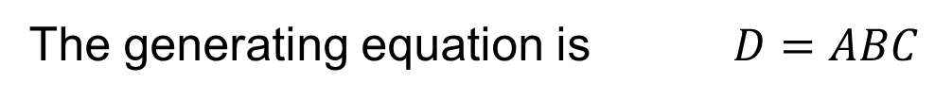
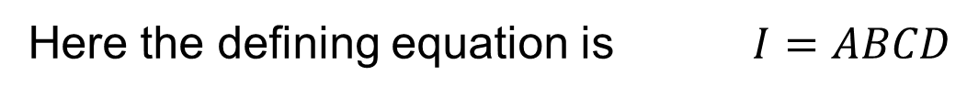
½ fraction design
Here the defining equation is $I=ABCD$
No. | I = ABCD | A = BCD | B = ACD | C = ABD | AB = CD | AC = BD | BC = AD | ABC = D
1 | + | − | − | − | + | + | + | −
2 | + | + | − | − | − | − | + | +
3 | + | − | + | − | − | + | − | +
4 | + | + | + | − | + | − | − | −
5 | + | − | − | + | + | − | − | +
6 | + | + | − | + | − | + | − | −
7 | + | − | + | + | − | − | + | −
8 | + | + | + | + | + | + | + | +
The generating equation is $D=ABC$

Slide 23
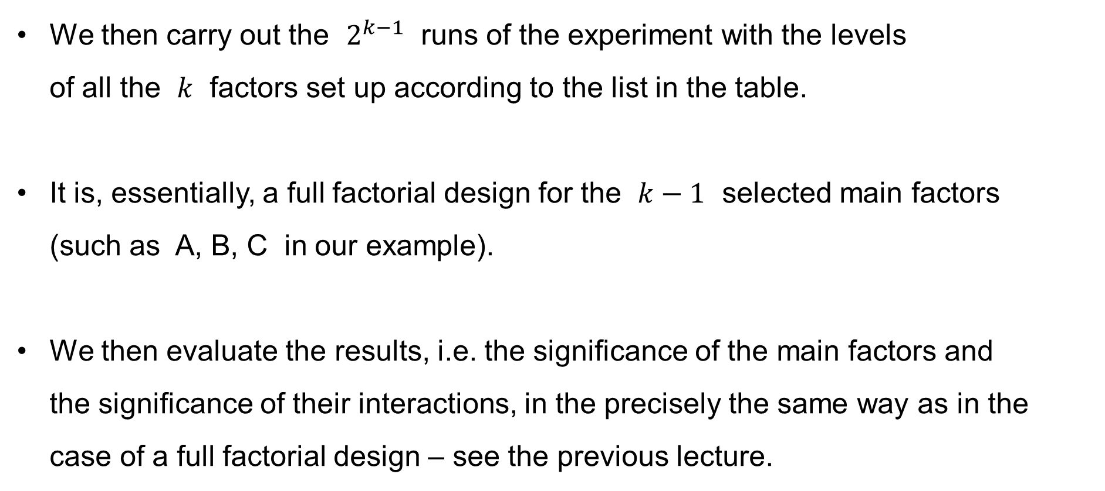
½ fraction design
We then carry out the $2^{k−1}$ runs of the experiment with the levels
of all the $k$ factors set up according to the list in the table.
It is, essentially, a full factorial design for the $k−1$ selected main factors
(such as A, B, C in our example).
We then evaluate the results, i.e. the significance of the main factors and
the significance of their interactions, in the precisely the same way as in the case of a full factorial design – see the previous lecture.

Slide 24

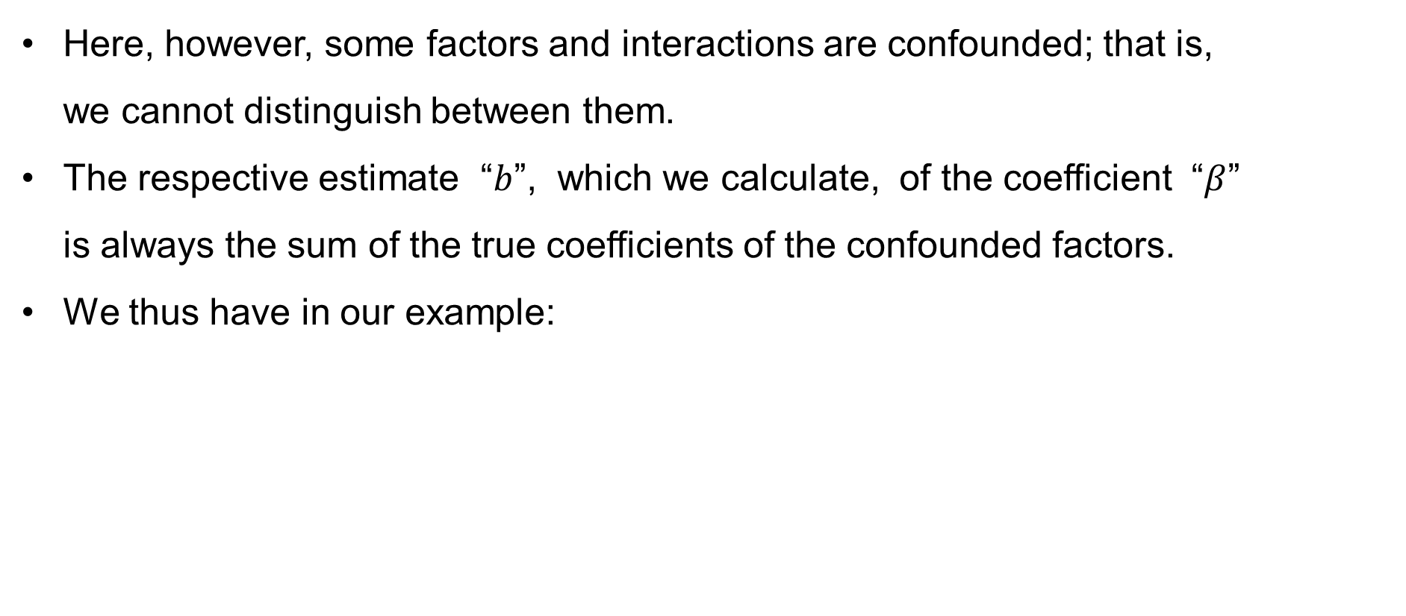

½ fraction design
Here, however, some factors and interactions are confounded; that is,
we cannot distinguish between them.
The respective estimate “$b$”, which we calculate, of the coefficient “$β$”
is always the sum of the true coefficients of the confounded factors.
We thus have in our example:
$$I=ABCD ⟶ I+ABCD$$
$$A=BCD ⟶ A+BCD$$
$$B=ACD ⟶ B+ACD$$
$$C=ABD ⟶ C+ABD$$
$$D=ABC ⟶ D+ABC$$
$$AB=CD ⟶ AB+CD$$
$$AC=BD ⟶ AC+BD$$
$$AD=BC ⟶ AD+BC$$

Slide 25
½ fraction design
Here the generating equation is $D=ABC$
No. | I + ABCD | A + BCD | B + ACD | C + ABD | AB + CD | AC + BD | BC + AD | ABC + D
1 | + | − | − | − | + | + | + | −
2 | + | + | − | − | − | − | + | +
3 | + | − | + | − | − | + | − | +
4 | + | + | + | − | + | − | − | −
5 | + | − | − | + | + | − | − | +
6 | + | + | − | + | − | + | − | −
7 | + | − | + | + | − | − | + | −
8 | + | + | + | + | + | + | + | +
We then use the three aforementioned principles
to decide which factors and interactions are significant.

Slide 26
Fractional Factorial Design: The Three Principles
We assume the following three principles:
Hierarchical Ordering Principle
— effects of lower orders are more likely to be important than
effects of higher orders; and
— effects of the same order are equally likely to be important
Effect Sparsity Principle (Pareto Principle)
— the number of relatively important effects in a factorial experiment is small
Effect Heredity Principle
— if an interaction is significant,
then at least one of its parent factors is significant

Slide 27

½ fraction design: Remarks
We used the defining equation
$I=ABCD$
in our example above.
We could use the defining equation
$I=−ABCD$
equally well.

Slide 28

½ fraction design: Remarks
We used the defining equation
$I=ABCD$
in our example above.
We could also use
$C=AB I=ABC$
but the design would not be so good.

Slide 29
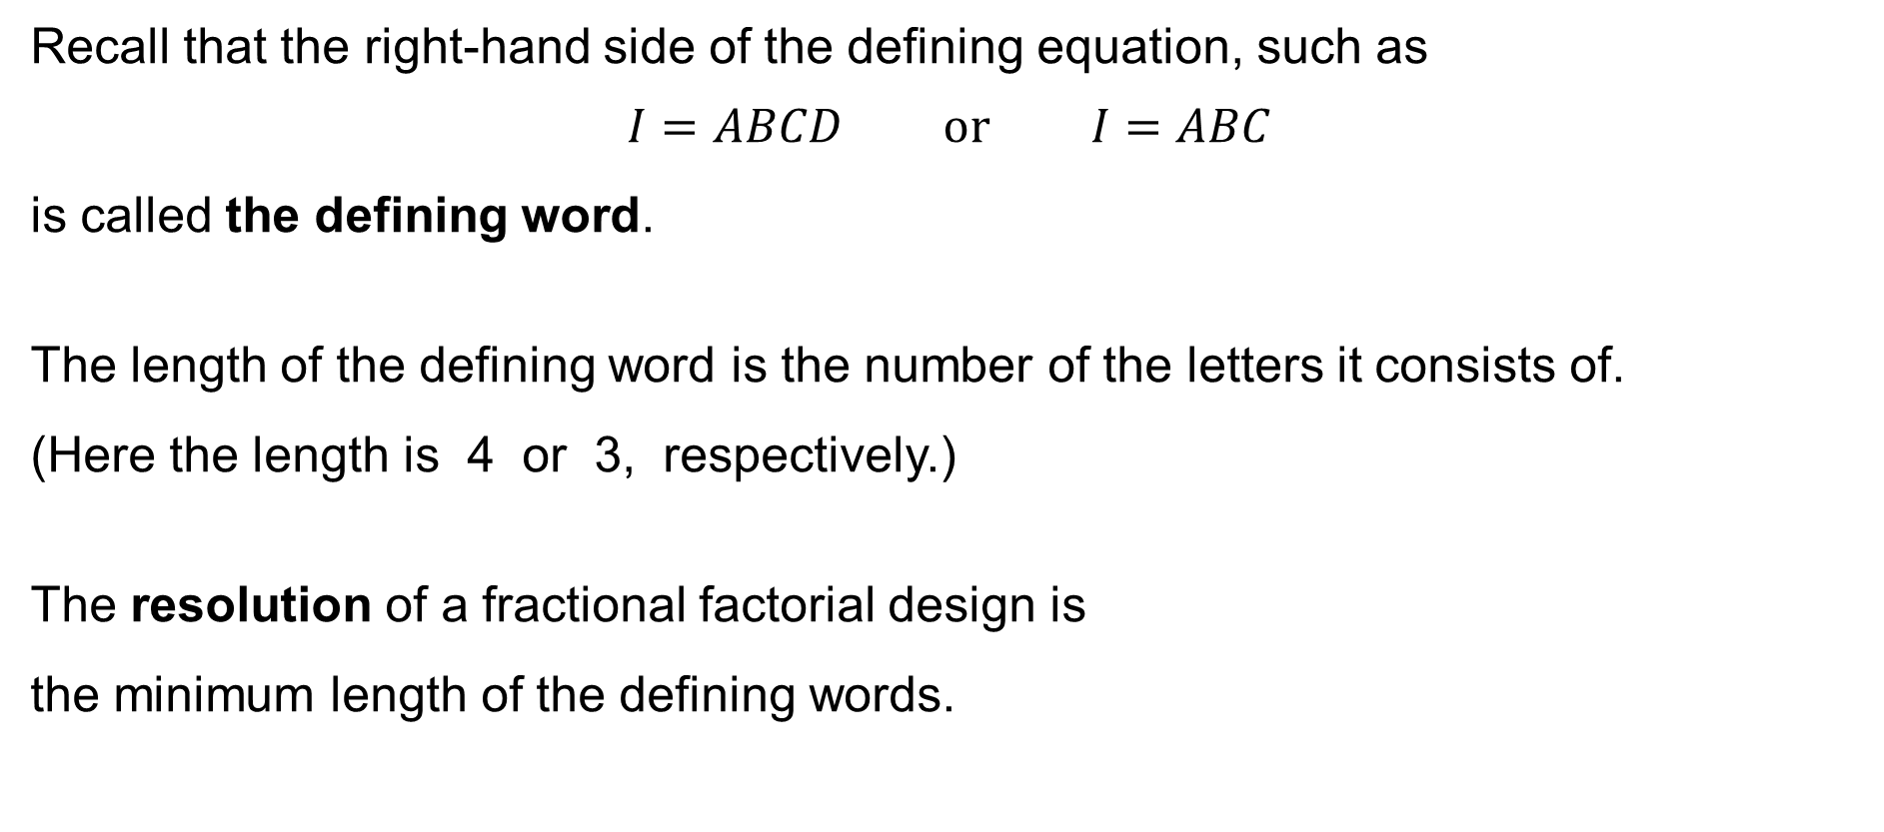
Fractional Factorial Design: Resolution of the design
Recall that the right-hand side of the defining equation, such as
$$I=ABCD \text{or} I=ABC$$
is called the defining word.
The length of the defining word is the number of the letters it consists of.
(Here the length is 4 or 3, respectively.)
The resolution of a fractional factorial design is
the minimum length of the defining words.

Slide 30
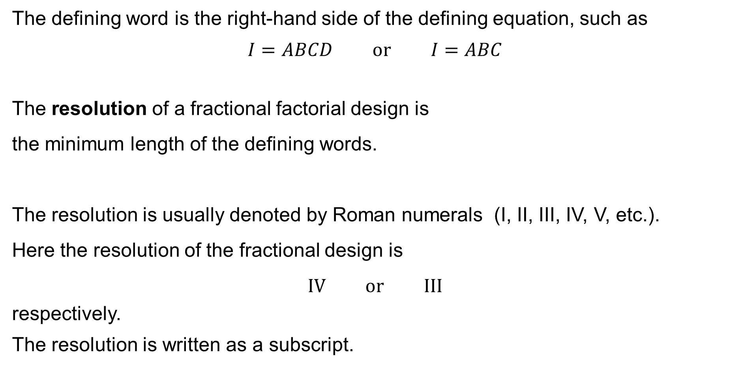
Fractional Factorial Design: Resolution of the design
The defining word is the right-hand side of the defining equation, such as
$$I=ABCD \text{or} I=ABC$$
The resolution of a fractional factorial design is
the minimum length of the defining words.
The resolution is usually denoted by Roman numerals (I, II, III, IV, V, etc.).
Here the resolution of the fractional design is
$$IV \text{or} III$$
respectively.
The resolution is written as a subscript.

Slide 31

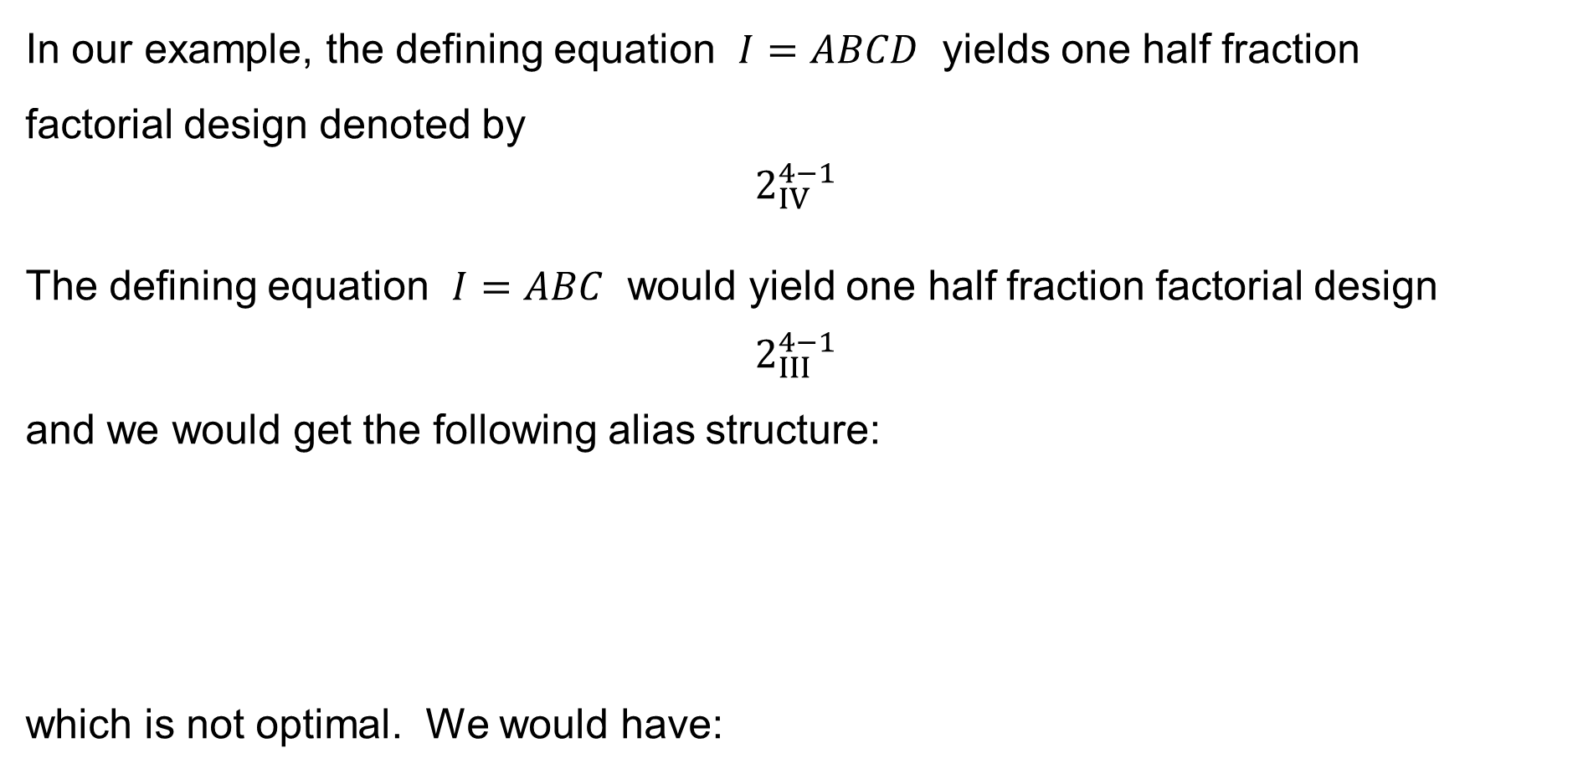

Fractional Factorial Design: Resolution of the design
In our example, the defining equation $I=ABCD$ yields one half fraction
factorial design denoted by
$$2_{IV}^{4−1}$$
The defining equation $I=ABC$ would yield one half fraction factorial design
$$2_{III}^{4−1}$$
and we would get the following alias structure:
which is not optimal. We would have:
$$I=ABC$$
$$A=BC \\ B=AC \\ C=AB$$

Slide 32
Fractional Factorial Design: Resolution of the design
Here the generating equation is $C=AB$
No. | I = ABC | A = BC | B = AC | D = ABCD | C = AB | AD = BCD | BD = ACD | CD = ABD
1 | + | − | − | − | + | + | + | −
2 | + | + | − | − | − | − | + | +
3 | + | − | + | − | − | + | − | +
4 | + | + | + | − | + | − | − | −
5 | + | − | − | + | + | − | − | +
6 | + | + | − | + | − | + | − | −
7 | + | − | + | + | − | − | + | −
8 | + | + | + | + | + | + | + | +
Here the interactions of the 2nd order are confounded with
the main factors as well as with some interactions of the 3rd order.

Slide 33
Fractional Factorial Design: Resolution of the design
Maximal Resolution Principle:
The higher the resolution is
the better the fractional factorial design is.

Slide 34
One quarter (¼) fraction design

Slide 35
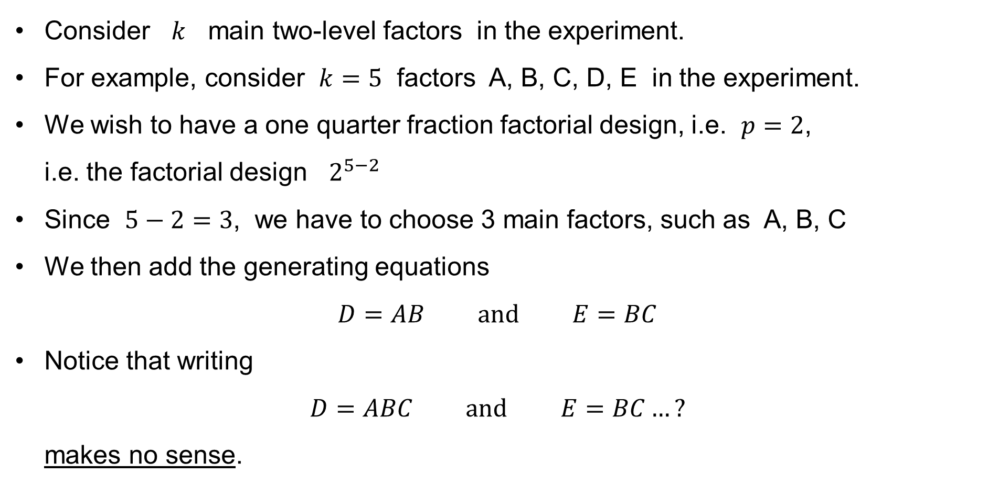
¼ fraction design
Consider $k$ main two-level factors in the experiment.
For example, consider $k=5$ factors A, B, C, D, E in the experiment.
We wish to have a one quarter fraction factorial design, i.e. $p=2$,
i.e. the factorial design $2^{5−2}$
Since $5−2=3$, we have to choose 3 main factors, such as A, B, C
We then add the generating equations
$D=AB \text{and} E=BC$
Notice that writing
$D=ABC \text{and} E=BC…?$
makes no sense.

Slide 36
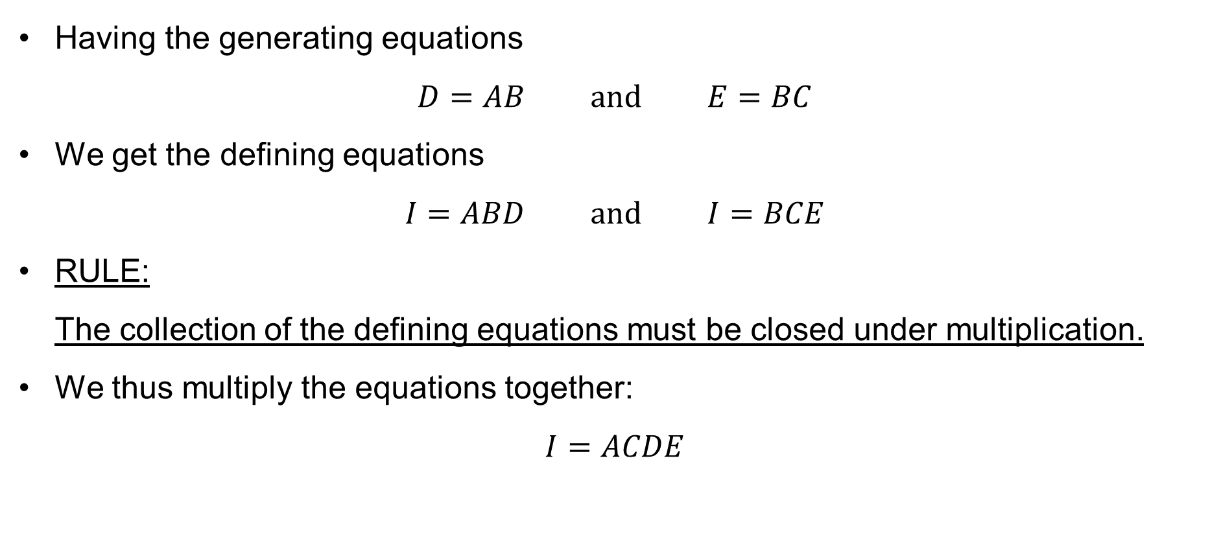
¼ fraction design
Having the generating equations
$D=AB \text{and} E=BC$
We get the defining equations
$I=ABD \text{and} I=BCE$
RULE:
The collection of the defining equations must be closed under multiplication.
We thus multiply the equations together:
$I=ACDE$

Slide 37
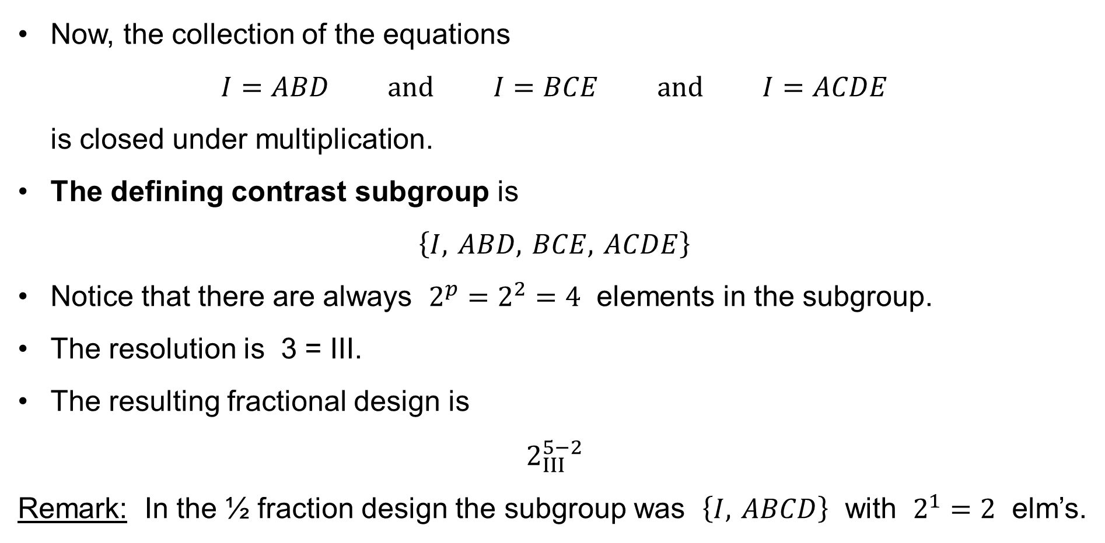
¼ fraction design
Now, the collection of the equations
$I=ABD \text{and} I=BCE \text{and} I=ACDE$
is closed under multiplication.
The defining contrast subgroup is
$\left\{I, ABD, BCE, ACDE\right\}$
Notice that there are always $2^{p}=2^{2}=4$ elements in the subgroup.
The resolution is 3 = III.
The resulting fractional design is
$2_{III}^{5−2}$
Remark: In the ½ fraction design the subgroup was $\left\{I, ABCD\right\}$ with $2^{1}=2$ elm’s.

Slide 38

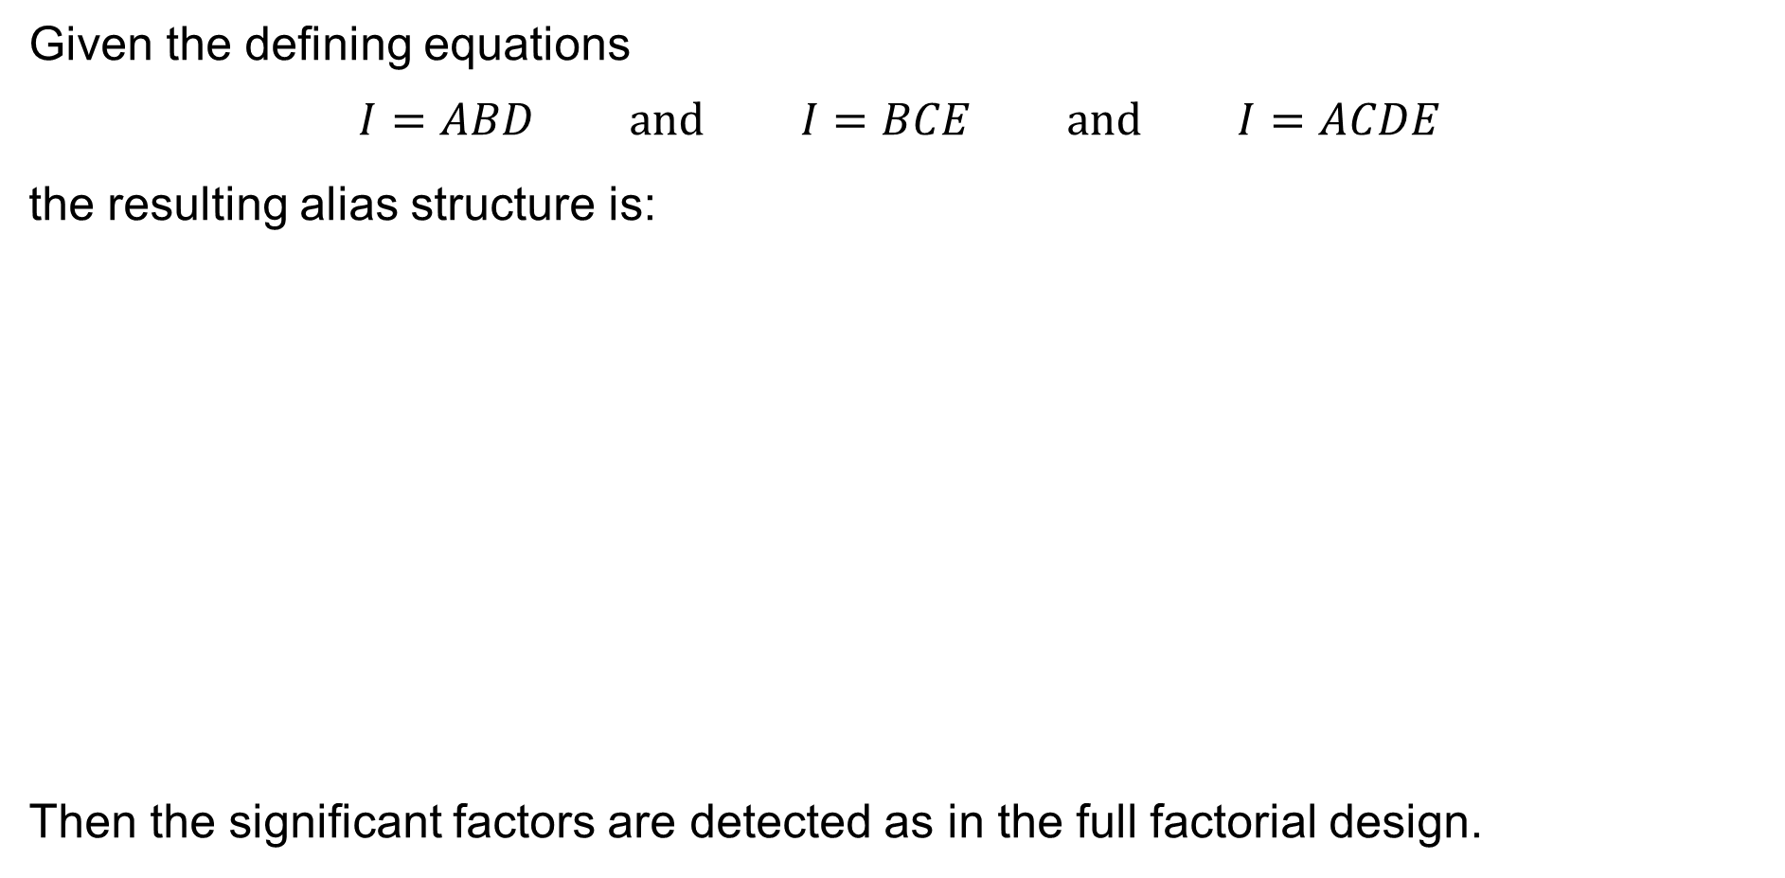

¼ fraction design
Given the defining equations
$$I=ABD \text{and} I=BCE \text{and} I=ACDE$$
the resulting alias structure is:
Then the significant factors are detected as in the full factorial design.
$$I=ABD=BCE=ACDE$$
$$A=BD=ABCE=CDE$$
$$B=AD=CE=ABCDE$$
$$C=ABCD=BE=ADE$$
$$D=AB=BCDE=ACE$$
$$E=ABDE=BC=ACD$$
$$AC=BCD=ABE=DE$$
$$AE=BDE=ABC=CD$$

Slide 39
One eight (⅛) fraction design

Slide 40
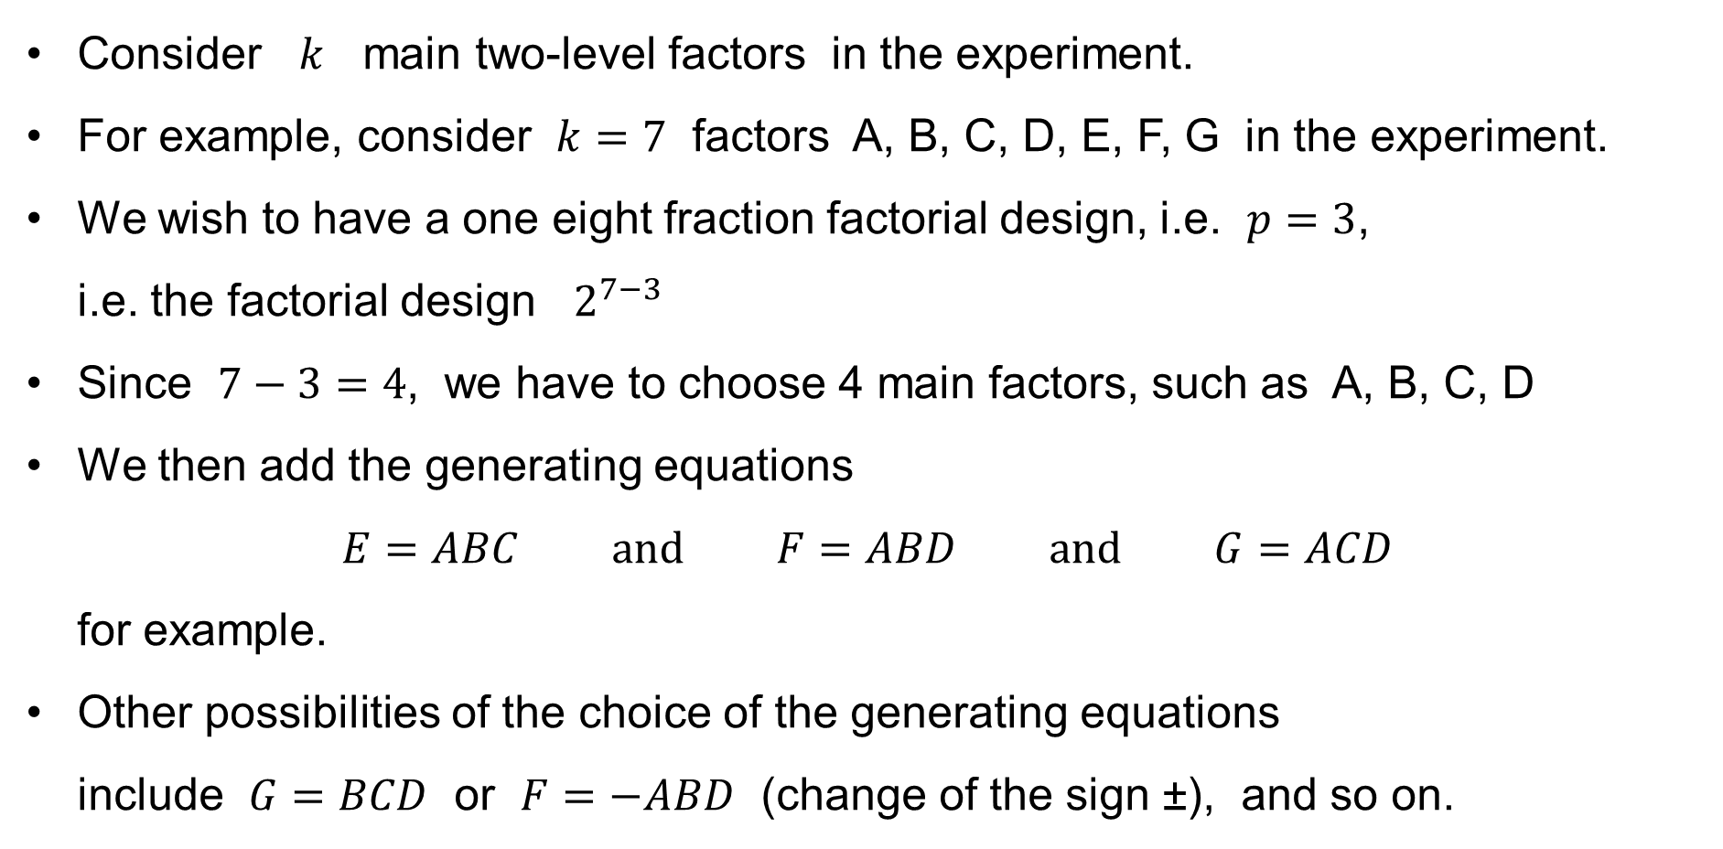
⅛ fraction design
Consider $k$ main two-level factors in the experiment.
For example, consider $k=7$ factors A, B, C, D, E, F, G in the experiment.
We wish to have a one eight fraction factorial design, i.e. $p=3$,
i.e. the factorial design $2^{7−3}$
Since $7−3=4$, we have to choose 4 main factors, such as A, B, C, D
We then add the generating equations
$E=ABC \text{and} F=ABD \text{and} G=ACD$
for example.
Other possibilities of the choice of the generating equations
include $G=BCD$ or $F=−ABD$ (change of the sign ±), and so on.

Slide 41
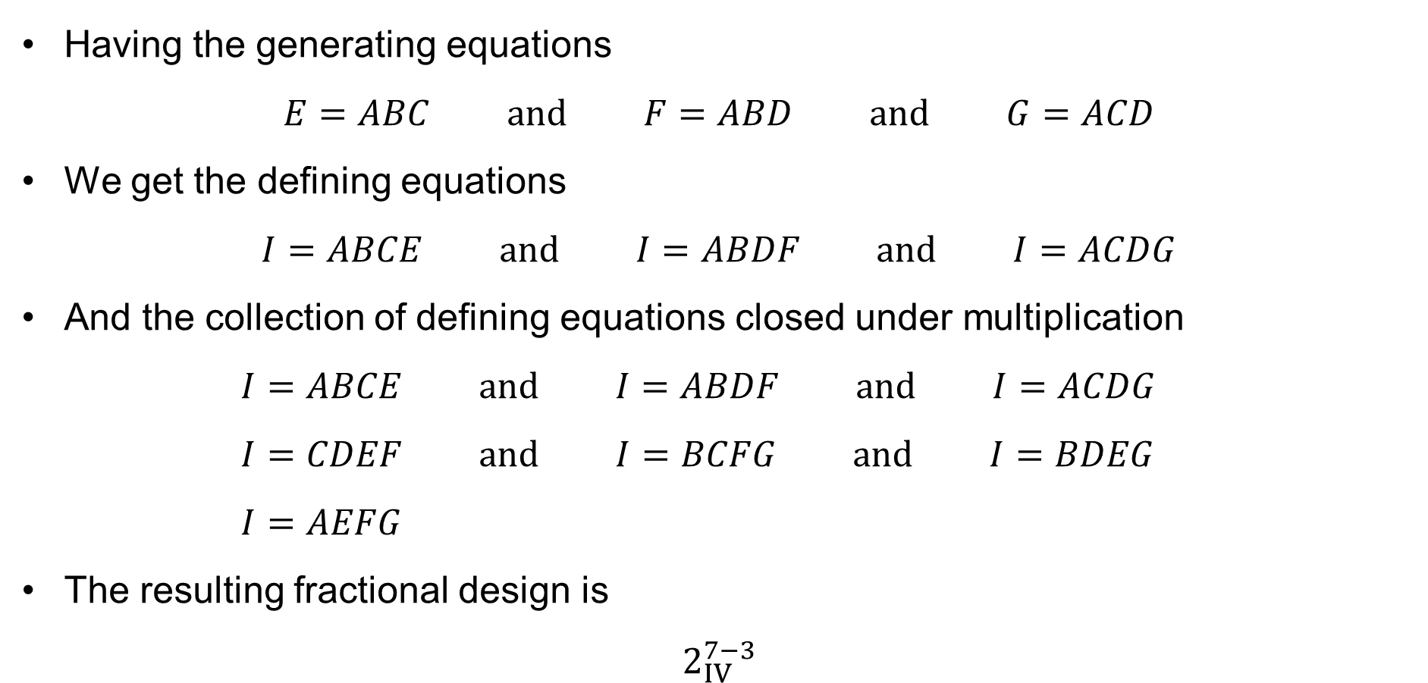
⅛ fraction design
Having the generating equations
$E=ABC \text{and} F=ABD \text{and} G=ACD$
We get the defining equations
$I=ABCE \text{and} I=ABDF \text{and} I=ACDG$
And the collection of defining equations closed under multiplication
$I=ABCE \text{and} I=ABDF \text{and} I=ACDG$
$I=CDEF \text{and} I=BCFG \text{and} I=BDEG$
$I=AEFG$
The resulting fractional design is
$2_{IV}^{7−3}$

Slide 42
For specialists in algebra:
The general 2^{−p} fraction design

Slide 43
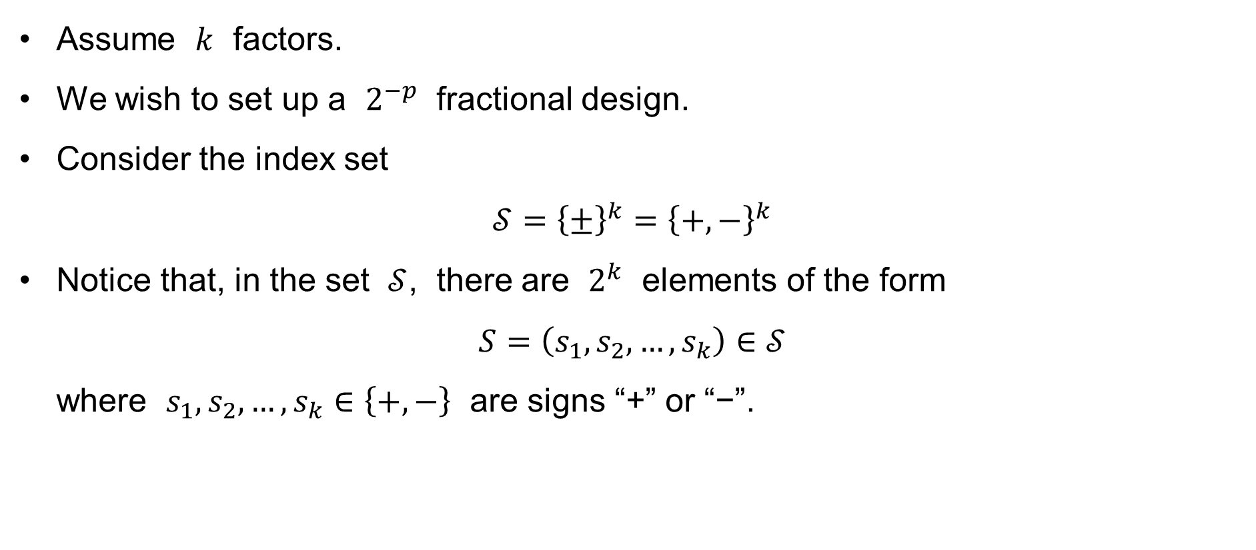
The general 2^{−p} fraction design
Assume $k$ factors.
We wish to set up a $2^{−p}$ fractional design.
Consider the index set
$𝒮={\left\{±\right\}}^{k}={\left\{+,−\right\}}^{k}$
Notice that, in the set $𝒮$, there are $2^{k}$ elements of the form
$S=\left(s_{1},s_{2},…,s_{k}\right)∈𝒮$
where $s_{1},s_{2},…,s_{k}∈\left\{+,−\right\}$ are signs “+” or “−”.

Slide 44
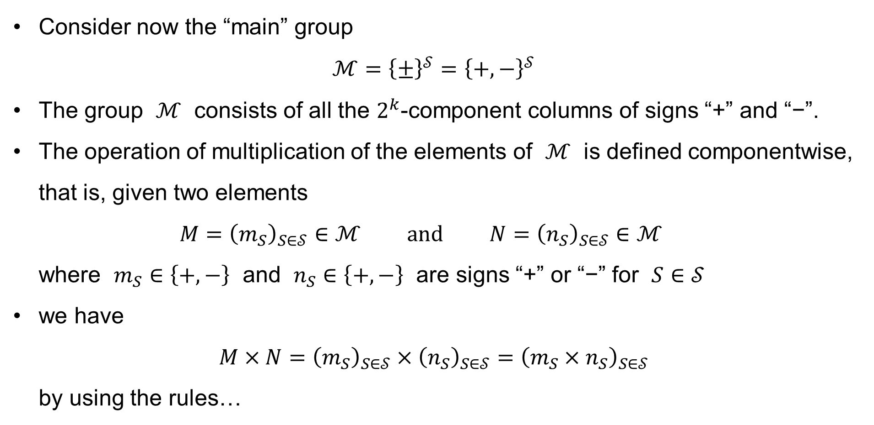
The general 2^{−p} fraction design
Consider now the “main” group
$ℳ={\left\{±\right\}}^{𝒮}={\left\{+,−\right\}}^{𝒮}$
The group $ℳ$ consists of all the $2^{k}$-component columns of signs “+” and “−”.
The operation of multiplication of the elements of $ℳ$ is defined componentwise, that is, given two elements
$M={\left(m_{S}\right)}_{S∈𝒮}∈ℳ \text{and} N={\left(n_{S}\right)}_{S∈𝒮}∈ℳ$
where $m_{S}∈\left\{+,−\right\}$ and $n_{S}∈\left\{+,−\right\}$ are signs “+” or “−” for $S∈𝒮$
we have
$M×N={\left(m_{S}\right)}_{S∈𝒮}×{\left(n_{S}\right)}_{S∈𝒮}={\left(m_{S}×n_{S}\right)}_{S∈𝒮}$
by using the rules…

Slide 45
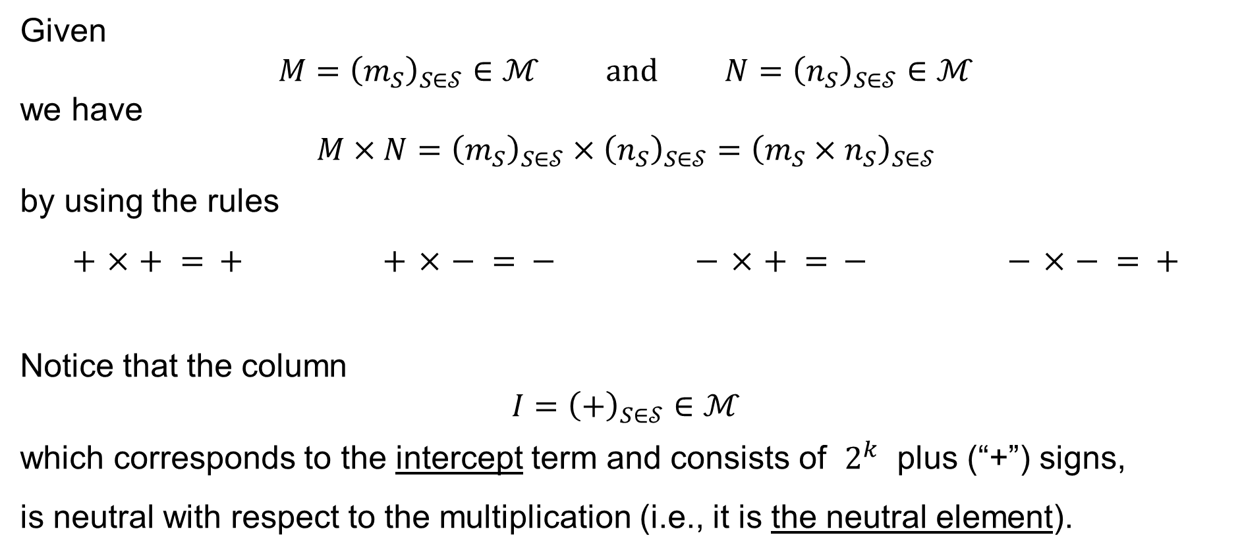
The general 2^{−p} fraction design
Given
$$M={\left(m_{S}\right)}_{S∈𝒮}∈ℳ \text{and} N={\left(n_{S}\right)}_{S∈𝒮}∈ℳ$$
we have
$$M×N={\left(m_{S}\right)}_{S∈𝒮}×{\left(n_{S}\right)}_{S∈𝒮}={\left(m_{S}×n_{S}\right)}_{S∈𝒮}$$
by using the rules
$$+ × + = + + × − = − − × + = − − × − = +$$
Notice that the column
$$I={\left(+\right)}_{S∈𝒮}∈ℳ$$
which corresponds to the intercept term and consists of $2^{k}$ plus (“+”) signs,
is neutral with respect to the multiplication (i.e., it is the neutral element).

Slide 46
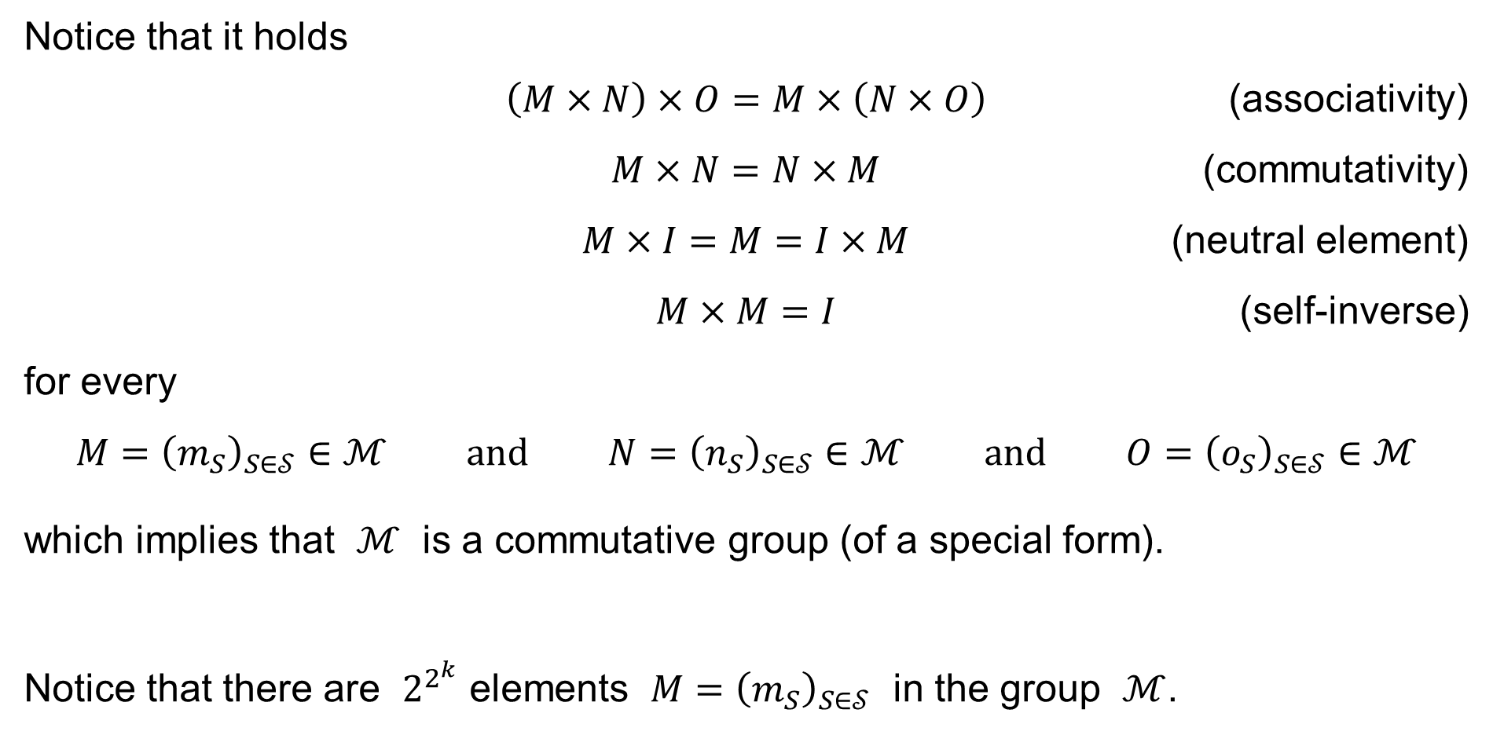
The general 2^{−p} fraction design
Notice that it holds
$\left(M×N\right)×O=M×\left(N×O\right)$ (associativity)
$M×N=N×M$ (commutativity)
$M×I=M=I×M$ (neutral element)
$M×M=I$ (self-inverse)
for every
$$M={\left(m_{S}\right)}_{S∈𝒮}∈ℳ \text{and} N={\left(n_{S}\right)}_{S∈𝒮}∈ℳ \text{and} O={\left(o_{S}\right)}_{S∈𝒮}∈ℳ$$
which implies that $ℳ$ is a commutative group (of a special form).
Notice that there are $2^{2^{k}}$ elements $M={\left(m_{S}\right)}_{S∈𝒮}$ in the group $ℳ$.

Slide 47
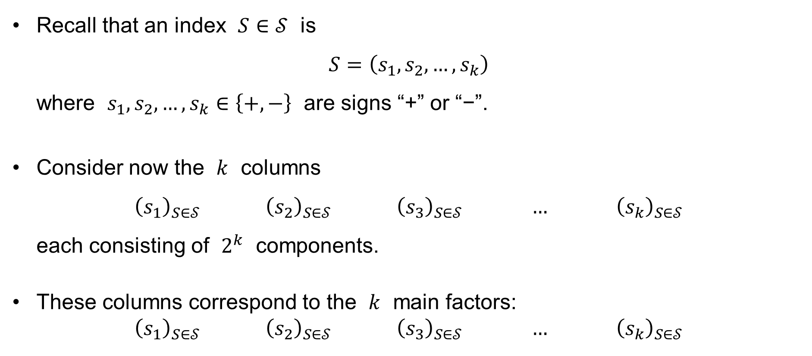
The general 2^{−p} fraction design
Recall that an index $S∈𝒮$ is
$S=\left(s_{1},s_{2},…,s_{k}\right)$
where $s_{1},s_{2},…,s_{k}∈\left\{+,−\right\}$ are signs “+” or “−”.
Consider now the $k$ columns
${\left(s_{1}\right)}_{S∈𝒮} {\left(s_{2}\right)}_{S∈𝒮} {\left(s_{3}\right)}_{S∈𝒮} … {\left(s_{k}\right)}_{S∈𝒮}$
each consisting of $2^{k}$ components.
These columns correspond to the $k$ main factors:
${\left(s_{1}\right)}_{S∈𝒮} {\left(s_{2}\right)}_{S∈𝒮} {\left(s_{3}\right)}_{S∈𝒮} … {\left(s_{k}\right)}_{S∈𝒮}$
A
B
C
K

Slide 48
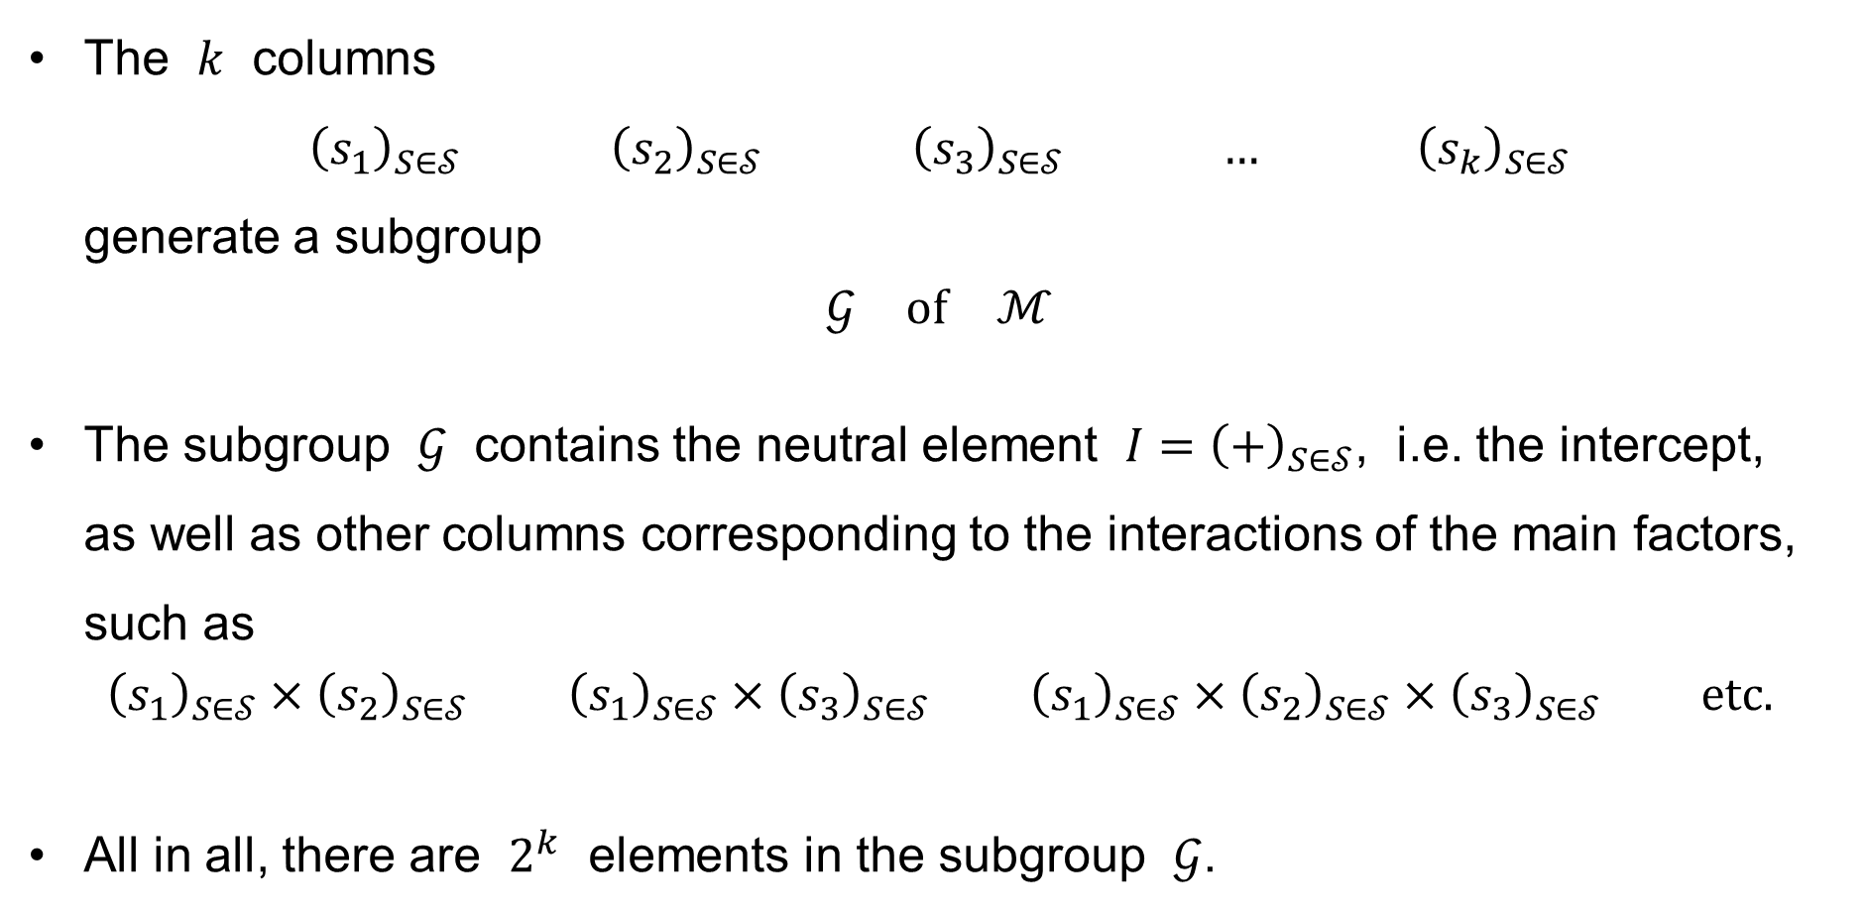
The general 2^{−p} fraction design
The $k$ columns
${\left(s_{1}\right)}_{S∈𝒮} {\left(s_{2}\right)}_{S∈𝒮} {\left(s_{3}\right)}_{S∈𝒮} … {\left(s_{k}\right)}_{S∈𝒮}$
generate a subgroup
$$𝒢 \text{of} ℳ$$
The subgroup $𝒢$ contains the neutral element $I={\left(+\right)}_{S∈𝒮}$, i.e. the intercept,
as well as other columns corresponding to the interactions of the main factors, such as
$${\left(s_{1}\right)}_{S∈𝒮}×{\left(s_{2}\right)}_{S∈𝒮} {\left(s_{1}\right)}_{S∈𝒮}×{\left(s_{3}\right)}_{S∈𝒮} {\left(s_{1}\right)}_{S∈𝒮}×{\left(s_{2}\right)}_{S∈𝒮}×{\left(s_{3}\right)}_{S∈𝒮} \text{etc}\text{.}$$
All in all, there are $2^{k}$ elements in the subgroup $𝒢$.
AB
AC
ABC

Slide 49

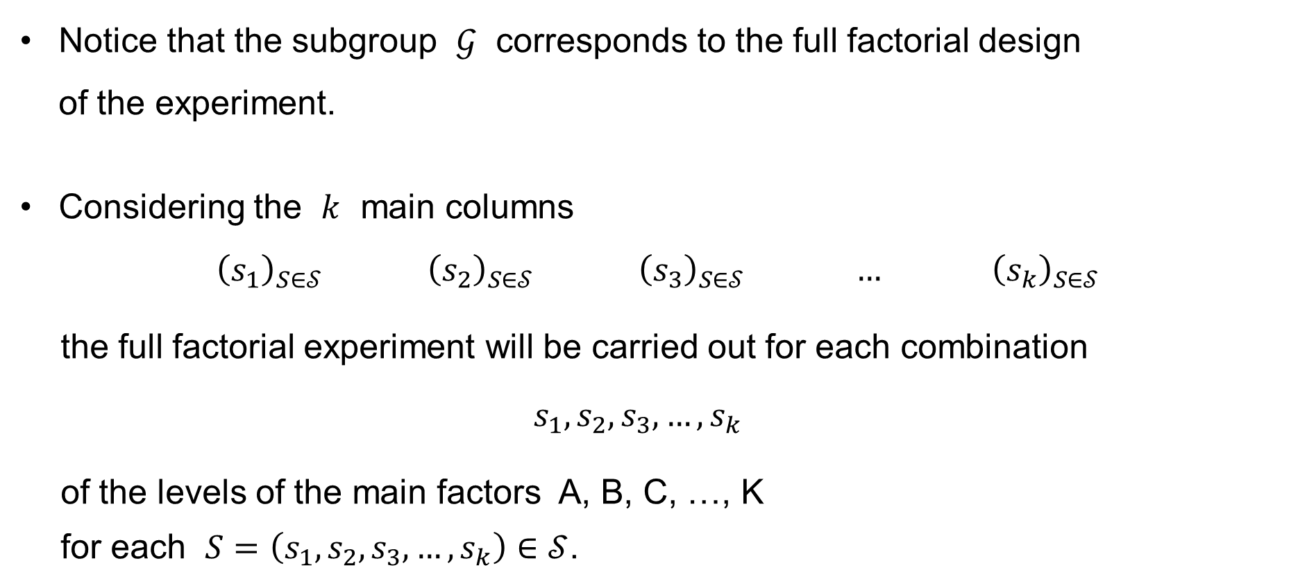
The general 2^{−p} fraction design
Notice that the subgroup $𝒢$ corresponds to the full factorial design
of the experiment.
Considering the $k$ main columns
${\left(s_{1}\right)}_{S∈𝒮} {\left(s_{2}\right)}_{S∈𝒮} {\left(s_{3}\right)}_{S∈𝒮} … {\left(s_{k}\right)}_{S∈𝒮}$
the full factorial experiment will be carried out for each combination
$$s_{1},s_{2},s_{3},…,s_{k}$$
of the levels of the main factors A, B, C, …, K
for each $S=\left(s_{1},s_{2},s_{3},…,s_{k}\right)∈𝒮$.
$k$ factors

Slide 50
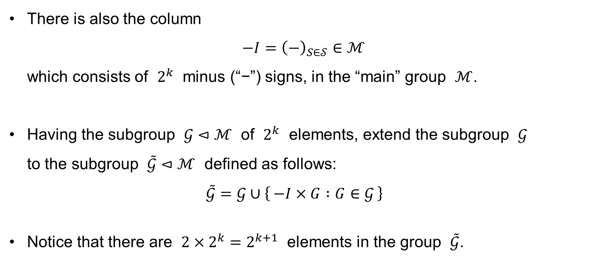
The general 2^{−p} fraction design
There is also the column
$−I={\left(−\right)}_{S∈𝒮}∈ℳ$
which consists of $2^{k}$ minus (“−”) signs, in the “main” group $ℳ$.
Having the subgroup $𝒢⊲ℳ$ of $2^{k}$ elements, extend the subgroup $𝒢$
to the subgroup $\tilde{𝒢}⊲ℳ$ defined as follows:
$\tilde{𝒢}=𝒢∪\left\{ −I×G :G∈𝒢 \right\}$
Notice that there are $2×2^{k}=2^{k+1}$ elements in the group $\tilde{𝒢}$.

Slide 51
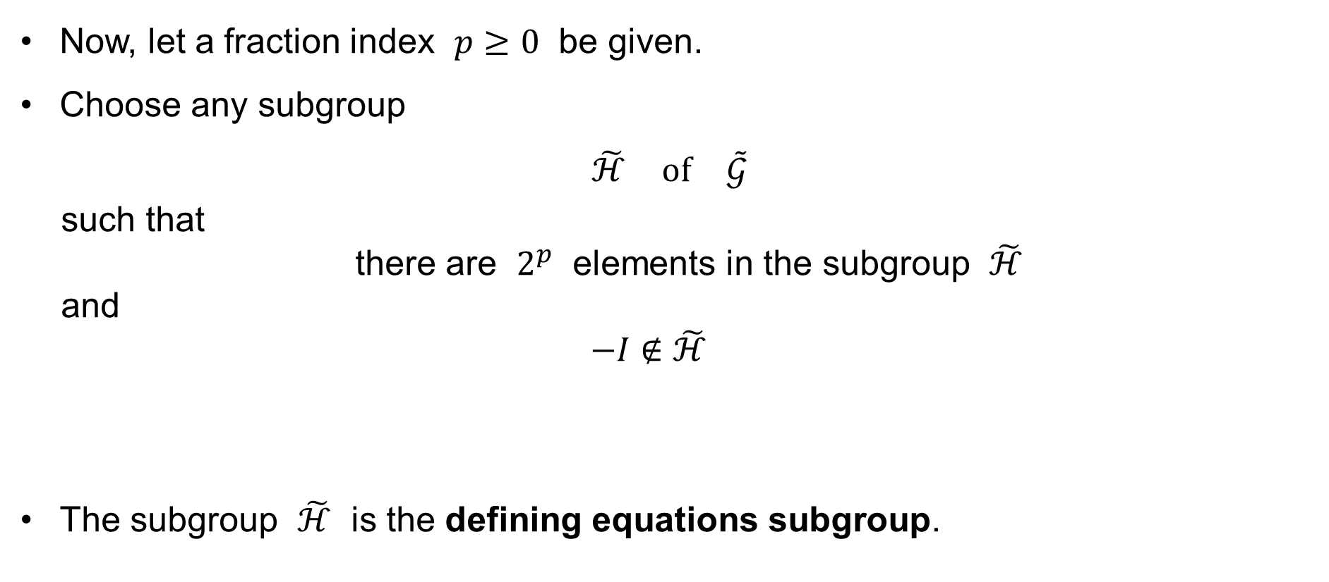
The general 2^{−p} fraction design
Now, let a fraction index $p≥0$ be given.
Choose any subgroup
$\tilde{ℋ} \text{of} \tilde{𝒢}$
such that
there are $2^{p}$ elements in the subgroup $\tilde{ℋ}$
and
$$−I∉\tilde{ℋ}$$
The subgroup $\tilde{ℋ}$ is the defining equations subgroup.

Slide 52
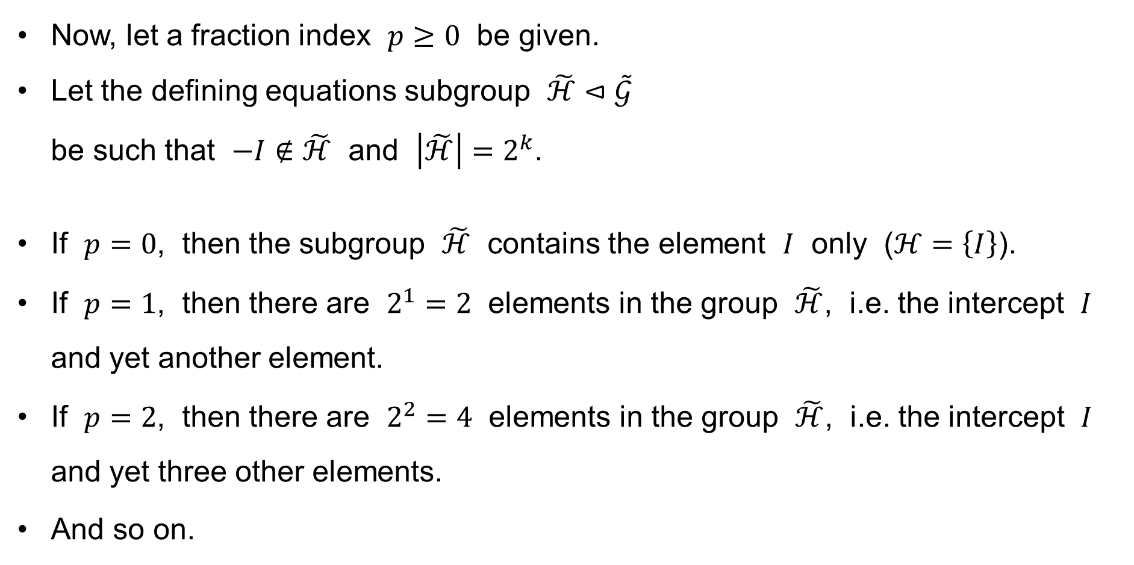
The general 2^{−p} fraction design
Now, let a fraction index $p≥0$ be given.
Let the defining equations subgroup $\tilde{ℋ}⊲\tilde{𝒢}$
be such that $−I∉\tilde{ℋ}$ and $\left|\tilde{ℋ}\right|=2^{k}$.
If $p=0$, then the subgroup $\tilde{ℋ}$ contains the element $I$ only ($ℋ=\left\{I\right\}$).
If $p=1$, then there are $2^{1}=2$ elements in the group $\tilde{ℋ}$, i.e. the intercept $I$ and yet another element.
If $p=2$, then there are $2^{2}=4$ elements in the group $\tilde{ℋ}$, i.e. the intercept $I$ and yet three other elements.
And so on.

Slide 53
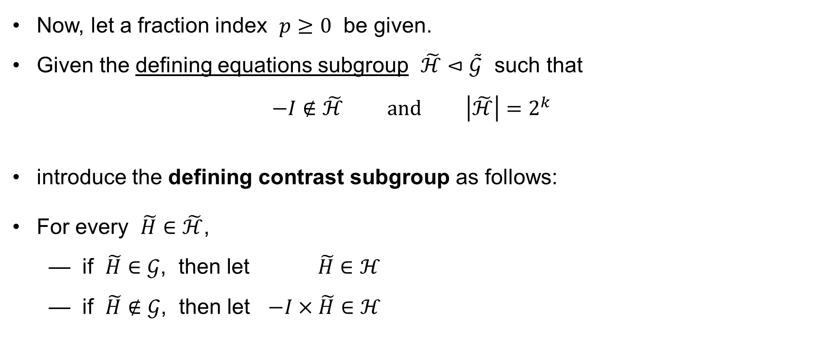
The general 2^{−p} fraction design
Now, let a fraction index $p≥0$ be given.
Given the defining equations subgroup $\tilde{ℋ}⊲\tilde{𝒢}$ such that
$−I∉\tilde{ℋ} \text{and} \left|\tilde{ℋ}\right|=2^{k}$
introduce the defining contrast subgroup as follows:
For every $\tilde{H}∈\tilde{ℋ}$,
— if $\tilde{H}∈𝒢$, then let $\tilde{H}∈ℋ$
— if $\tilde{H}∉𝒢$, then let $−I×\tilde{H}∈ℋ$

Slide 54
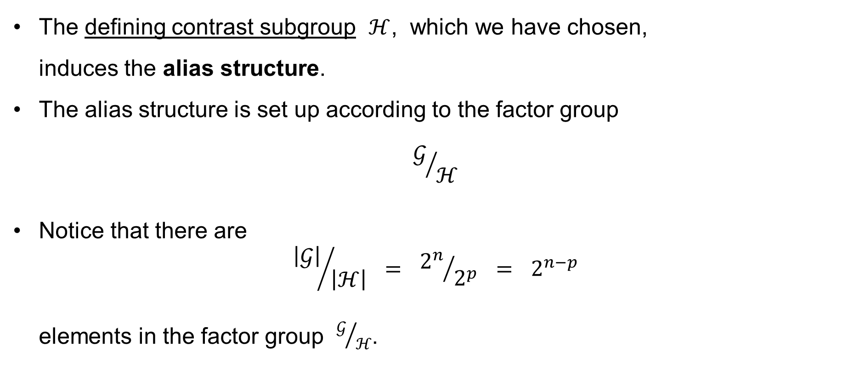
The general 2^{−p} fraction design
The defining contrast subgroup $ℋ$, which we have chosen,
induces the alias structure.
The alias structure is set up according to the factor group
$$𝒢/ℋ$$
Notice that there are
${\left|𝒢\right|}/{\left|ℋ\right|} = {2^{n}}/{2^{p}} = 2^{n−p}$
elements in the factor group $𝒢/ℋ$.

Slide 55

The general 2^{−p} fraction design: Example
Consider 4 main factors A, B, C, D.
Choosing the defining equations subgroup
$$\tilde{ℋ}=\left\{I, ABCD\right\} \text{or} \tilde{ℋ}=\left\{I, −ABCD\right\}$$
we obtain the defining contrast subgroup
$$ℋ=\left\{I, ABCD\right\}$$
and the alias structure
$$𝒢/ℋ=\left\{\begin{aligned}\begin{aligned}\left\{I, ABCD\right\}, \\ \left\{A, BCD\right\}, \left\{B, ACD\right\}, \left\{C, ABD\right\}, \left\{D, ABC\right\},\end{aligned} \\ \left\{AB, CD\right\}, \left\{AC, BD\right\}, \left\{AD, BC\right\}\end{aligned}\right\}$$
(see the examples above).

Slide 56

The general 2^{−p} fraction design: Example
Consider 4 main factors A, B, C, D.
Choosing the defining equations subgroup
$$\tilde{ℋ}=\left\{I, ABC\right\} \text{or} \tilde{ℋ}=\left\{I, −ABC\right\}$$
we obtain the defining contrast subgroup
$$ℋ=\left\{I, ABC\right\}$$
and the alias structure
$$𝒢/ℋ=\left\{\begin{aligned}\begin{aligned}\left\{I, ABC\right\}, \\ \left\{A, BC\right\}, \left\{B, AC\right\}, \left\{C, AB\right\}, \left\{D\right\},\end{aligned} \\ \left\{AD, BCD\right\}, \left\{BD, ACD\right\}, \left\{CD, ABD\right\}\end{aligned}\right\}$$
which is not as good as the one above (see the examples above).

Slide 57

The general 2^{−p} fraction design: Example
Consider 5 main factors A, B, C, D, E.
Choosing the defining equations subgroup
$$\tilde{ℋ}=\left\{I, ABD, BCE, ACDE\right\}$$
or
$$\tilde{ℋ}=\left\{I, −ABD, −BCE, ACDE\right\}$$
or
$$\tilde{ℋ}=\left\{I, −ABD, BCE, −ACDE\right\}$$
or
$$\tilde{ℋ}=\left\{I, ABD, −BCE, −ACDE\right\}$$
we obtain the defining contrast subgroup
$$ℋ=\left\{I, ABD, BCE, ACDE\right\}$$

Slide 58

The general 2^{−p} fraction design: Example
Consider 5 main factors A, B, C, D, E.
Given the defining contrast subgroup
$$ℋ=\left\{I, ABD, BCE, ACDE\right\}$$
we obtain the alias structure
$$𝒢/ℋ=\left\{\begin{aligned}\begin{aligned}\left\{I, ABD, BCE, ACDE\right\}, \\ \left\{A, BD, ABCE, CDE\right\}, \left\{B, AD, CE, ABCDE\right\}, \left\{C, ABCD, BE, ADE\right\},\end{aligned} \\ \left\{D, AB, BCDE, ACE\right\}, \left\{E, ABDE, BCDE, ACD\right\}, \\ \left\{AC, BCD, ABE, DE\right\}, \left\{AE, BDE, ABC, CD\right\}\end{aligned}\right\}$$
(see the examples above)

Slide 59

The general 2^{−p} fraction design: Example
Consider 7 main factors A, B, C, D, E, F, G.
Choosing the defining equations subgroup
$$\tilde{ℋ}=\left\{I, ABCE, ABDF, ACDG, CDEF, BCFG, BDEG, AEFG\right\}$$
or
$$\tilde{ℋ}=\left\{I, ABCE, ABDF, −ACDG, CDEF, −BCFG, −BDEG, −AEFG\right\}$$
or
$$\tilde{ℋ}=\left\{I, ABCE, −ABDF, ACDG, −CDEF, −BCFG, BDEG, −AEFG\right\}$$
or
$$\tilde{ℋ}=\left\{I, ABCE, −ABDF, −ACDG, −CDEF, BCFG, −BDEG, AEFG\right\}$$
or
…

Slide 60

The general 2^{−p} fraction design: Example
Consider 7 main factors A, B, C, D, E, F, G.
Choosing the defining equations subgroup
…
or
$$\tilde{ℋ}=\left\{I, −ABCE, ABDF, ACDG, −CDEF, BCFG, −BDEG, −AEFG\right\}$$
or
$$\tilde{ℋ}=\left\{I, −ABCE, ABDF, −ACDG, −CDEF, −BCFG, BDEG, AEFG\right\}$$
or
$$\tilde{ℋ}=\left\{I, −ABCE, −ABDF, ACDG, CDEF, −BCFG, −BDEG, AEFG\right\}$$
or
$$\tilde{ℋ}=\left\{I, −ABCE, −ABDF, −ACDG, CDEF, BCFG, BDEG, −AEFG\right\}$$

Slide 61

The general 2^{−p} fraction design: Example
Consider 7 main factors A, B, C, D, E, F, G.
Choosing the defining equations subgroup as above,
we obtain the defining contrast subgroup
$$ℋ=\left\{I, ABCE, ABDF, ACDG, CDEF, BCFG, BDEG, AEFG\right\}$$
and the alias structure
(see the next slide)

Slide 62

The general 2^{−p} fraction design: Example
$$𝒢/ℋ=\left\{\begin{aligned}\left\{I, ABCE, ABDF, ACDG, CDEF, BCFG, BDEG, AEFG\right\}, \\ \left\{A, BCE, BDF, CDG, ACDEF, ABCFG, ABDEG, EFG\right\}, \\ \left\{B, ACE, ADF, ABCDG, BCDEF, CFG, DEG, ABEFG\right\}, \\ \left\{C, ABE, ABCDF, ADG, DEF, BFG, BCDEG, ACEFG\right\}, \\ \left\{D, ABCDE, ABF, ACG, CEF, BCDEF, BEG, ADEFG\right\}, \\ \left\{E, ABC, ABDEF, ACDEG, CDF, BCEFG, BDG, AFG\right\}, \\ \left\{F, ABCEF, ABD, ACDFG, CDE, BCG, BDEFG, AEG\right\}, \\ \left\{G, ABCEG, ABDFG, ACD, CDEFG, BCF, BDE, AEF\right\}, \\ \left\{AB, CE, DF, BCDG, ABCDEF, ACFG, ADEG, BEFG\right\}, \\ \left\{AC, BE, BCDF, DG, ADEF, ABFG, ABCDEG, CEFG\right\}, \\ \left\{AD, BCDE, BF, CG, ACEF, ABCDFG, ABEG, DEFG\right\}, \\ \left\{AE, BC, BDEF, CDEG, ACDF, ABCEFG, ABDG, FG\right\}, \\ \left\{AF, BCEF, BD, CDFG, ACDE, ABCG, ABDEFG, EG\right\}, \\ \left\{AG, BCEG, BDFG, CD, ACDEFG, ABCF, ABDE, EF\right\}, \\ \left\{BG, ACEG, ADFG, ABCD, BCDEFG, CF, DE, ABEF\right\}, \\ \left\{ABCDEFG, DFG, CEG, BEF, ABG, ADE, ACF, BCD\right\}\end{aligned}\right\}$$
(see the examples above)

Slide 63

The general 2^{−p} fraction design
Since the subgroup $𝒢⊲ℳ$ is generated by the columns
$${\left(s_{1}\right)}_{S∈𝒮} {\left(s_{2}\right)}_{S∈𝒮} {\left(s_{3}\right)}_{S∈𝒮} … {\left(s_{k}\right)}_{S∈𝒮}$$
and $ℋ$ is a subgroup of $𝒢$, i.e. $ℋ⊲𝒢⊲ℳ$, it follows that each element of $ℋ$ can be generated by these columns. That is,
— for every element $H∈ℋ$, we have
$$H=\prod_{j∈J_{H}}{{\left(s_{j}\right)}_{S∈𝒮}} \text{for} \text{some} J_{H}⊆\left\{1, 2,…,k\right\}$$
The empty set $J_{I}=∅$ yields the intercept $I$.
The number $\left|J_{H}\right|$ of the elements of the set $J_{H}$ is the length of the word $H∈ℋ$.
A
B
C
K

Slide 64

The general 2^{−p} fraction design
The resolution of the defining contrast subgroup $ℋ$ is
the minimum length of a word in it (not counting the element “$I$”).
The resolution is written as a Roman number (I, II, III, IV, V, …).
For example, the resolution of the defining contrast subgroup
$$ℋ=\left\{I, ABD, BCE, ACDE\right\}$$
is 3 = III.
For example, the resolution of the defining contrast subgroup
$$ℋ=\left\{I, ABCE, ABDF, ACDG, CDEF, BCFG, BDEG, AEFG\right\}$$
is 4 = IV.

Slide 65

The general 2^{−p} fraction design
The resolution of the defining contrast subgroup $ℋ$ is
the minimum length of a word in it (not counting the element “$I$”).
The resolution is written as a Roman number (I, II, III, IV, V, …).
For example, the resolution of both the defining contrast subgroups
$$ℋ=\left\{I, ABCF, ABDEG, CDEFG\right\}$$
$$ℋ=\left\{I, ABCF, ADEG, BCDEFG\right\}$$
is 4 = IV.

Slide 66

The general 2^{−p} fraction design
The resolution of the defining contrast subgroup $ℋ$ is
the minimum length of a word in it (not counting the element “$I$”).
The aberration of the defining contrast subgroup $ℋ$ is
the count of the distinct minimum length words in the subgroup.
For example, the resolution of the defining contrast subgroup
$$ℋ=\left\{I, ABD, BCE, ACDE\right\}$$
is 3 = III and its aberration is 2.

Slide 67

The general 2^{−p} fraction design
The resolution of the defining contrast subgroup $ℋ$ is
the minimum length of a word in it (not counting the element “$I$”).
The aberration of the defining contrast subgroup $ℋ$ is
the count of the distinct minimum length words in the subgroup.
For example, the resolution of the defining contrast subgroup
$$ℋ=\left\{I, ABCE, ABDF, ACDG, CDEF, BCFG, BDEG, AEFG\right\}$$
is 4 = IV and its aberration is 7.

Slide 68

The general 2^{−p} fraction design
The purpose is to choose the defining equation subgroup $\tilde{ℋ}$ so that
the resolution of the defining contrast subgroup $ℋ$ is maximized.
If there are several defining equation subgroups $\tilde{ℋ}$ such that the corresponding defining contrast subgroups have the same maximum resolution,
then the purpose is to choose the defining equation subgroup $\tilde{ℋ}$ so that
the aberration of the defining contrast subgroup $ℋ$ is minimized.

Slide 69

The general 2^{−p} fraction design
For example, if the defining contrast subgroup is
$$ℋ=\left\{I, ABCF, ABDEG, CDEFG\right\}$$
the resolution is 4 = IV and the aberration is 1.
If the defining contrast subgroup is
$$ℋ=\left\{I, ABCF, ADEG, BCDEFG\right\}$$
the resolution is also 4 = IV, but the aberration is 2.
The former subgroup is better because its aberration is less than that of the latter.

Slide 70

The general 2^{−p} fraction design
It remains to set up the fractional factorial design of the experiment.
Our purpose is to set up the $2^{−p}$ fraction design, denoted by
$2^{k−p}$
The procedure is as follows
(see the following slides).

Slide 71


The general 2^{−p} fraction design
Write every word $\tilde{H}∈\tilde{ℋ}$ (except the element “$I$”)
of the defining equation subgroup $\tilde{ℋ}$ in the form
$$\tilde{H}=\prod_{j∈J_{\tilde{H}}}{{\left(s_{j}\right)}_{S∈𝒮}} \text{or} \tilde{H}=−\prod_{j∈J_{\tilde{H}}}{{\left(s_{j}\right)}_{S∈𝒮}} \text{for} \text{exactly} \text{one} J_{H}⊆\left\{1, 2,…,k\right\}$$
Write the corresponding defining equation:
$$+ =\prod_{j∈J_{\tilde{H}}}{s_{j}} \text{or} + =−\prod_{j∈J_{\tilde{H}}}{s_{j}}$$
respectively, where “$s_{j}$” are symbols (variables).
$$\left(∗\right)$$

Slide 72

The general 2^{−p} fraction design
For example, if the defining equation subgroup is
$$\tilde{ℋ}=\left\{I, −ABD, −BCE, ACDE\right\}$$
then the collection of the defining equations is
$$I=−ABD I=−BCE I=ACDE$$

Slide 73

The general 2^{−p} fraction design
The group $𝒢$ is generated by the columns
$${\left(s_{1}\right)}_{S∈𝒮} {\left(s_{2}\right)}_{S∈𝒮} {\left(s_{3}\right)}_{S∈𝒮} … {\left(s_{k}\right)}_{S∈𝒮}$$
corresponding to the $k$ main factors A, B, C, …, K,
and there are $2^{k}$ elements in the group $𝒢$.
The group $𝒢$ can be seen a $2^{k}×2^{k}$ table thus.
A row with the index $S=\left(s_{1},s_{2},…,s_{k}\right)∈𝒮$ is kept – and the experiment is carried out for this combination of the levels of the main factors – if and only if
all the defining equations $\left(∗\right)$ are fulfilled.
A
B
C
K

Slide 74

The general 2^{−p} fraction design
Finally, the effects of the factors and their interactions are confounded according to the defining equations subgroup $\tilde{ℋ}$.
To given an example, consider 5 main factors
A, B, C, D, E
and let the defining equations subgroup be
$$\tilde{ℋ}=\left\{I, ABD, −BCE, −ACDE\right\}$$
The resolution is 3 = III and the aberration is 2.

Slide 75

The general 2^{−p} fraction design: Example
Full factorial design $2^{5}$: the group $𝒢$
No. | I | A | B | C | D | E | AB | AC | AD | AE | BC | BD | BE | CD | CE | DE | ABC | ABD | ABE | ACD | ACE | ADE | BCD | BCE | BDE | CDE | ABCD | ABCE | ABDE | ACDE | BCDE | ABCDE
1 | + | − | − | − | − | − | + | + | + | + | + | + | + | + | + | + | − | − | − | − | − | − | − | − | − | − | + | + | + | + | + | −
2 | + | + | − | − | − | − | − | − | − | − | + | + | + | + | + | + | + | + | + | + | + | + | − | − | − | − | − | − | − | − | + | +
3 | + | − | + | − | − | − | − | + | + | + | − | − | − | + | + | + | + | + | + | − | − | − | + | + | + | − | − | − | − | + | − | +
4 | + | + | + | − | − | − | + | − | − | − | − | − | − | + | + | + | − | − | − | + | + | + | + | + | + | − | + | + | + | − | − | −
5 | + | − | − | + | − | − | + | − | + | + | − | + | + | − | − | + | + | − | − | + | + | − | + | + | − | + | − | − | + | − | − | +
6 | + | + | − | + | − | − | − | + | − | − | − | + | + | − | − | + | − | + | + | − | − | + | + | + | − | + | + | + | − | + | − | −
7 | + | − | + | + | − | − | − | − | + | + | + | − | − | − | − | + | − | + | + | + | + | − | − | − | + | + | + | + | − | − | + | −
8 | + | + | + | + | − | − | + | + | − | − | + | − | − | − | − | + | + | − | − | − | − | + | − | − | + | + | − | − | + | + | + | +
9 | + | − | − | − | + | − | + | + | − | + | + | − | + | − | + | − | − | + | − | + | − | + | + | − | + | + | − | + | − | − | − | +
10 | + | + | − | − | + | − | − | − | + | − | + | − | + | − | + | − | + | − | + | − | + | − | + | − | + | + | + | − | + | + | − | −
11 | + | − | + | − | + | − | − | + | − | + | − | + | − | − | + | − | + | − | + | + | − | + | − | + | − | + | + | − | + | − | + | −
12 | + | + | + | − | + | − | + | − | + | − | − | + | − | − | + | − | − | + | − | − | + | − | − | + | − | + | − | + | − | + | + | +
13 | + | − | − | + | + | − | + | − | − | + | − | − | + | + | − | − | + | + | − | − | + | + | − | + | + | − | + | − | − | + | + | −
14 | + | + | − | + | + | − | − | + | + | − | − | − | + | + | − | − | − | − | + | + | − | − | − | + | + | − | − | + | + | − | + | +
15 | + | − | + | + | + | − | − | − | − | + | + | + | − | + | − | − | − | − | + | − | + | + | + | − | − | − | − | + | + | + | − | +
16 | + | + | + | + | + | − | + | + | + | − | + | + | − | + | − | − | + | + | − | + | − | − | + | − | − | − | + | − | − | − | − | −
17 | + | − | − | − | − | + | + | + | + | − | + | + | − | + | − | − | − | − | + | − | + | + | − | + | + | + | + | − | − | − | − | +
18 | + | + | − | − | − | + | − | − | − | + | + | + | − | + | − | − | + | + | − | + | − | − | − | + | + | + | − | + | + | + | − | −
19 | + | − | + | − | − | + | − | + | + | − | − | − | + | + | − | − | + | + | − | − | + | + | + | − | − | + | − | + | + | − | + | −
20 | + | + | + | − | − | + | + | − | − | + | − | − | + | + | − | − | − | − | + | + | − | − | + | − | − | + | + | − | − | + | + | +
21 | + | − | − | + | − | + | + | − | + | − | − | + | − | − | + | − | + | − | + | + | − | + | + | − | + | − | − | + | − | + | + | −
22 | + | + | − | + | − | + | − | + | − | + | − | + | − | − | + | − | − | + | − | − | + | − | + | − | + | − | + | − | + | − | + | +
23 | + | − | + | + | − | + | − | − | + | − | + | − | + | − | + | − | − | + | − | + | − | + | − | + | − | − | + | − | + | + | − | +
24 | + | + | + | + | − | + | + | + | − | + | + | − | + | − | + | − | + | − | + | − | + | − | − | + | − | − | − | + | − | − | − | −
25 | + | − | − | − | + | + | + | + | − | − | + | − | − | − | − | + | − | + | + | + | + | − | + | + | − | − | − | − | + | + | + | −
26 | + | + | − | − | + | + | − | − | + | + | + | − | − | − | − | + | + | − | − | − | − | + | + | + | − | − | + | + | − | − | + | +
27 | + | − | + | − | + | + | − | + | − | − | − | + | + | − | − | + | + | − | − | + | + | − | − | − | + | − | + | + | − | + | − | +
28 | + | + | + | − | + | + | + | − | + | + | − | + | + | − | − | + | − | + | + | − | − | + | − | − | + | − | − | − | + | − | − | −
29 | + | − | − | + | + | + | + | − | − | − | − | − | − | + | + | + | + | + | + | − | − | − | − | − | − | + | + | + | + | − | − | +
30 | + | + | − | + | + | + | − | + | + | + | − | − | − | + | + | + | − | − | − | + | + | + | − | − | − | + | − | − | − | + | − | −
31 | + | − | + | + | + | + | − | − | − | − | + | + | + | + | + | + | − | − | − | − | − | − | + | + | + | + | − | − | − | − | + | −
32 | + | + | + | + | + | + | + | + | + | + | + | + | + | + | + | + | + | + | + | + | + | + | + | + | + | + | + | + | + | + | + | +

Slide 76

The general 2^{−p} fraction design: Example
Given the defining equations subgroup
$$\tilde{ℋ}=\left\{I, ABD, −BCE, −ACDE\right\}$$
the defining contrast subgroup is
$$ℋ=\left\{I, ABD, BCE, ACDE\right\}$$
and the alias structure is
$$𝒢/ℋ=\left\{\begin{aligned}\begin{aligned}\left\{I, ABD, BCE, ACDE\right\}, \\ \left\{A, BD, ABCE, CDE\right\}, \left\{B, AD, CE, ABCDE\right\}, \left\{C, ABCD, BE, ADE\right\},\end{aligned} \\ \left\{D, AB, BCDE, ACE\right\}, \left\{E, ABDE, BC, ACD\right\}, \\ \left\{AC, BCD, ABE, DE\right\}, \left\{AE, BDE, ABC, CD\right\}\end{aligned}\right\}$$

Slide 77

The general 2^{−p} fraction design: Example
Fractional factorial design $2_{III}^{5−2}$
The defining equations:
$$I=ABD I=−BCE I=−ACDE$$
No. | I + ABD − BCE − ACDE | A + BD − ABCE − CDE | B + AD − CE − ABCDE | C + ABCD − BE − ADE | D + AB − BCDE − ACE | E + ABDE − BC − ACD | AC + BCD − ABE − DE | AE + BDE − ABC − CD
1 ( 2) | + | + | − | − | − | − | − | −
2 ( 7) | + | − | + | + | − | − | − | +
3 ( 9) | + | − | − | − | + | − | + | +
4 (16) | + | + | + | + | + | − | + | −
5 (19) | + | − | + | − | − | + | + | −
6 (22) | + | + | − | + | − | + | + | +
7 (28) | + | + | + | − | + | + | − | +
8 (29) | + | − | − | + | + | + | − | −

