Slide 1
Working in "hybrid" mode
The situation at Tietoevry

Slide 2
Remote work and hybrid work at Tietoevry
Genesis of “remote work”
General practice in the IT sector
Guidelines and processes
How to do it practically
Joys and challenges
Q&A

Slide 3
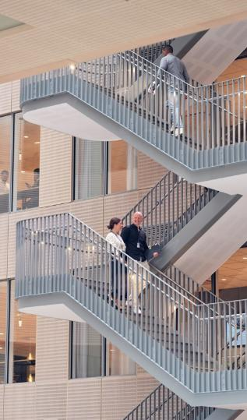
A bit of History
The 70s – Telework (Jack Nilles) An alternative to commuting due to traffic congestion and the oil crisis
90s – Internet IBM and AT&T
2000+ - Mobile Technology - Google Docs, Skype, Slack = better online collaboration. - The first digital nomads
2020+ - Pandemie Twitter, Facebook, Shopify = “full remote”

Slide 4
Current concepts
Remote-first model GitLab, Automattic = fully remote
Hybrid work Microsoft, Google, Amazon= office + home office
Digital nomadism Work from anywhere
Flexibility as a key benefit Companies offer remote as part of employee benefits
Investing in tools Growth in demand for Slack, Zoom, Asana, etc. for effective collaboration
Cybersecurity Increased emphasis on data protection and remote access

Slide 5
Czech reality
Hybrid model as standard Avast, Seznam.cz nebo Kiwi.com = office + home office
Smaller companies more remote-friendly Startups and smaller IT companies = often 100% remote work
Corporate sector more cautious Large corporations (e.g. banking IT) prefer a hybrid model for security
Coworking WeWork, HubHub and others have more clients among remote IT workers
Home office = benefit In recruitment, the ability to remote is often a key factor

Slide 6
Key findings from an internal employee survey
Key question
Finding
Key Implications
How much do people want to work remotely?
On average, 50-60% at a distance
Tietoevry must support remote work Employees will use our offices less than before
How will the use of offices by employees change in the future?
People perceive that they spend more time in the office collaborating and socializing and less individual work
Office design should be rethought site by site Offices must have spaces for both collaboration and socialization and individual work
How the meetings will take place in the future?
A total of 65% of meetings are expected to be virtual
Office infrastructure and layout must support virtual meetings
How well do our leaders and teams support remote work?
88% agree that remote work is possible and supported by divisions and executives
FiRemní culture encourages remote work A solid foundation for a hybrid model
What type of change is needed in the way we work?
Most employees would like to use the same desk when they come to the office
Location-specific projects will take into account the local needs and requirements of employees. The level of change management needed will be evaluated site by site
Do employees work effectively remotely?
84% feel similar or more efficient when working remotely
Increased flexibility and hybrid working life are a positive change for employees
Source: TietoEVRY global employee survey sent by the Future Workplace program to a randomized representative group of employees. Completed in November 2020 with 666 respondents from 19 countries.

Slide 7
Hybrid Working at Tietoevry
Upgrading Working Life

Slide 8
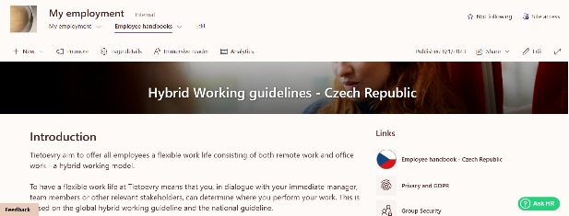
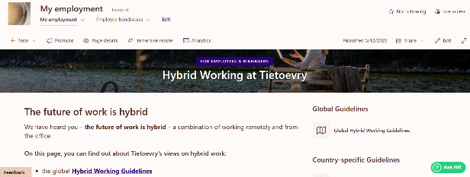
Guidelines and processes
Hybrid workplace
Internal regulations Legal Standards

Slide 9
Modernizing working life in Tietoevry What's in it for you?
Flexibility and wellbeing
The ability to decide how you want to work - focus and less distractions or cooperation and brainstorming?
Development
Developing and learning new skills, tools and new ways of working together
Digital tools
Tools to increase collaboration virtually and across locations
A sense of belonging
Greater emphasis is placed on strengthening team culture and collaboration across teams Training helps us explore new ways to engage our teams and create a sense of belonging Inclusion is everyone's responsibility
Better work experience
Attractive offices
More efficient and holistic use of offices for social gatherings, collaboration, innovation and focus
Remote work
Save time with less commute and running between meeting rooms Can fit a working day into our private schedule

Slide 10
Hybrid Workplace
Conditions
Support
Safety and productivity
Customer
Team
Individual
Global/local legislation and internal regulations
Security/Privacy
Equipment – HW, connection, ergonomics, safety
Tools – collaboration, working with files, scheduling
Training – for employees and managers
Help – processes, psychologist
Security – VPN, access management, training
Scheduling – calendars, role definitions and tasks
Involvement – meetings, workshops

Slide 11
Tools
Communication TEAMS – including all tools, SLACK – in selected teams
Workshops Online whiteboards, MIRO, Lucidchart, Mentimeter, Sli.do, Kahoot
Sharing Sharepoint, OneDrive
Information VIVA Engage
Support ASK HR

Slide 12
And what about offices?
People
Employees will use our offices less than before Employees and managers need to adapt to new ways of working Tietoevry must be able to support remote work Our people work in 23 different countries – global and local aspects
Spaces
Let's reduce office space for efficient use of offices Offices must have space for individual work as well as for collaboration and socialization There are significant differences between offices, which is why the program is designed to understand needs at the location level
Alignment
A security approach to meet customer expectations from different locations and increase remote work Differences in legal and tax regulations lead to the need for national solutions - not one size fits all

Slide 13
And what about our offices?
Our offices are designed for collaboration and social engagement with colleagues while fully supporting your individual work.
Our offices will allow you to:
Individual work in the concentration zone Socializing with colleagues through camps and chill-out zones Innovation through collaboration rooms and digital tools Communications, conferences and meeting rooms Future-proof office hardware and digital tools that allow us to work seamlessly in a hybrid environment

Slide 14
Benefits of hybrid/remote work in IT
Flexibilita and work-life balance The ability to work from anywhere and better balance work and personal life.
Higher productivity
Fewer interruptions than in open-plan offices, the ability to work at your own pace.
Lower costs for companies and employees
Savings are made on office space, commuting and catering.
Global talent pool Companies can recruit specialists from anywhere, which increases the chances of attracting top talent.
Environmental impacts Fewer commutes mean a lower carbon footprint.
Employee satisfaction The remote model is considered a standard benefit in IT, improving employee retention.

Slide 15
Challenges and disadvantages of hybrid/remote work
Social isolation and weaker corporate culture There is a lack of informal contact between colleagues, more difficult building of a team atmosphere.
Communication barriers
More frequent misunderstandings, the need to use clear rules and online tools.
More demanding team management
Remote team leadership requires new approaches to leadership and motivation.
Cybersecurity Remote work increases the risk of data breaches, the need for better security measures.
Not every worker is suitable for remote Some people have a problem with discipline and independence.
Time and cultural barrier for global teams It's difficult for companies with international teams to align time zones.

Slide 16
Burnout syndrome
Analysis and summary of the document on burnout syndrome in Tietoevry Create
Analysis and summary of the document on burnout syndrome in Tietoevry Create
Main findings Burnout syndrome and its factors The paper deals with the definition, history and factors that influence burnout. The main factors include stress, neurasthenia and depression, which negatively affect the mental and physical health of employees. Stressors can be physical or mental and are associated with the work environment, high demands or poor time management.
Research at Tietoevry Create The practical part of the thesis evaluates the rate of burnout among the company's employees. Most employees don't experience feelings of burnout, but there's a risk that they're unaware of it due to its creeping nature. Questionnaire surveys and correlation analysis were used to evaluate the situation. Recommendations for the company
- Based on the findings, steps to reduce the risk of burnout were proposed: Professional on-the-job training – Focus on preventing stress and burnout. Increase social support – Promoting collegiality and better communication between employees. Better work organization – Avoid overloading employees and ensure balanced working conditions. Mental health support – Offering programs for stress management and work-life balance.
Doporučení pro Tietoevry Create
1. Employee education Organize regular workshops on the prevention of stress and burnout. Provide training to managers to better recognize signs of burnout in subordinates.
2. Supporting work well-being To provide employees with access to professional advice or coaching. Introduce flexible working hours and the possibility of working from home. Improving the working environment Reduce employee overload and reassess work demands. Create a safe space to share problems and find solutions.
3. Monitoring and feedback Regularly evaluate employee satisfaction through questionnaires and interviews. Adapt company culture to promote mental health and employee satisfaction.
These recommendations can help reduce the risk of burnout and increase both productivity and employee satisfaction at Tietoevry Create.

Slide 17
Sources
1. Tietoevry's internal regulations and resources
2. Bachelor thesis: Analysis of employee burnout syndrome in a selected organization. Author: Matěj Kříbek, 2024 with his permission.
bydlet.cz
V informačních technologiích se z práce z domova stal standard, největší podíl patří Ostravsku 91%. Home office převálcoval práci ve firemních kancelářích. Potvrzují to statistiky zakázek IT společnosti Integra EMEA za roky 2019-2022.
1. Bydlet.cz / 2. Tiskové zprávy V INFORMAČNÍCH TECHNOLOGIÍCH SE Z PRÁCE Z DOMOVA STAL STANDARD, NEJVĚTŠÍ PODÍL PATŘÍ OSTRAVSKU 91%. HOME OFFICE PŘEVÁLCOVAL PRÁCI VE FIREMNÍCH KANCELÁŘÍCH. POTVRZUJÍ...
FeedIT.cz
Home office nabízí 39 % firem. O možnost pracovat střídavě z domova přitom stojí 3 z 5 mladých Čechů – FeedIT.cz
Praha, 21. června 2023 – Poptávka po kombinaci práce z domu a z kanceláře zůstává vysoká i s koncem postcovidového období. Nejvíce láká mladé, využívat by ji chtěli 3 z 5 zaměstnanců pod 35 let. Starš...
zpravy.kurzy.cz
V informačních technologiích se z práce z domova stal standard, největší podíl patří Ostravsku 91%. Home office převálcoval práci ve firemních kancelářích. Potvrzují to statistiky zakázek IT společnosti Integra EMEA za roky 2019-2022. | Kurzy.cz
NEJČTENĚJŠÍ DNES Zlevňování elektřiny pro domácnosti končí,… Od nového roku se změnila výše

