Slide 1
personnel management
Introduction
lecture 1
Ing. Helena Marková, Ph.D.
www.slu.cz/opf/cz

Slide 2
brief annotation of the lecture
Introduction
Historical background
Difference between personnel management and human resource management
Role and objectives of personnel management
Personnel management activities and functions
Slezská univerzita

Slide 3
CONDITIONS
LECTURE (2 lessons) + SEMINAR (1 lesson)
evaluation:
40% project, 60% final exam
communication:
e-mail, Teams
Methods of education
lectures
discussion
PM professionals lectures
project
presentation and exam
Slezská univerzita

Slide 4
Personnel manager (hr expert)
"It is a strategic, integrated and holistic approach to employing, developing and satisfying people working in organisations." (Armstrong, 2015)"It focuses on everything that concerns people in the process, i.e., acquiring, shaping, functioning, using, organizing and linking activities, work outcomes, as well as personal and social development." (Šafránková, 2018)
Definition for the purposes of the course:
holistic approach to employees, encompassing comprehensive employee care
is reactive (addresses problems as they arise), more focused on operational management
is based on current legislation governing the labour market in the Czech Republic or another country
reflects new trends in employment, including the implementation of sustainability principles, the use of AI, robotics and automation
is provided by specialists in the field, but part of the implementation is part of the work of all senior employees
Slezská univerzita

Slide 5
Pm vs. hrm
a broader and more strategic approachlong-term planning
professionals have a broader role - strategic partnership with senior management
the employee is a strategic resource to be developed
administrative and operational aspects of staff management
focus on practical and operational tasks reactive approach
ensuring the basic needs of staff are met
Decide, which of them is PM and HRM.
Slezská univerzita

Slide 6
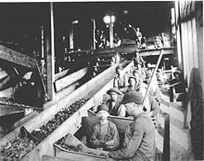
history of HR - pre-industrial and industrial era
Before the Industrial Revolution
HR was not an organised function. Agriculture and handicrafts, often in the form of family businesses, without the existence of formal administration.
Industrial Revolution (18th to 19th centuries)
Need to manage larger numbers of workers. Specialisation of workers. Need to set and manage working hours, remuneration and working
Slezská univerzita

Slide 7
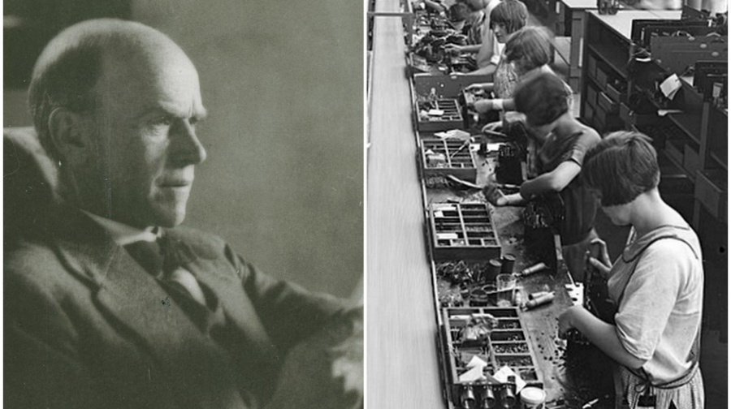
history of HR - 20th century
Scientific management (early 20th century)
Frederick Taylor - focus on increasing efficiency through standardization and specialization, control and optimization of processes.Human Relations Movement (30.-50.léta 20. století)
Response to mechanical access. Emphasis on psychological and social aspects of work. Significant figure: Elton Mayo. Hawthorn experiment
https://www.youtube.com/watch?v=n_pCYyTuixc
Why is good to know the history?
Slezská univerzita

Slide 8
Modern HR
60s to 80s
Professionalisation, the first HRM strategies and HR took on a more strategic role in organisations.
Digitalisation and globalization
Entry of new technologies, automation of routine activities. Flexibility of work. Sustainable approaches: diversity, inclusion. The need to work with talent.
The future of HR
Slezská univerzita

Slide 9
the main tasks of personnel work and the personnel activities to ensure them
They are based on the needs of strategic human resource management and arise from key areas: Recruitment and selection of staff - creating and analysing job vacancies, ensuring appropriate working conditions, including the establishment of employment relationships, contract management and compliance with legislation, amendments to existing employment relationships and agreements.
Employee working conditions - working hours and working patterns, health and safety and implementation of safety programmes, travel and travel reimbursement, leave, work-related obstacles.
Employee training and development - identification of training needs, development needs and employee motivation to implement development activities, ways of implementing training from the employer's perspective.
Employee appraisal and remuneration - importance for employee motivation, appraisal procedures, remuneration methods, benefits administration, differences in remuneration in business and non-business, use of digital tools and systems.
Slezská univerzita

Slide 10
the main tasks of personnel work and the personnel activities to ensure them
Termination of employment - types and methods of termination, company culture within the process, pension policy, outplacement, support systems, rights and obligations of employees and employers.
HR information systems
Competences of HR managers and supervisors - lifelong learning, communication, digital competence
Sustainability principles - equal access, diversity, inclusion, role of collective bargaining. .
Slezská univerzita

Slide 11
HR strategy
is an organization's long-term plan for the effective management and development of human resources (employees) that supports the achievement of the organization's goals. This strategy includes the concept of how the organisation plans to attract, develop, motivate and retain its employees so that they are able to perform their tasks and contribute to the overall success of the organisation.
Key factors:
Company business strategy
Company goals ans vision
Company culture
Internal and external sources
External Background
Trends and innovations in HR
Slezská univerzita

Slide 12
the importance of HR strategy
Why is it important for a company to have a HR strategy?
To support the achievement of the company's objectives
attracting and retaining talent employee
Development
improving motivation and performance
reducing the risk of skills shortages
flexibility and adaptability
cost optimization
ensuring compliance with legislation
strengthening company culture
Slezská univerzita

Slide 13
staffing strategy in different types of companies and their application
Large firms:
structured and formal, with an emphasis on specialization and a systematic approach to human resource management.
Medium-sized firms:
Flexible but more structured than small firms, with an emphasis on efficient growth and development.
Small firms:
Informal and personal, with an emphasis on versatility and close employer-employee relationships, often with a focus on retaining key employees.
Slezská univerzita

Slide 14
Task 1 – 3 strategies
There are 3 case studies from big companies in CR and in the world.
Read about the change they have done and answer the questions.
Compare their approach.
Slezská univerzita

Slide 15
strategic human resource management and its application in practice
What is the main objective of the management of any business?
Efficient operation of the company =
Business strategy + HRM + Organisational structure of the company.
HR Business Partner Model (Ulrich, 1999).
The concept of business partnership is about growing the strategic role of human resources. How do we understand this? What do we mean by this?
dividing strategical and operative task of HRM.
Slezská univerzita

Slide 16
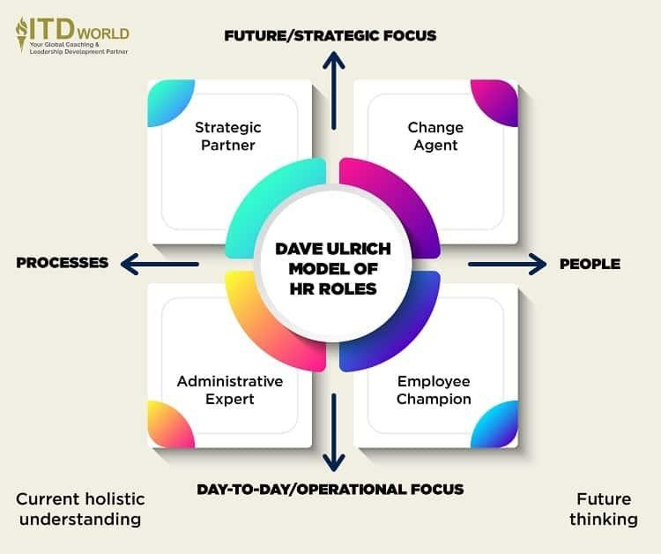
The role of the HR manager
as a business partner
By Ulricha 4 roles altogether:
Strategic partner
Change agent
Administrative Expert
Employee Champion
Slezská univerzita

Slide 17
the current labour market –
key trends and challenges
Digitalization and automation
The concept of Industry 4.0 - the use of cyber-physical systems, the emergence of a new working class (light blue collars), the interconnection
the disappearance of certain jobs
Focus on IT, data analysis, AI, robots
automation of mainly routine tasks and administrative work - need for education
security of system solutions
Remote work
COVID-19 accelerated development and forced to overcome barriers remote work, or hybrid models
changing company culture
new communication technologies and management methods
Slezská univerzita

Slide 18
the current labour market –
key trends and challenges
Shortage of skilled labout
Rapid technological advances create the need to fill new positions
the need to invest in education,
increased demands change in required qualifications
the need for lifelong learning
Flexibility of the work arrangements
Part time, remote, freelancers
Need of employees and employes
work-life balance
concept gig economy
Slezská univerzita

Slide 19
the current labour market –
key trends and challenges
Increasing mobility and globalisation
Developement of communication technology led to bigger geographical flexibility.
Changes in recruitment
Changes in leading the people – diversity a inklusion
competition between employees from different regions (wages, working conditions)
Ageing population
Involvement of older employees,
greater age difference between employee groups
age-management - intergenerational approach
adapting working conditions
the need to address succession and the emphasis on workforce planning in general
Slezská univerzita

Slide 20
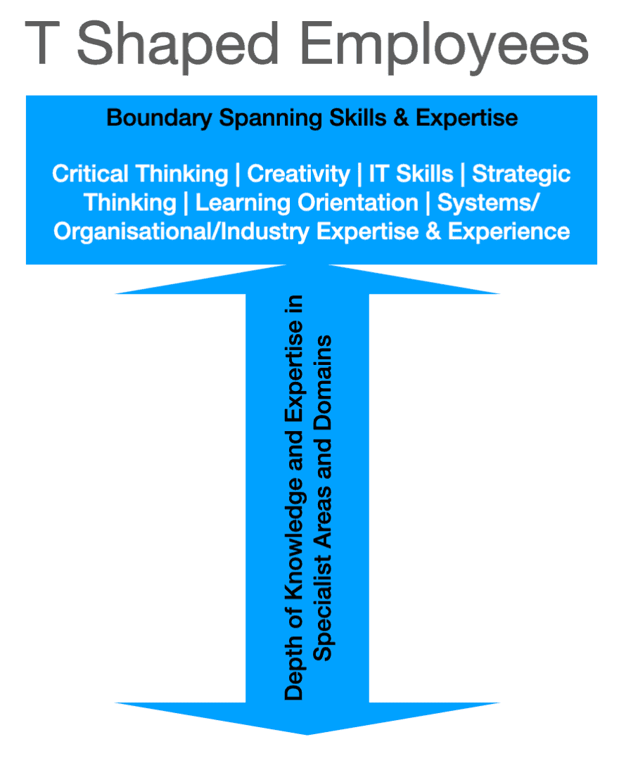
the current labour market –
key trends and challenges
Increasing signifikance of „soft skills“
are necessary to adapt to rapid changes in the environment
examples of individual skills and their application in specific situations
leadership competences
Growing demands for retraining and lifelong learning
faster disappearance of jobs associated with lower levels of education,
new jobs being created have greater demands on knowledge and skills
T-shaped professional - Depth of Expertise x Breadth of Knowledge
Slezská univerzita

Slide 21
the impact of digitisation on HR activities
Digitalization in HR activities increases efficiency, improves communication, speeds up processes and provides more opportunities for data analysis and strategic decision-making.
On the other hand, it requires companies to invest in technology and employee training to take advantage of the benefits that digitisation brings.
Main areas, where we can find it:
automation of administrative processes (software and cloud storage)
recruitment and selection of employees (use of networks, AI, communication systems)
onboarding (online learning systems, e-learning, digital manuals)
training and development (interactive courses, VR, AR)
performance evaluation (automated systems tracking performance in real time according to targets and KPIs, better feedback
Slezská univerzita

Slide 22
the impact of digitisation on HR activities
talent management and retention strategies - HR analytics (effective career tracking, talent identification, tailor-made development and retention measures, career and development plan)
improved communication and collaboration (more flexible interaction, online platforms allow easy communication across departments and locations, video conferencing)
Data analysis and predictive models (to analyse performance, attrition, satisfaction, training effectiveness)
increasing importance of digital security (GDPR, data and
There are also threats arising from the digitalisation of HR processes.
Discuss the possible negative aspects of each step.
Slezská univerzita

Slide 23
use of AI in HR processes
HR department of the future transforming HR operations with AI advantages,
disadvantages,
ethical issues
learning through discussion and teamwork
Possible use of AI
recruitment and selection of employees
staff training and development
performance evaluation
talent management and predictive analytics
administration and HR operations
Slezská univerzita

Slide 24
summary of findings
Orientation in the basic development phases of HR.
Definition of human resource management and HRM.
Definition of basic HR activities.
The importance of HR strategies and their place in the enterprise.
Presentation of basic legislative norms and recommended literature.
Questions:
What challenges are there in PM?
Why are strategies important?
What is the significance of PM in organisations ?
Slezská univerzita

Slide 25
rEFERENCES
Armstrong, M., 2020. Armstrong's handbook of human resource management practice. London: Kogan Page. ISBN: 978-0-7494-9827-6.
CRAWSHAW, J., BUDHWAR, P. a DAVIS, A., 2020. Human Resource Management. 3rd edition. SAGE Publications Ltd., London. ISBN 978-1-5264 9900-4.
Internetové zdroje – specializované weby zaměřené na personální práci, odborná diskuzní fóra, vzhledem ke značnému množství změn i zprávy z denního tisku.
Slezská univerzita

Slide 26
Legal Frame - CR
Zákoník práce (Zákon č. 262/2006 Sb.) – Labor Code
Hlavní právní předpis upravující pracovněprávní vztahy mezi zaměstnavatelem a zaměstnancem.
Obsahuje úpravu pracovních smluv, pracovních podmínek, pracovní doby, dovolené, bezpečnosti práce, náhrad škod a dalších záležitostí týkajících se zaměstnanců.
Občanský zákoník (Zákon č. 89/2012 Sb.) – Civil Code
Zahrnuje obecné právní normy, které mohou být využívány v pracovněprávních vztazích, například při náhradě škody nebo ochraně osobních údajů.
Zákon o zaměstnanosti (Zákon č. 435/2004 Sb.) – Employment Act
Reguluje oblasti spojené s trhem práce, podmínky zaměstnávání a služby zaměstnanosti.
Obsahuje také úpravu podpory v nezaměstnanosti a další aspekty související se zaměstnáním a jeho ztrátou.
Zákon o ochraně osobních údajů (Zákon č. 110/2019 Sb.) – General Data Protection Regulation
Tento zákon spolu s nařízením GDPR (Nařízení Evropského parlamentu a Rady (EU) 2016/679) upravuje pravidla zpracování a ochrany osobních údajů zaměstnanců.
Slezská univerzita

Slide 27
základní legislativní dokumenty
Zákon o inspekci práce (Zákon č. 251/2005 Sb.)
Tento zákon zajišťuje výkon státního dozoru nad dodržováním pracovněprávních předpisů, zejména pokud jde o podmínky zaměstnávání, bezpečnost a ochranu zdraví při práci.
Nařízení vlády a vyhlášky
Doplňují zákony a upravují konkrétní detaily, jako jsou minimální mzda, bezpečnostní normy či ochrana zdraví při práci.
Zákon o kolektivním vyjednávání (Zákon č. 2/1991 Sb.)
Upravuje proces kolektivního vyjednávání mezi zaměstnavateli a odbory a otázky související s kolektivními smlouvami.
Antidiskriminační zákon (Zákon č. 198/2009 Sb.)
Zakazuje diskriminaci na pracovišti z důvodu pohlaví, věku, rasy, náboženského vyznání, zdravotního stavu nebo jiných chráněných charakteristik.
Slezská univerzita

Slide 28
Thank you for your attention
www.slu.cz/opf/cz

