Slide 1
personnel management
Job analysis
lecture 2
Ing. Helena Marková, Ph.D.
www.slu.cz/opf/cz

Slide 2
brief annotation of the lecture
Definition of job analysis.
Reasons to invest time in performing job analysis.
Basic steps of job analysis.
Job analysis methods and resources.
Procedure of job analysis.
Responsibilities of human resources management.
The data collection process.
Job descriptions and specification.
Slezská univerzita

Slide 3
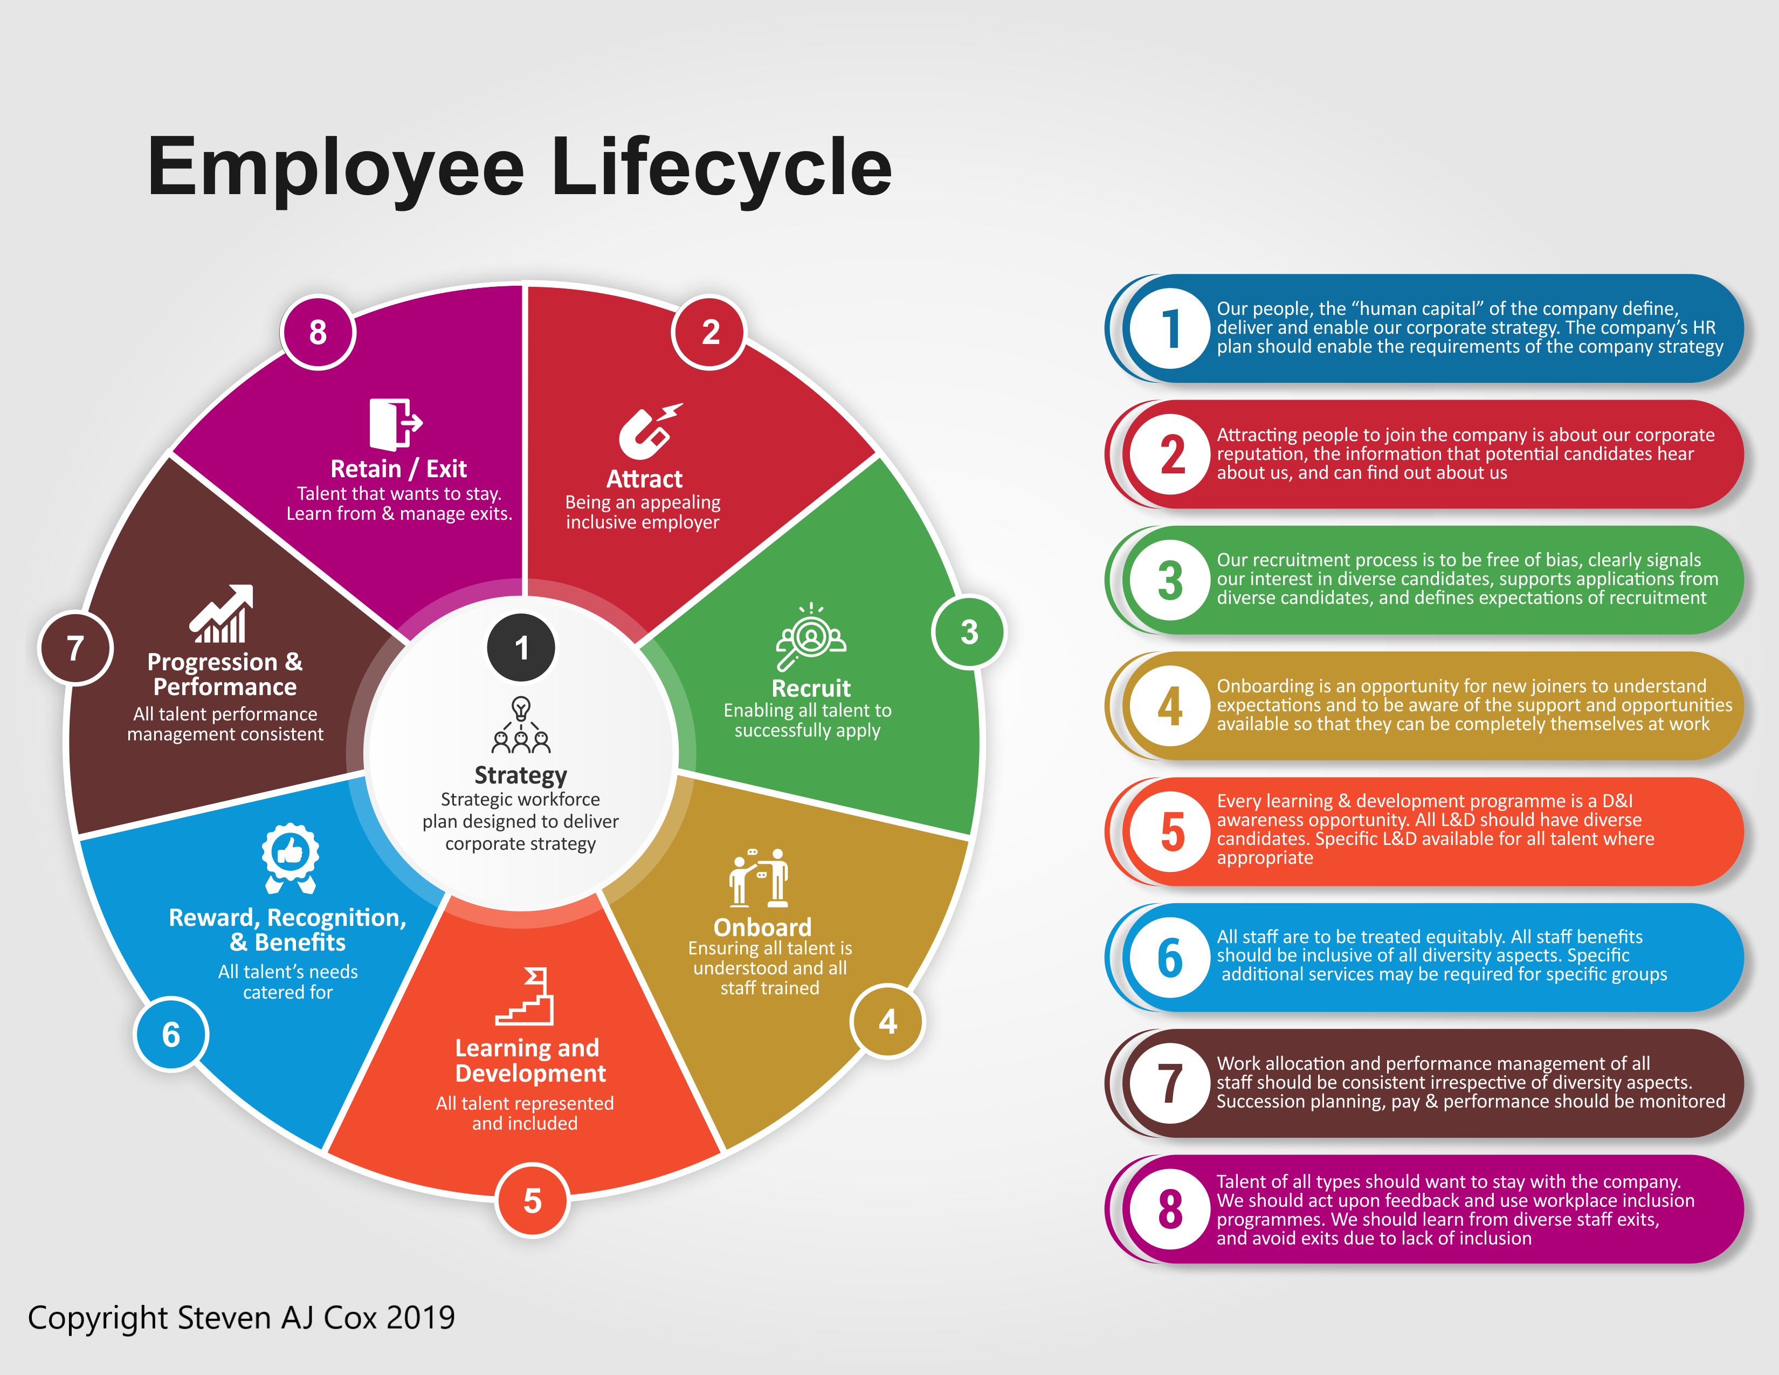
lifecycle of HR
Slezská univerzita

Slide 4
Human Resource Planning
The aim is to identify the employee needs that are essential for the company to implement its strategy and to develop procedures (plans) to meet these needs.
Effective planning = right people + right skills + right time + right place
The company needs to ensure that it has the following in the future
the necessary number of peoplewith the required education, skills and abilitiesat the right time and in the right placeat a reasonable cost !
"Hard planning" is about numbers of suitable people (quantitative analysis).
"Soft planning" is about qualities, motivation, loyalty, commitment (i.e. quality).
Slezská univerzita

Slide 5
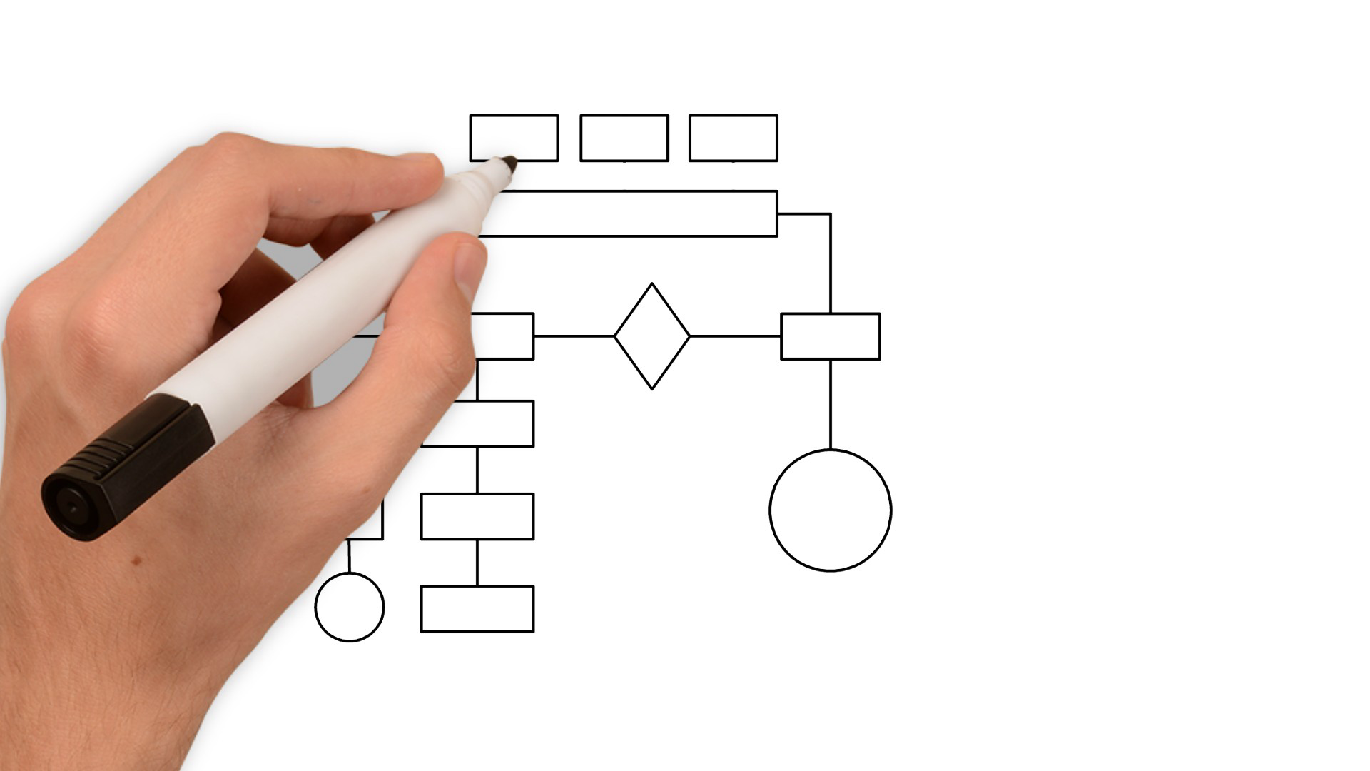
HR planning
Factors that influence the decision on need:
economic development,
political relations,
stability of markets,
anticipated state measures (taxes, interest rates, minimum wage development,
changes in legislation,
EMPLOYMENT DEVELOPMENT
what and how the company wants to invest in development
legislative constraints and frameworkage structure and employee mobility
Slezská univerzita

Slide 6
hr planning
business strategy
market analysis
technologies, plans, norms
specification of position and structure
position description
Slezská univerzita

Slide 7
HR planning
1
company has enough in appropriate quality
company has enough in appropriate structure (numbers of…)
2
lack of employees
3
surplus staff
Methods for estimating future need:
Expert estimates
based on past trends
in SME mainly intuitive methods
In an existing company - human resources audit.
What is examined in it?
Possible situations and measures:
Slezská univerzita

Slide 8
hr planning
In order to match the demand for work with the supply, the company creates an ACTION PLAN and "sub-plans".
recruitment plan training and development plans
career development plans
succession plans / talentmanagement
flexibility plans
stabilisation plans
plans for reducing redundancies (redundancies, retraining)
Slezská univerzita

Slide 9
the benefits of employee scheduling and
the role of technology and data
Advantages:
flexibility in responding to market changes without major losses (if the process is continuous)
reducing the costs of personnel changes
better employee morale (sense of stability)
competitive advantage
The role of technology and data:
analysis of employee performance
identification of training needs
recruiting new talent based on data and trends
helps to predict
Slezská univerzita

Slide 10
planning stuff and design of the role
Planning recap: objective and output.
Once we know how many employees we need and what skills they should have, the next logical step is to figure out what work these people will do and how they will do it.
Once we have planned our workforce, we need to ensure that the jobs are designed to:
Maximize productivity and efficiency.
Are attractive to employees.
Were meaningful and relevant to the skills and needs of the organisation.
Slezská univerzita

Slide 11
planning stuff and design of the role
Creating an optimal job structure is the essence of the HR process.
Each job is assigned a job task.
Each job is linked to the responsibility for the tasks assigned.
An important step is to determine the requirements of the employees and the conditions for effective performance of the tasks.
Slezská univerzita

Slide 12
job position
The job also determines the employee's position in the company and his or her placement in the organisational structure.
supervising position
job position
subordinate job posiotion
subordinate job posiotion
same job position
subordinate job posiotion
A workplace is the smallest organizational unit in an organization.
A group of jobs with similar descriptions and specifics = job function.
One job function in an enterprise may contain X number of jobs.
Control question: What does it matter how many there are?
Slezská univerzita

Slide 13
job design
The work assignment is part of the job.
Work tasks can be broken down into work operations.
The important thing is that the tasks are directed towards a result.
Division of labor = how the work process is divided into tasks.
E.g. software development team, restaurant staff...
job position
tasks and duties
Powers (competencie) and responsibilities
sources
conditions for an employee
requirements for the employee
Divide the position on the steps and define what is the required output:
Task 1: customer support
Task 2: completing some part of the product
Slezská univerzita

Slide 14
job design
There are responsibilities associated with the performance of tasks.
For example, customer support
Work task: Resolve customer queries and problems.
Duties: Adherence to communication principles. Employee must be professional, courteous and communicate clearly with customers.
Responding on time:Customer support must respond to inquiries in a timely manner to maintain customer satisfaction.
Follow company rules and policies: Problem resolution must be in accordance with company policies, including services offered, warranties, or return policies.
job position
tasks and duties
competence and responsibility
sources
conditions
requirements for the employee
Next samples of positions: waiter, software developer
Slezská univerzita

Slide 15
job design
Competencies enable staff to carry out their tasks and duties, while accountability ensures that they bear the consequences for the results of their work.
E.g. again customer support.
Competencies:
Ability to decide on refunds or replacements: a customer support worker can, to a certain extent, decide on his/her own to approve a complaint or refund, without having to consult a supervisor for each decision.
Access to sensitive customer data: The worker has access to customer accounts and personal data in order to effectively resolve their problems.
Accountability (responsibility):
Accountability for the quality of customer service: The employee is responsible for customer satisfaction and for ensuring that their problems are resolved correctly and in a timely manner.
Responsibility for the protection of sensitive data: the employee is responsible for the proper handling of personal data and must not misuse or disclose it to unauthorized persons.
PRACOVNÍ MÍSTO
Úkoly a povinnosti
Pravomoci a odpovědnost
Využívané zdroje
Podmínky vykonávání práce
Požadavky na pracovníka
Slezská univerzita

Slide 16
job design
Job conditions can effect the effectivity of empoyees and the way, how the fulfill their tasks. It is not only physical aspects, also organizational.
That's what they look like for customer support positions:
Work environment: Usually in an office or remote (home office), with access to a computer, telephone and specialized software to manage customer requests.
Working hours: work often involves shifts, including evenings, weekends and holidays if the company offers round-the-clock support.
Stress and Pressure: Working under pressure, especially with demanding or conflicted customers, can be stressful. Good communication skills are key to successfully handling these situations.
PRACOVNÍ MÍSTO
Úkoly a povinnosti
Pravomoci a odpovědnost
Využívané zdroje
Podmínky vykonávání práce
Požadavky na pracovníka
Slezská univerzita

Slide 17
specification of position
Each job has its own specific requirements, which include the necessary knowledge, skills, abilities and sometimes even personal qualities.
These requirements are necessary to successfully perform job tasks and duties.
Customer support worker requirements:
Communication Skills: Excellent verbal and written communication is essential for effective problem solving and customer interaction.
Ability to handle stress: The employee must be able to work under pressure, handle complaints and conflict situations with customers.
Knowledge of the company's products or services: Must have a thorough knowledge of products and services in order to effectively respond to inquiries and resolve problems.
Patience and empathy: Ability to deal with customers in a helpful and empathetic manner, especially in crisis situations.
jo position
tasks and duties
competencies and responsibilities
sources
conditions
requirements on the employee
Slezská univerzita

Slide 18
sources used in job position
Resources used are an important part of any job and include everything that employees use to perform their tasks, from physical tools and equipment to software, information or human resources.
Resources used - customer support:
Customer Relationship Management (CRM) software:
Tools like Salesforce, Zendesk, or other CRM systems are used to record and track customer interactions.
Knowledgebase: An internal database with product, service, and process information to solve common problems.
Communication tools: phone systems, email, chat systems to communicate with customers and colleagues.
Company policies and guidelines: internal documents and policies that employees use to make decisions when working with customers.
job position
tasks and duties
competencies and responsibilities
sources
conditions
requirements
Slezská univerzita

Slide 19
job design process
Job creation is linked to the organisational structure. Closely linked to planning.
Each job has the following structure (Armstrong, 2020):
job content
job autonomy
work relationships
In which HR activities do we work most with job descriptions? (recruitment, appraisal, development and training, remuneration...)
Job analysis= A process that collects and analyses information about the tasks, responsibilities and job descriptions of a job.
It is carried out by HR in close collaboration with management and the people who work in the job.
However, there are also other actors involved (cooperating employees, internal and external customers, external consultancy agency...).
Sources of information:
analysis of internal documents (inventory of existing descriptions, organisation chart,working procedures and standards)
interviews with employees
snapshot of the working day observation
job design and specification
Slezská univerzita

Slide 20
databases of existing positions
www.nsp.cz
Updated regularly, the National Occupational Directory is a catalogue of descriptions, including pay and current labour market needs.It is managed by the Ministry of Labour and Social Affairs, with the cooperation of administrative authorities and local government.It serves as a basis for https://www.narodnikvalifikace.cz/ .
https://www.onetonline.org/
The American equivalent, it contains very current occupations, It also includes apps for users to test themselves for their own career needs (Interest Profiler), their profile and options (My Next Move), an app for veterans (how to use military experience in civilian life), and a Spanish voice module, for example.
Slezská univerzita

Slide 21
flexibility of job positions
Job flexibility refers to the ability of an organisation to adapt jobs, working conditions or the actual tasks of individual workers to the changing needs of the business, the market or the employees.
Flexibility in tasks: employees can take on different roles or tasks according to the needs of the company. For example, they will focus on one project during a certain period but perform different tasks in the following period.
Geographical flexibility: The ability to work in different locations - for example, within different branches of the company, or to work remotely.
The goal of job flexibility is to increase efficiency, productivity, employee satisfaction and the company's ability to respond quickly to changes in the market or internal processes.
Flexible working hours: employees can work at times that suit them, while still completing their tasks by the deadlines. This includes part-time work, working from home or rotating shifts.
Slezská univerzita

Slide 22
agile approach to organisational change
The agile approach to organizational change is based on agile methodologies that are often used in project management, especially in IT. In the context of organisational change, agile means that an organisation is able to respond quickly and effectively to change, adapting its structures, processes and culture to dynamic market conditions.
Teamwork: the agile approach emphasizes the autonomy of teams that have greater decision-making power. Teams can respond quickly to new demands and changes, increasing their flexibility and efficiency.
Adaptability and innovation: Agile companies are open to new ideas and change. They encourage continuous improvement and innovation in all parts of the organisation.
Feedback and continuous evaluation: changes are constantly evaluated and analyzed, allowing for quick adjustments if results are different than expected.
An agile approach to organisational change is often associated with a high degree of adaptability and the ability of the organisation to survive and thrive in an environment of constant change and uncertainty.These approaches are particularly important today for companies that want to be competitive and innovative while ensuring the satisfaction and motivation of their employees.
Iterative processes: changes are made in smaller steps and based on feedback from employees or customers. Smaller steps that are quick to implement and adaptable are preferred instead of large and complex organisational changes.
Slezská univerzita

Slide 23
task
First steps with your project
Select a specific job position and create a detailed description based on data from the National System of Occupations (NSP, Czech Republic) or the O*NET OnLine (USA) database. This task will help you understand job definitions, key requirements, and responsibilities.
Steps to Complete the Task:
Job Selection
Choose one of the proposed positions or another relevant job of your interest.
Examples of possible positions: Marketing Specialist, HR Generalist, IT Project Manager, Financial Analyst…
Slezská univerzita

Slide 24
task
2. Research in Databases
Use the National System of Occupations (https://nsp.cz/) or O*NET OnLine (https://www.onetonline.org/) to gather job-related information.
Find information about:
Typical tasks and responsibilities
Required skills and qualifications
Salary range and working conditions
3. Structured Job Description
Create a structured job description following this outline:
Job title
Main responsibilities and tasks
Required skills and qualifications
Industry or region-specific requirements
Slezská univerzita

Slide 25
rEFERENCES
Armstrong, M., 2020. Armstrong's handbook of human resource management practice. London: Kogan Page. ISBN: 978-0-7494-9827-6.
CRAWSHAW, J., BUDHWAR, P. a DAVIS, A., 2020. Human Resource Management. 3rd edition. SAGE Publications Ltd., London. ISBN 978-1-5264 9900-4.
Internetové zdroje – specializované weby zaměřené na personální práci, odborná diskuzní fóra, vzhledem ke značnému množství změn i zprávy z denního tisku.
Slezská univerzita

Slide 26
Thank you for your attention
www.slu.cz/opf/cz

