Slide 1
personnel management
Performance appraisal
lecture 4
Ing. Helena Marková, Ph.D.
www.slu.cz/opf/cz

Slide 2
brief annotation of the lecture
Motivation
Performance management cycle.
Main features of performance appraisal.
Performance appraisal system: tools and techniques.
Relationship of performance appraisal and job analysis.
Objectives of performance appraisal: potential benefits and potential complications.
Methods of collecting data: past-oriented and future oriented.
Peer and self-assessment: principles and criteria.
Legal and cross-cultural implications.
Slezská univerzita

Slide 3
motivation
Employee motivation is a process that leads to people wanting to do their jobs effectively and with commitment. It is why employees do what they do and how hard they try.
Key elements of motivation:
Needs and wants - People want to satisfy their personal needs, such as having a secure income, being recognised, or having opportunities for development.
Goals - Employees need to see the purpose of their work and know that they are achieving some goals.
Rewards - Motivation is enhanced by rewards, which can be tangible (money, bonuses, benefits) and intangible (praise, recognition, good relationships with colleagues)
Why is motivation important?
Motivated employees are more productive, more loyal and contribute to a better company atmosphere. Conversely, demotivation leads to lost performance, higher turnover and stress in the workplace. Motivation is what drives people forward. For employees, it is a combination of rewards, goals and an environment that gives them purpose. Without motivation, performance declines; with motivation, performance increases.
Slezská univerzita

Slide 4
Theory of motivation
All of these theories arose in response to specific problems:
The Industrial Revolution raised productivity issues in factories.
Economic crises forced firms to look for ways to maintain employee performance.
Technological advances and the development of new industries increased the emphasis on human creativity and self-actualization.
Slezská univerzita

Slide 5
Theory of motivation
Slezská univerzita

Slide 6
Theory of motivation
Slezská univerzita

Slide 7
Theory of motivation
Slezská univerzita

Slide 8
Theory of motivation
Slezská univerzita

Slide 9
Motivation & performance appraisal
Motivation theories show us that people have different needs and desires that drive them to perform better - some want recognition, others want security, others want growth.
How can we as managers find out what really motivates each individual employee?
One of the best tools is employee evaluations.
With it, we can not only evaluate their performance, but also discover what motivates them, what's holding them back, and how to provide feedback that will drive them forward.
So if we understand how motivational theories work, we can link them directly to the practice of employee appraisal.
How to effectively appraise employees and how the process affects their motivation.
Setting goals and performance management practices based on them is also important to getting the appraisal process right.
Slezská univerzita

Slide 10
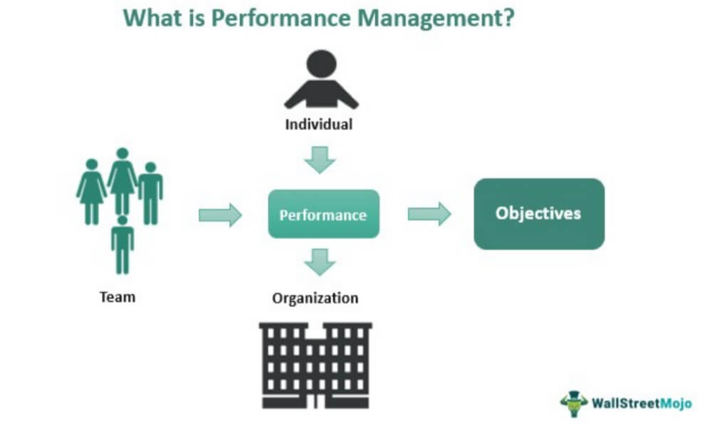
Motivation & performance appraisal
Definition of performance management: Performance management is a periodic, systematic, and objective process of developing an employee to perform their job to the best of their ability. The performance appraisal is thus part of performance management.
Stages of the cycle: Planning → Monitoring → Reviewing → Rewarding
Role in organizational strategy
Slezská univerzita

Slide 11
Why performance appraisal
Improve employee performance as well as ......
provide feedback
motivate employees
set new goals and development plans
support career development and identify talent
strengthen equity (equal access to rewards, promotions...)
improve communication between employees and management
identify training needs and development opportunities
align individual goals and organizational goals
Slezská univerzita

Slide 12
3 areas of appraisal
The concept of goal setting (individual, team) is used to evaluate performance
Ii is used the code of ethics, corporate culture values to evaluate behaviour. Usually a rating scale is used because this evaluation is quite subjective.
Work and social behavior are evaluated by interviews, psychological tests, Development Centers are used to determine potential.
potential
performance
behavior
Slezská univerzita

Slide 13
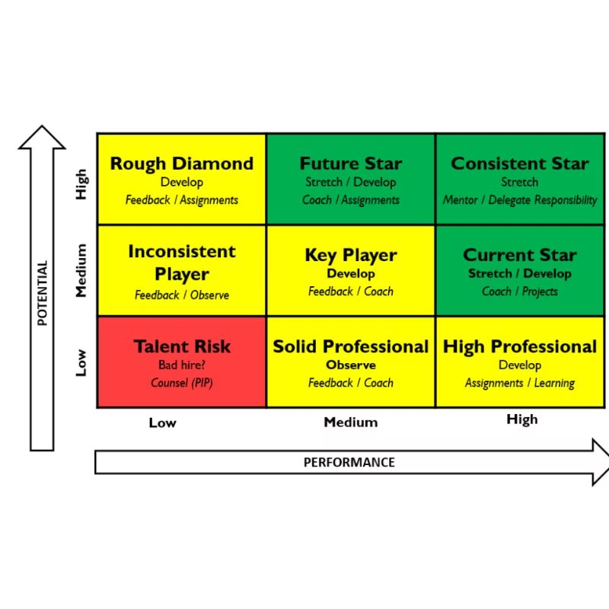
PERFORMANCE AND POTENTIAL RATING MATRIX - STARS, CENTRE AND BRAKES
Slezská univerzita

Slide 14
Main Features of Performance Appraisal
Periodic evaluation
Individual vs team focus
Goal alignment
Feedback mechanism
Slezská univerzita

Slide 15
Objectives of Performance Appraisal
🎯 Main Objectives:
Evaluate employee performance against predefined standards.
Provide feedback to guide performance improvement.
Support decision-making related to promotions, compensation, training, and development.
Align individual goals with organizational strategy.
✅ Potential Benefits:
Performance Improvement: Helps employees understand what is expected and how to improve.
Employee Development: Identifies skill gaps and training needs.
Motivation & Engagement: Recognition can boost morale and productivity.
Succession Planning: Highlights high-potential employees for leadership roles.
Legal Documentation: Maintains a record of employee performance for HR decisions.
⚠️ Potential Complications:
Bias and Subjectivity: Appraisals can be influenced by personal opinions, halo/horn effect, or favoritism.
Inconsistency: Without standardized criteria, appraisals can vary widely between managers.
Stress and Demotivation: Negative feedback, if not delivered constructively, can lead to disengagement.
Time-Consuming: Especially in large organizations, preparing and conducting evaluations requires significant time and effort.
Resistance to Feedback: Some employees may reject feedback or become defensive, undermining the appraisal's purpose.
Slezská univerzita

Slide 16
Relationship with job analysis
How job descriptions and specifications inform appraisal? Examples from your task – HR expert
Importance of clear job standards
Appraisal based on job-relevant criteria
Slezská univerzita

Slide 17
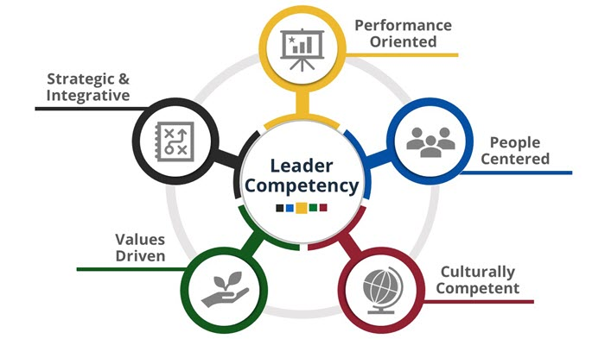
Competency framework model as a base
Slezská univerzita

Slide 18
Tools and techniques of appraisal systems
Quantitative Tools: Rating scales, checklists (Rating Scales: Employees are rated, e.g., from 1 to 5, based on specific criteria such as cooperation, accuracy, or initiative.Checklists: The manager checks whether the employee meets certain tasks or skill requirements.)
Qualitative Tools: Narrative reports, critical incidents (Narrative Reports: The manager writes a descriptive evaluation of the employee’s performance – strengths, weaknesses, and recommendations.Critical Incident Method: Records specific positive or negative events that had a significant impact on performance.)
Digital tools: Performance management software, dashboards (Performance Management Software (e.g., SAP SuccessFactors, Workday): Enables automated data collection, goal setting, 360-degree feedback, and real-time performance tracking.Online Dashboards: Visual representation of employee performance, comparisons between teams or individuals.)
Slezská univerzita

Slide 19
Methods of collecting appraisal data
Past-Oriented:
Performance records (https://hubstaff.com/blog/wp-content/uploads/2024/03/Hubstaff-monthly-template-document.png)
Behaviorally Anchored Rating Scales (BARS) (https://www.purdue.edu/hr/lod/media/docs/annualevaluationcompetencybehavioranchors.pdf )
Future-Oriented:
Management by Objectives (MBO)
Assessment centers
Development planning
Slezská univerzita

Slide 20
360 degree feedback
Slezská univerzita

Slide 21
360 degree feedback
Phase 1 - communication, identification with the method - emphasis must be placed primarily on explanation, clarification of benefits.
Phase 2 - evaluation process - participating evaluators at all levels develop the evaluation, the evaluated also performs self-assessment. The outputs are forwarded to the evaluator's supervisor.
Phase 3 - evaluation - the evaluator's supervisor processes the evaluation outputs, summarises them.
Phase 4 - feedback - the evaluator's supervisor sensitively confronts the evaluator with the findings. Together with the appraisee, updates learning needs and sets SMART g
Slezská univerzita

Slide 22
360 degree feedback
Example of attributes that can be evaluated:
Communication - timely, feedback communication to external and internal partners
Creativity - employee comes up with new ideas, innovates processes
Collaboration - employee is a team player, respects other members in the project
Leadership - uses leadership competencies in accordance with their responsibilities
Method of evaluation: - e.g. three scale numerical value, verbal evaluation
Slezská univerzita

Slide 23
Peer and self assessment (evaluation)
Peer Assessment:
Employees evaluate the performance of their colleagues—typically within teams where they closely collaborate.
It offers valuable insight into areas like teamwork, communication, helpfulness, and cooperation that managers might not fully observe.
Self-Assessment:
The employee evaluates their own performance, achievements, and areas for improvement.
It encourages reflection, self-awareness, and personal development, and helps employees prepare for performance discussions with their manager.
Principles and Criteria:
Trust and openness: The process must be built on mutual trust—employees need to feel safe giving and receiving feedback.
Objectivity: Clearly defined criteria help reduce personal bias or emotion-driven judgments.
Constructive focus: The goal is to support improvement—not to criticize or blame.
Anonymity (in peer reviews): In some systems, peer feedback is anonymous to encourage honesty and minimize tension.
Advantages:
Provides a broader view of employee performance—not just from a supervisor.
Encourages a team-oriented culture and mutual support.
Increases personal responsibility for one's own performance and development.
Disadvantages:
Risk of bias, favoritism, or rivalry between colleagues.
Reluctance to give honest feedback—especially negative.
Requires training on how to give and receive constructive feedback effectively.
Slezská univerzita

Slide 24
Legal Implications of Performance Appraisal
Performance appraisals are not just tools for development and feedback—they also have important legal consequences. When done poorly or unfairly, they can expose organizations to legal risks such as discrimination claims or wrongful termination lawsuits.
Avoiding discrimination (EEO laws) – legal compliance matters!
Appraisals are often used to make decisions about promotions, disciplinary actions, or dismissals.
Poor documentation or inconsistent evaluation can lead to legal challenges.
In many countries, employment laws require fair and non-discriminatory treatment of employees.
Slezská univerzita

Slide 25
Cross-cultural considerations
Cultural bias in performance expectations
Global performance standards vs local norms
Tips for multicultural settings (e.g., use of neutral language, diverse panels)
Hofstede cultural dimension theory
TASK 1
https://www.theculturefactor.com/country-comparison-tool?countries=france%2Cmalaysia
Slezská univerzita

Slide 26
Appraisal process - interview
prepration
Prepration of evaluatore
Appraisal interview
Appropriate time and place
Relationship with remuneration
outputs
Developent plan
Self evaluation
Supervisors evaluation
Developement, carrier and educational plat
Furute goals
Carrier promotion
Correction of remuneration
Preparation of employees
Preparation of dokcuments and materials
Slezská univerzita

Slide 27
appraisal interview common mistakes
Lack of Preparation
Focusing Only on Recent Events (Recency Bias)
Being Too Vague or General
Avoiding Difficult Conversations
Talking Too Much, Listening Too Little
Letting Personal Bias Influence Judgement
Not Linking Performance to Goals
No Action Plan or Follow-Up
Lack of Empathy or Emotional Intelligence
Inconsistent Standards
Slezská univerzita

Slide 28
appraisal interview
Tips for employee
https://www.youtube.com/watch?v=3AAvj8WMaXc
Slezská univerzita

Slide 29
Task 2
Design appraisal criteria and process for your proffesion – HR expert
Next lesson – check part of your semestral project
Slezská univerzita

Slide 30
rEFERENCES
Armstrong, M., 2020. Armstrong's handbook of human resource management practice. London: Kogan Page. ISBN: 978-0-7494-9827-6.
CRAWSHAW, J., BUDHWAR, P. a DAVIS, A., 2020. Human Resource Management. 3rd edition. SAGE Publications Ltd., London. ISBN 978-1-5264 9900-4.
https://www.shrofile.com/blog/recruitment-process/
Internetové zdroje – specializované weby zaměřené na personální práci, odborná diskuzní fóra, vzhledem ke značnému množství změn i zprávy z denního tisku.
Slezská univerzita

Slide 31
Thank you for your attention
www.slu.cz/opf/cz

