Slide 1



Business environment
Ing. Lucie Reczková

Slide 2
Introduction and Important Information
Lucie Reczkova
Office: B304
Email: reczkova@opf.slu.cz
Office hours: Tuesdays – 9:00 – 10:30
Notes:
csvukrs

Slide 3
Teaching Delivery Schedule
Week | Date | Lecture
w1 | 20.02.2025 | What is a business environment
w2 | 27.02.2025 | External business environment 1
w3 | 06.03.2025 | External business environment 2
w4 | 13.03.2025 | Internal business environment 1
w5 | 20.03.2025 | Internal business environment 2
w6 | 27.03.2025 | Internal business environment 3
w7 | 03.04.2025 | Half-term Exam
w8 | 10.04.2025 | Global business environment
w9 | 17.04.2025 | Business environment of multinational and transnational companies
w10 | 24.04.2025 | Evaluation of the quality of the business environment
w11 | 01.05.2025 | Bank holidays
w12 | 08.05.2025 | Bank holidays
w13 | 15.05.2025 | Family business
Notes:
csvukrs

Slide 4
Exams and Assessment Guide
1. You need to complete an assignment for max. of 15 points (20%). The due date is 18.5.2025 (midnight).
2. You need to record a video presentation of your assignment (5 points), due date is on 18.5.2025 (midnight).
3. There will be a half-term exam for max. of 20 points (20%). The date is 03.04.2025.
4. Final examination will start on 19.05.2025. You can get max. of 60 points (60%).
Notes:
csvukrs

Slide 5
Exams and Assessment Guide
The final marking guide is as follows:
Grade Points
A 100-92
B 91-84
C 83-76
D 75-68
E 67-60
F 59-0
Notes:
csvukrs

Slide 6
Assignment
Group assignment (2500 words +/-10%)
Group of 2 to 3 members
Due date: 18.5.2025 (until midnight)
Assignment Task:
The purpose of your assignment is to analyse the internal and external environment of a company of your choice.
For your assignment, choose ONE company of small or medium size and analyse the company’s external and internal environment in which it inhabits.
Notes:
csvukrs

Slide 7
Assignment
General guidance:
Before you choose your company, please think about the sources for your assignment. Are they easily available from the internet or any database? Are they relevant? Are they available in English or will you have to translate them? I strongly recommend finding a company with information available in English as it will save you time to translate it.
Cite all information used in your work that is clearly from a source. Try to ensure that all sources in your reference list are seen as citations in your work, and all names cited in the work appear in your reference list.
Reference and cite your work in accordance with the University’s chosen referencing style (use the University’s internal norm for citing and referencing https://www.slu.cz/opf/cz/file/cul/e617c25f-1c26-4c28-9e09-a2920f626d1d look at the appendix 4. and 5.).
Please do not exceed the word limit.
Notes:
csvukrs

Slide 8
Assignment - Task specific guidance
1. Introduce your company: Who is it? What does it do – product/services? Is it private/public/voluntary? Which country does it operate in? What is the size of the company?
2. An analysis of the external environment in which the company exists:
· PESTEL - For each factor detailed state what the implications are.
· Opportunities and Threads from SWOT analysis
· Market analysis – using STP and Perceptual mapping.
· Competitor analysis using Porter’s Five forces analysis.
3. An analysis of the internal environment including:
· Product analysis – using BCG model.
· Competitive advantage – using VRIO analysis.
· Strengths and weaknesses from SWOT analysis
· Business model using Business model canvas.
· The impact of the company on the environment and vice versa the impact of the environment on the company – how ecological is their production (the resources, processes, and products/services), how this company mitigates its impact on the environment (what measures does it apply and how this is communicated to their stakeholders), do they practice CSR or ESG (they can practice some of the activities of CSR even without publicly stating this).
Opportunities for feedback sessions for the assignment will be provided during lectures or office hours.
Notes:
csvukrs

Slide 9
Assignment – video presentation
You need to record a video presentation of your assignment (5 points), due date is on 18.5.2025 (midnight).
The video should be a max. of 5 minutes
The presentation should be done by all members of the team.
You need to upload the video presentation to the box.slu.cz – the link is in the interactive syllabus.
Notes:
csvukrs

Slide 10
Reading list
The main reading will be from supplied material available on IS in the folder of each lecture.
For today:
The Business Environment - A Global Perspective: Chapter 1 - External environment
Notes:
csvukrs

Slide 11
Lecture outline
What is business environment?
Environments and the business
Circular economy
Sustainable development goals (SDG)
The European Green deal

Slide 12

What is business environment?
‘Environment’ general concept
covers all forces influencing any aspect of organisation and its activity.
‘Business’ is any type of organisation
=> commercial, government, non-for-profit
‘Business Environment’ - encompassing any and all influences which are external and internal to the organisation in question.

Slide 13
Why we need to study business environment?
We need to analyse business environment for many reasons:
The nature of the BE directly influences the business activities (e.g. its markets, technologies, workforce etc.)
To recognise environmental factors and changes to ensure the success of the organisation (changes such as new product launch, changes in production technology, staff recruitment drives etc.)
Profit and the prosperity of organisation are related to global, national and local environmental conditions.
Reaction to changes is important for strategic planning of the organisation.

Slide 14
Model of Business Activity
We can differentiate between organisations in terms of their:
Size
Type of product/market
Methods of business finance (loan, asset finance, angel investors, grants, invoice financing etc.)
Scale of operations (capacity to produce)
Legal status (Public Limited Companies, Limited Liability companies, Joint Ownership, Cooperative Society, Public Administrations including Local Authority, Religious Institutions)
Notes:
csvukrs

Slide 15
Model of Business Activity
Regardless of previous distinctions, all businesses are involved in the same basic activity:
=> ‘transformation of inputs (resources) into outputs (products or services)’
Notes:
csvukrs

Slide 16
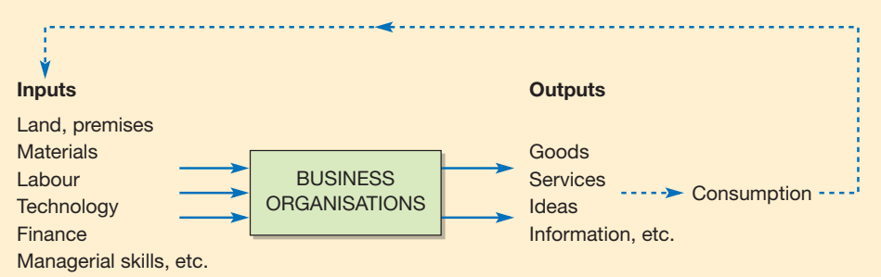
Model of Business Activity
The combination of resources transformed into products and services vary in terms of needs of the organisation and vary over time.
Notes:
csvukrs

Slide 17
Model of Business Activity
Inputs help create output and output creates inputs.
The output of one organisation may represent input for another, thus:
=> organisations are interrelated, and the prosperity of any single business is constantly linked with the prosperity of another company/ies.
‘organisations are entities made up of interrelated parts which are intertwined with the outside world’.
Notes:
csvukrs

Slide 18
What Environments does the business operate in?
Environment
External Internal
Notes:
csvukrs

Slide 19
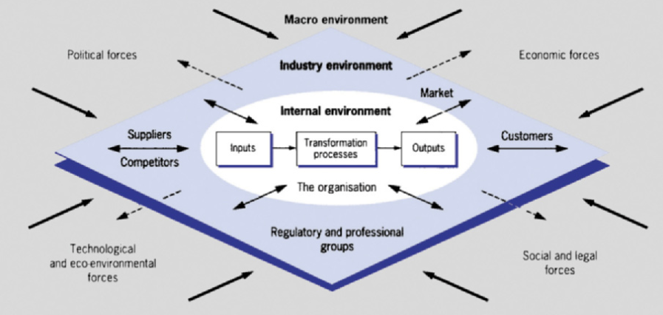
What Environments does the business operate in?
Notes:
csvukrs

Slide 20
Exercise – 10 mins
Think of any company of your choice, then list as many of its inputs and outputs. Then explain how the company outputs can be related to other companies’ inputs.
Notes:
csvukrs

Slide 21
Environments and the business
‘The environment is in the process of becoming a major new competitive area for business’
quoted by Elkington and Burke already in 1987
the impact is in both ways business on the environment and the environment on the business

Slide 22
Environments and the business
‘Some companies have acknowledged that there is enhanced corporate reputation to be gained through recognizing that capitalism will be most successful when it cares for its customers, its producers, the environment and the communities in which it operates.’
(McIntosh, 1998, p.3)
Business Ethics
Sustainability
Corporate Social Responsibility (CSR)
Notes:
csvukrs

Slide 23
Sustainability
Three broad areas – economic, societal, and environmental
A development that ‘meets the needs of the present without compromising the ability of future generations to meet their own needs’.
Notes:
csvukrs

Slide 24
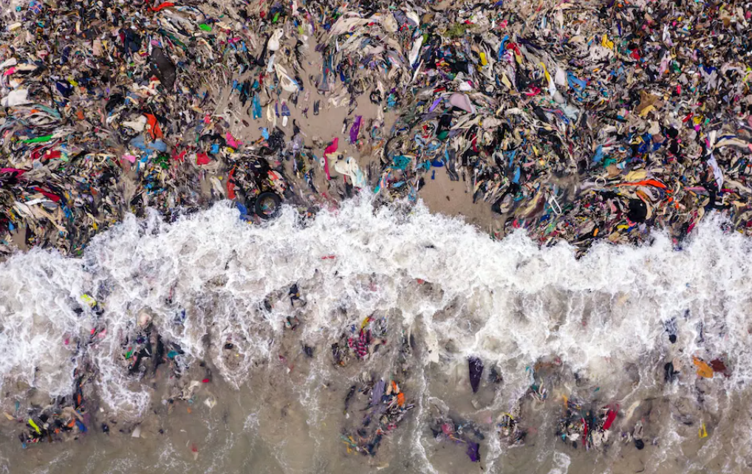
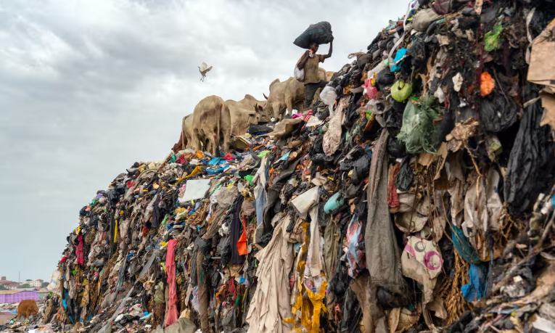
Sustainability
Growing pressure of national governments and societies on organisations to consider the impact of their entire value chain on the planet.
Questions for you: 5 mins. excercise
Do you think we as society, including businesses and governments are doing enough for sustainable development?
In assessing claims by companies that they are sustainable, how can we judge the genuine from the tactical? Is it even possible to find the truth?
Notes:
csvukrs

Slide 25
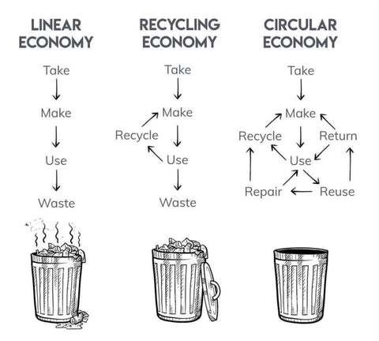
Circular economy
The circular economy is a model of production and consumption, which involves:
sharing,
leasing,
reusing,
repairing,
refurbishing and
recycling
existing materials and products as long as possible. In this way, the life cycle of products is extended.

Slide 26
Circular economy in a nutshell
Let’s watch a video:
https://www.europarl.europa.eu/topics/en/article/20151201STO05603/circular-economy-definition-importance-and-benefits
Notes:
csvukrs

Slide 27
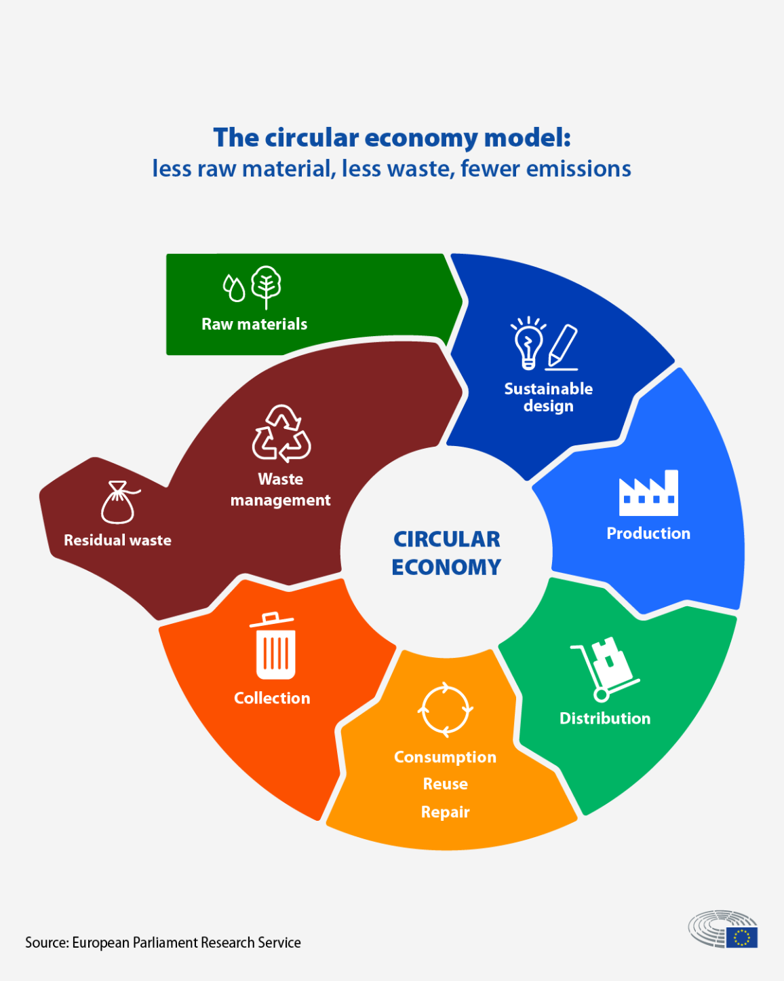
Circular economy in a nutshell
In practice, a circular economy implies reducing waste to a minimum.
When a product reaches the end of its life, its materials are kept within the economy wherever possible.
These can be productively used again and again, thereby creating further value.
Measures leading towards a circular economy include reusing, repairing, refurbishing and recycling existing materials and products.
What used to be considered as 'waste’ can be turned into a valuable resource.
Let’s research these terms
Notes:
csvukrs

Slide 28
Opportunities and challenges of Circular economy
Potential opportunities
Moving towards a more circular economy has both an environmental and economic rationale.
Reduced pressures on the environment: a circular economy would significantly reduce greenhouse gas (GHG) emissions through better waste management and reduced use of resources (such as energy, water, land and materials) in manufacturing, with positive impacts on the climate.
Enhanced security of supply of raw materials: a circular economy would mitigate risks associated with the supply of raw materials, such as price volatility, availability and import dependency.
Increased competitiveness: a circular economy could bring savings to businesses and consumers through improved resource efficiency. A 2015 Ellen MacArthur Foundation report estimates that by 2030, a shift towards a circular economy could reduce net resource spending in the EU by €600 billion annually, bringing total benefits estimated at €1.8 trillion per year once multiplier effects are accounted for.
Notes:
csvukrs

Slide 29
Opportunities and challenges of Circular economy
Potential opportunities
Innovation: a circular economy could trigger a large innovation drive across sectors of the economy because of the need to redesign materials and products for circular use.
Growth and jobs: a circular economy could strengthen growth and create new jobs. It is estimated that the transition would increase GDP by 1 to 7 percentage points by 2030, depending on whether a higher pace of technological change is taken into account, and that it would have an overall positive impact on employment, although jobs in specific sectors could also be threatened.
Notes:
csvukrs

Slide 30
Opportunities and challenges of Circular economy
Potential challenges:
A transition towards a more circular economy would face a number of barriers and challenges.
Finance: a transition to a circular economy would involve considerable transition costs, such as R&D and asset investments, subsidy payments to promote new business models, and public investment in waste management and digital infrastructure. For businesses, in particular small and medium-sized enterprises (SMEs), the cost of 'green' innovation and business models is considered as one of the major barriers to the adoption of more sustainable practices.
Key economic enablers: a series of key economic enablers are lacking, inter alia, pricing systems encouraging efficient resource reuse and reflecting full environmental costs; incentives for producers and recyclers to work together in order to improve performance within and across specific value chains; and markets for secondary raw materials.
Skills: a circular economy would require technical skills which are currently not present in the workforce. Skills would for instance enable businesses to design products with circularity in mind, and to engage in reuse, refurbishment and recycling. Missing technical skills could be particularly problematic for SMEs.
Notes:
csvukrs

Slide 31
Opportunities and challenges of Circular economy
Potential challenges:
A transition towards a more circular economy would face a number of barriers and challenges.
Consumer behaviour and business models: a circular economy would require systemic shifts in consumer behaviour and business models, with implications for everyday behaviour, in terms of waste sorting and food waste for instance. Many industries are currently based on a fast turn-around driven by fashion (typified by fast fashion in clothes and electronic devices, among others). Businesses and consumers have little knowledge about the potential benefits of a circular economy and tend to be reluctant to adopt new business models (e.g. leasing rather than owning).
Multi-level governance: a transition to a circular economy would require action at many levels (e.g. international, European, national, local, business, and individual) and in many policy areas (e.g. waste management, professional training, packaging and product design, research and development, and finance). External trade aspects and existing EU policies such as the internal market would have to be taken into account.
Notes:
csvukrs

Slide 32
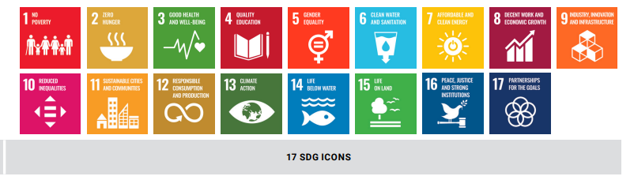
Sustainable development goals (SDG)
Do you know the 17 Sustainable development goals?
Let’s watch together
https://www.youtube.com/watch?v=e2S9wf5oVT4
https://www.youtube.com/watch?v=qfOgdj4Okdw

Slide 33
SDG history
The 2030 Agenda for Sustainable Development, adopted by all United Nations Member States in 2015, provides a shared blueprint for peace and prosperity for people and the planet, now and into the future.
At its heart are the 17 Sustainable Development Goals (SDGs), which are an urgent call for action by all countries - developed and developing - in a global partnership.
They recognize that ending poverty and other deprivations must go hand-in-hand with strategies that improve health and education, reduce inequality, and spur economic growth – all while tackling climate change and working to preserve our oceans and forests.
Notes:
csvukrs

Slide 34
SDG history
In June 1992, at the Earth Summit in Rio de Janeiro, Brazil, more than 178 countries adopted Agenda 21, a comprehensive plan of action to build a global partnership for sustainable development to improve human lives and protect the environment.
Member States unanimously adopted the Millennium Declaration at the Millennium Summit in September 2000 at UN Headquarters in New York. The Summit led to the elaboration of eight Millennium Development Goals (MDGs) to reduce extreme poverty by 2015.
The Johannesburg Declaration on Sustainable Development and the Plan of Implementation, adopted at the World Summit on Sustainable Development in South Africa in 2002, reaffirmed the global community's commitments to poverty eradication and the environment, and built on Agenda 21 and the Millennium Declaration by including more emphasis on multilateral partnerships.
At the United Nations Conference on Sustainable Development (Rio+20) in Rio de Janeiro, Brazil, in June 2012, Member States adopted the outcome document "The Future We Want" in which they decided, inter alia, to launch a process to develop a set of SDGs to build upon the MDGs and to establish the UN High-level Political Forum on Sustainable Development. The Rio +20 outcome also contained other measures for implementing sustainable development, including mandates for future programmes of work in development financing, small island developing states and more.
Notes:
csvukrs

Slide 35
SDG history
In 2013, the General Assembly set up a 30-member Open Working Group to develop a proposal on the SDGs.
In January 2015, the General Assembly began the negotiation process on the post-2015 development agenda. The process culminated in the subsequent adoption of the 2030 Agenda for Sustainable Development, with 17 SDGs at its core, at the UN Sustainable Development Summit in September 2015.
2015 was a landmark year for multilateralism and international policy shaping, with the adoption of several major agreements:
Sendai Framework for Disaster Risk Reduction (March 2015)
Addis Ababa Action Agenda on Financing for Development (July 2015)
Transforming our world: the 2030 Agenda for Sustainable Development with its 17 SDGs was adopted at the UN Sustainable Development Summit in New York in September 2015.
Paris Agreement on Climate Change (December 2015)
Now, the annual High-level Political Forum on Sustainable Development serves as the central UN platform for the follow-up and review of the SDGs.
Notes:
csvukrs

Slide 36
Implementation of SDG
Implementation Progress
Every year, the UN Secretary General presents an annual SDG Progress report, which is developed in cooperation with the UN System, and based on the global indicator framework and data produced by national statistical systems and information collected at the regional level.
Website to see the SDG Report: https://dashboards.sdgindex.org/
Notes:
csvukrs

Slide 37
The European Green deal
Striving to be the first climate-neutral continent
Very ambitious plan
Climate change and environmental degradation are an existential threat to Europe and the world.
To overcome these challenges, the European Green Deal will transform the EU into a modern, resource-efficient and competitive economy, ensuring:
no net emissions of greenhouse gases by 2050
economic growth decoupled from resource use
no person and no place left behind.
the balance between the amount of greenhouse gas (GHG) that's produced and the amount that's removed from the atmosphere
raising economic output while reducing negative environmental impacts that arise from the extraction of natural resources

Slide 38

The European Green deal
The European Commission has adopted a set of proposals to make the EU's climate, energy, transport and taxation policies fit for reducing net greenhouse gas emissions by at least 55% by 2030, compared to 1990 levels.
3 billion additional trees to be planted in the EU by 2030
Notes:
csvukrs

Slide 39
The European Green deal
All 27 EU Member States committed to turning the EU into the first climate neutral continent by 2050.
The EU now has legally binding climate targets covering all key sectors of the economy. The overall package includes:
emissions reduction targets across a broad range of sectors
a target to boost natural carbon sinks
an updated emissions trading system to cap emissions, put a price on pollution and generate investments in the green transition and social support for citizens and small businesses.
Member States will now spend 100% of their emissions trading revenues on climate and energy-related projects and the social dimension of the transition.
Carbon sinks- anything that absorbs more carbon from the atmosphere than it releases – for example, plants, the ocean and soil
The cap limits the total amount of greenhouse emissions cumulatively emitted by companies covered by the EU ETS.
Notes:
https://icapcarbonaction.com/en/about-emissions-trading-systems#:~:text=In%20an%20emissions%20trading%20scheme,are%20included%20in%20the%20the cap limits the total amount of

Slide 40
The European Green deal – is it achievable?
Is there a problem with the European Green Deal & can we fix it?
https://www.youtube.com/watch?v=64FIW0rbU-M
What’s the next for EU Green deal?
https://www.aljazeera.com/program/counting-the-cost/2024/6/6/whats-next-for-the-eus-green-deal
Notes:
csvukrs

Slide 41
Exercise
How can we all help to make a difference?
Work in pairs to make a list of things you’ve bought/been given this month. It could be food, beauty products, entertainment, clothing/fashion items or anything else!
Discuss what are they made from, how long will they last, what will you do with the item when it’s finished/you no longer have use for it? Can you think of alternatives that will create less waste? Think about Repairing, Reuse and Refill alternatives.

Slide 42
References
https://www.europarl.europa.eu/topics/en/article/20151201STO05603/circular-economy-definition-importance-and-benefits
https://thercollective.com/blogs/r-stories/circular-economy-vs-linear-economy
https://sustainabilityguide.eu/sustainability/circular-economy/
https://sdgs.un.org/goals
https://commission.europa.eu/strategy-and-policy/priorities-2019-2024/european-green-deal_en
Needle, D., & Burns, J. (2023). Business in context : an introduction to business and its environment. (8th edition / David Needle and Jane Burns.). Cengage.

