Slide 1
External Business Environment – part 1
Ing. Lucie Reczková

Slide 2
Lecture outline
External business environment
General business environment
PESTEL
The impact of business on the environment; the environment influencing business
The future of the relationship between environment and business
EU Taxonomy
Notes:
csvukrs

Slide 3
Reading material
The_Business_Environment_A_Global_Perspective_----1. Chapter External environment
Environment and business- CH1 the nature of the relationships
https://finance.ec.europa.eu/sustainable-finance/tools-and-standards/eu-taxonomy-sustainable-activities/eu-taxonomys-uptake-ground_en
https://www.unep.org/interactive/global-environment-outlook/
Notes:
csvukrs

Slide 4
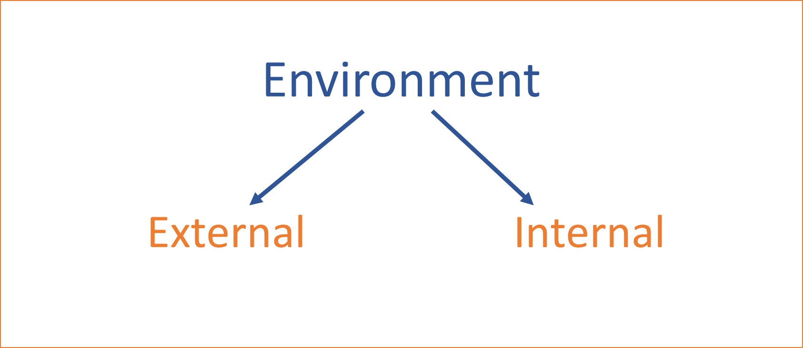
Recap from last lecture
Notes:
csvukrs

Slide 5
External business environment
‘proactive’
‘unknowable’
‘unstoppable’
Company X
‘threats’
‘reactive’
‘opportunities’
‘unpredictable’
External Environment

Slide 6
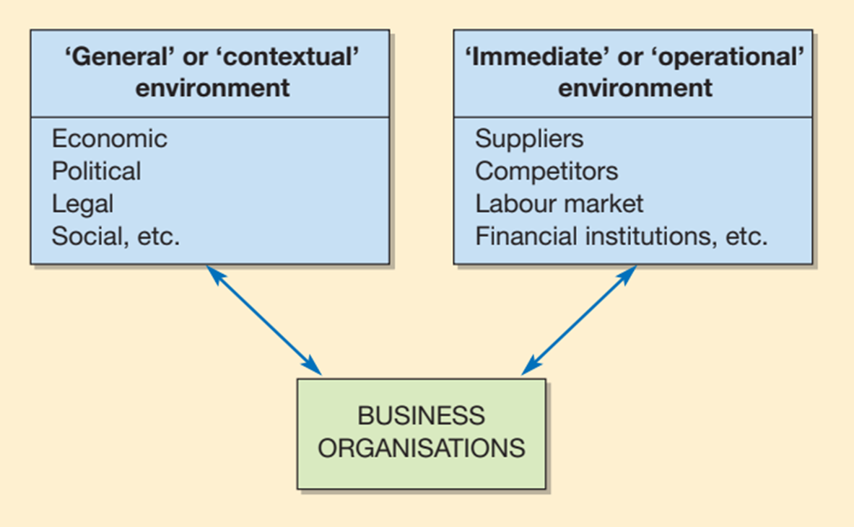
External business environment
Notes:
csvukrs

Slide 7
General (contextual) environment
general background where all companies operate
can emerge not only from local and national sources, but also from international and global sources.
macroenvironmental forces: economic, political, socio-cultural, demographical, technological, legal, ethical, and ecological.
Notes:
csvukrs

Slide 8
General (contextual) environment
These factors act on companies and industry environment.
These factors are so large that the business cannot control them and hardly influence them (there are some attempts to influence these factors).
Question: how can companies influence the macroenvironmental forces?
Notes:
csvukrs

Slide 9
Macroenvironmental factors
P = Political
E = Economic
S = Social/cultural
T = Technological
E = Ethical/Ecological
L = Legal
Why companies need to analyse these factors?
To understand these forces and on the basis of understanding them find out the opportunities and threads and therefore to be able to do strategic planning.
We need to analyse them
Notes:
csvukrs

Slide 10
Macroenvironmental factors
PESTEL analysis answers four key questions:
1. What environmental factors are affecting the industry/organisation?
2. Which of these are the most important for a company at the present time?
3. Which will be the most important for a company in the next few years?
4. What factors might represent opportunities or threats for a company (used in SWOT analysis)?
Notes:
csvukrs

Slide 11
PESTEL - Political factors
What is the political situation? How can it affect us?
A Politics - is a universal activity to resolve any conflicts or problems at the state level that affects (not only) businesses of all types and sizes.
A Government - refers to the institutions through which power tends to be formally and legitimately exercised.
Government can be cabinets, parliaments, councils, committees or congresses.
Government comprises of individuals and groups who at a particular time have the responsibility for controlling the state.
Notes:
csvukrs

Slide 12
PESTEL - Political factors
Government’s direct and indirect activities influence business activities.
Government can be seen as the biggest business on the national level.
The nature of political system and its institutions –
A political system refers to the organization and structure through which a society governs itself, encompassing various institutions and processes that manage power, authority, and decision-making within a community.
Stable government system – is one that survives through crises without internal warfare (engagement in war or conflict)
Notes:
https://www.sciencedirect.com/topics/computer-science/political-system

Slide 13
PESTEL - Political factors
Ease of doing business - measures an economy’s performance with respect to a measure of regulatory best practices
Easy of doing business by World Bank, discontinued from 202, awaiting new form of assessing business and investment.
https://data.worldbank.org/indicator/IC.BUS.EASE.XQ
Czech Republic – rank 41
Can you find out how is your country doing?
Notes:
csvukrs

Slide 14
PESTEL - Political factors
Influence of public opinion on political policy –
how much impact it has;
how much the impact increases as the importance of issues increases;
to what extent the impact of public opinion may be negated by interest groups, social movement organizations, political parties, and elites;
whether responsiveness of governments to public opinion has changed over time.
Notes:
https://www.researchgate.net/publication/240724456_The_Impact_of_Public_Opinion_on_Public_Policy_A_Review_and_an_Agenda

Slide 15
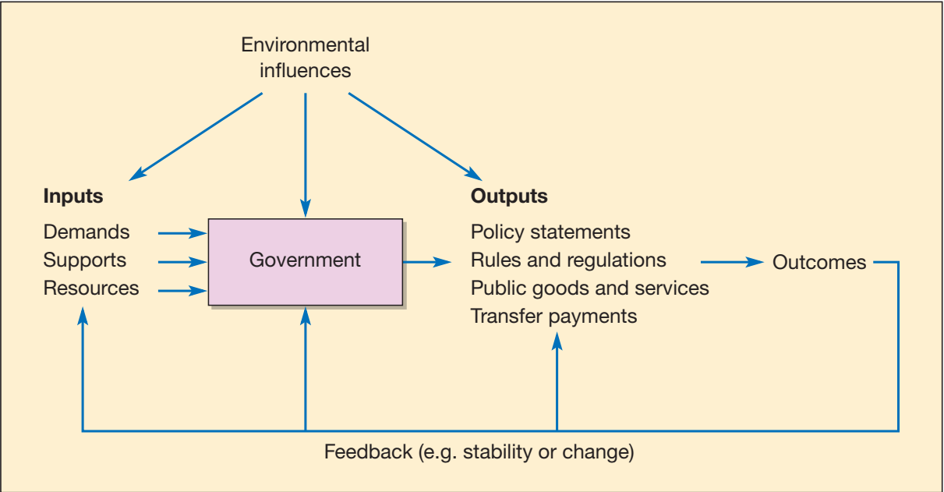
PESTEL - Political factors
Notes:
csvukrs

Slide 16
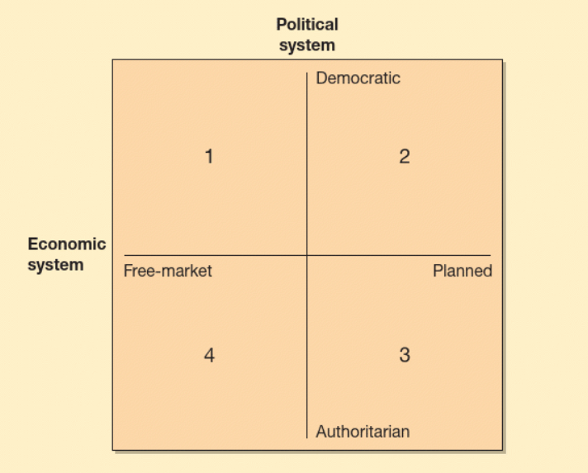
PESTEL - Economic factors
What are the prevalent economic factors?
Economic system is very closely related to the political system
Political system – Degree of public involvement in decision making
Economic system – the level of state intervention in process of allocation of resources
Notes:
csvukrs

Slide 17
PESTEL - Economic factors
What kind of resources the government has to satisfy the needs of the society and how it is going to distribute/allocate them.
Example: spending on healthcare, building/maintaining roads…
3 main questions:
What to use the resources for?
How to use those resources in the best way?
How to distribute the products and services made out of those resources?
Notes:
csvukrs

Slide 18
PESTEL - Economic factors
Centrally planned economy
Owns and controls the main economic resources
Establish priorities in the use of the resources
Sets output targets for businesses, largely under state ownership and control
Directs resources in an effort to achieve these targets
Sets to coordinate production
Notes:
csvukrs

Slide 19
PESTEL - Economic factors
Free market economy
Resources and firms in private ownership
They are free to use those resources as they wish
Decisions on resources allocation result of system of markets and prices
Consumers dictate the patterns of supply and such also the pattern of resources allocation
Notes:
csvukrs

Slide 20
PESTEL - Economic factors
1. General economic confidence, economic cycle- where is the economy now
2. Government statements, plans, spending, taxes
3. Employment – levels, prospects, common beliefs
4. Housing market
5. Interest rates
6. Exchange rates
7. Inflation rates
8. Disposable income level (disposable income - income remaining after deduction of taxes and social security charges, available to be spent or saved as one wishes)
Notes:
csvukrs

Slide 21
PESTEL - Social-cultural and demographic factors
What are the determinant social attitudes, trends, and behaviors? What (were) are the demographic trends? How much does these affect us as a company?
Demographic factors
1. The size of the population – implications on workforce, size of the market, public expenditure etc.
2. Age and gender distribution – western population is ageing, demographic time bomb – implications for demand for public and private goods
3. Population change – the birth rate, the death rate, net migration

Slide 22
PESTEL - Social-cultural and demographic factors
Social factors
1. Social class – education, income, occupation
2. Lifestyle – the way we live, how we spend money
3. Family life cycle – changing pattern of consumption from being a child in a family to being a parent
4. Reference groups – individuals or groups of people that influence us during our lifetime in terms of opinions, values, attitudes.
Notes:
csvukrs

Slide 23
PESTEL - Social-cultural and demographic factors
Cultural factors
Influence on individual’s response to product and nature of buying and selling process.
Set of values, norms, beliefs, attitudes, customs, systems and artifacts.
Some parts of culture can be changed, but some can’t.
Notes:
csvukrs

Slide 24
PESTEL - Technology and natural resources factors
What technological advances and innovations we should be looking at?
What natural resources do we need and how do we get them?
Technological change – information technology, new materials, biotechnology, energy
Technology and investment – product and process innovation
Research and development – base for technological change
Limits to a technological change – high level of unemployment and exhaustion of natural resources
Natural resources – uneven distribution can lead to use as economic and political weapons (Trump –Ukraine and Greenland, Congo)
Use of AI and AI development (https://www.instagram.com/reel/DGb04tnITAy/?igsh=QkE2ZVRMYmNiRA%3D%3D)
Notes:
https://www.instagram.com/reel/DGb04tnITAy/?igsh=QkE2ZVRMYmNiRA%3D%3D

Slide 25
PESTEL - Ecological and Ethical factors
How might environmental changes help or hinder our strategy?
Global warming
Pollution and waste
Environmental legislation - Carbon trading, environmental taxes, environmental subsidies
Pressure groups – social media increases reach and impact
Eco-label – environmentally safe product
Notes:
csvukrs

Slide 26
PESTEL - Ecological and Ethical factors
Corporate Social Responsibility – integrate social and environmental concerns in their business operations and interactions with their stakeholders.
Social welfare concerns – public becoming more vocal, fair trading, food miles, child workers.
USA – scraping of DEI (diversity, equity and inclusion) policies mainly in big corporations
Notes:
csvukrs

Slide 27
PESTEL – Legal factors
What are the legal factors, limitations or upcoming changes that affect our ability to operate?
Employment legislation
Consumer law
Healthy and public safety
Local trade regulation and restrictions
International trade regulation and prohibitions
It is crucial for an organization to know what is legal and allowed within the territories of the country they operate. They also must be aware of any possible change in laws or legislation in the country and its impact on industry operations.
Notes:
csvukrs

Slide 28
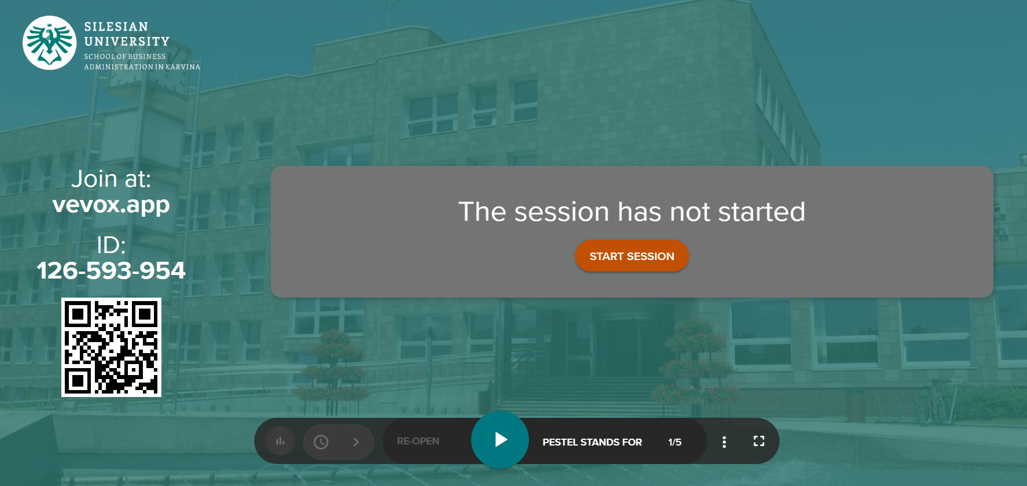
PESTEL – Quiz
Notes:
csvukrs

Slide 29
The impact of business on the environment; the environment influencing business
Environment
=> ‘surroundings’ and this can be interpreted in many ways
Physical environment - to include both the tangible elements and the processes of the physical world
Environment - factors as the behaviour of the market, the international economy, the legal framework, competitor activity and consumer behaviour

Slide 30
The Environments
Physical environment - the tangible physical resources of the globe, the atmosphere, the land surface, rocks and minerals, plants, animals and the seas. It is also taken to include the physical and biological processes that go on close to the surface of the earth independently of any input from humans, although they are constantly modified by the actions of man. These processes result in the movement of water, energy, biological organisms and other essential compounds within the physical world.
Environment - the business paradigm understands the surroundings not in terms of a physical entity but rather as such factors as the behaviour of the market, the international economy, the legal framework, competitor activity and consumer behaviour.
Notes:
csvukrs

Slide 31
The impact of business on the environment
Some of the business are more closely linked to the environment than others.
The individual company will impact the environment in a variety of ways. We would expect that as the impact on the environment increased, so a firm would become more concerned with its relationship with the environment, although this may not be the case.
The business has two effects on the environment and environmentalism:
First, it changes the environment either directly or indirectly as a result of its commercial activities.
Second, it influences environmental legislation and the attitudes of government, society at large and other organizations.
Businesses are not only subject to influence from other organizations but also from the collective pressure exerted by individuals in society.
Notes:
csvukrs

Slide 32
The environment influencing business
The ways in which the physical environment influences business operations.
Mainly concerned with either systematic changes in environmental conditions, e.g. global warming, or
as a result of sudden and unexpected ‘natural’ events such as floods, storms or earthquakes.
What is important to realize is that business behaviour is adjusted to expected variations in physical conditions.
Just as companies successfully operate within an envelope of changing economic conditions—economic growth, inflation, unemployment, etc., so they operate within an envelope of varying physical conditions.
Notes:
csvukrs

Slide 33
The environment influencing business
There are number of ways in which the natural environment can influence a business, which result from one of three broad causes:
the absence of physical resources (raw materials or natural elements to produce raw materials); this usually comes about due to the raw materials having been used up;
presence or absence of land with the required physical attributes;
changes in the prevailing environmental conditions. These changes may be systematic and predictable or sudden and unpredictable.
Notes:
csvukrs

Slide 34
The environment influencing business
Most influences are predominantly long term, such as those relating to changing climate, sea level or soil structure changes.
A distinction should be drawn between a real change that exerts an influence on business and a perceived change for which society legislates and with which a business is required to comply.
A real change - rising sea levels will directly force a coastal business to move or carry out some flood protection work.
A perceived change - a government demand for a company to reduce its emissions of carbon dioxide and so contribute to international targets of greenhouse gas reduction intended to mitigate global warming, will indirectly help to prevent sea levels from rising and thus prevent flooding.
Notes:
csvukrs

Slide 35
The environment influencing business
The natural world is constantly evolving and while a state of dynamic equilibrium exists, nature is not static.
Some insects have become resistant to certain pesticides.
Hydrological variations in precipitation amounts and distribution coupled with naturally varying groundwater and run-off levels have resulted in changes in agricultural practices.
As populations grow, the physical limit of some migratory agricultural practices in the drier parts of Africa puts an absolute physical limit on the available physical resources.
Notes:
csvukrs

Slide 36
The environment influencing business
the exhaustion of minerals may result in businesses needing to seek exotic sources or materials substitution if they are to continue in business (circular economy).
Overfishing has resulted in the demise of the North Sea herring industry. Some agricultural lands now been abandoned (badlands of the plains of the United States due to extensive dryness and erosion).
Tertiary sector (tourism and services): the decline of big game from the plains of parts of Africa – decline in tourism and big ecological footprint.
“Conservationists who support trophy hunting as a means of raising funds for preserving wild areas and wild animals have always argued that ‘if it pays, it stays’. But new studies seem to indicate that the financial contribution of trophy hunting to conservation in Africa is negligible, and the practice could soon become an anachronism (it is sport placed in a bad time)”
Notes:
csvukrs

Slide 37
Let’s watch
Notes:
csvukrs

Slide 38
The future of the relationship between environment and business
We identify three important areas to review:
• globalization;
• the New world order (or Disorder);
• global environmental trends.

Slide 39
The future of the relationship between environment and business
Some talk instead of a new world disorder and predict instead of stability, a spreading anarchy with countries being taken over by warlords, religious fanatics or organized crime (Kaplan, 1998). Connected with World governance.
Most of the countries where these depressing events take place are the poor and marginal countries that are outside the limits of globalization at present. Such countries do not make good sites for investment.
Companies are not likely to invest in countries which are disastrously unstable, dangerous to operate in and most of all, unprofitable because they lack much purchasing power. Almost their only value is for primary production.
Notes:
csvukrs

Slide 40
The future of the relationship between environment and business
UN Environment’s Sixth Global Environmental Outlook (GEO-6) is the most comprehensive assessment of the state of the world's environment. The report also offers a rigorous analysis of our prospects for a healthy future.
GEO-6 shows that a healthy environment is both a prerequisite and a foundation for economic prosperity, human health and wellbeing. It addresses the main challenge of the 2030 Agenda for Sustainable Development: that no one should be left behind, and that all should live healthy, fulfilling lives for the full benefit of all, for both present and future generations.
Unsustainable production and consumption patterns and trends and inequality, when combined with increases in the use of resources that are driven by population growth, put at risk the healthy planet needed to attain sustainable development. Those trends are leading to a deterioration in planetary health at unprecedented rates, with increasingly serious consequences, in particular for poorer people and regions.
Notes:
csvukrs

Slide 41
The future of the relationship between environment and business
Furthermore, the world is not on track to achieve the environmental dimension of the Sustainable Development Goals (SDG 17 goals) or other internationally-agreed environmental goals by 2030; nor is it on track to deliver long-term sustainability by 2050. Urgent action and strengthened international cooperation are urgently needed to reverse those negative trends and restore planetary and human health.
Past and present greenhouse gas emissions have already committed the world to an extended period of climate change with multiple and increasing environmental and society-wide risks.
Notes:
csvukrs

Slide 42
EU Taxonomy
Overcoming challenges such as climate change and environmental degradation:
1. no net emissions of greenhouse gases by 2050
2. economic growth decoupled from resource use
The EU taxonomy is a cornerstone of the EU’s sustainable finance framework and an important market transparency tool.
It helps direct investments to the economic activities most needed for the transition, in line with the European Green Deal objectives.
The taxonomy is a classification system that defines criteria for economic activities that are aligned with a net zero trajectory by 2050 and the broader environmental goals other than climate.
The Green Deal
The European Commission has adopted a set of proposals to make the EU's climate, energy, transport and taxation policies fit for reducing net greenhouse gas emissions by at least 55% by 2030, compared to 1990 levels.

Slide 43
EU Taxonomy

Slide 44
EU Taxonomy
The EU taxonomy allows financial and non-financial companies to share a common definition of economic activities that can be considered environmentally sustainable.
It plays an important role in helping the EU scale up sustainable investment, by creating security for investors, protecting private investors from greenwashing, helping companies become more climate-friendly and mitigating market fragmentation.
The Taxonomy Regulation entered into force on 12 July 2020. It establishes the basis for the EU taxonomy by setting out the 4 overarching conditions that an economic activity has to meet in order to qualify as environmentally sustainable.

Slide 45
EU Taxonomy
Companies
Companies have started using the Taxonomy to plan and highlight their green investments. On average, around 20% of companies’ capital investments are aligned with the Taxonomy. The highest investments are made in the utilities sector, in particular by electricity providers (over 60% Taxonomy-aligned).
Capital investments into Taxonomy-aligned activities have increased in 2024 compared to the previous year. In 2023, around 600 European companies reported capital investments into Taxonomy-aligned activities of €191bn. Thus far in 2024, companies have already reported €249bn.
This adds up to a total of €440bn in 2023 and 2024 so far (as of 6 May 2024).These numbers are expected to grow further as companies start to report on the four environmental objectives of the Taxonomy, increasing the scope of eligible companies.

Slide 46
EU Taxonomy
Public sector
In 2023, 90% of green bonds issued by EU public actors mentioned the EU Taxonomy to illustrate their commitment of using the raised funds for green projects.
Banks & financial markets
Banks are starting to use the Taxonomy in their lending strategies and in their assessment of companies’ investment plans. Mortgages and other loans to activities in the scope of the Taxonomy represent, on average, over 50% of the assets of large EU banks based on first-year figures.

Slide 47
EU Taxonomy
Investors
56% of EU funds either promote environmental or social characteristics or have a sustainable investment objective as disclosed according to the Sustainable Finance Disclosure Regulation (SFDR).
The assets aligned with the Taxonomy form a small, but growing part of what these funds invest in.

Slide 48
References
Brooks, I. (2010) The international business environment.: challenges and changes. Pearson Prentice Hall.
Arshed, N., McFarlane, J., & MacIntosh, R. (Eds.). (2016). Enterprise and its business environment. Goodfellow Publishers, Limited.
Worthington, I., Britton, C., & Thompson, E. (2018). The business environment : A global perspective. Pearson Education, Limited.
https://finance.ec.europa.eu/sustainable-finance/tools-and-standards/eu-taxonomy-sustainable-activities/eu-taxonomys-uptake-ground_en
Blair, A., & Hitchcock, D. (2000). Environment and business. Taylor & Francis Group.
https://www.unep.org/interactive/global-environment-outlook/

